Slide 1
NumPy and Pandas
Rizwana Rashad

Slide 2
Learning Objectives
At the end of this session, you should be able to:
differentiate between NumPy arrays and Pandas data structures
use Pandas data structures for manipulating data
load, read and analyse data using Pandas Series and Dataframes

Slide 3
NumPy Library
NumPy standards for Numerical Python, and one of its key features is the N-dimensional array. It is also known for its efficiency when working with numerical values.

Slide 4
NumPy Array
A NumPy array can only hold one type of data
The array object is known as ndarray
The NumPy library is usually imported using np as the alias (import numpy as np)

Slide 5
Creating a 1-d NumPy Array
1 dimensional array
Code:
import numpy as np
age = np.array([65, 9, 41, 3, 17, 5, 8])
print(age)
Result:
[65, 9, 41, 3, 17, 5, 8]
Index
0 | 1 | 2 | 3 | 4 | 5 | 6
65 | 9 | 41 | 3 | 17 | 5 | 8

Slide 6
Creating a 2-d NumPy Array
2 dimensional array
Code:
import numpy as np
age = np.array([[65, 9, 41, 3], [17, 5, 8,11], [25, 32, 1, 96]])
print(age)
Result:
[[65, 9, 41, 3]
[17, 5, 8,11]
[25, 32, 1, 96]])
INDEX | 0 | 1 | 2 | 3
0 | 65 | 9 | 41 | 3
1 | 17 | 5 | 8 | 11
2 | 25 | 32 | 1 | 96

Slide 7
Pandas Library
Pandas is a Python Data Analysis Library. It can be used for analysing and manipulating data. In this module we will be using Pandas to:
load data
inspect data
clean data
normalise data
and much more

Slide 8
Pandas Series and DataFrame
A Pandas Series is like a one dimensional array, which unlike NumPy, can hold data of any type
A Pandas Dataframe is like a two dimensional array, which can be made up of a number of Series.
The Pandas library is usually imported using pd as the alias (import pandas as pd)

Slide 9
Creating a Pandas Series
1 dimensional array
Code: Result:
import pandas as pd 0 65
age = pd.Series([65, 9, 41, 3, 17, 5, 8]) 1 9
print(age) 2 41
3 3
4 17
5 5
6 8
dtype: int64
Index
0 | 1 | 2 | 3 | 4 | 5 | 6
65 | 9 | 41 | 3 | 17 | 5 | 8

Slide 10
Creating a Pandas DataFrame
2 dimensional array
Code:
import pandas as pd
age = pd.DataFrame([[65, 9, 41, 3], [17, 5, 8,11], [25, 32, 1, 96]])
print(age)
Result:
0 1 2 3
0 65 9 41 3
1 17 5 8 11
2 25 32 1 96
INDEX | 0 | 1 | 2 | 3
0 | 65 | 9 | 41 | 3
1 | 17 | 5 | 8 | 11
2 | 25 | 32 | 1 | 96

Slide 11


Selecting Data from a Column
Code:
Result:
INDEX | 0 | 1 | 2 | 3
0 | 65 | 9 | 41 | 3
1 | 17 | 5 | 8 | 11
2 | 25 | 32 | 1 | 96

Slide 12


Selecting Data from Columns
Code (two square brackets):
Result:
INDEX | 0 | 1 | 2 | 3
0 | 65 | 9 | 41 | 3
1 | 17 | 5 | 8 | 11
2 | 25 | 32 | 1 | 96

Slide 13


Selecting Data from a Row
Code (use iloc):
Result:
INDEX | 0 | 1 | 2 | 3
0 | 65 | 9 | 41 | 3
1 | 17 | 5 | 8 | 11
2 | 25 | 32 | 1 | 96

Slide 14


Selecting Data from Rows
Code (use iloc):
Result:
INDEX | 0 | 1 | 2 | 3
0 | 65 | 9 | 41 | 3
1 | 17 | 5 | 8 | 11
2 | 25 | 32 | 1 | 96

Slide 15

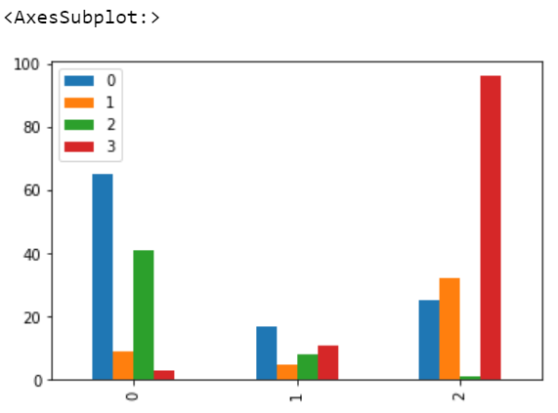
Visualising DataFrames
Code:
Result:

Slide 16
Handling Missing Data
The two main ways of dealing with missing data are:
delete the row that contains the missing data
fill the missing data with some value

Slide 17


Using dropna
Code:
Result:
INDEX | 0 | 1 | 2 | 3
0 | 65 | 9 | 41 | 3
1 | 17 | 5 | 11 | NaN
2 | 25 | 32 | 1 | 96

Slide 18


Using fillna
Code:
Result:
INDEX | 0 | 1 | 2 | 3
0 | 65 | 9 | 41 | 3
1 | 17 | 5 | 11 | NaN
2 | 25 | 32 | 1 | 96

Slide 19
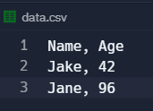


Loading a DataFrame
Pandas can load a dataset stored in file, into a DataFrame.
Code:
Result:

Slide 20
Any Questions?

