Slide 1

Heuristic Algorithms
An Introduction

Slide 2

Heuristic Algorithms
We are used to using computers to solve incredibly complex problems
We do this by developing algorithms
Not all problems can be solved using exact algorithms
We therefore need some approximate solutions that are acceptable in time and space complexity
Algorithms that either give nearly right answer or provide a solution not for all instances of the problems being solved are called HEURISTIC algorithms.

Slide 3
What is a Heuristic Algorithm/Search?
A heuristic algorithm is a technique for solving problems that are difficult to solve using the traditional techniques
A heuristic search uses algorithms that branch at each step, evaluates available data, and makes decision on the next branch to follow
To do this, it ranks each alternative routes and selects the best route
It produces an approximate solution in a reasonable amount of time
However, a heuristic algorithm though maybe effective, there is no guarantee that it will always work in all cases.

Slide 4
Algorithms and Complexity-traditional Search methods
Traditional Search algorithms are exhaustive
Examples:
Local search – focuses on a limited area of the search space, e.g. hill climbing
Divide and Conquer – splits the problem into smaller problems that are easier to solve. The solution of the smaller problems are then combined as the solution of the original problem
Branch and bound –involves critical enumeration of the search space by trying to rule out parts of the search space that cannot contain the best solution
Dynamic programming – avoids re-computation by storing the solutions of subproblems. The key here is formulating the solution process as a recursion.

Slide 5
Classes of Problems
Problems can be solved in polynomial time
Polynomial time is the number of steps required to complete the algorithm
P problem is polynomial time problem the problem is tractable
NP problem (which stands for non-deterministic polynomial time) is the set of problems whose solutions can be verified in polynomial time but are difficult to solve.

Slide 6
Problems which can
be solved in polynomial
time using a “magic box”
(Non-deterministic)
NP
P
Problems which
can be solved in
polynomial time
6

Slide 7
If a polynomial time algorithm is found for any problem in
NP-Complete then every problem in NP can be solved in polynomial time
I.e. P = NP
NP
P
NP-Complete
Easy ➔ P
Medium ➔ NP
Hard ➔ NP-Complete
Hardest ➔NP-Hard
The “hardest”
problems in NP

Slide 8
Heuristic Search
Some problems (NP-Hard) cannot be solved in a straightforward manner
We need to develop approximation algorithms to solve these problems
A type of method called Heuristic Search can be used to try and find a solution
We search for the best solution from a very large number of potential solutions
We score the worth of each solution using a Fitness Function
There is a theorem in heuristic search called the No Free Lunch Theorem!

Slide 9

Heuristic Search
A heuristic is a “rule of thumb” or some loose set of guidelines
Getting out of a maze by keeping your hand against the maze wall
In Artificial Intelligence these are used to improve the performance of methods, in our case, search methods
Expert knowledge
Common sense

Slide 10

Search Problems
Many problems can be thought of as searching through candidate solutions to find one that is optimal
Systematically search through potential solutions without considering all of them…
Need some way to evaluate the fitness of the candidate solutions
Optimal = fittest
Some sense of the adjacency (similarity) of solutions (or neighbourhood)

Slide 11
Fitness
The fitness of a solution that’s measurable.
Examples:
A good car is defined as having the least number of breakdowns in 2 years. Fitness = number of breakdowns in 2 years (minimise).
A bullet train. Fitness = Maximum speed (km/h)
A good singer. Fitness = can sing a perfect pitch for more than 3 genres.
The Travel Salesperson Problem. Fitness = A route with the minimum distance! (minimise)

Slide 12

Fitness
To search for a solution, we must be able to compare potential solutions
E.g. Is solution s₁ better than solution s₂?
Thus, we have the concept of fitness
We must derive a function (the fitness function) that maps a solution to a value that rates how good the solution is in solving the problem at hand
We either maximise or minimise the fitness
A slight change in solution quality should result in a corresponding change in the fitness
Solution quality goes down → Fitness goes down
Solution quality goes up → Fitness goes up

Slide 13
Fitness Landscape
It could be helpful to think of searching a landscape of solutions where:
The x and y co-ordinates represent a particular solution
Altitude (z axis) represents the fitness of that solution
This leads to the analogy that we wish to search for e.g. climbing to the peaks
Describing the nature of a landscape characterises (in an abstract way) classes of problem

Slide 14
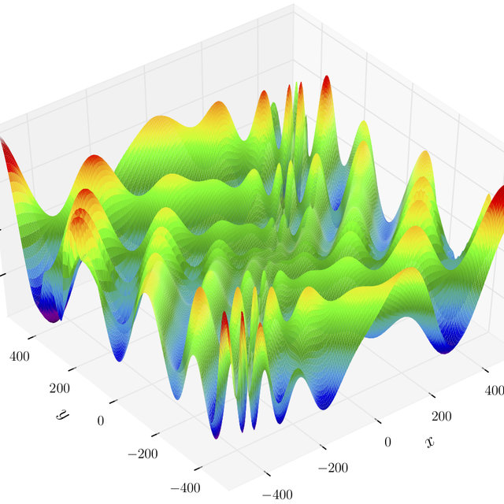
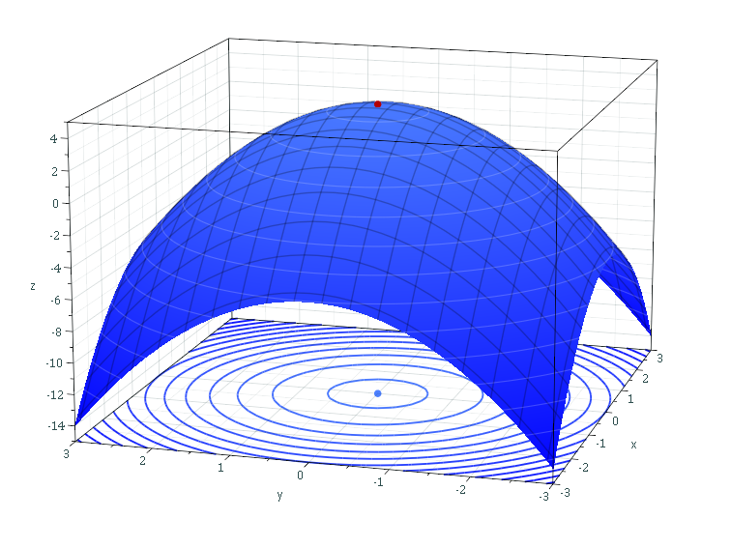
Fitness Landscape
Smooth and regular spaces are easy to search
Irregular spaces are difficult to search

Slide 15
Global and local optima
The global optimum is the point or points in the search space with the best objective function evaluation
A local optimum is the point or points in a subset or section of the search space with the best objective function evaluation
Note that the subset or section of the search space in question may contain the global optima
Many search techniques can find local optima, but get “stuck” at them and cannot move on to find the global optimal

Slide 16
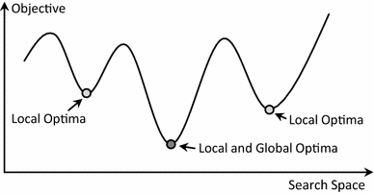
Global and local optima - Minimisation

Slide 17
Representation
When we are trying to solve a search-based problem, we need a way to represent a potential solution
This is usually a mathematical and/or data structure way of describing the solution to the problem
A good representation:
Should be a one-to-one mapping
No redundancy
No ambiguities
All potential solutions should be represented

Slide 18
The Travel Salesman Problem
The Travelling Salesman Problem is well known to be NP-Hard
This means there is no direct algorithmic or mathematical way to arrive at an optimal solution in polynomial time
The search space is O(N!)
One of the worst that we have seen to date…
We need approximate or Heuristic search methods to find a solution (or partial solution)
Genetic Algorithm
Hill Climbing
Simulated Annealing
Ant Colony
etc...

Slide 19
The Travel Salesman Problem
A salesperson must visit N cities as part of their job
The aim is to start off at one of the cities, visit each city exactly once and then to arrive back at the starting city
This is called a tour
The objective is to find a tour where the sum of the total distance travelled is a minimum

Slide 20
The Travel Salesman Problem
To solve the TSP we need to know how “far” each city is from each other
We will use the notation d(i,j) to represent the distance from city i to city j
Note:
d(i,j)=d(j,i), i.e. the distance from city i to city j is the same as from city j to city i
d(i,i) = 0, i.e.: a city is zero distance from itself
1
4
3
5
3
2
2
1.5
2.5
4
d(1,2)=3
d(1,3)=4
d(1,4)=5
d(2,3)=2
d(2,4)=2.5
d(3,4)=1.5

Slide 21
TSP Representation
A natural way to represent a solution to the TSP problem is to represent a tour as a permutation of the integers 1,2,...,N
Starting at the left-hand side of the permutation and visiting the cities in the specified order, moving from left to right
This will ensure that we do not visit any city twice
A permutation is defined as a shuffling of a set of objects
e.g. the permutation of {1,2,3}: (1,2,3),(1,3,2),(2,1,3),(2,3,1),(3,1,2) and (3,2,1)
If we have N objects, then there are N! possible permutations

Slide 22
Other Paradigm Problems
Bin Packing - https://youtu.be/vUxhAmfXs2o
Scales Problem - https://youtu.be/-n-A5qcO398
Reference – An introduction to heuristic algorithms by Natallia Kokash, 2005

