Slide 1
Game Development 2022/2023
Rolito by Raf

Slide 2
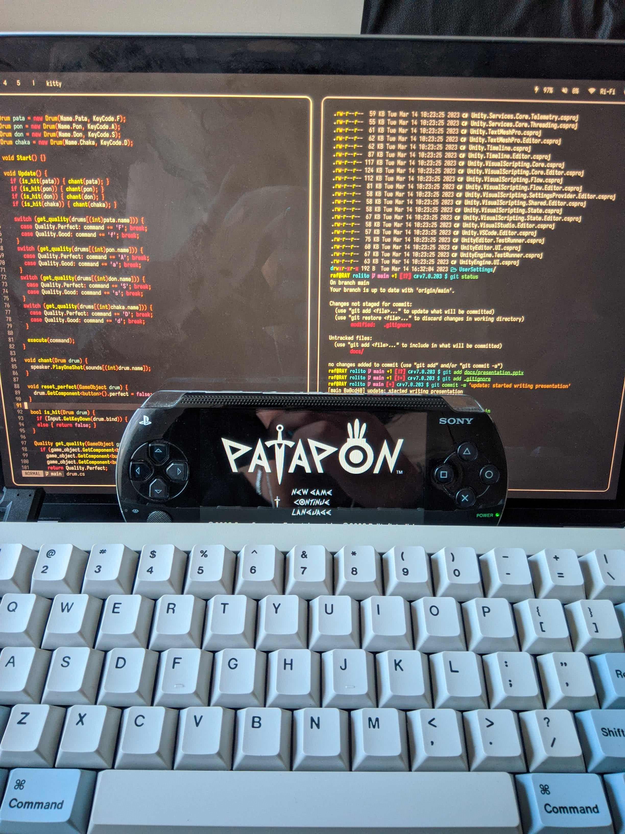
Week 0 [module preparation]
Rolito is named after someone Assets are ripped from Patapon Yes that includes music Sprites were upscaled Played Patapon to learn Successfully recreated main system

Slide 3
Week 1 - 4 [scripts, input, collision, physics]
First script Checks for drum combo Sends beats Switches music loops drum.cs rhythm.cs | rhythm.cs: 31 - 64 void Update() { if (timer < spawn_rate) { timer += Time.deltaTime; } else { send_beat(); timer = 0; } if (drum.GetComponent<drum>().combo == 3) { speaker.clip = loops[(int)Loop.Combo01]; if (!speaker.isPlaying) { speaker.PlayDelayed(.5f); } } if (drum.GetComponent<drum>().combo == 6) { speaker.clip = loops[(int)Loop.Combo02]; if (!speaker.isPlaying) { speaker.PlayDelayed(.5f); } }.. } void send_beat() { if (beat != null) { Instantiate(beat, transform.position, transform.rotation); } }

Slide 4
Week 1 - 4 [scripts, input, collision, physics]
Checks if key is down Checks if for collision Rates input against timing Drum itself made up of buttons Drum is a kinematic object button.cs beat.cs | button.cs: 19 - 37 void Update() { if (pressed_on_time(bind) == Quality.Perfect) { perfect = true; } if (pressed_on_time(bind) == Quality.Good) { good = true; } if (pressed_on_time(bind) == Quality.Bad) { bad = true; } } private Quality pressed_on_time(KeyCode key) { if (Input.GetKeyDown(key) && can_be_pressed) { return Quality.Perfect; } if (Input.GetKeyDown(key) && !can_be_pressed) { return Quality.Good; } else { return Quality.Bad; } } private void OnTriggerEnter2D(Collider2D other) { if (other.tag == "beat") { can_be_pressed = true; } } private void OnTriggerExit2D(Collider2D other) { if (other.tag == "beat") { can_be_pressed = false; } }

Slide 5
Week 6 - 10 [prefabs, graphics, audio, scenes & ui]
Checks if key is down Checks if for collision Rates input against timing Drum itself made up of buttons Drum is a kinematic object button.cs beat.cs | button.cs: 19 - 37 void Update() { if (pressed_on_time(bind) == Quality.Perfect) { perfect = true; } if (pressed_on_time(bind) == Quality.Good) { good = true; } if (pressed_on_time(bind) == Quality.Bad) { bad = true; } } private Quality pressed_on_time(KeyCode key) { if (Input.GetKeyDown(key) && can_be_pressed) { return Quality.Perfect; } if (Input.GetKeyDown(key) && !can_be_pressed) { return Quality.Good; } else { return Quality.Bad; } } private void OnTriggerEnter2D(Collider2D other) { if (other.tag == "beat") { can_be_pressed = true; } } private void OnTriggerExit2D(Collider2D other) { if (other.tag == "beat") { can_be_pressed = false; } }

