Slide 1
Multi-Client Chat
Putu Arva Raysendriya Ersuputra
21/472606/PA/20312
Rabbani Nur Kumoro
21/472599/PA/20310
Henzel Theodore Putra
21/475040/PA/20516

Slide 2
01
Flowchart

Slide 3
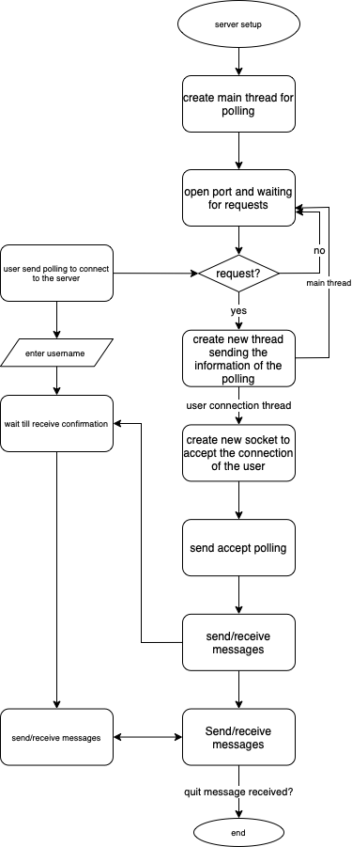

Slide 4
02
Server.java

Slide 5
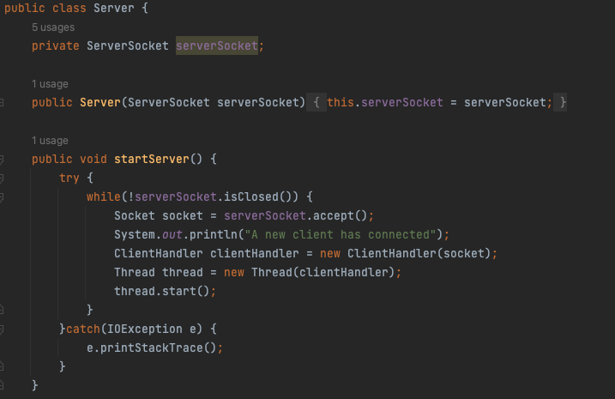
The server class is responsible for listening to clients trying to connect and spawn new thread to handle them once they connected
Notes:
Server socket object responsible for listening for incoming connections or clients and creating a socket object to communicate with them. startServer method keeps the server running (while the server socket is open it waits for client to connects and it is a blocking method meaning the program halted until a client connect and when a client does connect a socket object is returned which can be used to communicate with the client)
Each object of the clientHandler class responsible for communicating with with a client

Slide 6
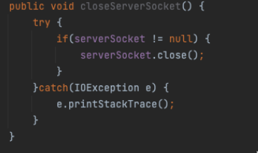
If an error occurs we want to shut down our server socket

Slide 7
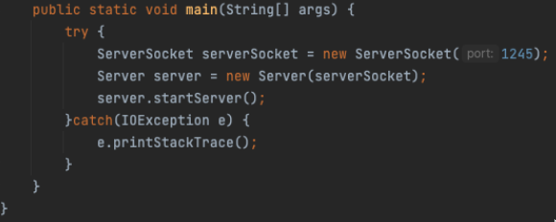
The server will be listening for clients that are making a connection to the port number

Slide 8
03
ClientHandler.java

Slide 9
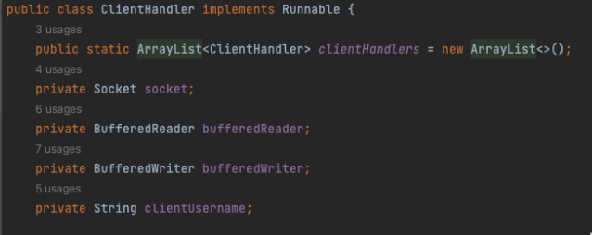
The array keep tracks of all the clients
Notes:
Implements runnable means the instances will be execute by a separate thread
Socket used to established a connection between client and server
bufferedReader used to read data (messages sent from client)
bufferedWriter used to write data (send messages from clients)
Username to represent each client

Slide 10
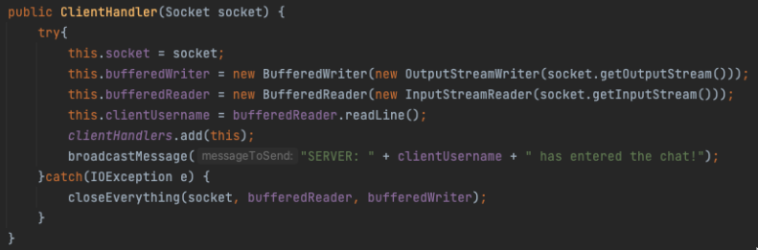
In the constructor we initialize socket, bufferedWriter, bufferedReader, and client username
We add clients to the arraylist and send broadcast message every time a client connects
Notes:
Each socket connection has an output and input stream, output stream is used to send data and input stream is used to read data
We set up the bufferedWriter using the socket’s output stream and as it is a byte stream and we need a character stream so we have to wrap it in the OutputStreamWriter same thing goes to the bufferedReader
We read the user’s input for the client username and we add each client to the arraylist and send broadcast message each time a client is connected

Slide 11
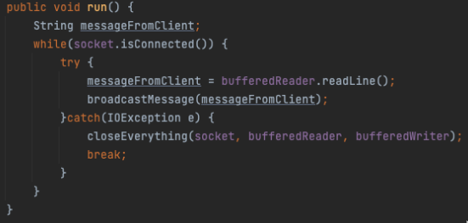
In this method we read the input messages from the client
Notes:
This run in a separate thread because we want to listen to messages and as it is a blocking method which means that the program is stuck until the operation is completed
Program is hold in the readLine() until we received message from client

Slide 12
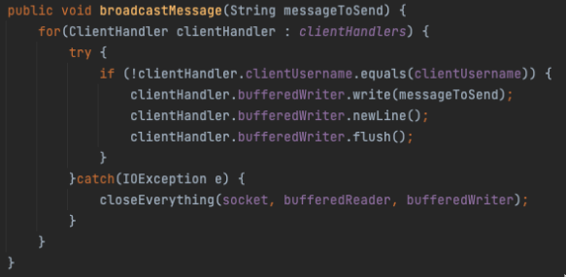
In this method we loop to send message to each client that is connected and avoid to send message to the same client that is sending the message
Notes:
If statement is to avoid sending message to ourselves
newLine() basically saying that we’re done sending data/writing messages
flush() is used to manually send the output stream because a buffer will not sent down output stream unless it is full and probably the message we are sending won’t be big enough to fill the buffer

Slide 13
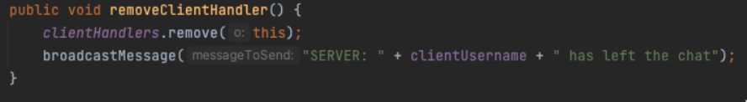
Removes client from the arraylist when they disconnects

Slide 14
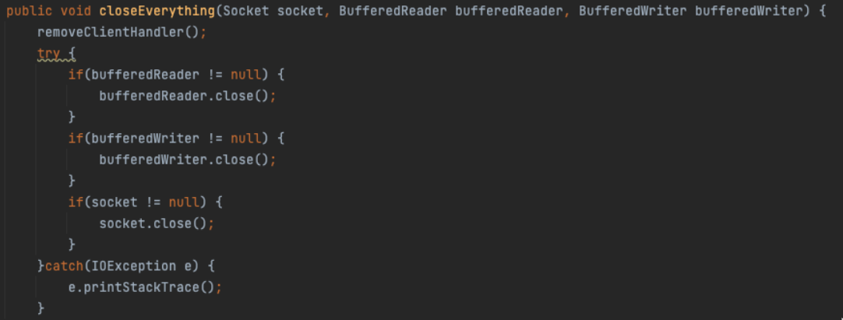
This method is used to close down our connection and streams

Slide 15
04
Client.java

Slide 16
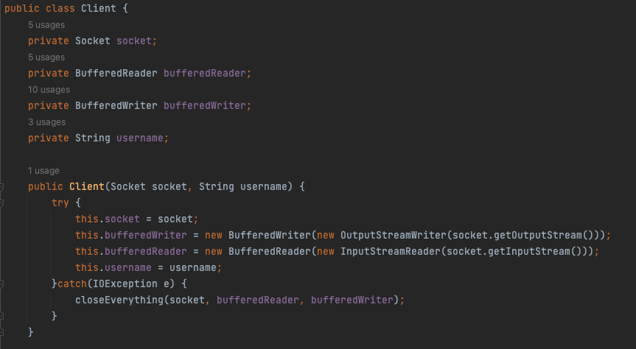
For the constructor here is more or less similar to the client handler

Slide 17
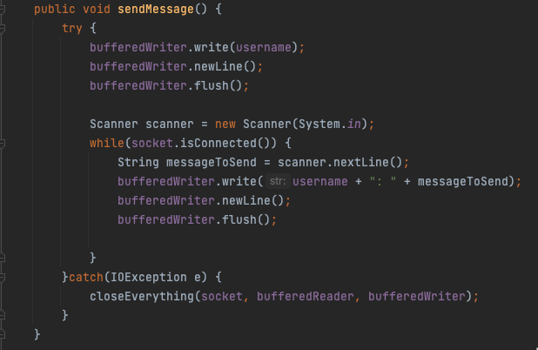
Method to send message, we use scanner to read input from the console as long as socket is connected

Slide 18
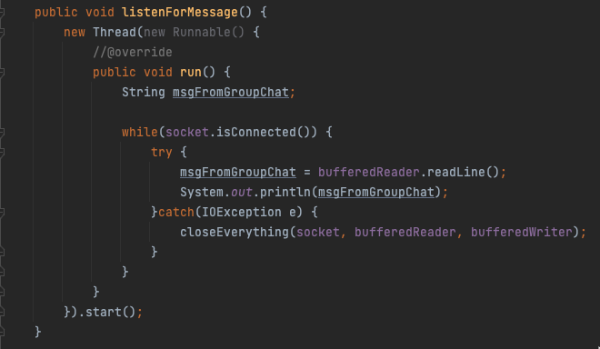
This executed on separate thread to read the broadcast from the bufferedReader and output them to the client

Slide 19
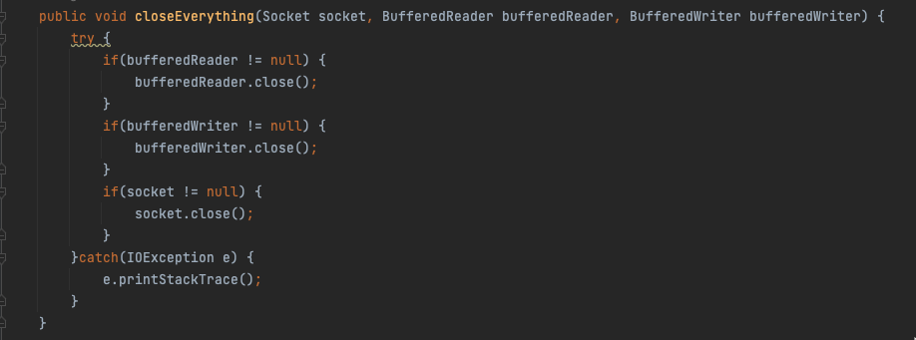
This method is used to close down our connection and streams

Slide 20
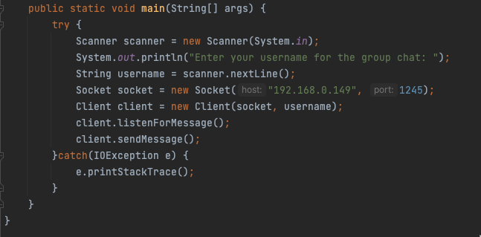
The client will make connection to the port that the server is listening on
Both the listenForMessage() and sendMessage() methods are blocking method but they will still be running because they’re running in separate thread

Slide 21
05
Program Demo

Slide 22

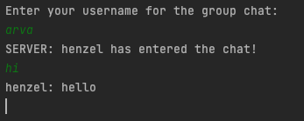
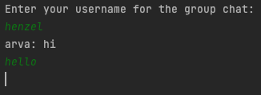
Server
Client 1
Client 2

Slide 23
Thank
You

