Slide 1
A stable proxy can still measure the wrong thing
Climate-health construct validation across 34 economies — AI-first under §18 Raymond Adofina · Asian Development Bank

Slide 2
The old result passed the wrong test
The inherited proxy multiplied agriculture plus half of industry employment by a national PM2.5 pressure transformation.
Its leading set survived ±50% parameter changes.
It contained no temperature, humidity, workload, or labor outcome.
Internal stability did not establish heat-work-loss validity.
Question: does the proxy recover a documented direct heat-labor construct?

Slide 3
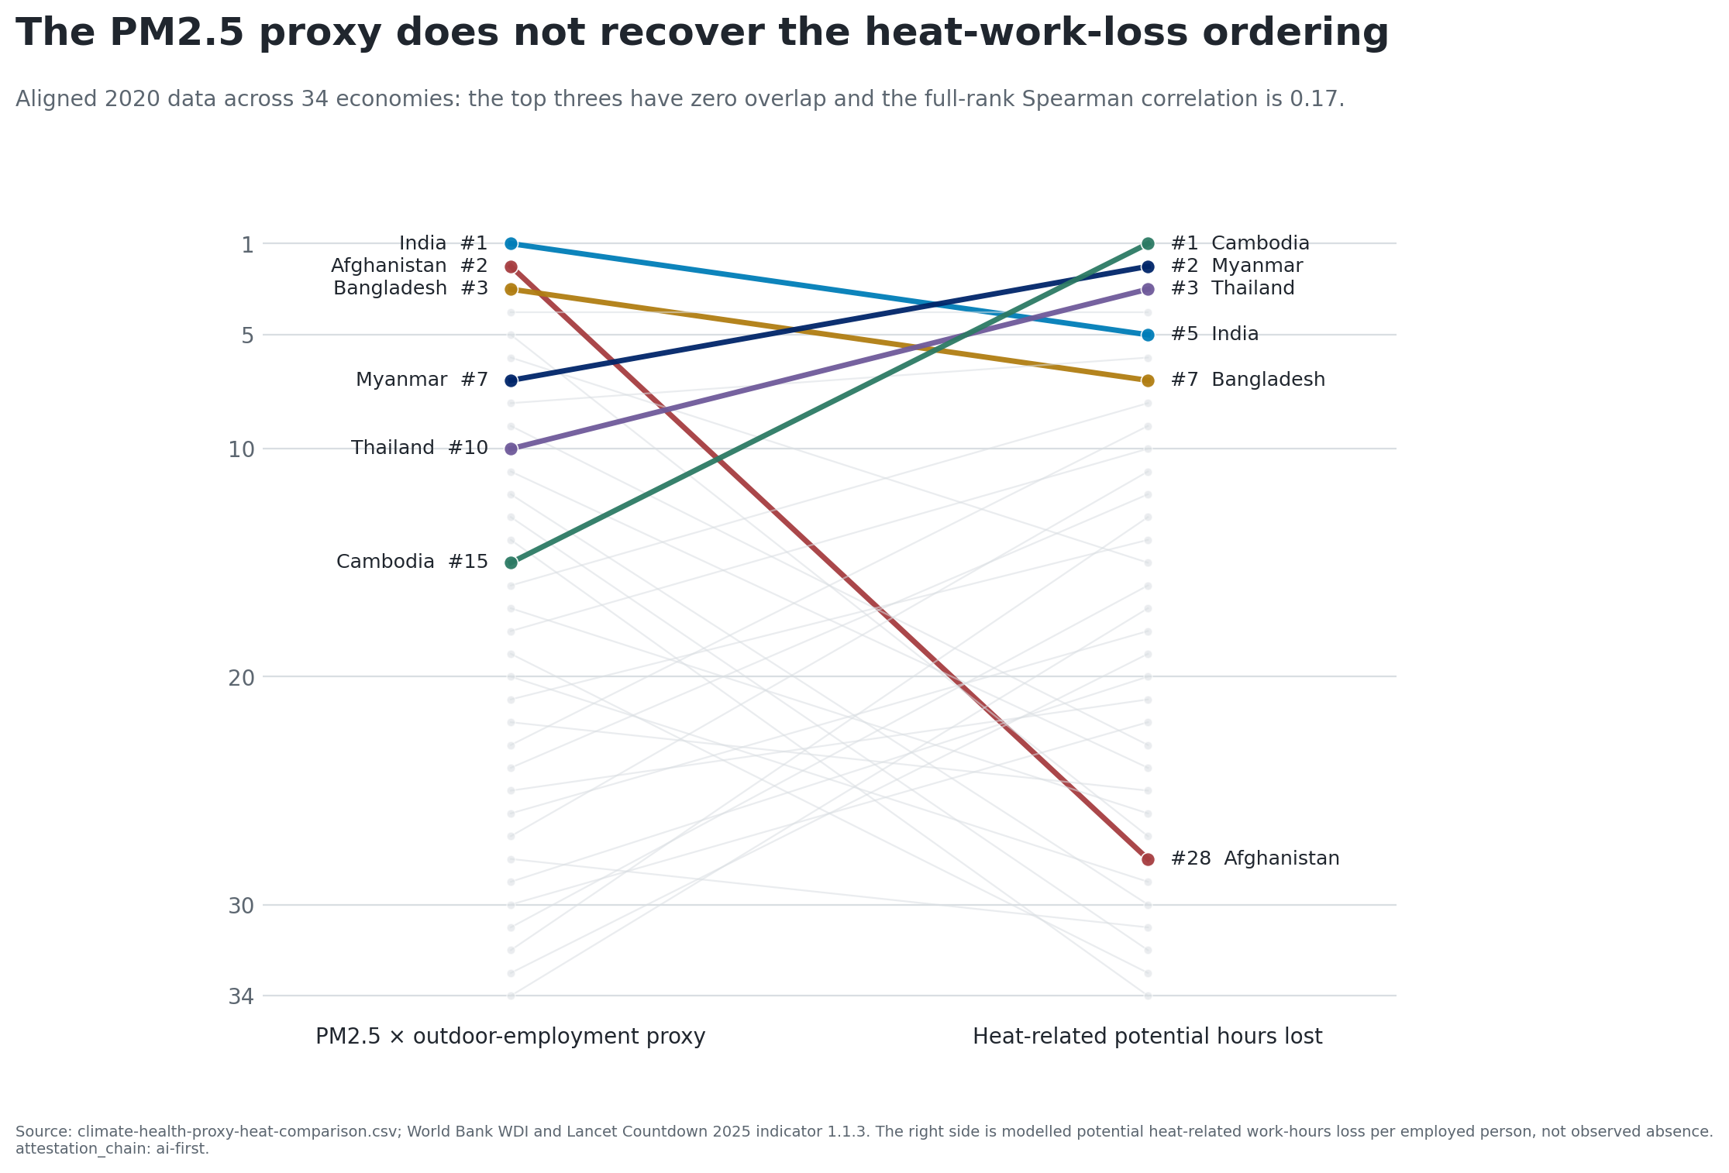
The aligned 2020 top threes have zero overlap

Slide 4
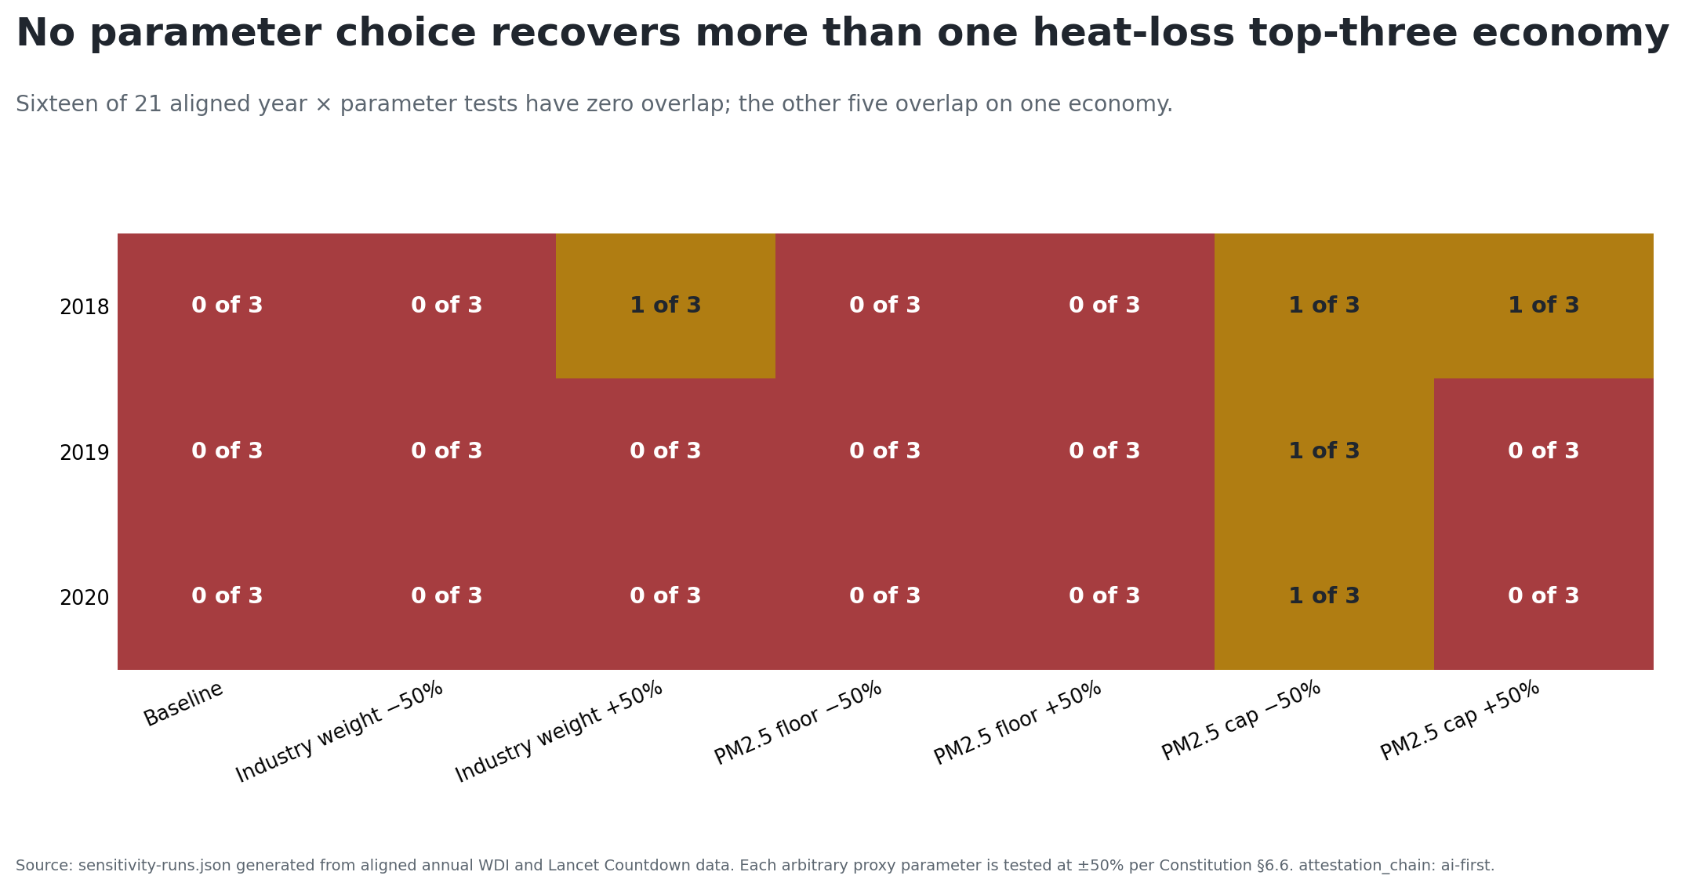
The disagreement persists across all 21 tests

Slide 5
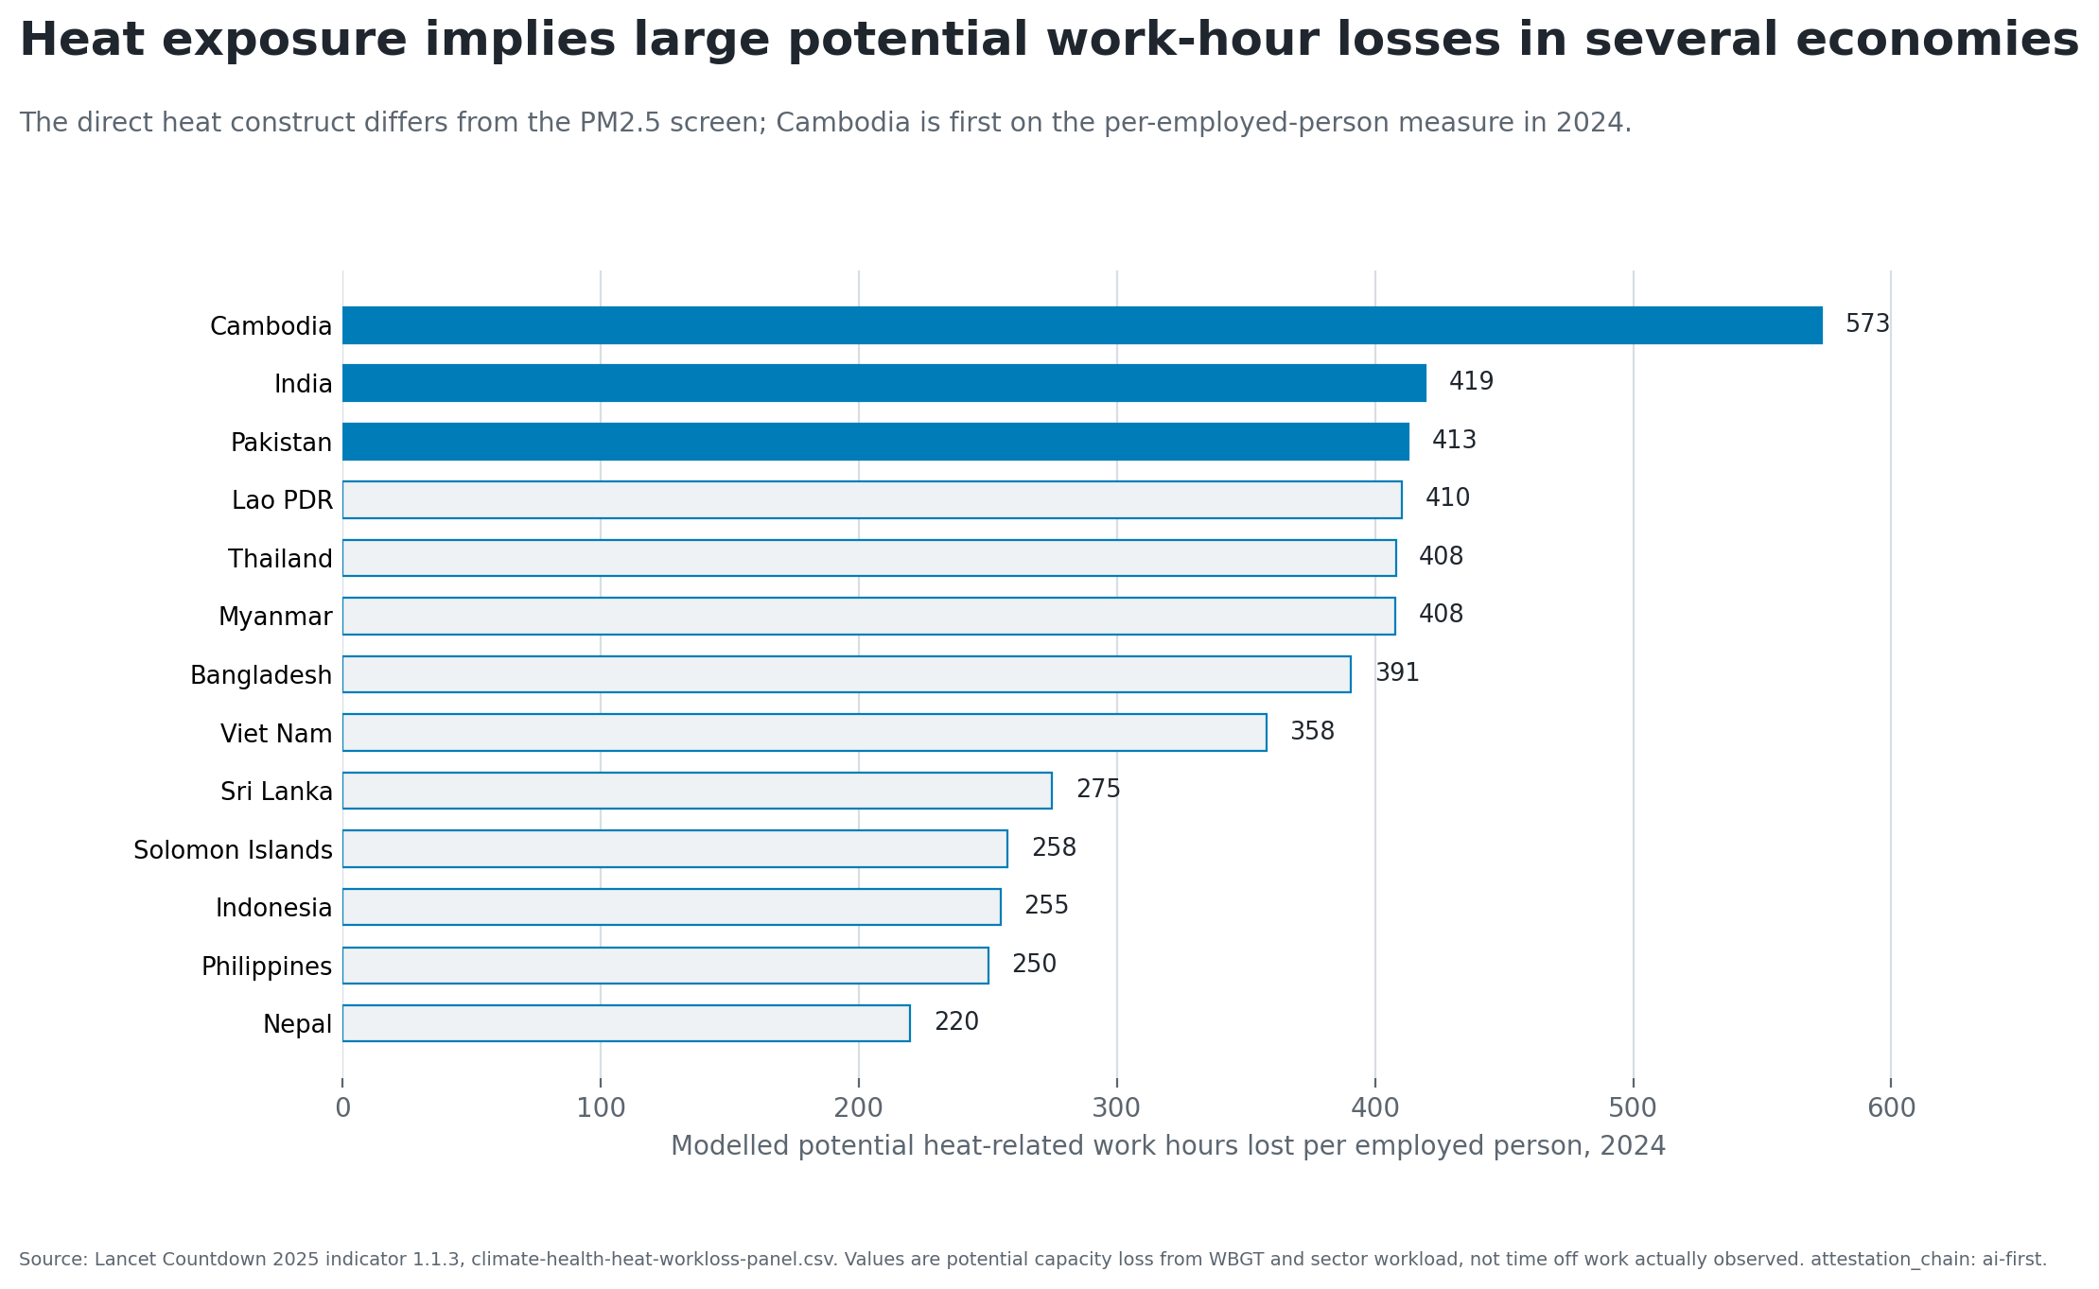
The direct heat rate identifies a different profile

Slide 6
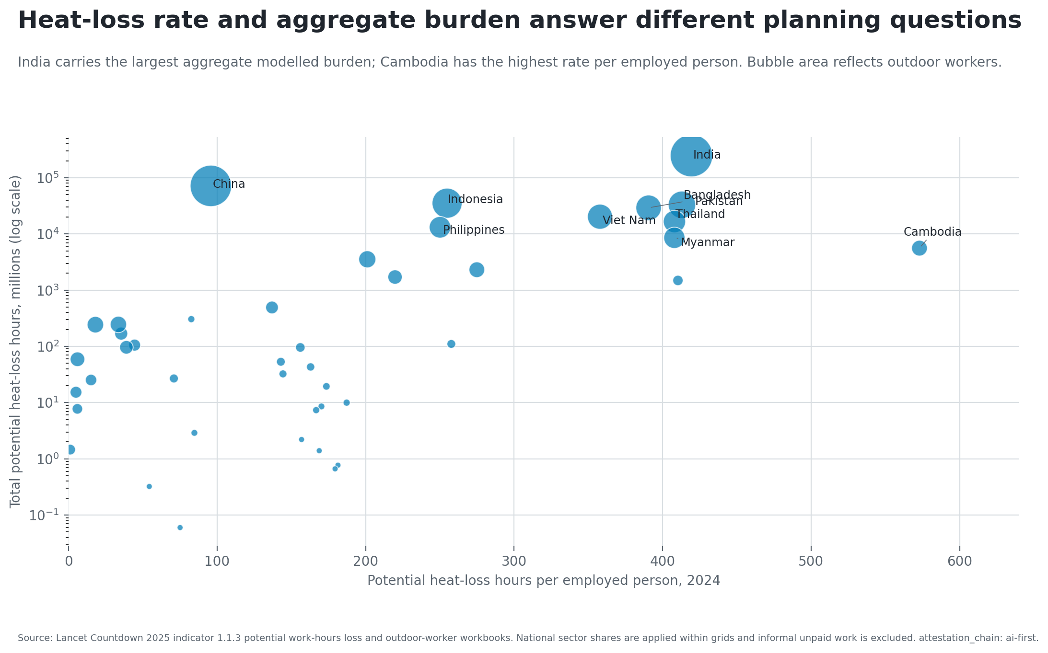
Rate and aggregate scale answer different questions

Slide 7
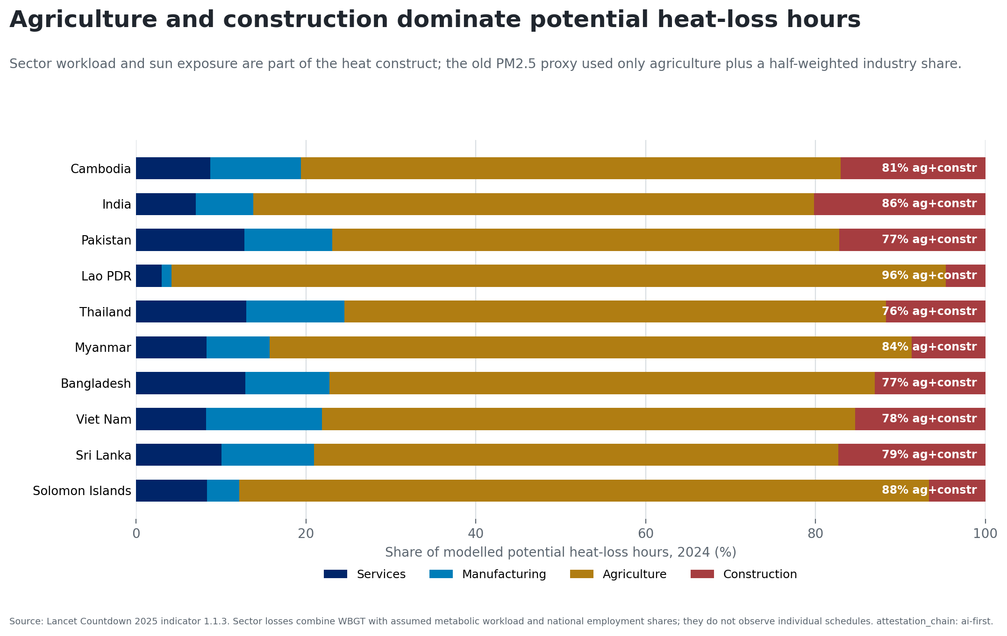
Sector workload is part of the direct construct

Slide 8
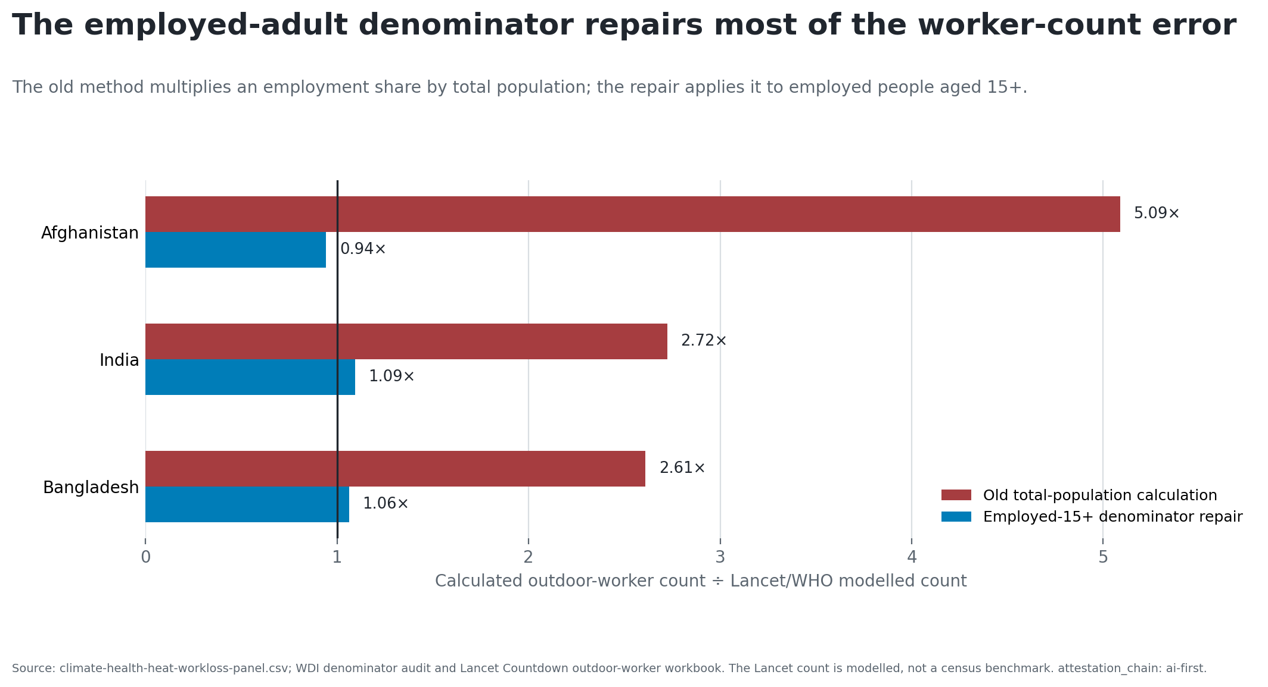
The old worker denominator was also overstated

Slide 9
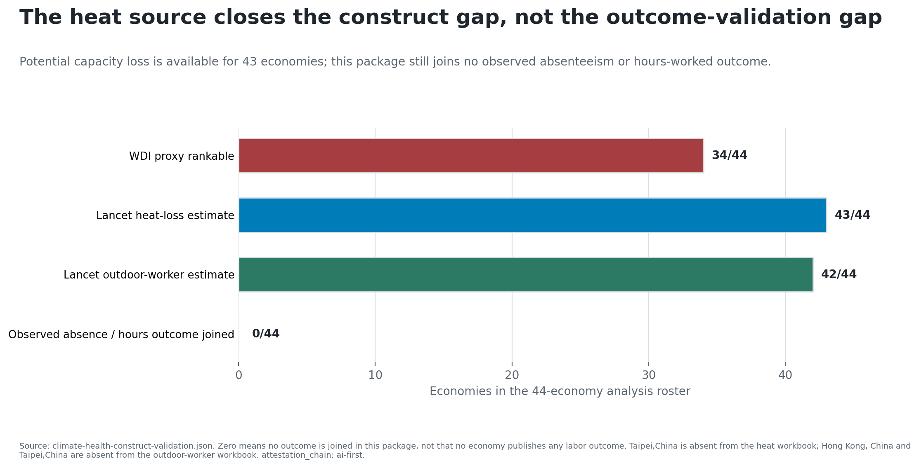
The outcome-validation gap remains open

Slide 10
Replace the ranking with four research rules
Test external construct validity, not only internal parameter stability.
Keep heat and PM2.5 as separate mechanisms unless a joint design identifies both.
Use an employed-population denominator for worker counts.
Do not report modelled potential capacity loss as observed absence.
Next object: observed hours, absence, output, or labor supply aligned with workplace or subnational exposure.

