Slide 1
Five DMCs persistently cluster as remittance-corridor-stress-exposed
A cap-stable, aggregation-stable top-five set across the ±50% sensitivity suite — ADB DMCs, AI-first under §18 Raymond Adofina · Asian Development Bank

Slide 2
The question

Slide 3
Two indicators, read separately today
A planner deciding where corridor-cost interventions should go has two public indicators:
WDI: personal remittances received, % GDP — macro dependence. Published yearly by the World Bank.
RPW: Remittance Prices Worldwide — published corridor-firm costs, destination side. Published quarterly by the World Bank.
The two are usually read separately. The economies exposed on both axes — high dependence and high cost — do not announce themselves.
This deck reports a joint screen for ADB developing member economies. It carries an ai-first attestation chain under CONSTITUTION.md §18.

Slide 4
The headline

Slide 5
Five DMCs sit in the top five of the joint exposure screen
Rank | DMC | Dependence (% GDP) | Mean cost % | Cost vs SDG 10.c.1 (3%)
1 | Kyrgyz Republic | 26.6 | 10.5 | 3.5×
2 | Samoa | 24.0 | 8.0 | 2.7×
3 | Tonga | 42.6 | 7.5 | 2.5×
4 | Vanuatu | 18.8 | 9.5 | 3.2×
5 | Nepal | 26.2 | 6.7 | 2.2×

Slide 6
The set is the headline. The rank inside the set is not.

Slide 7
The picture

Slide 8
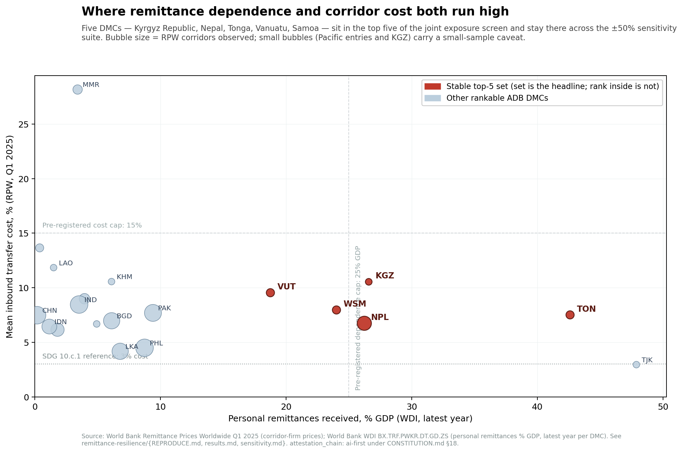
The five red bubbles stay in the upper-right region
Dot-plot of 20 rankable ADB DMCs in dependence × cost space. Five red bubbles in the upper-right — KGZ, NPL, TON, VUT, WSM — mark the stable top-five set. Bubble size = RPW corridors observed; small bubbles for Pacific entries and KGZ flag the small-sample caveat. Pre-registered caps (25% dependence, 15% cost) and SDG 10.c.1 reference (3% cost) shown as reference lines.

Slide 9
Robustness

Slide 10
The top-five set survives every parameter at ±50%
Per CONSTITUTION.md §6.6, every arbitrary numeric was tested at ±50%:
Dependence cap halved (12.5%) and raised to 37.5%: top-five unchanged.
Cost cap halved (7.5%) and raised to 22.5%: top-five unchanged.
Both caps moved together: top-five unchanged.
Multiplicative aggregation replaced with additive: top-five unchanged.
Top-10 overlap with baseline: 9 of 10 (under additive) to 10 of 10 (in every cap perturbation).
The pre-registered decision rule — at most one entry change in any single perturbation — is satisfied with margin.

Slide 11
Three patterns inside the set

Slide 12
Three different corridor stories
Pacific small islands (TON, VUT, WSM). High macro dependence, high published inbound cost. Each is observed at two corridors only in Q1 2025 — small-sample caveat.
Central Asia, Russia-corridor (KGZ). Headline mean cost (10.5%) is dragged up by non-Russia corridors that account for a small share of actual flow. Observed at one corridor. Volume-weighted cost would be more appropriate; the data is not in RPW.
South Asia, GCC-corridor (NPL). GCC corridors (Saudi Arabia, UAE, Qatar) dominate inbound flow at moderate cost. Higher-cost Malaysia and Korea corridors pull the destination mean up. Eight corridors observed — the only top-five entry with a well-sampled mean.

Slide 13
Why this matters for project preparation

Slide 14
A triage instrument, not a country rating
The joint screen is a defensible triage tool: it tells a project pipeline which economies deserve deeper corridor audits first.
It does not tell a planner:
What the household-level cost incidence is (LSMS / DHS microdata needed).
Whether informal corridors (hawala / hundi) substitute for the formal ones RPW observes.
Whether volume-weighted corridor cost would re-order the set (central-bank flows or IMF DOTS needed).
The set-stability finding is robust; what comes next is harder data.

Slide 15
Honest limits

Slide 16
What this deck does NOT claim
It does not measure resilience. The program name is a legacy; the screen measures exposure to corridor-cost stress combined with macro dependence. Resilience proper requires a different program.
It does not measure household exposure. WDI is country-level.
It does not produce a country-quality ranking. Composite indices are triage instruments only per CONSTITUTION.md §6.4.
Four of five top-set members rest on small RPW corridor samples (1–2 corridors). Only Nepal has more than two corridors observed.
Myanmar’s exceptional 28.16% cost reflects post-2021 sanctions / FX friction and is excluded from the headline cluster.
It is not human-final. Under §18, this artifact is AI-attested.

Slide 17
Reproducibility

Slide 18
Every number traces to a committed script
Working paper: articles/remittance-corridors-vulnerability-cluster.md
Brief: articles/_brief/remittance-resilience.md
Blog: articles/_blog/remittance-resilience.md
Pipeline: remittance-resilience/scripts/process-remittance.py
Sensitivity: remittance-resilience/sensitivity.md
Limitations: remittance-resilience/limitations.md
Chart: rendered by remittance-resilience/scripts/build-fragility-chart.py from generated/remittance-resilience-adb-panel.csv.

Slide 19
Attestation chain
This deck is attestation_chain: ai-first under CONSTITUTION.md §18.
Path to human-final:
Owner adds volume-weighted corridor costs (central-bank, IMF, or corridor-flow data) and re-runs the screen.
Owner adds household receipt concentration from LSMS, DHS, or national surveys.
Owner contacts at least one external reviewer (KNOMAD, World Bank Payment Systems Development Group, IZA migration cluster, Pacific Community SDD, Nepal Rastra Bank, OSCE Academy in Bishkek) and replaces the AI-synthesized red-team review with actual feedback.
Owner-designated internal review.
Owner-signed commit promotes the artifact to human-final.

