Slide 1
A plausible heat-reliability story fails its regional measurement test
Generation concentration survives; the heat-outage direction does not — AI-first under §18 Raymond Adofina · Asian Development Bank

Slide 2
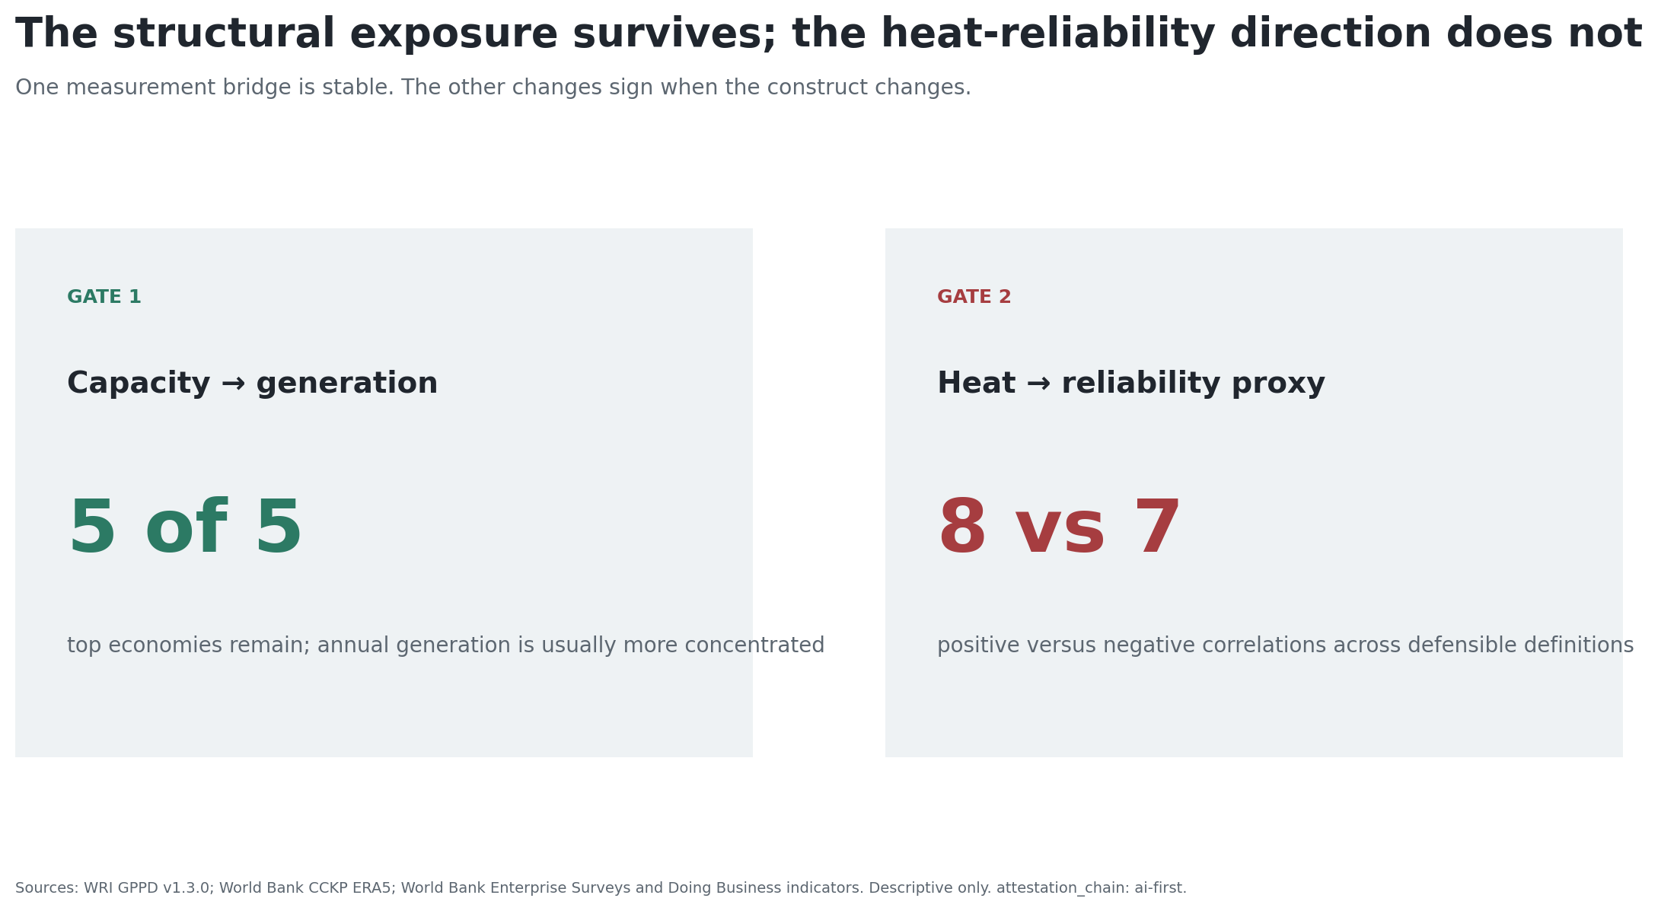
One result survives; one does not

Slide 3
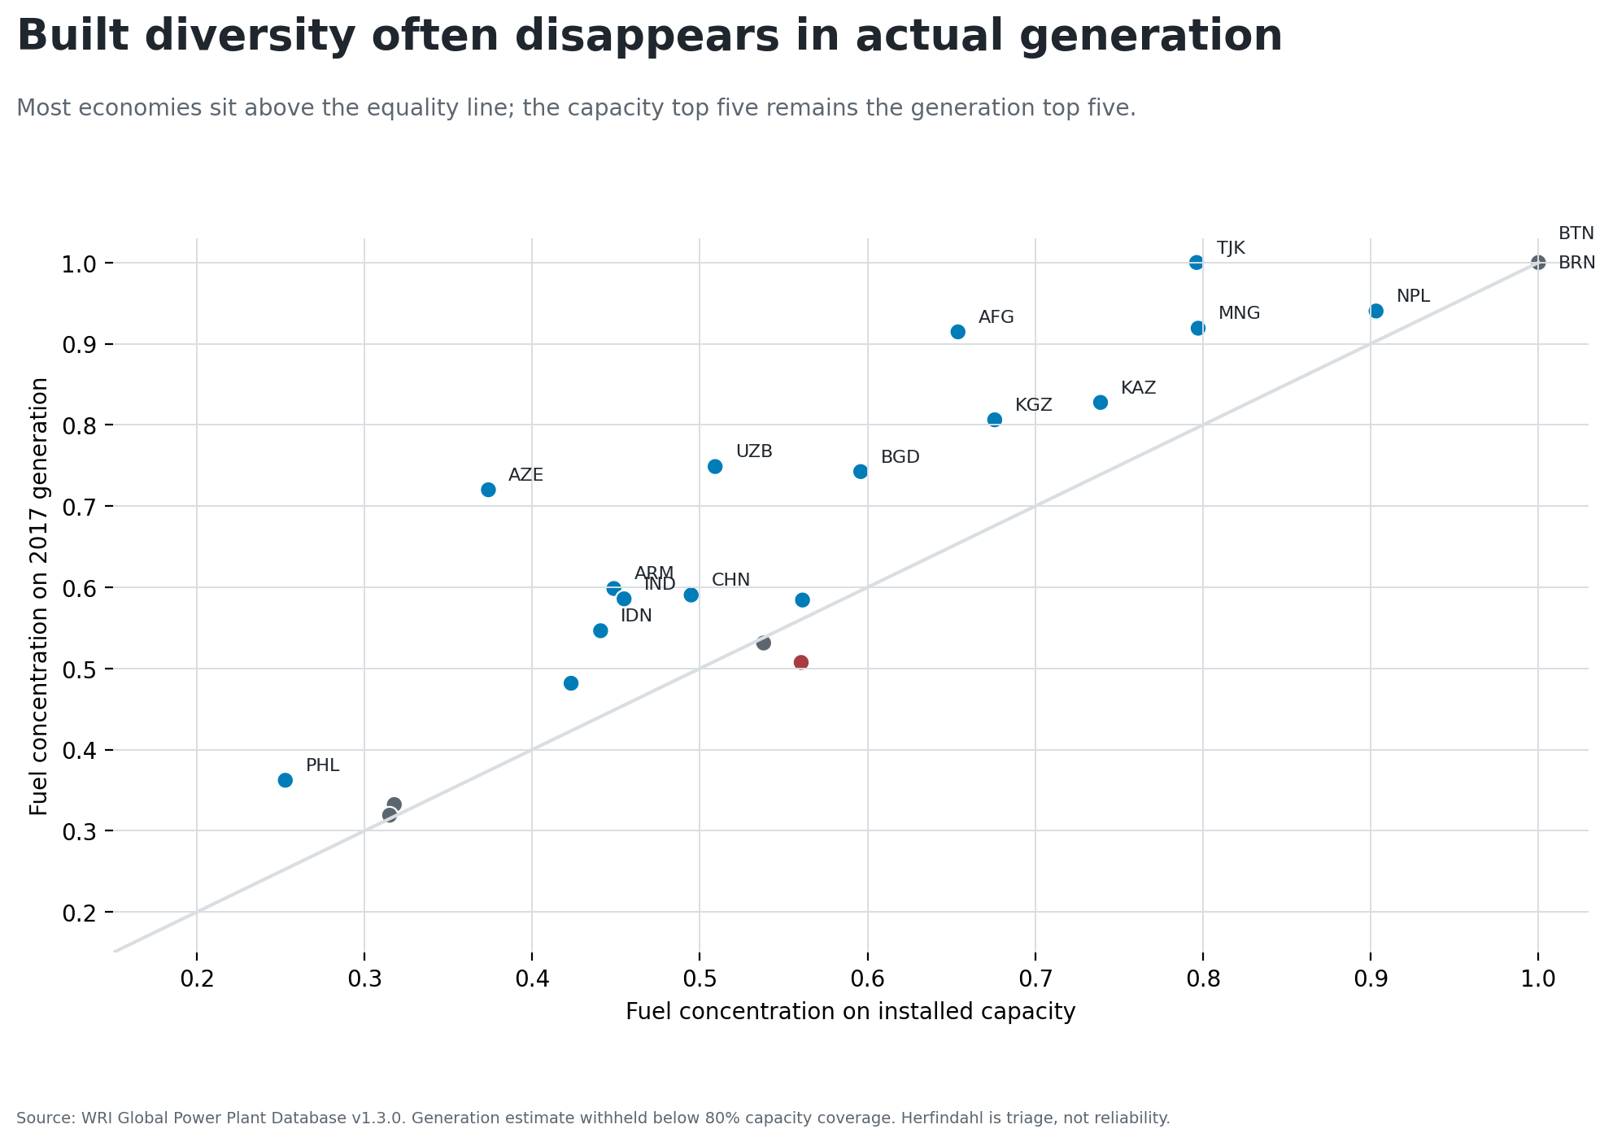
Built diversity can disappear in generation

Slide 4
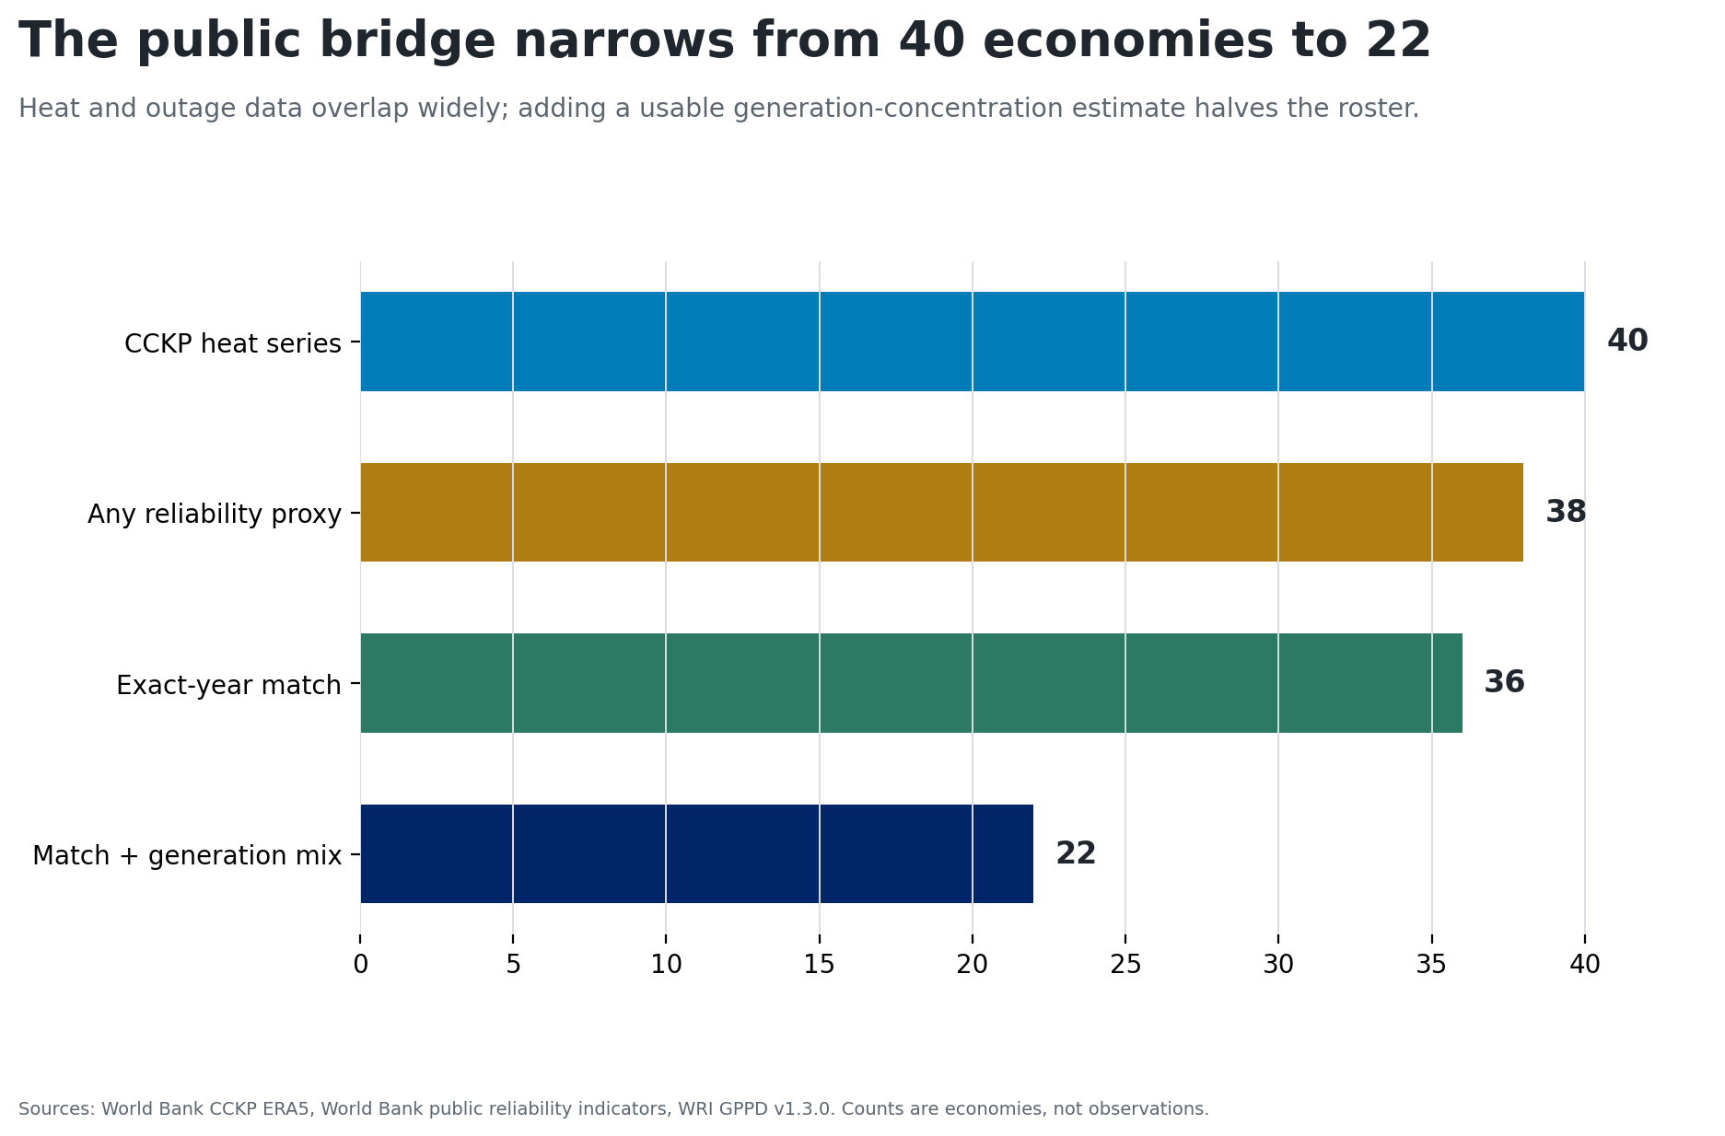
The public bridge is real but narrow

Slide 5
Exact-year does not mean comparable
451 country-year-outcome rows across 36 economies, 2007–2022.
Three heat definitions; five reliability outcomes.
Firm surveys arrive in waves; Doing Business SAIDI is a separate method.
Annual country heat does not observe event timing or service territory.

Slide 6
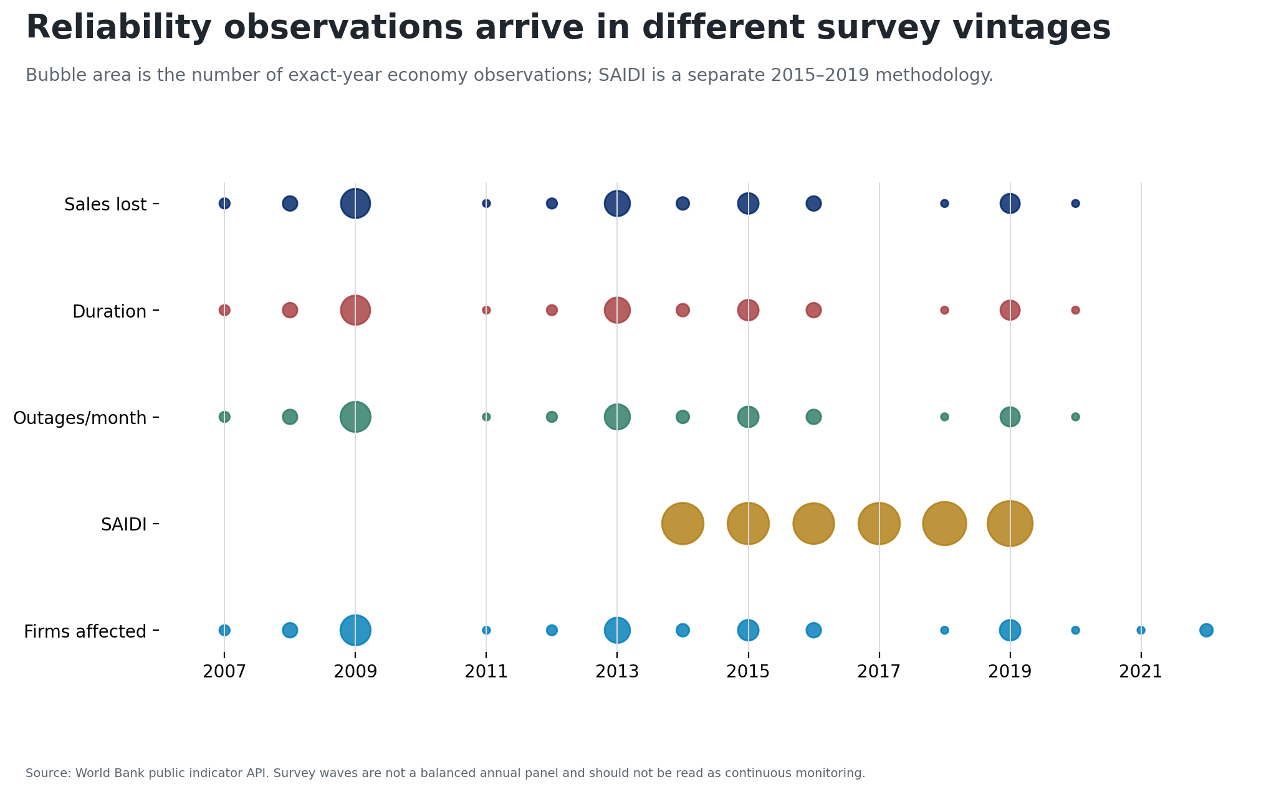
Reliability proxies arrive in different vintages

Slide 7
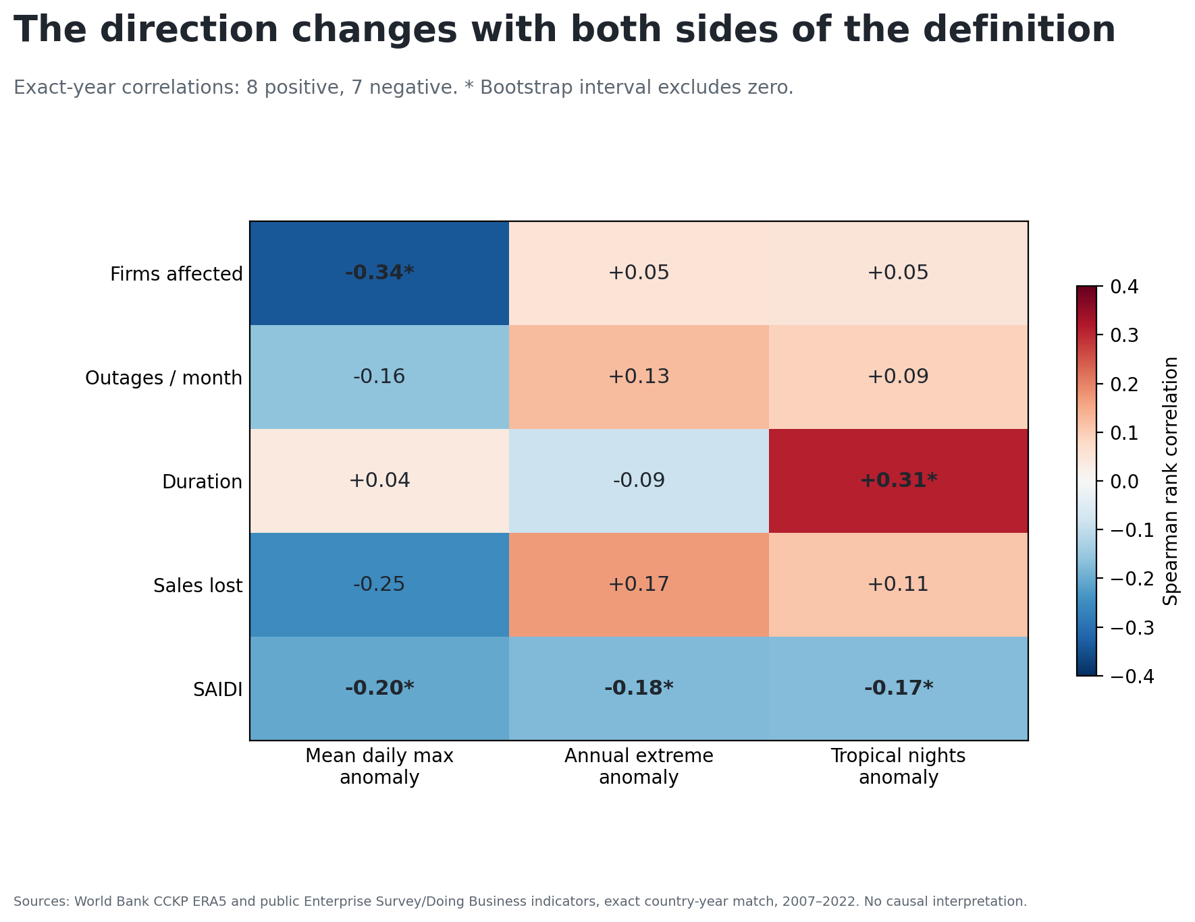
The direction changes with the construct

Slide 8
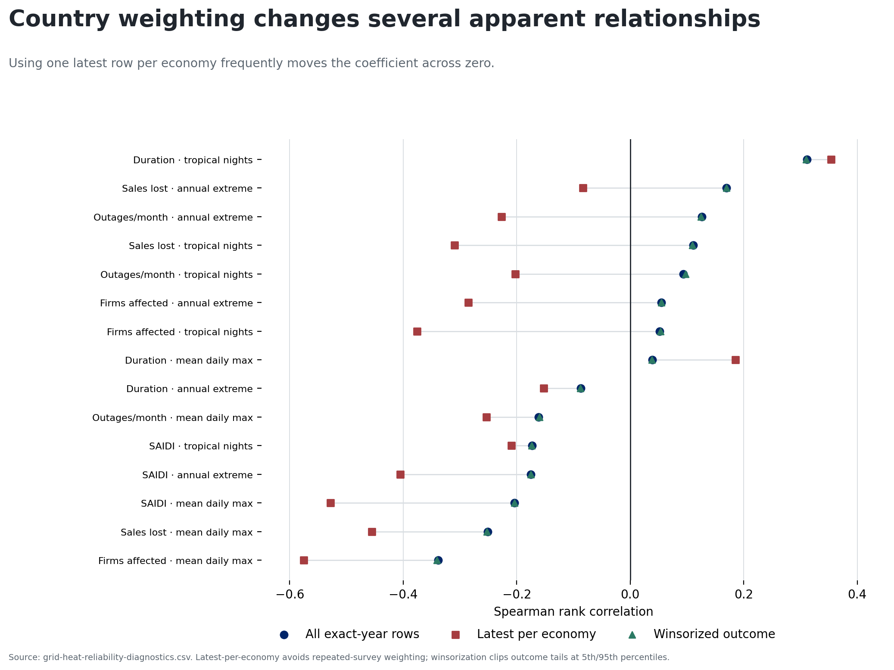
Country weighting changes apparent relationships

Slide 9
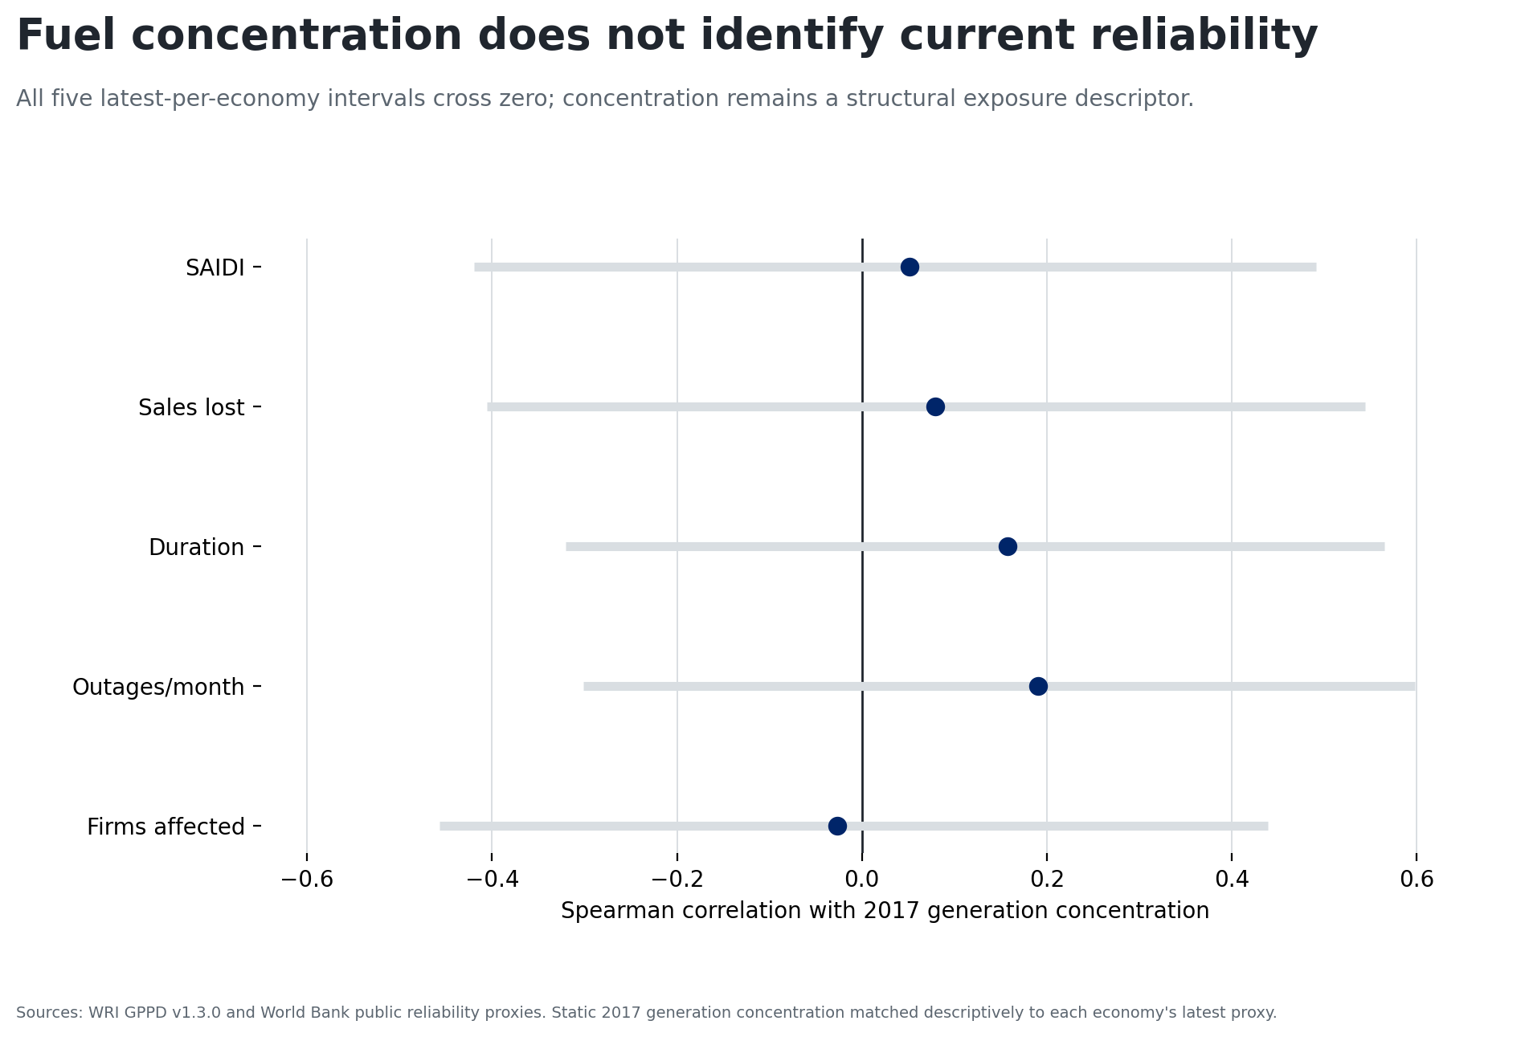
Fuel concentration is not current reliability

Slide 10
Publish the boundary, not a ranking
Supported: the same five economies top capacity- and generation-based fuel concentration.
Not supported: a directional regional heat–reliability association or vulnerability leaderboard.
Next object: interruption timing, customers or load affected, daily/hourly heat, demand, available generation, imports, maintenance, and network conditions at a common service territory.

