Slide 1
The stable top four does not survive its own constructs
Water × crop construct validation — AI-first under §18 Raymond Adofina · Asian Development Bank

Slide 2
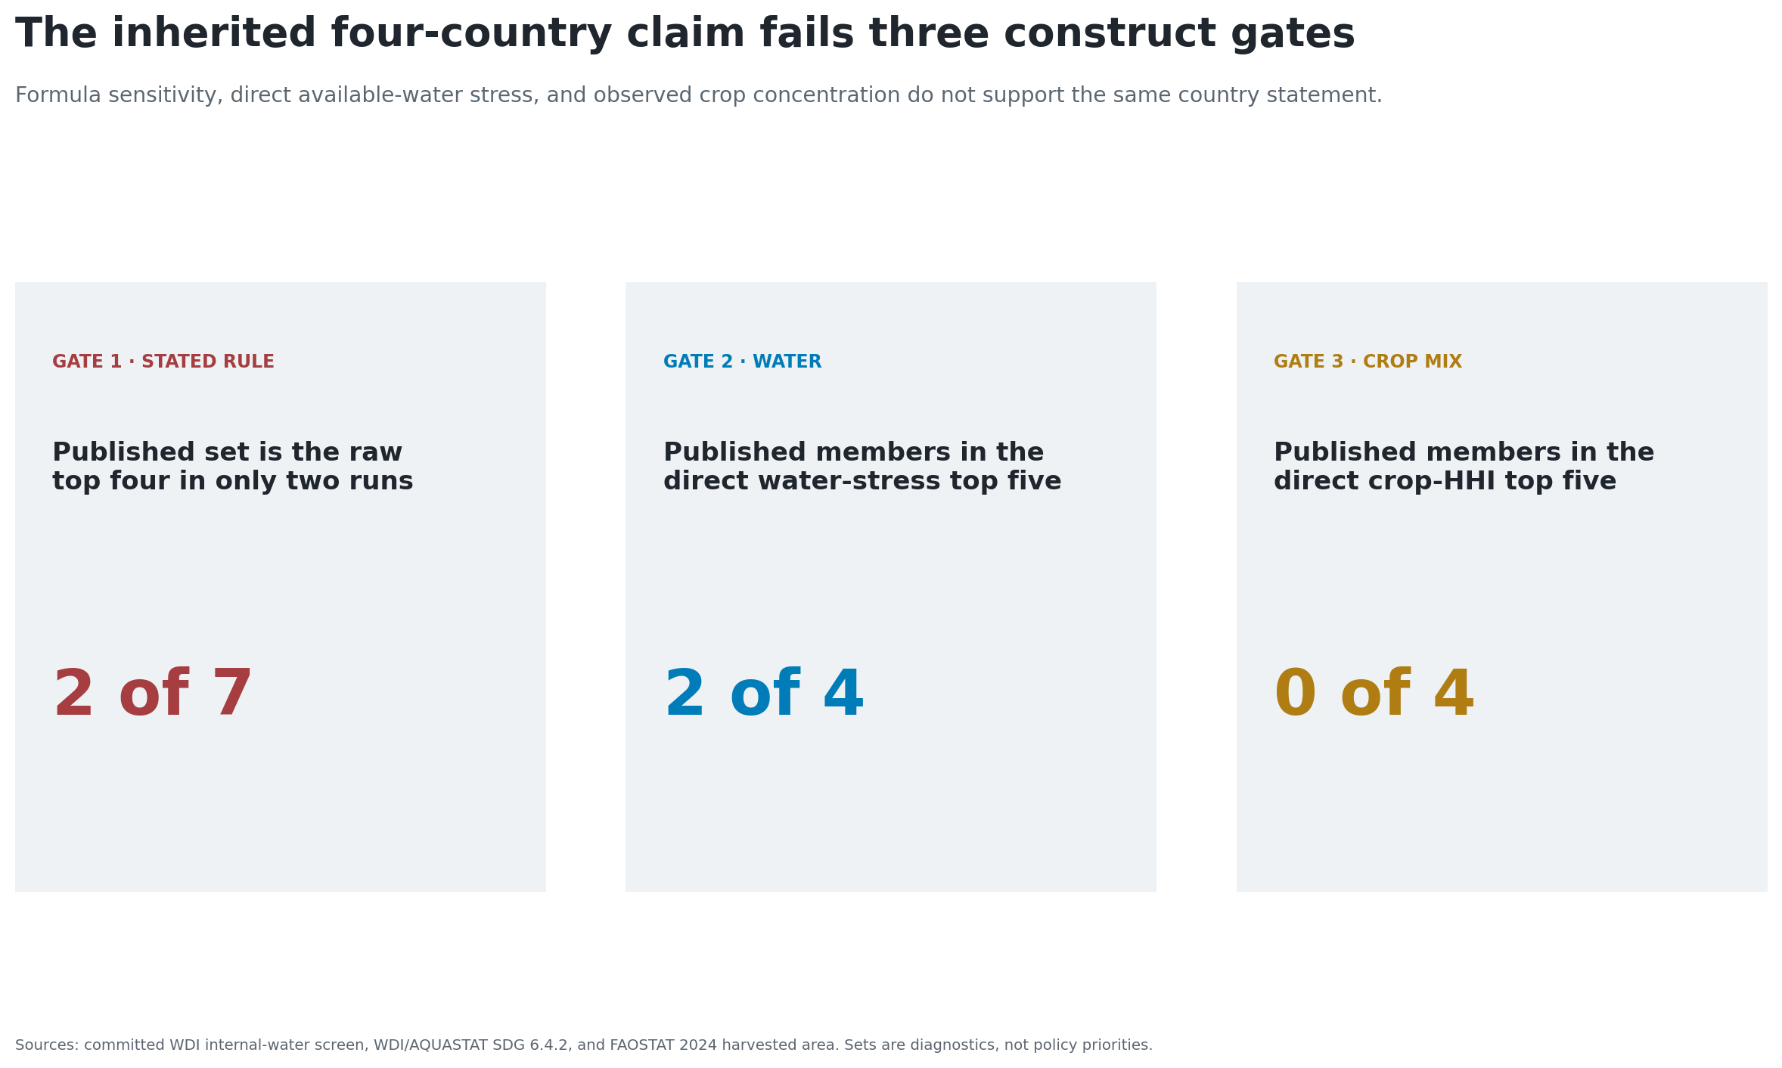
The claim fails three construct gates

Slide 3
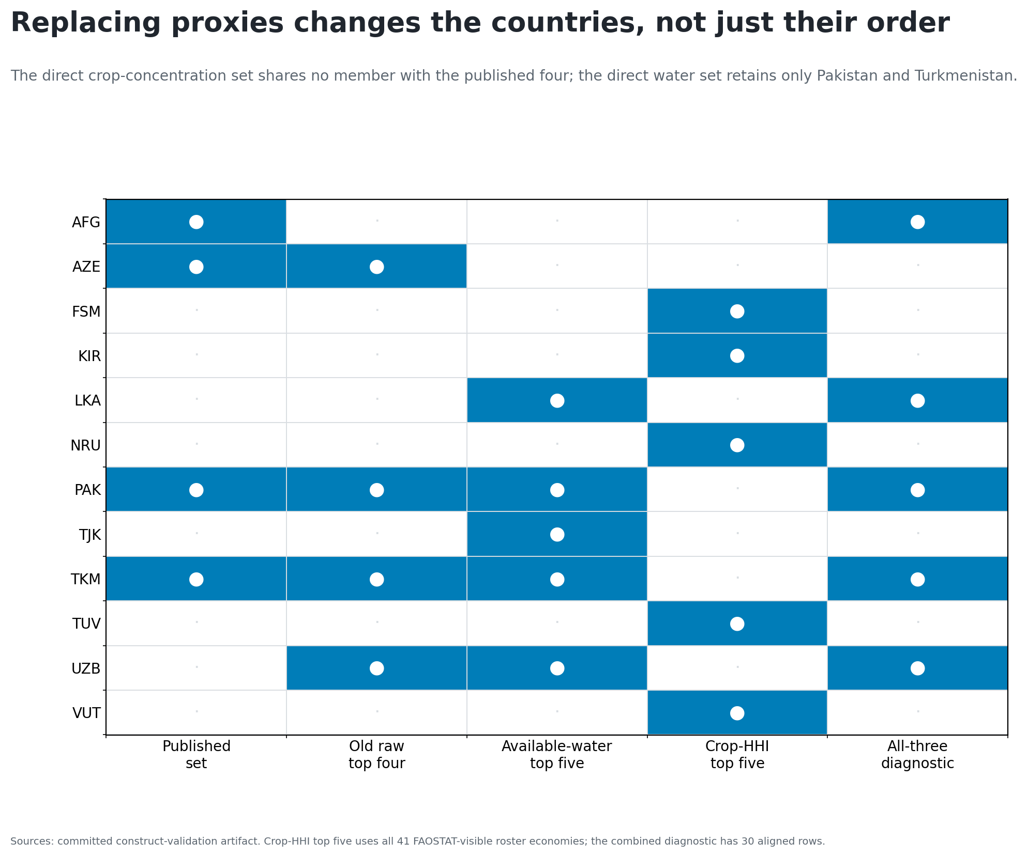
Replacing proxies changes the countries

Slide 4
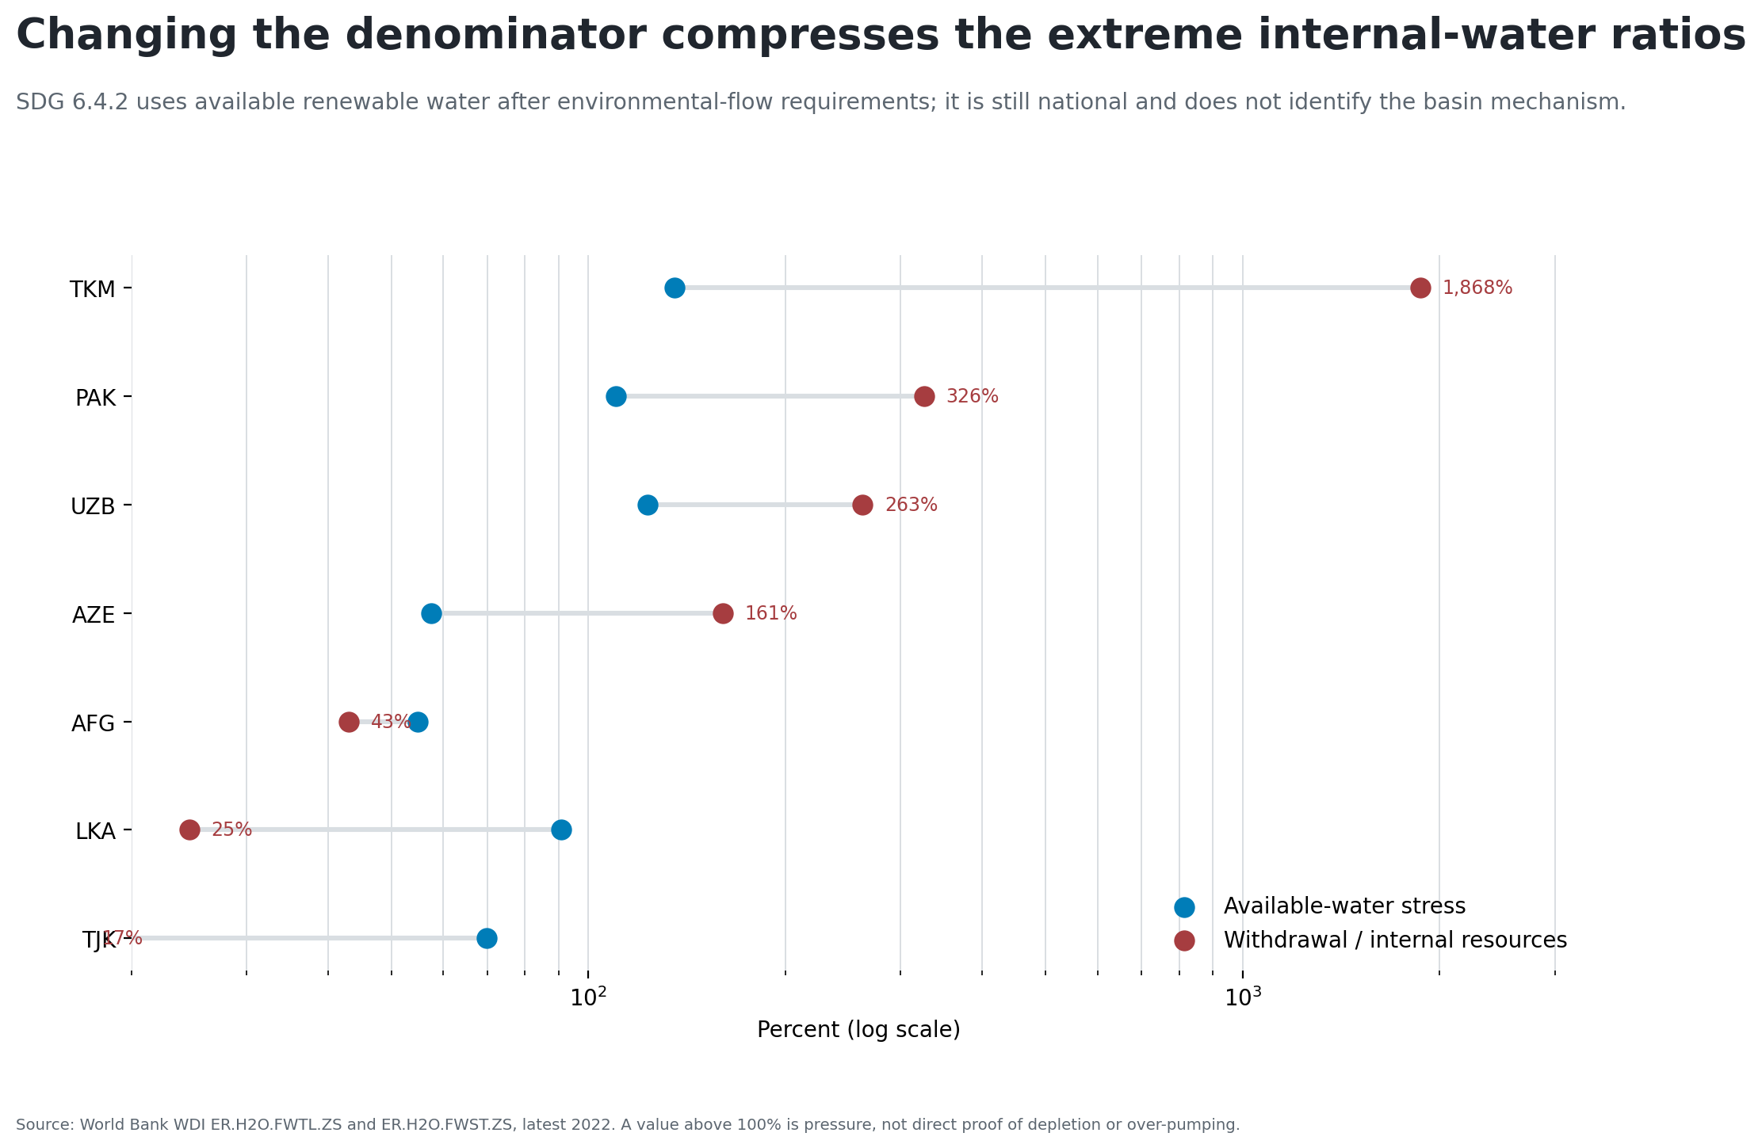
The old denominator created extreme but flat water terms

Slide 5
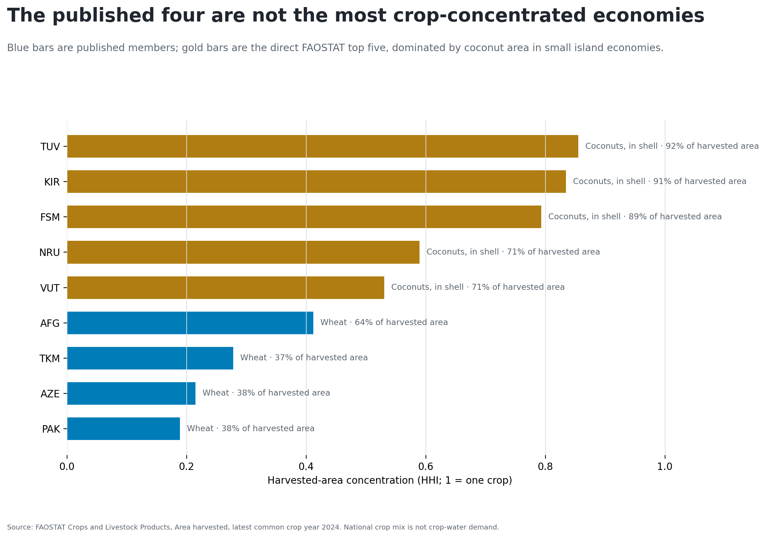
Direct crop concentration selects a different set

Slide 6
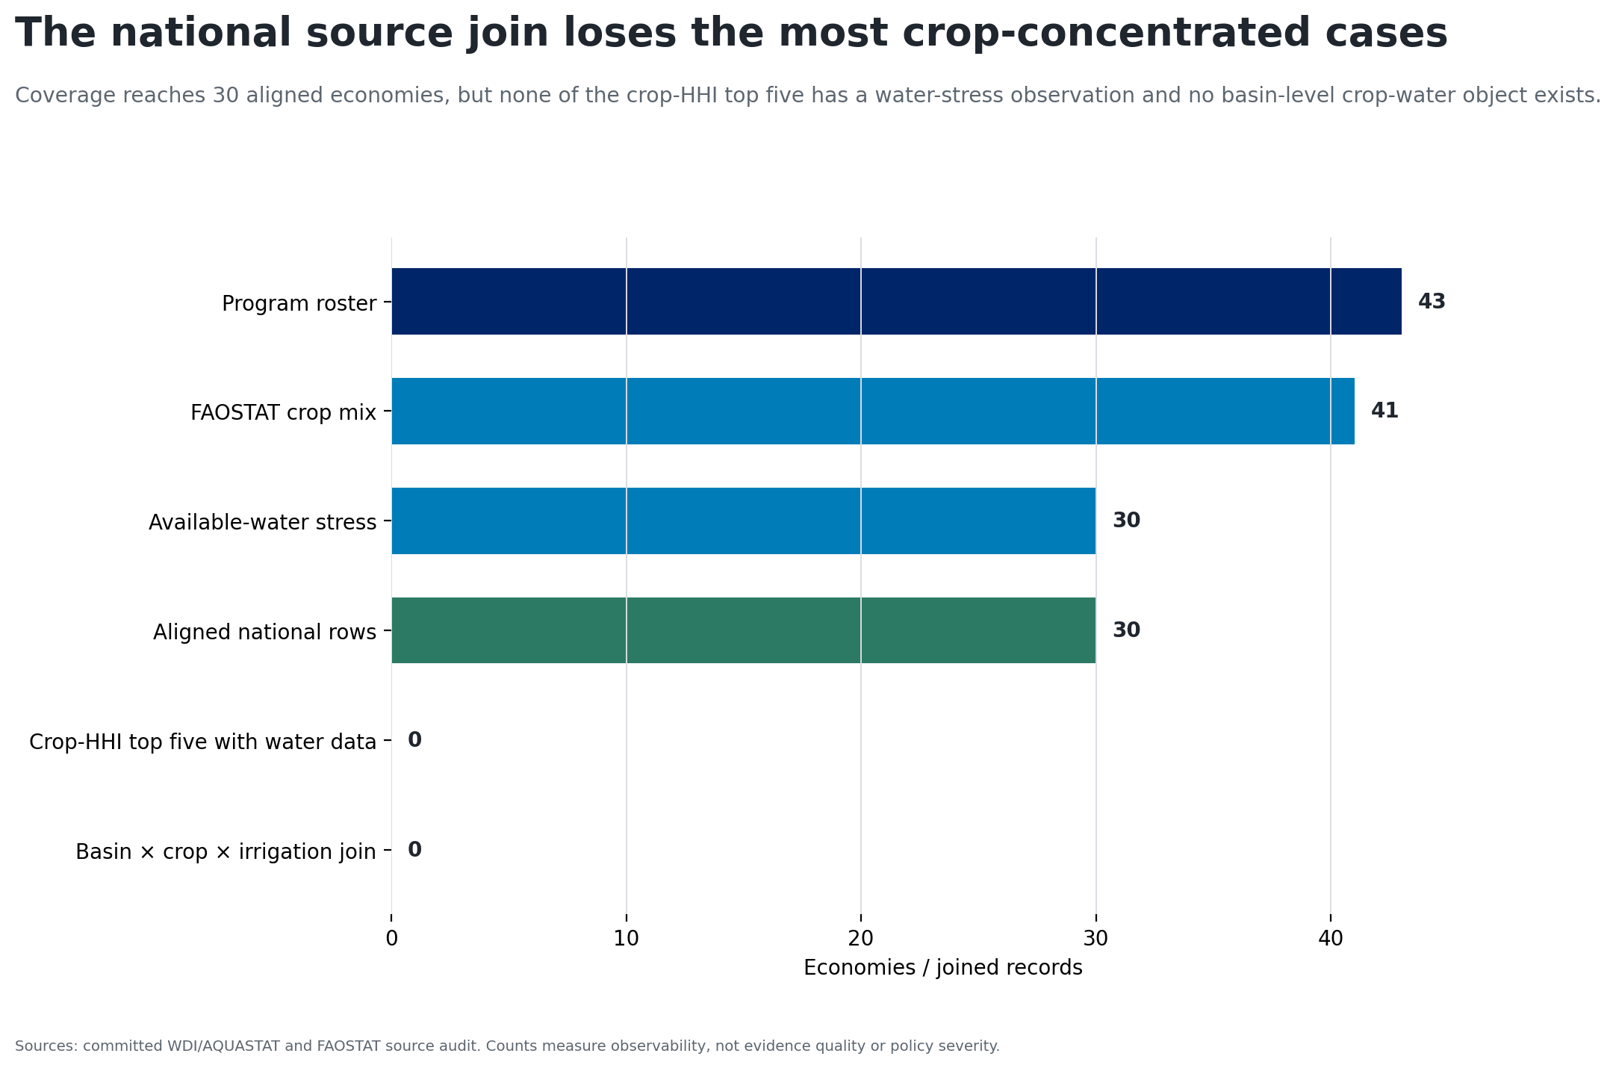
Coverage removes all five crop-HHI leaders

Slide 7
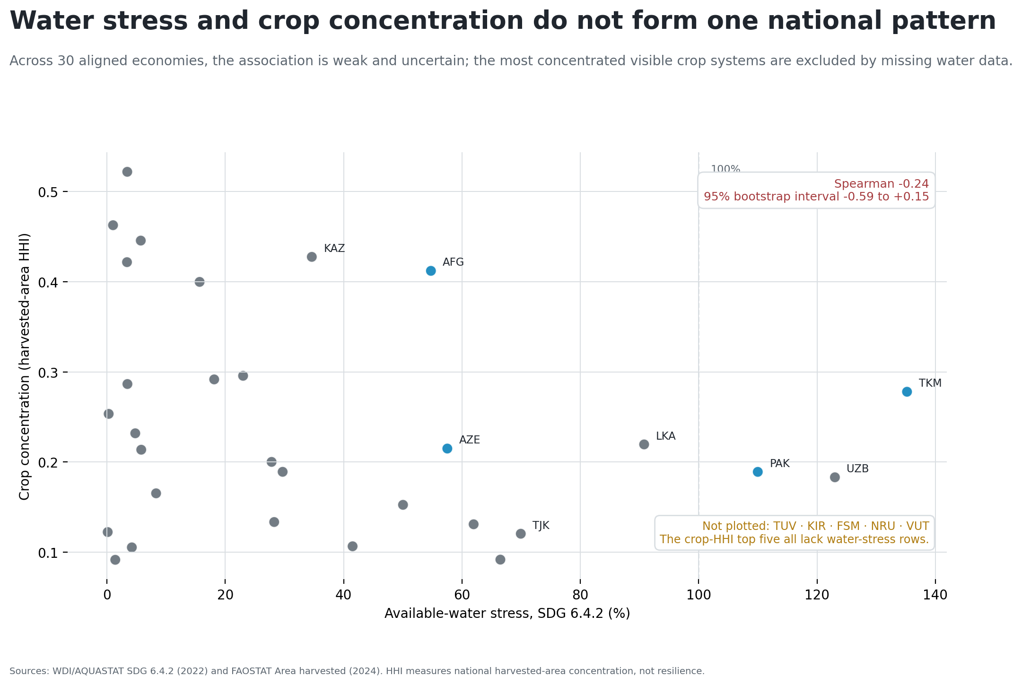
Water and crop concentration do not align nationally

Slide 8
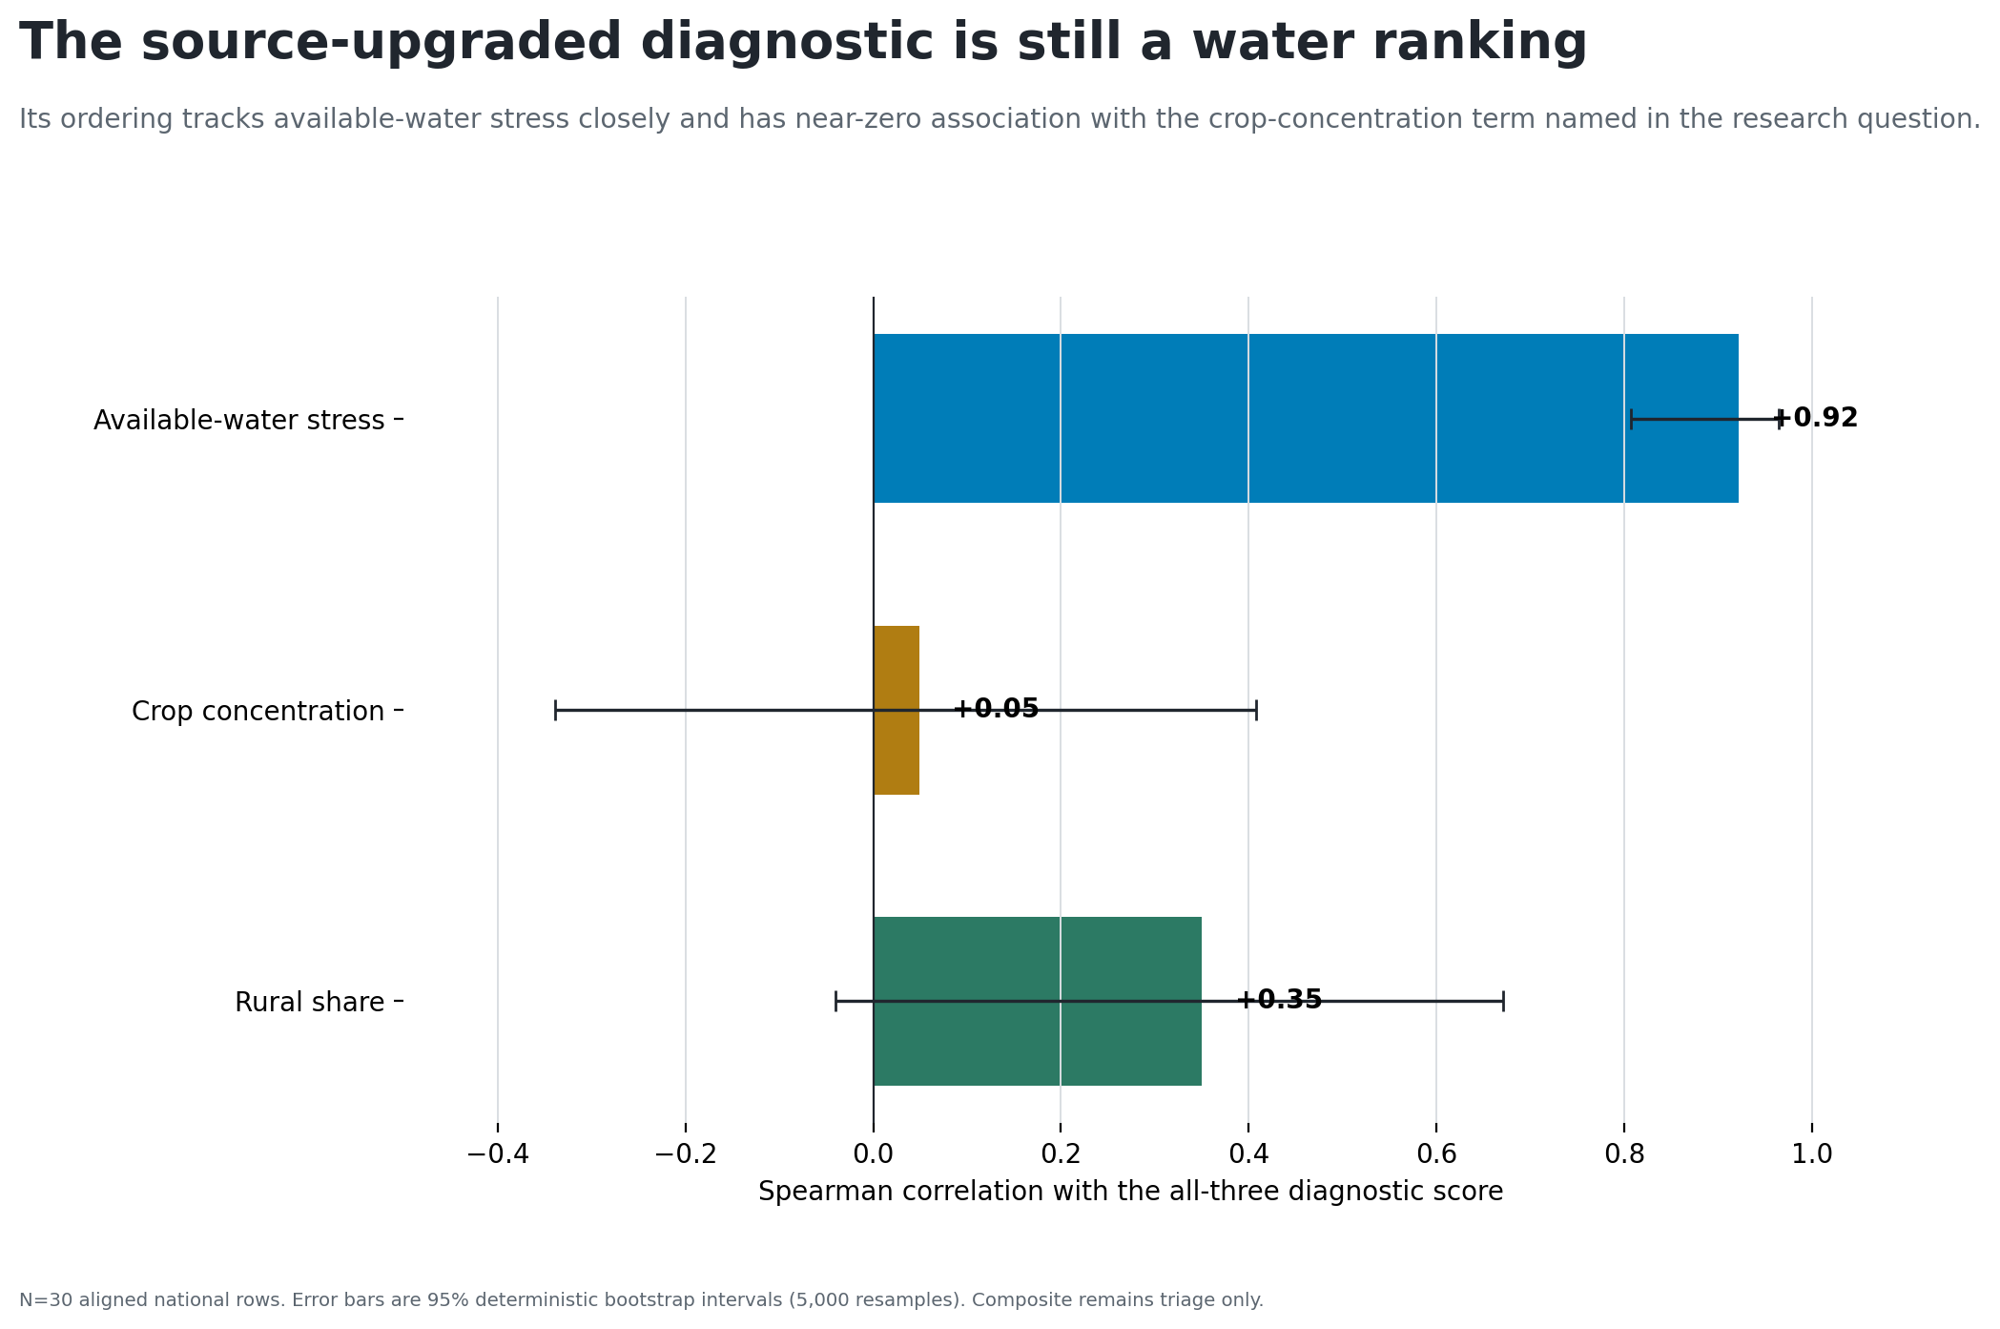
The replacement diagnostic is still water-dominated

Slide 9
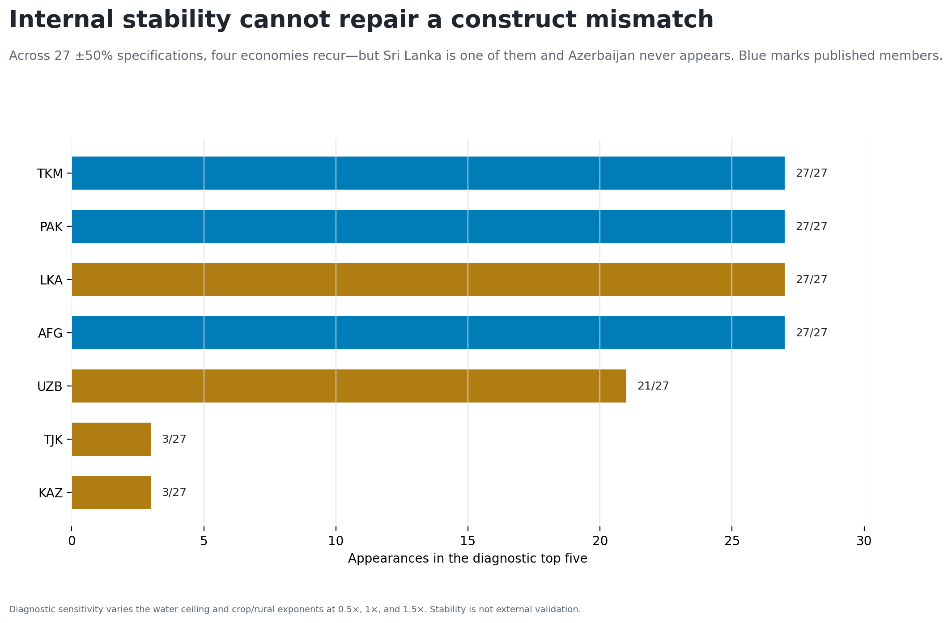
Internal stability does not establish construct validity

Slide 10
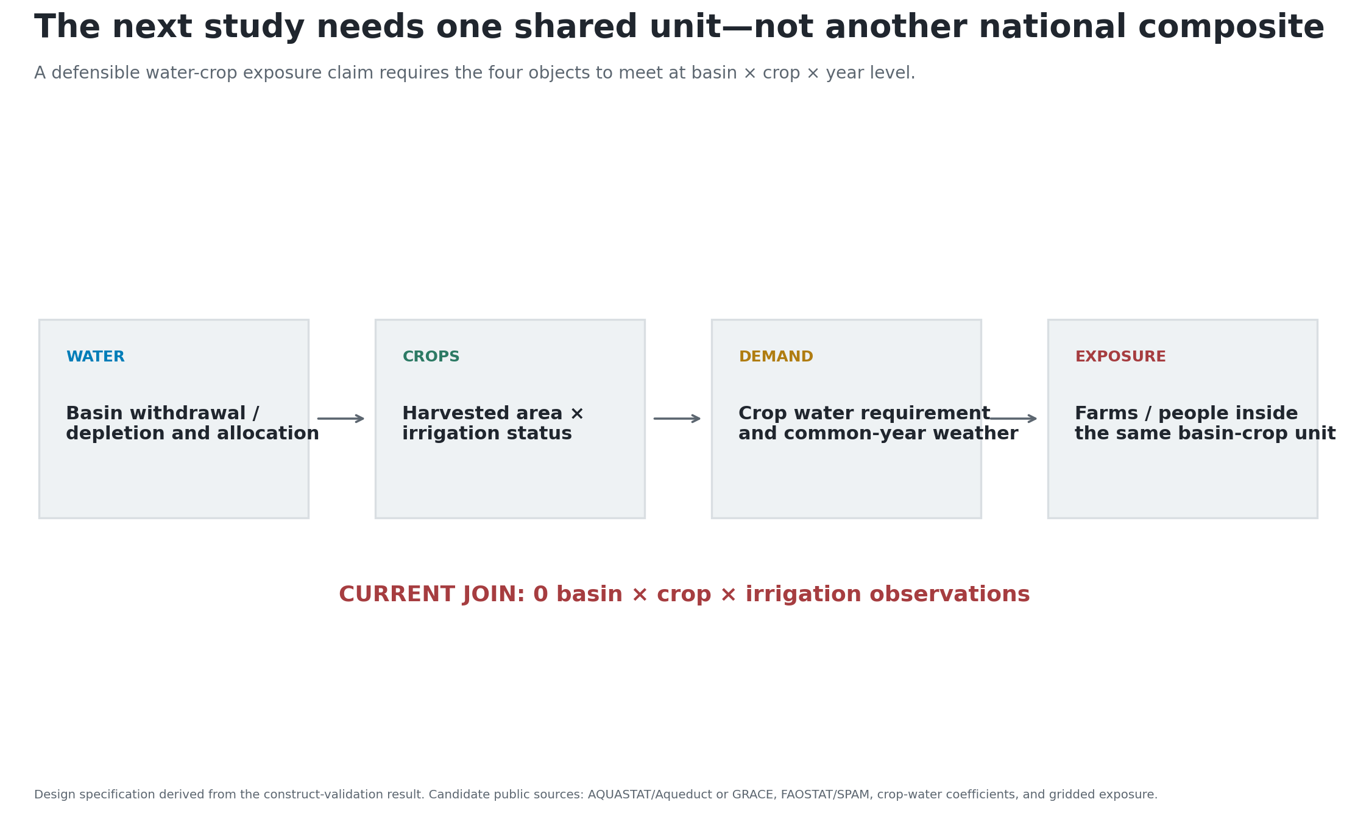
Retire the ranking; build the shared unit

Slide 11
Decision: no replacement country ranking from the current national source stack. The next qualified object is basin × crop × irrigation × year with an observed outcome.

