Slide 1
Where OpenStreetMap and the official health-facility registry disagree
ADB DMC measurement-gap evidence — Philippines and Bangladesh pilots, AI-first under §18 Raymond Adofina · Asian Development Bank

Slide 2
The question

Slide 3
Two maps of the same country, two answers
When a planner asks how many health facilities serve this district, two reasonable public sources answer differently:
OpenStreetMap — volunteer-edited, open, frequently used in spatial-analysis pipelines.
The official national registry — administrative record kept by the health ministry, used for licensing and reporting.
Both are public. Both are used. They disagree, and the disagreement is systematic, not random.
This deck reports the first methodologically careful version of that finding for two ADB developing member economies. It carries an ai-first attestation chain under CONSTITUTION.md §18.

Slide 4
The headline

Slide 5
OpenStreetMap captures a small share of the official registry
Country | Source | Active facilities | OSM matches | OSM ÷ clinical
Philippines | DOH NHFR v2.0 | 44,267 | 6,401 | 17.1%
Bangladesh | DGHS Facility Registry | 39,421 | 3,298 | 11.8%

Slide 6
Both ratios fall below the 30% fit-for-planning threshold from the methodological literature on African MOH systems.

Slide 7
The pattern

Slide 8
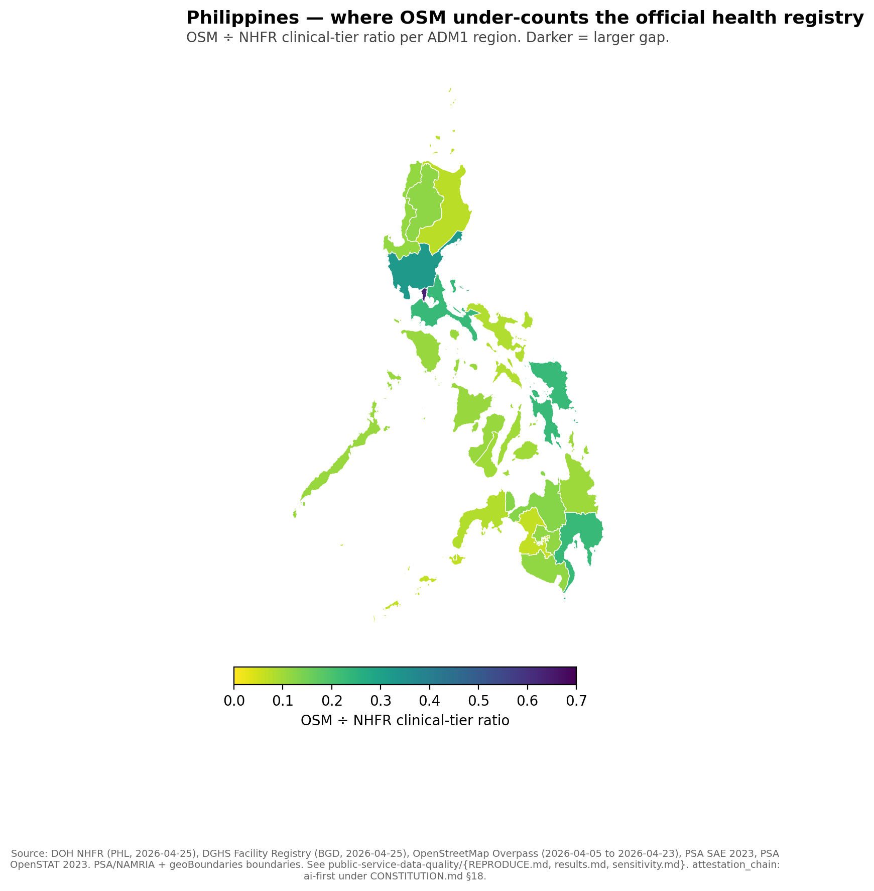
Philippines — 9.8× rural-urban gradient
NCR 63.5% → BARMM 6.5%. Every region disagrees with OSM by more than ±10%.
Philippines — OSM ÷ NHFR clinical-tier ratio per ADM1 region. NCR (top of the country) shows the highest ratio (about 0.6); BARMM and the rural Mindanao regions show the lowest (about 0.07). 17 regions total.

Slide 9
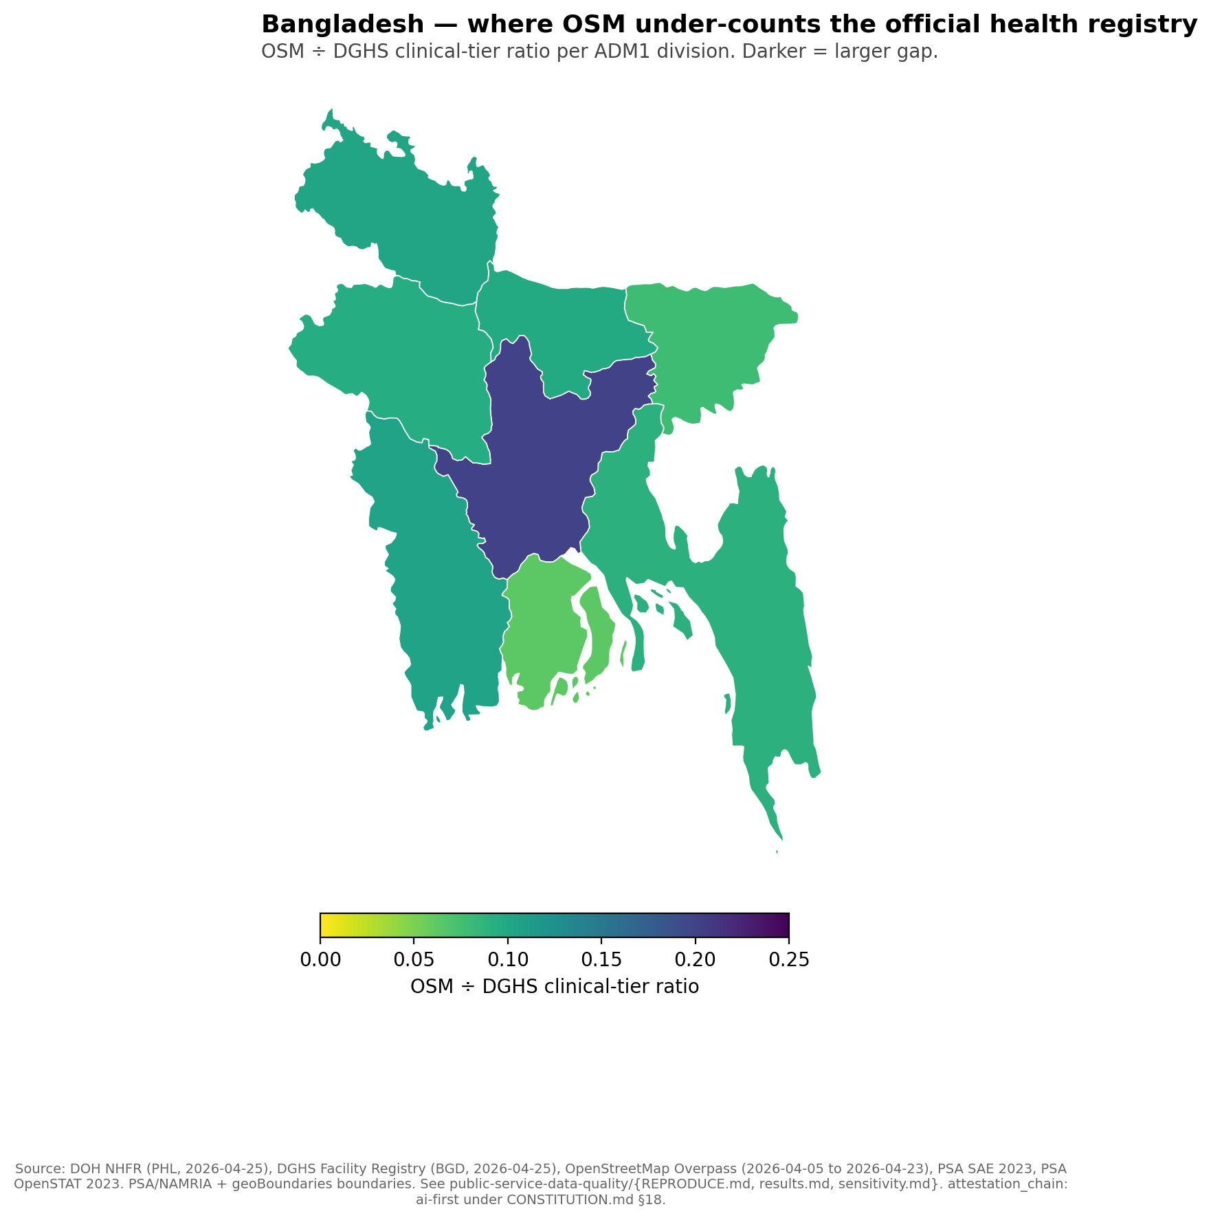
Bangladesh — same direction at smaller scale
Dhaka 20.1% → Barisal 6.2%. Different country, different registry, different volunteer community, same direction of gradient.
Bangladesh — OSM ÷ DGHS clinical-tier ratio per ADM1 division. Dhaka (centre) shows the highest ratio (about 0.20); Sylhet and Barisal show the lowest (about 0.06 to 0.08).

Slide 10
Robustness

Slide 11
The pattern survives every parameter at ±50%
Per CONSTITUTION.md §6.6, every arbitrary numeric was tested at ±50%:
Factype set cardinality (PHL 19→10 or 19→28; BGD keyword sets): ratio range 14.5%–17.3% (PHL), 11.6%–11.8% (BGD).
Rural-urban gradient quintile size (20%→10% or 20%→30%): gradient ranges 4.0×–7.0× (PHL), 2.18×–3.21× (BGD).
Falsification threshold (±5%, ±10%, ±15%): zero of 17 PHL ADM1 units within tolerance at any threshold.
No row flips the §8 decision rule in either country.

Slide 12
The granularity upgrade

Slide 13
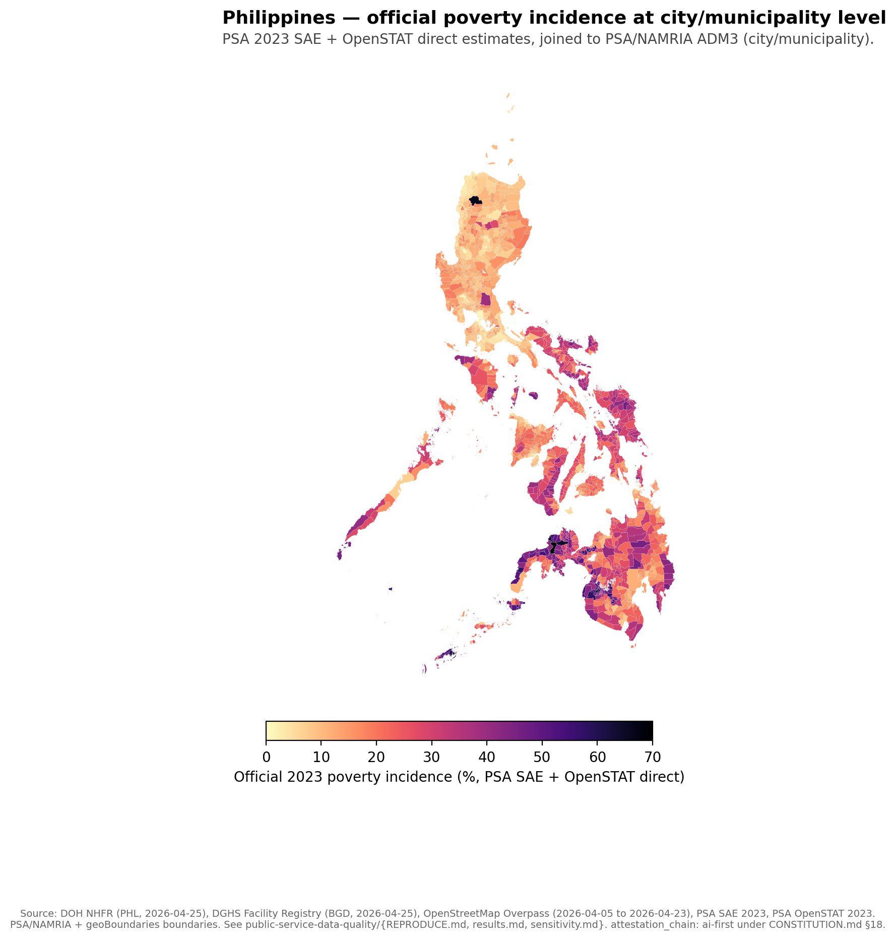
Philippines — at city/municipality level (1,632 of 1,642)
Owner-downloaded PSA 2023 SAE workbook + PSA OpenSTAT direct estimates. 10 polygons remain explicitly source-missing rather than imputed.
Philippines official 2023 poverty incidence at city/municipality level, joined to PSA/NAMRIA ADM3 polygons. Highest poverty concentrations in BARMM, the Cordillera, and parts of Eastern Visayas; lowest in NCR and Calabarzon. Ten polygons stay gray, marking source-missing rows that were not imputed.

Slide 14
Why this matters for project preparation

Slide 15
Project pipelines that read OSM alone misread service supply
A planner reading the public map alone reads a different country than a planner reading the registry alone. The miscount is not uniform:
It is largest in rural and conflict-affected admin units.
It is smallest in capital regions.
So OSM-only denominators systematically under-state facility density exactly where additional access most matters. This is a methodological finding about data infrastructure, not a quality judgment about countries.
The same logic applies to schools, markets, and other public-service amenities visible in OpenStreetMap.

Slide 16
Honest limits

Slide 17
What this deck does NOT claim
It does not claim OSM is wrong. Without a third independent source we cannot adjudicate which map is closer to ground truth.
It does not rank countries. Registry definitions differ; the cross-country ratios are not directly comparable. The within-country gradient is the comparable quantity.
It does not establish causal mechanisms. Volunteer behaviour, registry incentives, and conflict exposure all plausibly contribute in ways we have not separated.
It is not human-final. Under §18, this artifact is AI-attested. Owner attestation, line-by-line paper reading, and contact with external reviewers (Macharia, Zipf, PIDS, BIDS) are pre-conditions for a human-final upgrade.

Slide 18
Reproducibility

Slide 19
Every number traces to a committed script
Working paper: articles/measurement-gap-philippines-bangladesh.md
Brief: articles/_brief/public-service-data-quality.md
Pipeline: public-service-data-quality/scripts/
Sensitivity: public-service-data-quality/sensitivity.md
Limitations: public-service-data-quality/limitations.md
Evidence packet: /program/public-service-data-quality/evidence
Charts: rendered by build-choropleth.py from generated/public-service-data-quality-{PHL,BGD}.csv and generated/psdq-phl-admin3-poverty-context.csv.

Slide 20
Attestation chain
This deck is attestation_chain: ai-first under CONSTITUTION.md §18.
Path to human-final:
Owner reads each cited paper line-by-line.
Owner runs internal review with co-author Arturo Martinez Jr.
Owner contacts at least one external reviewer (Macharia / Zipf / PIDS / BIDS) and replaces the AI-synthesized review-external.md §3 with the actual feedback.
Owner-signed commit promotes the artifact to human-final.

