Slide 1
Where OpenStreetMap and the official health-facility registry disagree
Two ADB economies, two public maps, and a systematic gap planners should not ignore — AI-first under §18 Raymond Adofina · Asian Development Bank

Slide 2
Why facility counts disagree

Slide 3
Two maps of the same country, two answers
When a planner asks how many health facilities serve this district, two reasonable public sources answer differently:
OpenStreetMap — volunteer-edited, open, and often fed into spatial analysis.
The official national registry — the health ministry’s administrative record for licensing and reporting.
Both are public. Both are used. They disagree, and the disagreement is systematic, not random.
This deck is the first careful version of that finding for two ADB developing member economies. It carries an ai-first attestation chain under CONSTITUTION.md §18.

Slide 4
How much of the registry OSM captures

Slide 5
OpenStreetMap captures a small share of the official registry
Country | Source | Active facilities | OSM matches | OSM ÷ clinical
Philippines | DOH NHFR v2.0 | 44,267 | 6,401 | 17.1%
Bangladesh | DGHS Facility Registry | 39,421 | 3,298 | 11.8%

Slide 6
Both ratios fall below the 30% fit-for-planning threshold from the methodological literature on African MOH systems.

Slide 7
Where the gap is largest

Slide 8
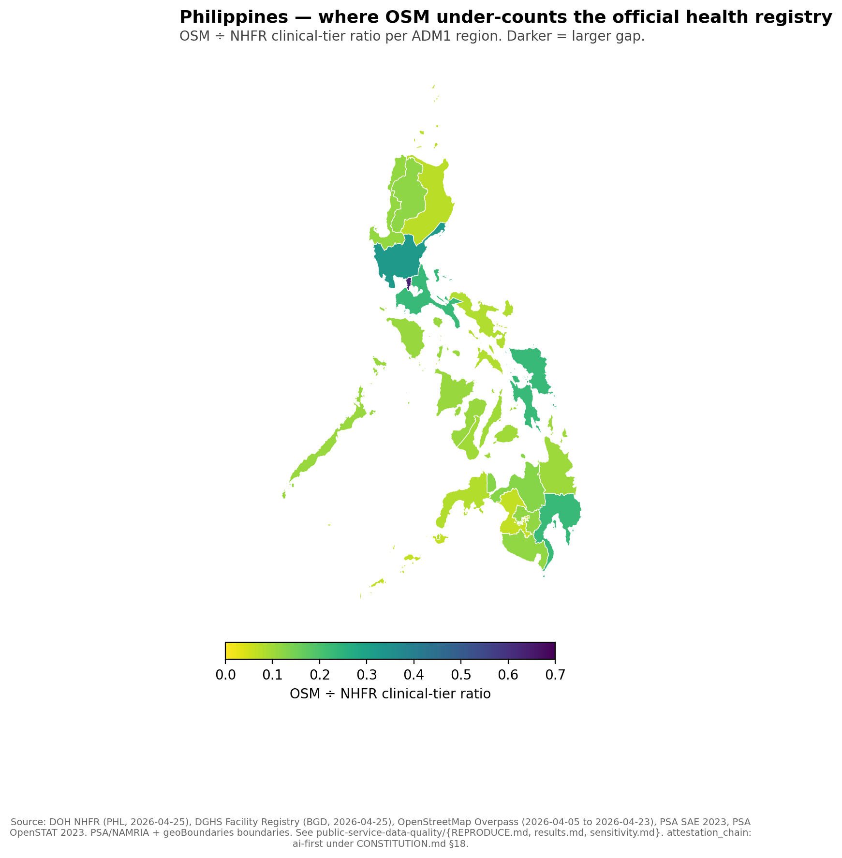
Philippines — 9.8× rural-urban gradient

Slide 9
NCR 63.5% → BARMM 6.5%. Every region disagrees with OSM by more than ±10%.

Slide 10
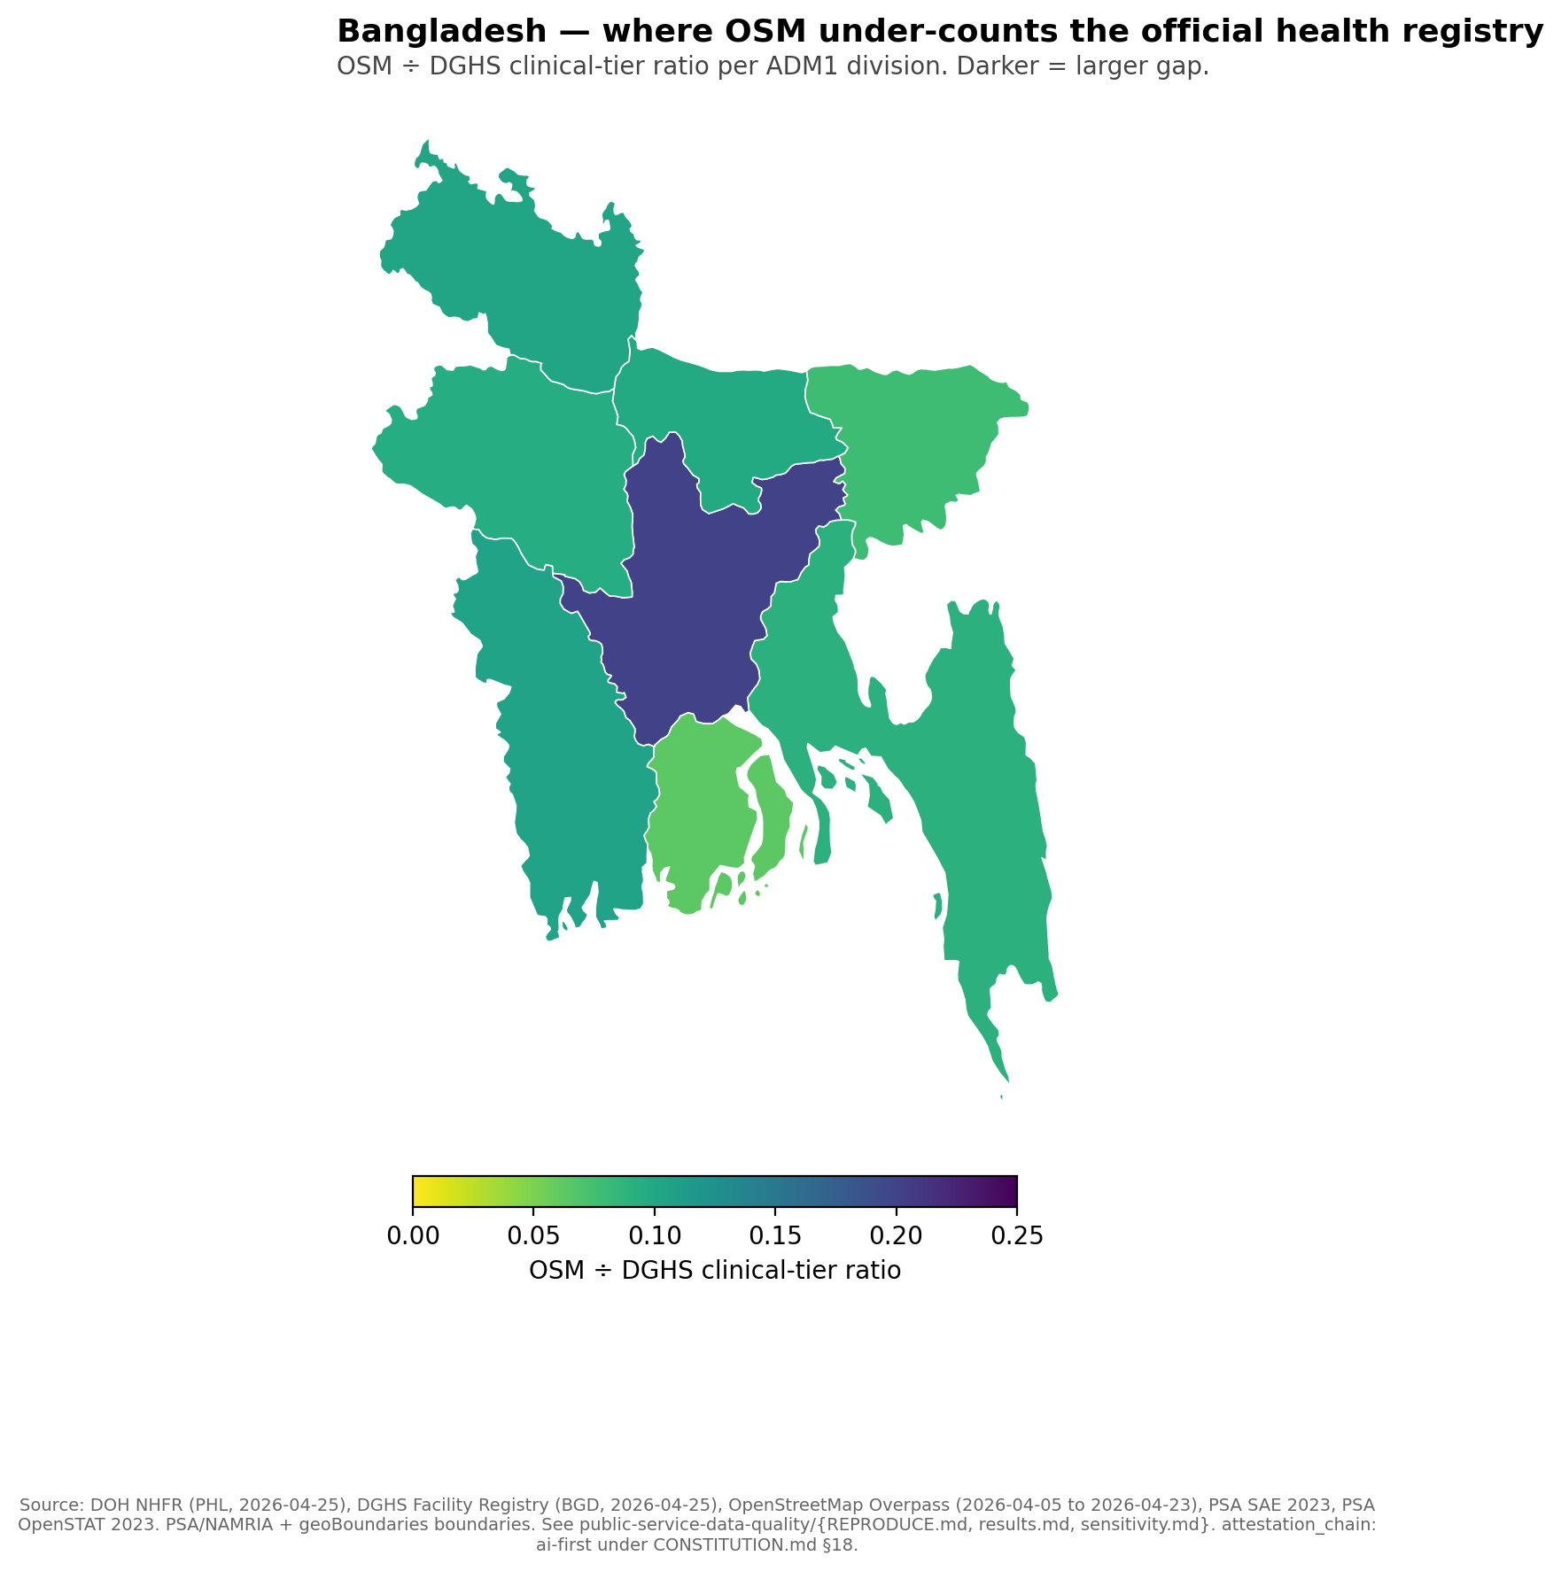
Bangladesh — same direction at smaller scale

Slide 11
Dhaka 20.1% → Barisal 6.2%. Different country, different registry, different volunteer community, same direction of gradient.

Slide 12
Does the pattern hold when the rules change?

Slide 13
The pattern survives every parameter at ±50%
Per CONSTITUTION.md §6.6, every arbitrary numeric was tested at ±50%:
Which facility types count (PHL 19→10 or 19→28; BGD keyword sets): ratio range 14.5%–17.3% (PHL), 11.6%–11.8% (BGD).
Rural-urban gradient quintile size (20%→10% or 20%→30%): gradient ranges 4.0×–7.0× (PHL), 2.18×–3.21× (BGD).
How tight “agreement” is defined (±5%, ±10%, ±15%): zero of 17 PHL ADM1 units within tolerance at any threshold.
No row flips the §8 decision rule in either country.

Slide 14
What finer geography shows

Slide 15
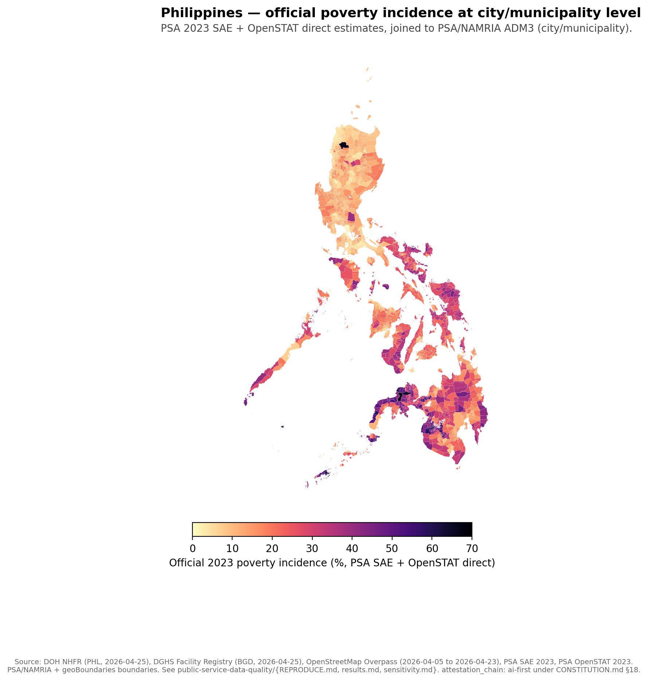
Philippines — at city/municipality level (1,632 of 1,642)

Slide 16
Owner-downloaded PSA 2023 SAE workbook + PSA OpenSTAT direct estimates. 10 polygons remain explicitly source-missing rather than imputed.

Slide 17
Why this matters for planners

Slide 18
Project pipelines that read OSM alone misread service supply
A planner reading the public map alone reads a different country than a planner reading the registry alone. The miscount is not uniform:
It is largest in rural and conflict-affected admin units.
It is smallest in capital regions.
So OSM-only denominators systematically under-state facility density exactly where additional access most matters. This is a measurement finding about data infrastructure, not a quality judgment about countries.
The same logic applies to schools, markets, and other public-service amenities visible in OpenStreetMap.

Slide 19
What this deck does not claim

Slide 20
Limits a careful reader should keep in view
It does not claim OSM is wrong. Without a third independent source we cannot adjudicate which map is closer to ground truth.
It does not rank countries. Registry definitions differ; the cross-country ratios are not directly comparable. The within-country gradient is the comparable quantity.
It does not establish causal mechanisms. Volunteer behaviour, registry incentives, and conflict exposure all plausibly contribute in ways we have not separated.
It is not human-final. Under §18, this artifact is AI-attested. Owner attestation, line-by-line paper reading, and contact with external reviewers (Macharia, Zipf, PIDS, BIDS) are pre-conditions for a human-final upgrade.

Slide 21
Where the numbers come from

Slide 22
Every number traces to a committed script
Working paper: articles/measurement-gap-philippines-bangladesh.md
Brief: articles/_brief/public-service-data-quality.md
Pipeline: public-service-data-quality/scripts/
Sensitivity: public-service-data-quality/sensitivity.md
Limitations: public-service-data-quality/limitations.md
Evidence packet: /program/public-service-data-quality/evidence
Charts: rendered by build-choropleth.py from generated/public-service-data-quality-{PHL,BGD}.csv and generated/psdq-phl-admin3-poverty-context.csv.

Slide 23
Attestation chain
This deck is attestation_chain: ai-first under CONSTITUTION.md §18.
Path to human-final:
Owner reads each cited paper line-by-line.
Owner runs internal review with co-author Arturo Martinez Jr.
Owner contacts at least one external reviewer (Macharia / Zipf / PIDS / BIDS) and replaces the AI-synthesized review-external.md §3 with the actual feedback.
Owner-signed commit promotes the artifact to human-final.

