Slide 1
A disaster-recovery ranking fails two validity gates
Metric falsification and a 108-orbit Typhoon Haiyan pilot — AI-first under §18 Raymond Adofina · Asian Development Bank

Slide 2
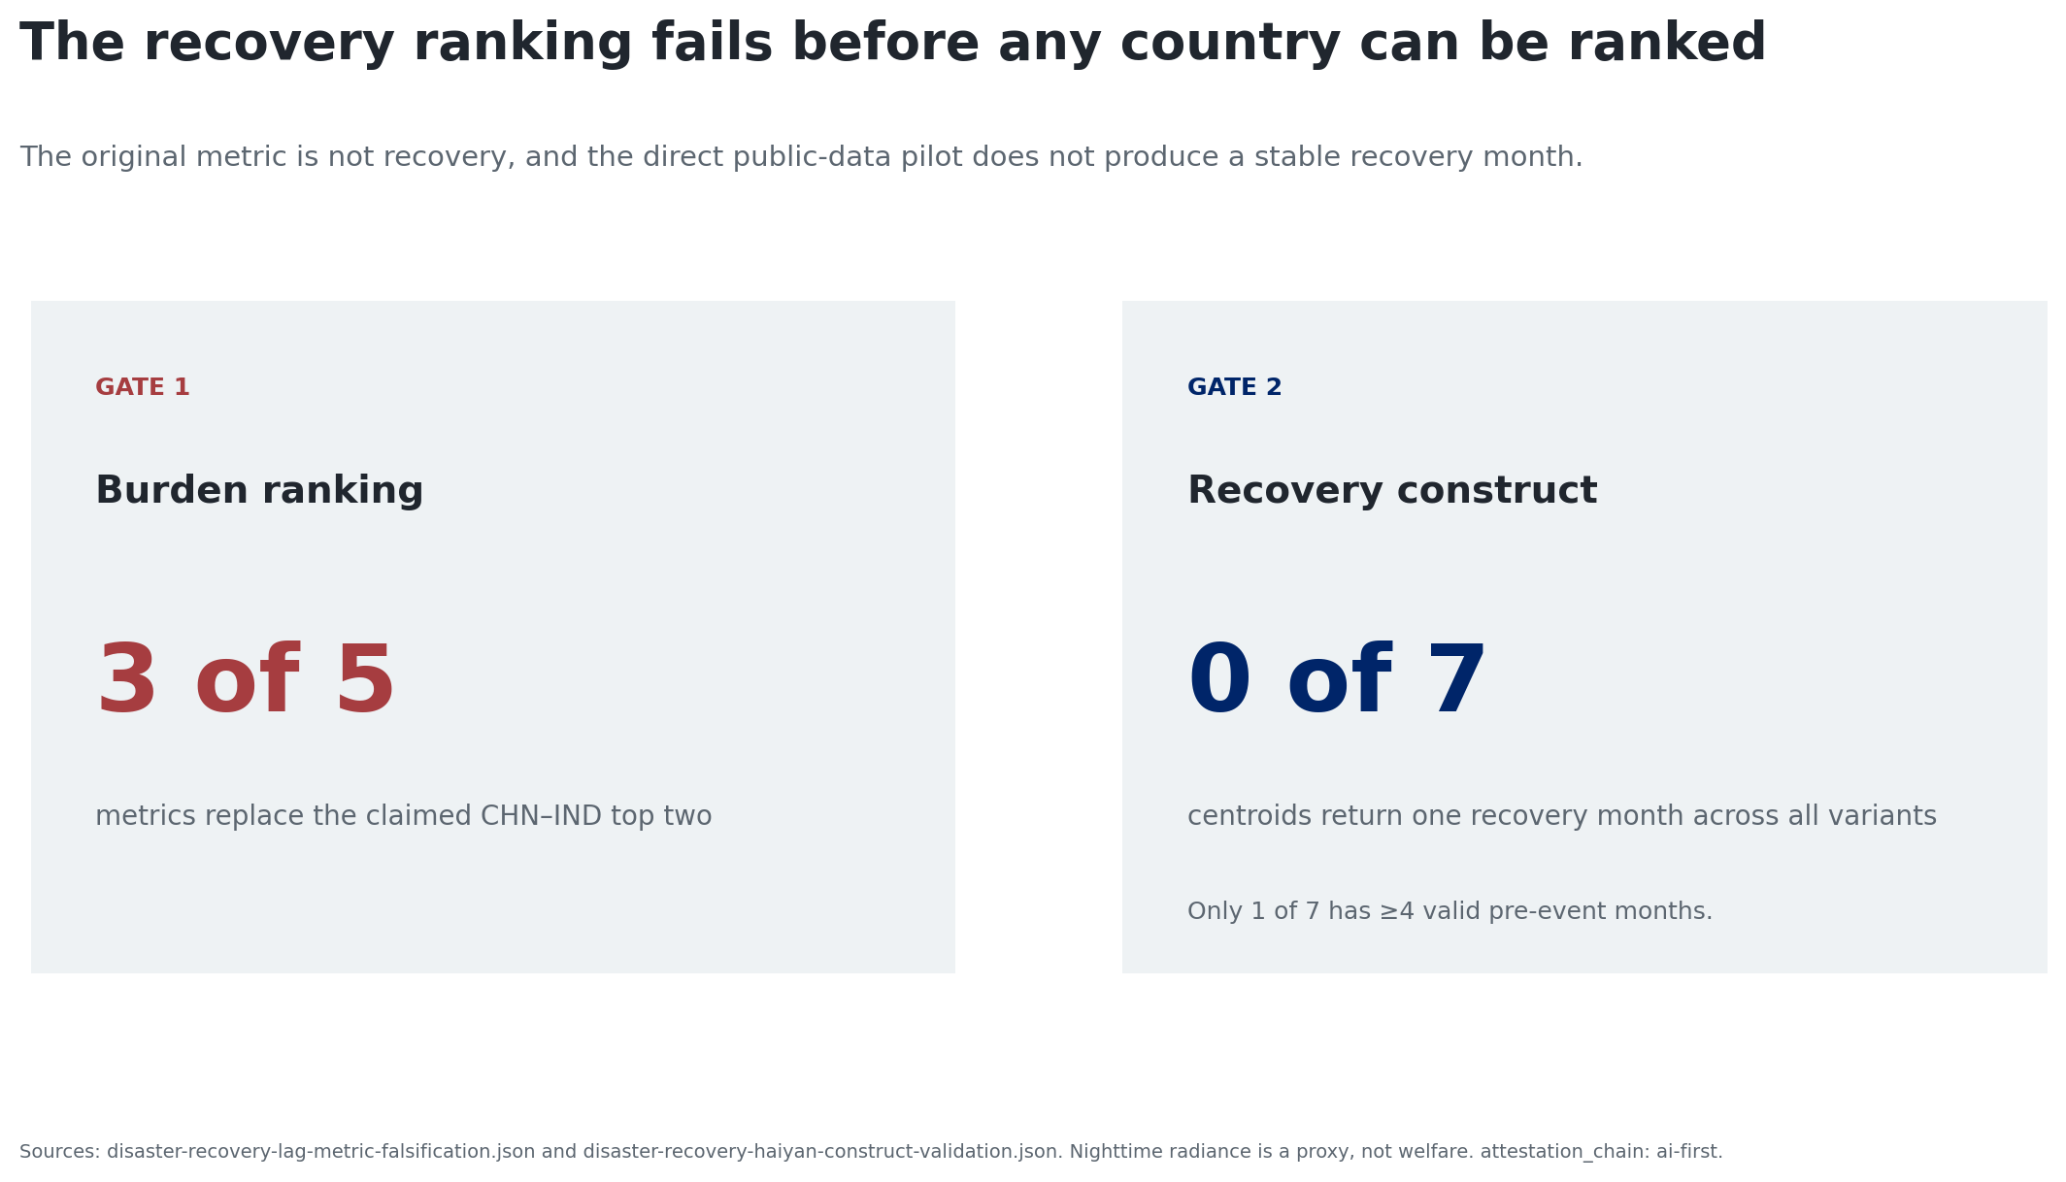
The measurement chain fails twice

Slide 3
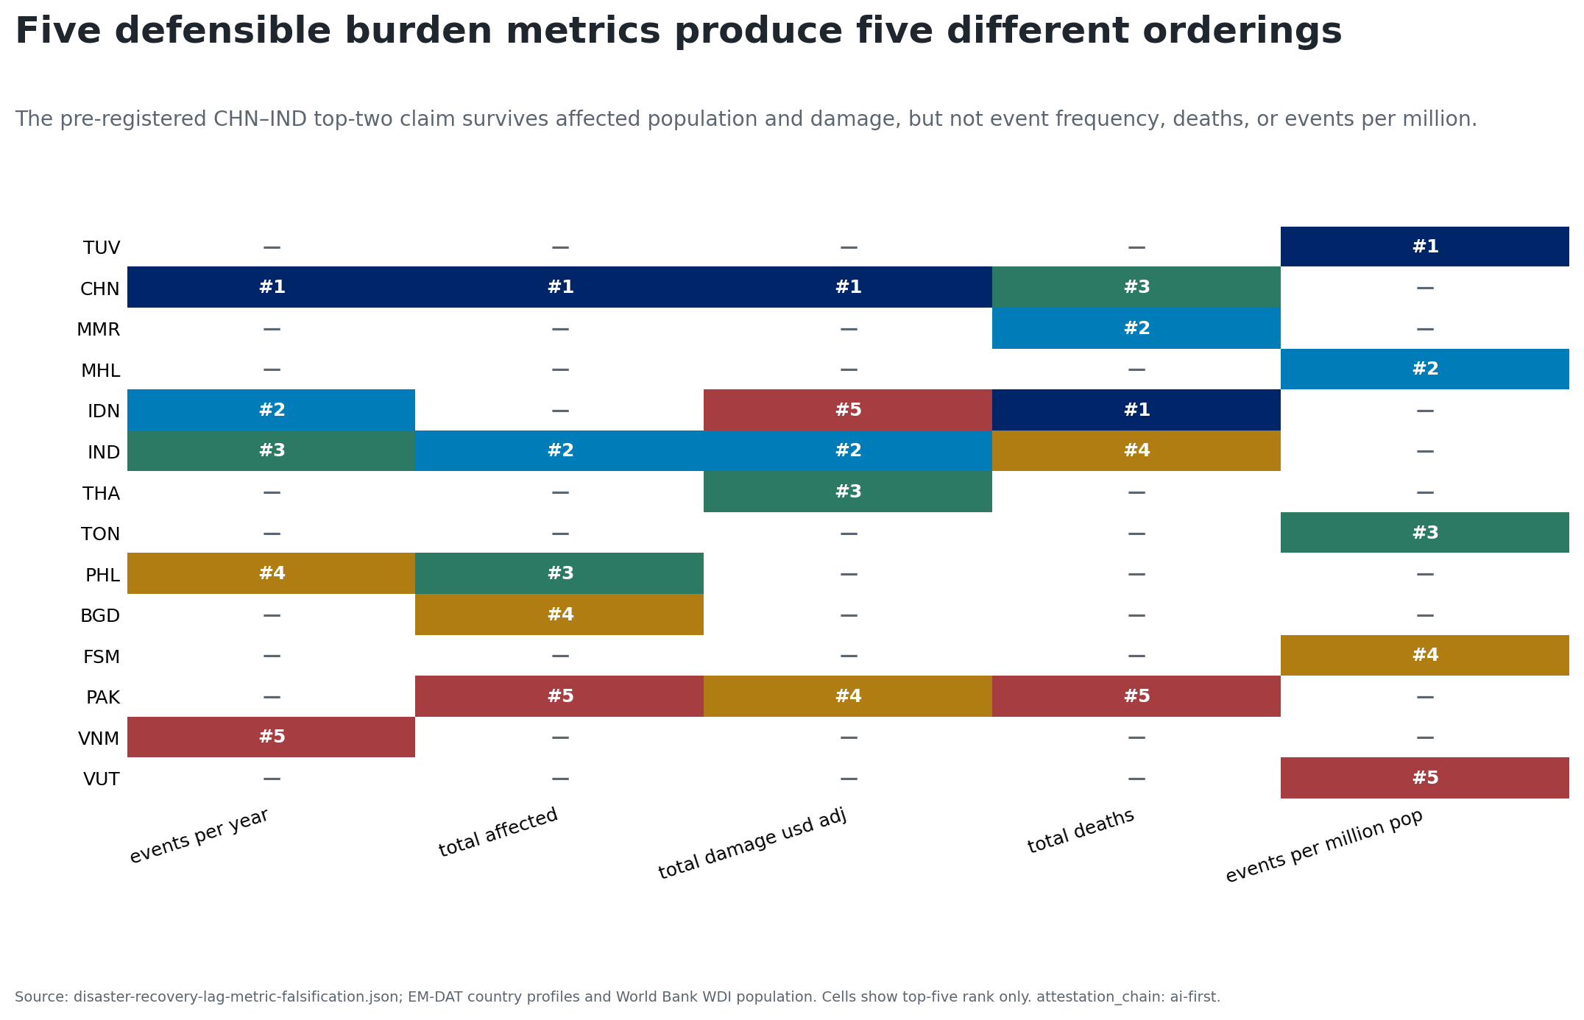
Burden changes when the outcome changes

Slide 4
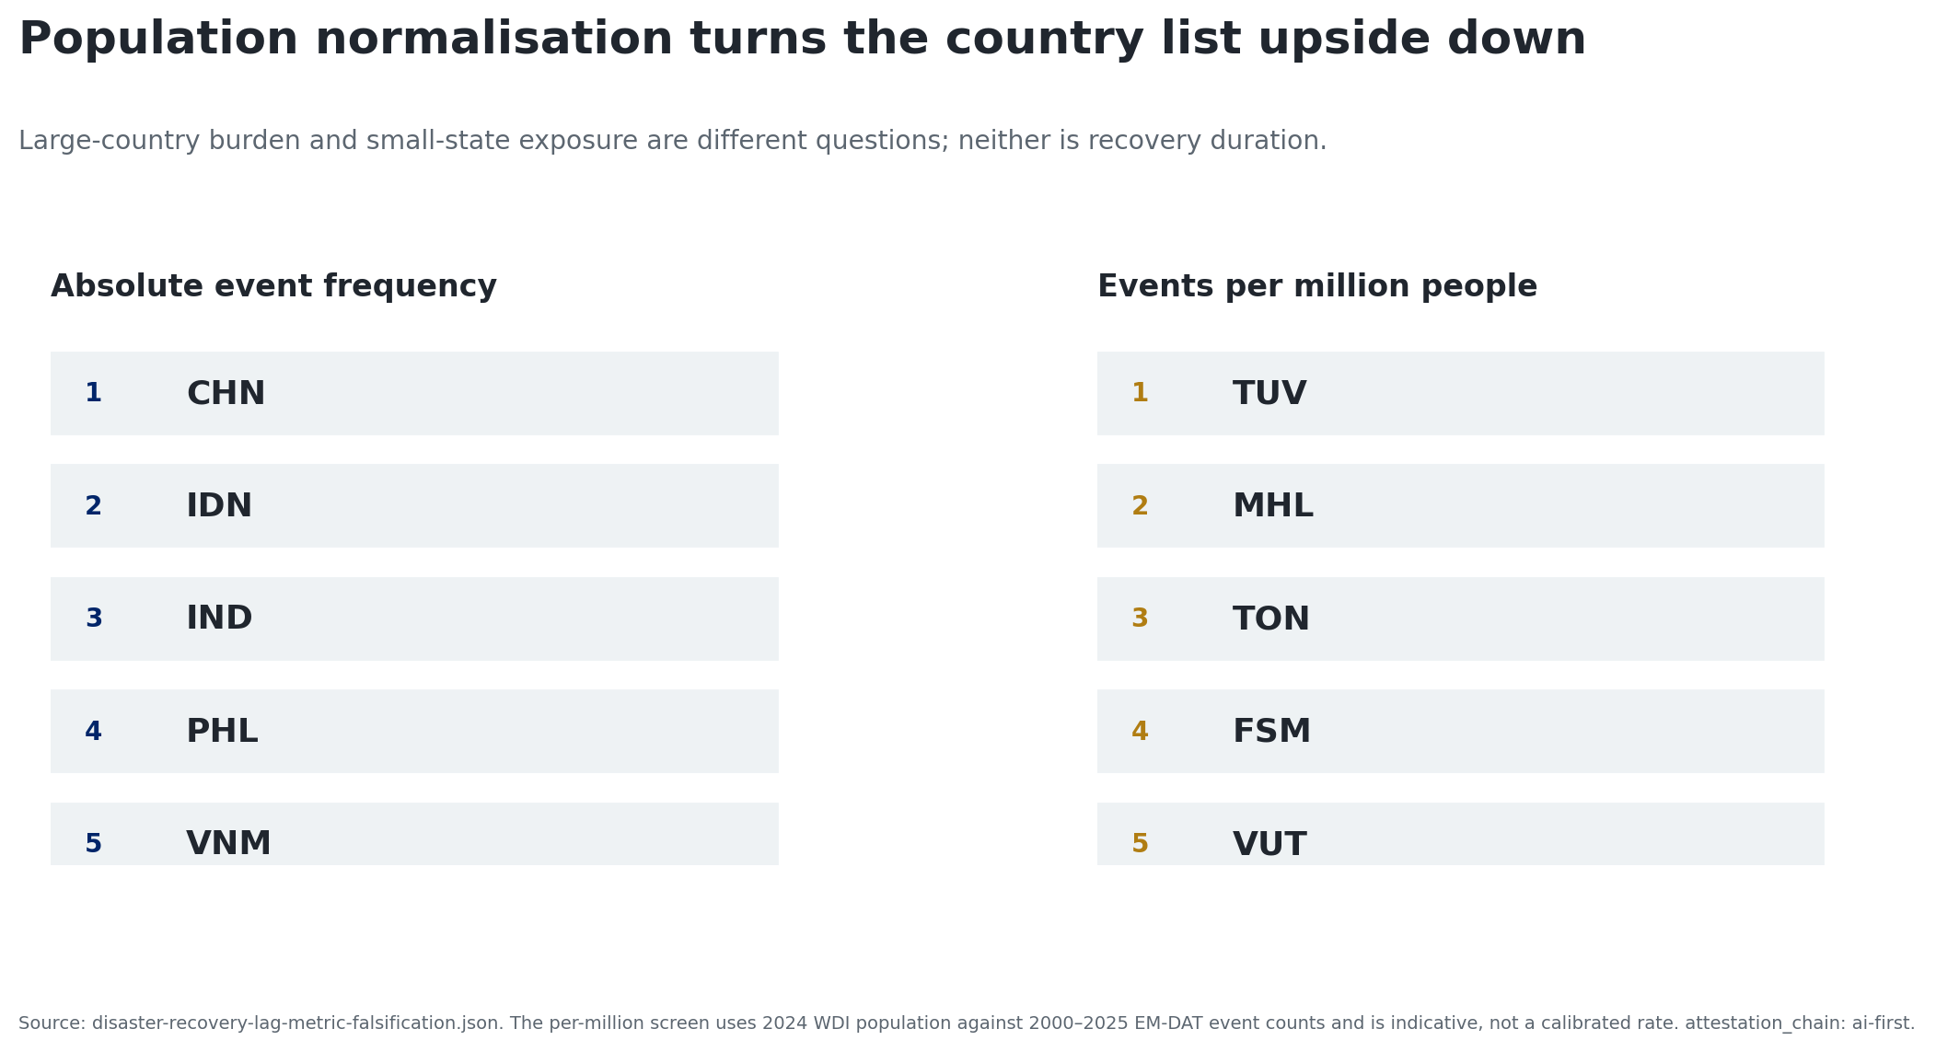
Scale reversal is part of the result

Slide 5
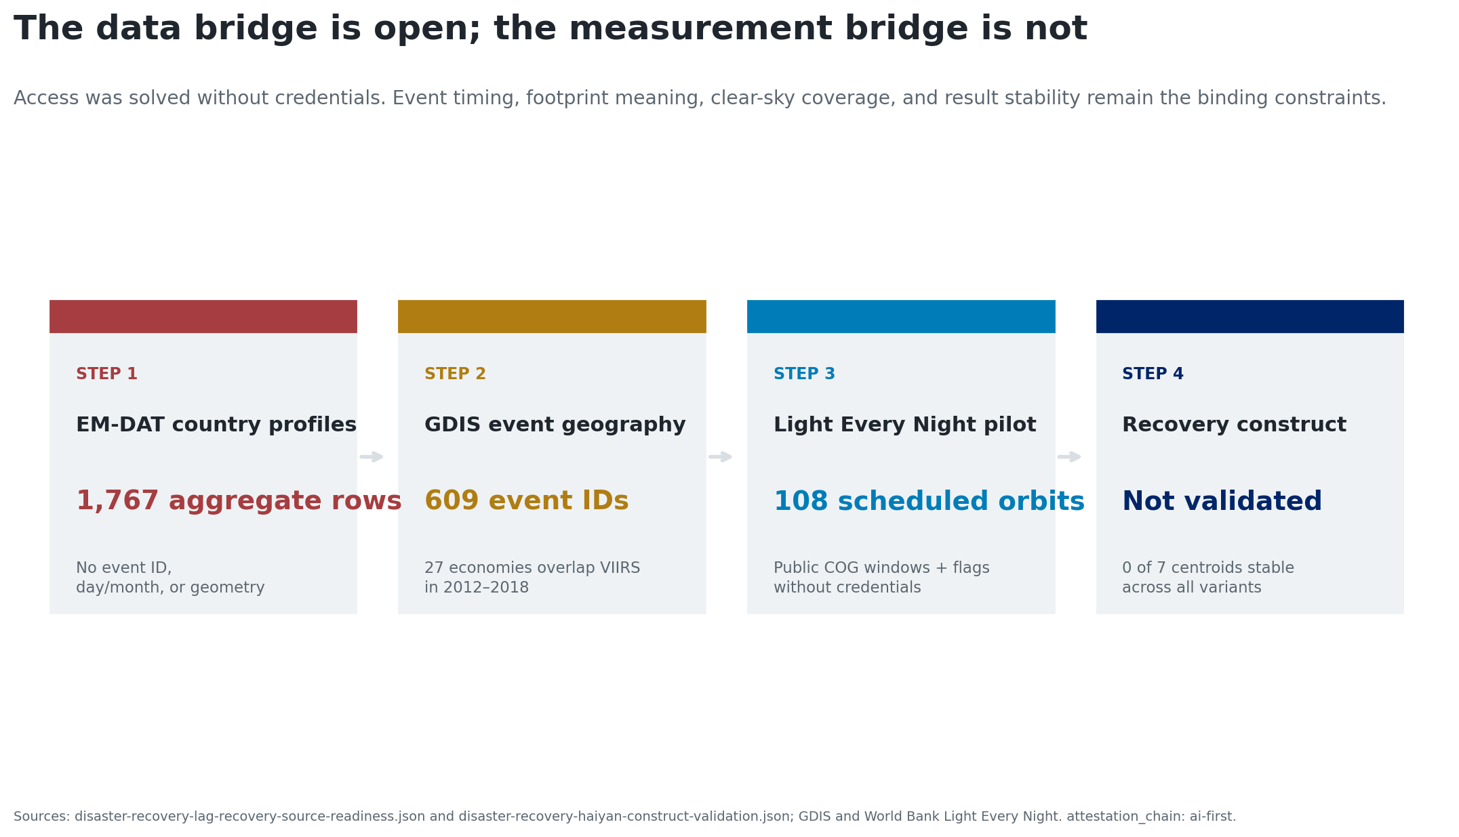
Public access is only one gate

Slide 6
The frozen Haiyan pilot
Seven GDIS administrative centroids; event date 8 November 2013.
Six fixed dates per month, May 2013–October 2014: 108 scheduled orbits.
Clear, nighttime, valid radiance paired to a same-orbit Manila reference.
Main rule: 50 km, mean, 90% of baseline, two-month persistence.
Full matrix: 25/50/75 km × mean/p75 × 80/90/100% × 1/2/3 months.

Slide 7
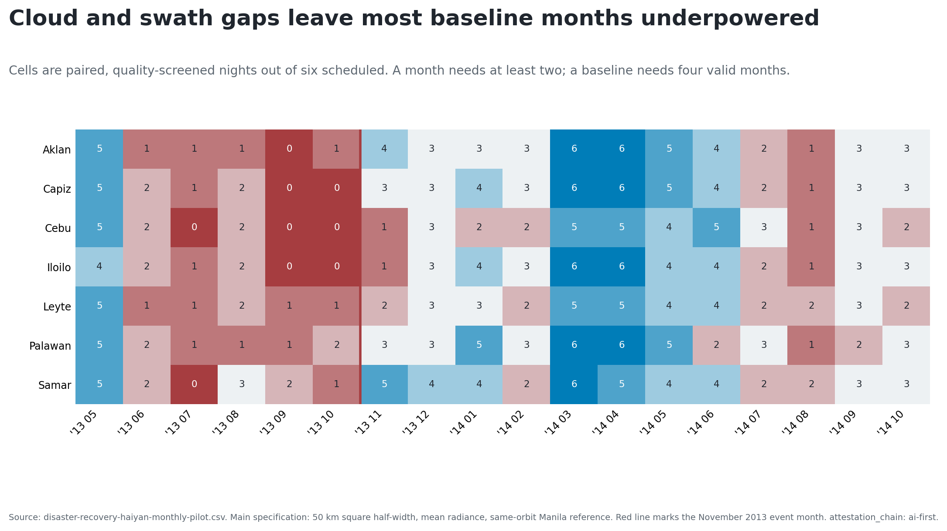
Baseline coverage is thin

Slide 8
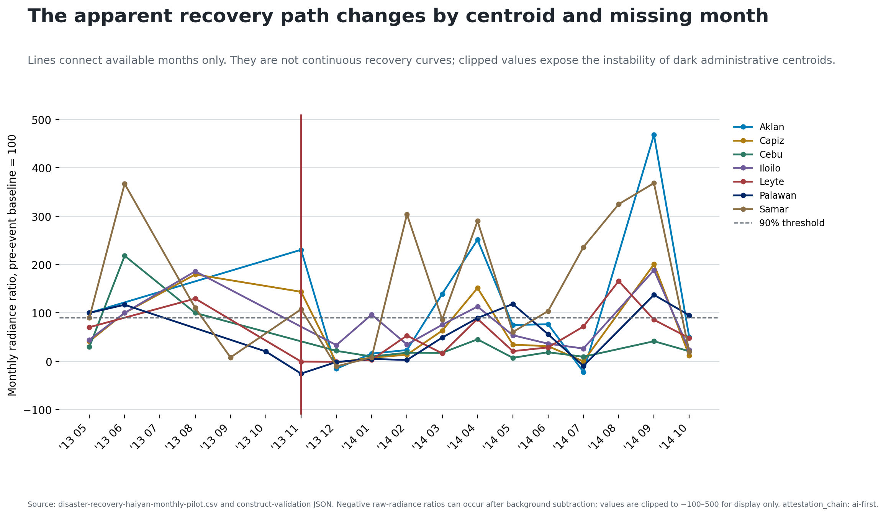
Main dates are candidates, not the finding

Slide 9
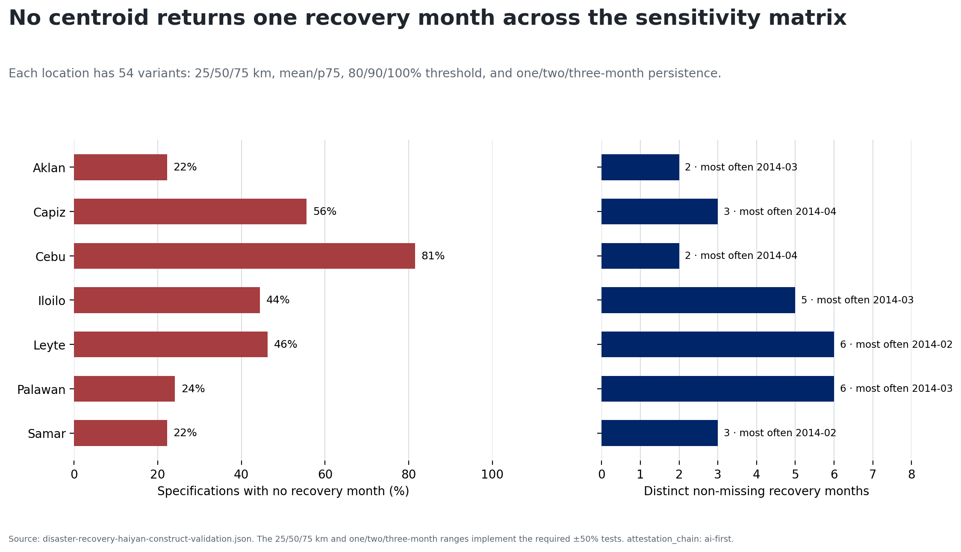
Zero of seven centroids retain one month

Slide 10
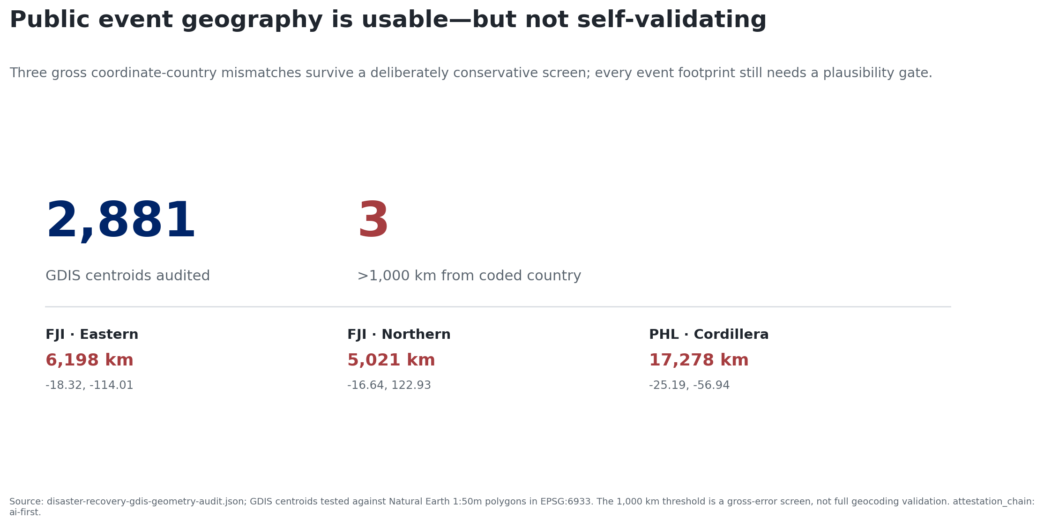
Geography also needs validation

Slide 11
Keep the pipeline; retire the claim
Decision: the public archive is scalable; the recovery construct is not yet validated.
Next design:
verified event footprints;
longer, settlement-aware baselines;
credible comparison areas; and
independent service or household outcomes.
Radiance is a proxy—not welfare or a causal recovery estimate.

