Slide 1
Low-elevation urban growth is concentrated
From an inherited national proxy to a direct urban-centre exposure object

Slide 2
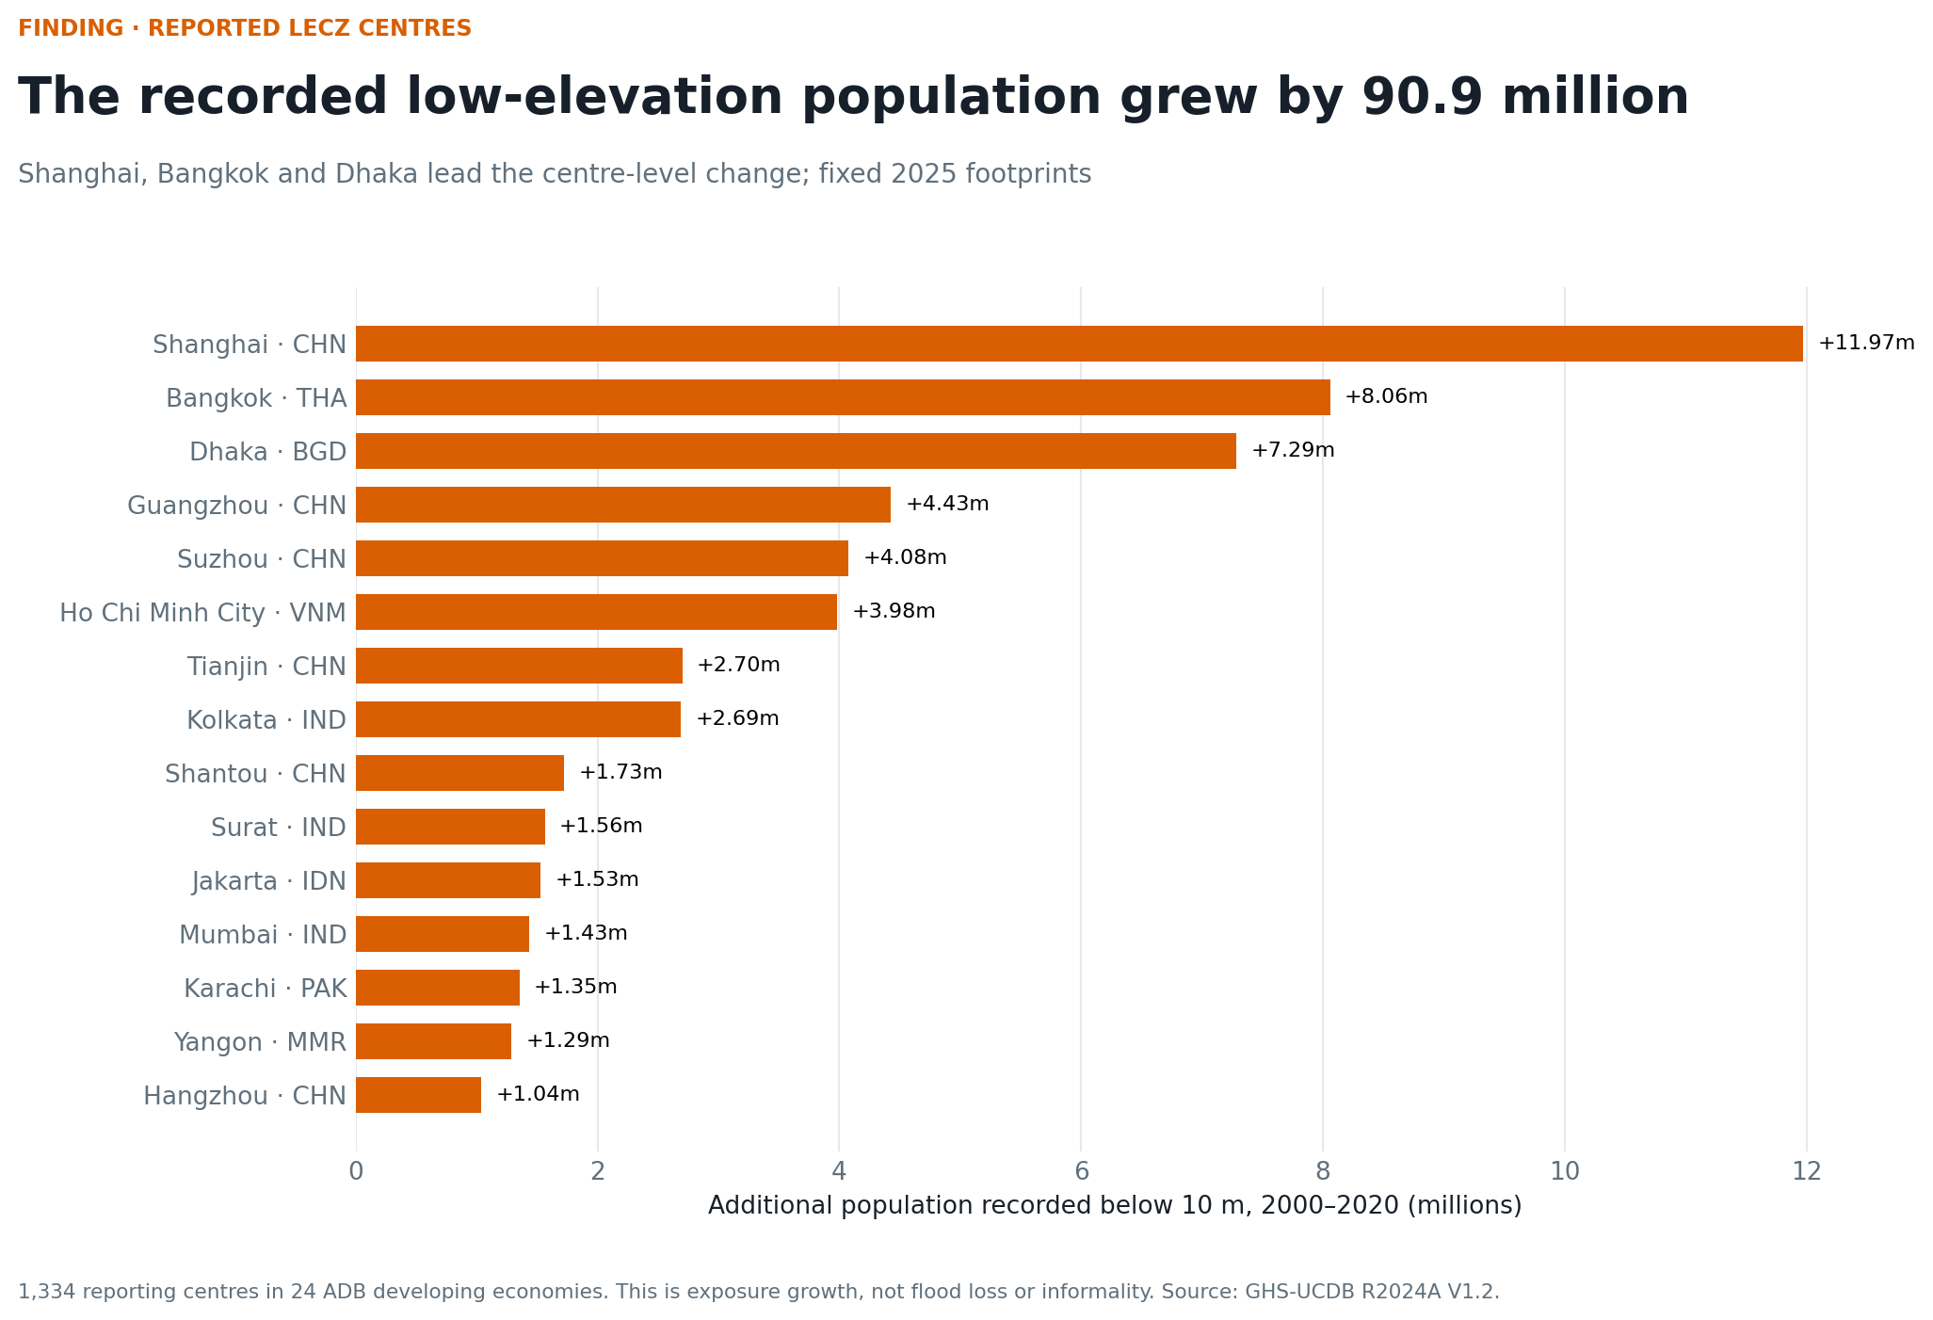
1 · Finding
+90.9 million people recorded below 10 metres across 1,334 reporting urban centres, 2000–2020.

Slide 3
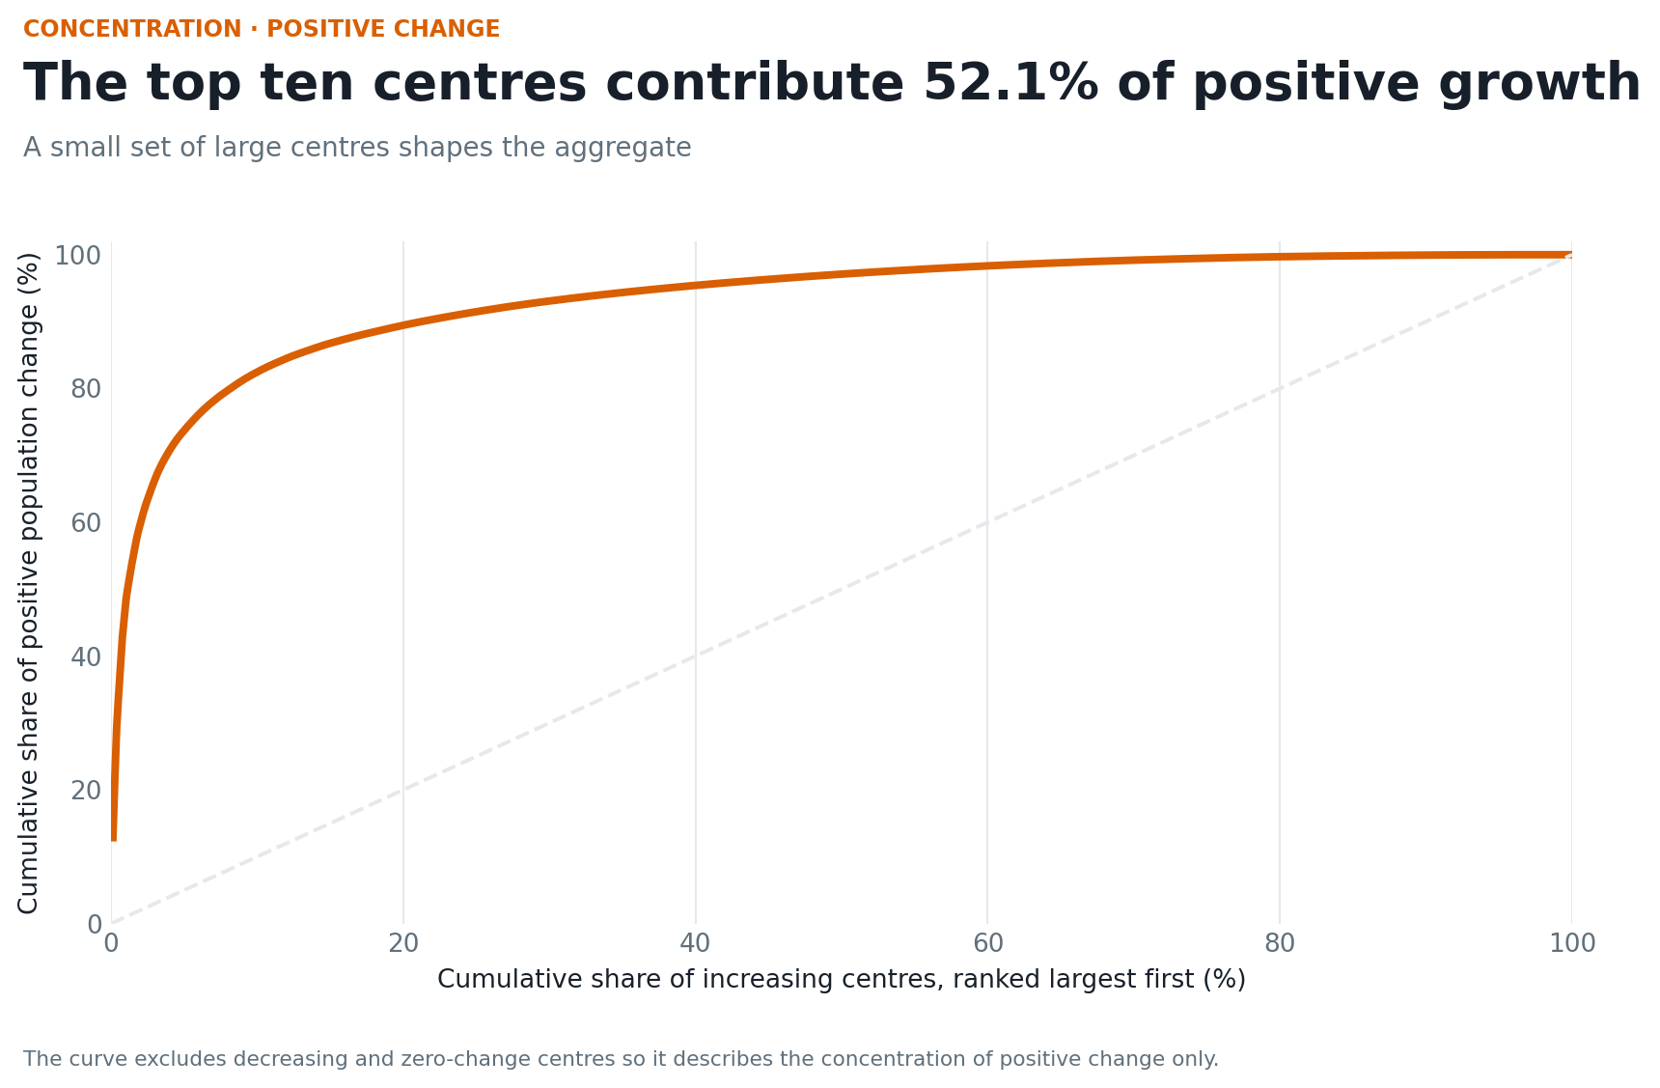
2 · Named centres drive the aggregate
Shanghai, Bangkok, and Dhaka lead. The top ten centres account for 52.1% of positive change.

Slide 4
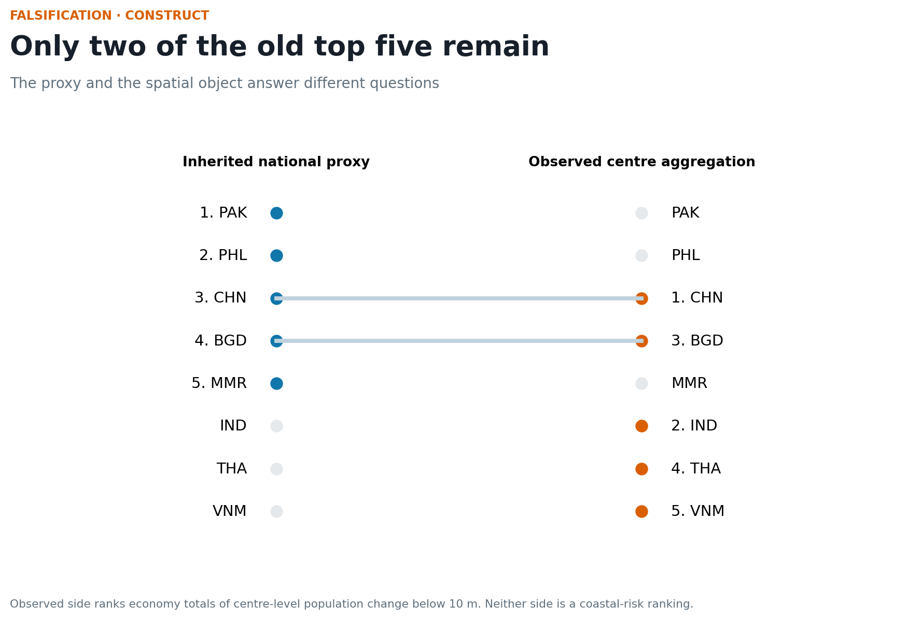
3 · The old ranking was a different construct
Only China and Bangladesh appear in both top-five economy sets.

Slide 5
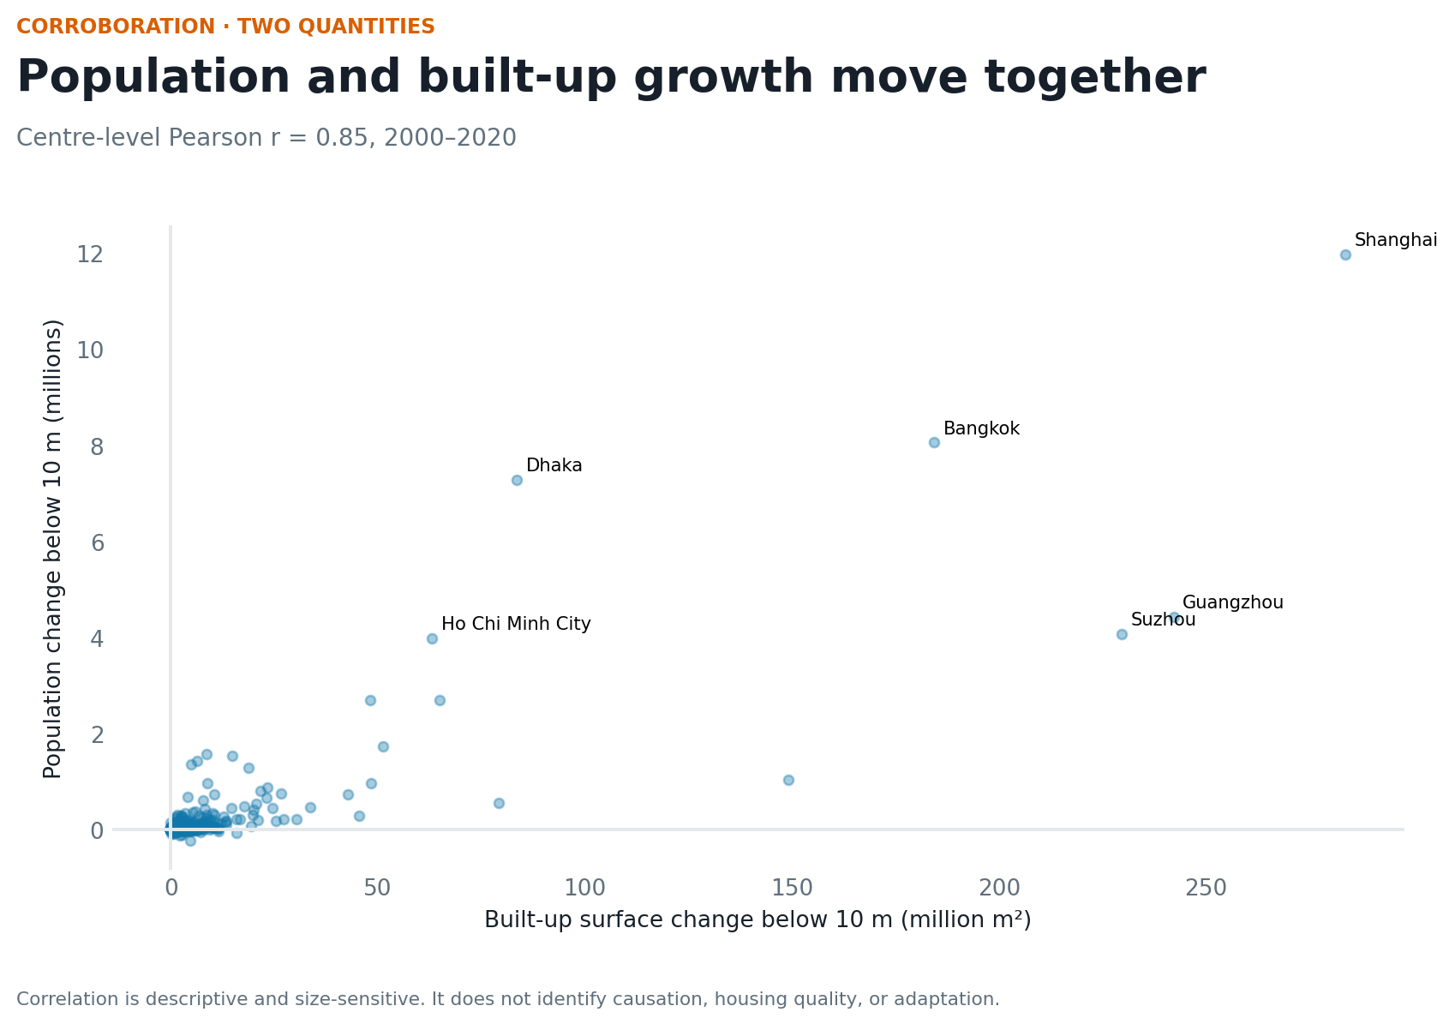
4 · A second quantity corroborates the pattern
Population and built-up change below 10 metres correlate at 0.85.

Slide 6
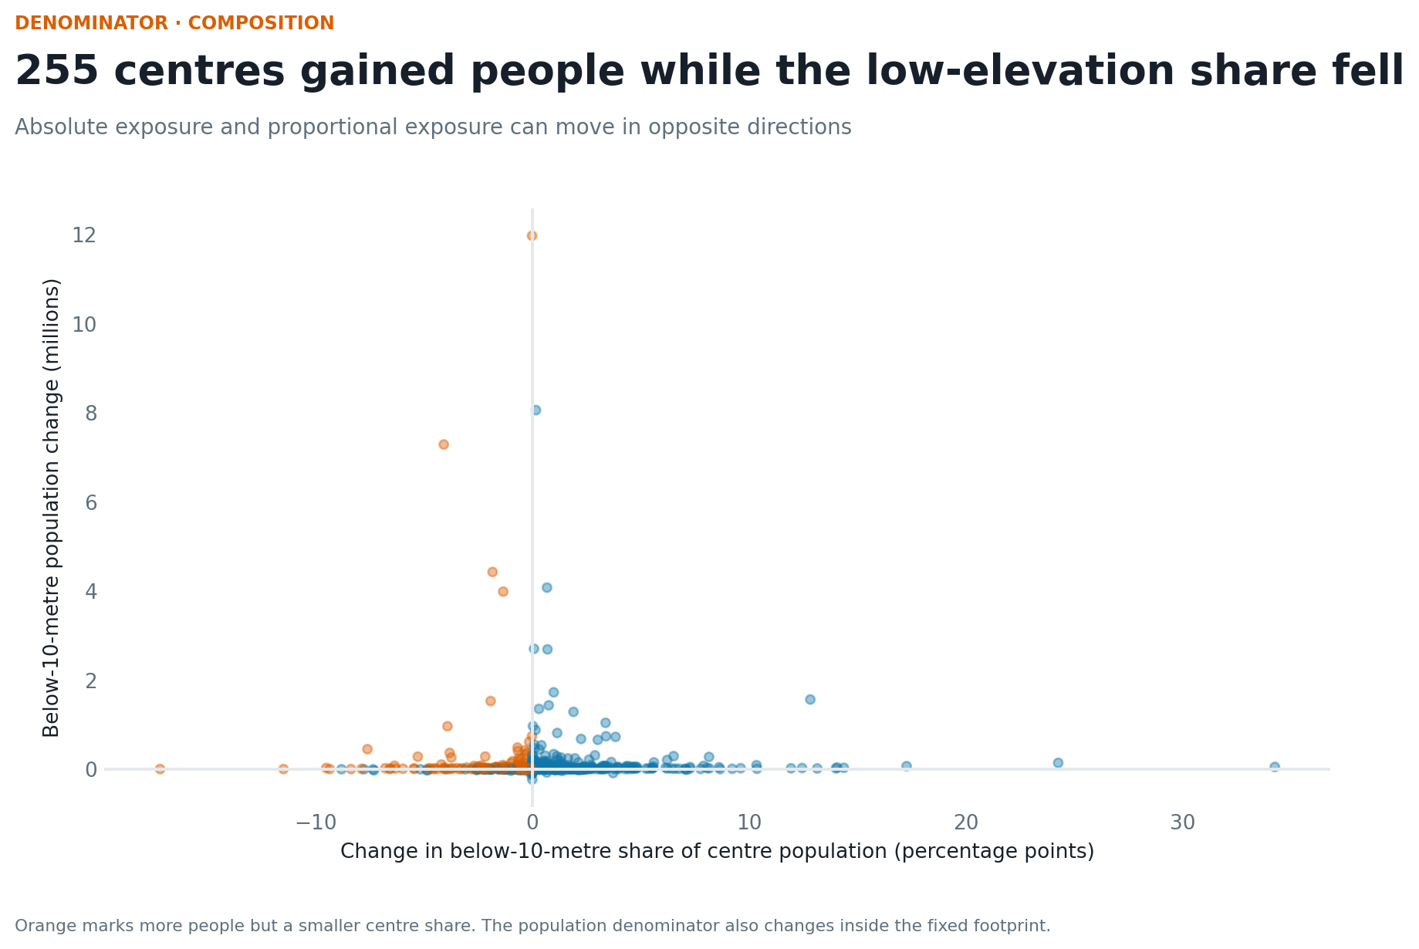
5 · Shares can conceal counts
255 centres gained low-elevation population while the share fell.

Slide 7
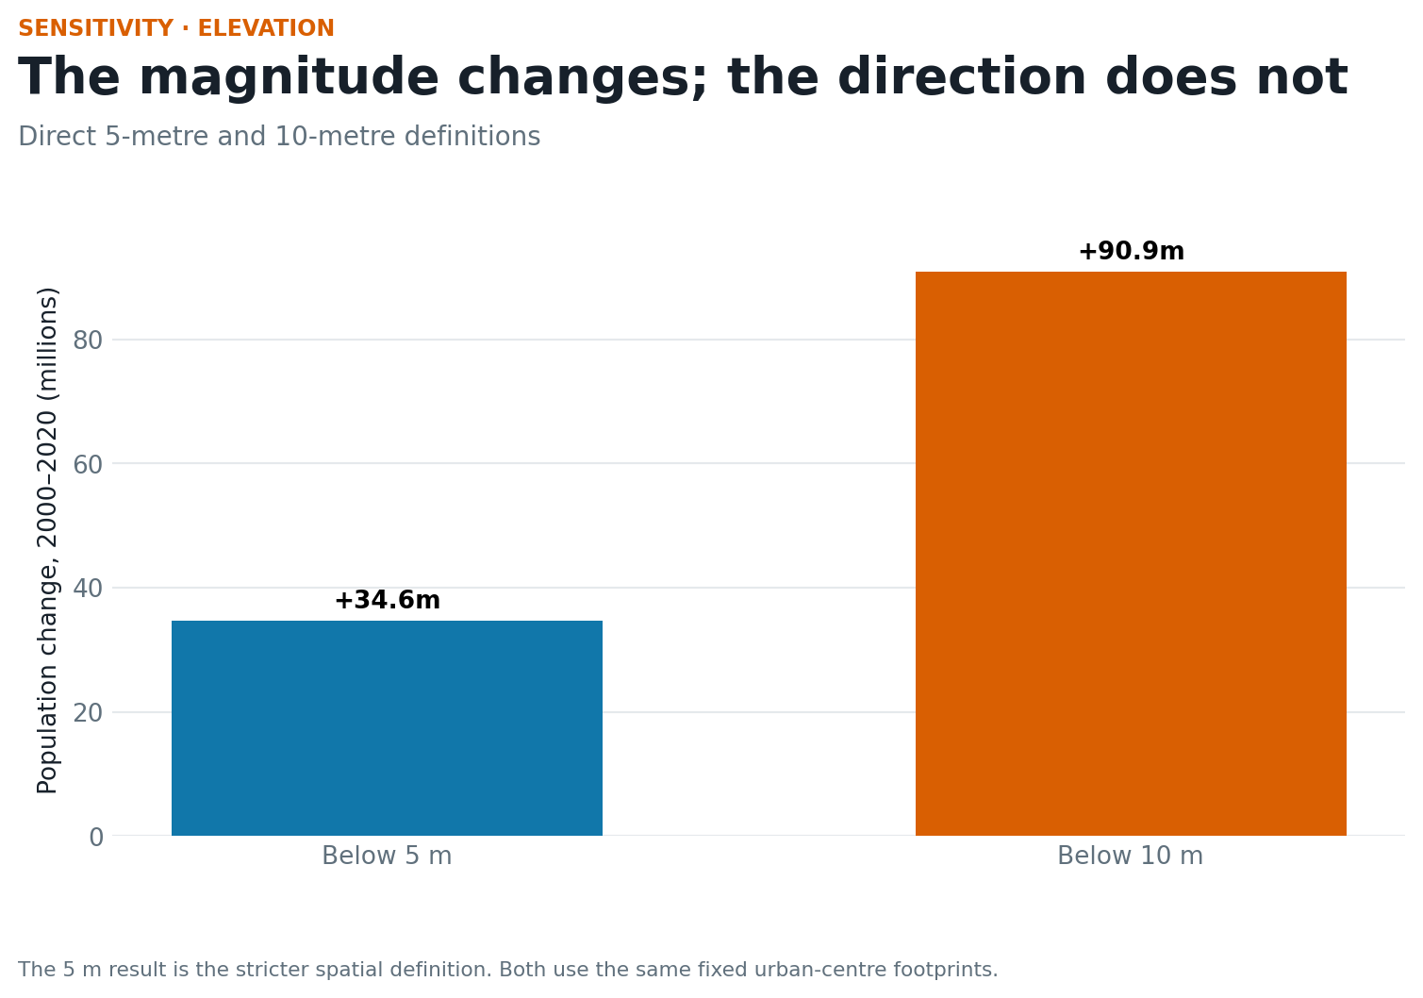
6 · Elevation sensitivity
The 2000–2020 increase is +34.6 million below 5 metres and +90.9 million below 10 metres.

Slide 8
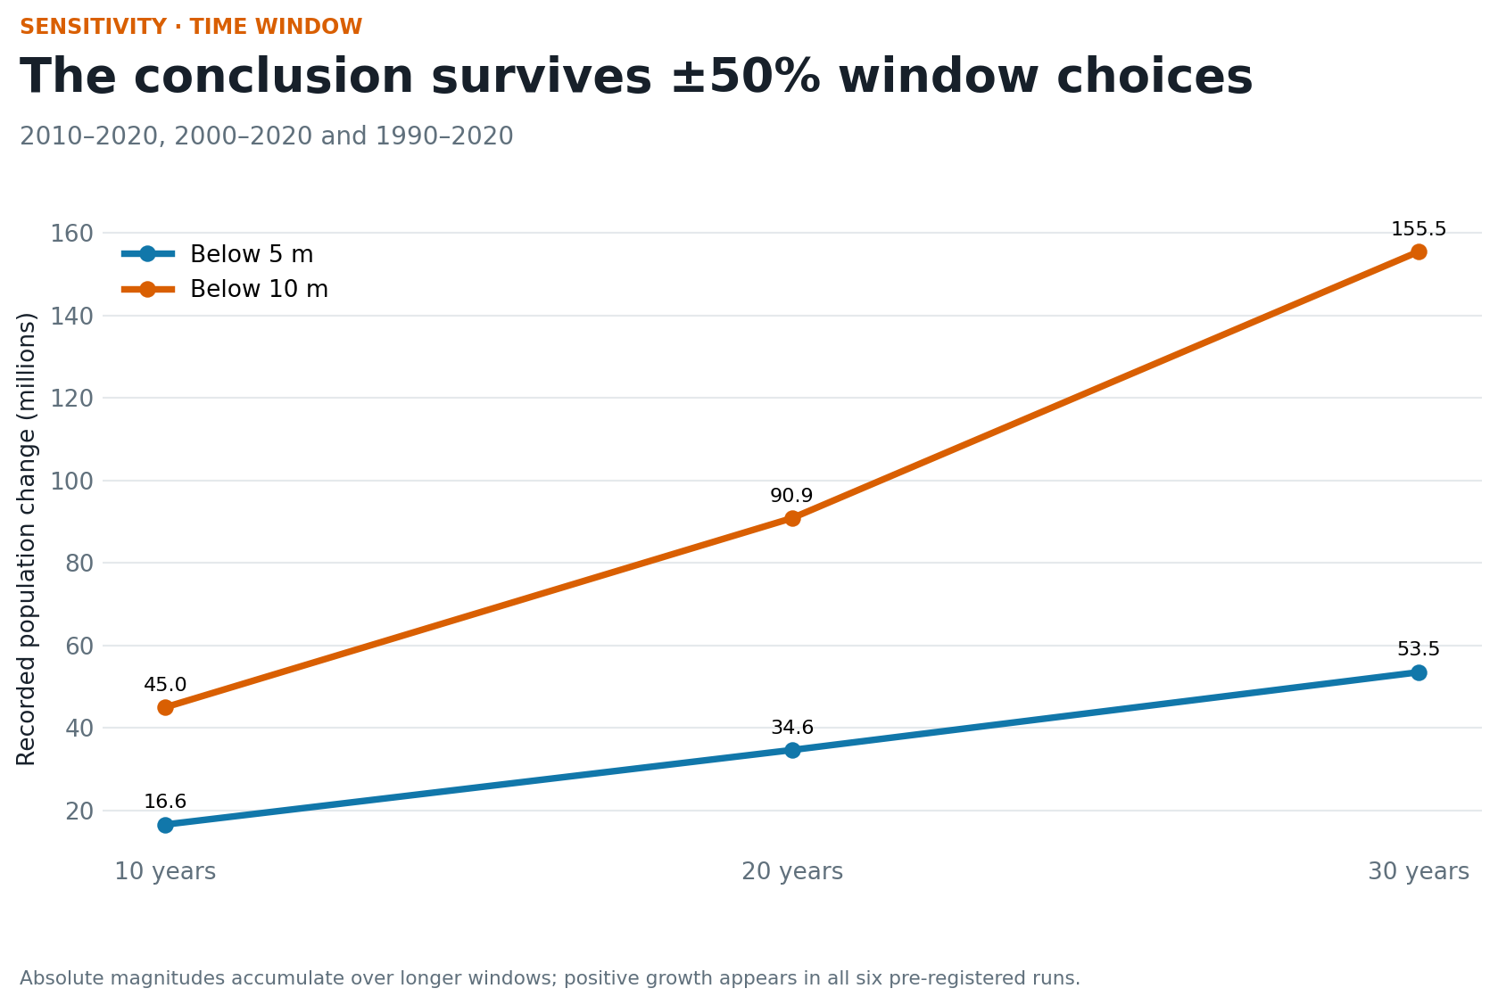
7 · ±50% time-window sensitivity
Every 10-, 20-, and 30-year run is positive under both thresholds.

Slide 9
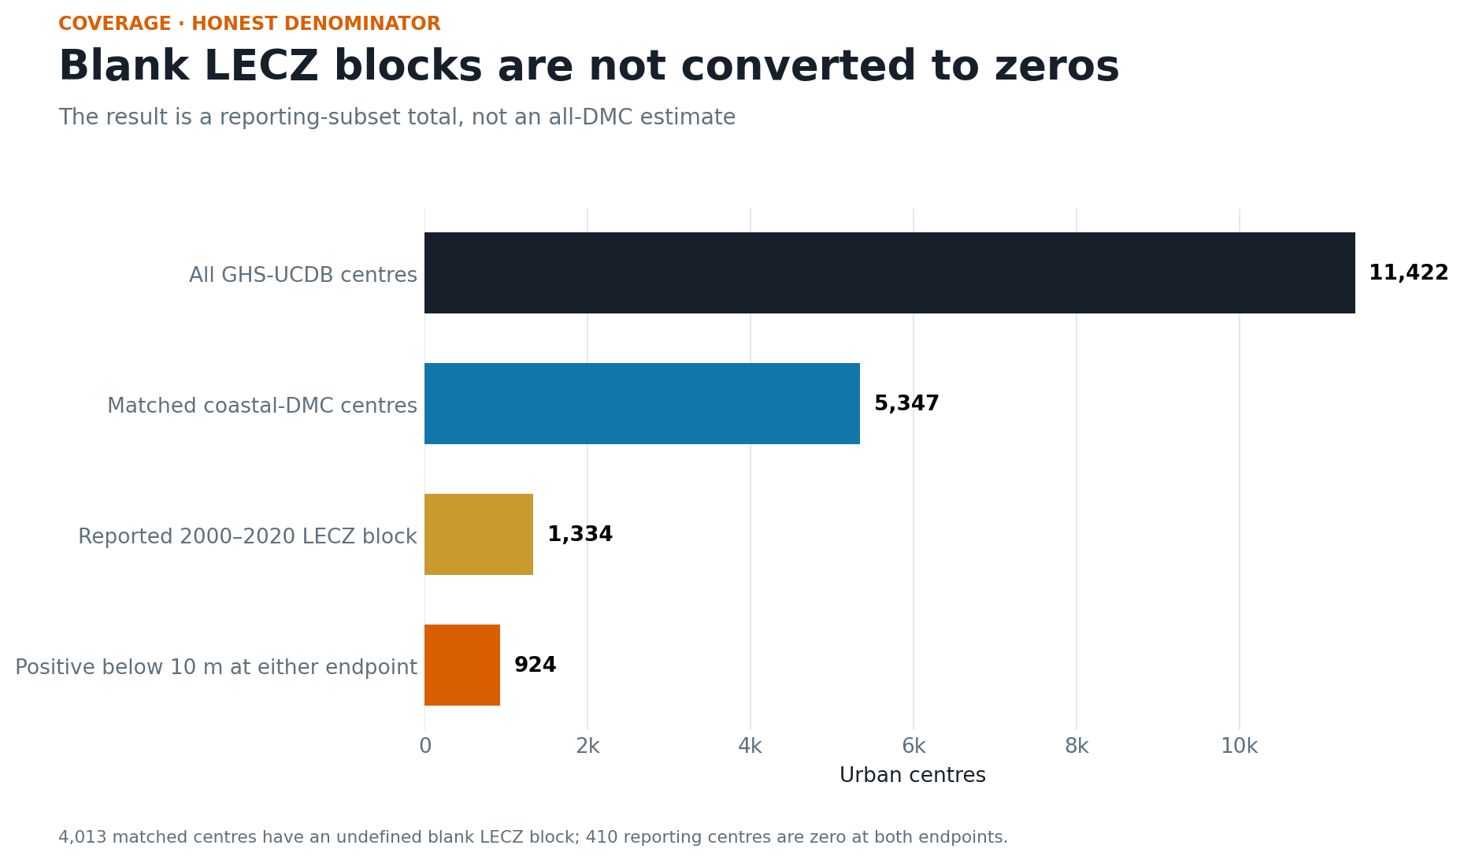
8 · Coverage is the binding limit
The source-matched roster has 5,347 centres; 1,334 report the required block. No blank is converted to zero.

Slide 10
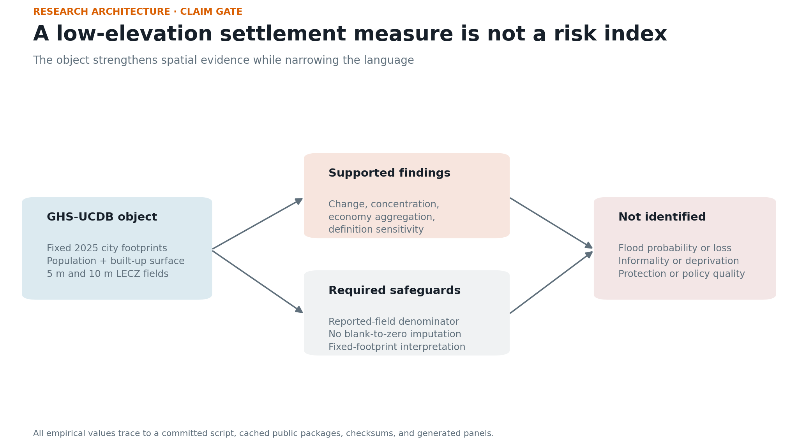
9 · Claim gate
The object measures exposure growth. It does not identify flood loss, informality, deprivation, protection, or policy quality.

Slide 11
10 · Next study
Take a small set of leading centres and add local hazard, subsidence, protection, planning-boundary, and validated housing or service data.
AI-first prepared pipeline; not externally reviewed.

