Slide 1
Flood water cuts modeled market access for about 346,000 people
Sylhet observed-flood route pilot · AI-first §18 Raymond Adofina · Asian Development Bank

Slide 2
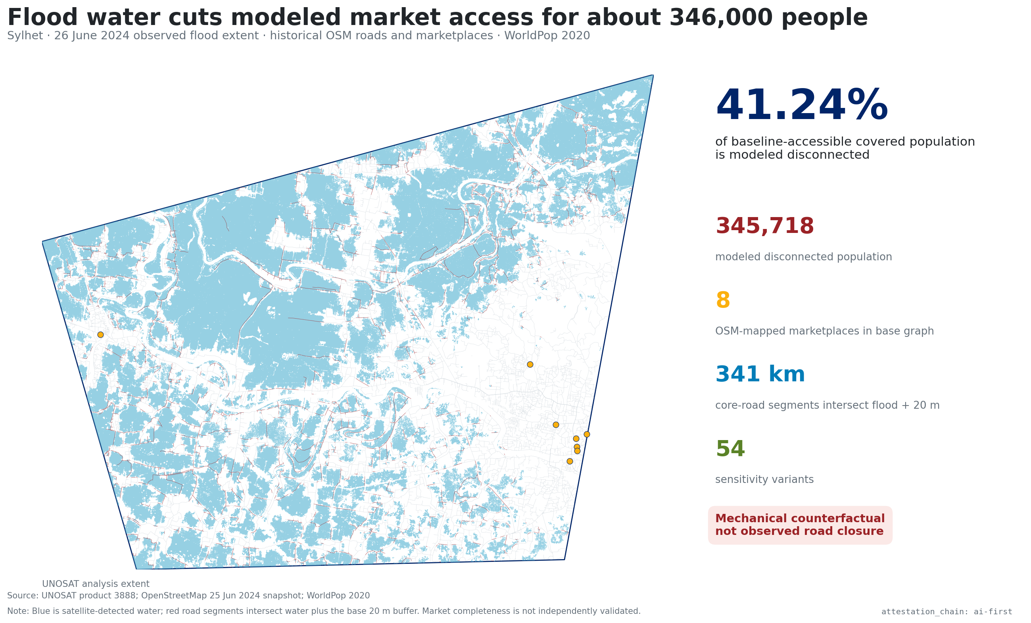
The observed flood footprint cuts modeled routes

Slide 3
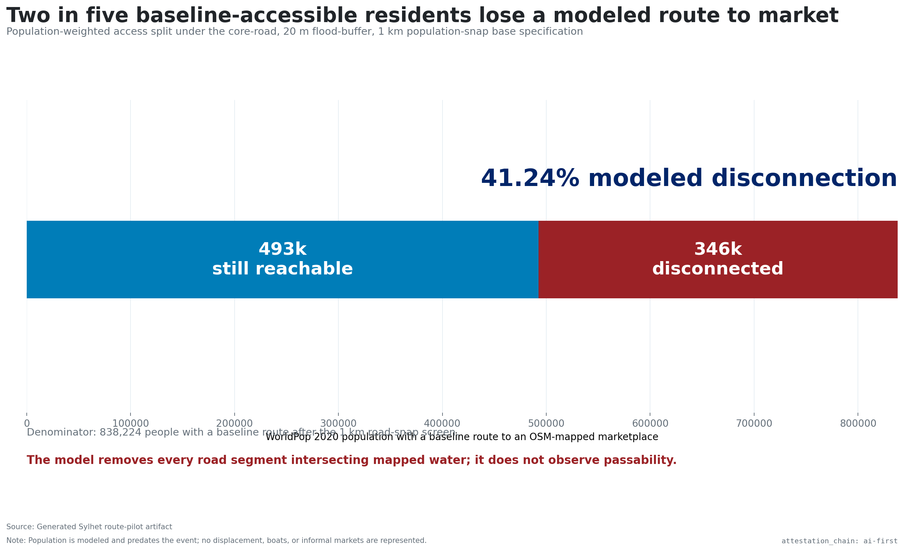
About two in five baseline-accessible residents are disconnected

Slide 4
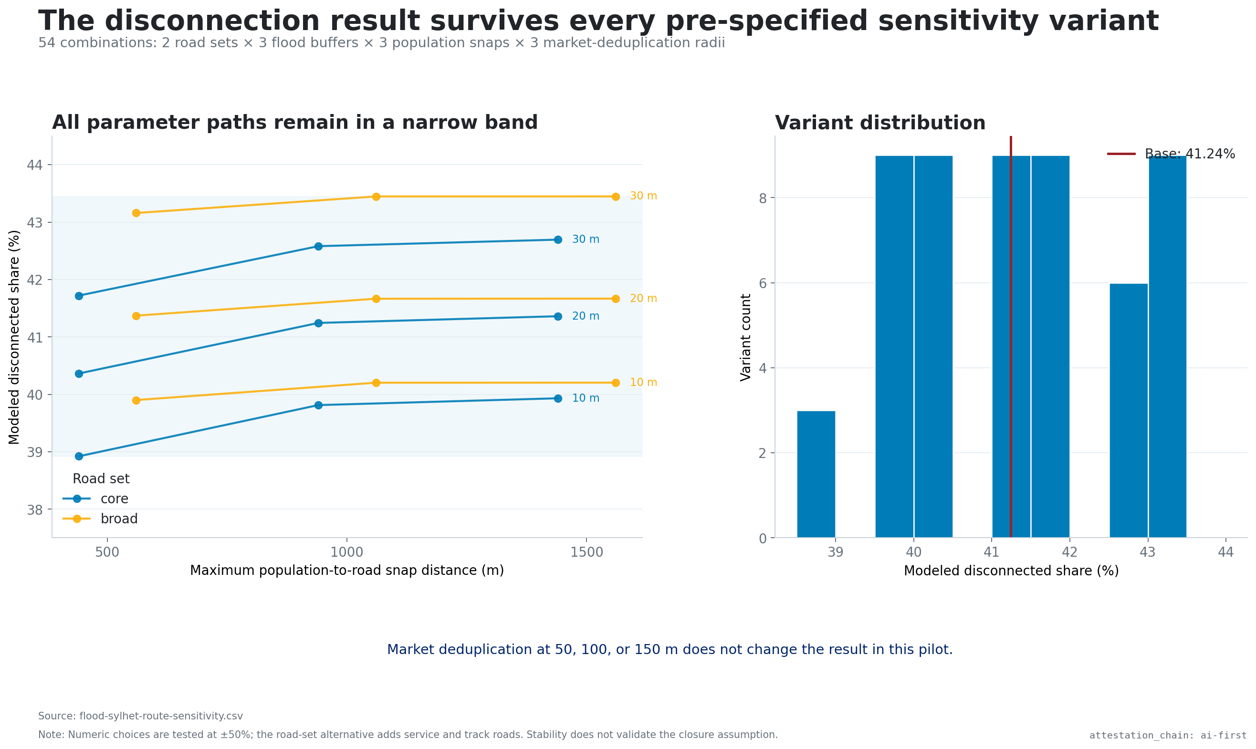
The finding survives all 54 variants

Slide 5
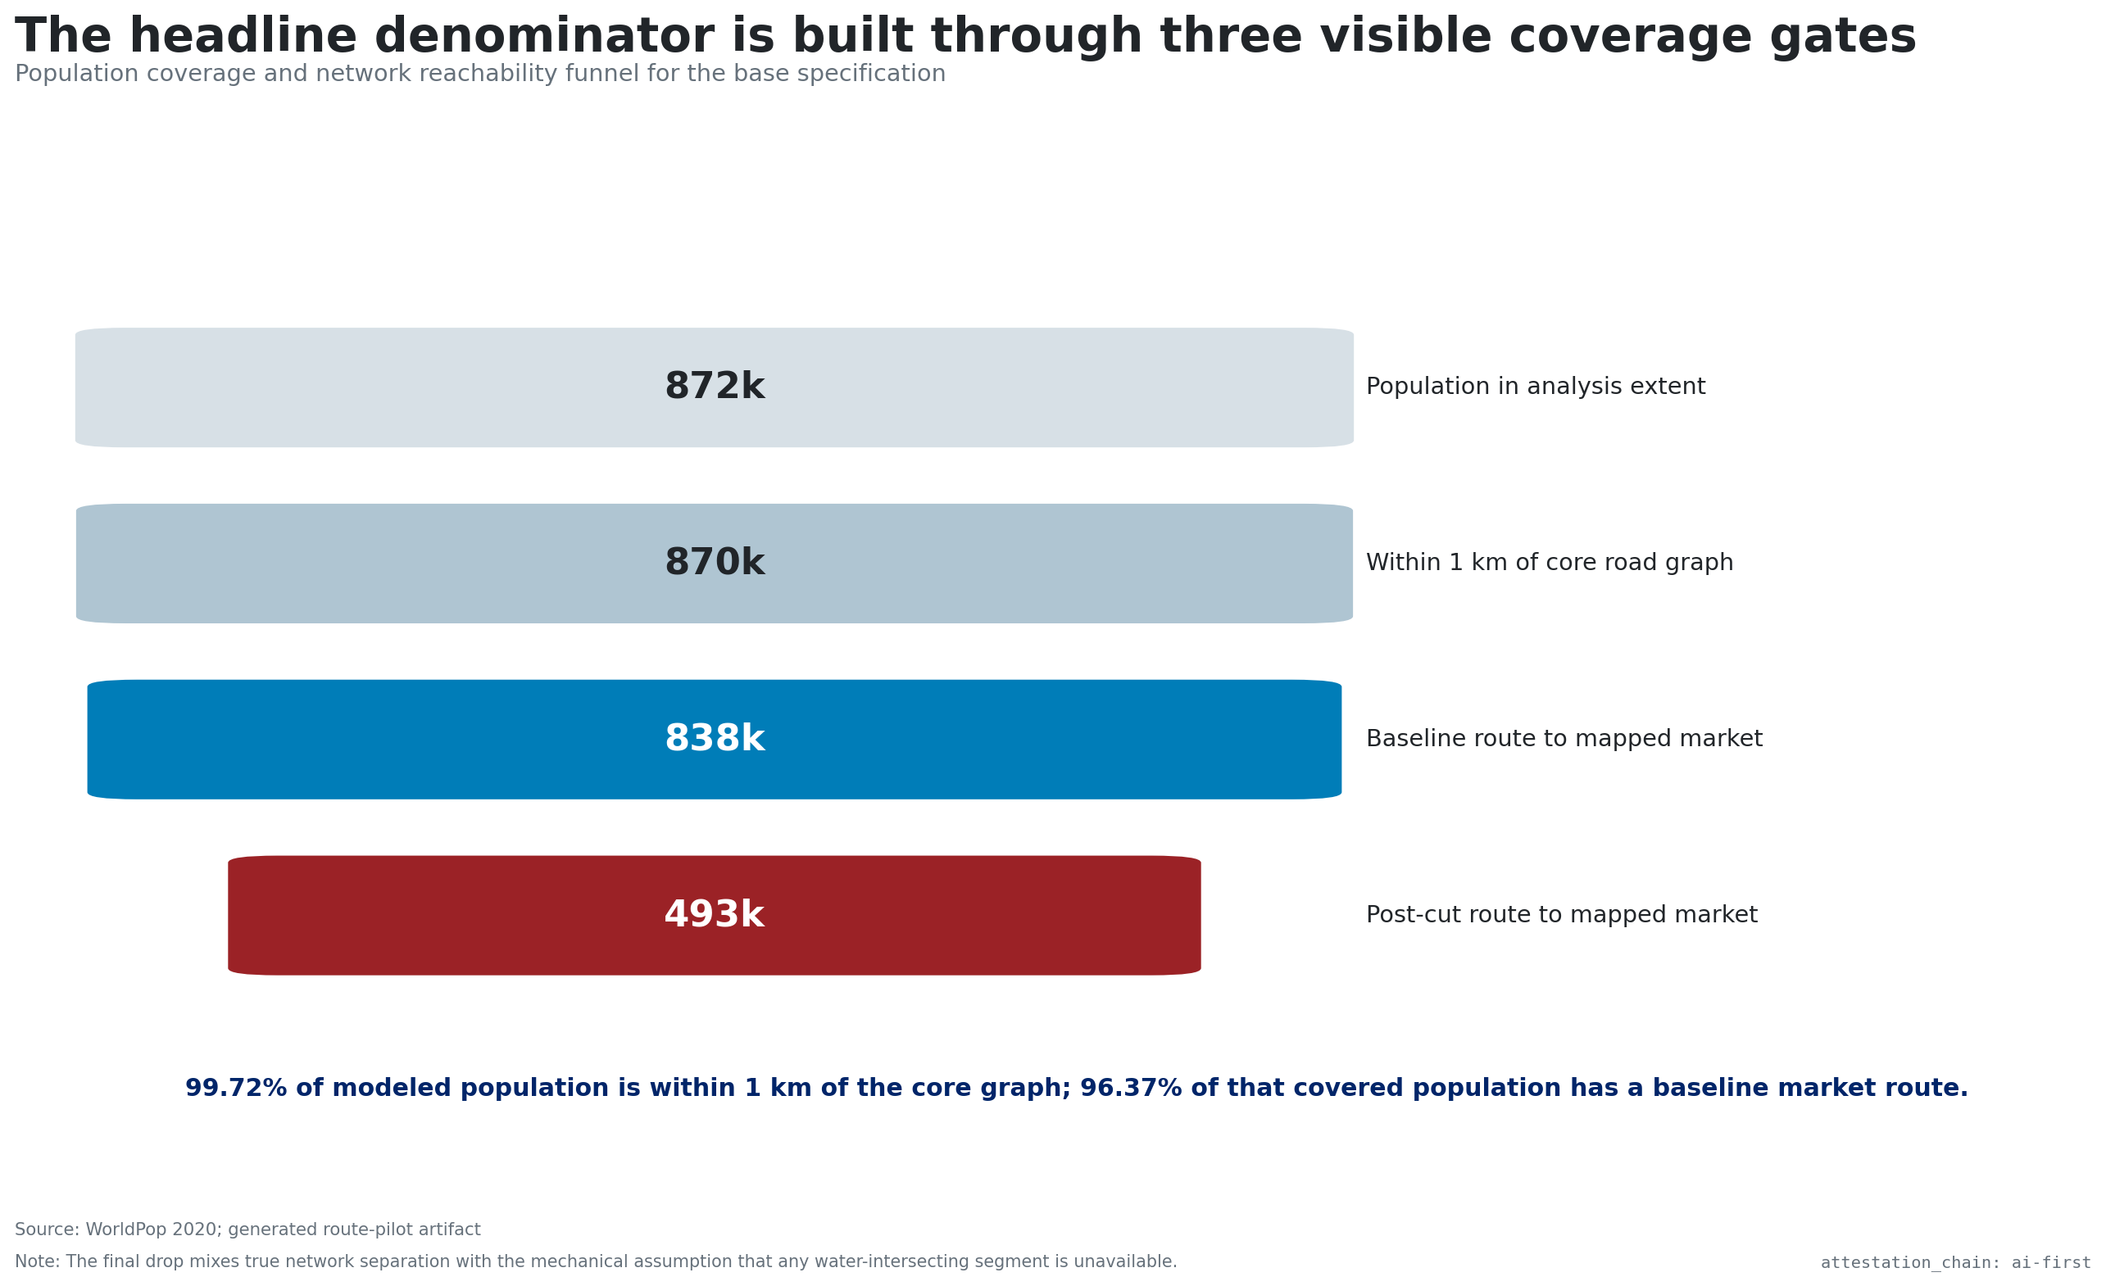
The headline denominator passes three visible gates

Slide 6
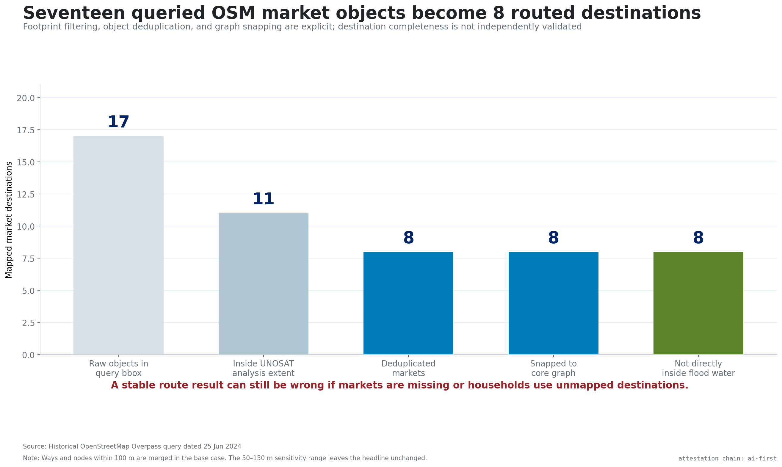
Seventeen queried market objects become eight destinations

Slide 7
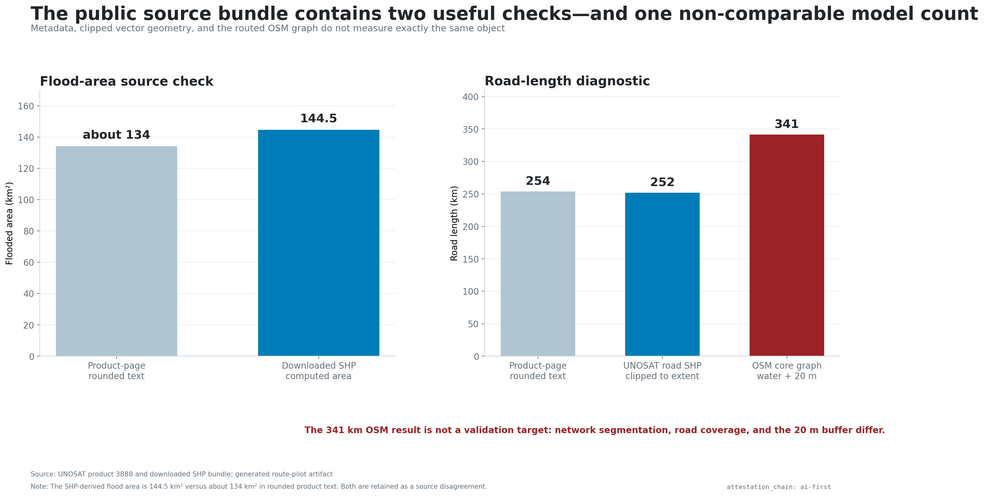
Source objects disagree—and are not interchangeable

Slide 8
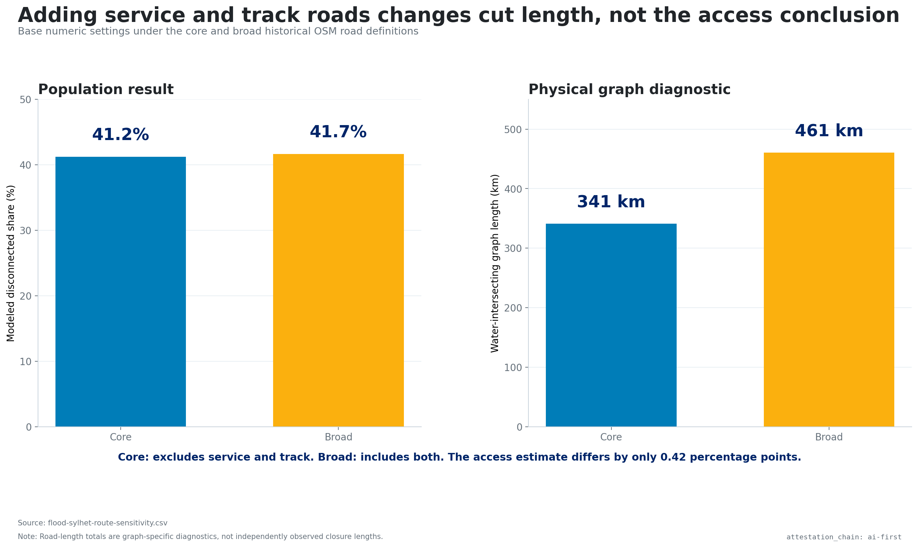
Road definition changes cut length more than access

Slide 9
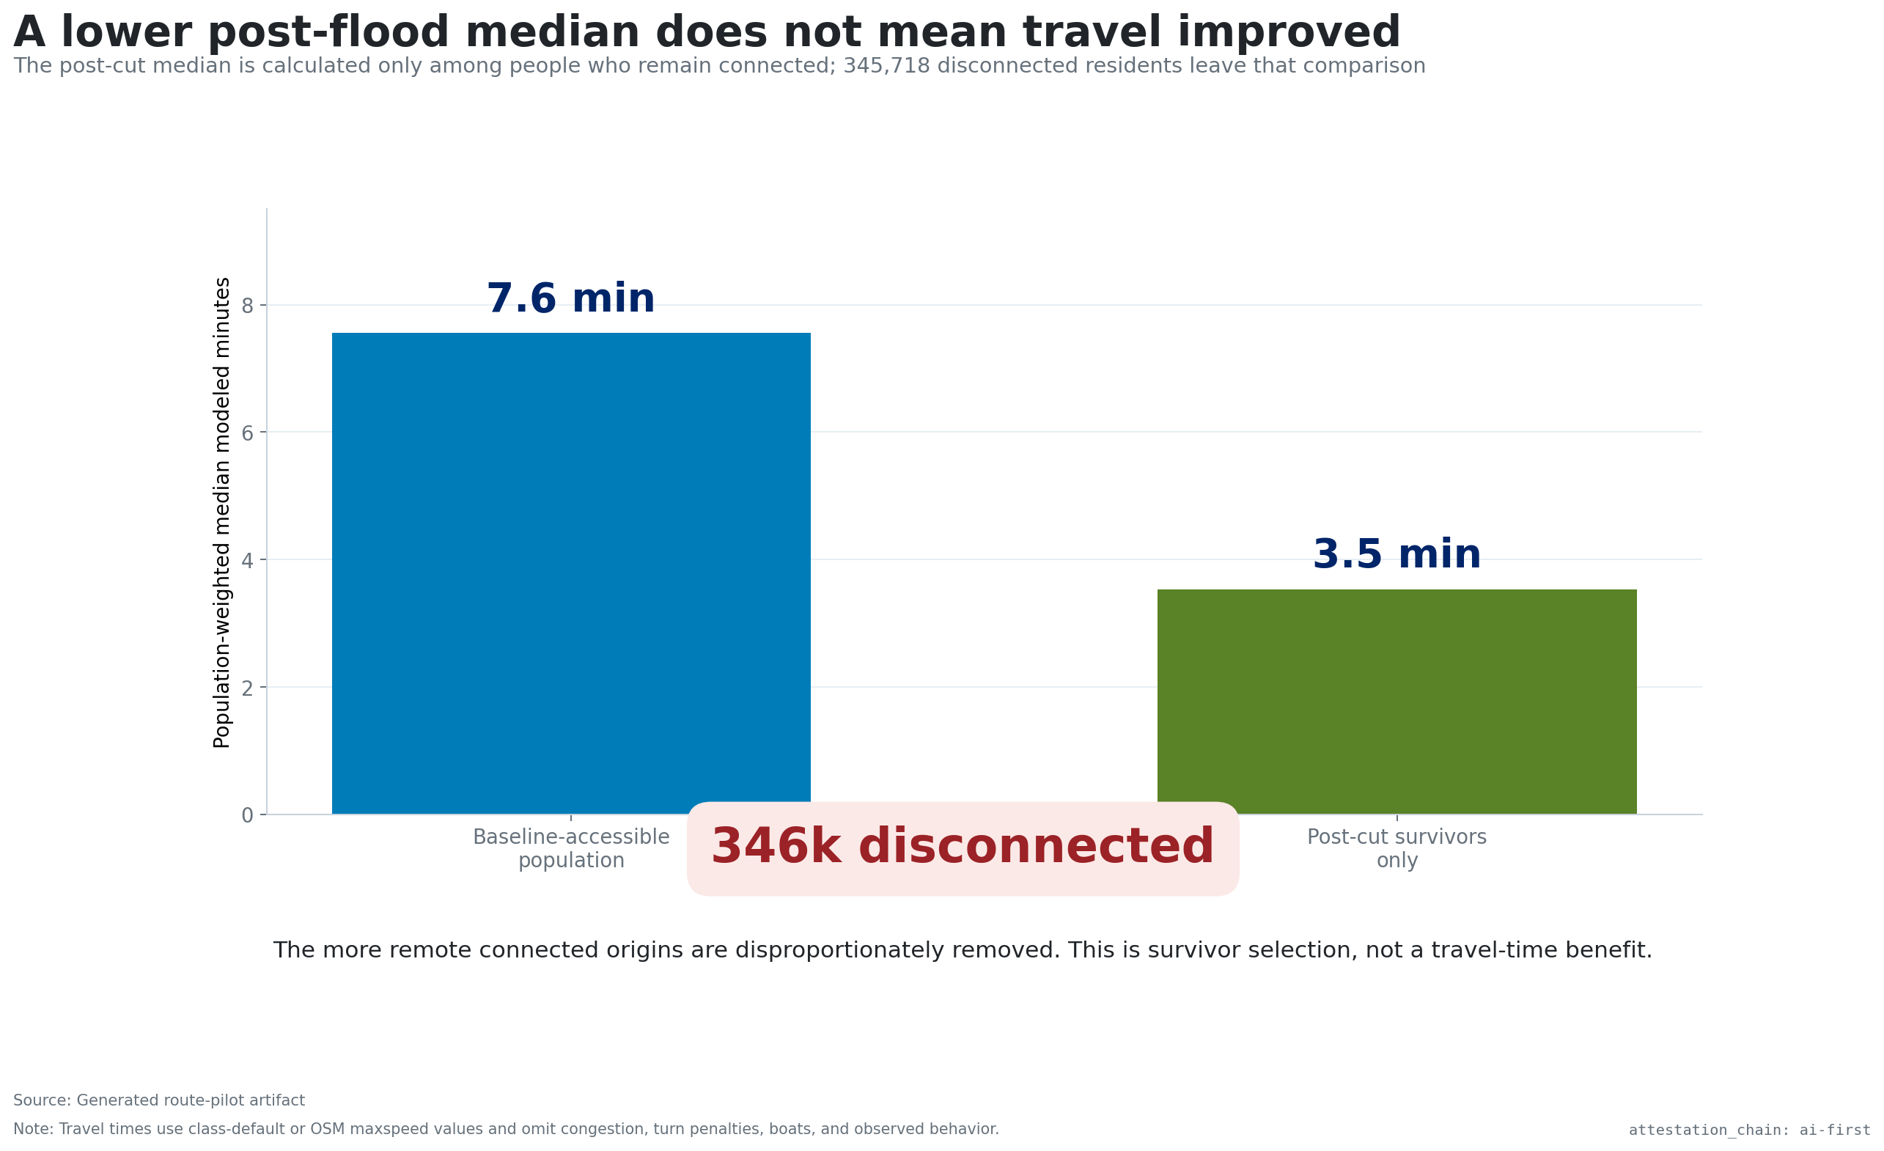
A lower survivor median is not an improvement

Slide 10
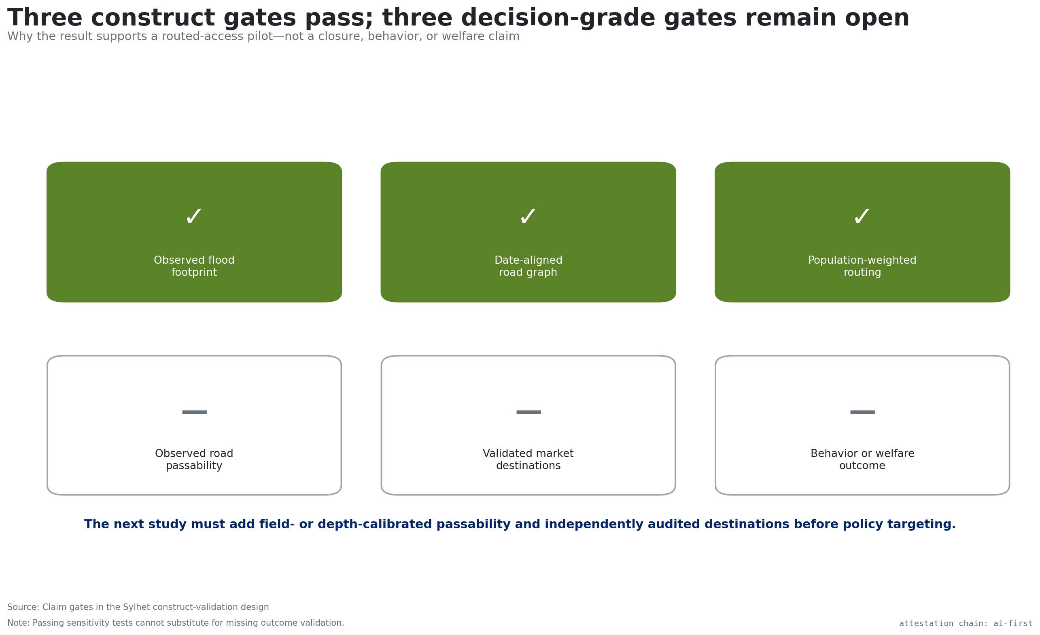
Passability and destination validation remain open

