Slide 1
When urbanization depends on the definition
GHSL–WDI measurement gaps, administrative scale, and classification dynamics

Slide 2
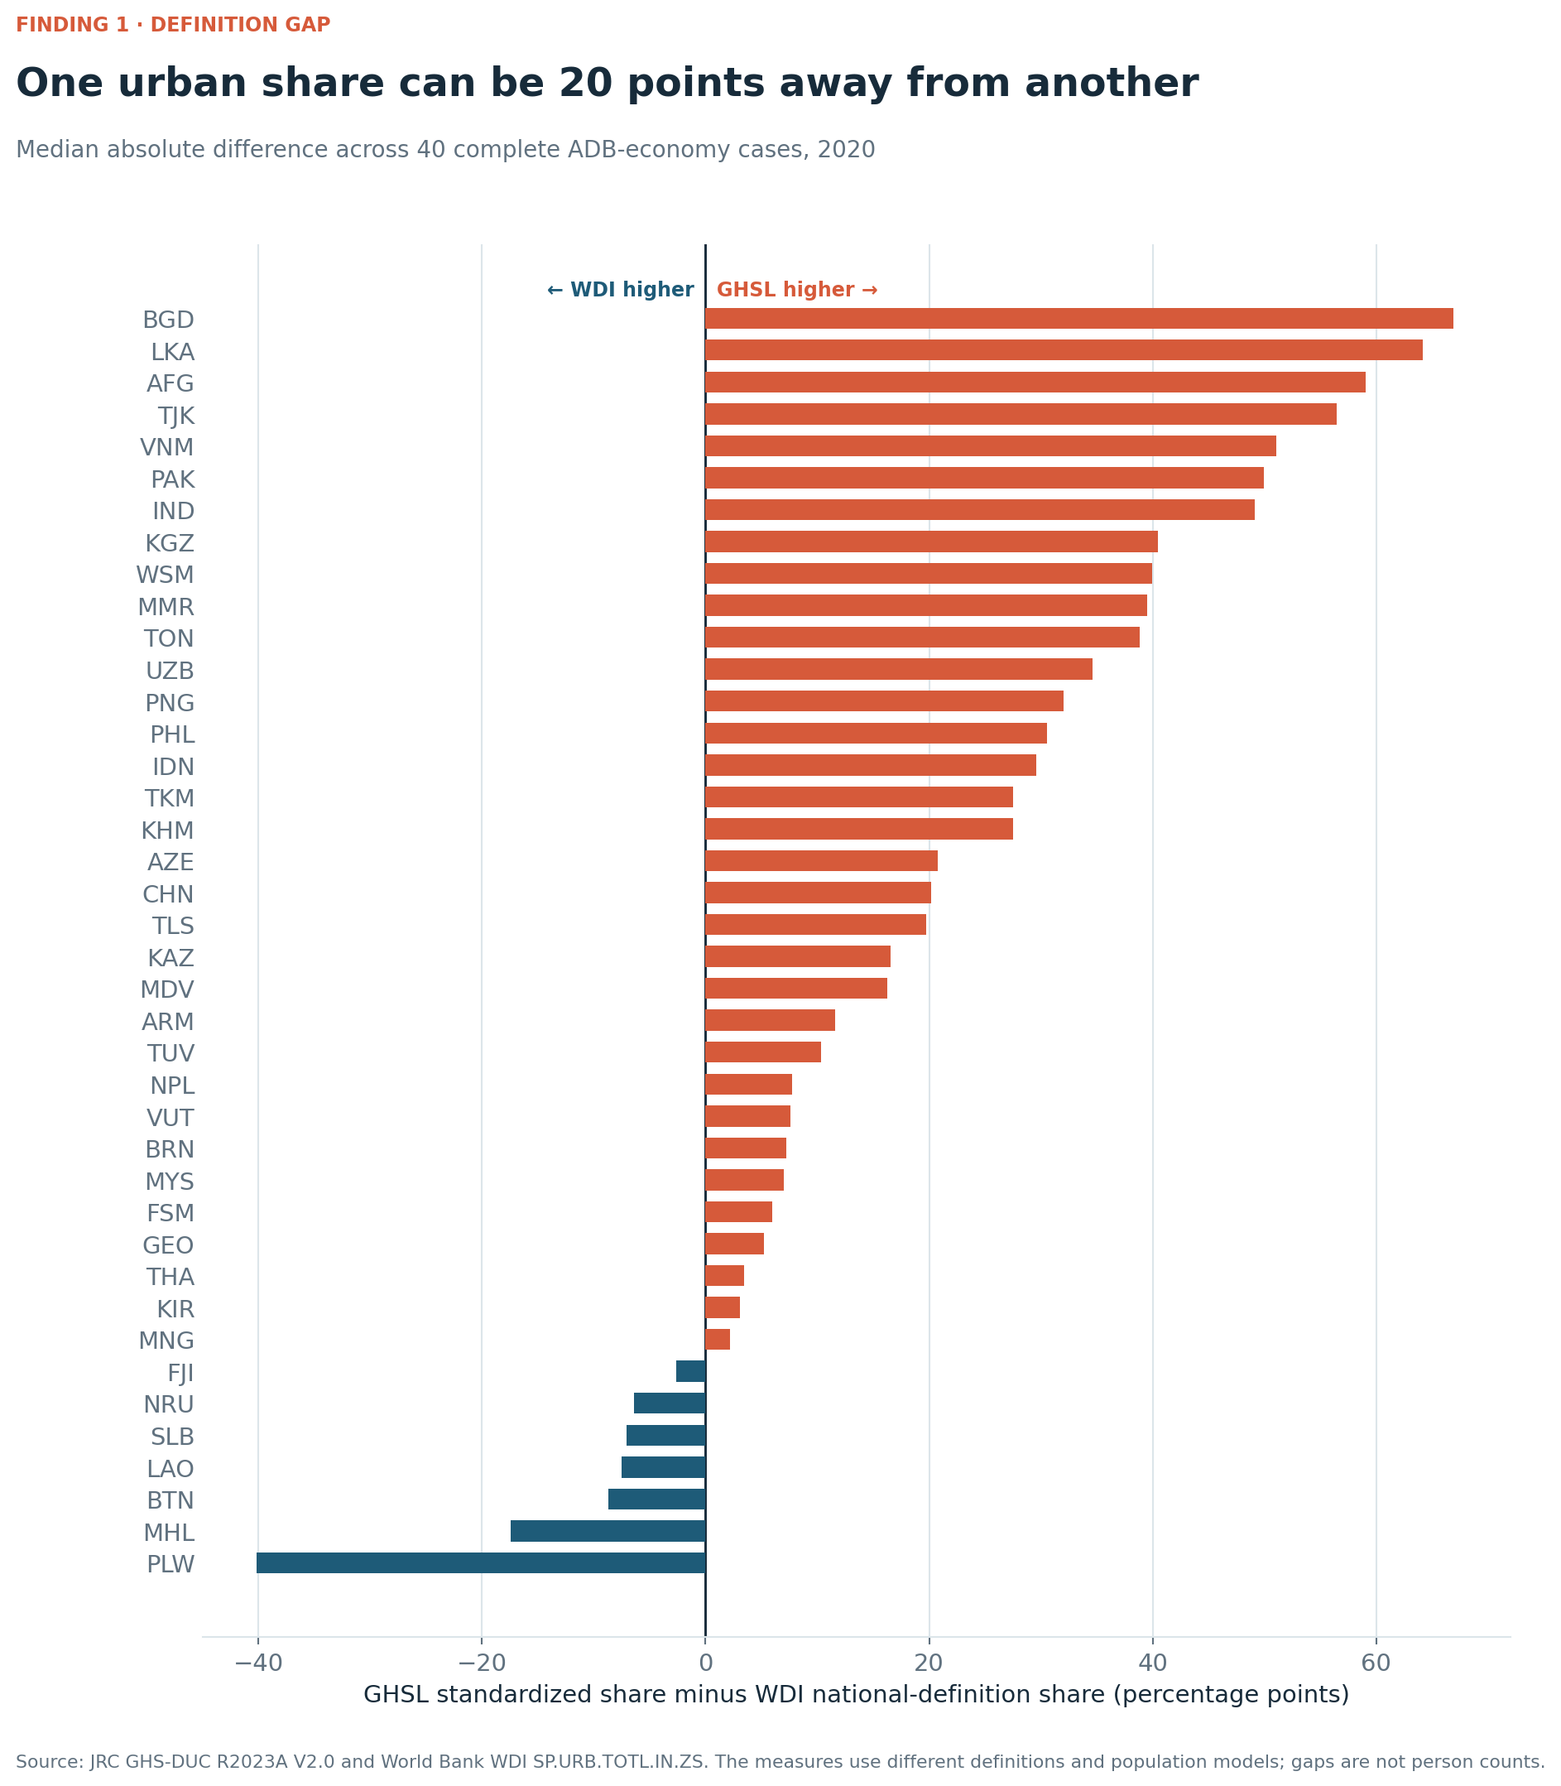
1 · Finding
20.0 percentage points
Median absolute GHSL–WDI urban-share gap across 40 complete ADB developing- economy cases, 2020.

Slide 3
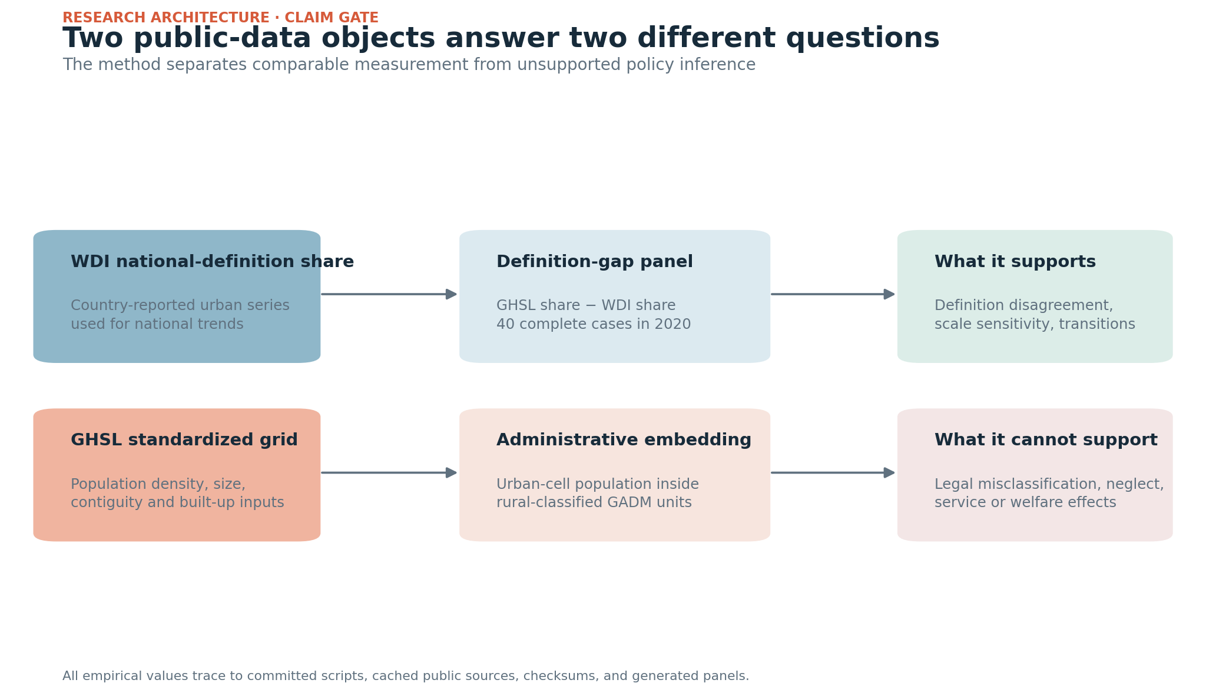
2 · Two valid but different constructs
WDI: urban population under national definitions.
GHSL: one harmonized grid-based Degree of Urbanisation method.
The gap is a construct disagreement, not an error estimate.

Slide 4
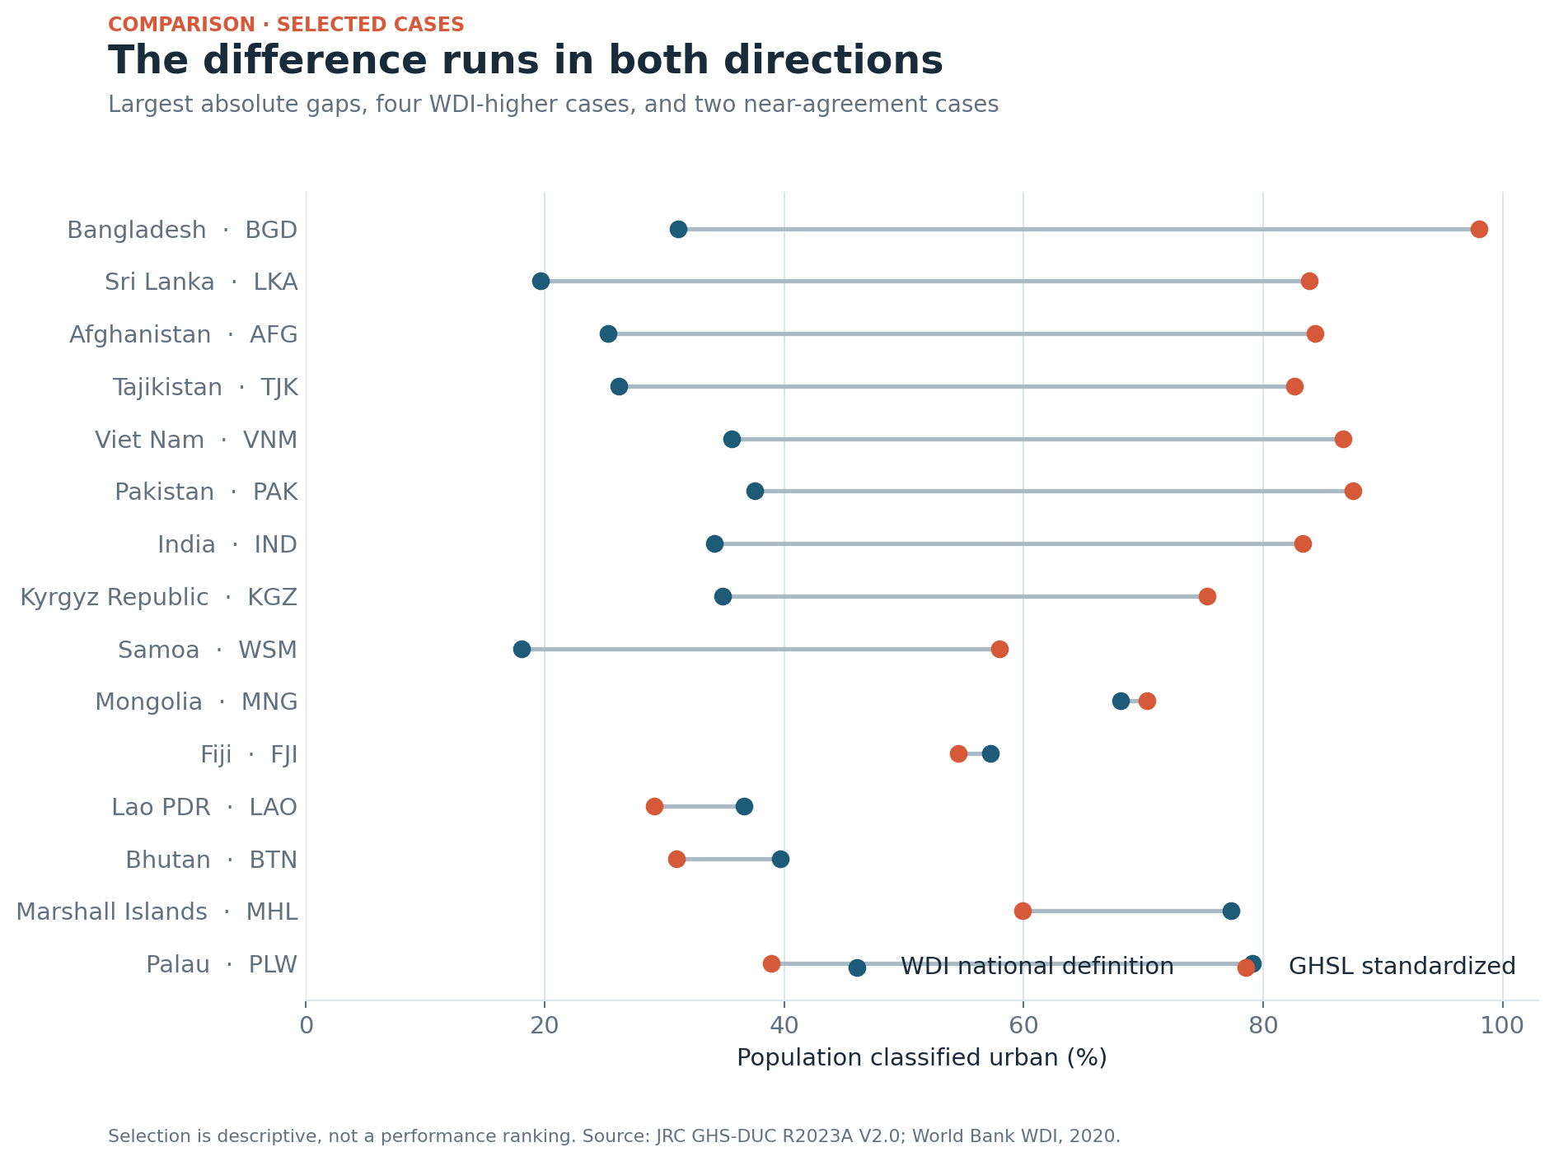
3 · Both directions
GHSL is higher in 33 cases; WDI is higher in seven.

Slide 5
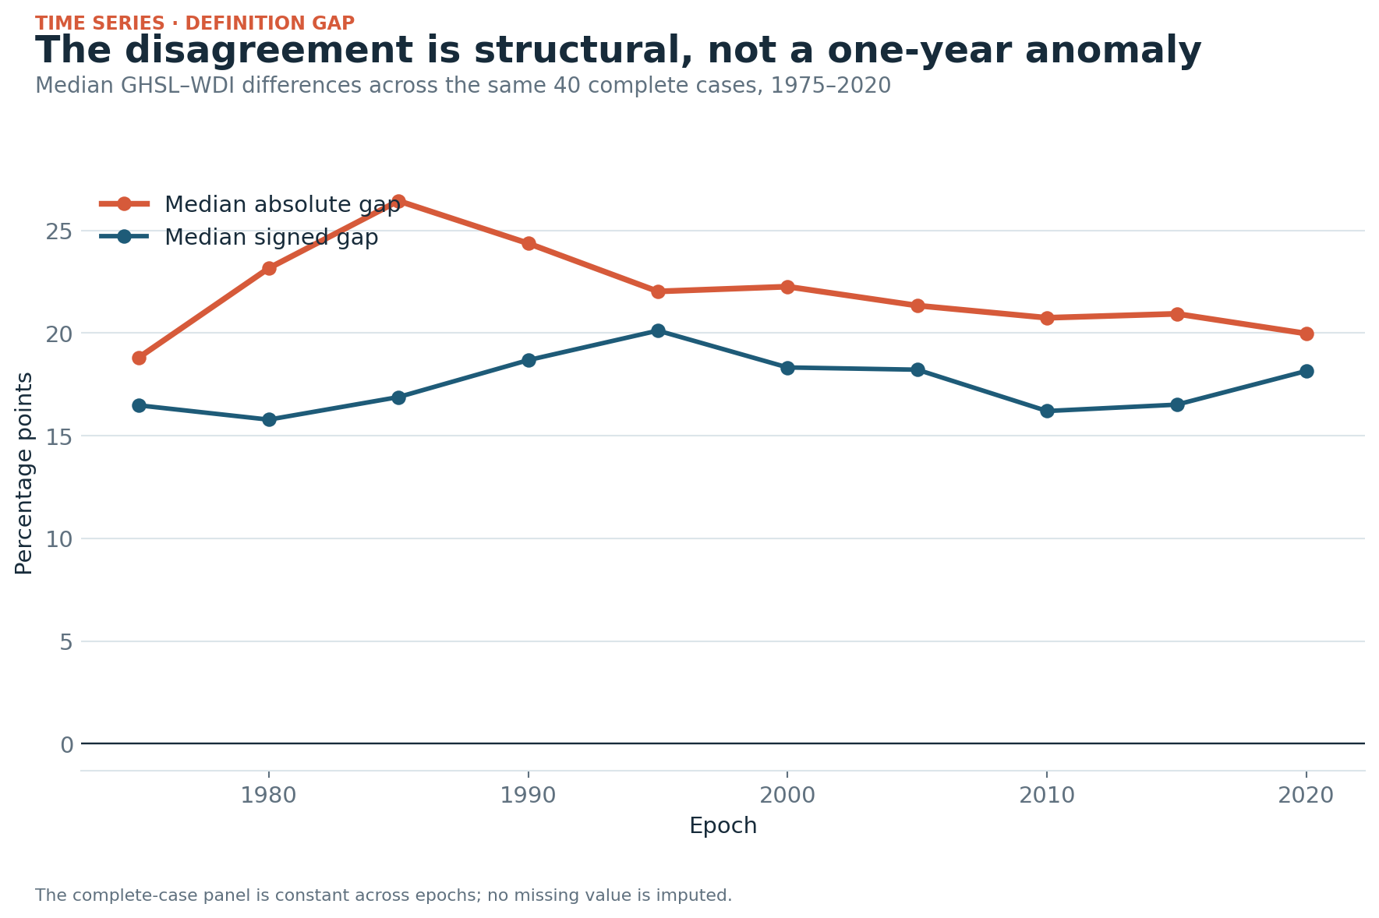
4 · Persistent difference
The median absolute gap stays near 20–26 points across 1975–2020.

Slide 6
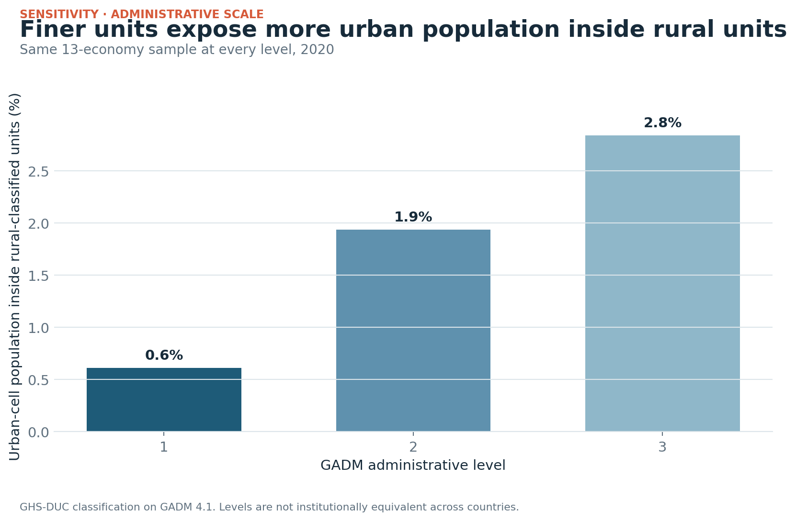
5 · Administrative scale changes the answer
Same 13 economies: 0.6% embedded at level 1, 1.9% at level 2, 2.8% at level 3.

Slide 7
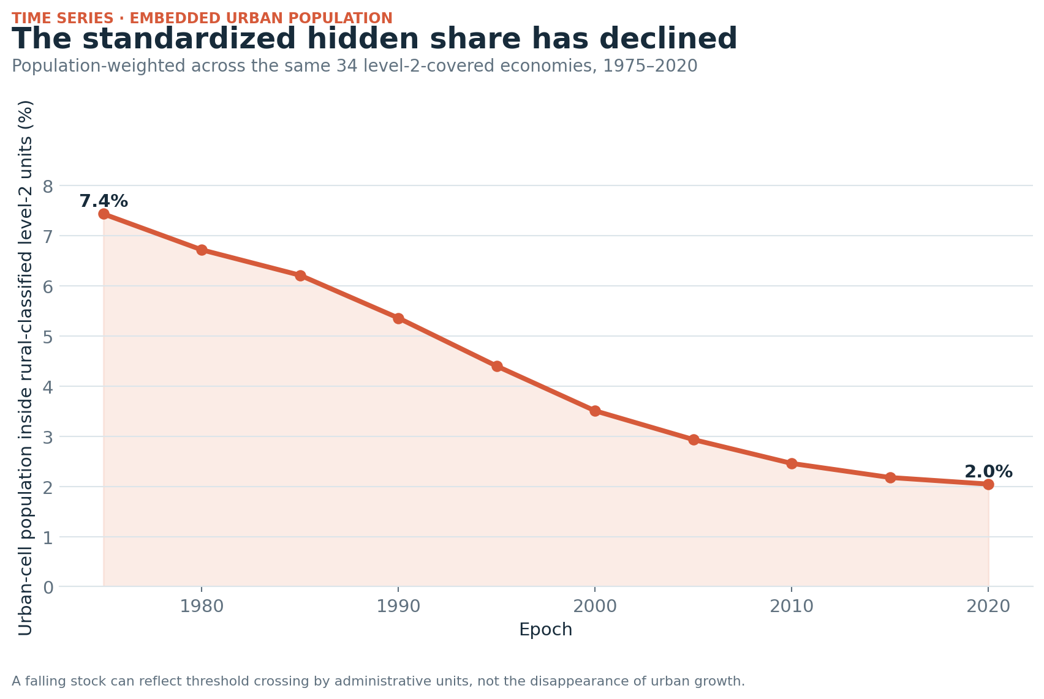
6 · The stock fell
Across the same 34 level-2-covered economies, the embedded share fell from 7.4% in 1975 to 2.0% in 2020.

Slide 8
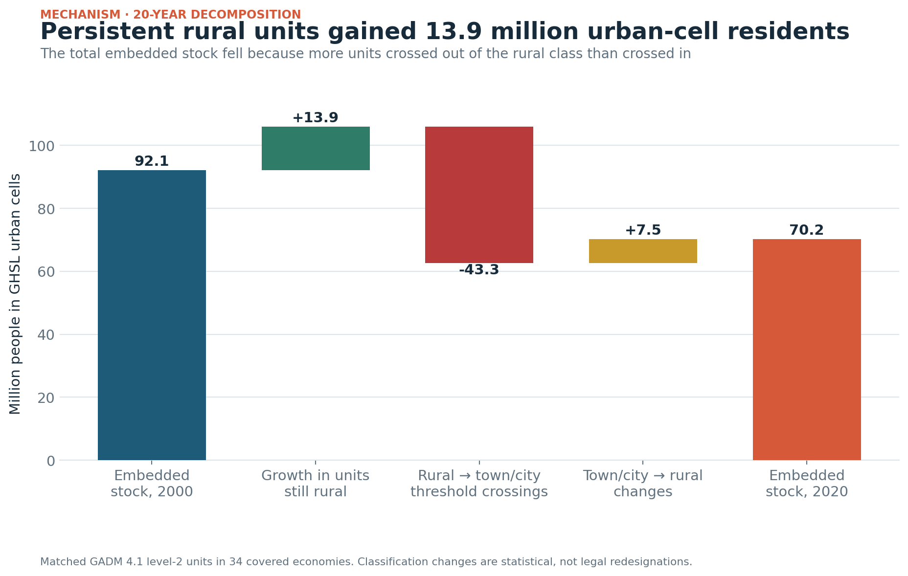
7 · But persistent rural units kept growing
From 2000–2020, units that stayed rural gained 13.9 million urban-cell residents. Rural-to-town/city threshold crossings removed 43.3 million from the embedded category.

Slide 9
8 · Use and limit
Use national definitions for national reporting and GHSL for harmonized comparison. Show both when they diverge.
Do not infer legal misclassification, neglect, services, or welfare from the gap alone.

Slide 10
9 · Next study
One-country join of official classification vintages, historical boundaries, GHSL grids, and one service or fiscal outcome.
AI-first prepared pipeline; not externally reviewed.

