Slide 1
The migration leaders change when population enters the denominator
A 44-economy stock audit — AI-first under §18 Raymond Adofina · Asian Development Bank

Slide 2
One stock measure cannot answer two migration questions
The inherited 44-economy panel ranks UN DESA 2024 emigrant stock by origin.
Useful for diaspora-scale and service-population questions.
Not a current flow, migration rate, or individual propensity.
Test: divide the same stock by WDI 2024 resident population.
Distinguish scale, population-relative stock, and forced displacement before interpreting an origin ranking.
attestation_chain: ai-first; current maturity PP.

Slide 3
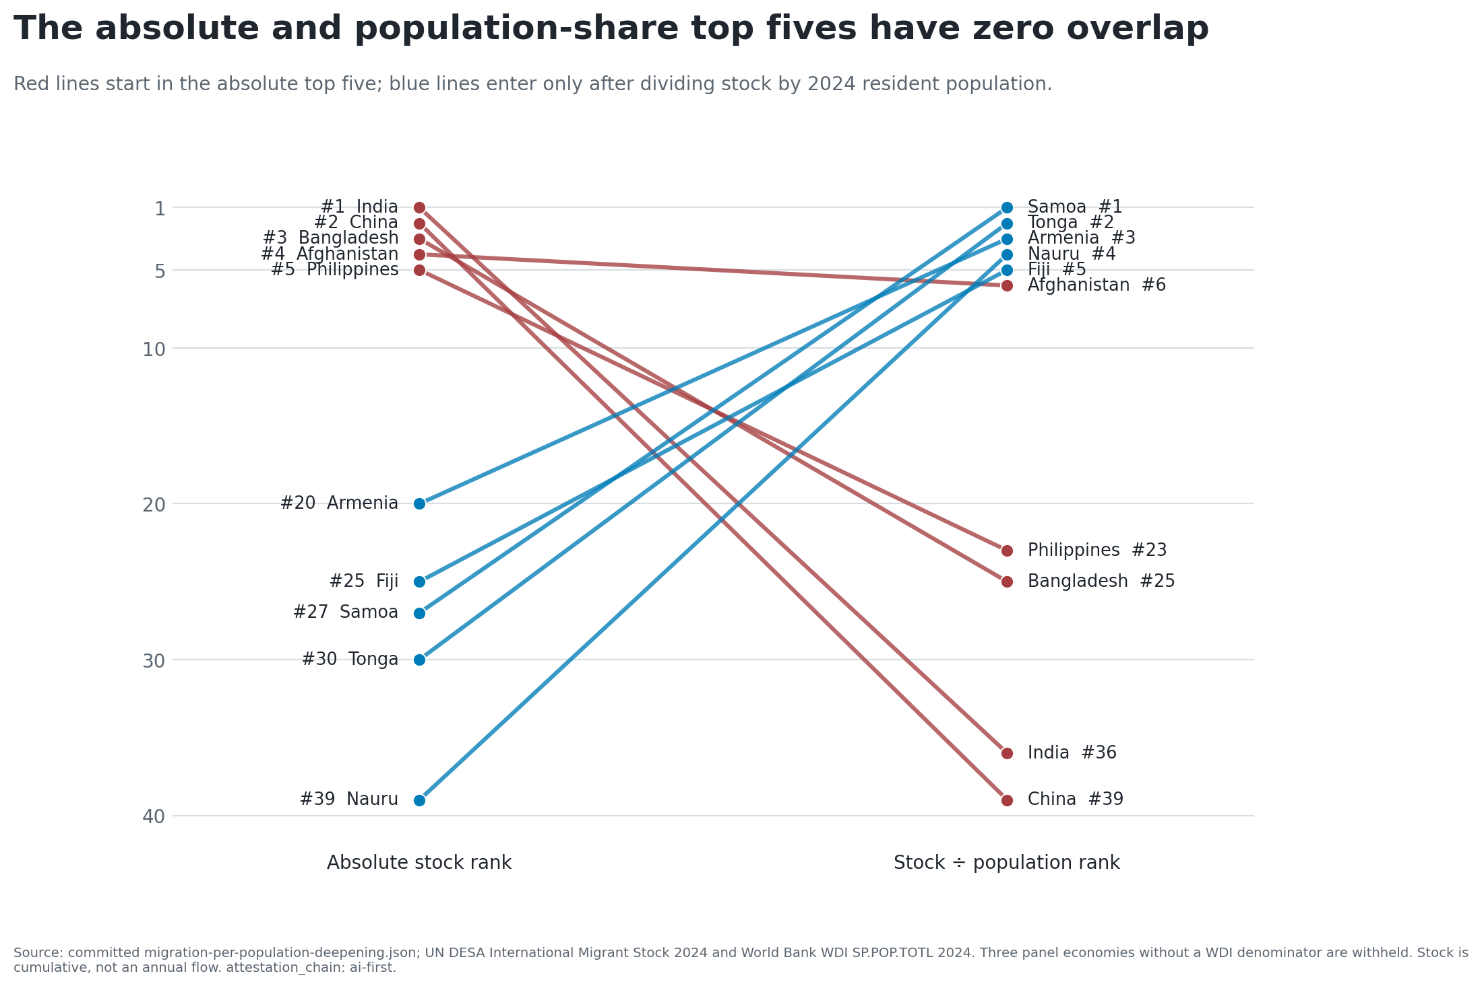
India and China lead by scale; Samoa and Tonga after normalization

Slide 4
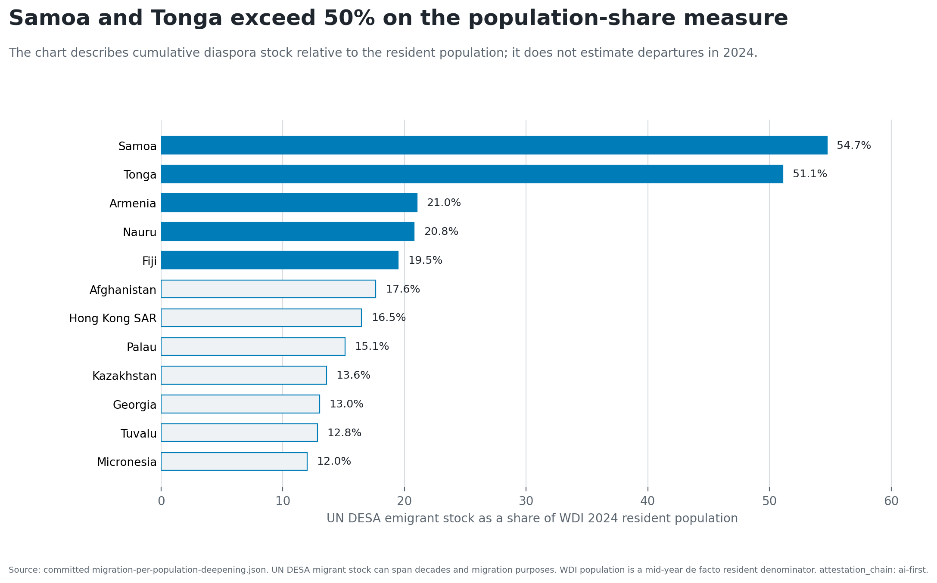
Samoa and Tonga exceed 50%; three denominators are withheld

Slide 5
The result survives every ranking choice tested
Top 3: no shared origins; 0% overlap.
Top 5: no shared origins; 0% overlap.
Top 8: Afghanistan only; 12.5% overlap.
The result remains material at overlap thresholds of 25%, 50%, and 75%.
Decision: retire the absolute-stock intensity headline.

Slide 6
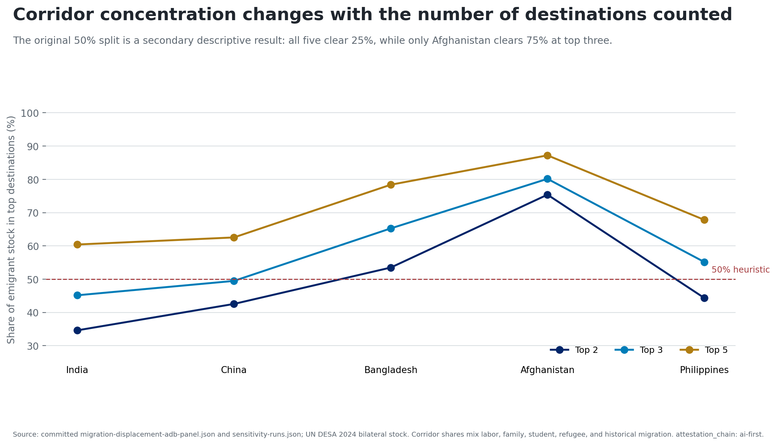
Top-three corridor shares range from 45.15% to 80.15%

Slide 7
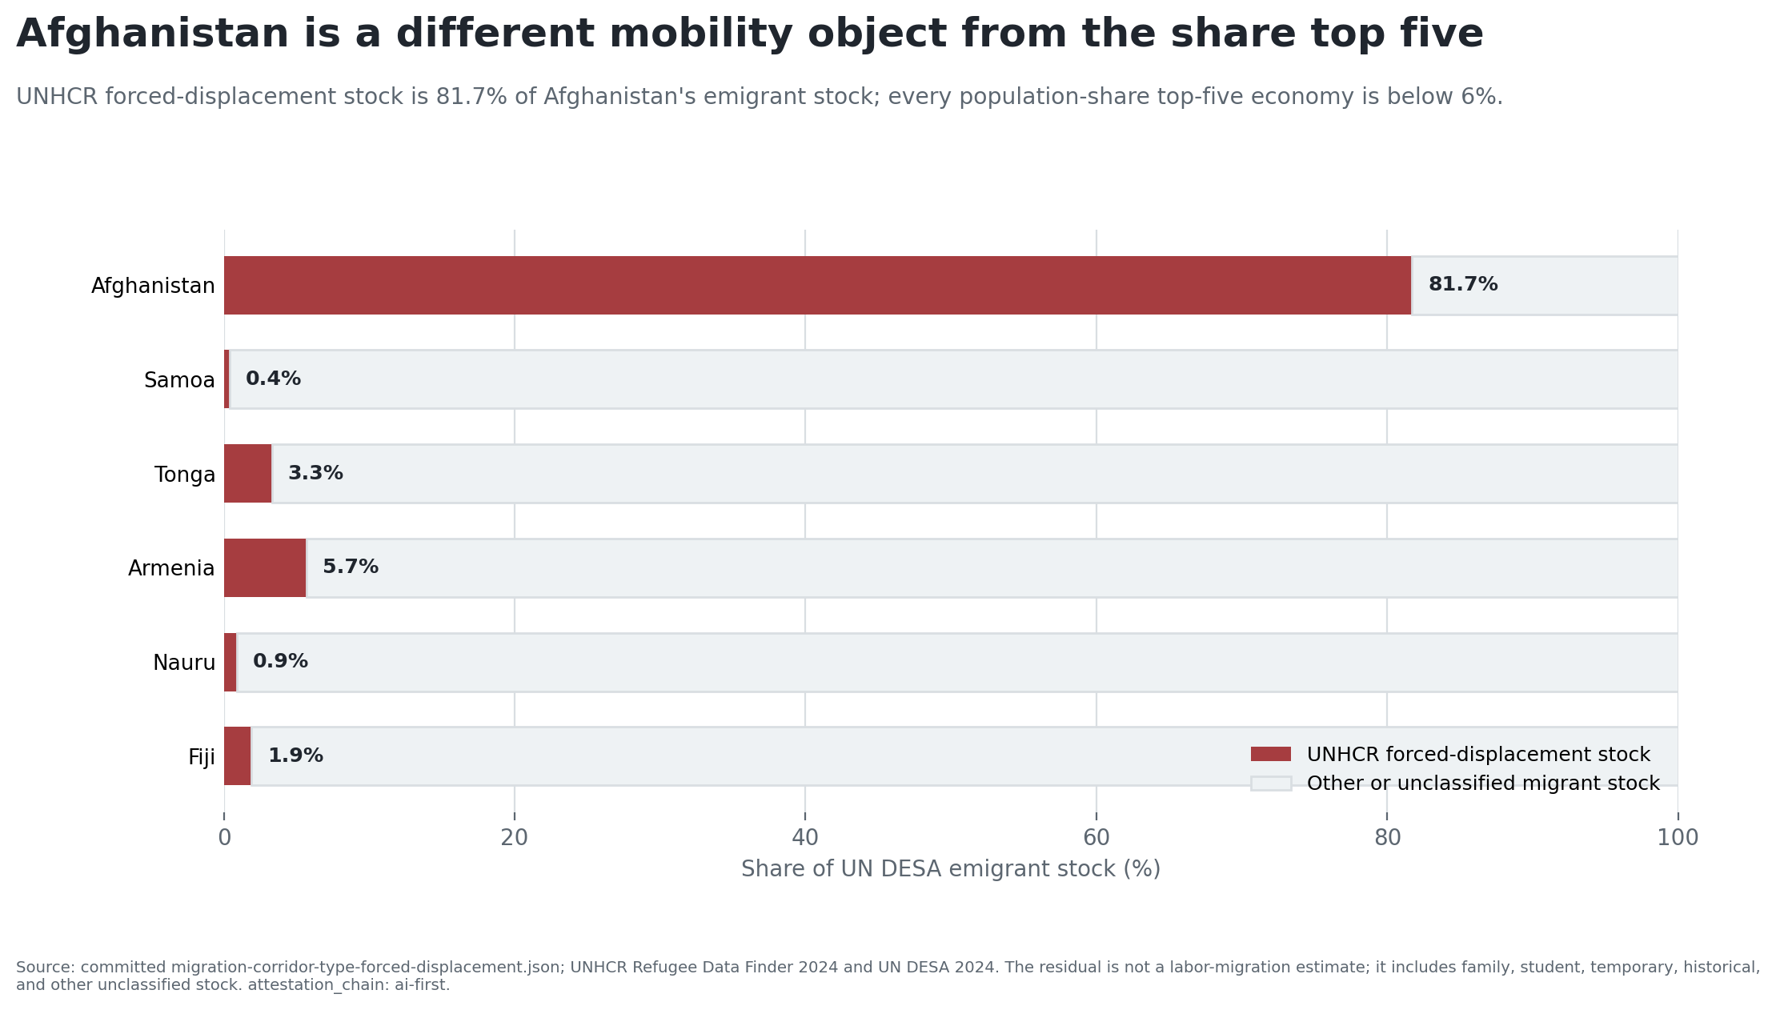
Afghanistan is a forced-displacement-majority exception

Slide 8
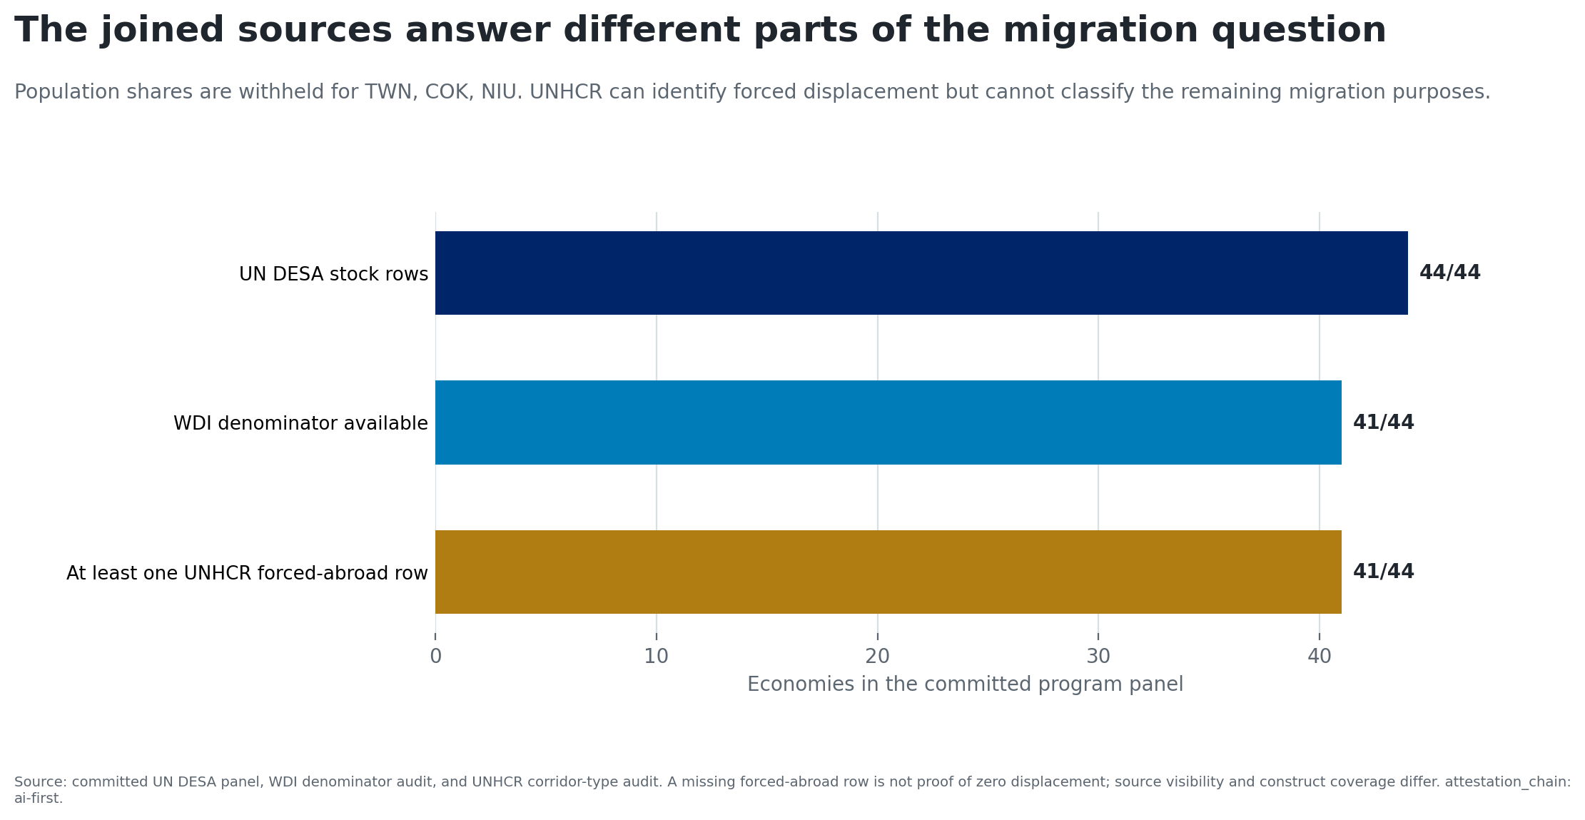
No source in the spine classifies every migration purpose

Slide 9
Use the denominator that matches the decision
Use absolute stock for diaspora scale and service populations.
Use stock relative to resident population for population-relative exposure.
Use UNHCR categories to identify forced-displacement cases.
For labor mobility or current flows, obtain annual flow, visa, recruitment, return, or household data.
Every number traces to committed evidence. attestation_chain: ai-first; human-final requires owner re-attestation and named expert review.

