Slide 1
The stable top five was fixed by a missing-data rule
Social-protection construct validation — AI-first under §18 Raymond Adofina · Asian Development Bank

Slide 2
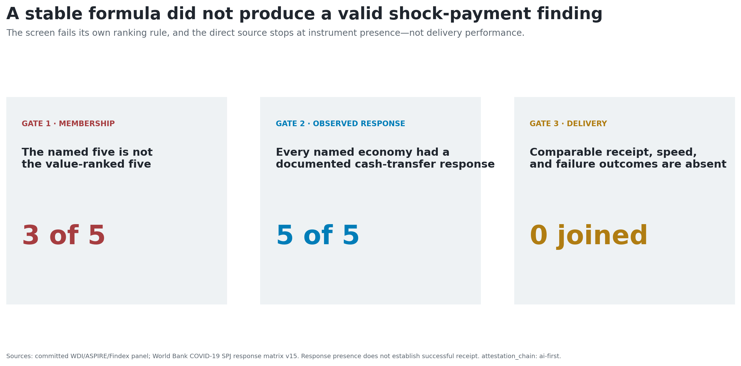
The claim fails three validity gates

Slide 3
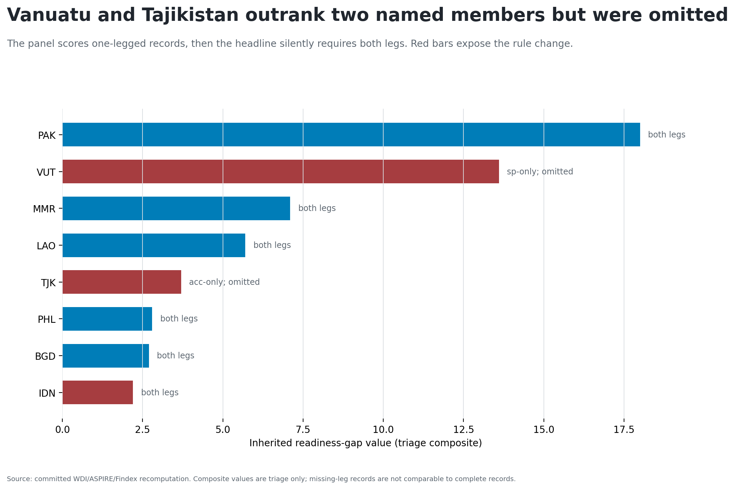
The panel’s own value order changes two members

Slide 4
Mean imputation does not restore the published set
Vanuatu: 13.6 committed; 10.4 after mean-imputing account ownership.
Tajikistan: 3.7 committed; 3.3 after mean-imputing all-SP coverage.
Both remain above the Philippines at 2.8 and Bangladesh at 2.7.
This is a falsification diagnostic, not an endorsed imputation model.

Slide 5
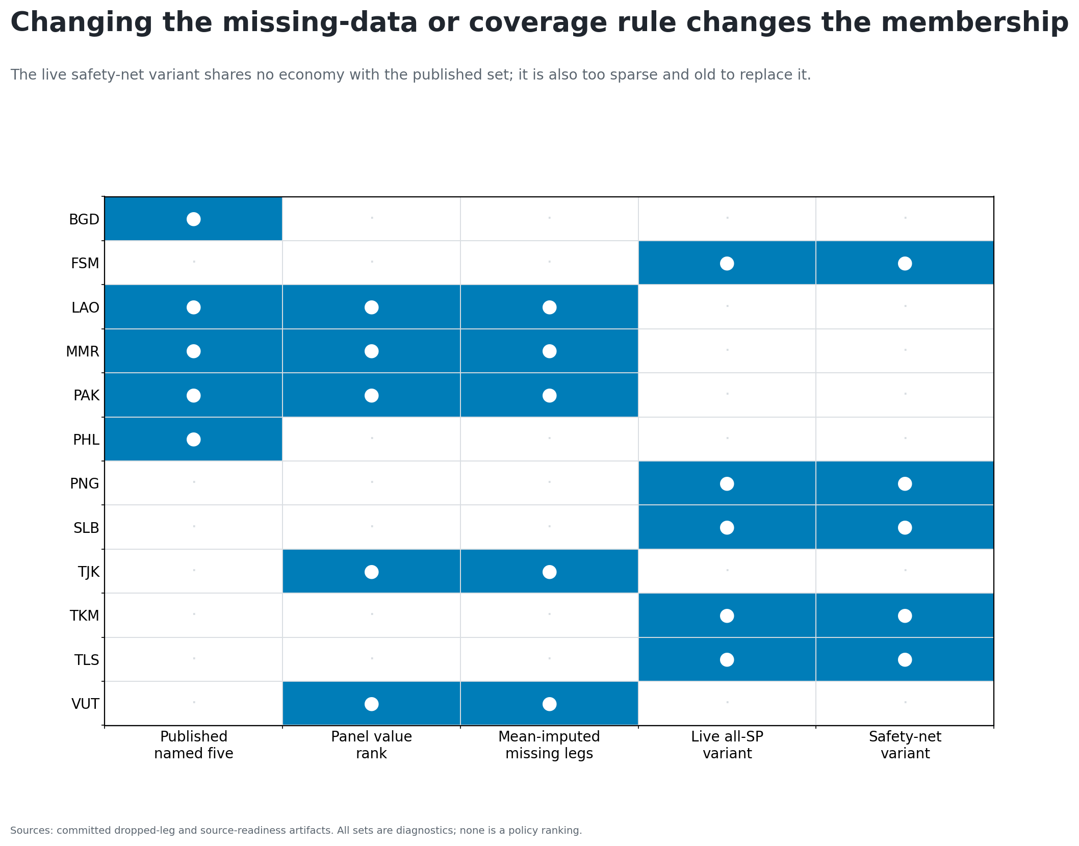
Changing the coverage construct changes the membership

Slide 6
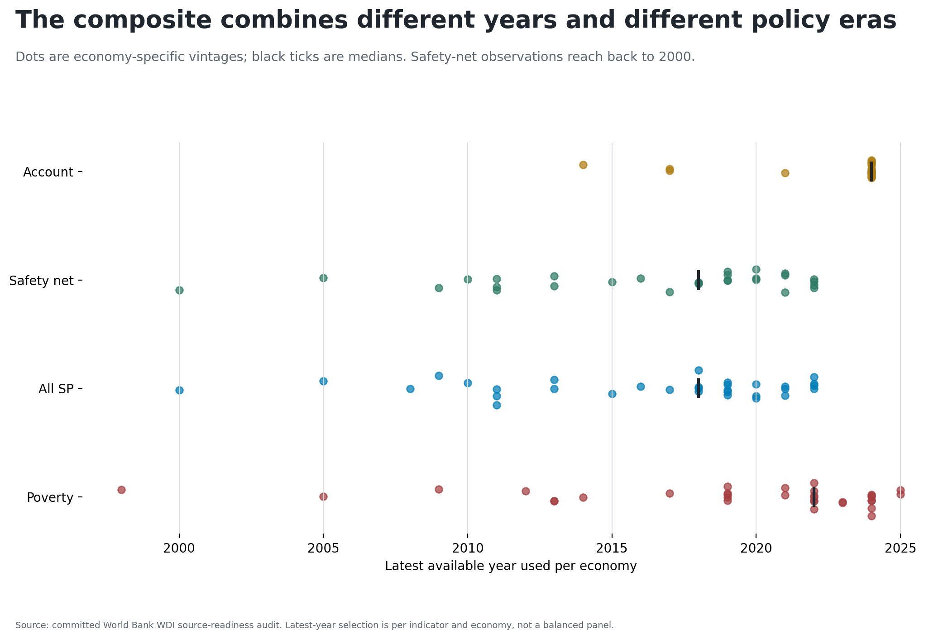
The variant also mixes different policy eras

Slide 7
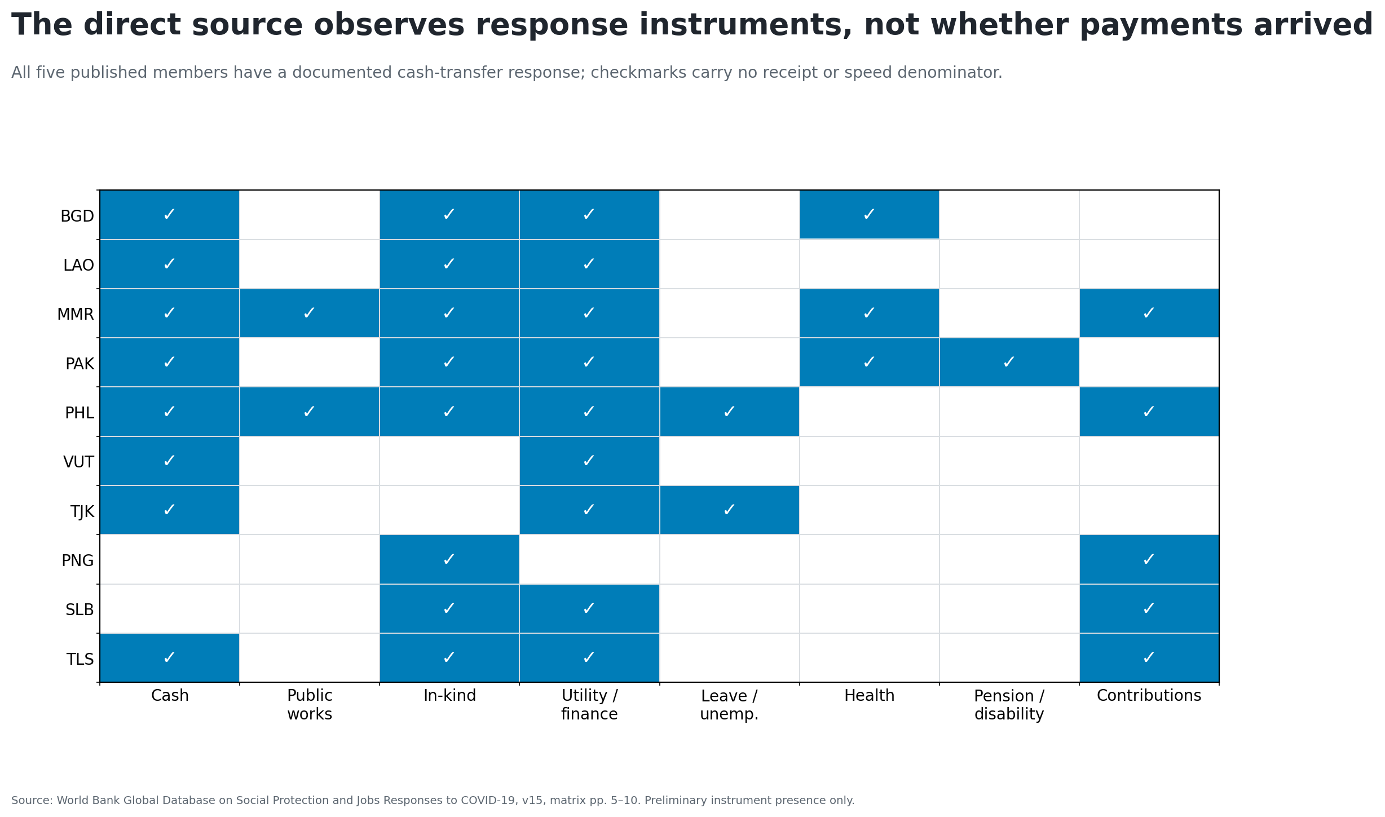
The direct source records instruments, not receipt

Slide 8
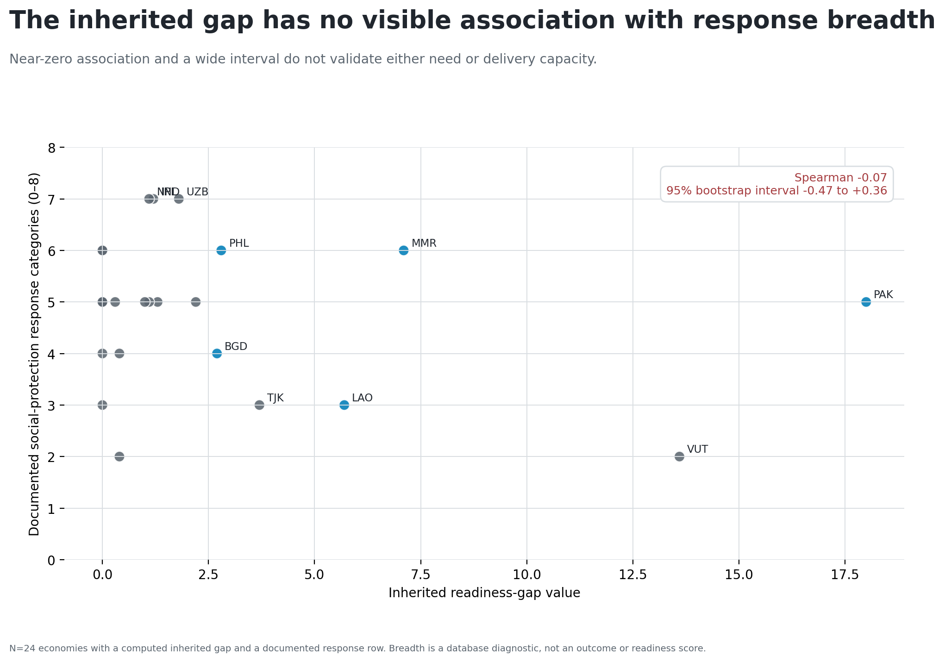
The composite does not align with response breadth

Slide 9
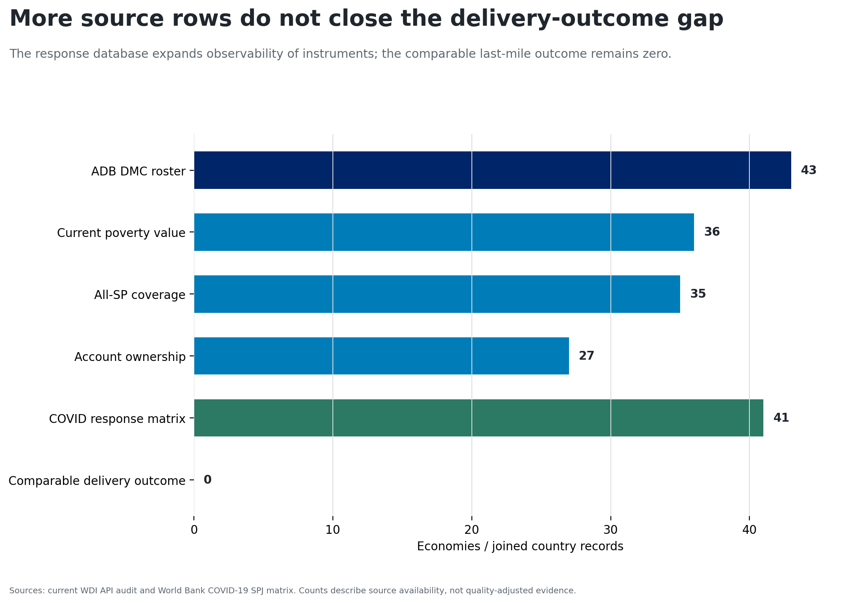
More rows do not close the outcome gap

Slide 10
Retire the ranking; specify the next data object
The next study begins with an event-level public table:
shock and reference date;
affected or eligible population;
planned and actual recipients;
successful and failed payments;
initiation and receipt timestamps;
amount, channel, geography, and program identifier.
Decision: no replacement readiness ranking from the current source stack.

