Slide 1
Public monitor routes are visible. Claim-ready QA evidence is not.
Air-monitoring public QA observability · AI-first §18 Raymond Adofina · Asian Development Bank

Slide 2
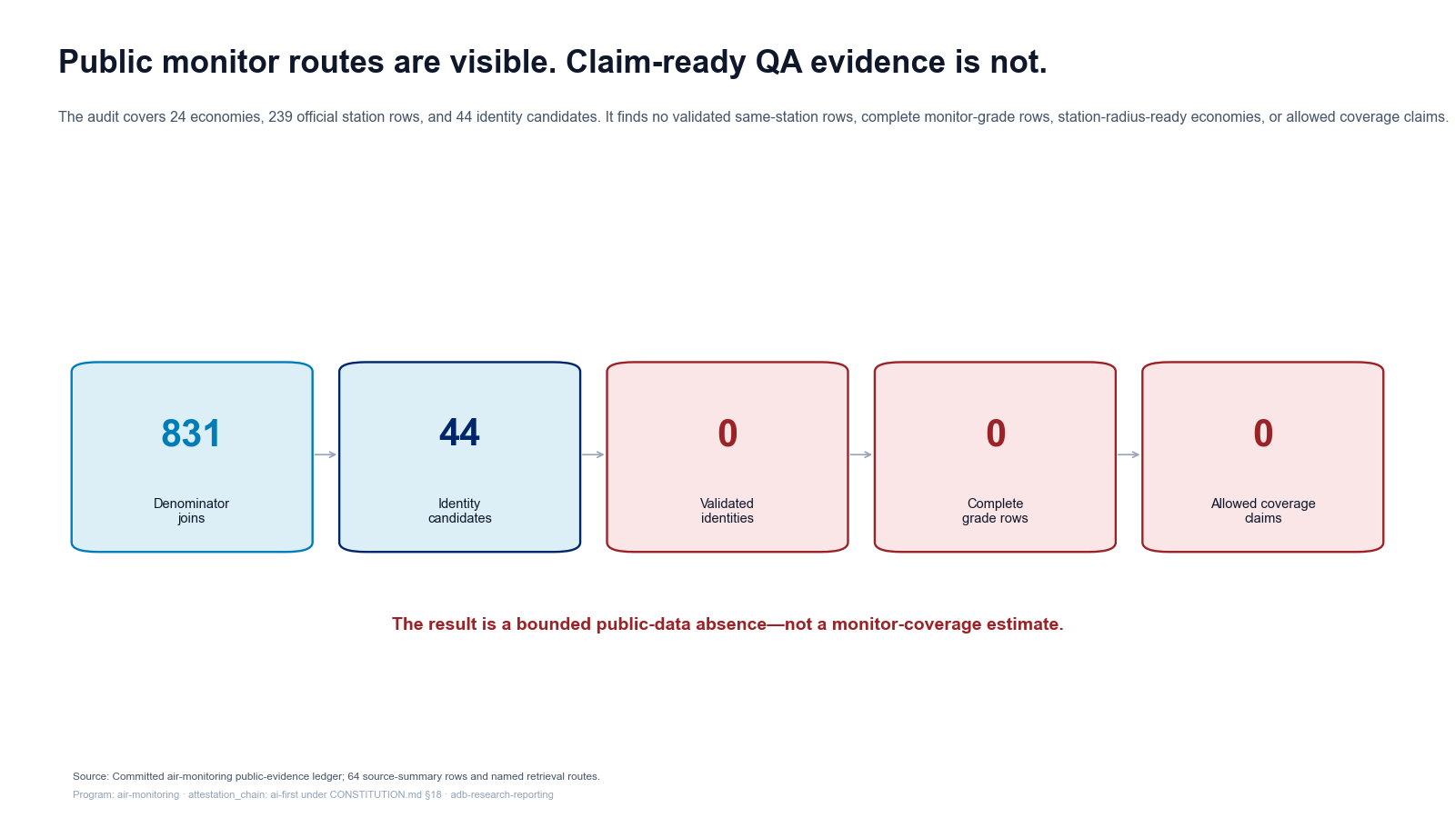
The claim-permission chain stops before coverage

Slide 3
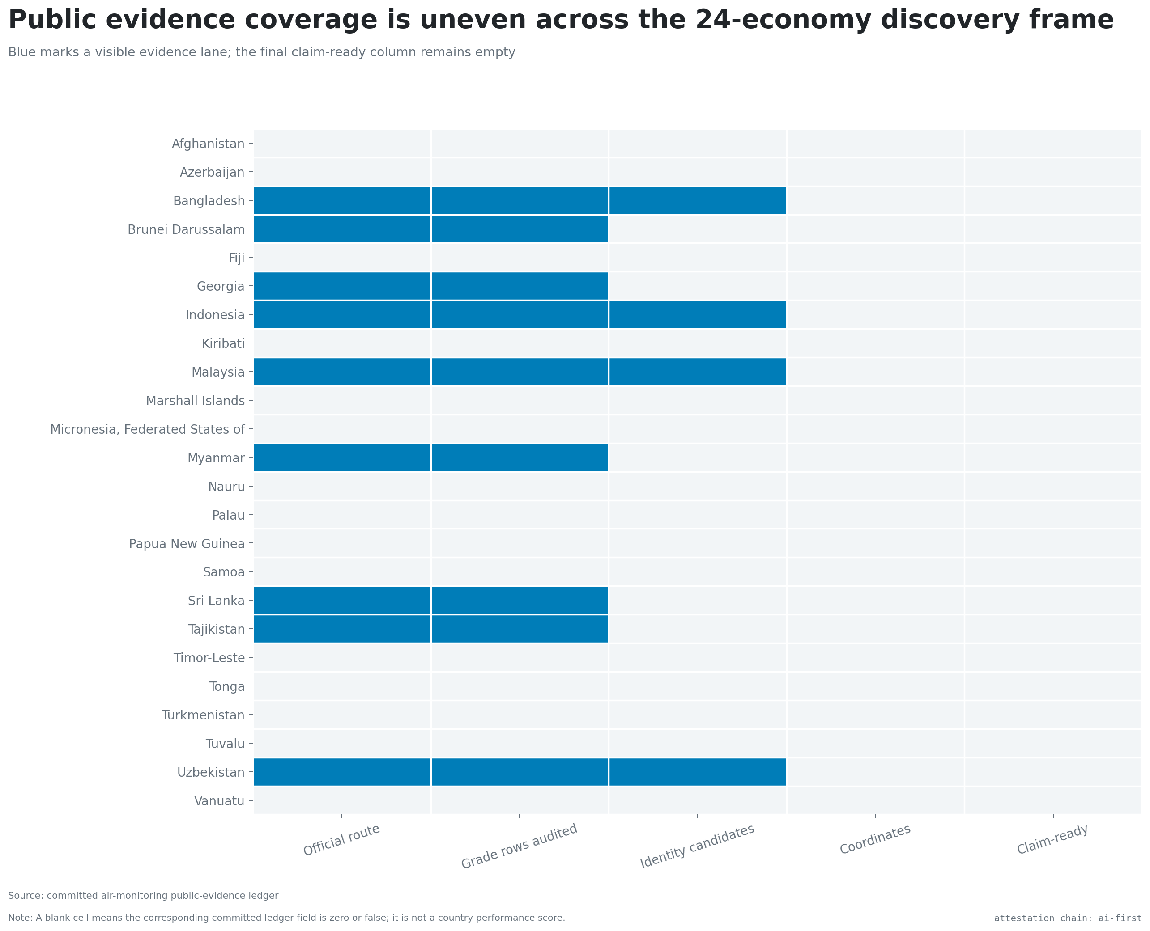
Public evidence lanes differ across 24 economies

Slide 4
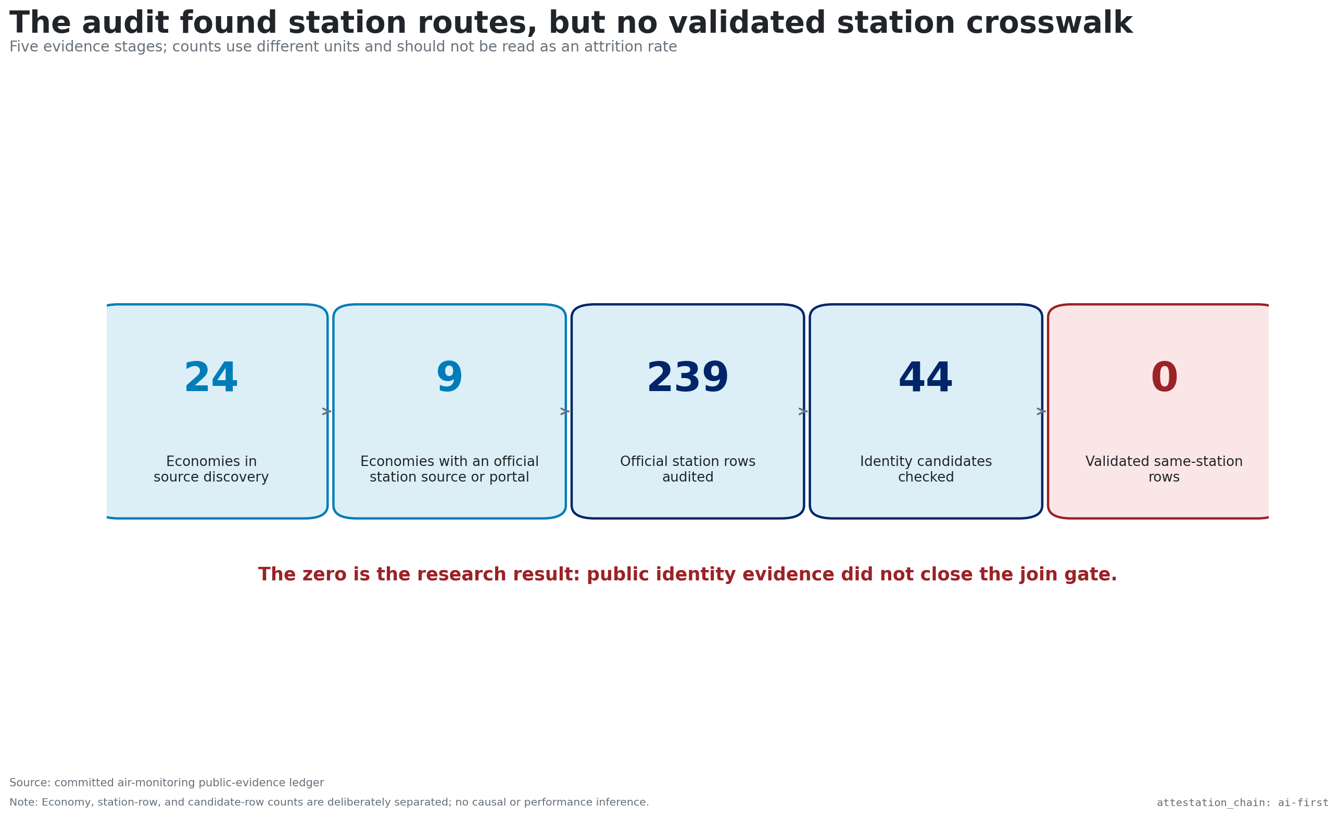
Discovery is not a validated station crosswalk

Slide 5
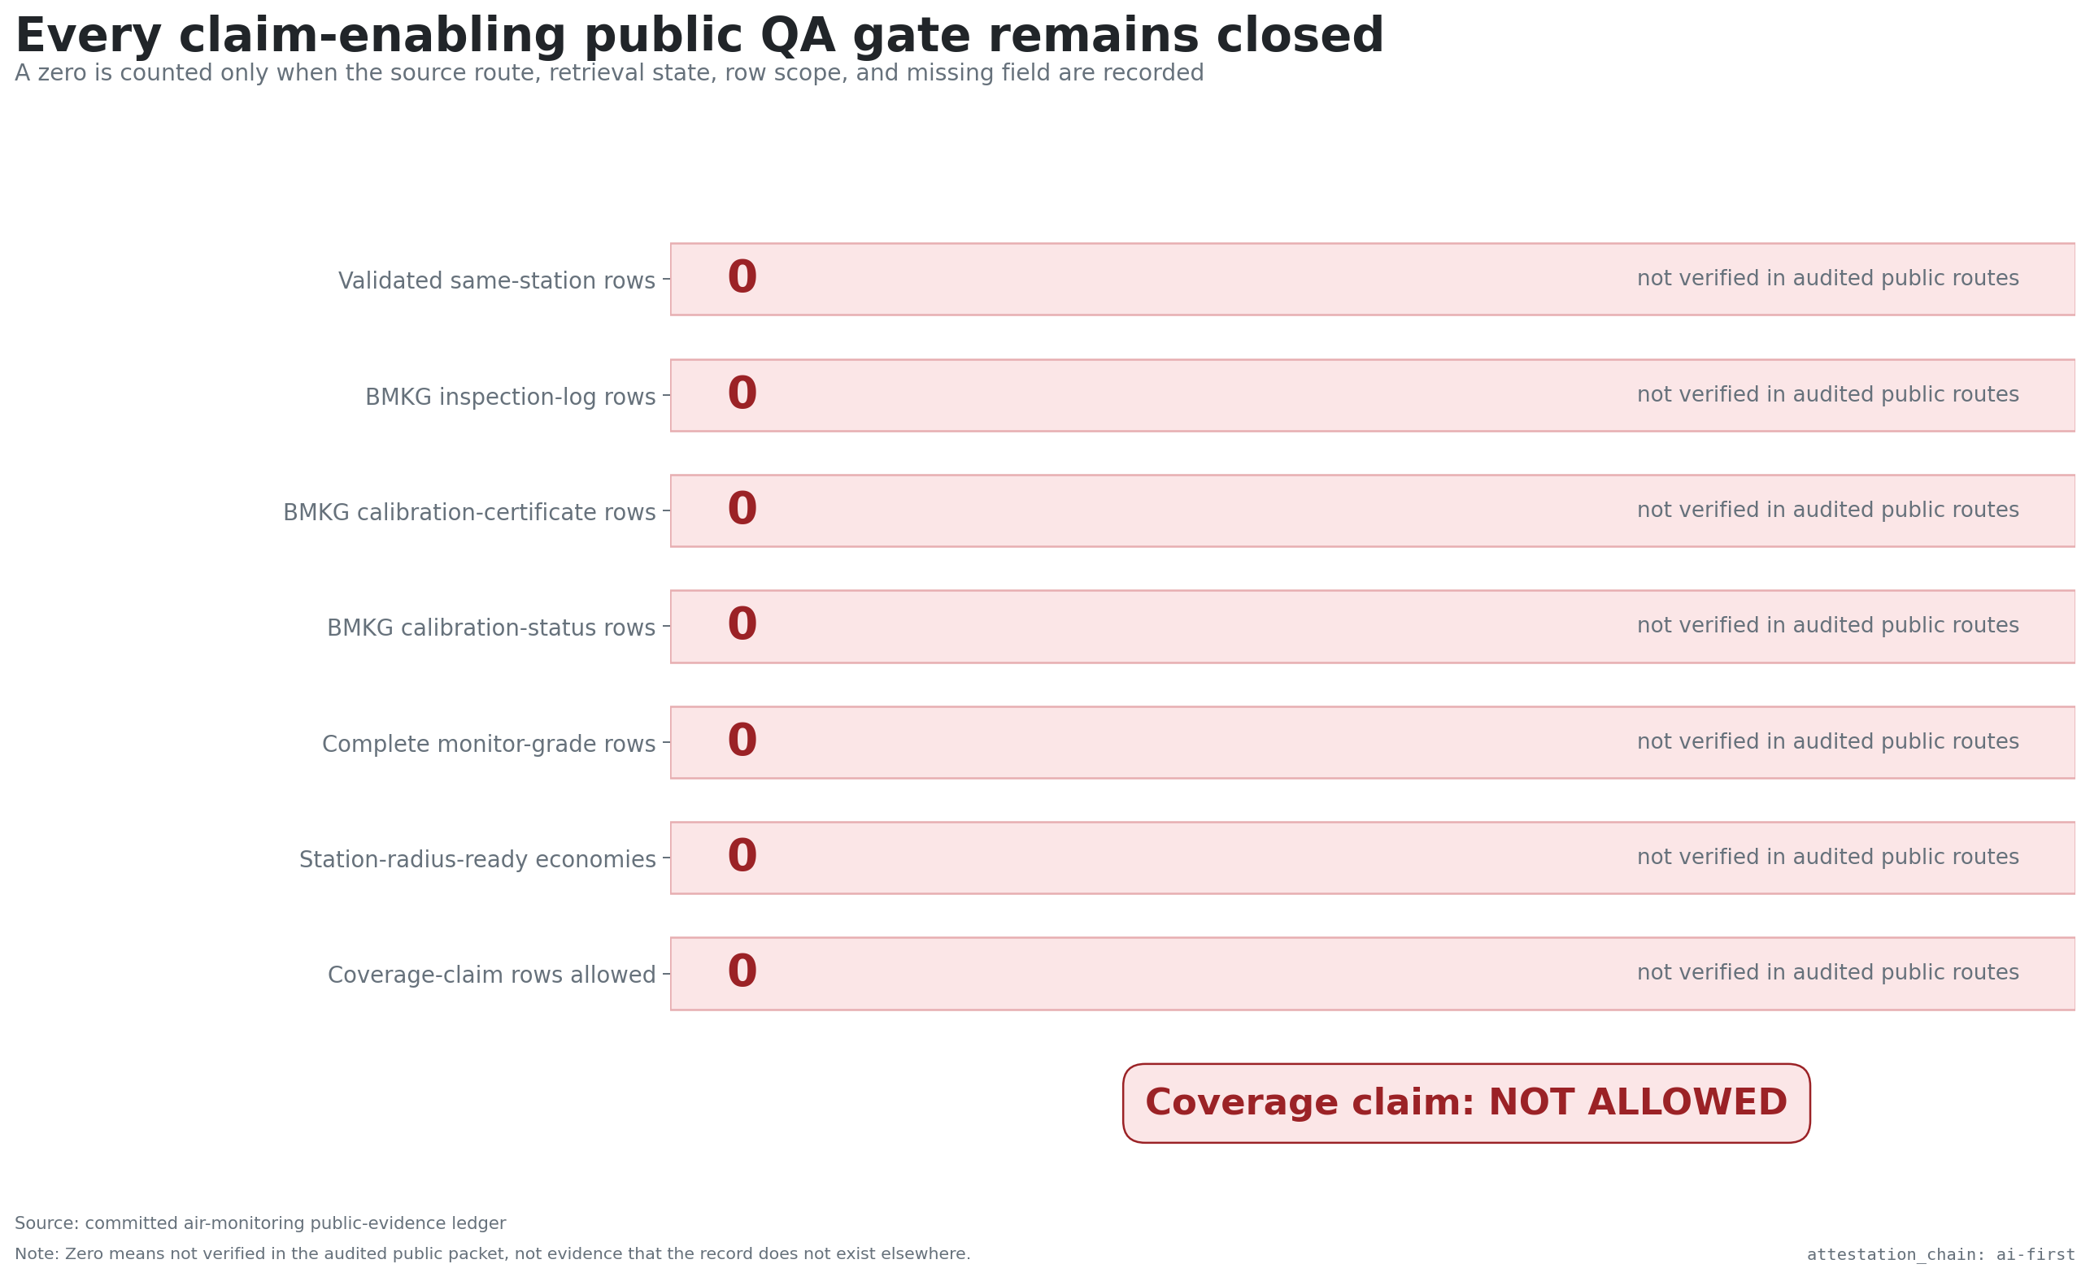
Every claim-enabling public QA gate is closed

Slide 6
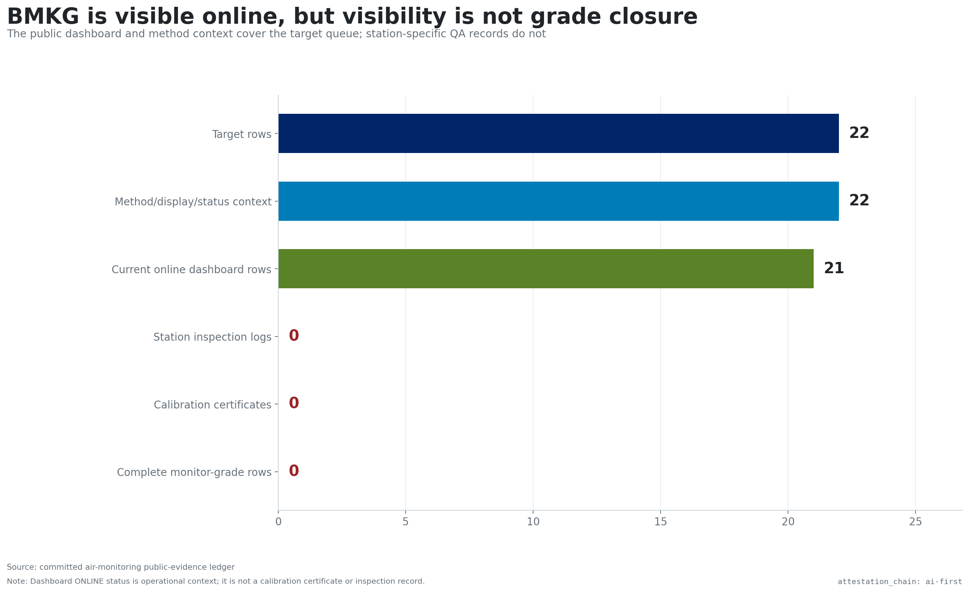
BMKG visibility does not close station grade

Slide 7
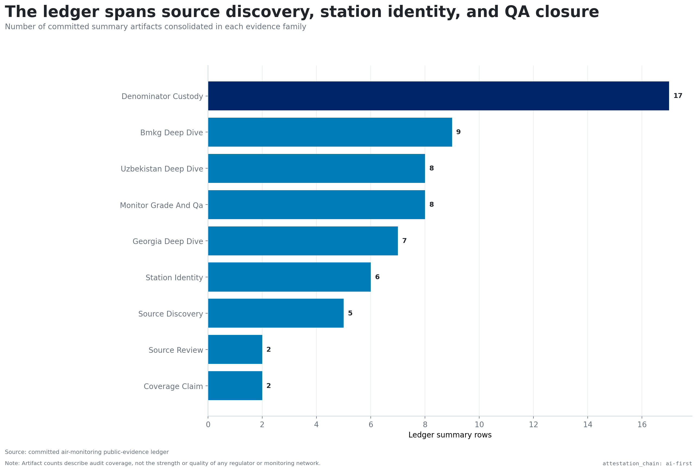
The ledger consolidates multiple evidence families

Slide 8
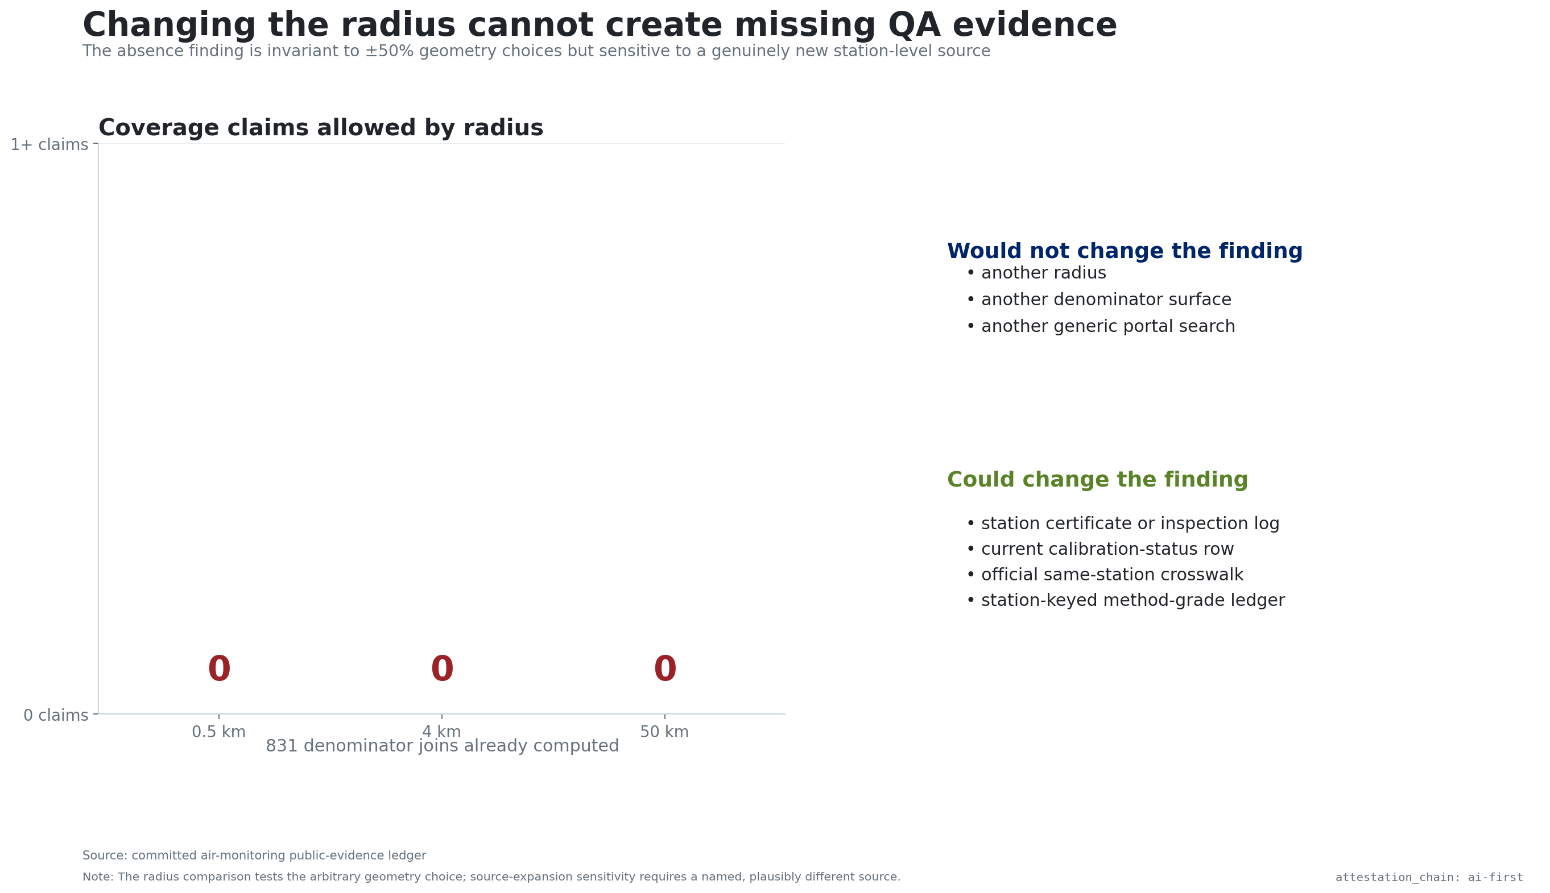
Geometry sensitivity does not create QA evidence

Slide 9
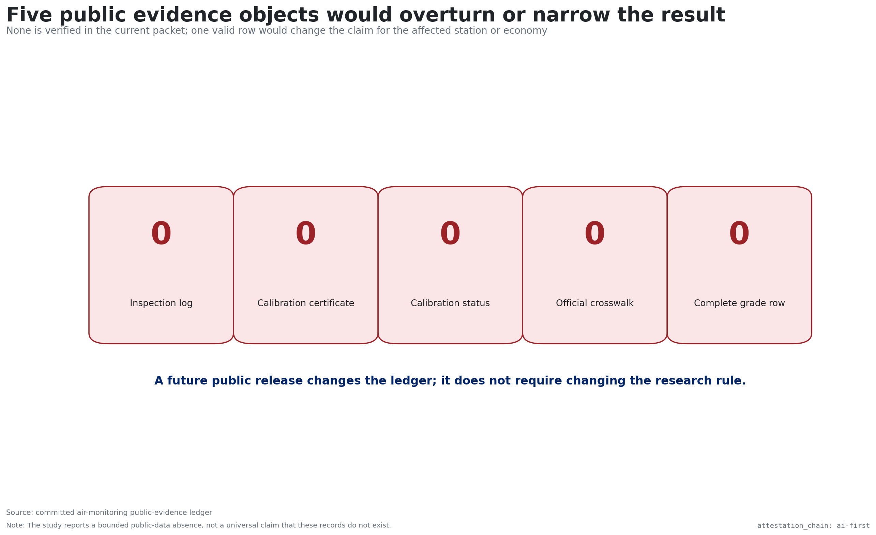
Five public evidence objects would change the result

Slide 10
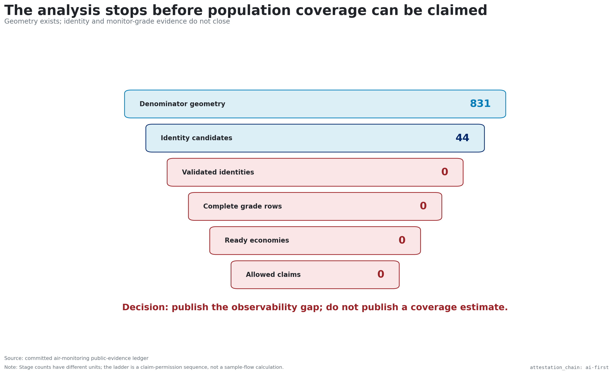
Decision: publish the gap and withhold coverage

