Slide 1
Trade volume did not predict observed port delay
A direct CPPI construct test for an inherited national logistics screen

Slide 2
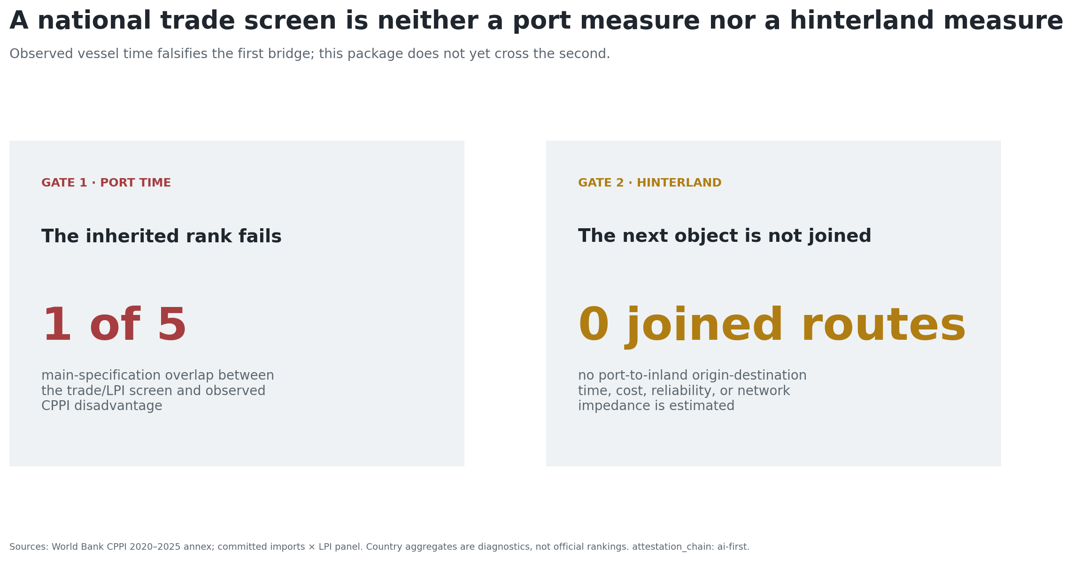
The national screen fails at the port boundary
Can imports × perceived national logistics performance stand in for observed port-hinterland friction?
Finding: only 1 of 5 inherited top-five members remains in the main CPPI port-time diagnostic.

Slide 3
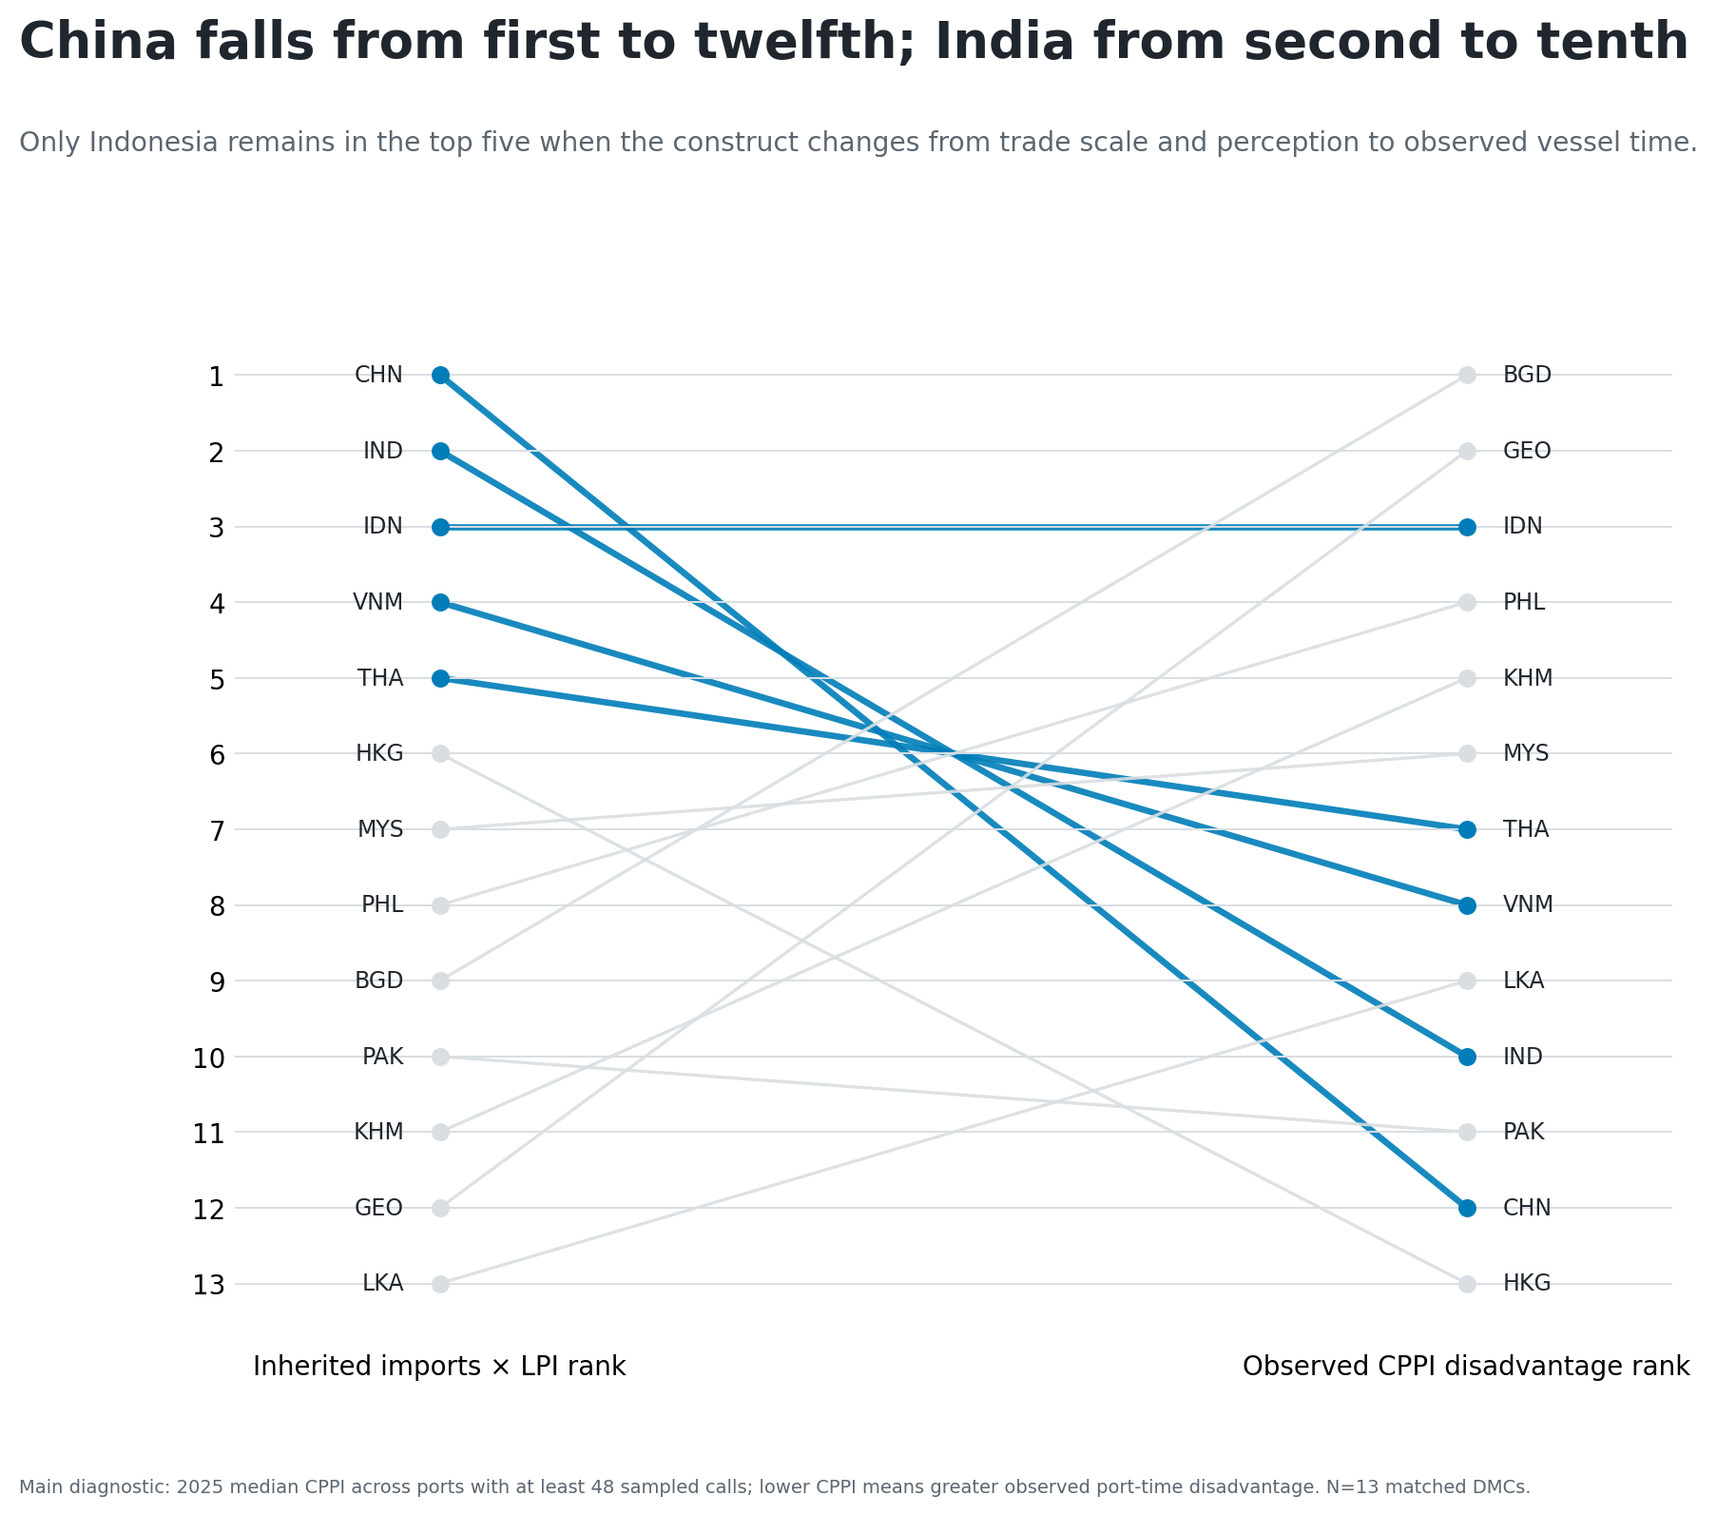
China and India fall sharply in the direct test
China moves from inherited rank 1 to observed-disadvantage rank 12; India from 2 to 10.

Slide 4
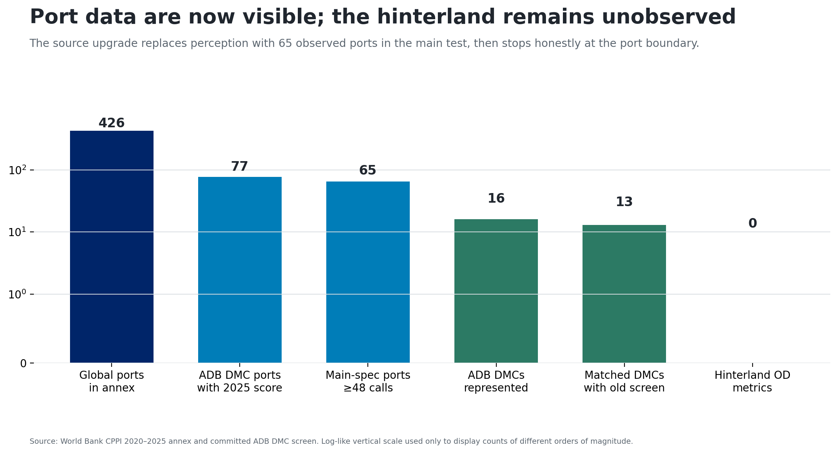
The common sample contains 65 observed ports
World Bank CPPI 2025 annex: 426 ports.
ADB developing member economies with 2025 scores: 16.
Main common diagnostic: 65 ports in 13 economies.

Slide 5
The test varies the observed-data choices
Keep 2025 ports with at least 48 sampled calls.
Take the country median CPPI as a diagnostic.
Compare top-five membership with the inherited screen.
Vary year, call threshold, and aggregation.
Bootstrap rank correlations with 2,000 deterministic draws.

Slide 6
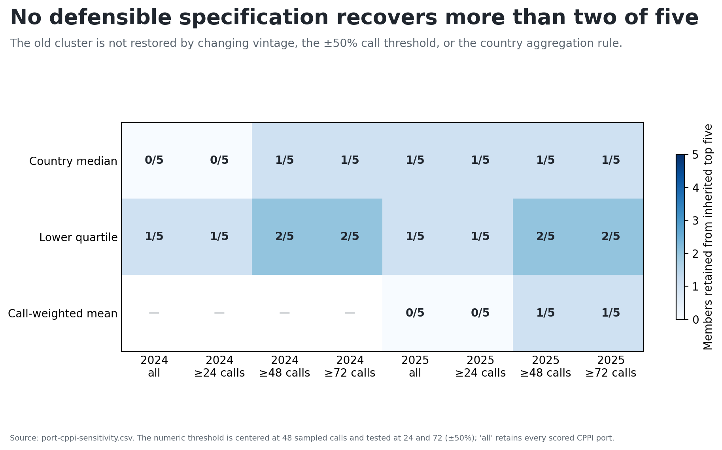
No specification recovers more than two of five
Top-five overlap ranges from zero to two. Four variants have zero overlap.

Slide 7
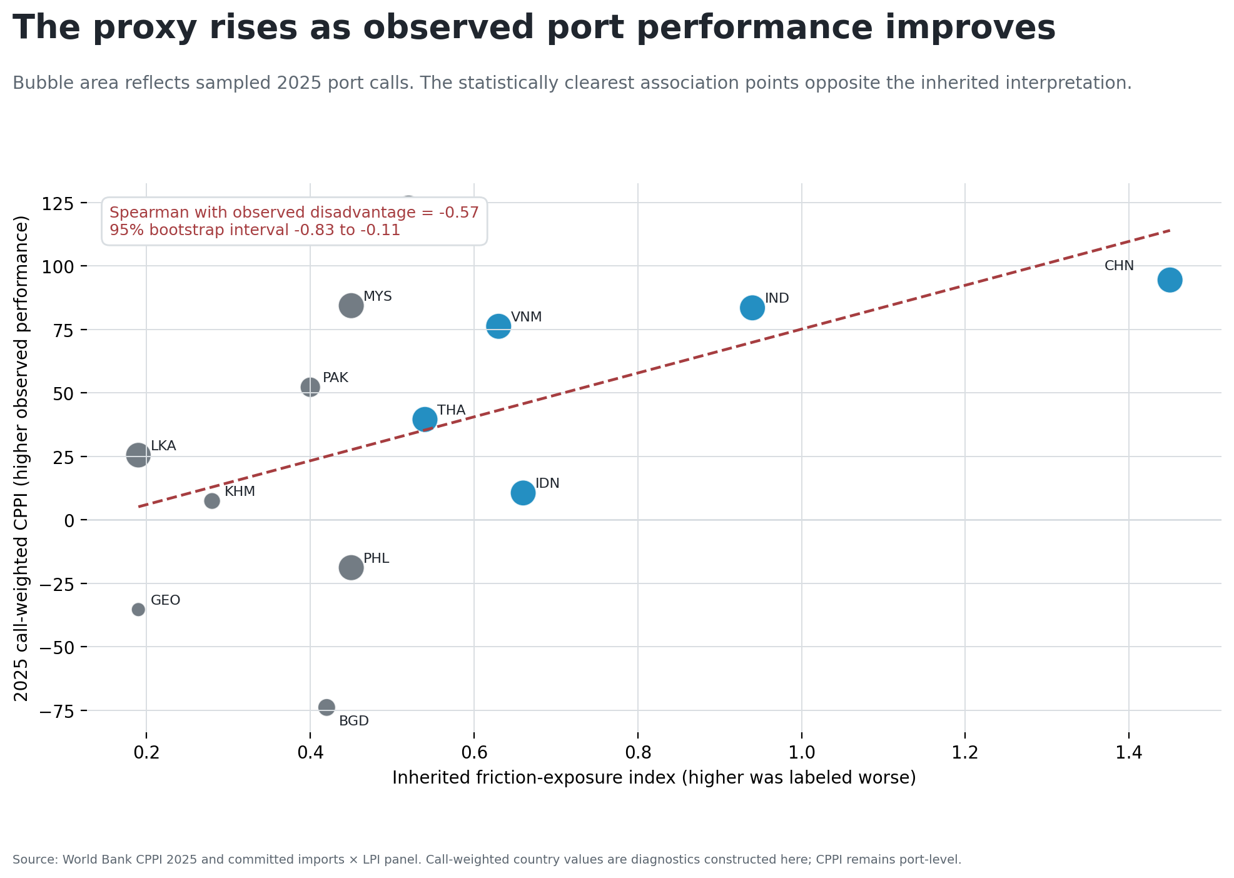
The strongest association points the other way
Call-weighted Spearman association: −0.57
95% bootstrap interval: −0.83 to −0.11

Slide 8
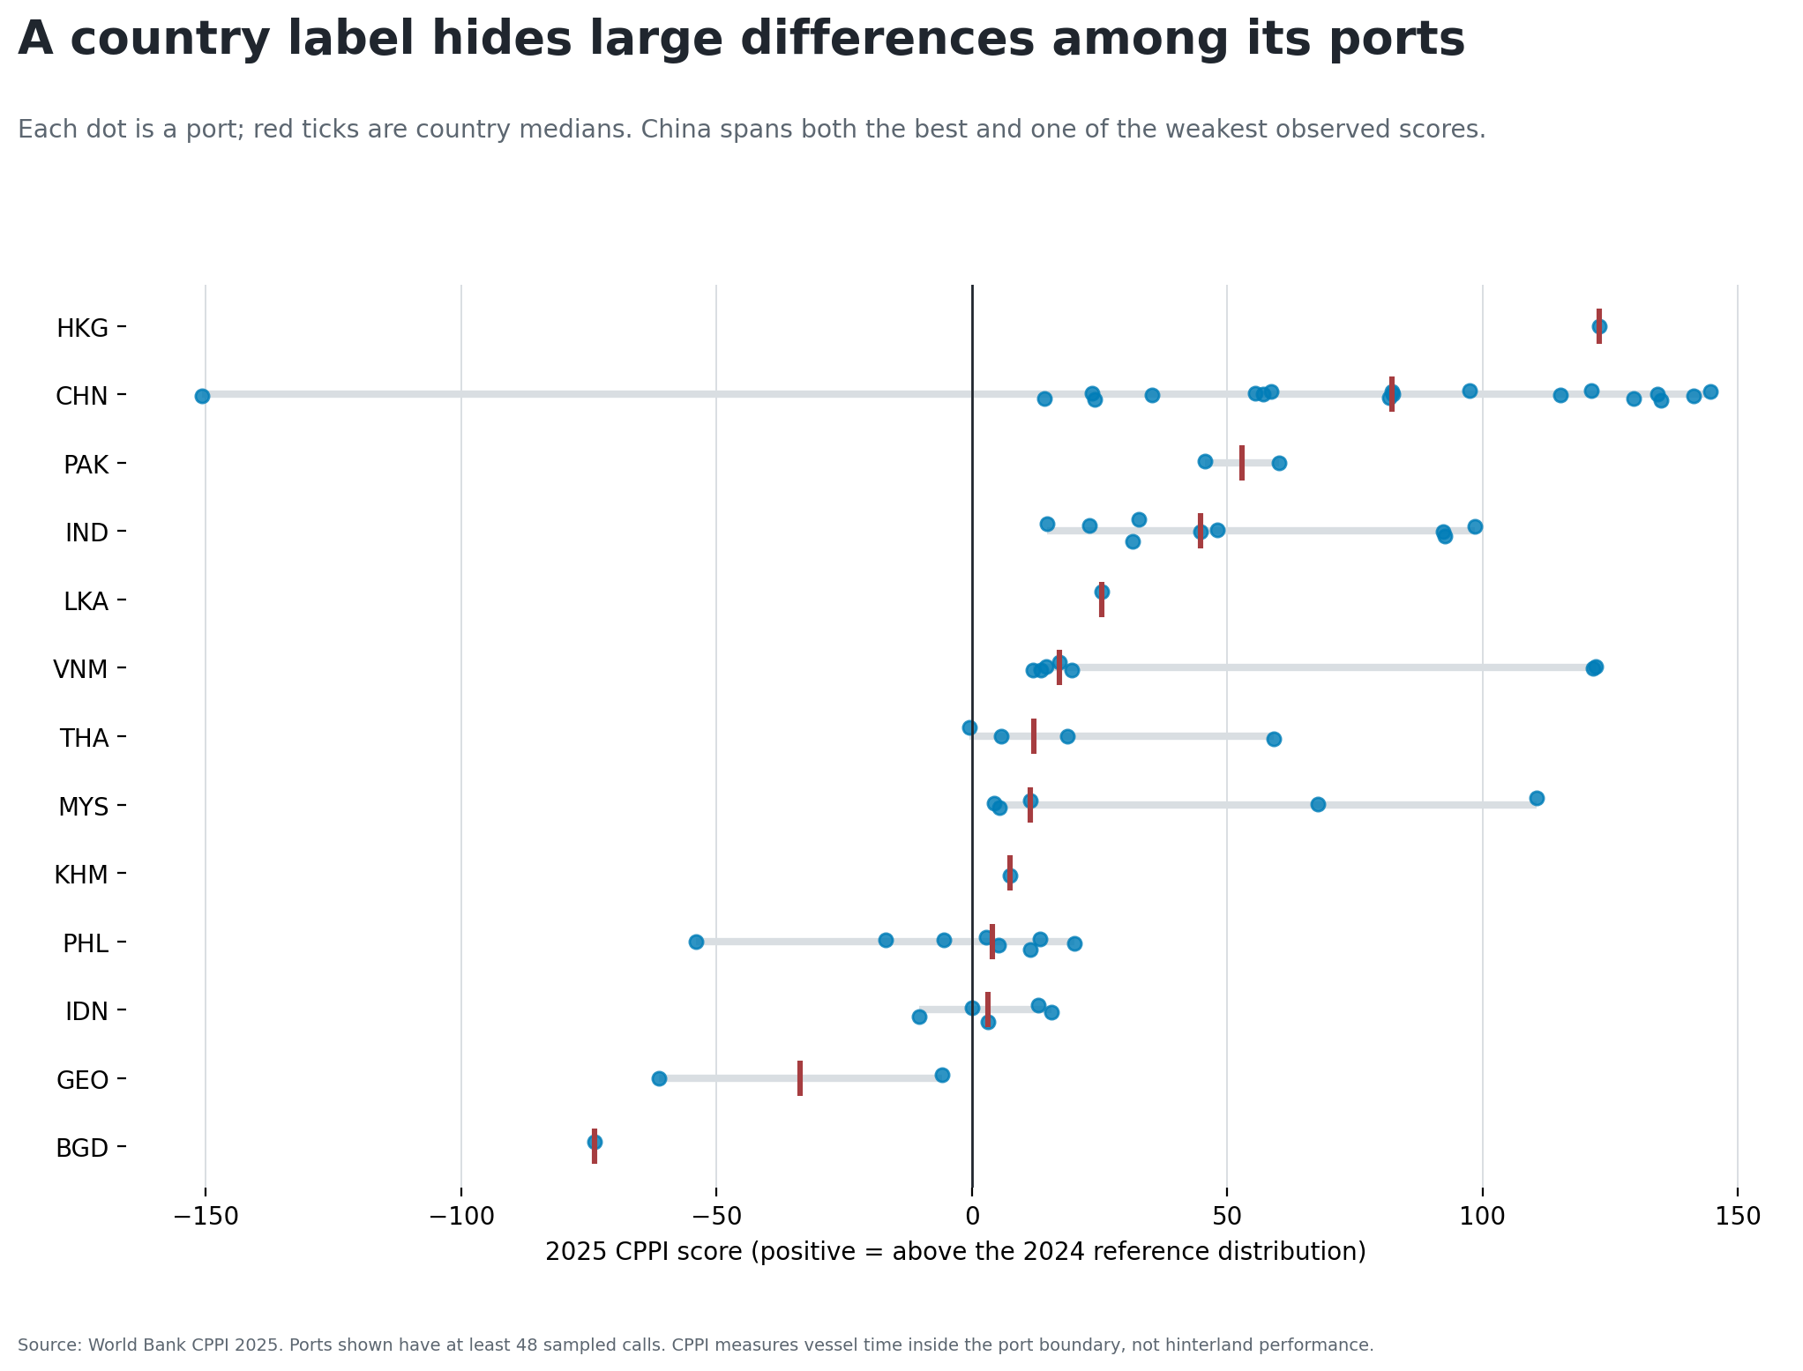
Country summaries hide operating differences
A national trade or survey score cannot identify which port is the operating bottleneck.

Slide 9
Retire the proxy; keep the evidence boundary
Use: retire the inherited proxy; use CPPI for port-boundary diagnostics.
Do not claim: an official economy ranking, corridor delay, customs performance, inland reliability, logistics cost, or causal effects.

Slide 10
The next valid upgrade is shipment-level
Join the official World Bank LPI 2.0 shipment file to the CPPI port layer. Preserve route, vintage, sample, and coverage limits.
The interactive file is currently access-blocked; do not substitute another national proxy.
AI-first prepared pipeline; not externally reviewed.

