Slide 1
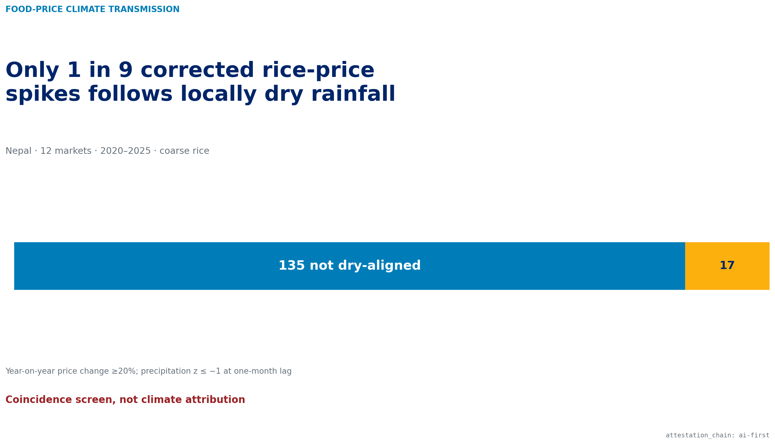
NEPAL MARKET-MONTH CONSTRUCT VALIDATION
Only one in nine corrected rice-price spikes followed locally dry rainfall
The annual DMC qualifier is retired. The remaining result is a coincidence screen—not climate attribution.
Raymond Adofina · Asian Development Bank
AI-first §18 · PP · 19 July 2026
WFP Nepal market prices · NASA POWER monthly rainfall · World Bank CPI context
01

Slide 2
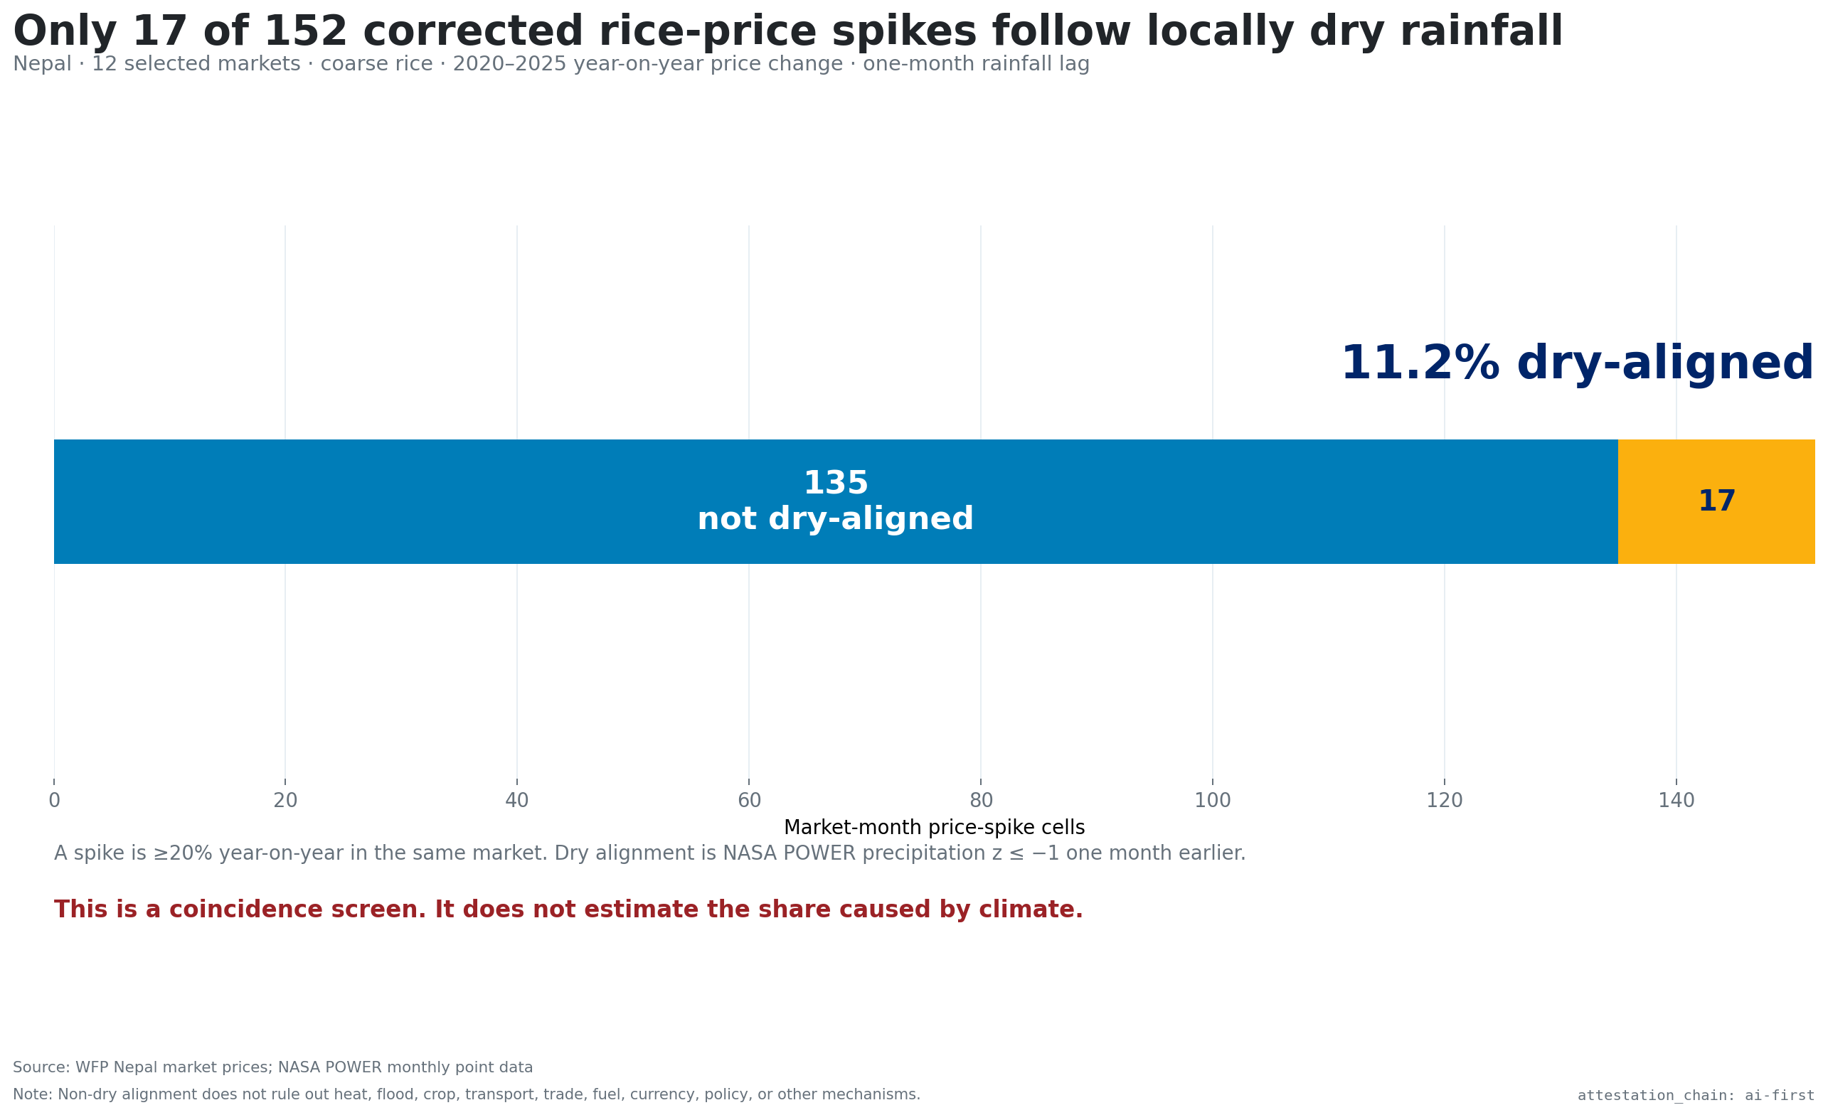
Most rice-price spikes do not follow local dryness
17 / 152
spike cells are dry-aligned at one month
The other 135 corrected spike cells are not. This is a threshold coincidence share, not a causal contribution.
WFP coarse-rice retail prices · NASA POWER point rainfall · 12 Nepal markets
02

Slide 3
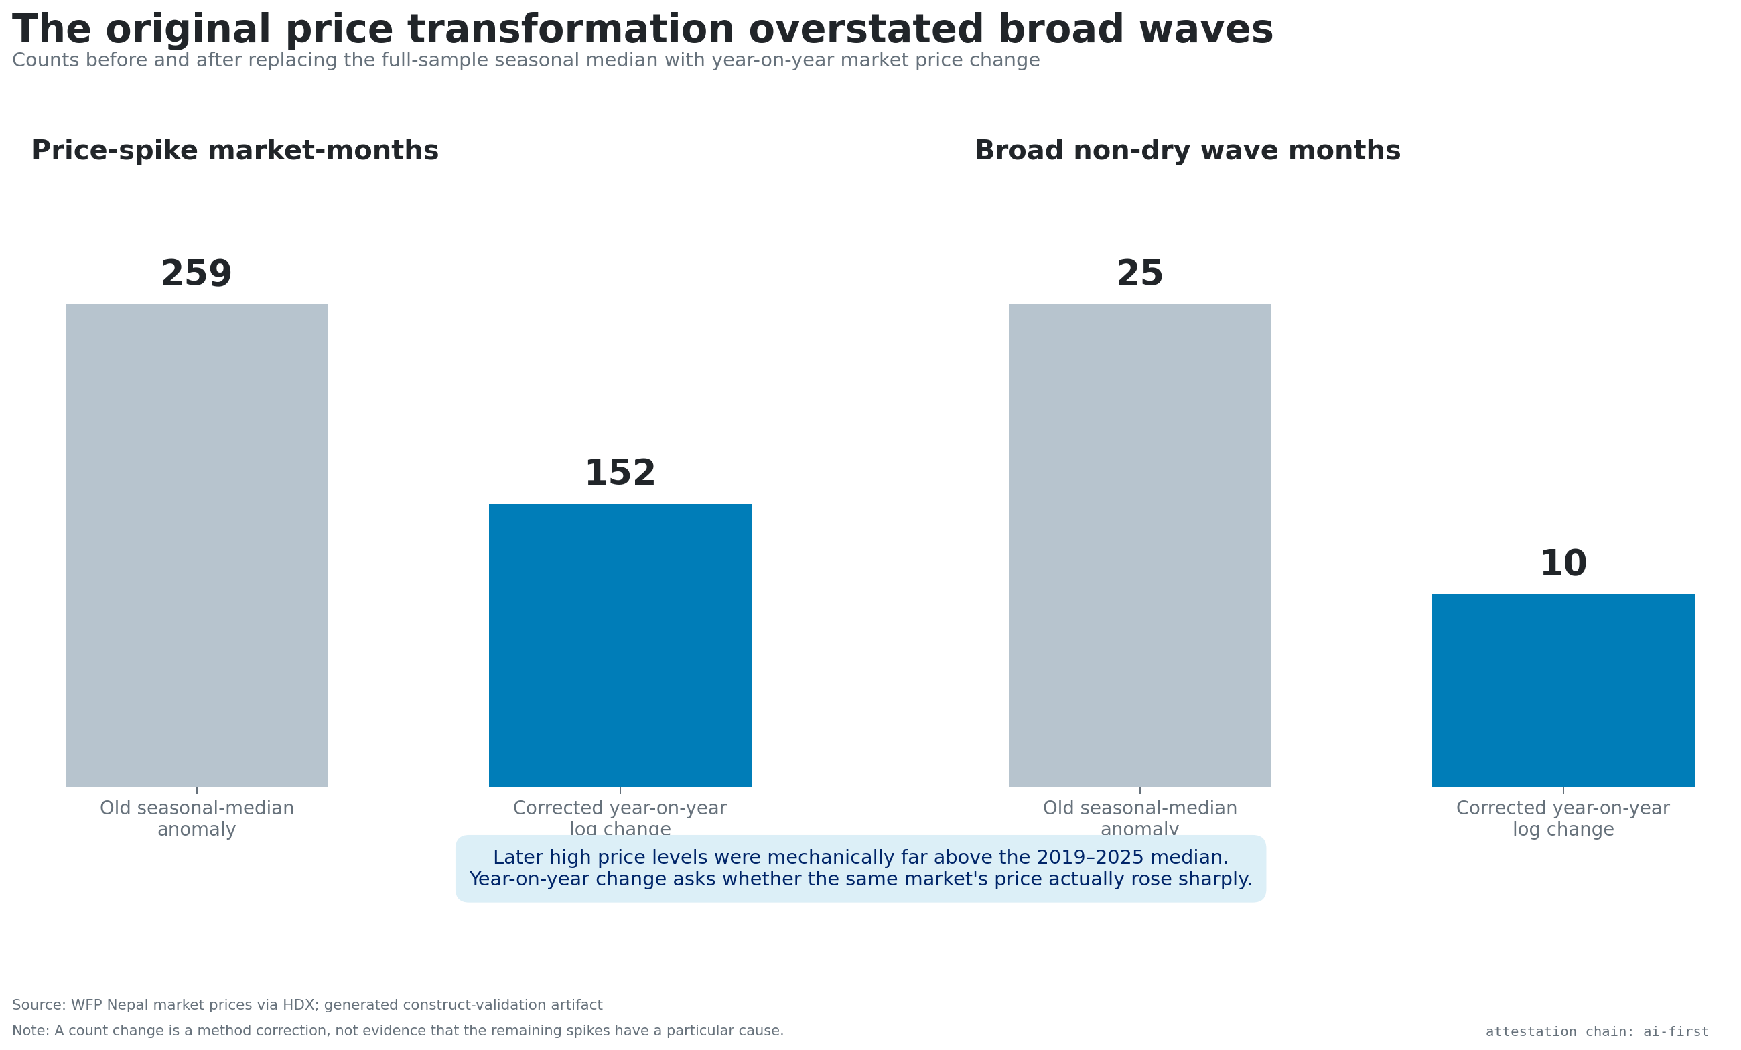
The old outcome inflated the apparent wave
259 → 152
spike cells after correcting the price outcome
Year-on-year change replaces distance to the full-sample calendar-month median, which mechanically flagged later high price levels.
Committed construct-validation pipeline · 2019–2025 WFP price panel
03

Slide 4
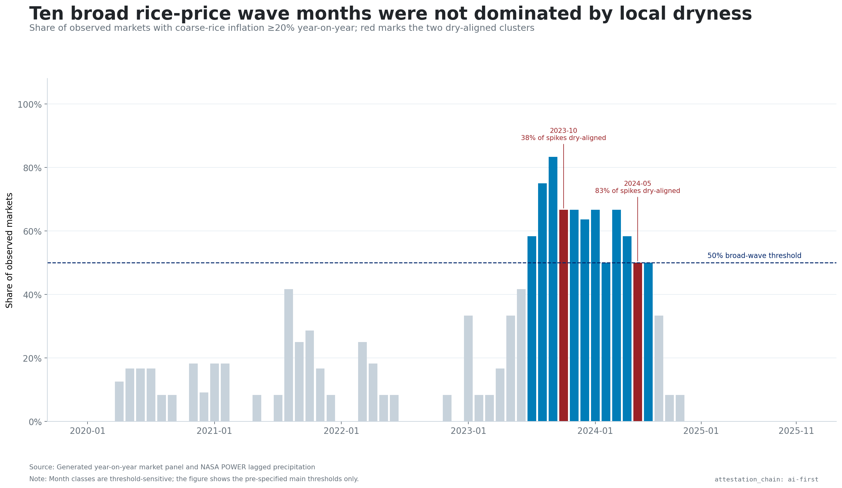
A broad 2023–2024 wave remains—but rarely looks locally dry
10 months
meet the main broad non-dry wave definition
The count is descriptive and threshold-sensitive. The pattern motivates investigation of common or connected price drivers.
Main thresholds: ≥20% YoY · ≥50% of observed markets · dry share ≤34%
04

Slide 5
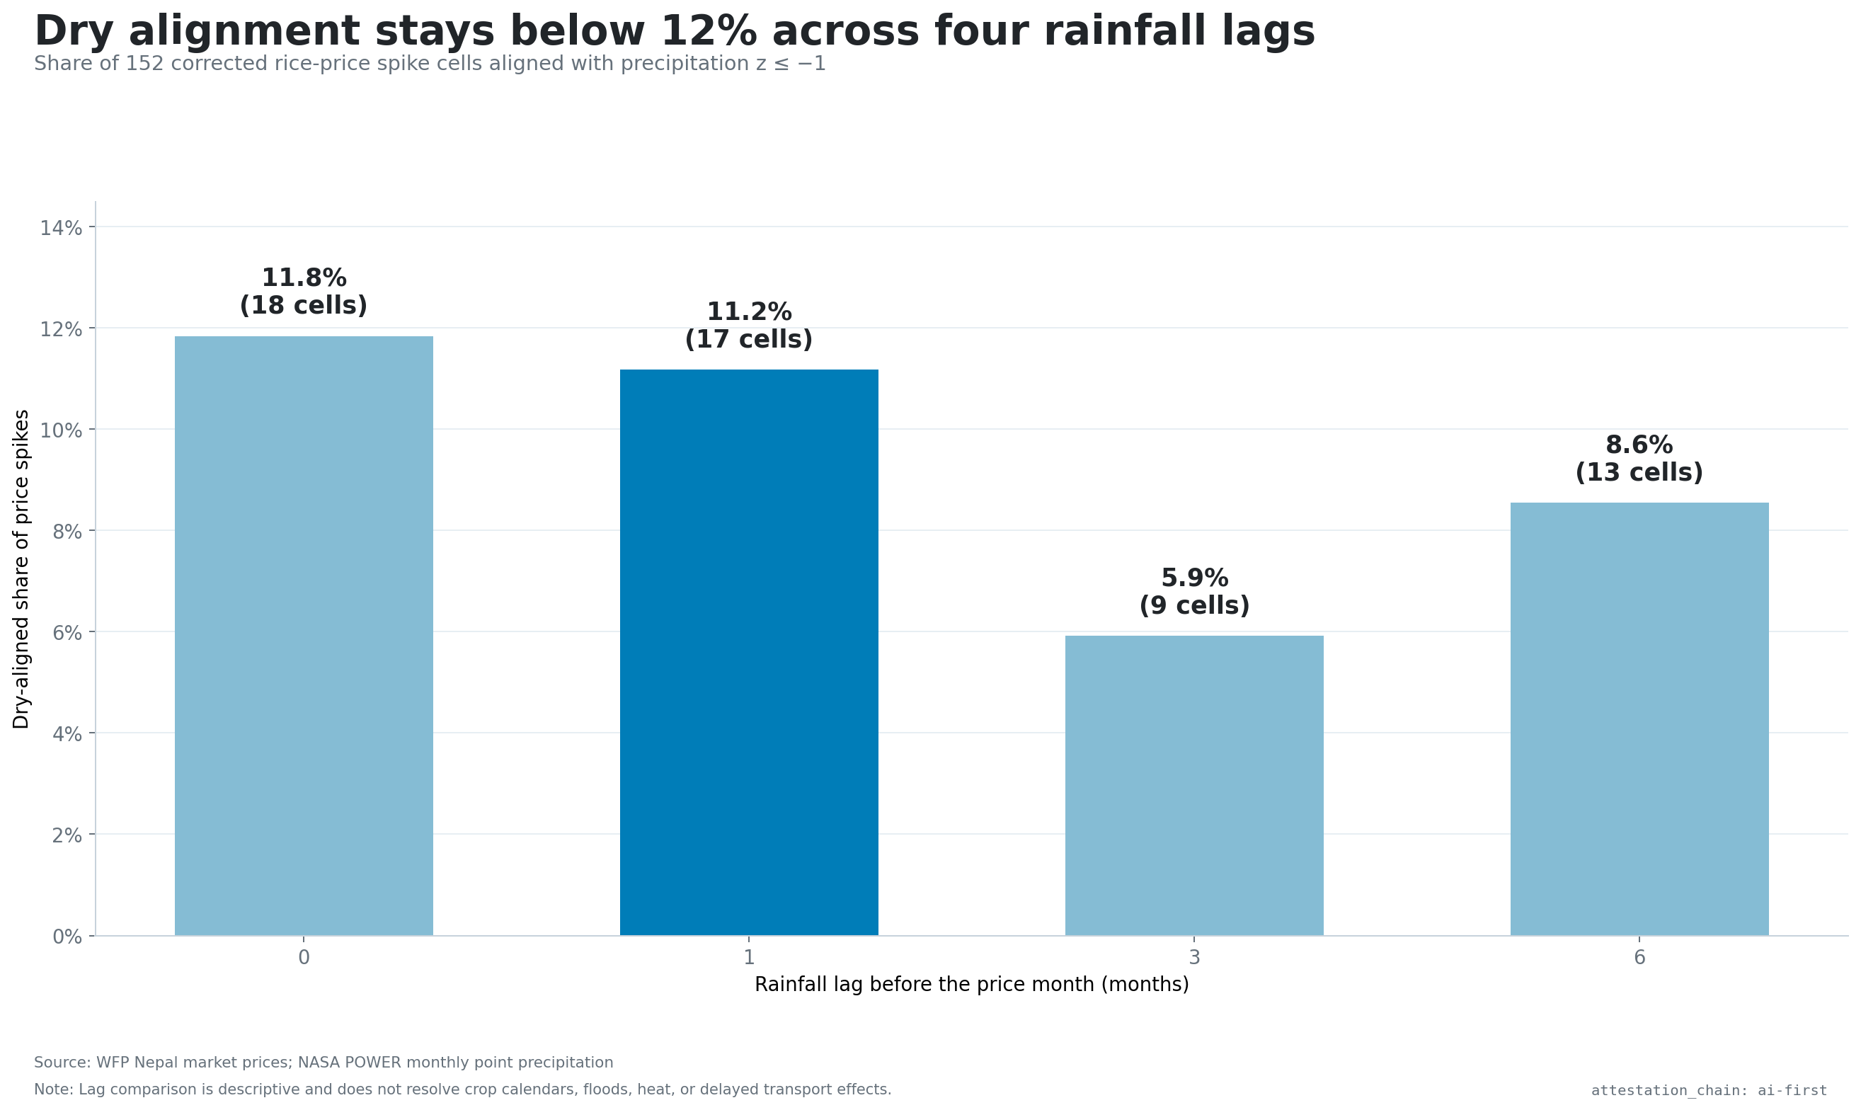
No tested rainfall lag makes dryness the dominant pattern
5.9–11.8%
dry-aligned share across 0-, 1-, 3-, and 6-month lags
Timing choices change the share modestly, but none turns local dryness into the common near-term signature.
Same 152 corrected price-spike cells · NASA POWER monthly point rainfall
05

Slide 6
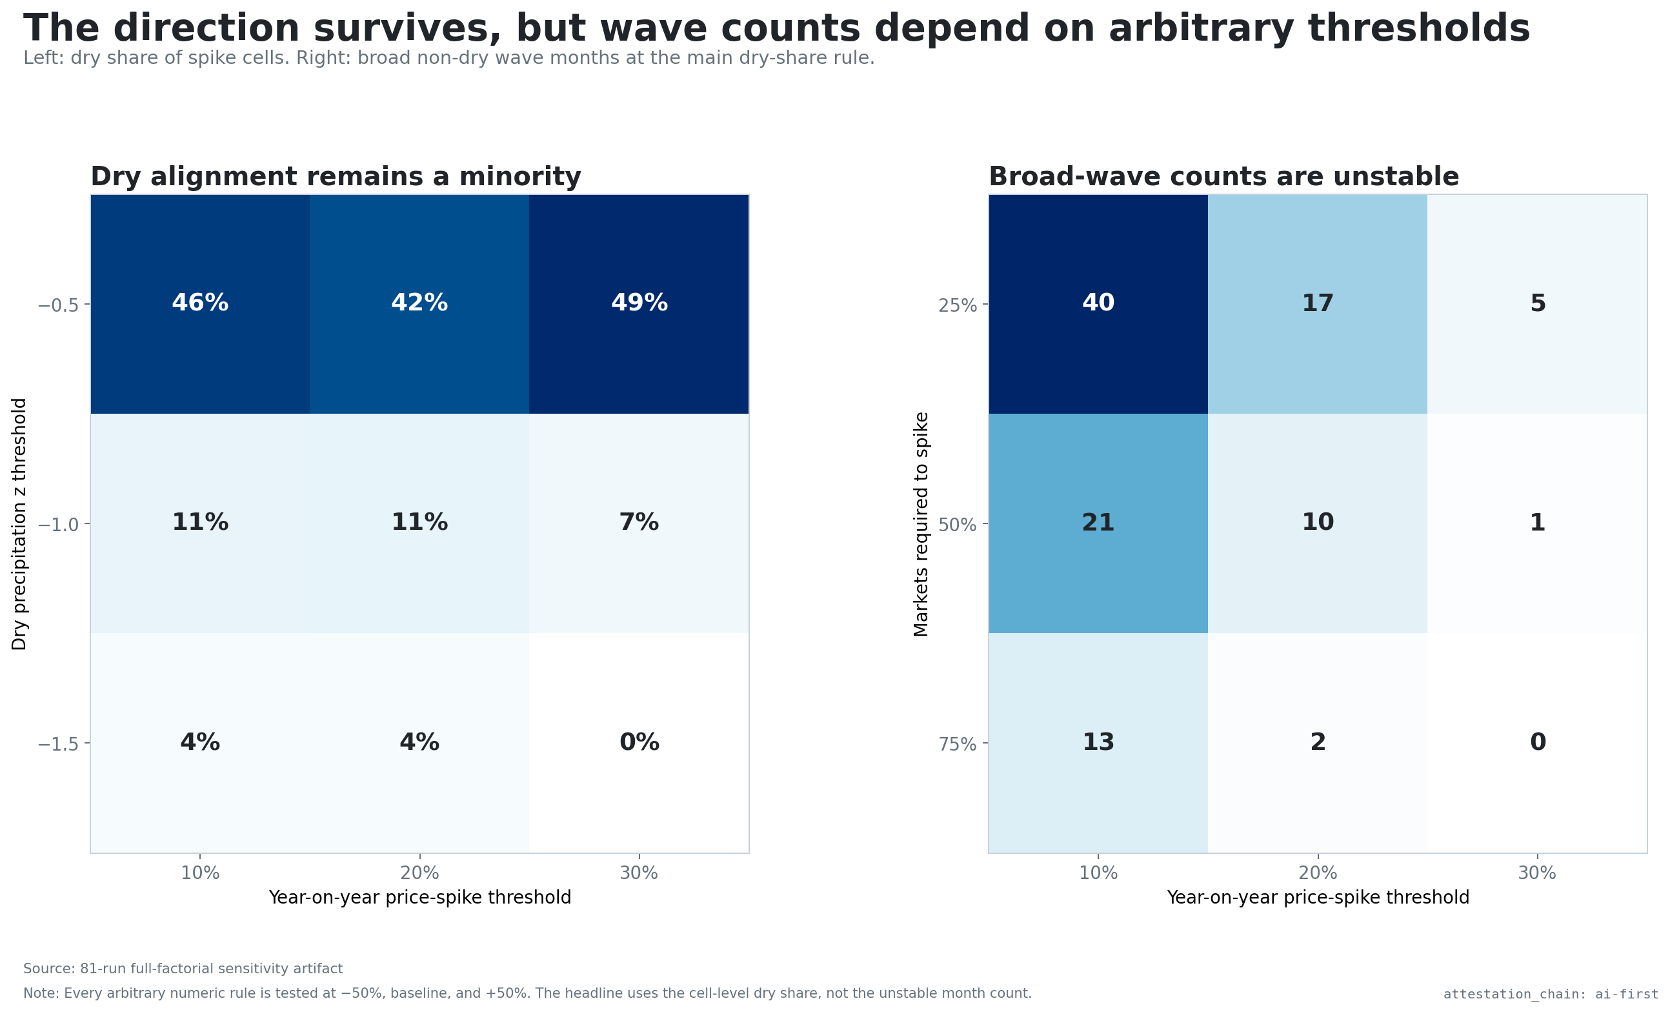
The minority direction survives all 81 threshold runs
0–48.8%
dry share across the full ±50% factorial
Direction survives. Counts do not: broad-wave months range 0–44 and dry clusters 0–27, so neither count earns the headline.
3×3×3×3 sensitivity: price, dryness, breadth, and dry-share thresholds
06

Slide 7
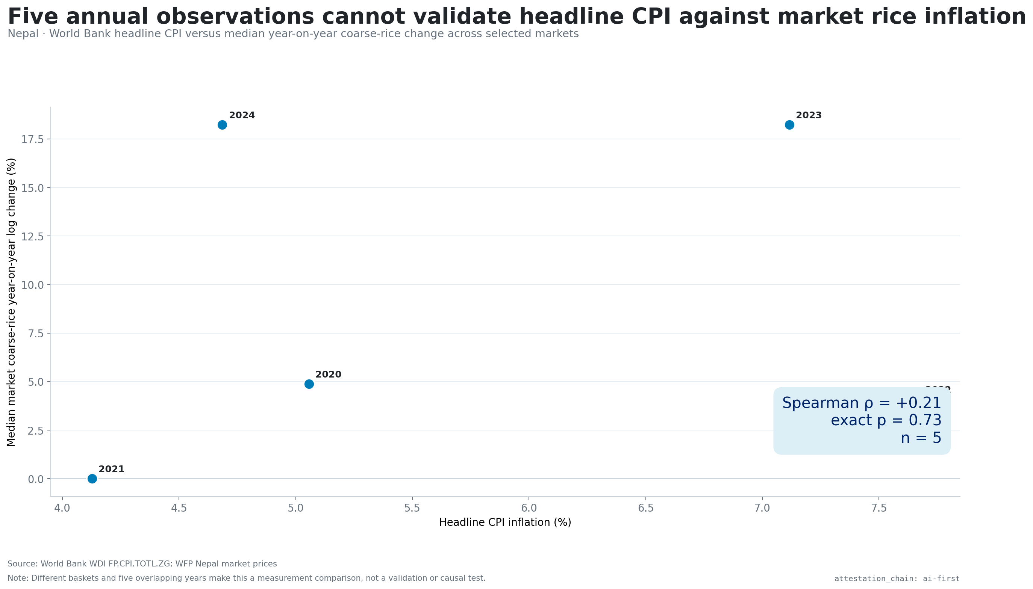
Five annual observations cannot validate the market result
ρ = +0.21
headline CPI vs median market rice-price change
Exact permutation p=0.73. More importantly, national CPI and selected market coarse-rice prices are different baskets and units.
World Bank WDI headline CPI · WFP market rice prices · 2020–2024
07

Slide 8
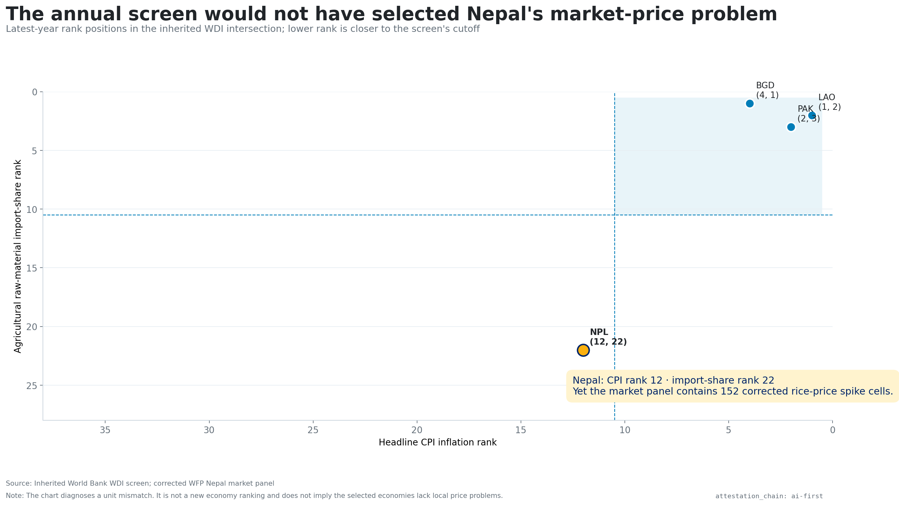
The inherited annual screen would not even select Nepal
#12 / #22
Nepal CPI and raw-ag import ranks
The annual intersection ranks macro indicators, not commodity-market mechanisms. Its stable LAO–PAK set is retired as the program finding.
World Bank WDI latest headline CPI and agricultural raw-material import share
08

Slide 9
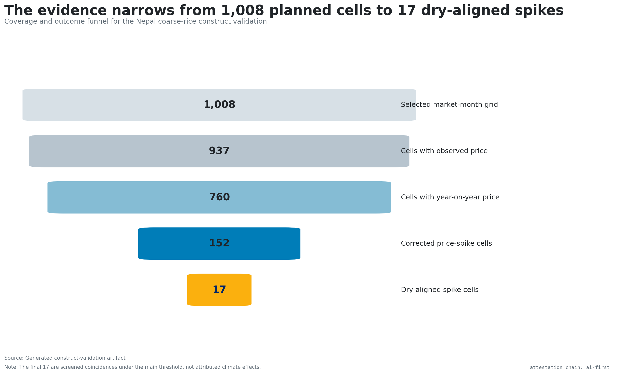
The usable evidence narrows to 760 aligned market-month cells
760
cells with year-on-year price and main-lag rainfall
The object is complete enough for a descriptive alignment test, but covers only coarse rice in 12 selected Nepal markets.
WFP Nepal price and market resources · NASA POWER monthly point API
09

Slide 10
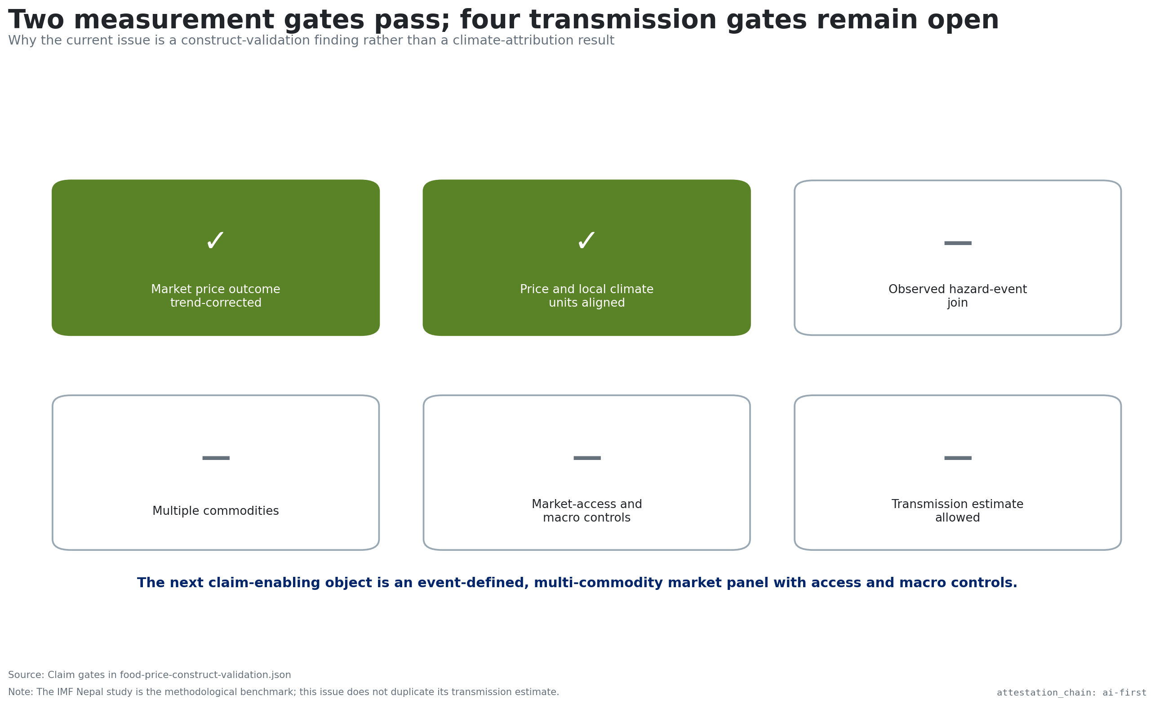
Alignment gates pass; attribution gates remain closed
4 gaps
block a climate-to-price effect claim
No recorded hazard event, multi-commodity result, market-access controls, or causal design is joined.
Claim gate defined before publication · attestation_chain: ai-first
10

Slide 11
DECISION
Retire the ranking. Investigate the wave.
The next claim-enabling object is an event-defined, multi-commodity market panel—not another country score.
01 Observe the event
02 Align the market
03 Estimate the response
Dated geocoded drought, flood, heat, or production shock
Commodity, sourcing zone, roads, fuel, trade, exchange rate, and policy
Pre-specified fixed effects, event study, or local projections
Replication boundary: Baptista, Spray & Unsal (2023), IMF Working Paper 2023/166
11

