Slide 1
Cambodia led the proxy—but ranked last in the observed heatwave subset
AI-first construct validation · §18 Raymond Adofina · Asian Development Bank

Slide 2
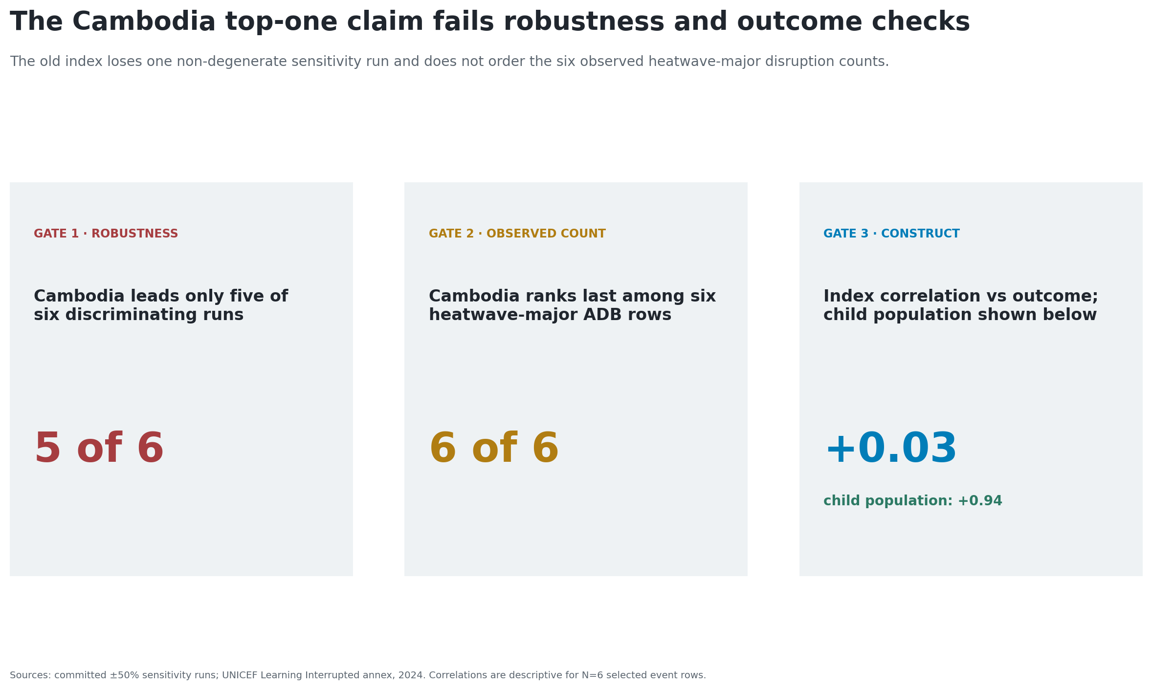
The inherited claim fails three validity gates

Slide 3
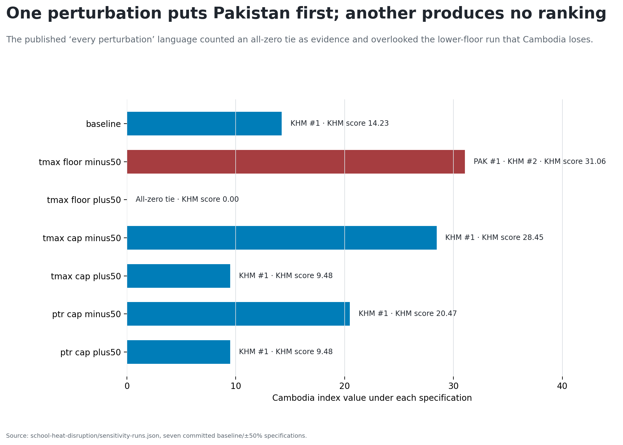
“First in every perturbation” is false

Slide 4
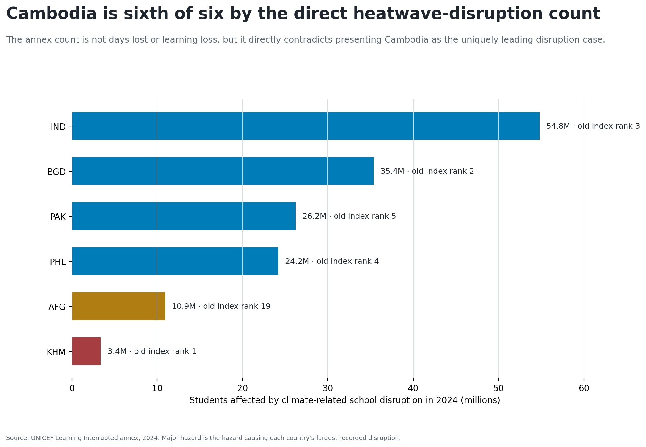
The observed outcome reverses the order

Slide 5
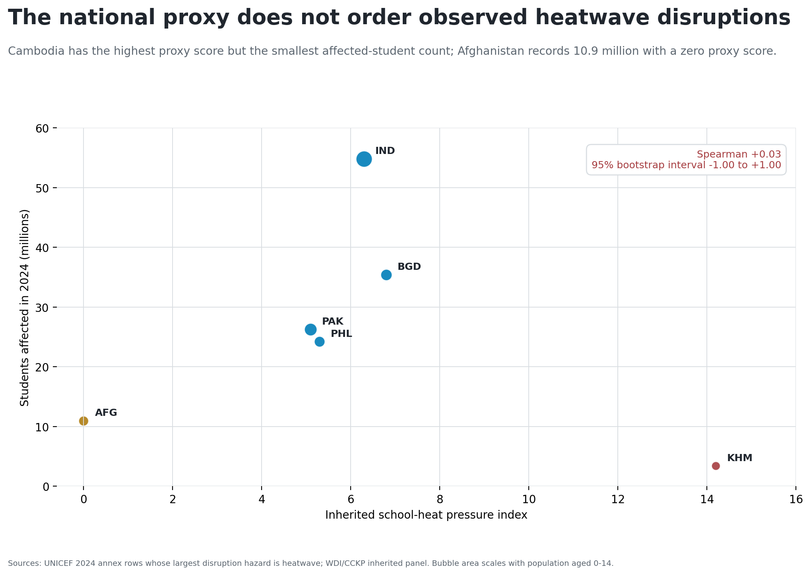
The proxy does not order the counts

Slide 6
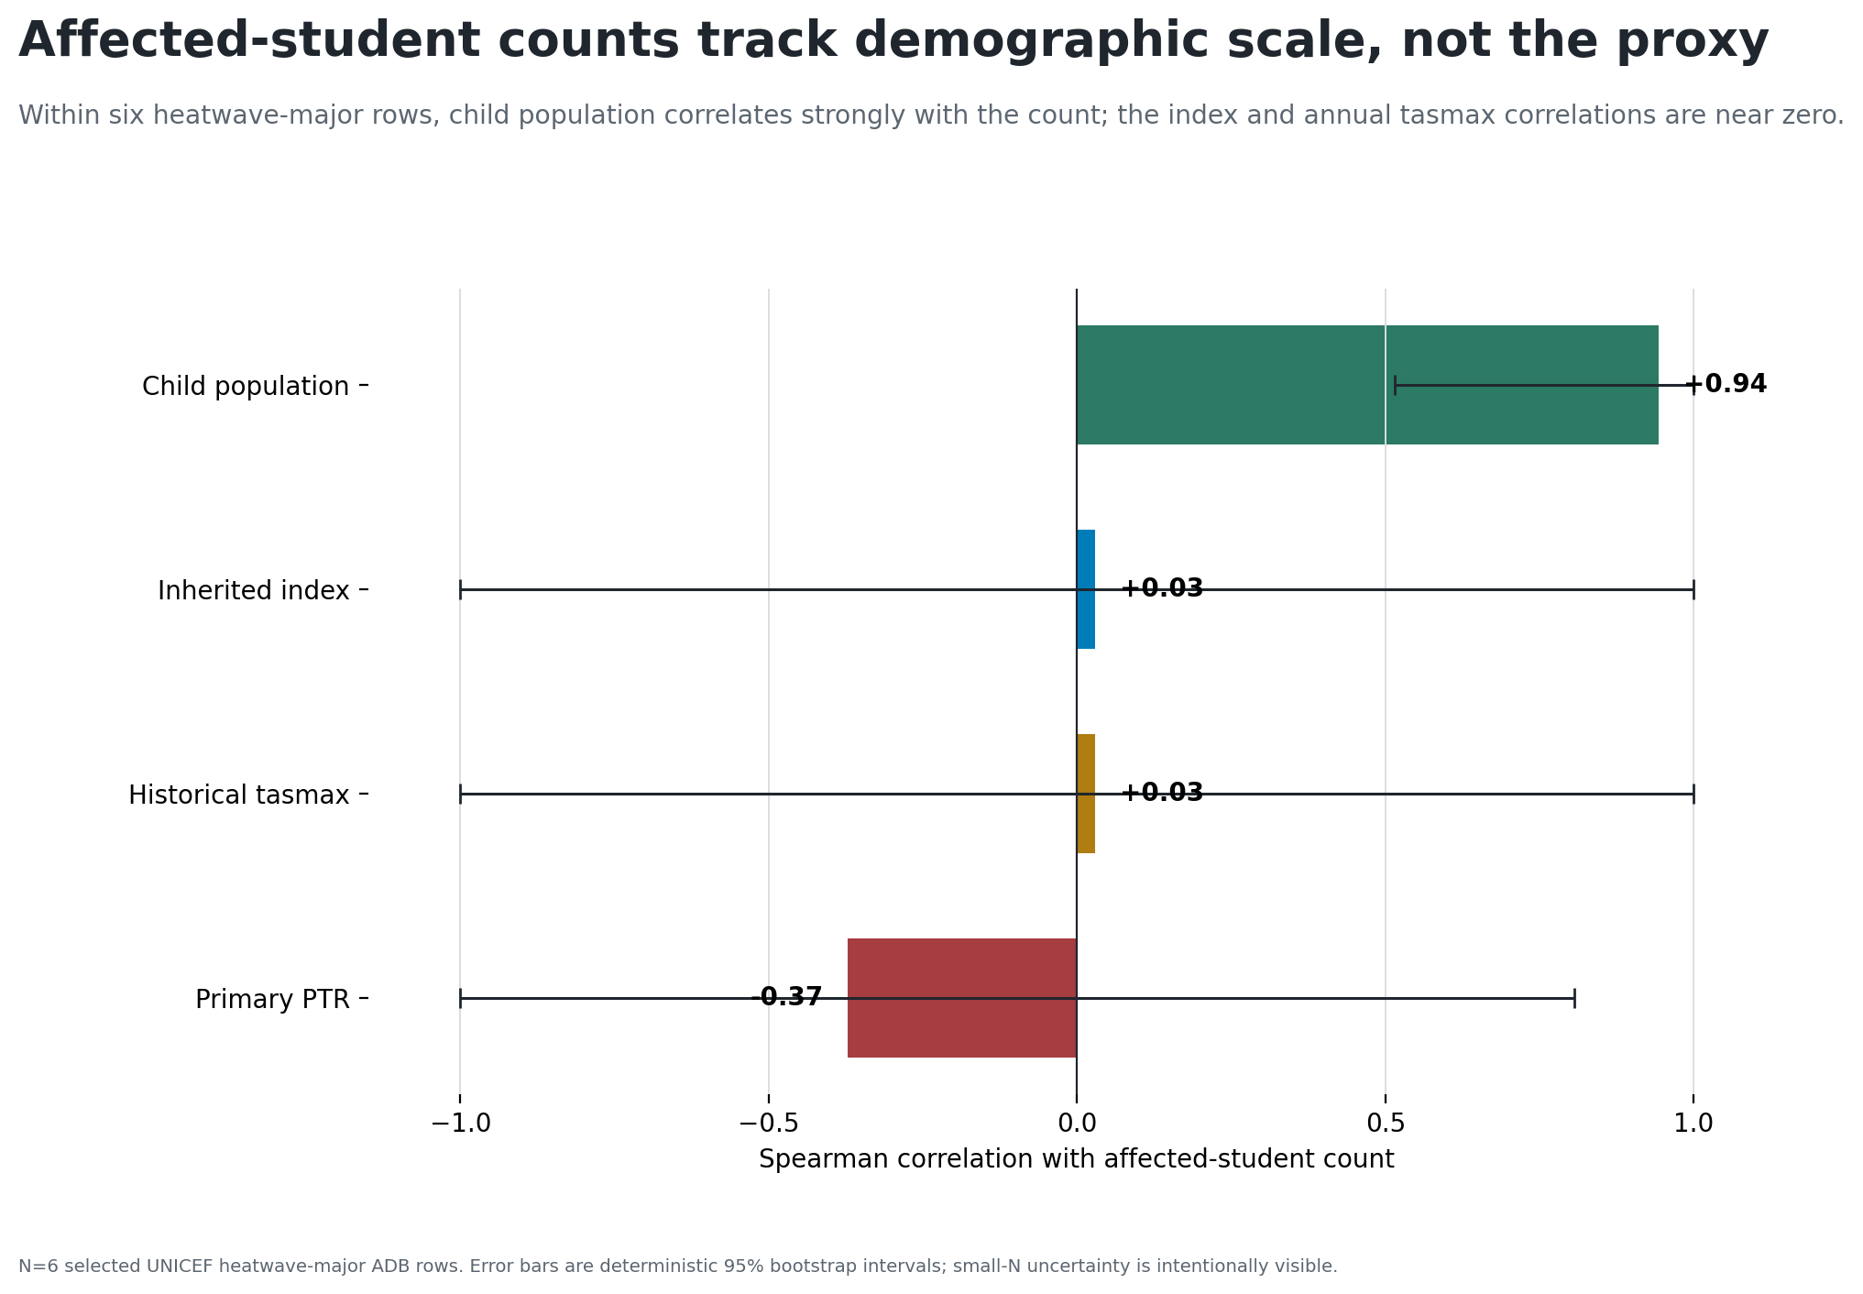
Child population carries the count order

Slide 7
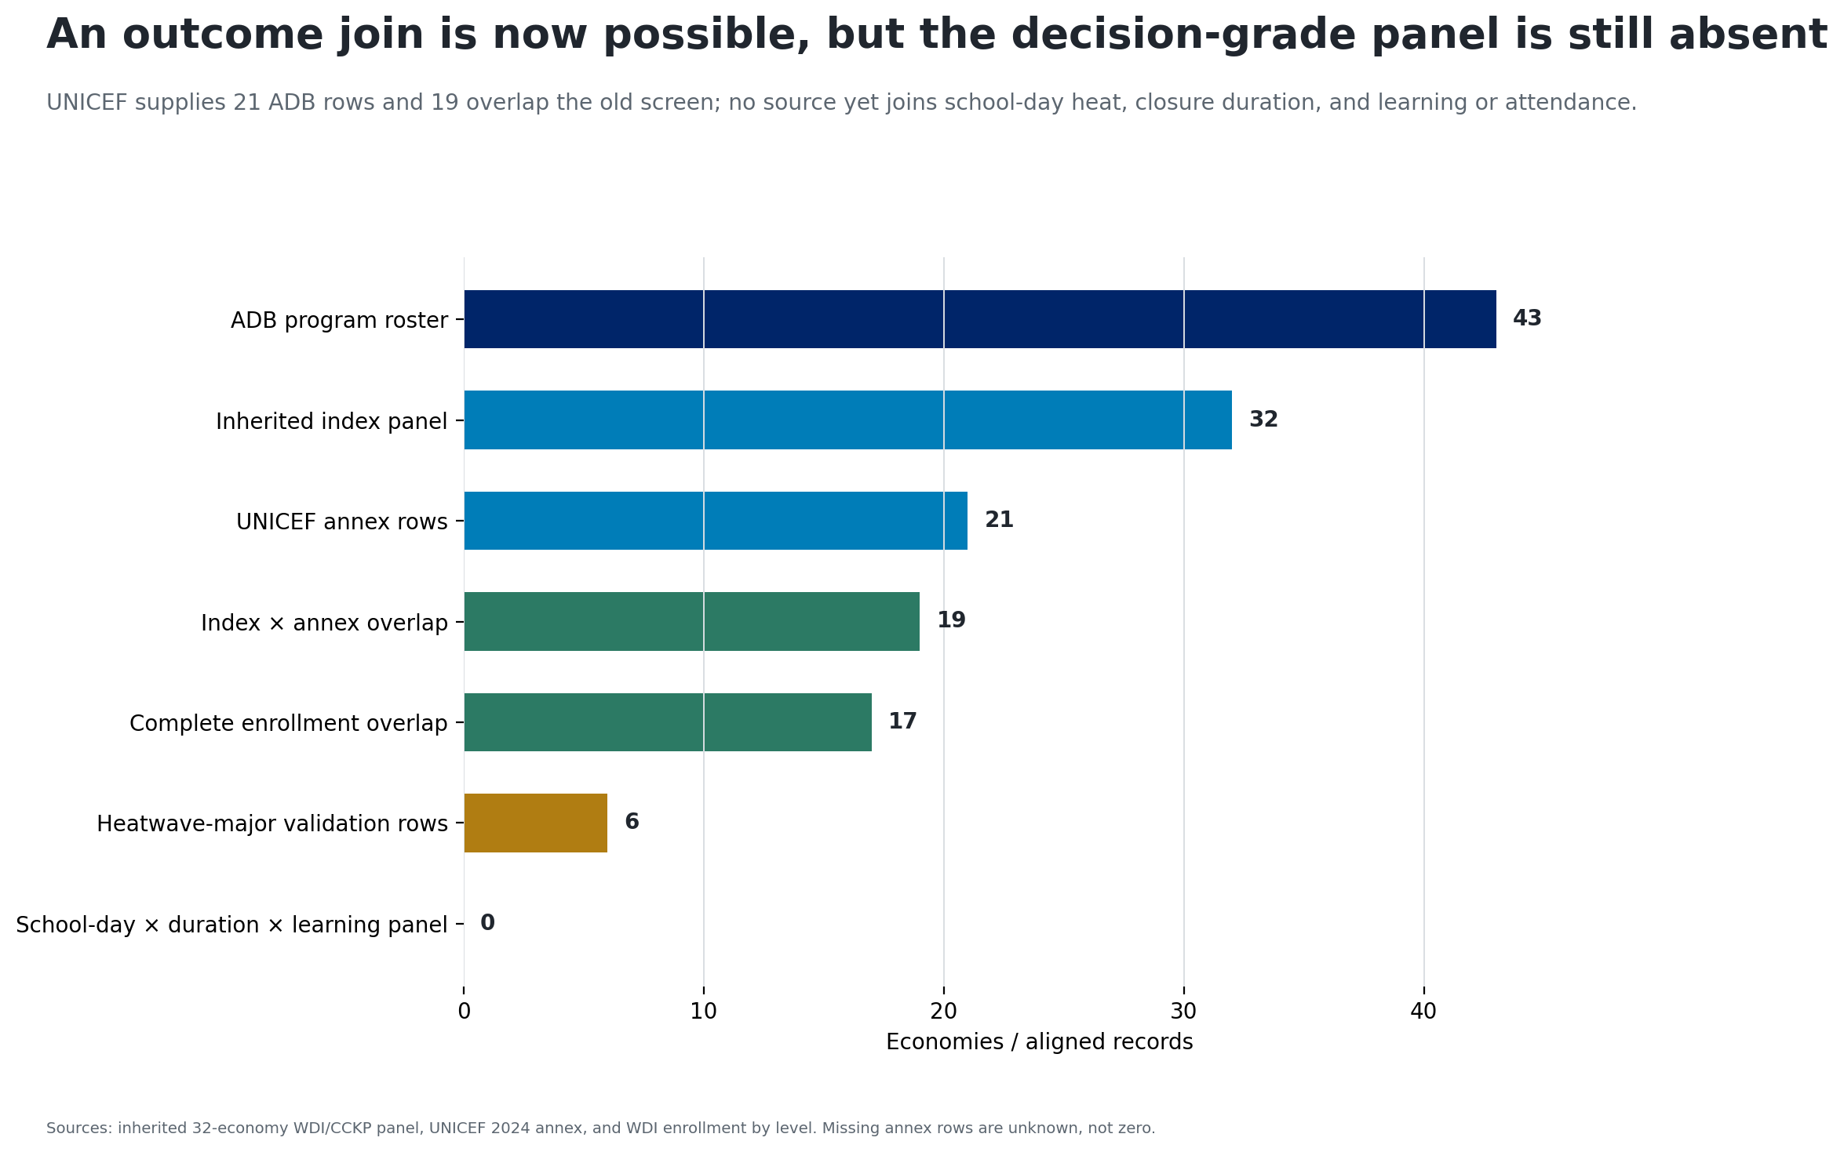
The direct source covers only part of the roster

Slide 8
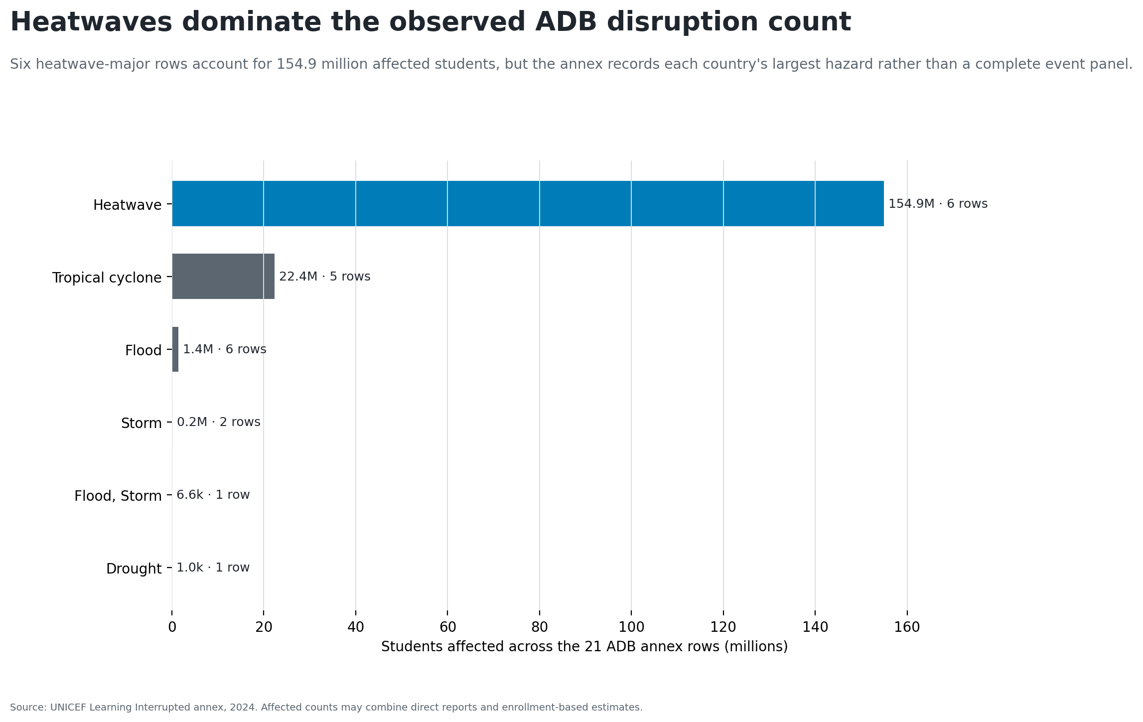
Heatwaves dominate the selected annex

Slide 9
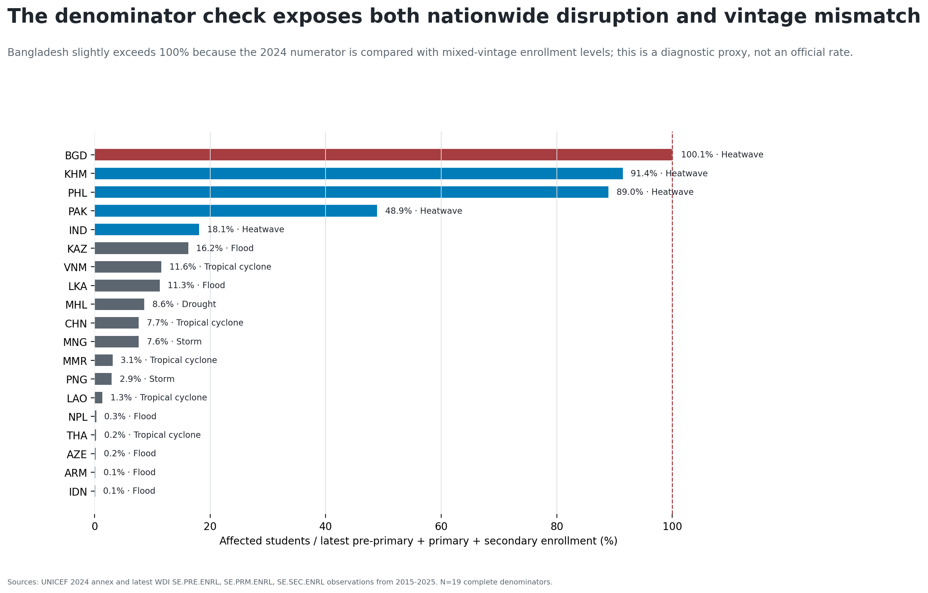
Enrollment ratios expose vintage mismatch

Slide 10
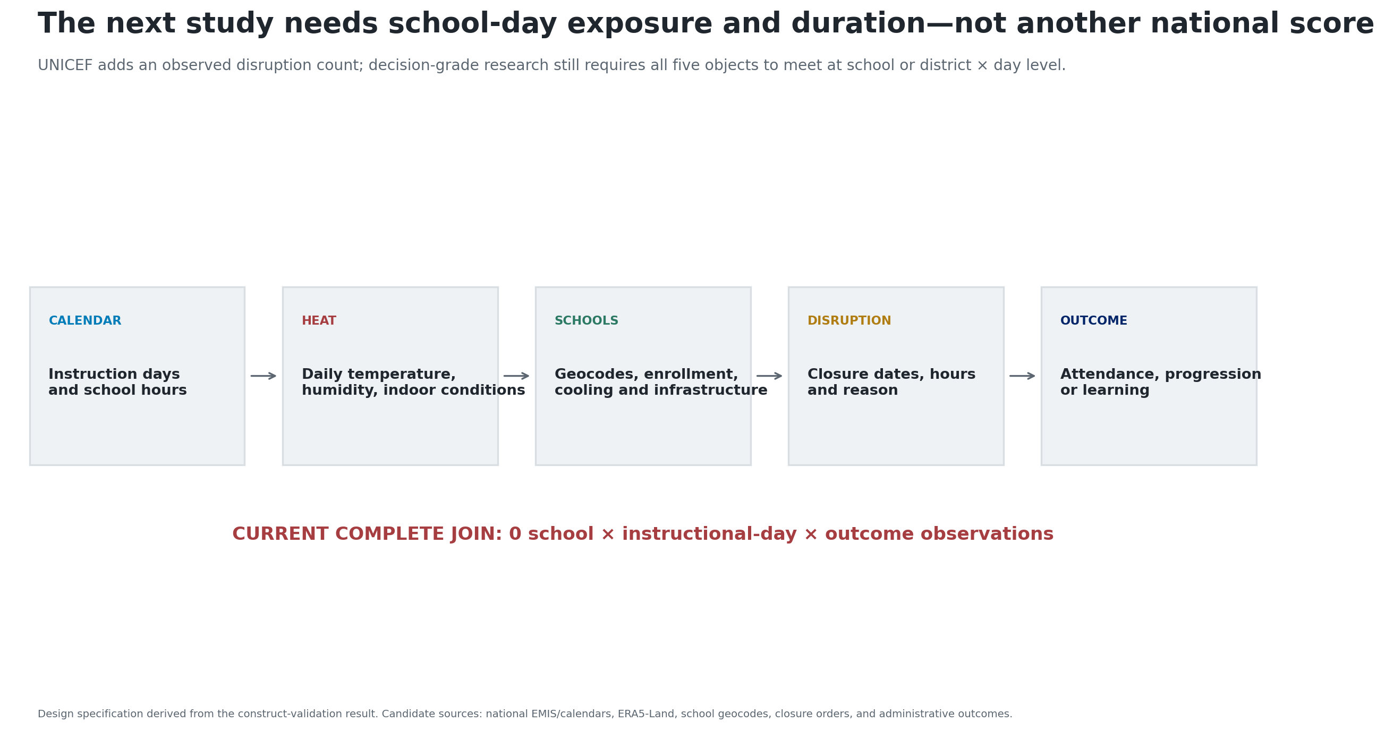
Retire the ranking; build the school-day object

