Slide 1
Before ranking access, check the facility map
Official registries reshape an eight-economy OSM screen — AI-first under §18 Raymond Adofina · Asian Development Bank

Slide 2
The question

Slide 3
Does an open facility map support a service-access rank?
The inherited pilot divides ADM1 population by OSM service points across eight ADB developing member economies.
Public and reproducible.
Useful for discovering possible data gaps.
But the map denominator may vary with mapping effort.
Test the denominator before extending the access story.
attestation_chain: ai-first; current maturity PP.

Slide 4
The main finding

Slide 5
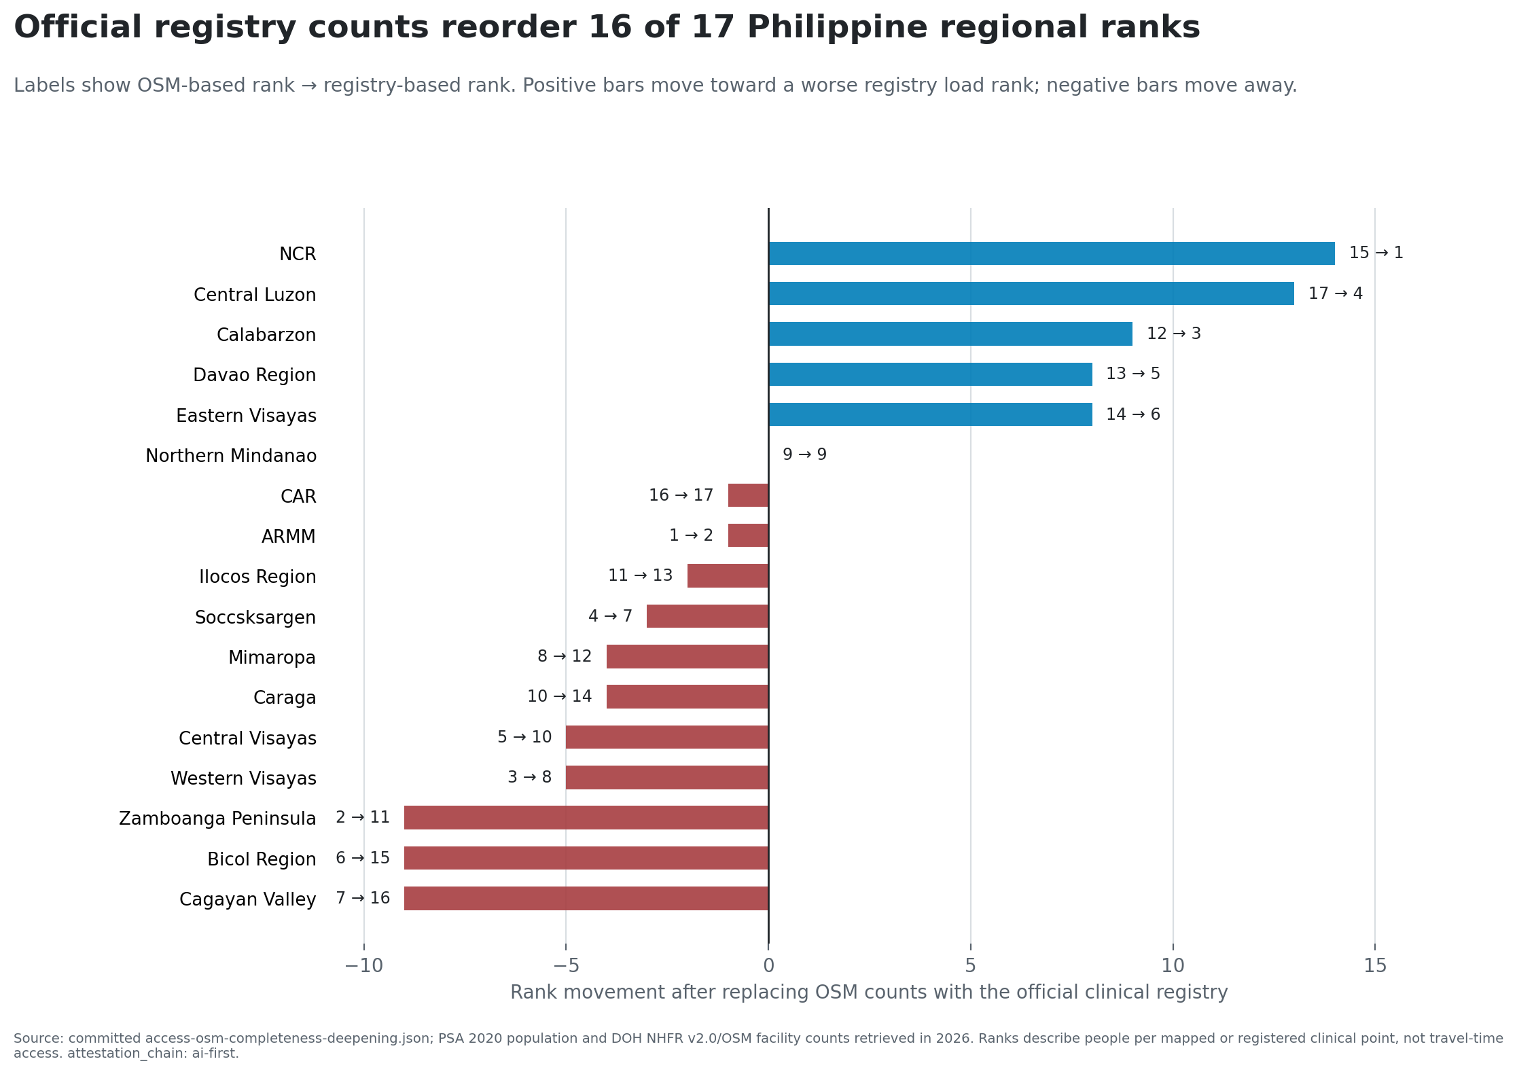
Official registry counts reorder 16 of 17 Philippine ranks
Diverging bars show Philippine rank movement after official clinical registry counts replace OSM health-point counts.

Slide 6
Why the rank changes

Slide 7
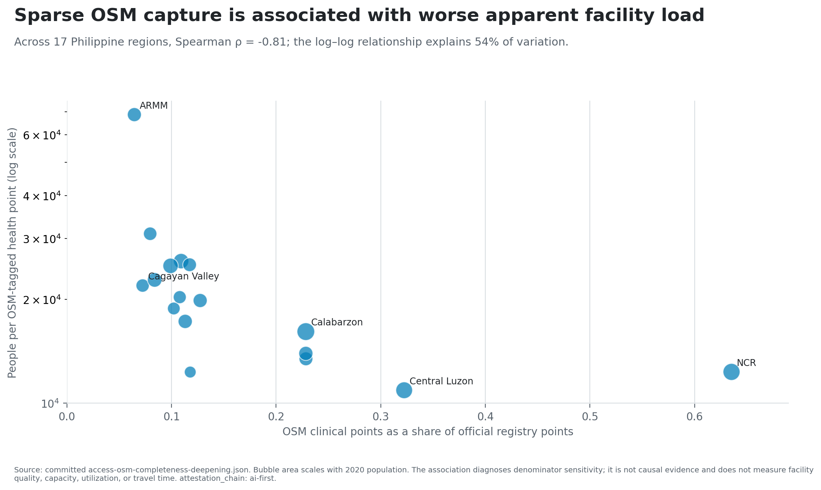
Map capture is associated with apparent facility load
OSM capture: 6.45% in ARMM to 63.53% in NCR.
Spearman rho with apparent OSM load: -0.81.
Descriptive source signal—not causal evidence.
Scatterplot of Philippine OSM clinical capture and people per OSM health point.

Slide 8
The eight-economy boundary

Slide 9
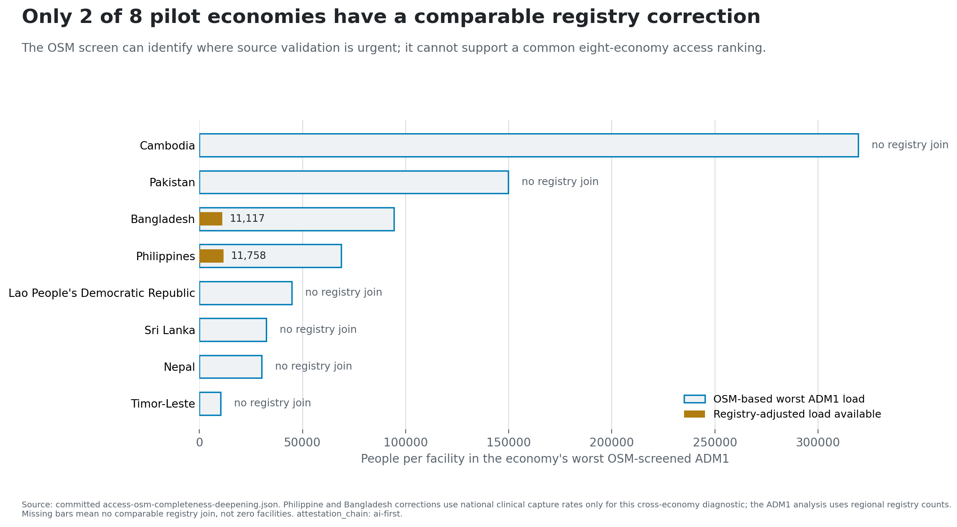
Only two pilot economies have comparable registry corrections
Missing correction means no comparable join, not zero facilities.
Eight-economy readiness wall shows registry-adjusted loads only for the Philippines and Bangladesh.

Slide 10
A second source is not automatically validation

Slide 11
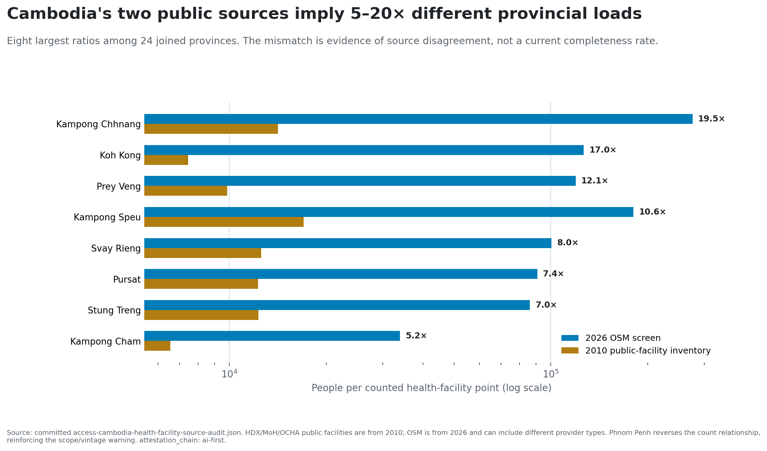
Cambodia exposes source and vintage disagreement
21 of 24 joined province ranks change.
2010 public providers versus 2026 OSM and broader tags.
Report disagreement, not current completeness.
Paired bars compare 2026 OSM loads with a 2010 Cambodia public-facility inventory.

Slide 12
What the screen can do

Slide 13
Use it as a source-validation queue
The panel can prioritize:
facility-master-list discovery;
taxonomy and provider-scope crosswalks;
boundary and identifier repair; and
mapping review where capture is thin.
It cannot rank travel time, capacity, quality, utilization, affordability, household access, welfare, or DMC performance.

Slide 14
The next evidence object

Slide 15
Build access from validated inputs
Current, geocoded, provider-scoped facility master lists.
Stable facility identifiers and boundary crosswalks.
Routable networks, terrain, barriers, and transport modes.
Services, staffing, operating status, and capacity.
Utilization or household evidence with appropriate review.
The old access-ranking headline is retired. The map-observability finding is the result.

Slide 16
Reproducibility and attestation

Slide 17
Every displayed number traces to committed evidence
Main evidence: access-osm-completeness-deepening.json
Cambodia audit: access-cambodia-health-facility-source-audit.json
Figure dossier: access-services/scripts/build-figure-dossier.py
Method and sensitivity: pre-registration.md, sensitivity.md
Limits and upgrade: limitations.md, upgrade-gap.md
The package is attestation_chain: ai-first under §18. No individual external reviewer was contacted. Human-final requires owner re-attestation and named domain/country/statistical review.

