Slide 1


StegLock
Steganography Mobile Application
Coordinator
Assoc. Prof. Popa Marius Ph.D.
Master Student
Ionescu Radu Ștefan

Slide 2
Introduction
StegLock is a mobile application for communication, secured by digital steganography combined with cryptographic techniques.
Simple and user friendly
Fast real-time communication
Secure message interchange

Slide 3
Objective
The main objective of the StegLock mobile application is to secure the communication of sensitive information, interchanged by two parties. Also, the existence of the secret messages should not be detected.
The StegLock mobile application works as a simple chat solution, which can be used to send text messages, images and audio recordings, but the multimedia files may contain hidden text messages.

Slide 4
Problem Description
The objective of the application is achieved using digital steganography techniques. By implementing these techniques, the sensitive information is embedded inside multimedia documents, without altering their appearance.
These multimedia documents can then be sent to anybody and if an attacker intercepts the files, even if the existence of the hidden information is revealed, the extraction of it should not be possible.
The main problems of steganographic algorithms are lossy compression, which might remove parts of the embedded information and steganalysis, which is a statistical approach for detecting the alteration of the multimedia cover files.

Slide 5
Methods and Technologies
StegLock uses new technologies like the latest Android SDK, Google Firebase and Facebook libraries, but also a self developed steganographic module.
Andoid API level 29
Google Firebase: Authentication, Database, Storage
Facebook: Login library

Slide 6
Methods and Technologies
The applications' core functionality is written in Java and is made up of a steganographic engine that operates at bit level to achieve the desired results.
Advanced Encryption Standard algorithms for encryption (128 bit key)
Algorithms for embedding and for extracting the secret message

Slide 7
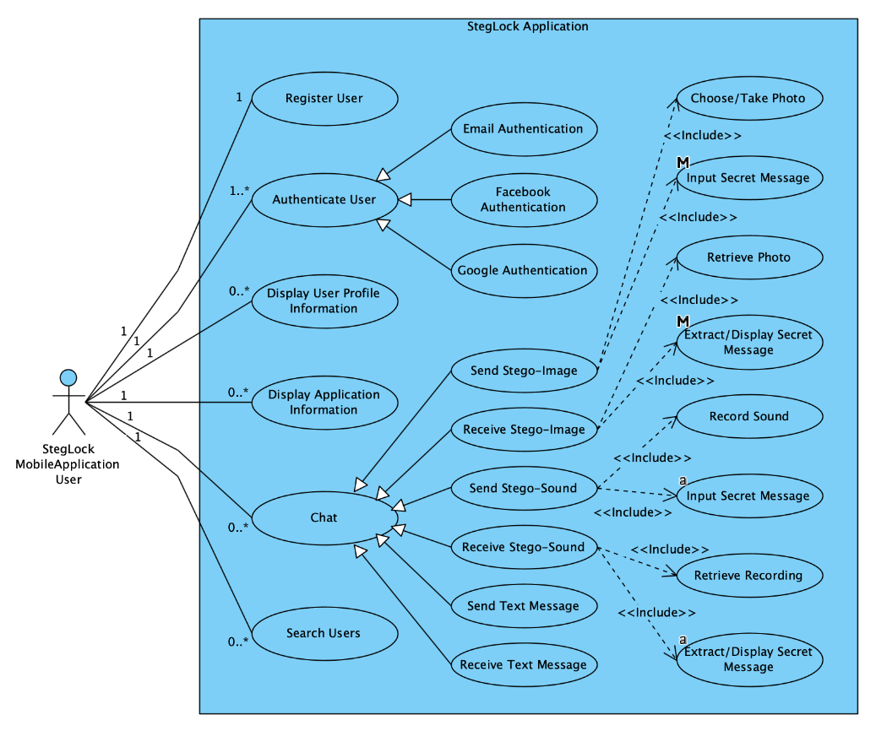
Solution Architecture
StegLock is a simple mobile chat application
User friendly activities
Using latest Google technologies for authentication, user management and persistent storage
Send and receive image and sound files with secret messages embedded

Slide 8
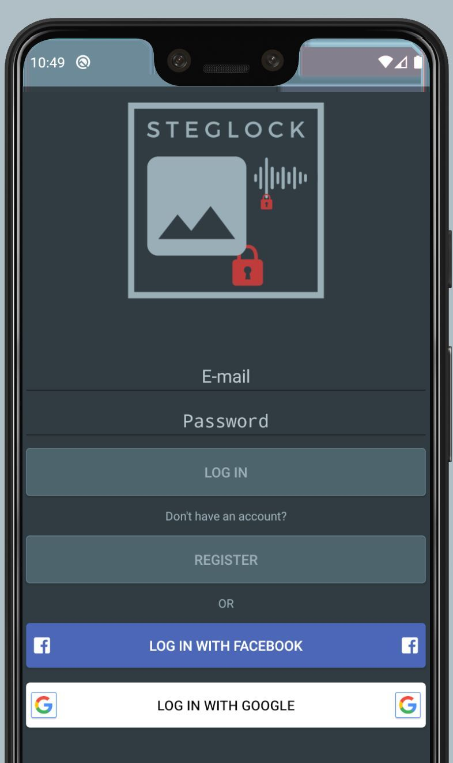
Solution Implementation
StegLock is implementing a Least Significant Bit steganography algorithm
Secure steganographic algorithm
Symmetric Cryptography
Implemented using Java, Android SDK and Google Firebase

Slide 9
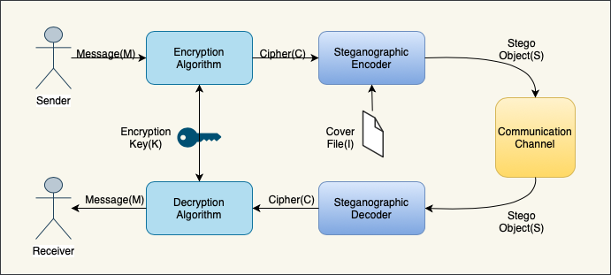
Solution Implementation
The sensitive information is encrypted before the steganographic process.
Higher level of security if the existence of the hidden information is revealed
Better against steganalysis because the cipher text is more random looking than the plain text

Slide 10
Solution Implementation
Only one bit hidden inside a whole pixel
Some of the pixels may not need to be altered
The total impact on the original image should not be great

Slide 11
DEMO

Slide 12
Conclusions
StegLock is a simple mobile application for communication, secured by modern steganographic techniques combined with cryptography. The Java LSB steganographic module ensures the safe and fast communication. There are multiple applications implementing steganographic algorithms but none of them is fail proof. Steganography may be used in conjunction with cryptography, digital watermarking and fingerprinting techniques to achieve a higher security level, but in my opinion further research must be done in this field.

