Slide 1


StegLock
Steganography Mobile Application
Coordinator
Conf. univ. dr. Doinea Mihai
Master Student
Ionescu Radu Ștefan

Slide 2
Introduction
StegLock is a mobile application for communication, secured by digital steganography combined with cryptographic techniques.
Simple and user friendly
Fast real-time communication
Secure

Slide 3
Objective and Problem Description
StegLock application is designed to ensure secure communication by:
Implementing a LSB steganography algorithm
Encrypting the secret message before embedding
Protection against steganalysis techniques
The main problems are lossy compression and statistical analysis

Slide 4
Methods and Technologies
StegLock uses new technologies like Android SDK, Google Firebase and Facebook libraries, but also a self developed steganographic module
Andoid API level 29
Google Firebase: Authentication, Core, Database, Storage
Facebook: Login library
Secure steganographic module

Slide 5
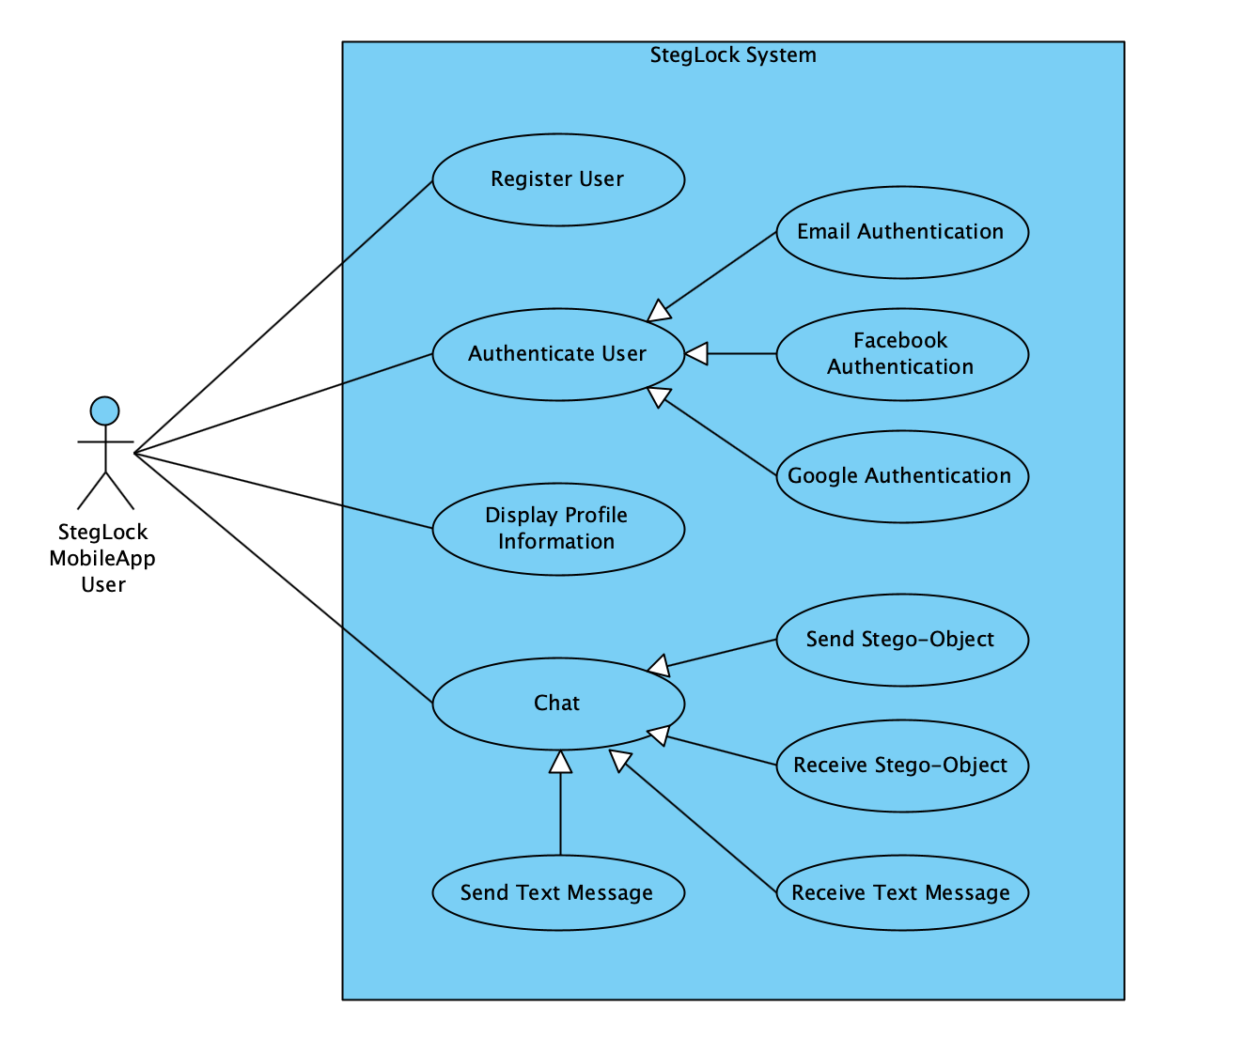
Solution Architecture
StegLock is a simple mobile chat application
User friendly activities
Using latest Google technologies for authentication, user management and persistent storage
Send and receive image and sound files with secret messages embedded

Slide 6
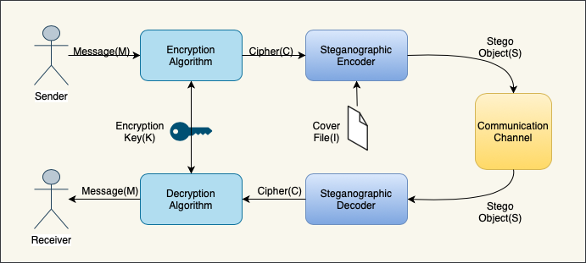
Solution Implementation
StegLock is implementing a secure LSB steganography algorithm
Secure steganographic algorithm
Steganalysis protection
Cryptography and Digital Signature
Implemented using Java, Android SDK and Google Firebase

Slide 7
Conclusions
StegLock is a simple mobile application for communication, secured by digital steganography combined with cryptographic techniques. The Java LSB steganographic module should secure the communication using cryptography and digital signature techniques also.

