Slide 1
Bill Reminder App
Raelyn Loh 23050595
C369 Financial Technology

Slide 2
Table of contents
01
02
03
04
05
06
Introduction
Customer
Pain Points
Target Audience
Proposed
Solution
MAS
Regulations
References

Slide 3

Introduction
From electricity and water bills to phone and credit card payments, missing due dates can result in avoidable late fees and financial strain. The Bill Reminder App offers a comprehensive solution for those who find it difficult to manage their bill payments efficiently.

Slide 4

Customer Pain Points
Late Fees
Inadequate Reminders
Forgetting to pay bills, leading to extra charges.
Ineffective reminders to alert users about upcoming bill deadlines.
Insufficient Planning
Risk of Fraud
Concerned about unauthorized transactions and falling victim to fraudulent activity.
Users feel overwhelmed to keep up with multiple bills.

Slide 5

Target Audience
Families
Have multiple bills
Unable to track payments
Busy Individuals
No time to pay bills
Unable to stay organised
Elderly
Forgetful
Unsure how to pay bills
Afraid of fraudulent activity
Students /
Young Adults
First time paying bills
Going over their budgets

Slide 6

Proposed Solution
User Friendly Interface
01
06
AI-Powered Fraud Detection
Bill Tracking and
Reminder
02
05
Blockchain Technology
03
04
Payment
Insights

Slide 7
Proposed Solution
User Friendly Interface
Bill Tracking and Reminder
Easy and accessible to all ages.
Able to customise different profiles.
Able to access all past transactions.
View, add and manage bills.
The app sends notifications 3 days before the due date.

Slide 8
Proposed Solution
Payment
Insights
Able to pay bills on the app through bank accounts, credit/debit cards, installations.
Able to consolidate all bills and pay together.
Automated payment.
Monthly summary of bills and show upcoming bills.
Track expenses.
Recommend budgets.

Slide 9
Proposed Solution
Blockchain Technology
AI-Powered
Fraud Detection
All transactions made are recorded on blockchain ledger.
Decentralised system which can verify transactions.
Monitors every transaction.
Receive real-time alerts if there is a suspicious activity.
Enable Multi-Factor Authentication (MFA) when confirming payments.

Slide 10

Personal Data Protection Act (PDPA)
MAS Regulations
PDPA establishes a general data protection law that organisations are required to follow guidelines for the collection, use and disclosure of an individual’s personal data
Technology Risk Management Guidelines
Focuses on financial institutions in Singapore that assist in managing technology risks by establishing best practices and risk management principles to prevent security incidents.

Slide 11
Payment Services Act
MAS Regulations
Governs Singapore’s licensing and regulation of payment service providers and the oversight of payment systems.

Slide 12

References
https://cushion.ai/blog/best-bill-reminder-app/
https://datadome.co/learning-center/ai-fraud-detection/
https://gocardless.com/guides/invoicing/blockchain-and-e-billing/
https://www.mas.gov.sg/-/media/MAS/News-and-Publications/Consultation-Papers/2-Jun-2014-CP-on-PDPA_Amendts-to-AMLCFT-Notices.pdf
https://www.pdpc.gov.sg/overview-of-pdpa/the-legislation/personal-data-protection-act#:~:text=The%20PDPA%20recognises%20both%20the,for%20legitimate%20and%20reasonable%20purposes.
https://www.dataguidance.com/opinion/singapore-data-protection-financial-sector#:~:text=The%20Personal%20Data%20Protection%20Act,individuals'%20personal%20data%20by%20organisations.
https://panorays.com/blog/what-is-mas-trm/#:~:text=The%20MAS%20TRM%20guidelines%2C%20or,to%20defend%20against%20security%20incidents.
https://www.mas.gov.sg/regulation/payments#:~:text=The%20Payment%20Services%20Act%202019,amended%20on%204%20April%202024.

Slide 13
Thank You!

Slide 14
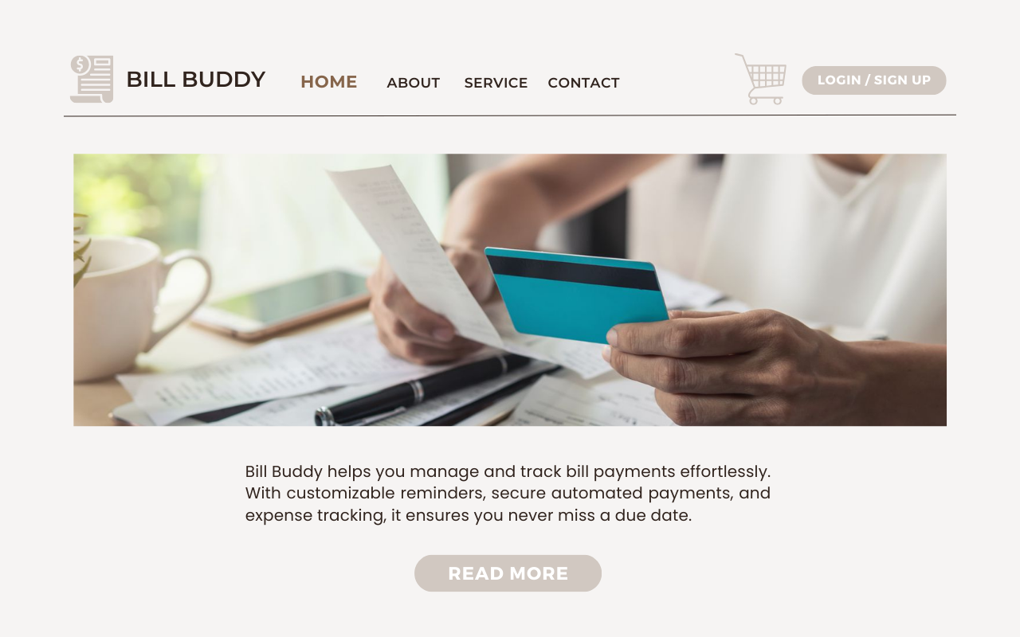
Home Page
Short introduction of business idea and the financial service offered by Bill Buddy.

Slide 15
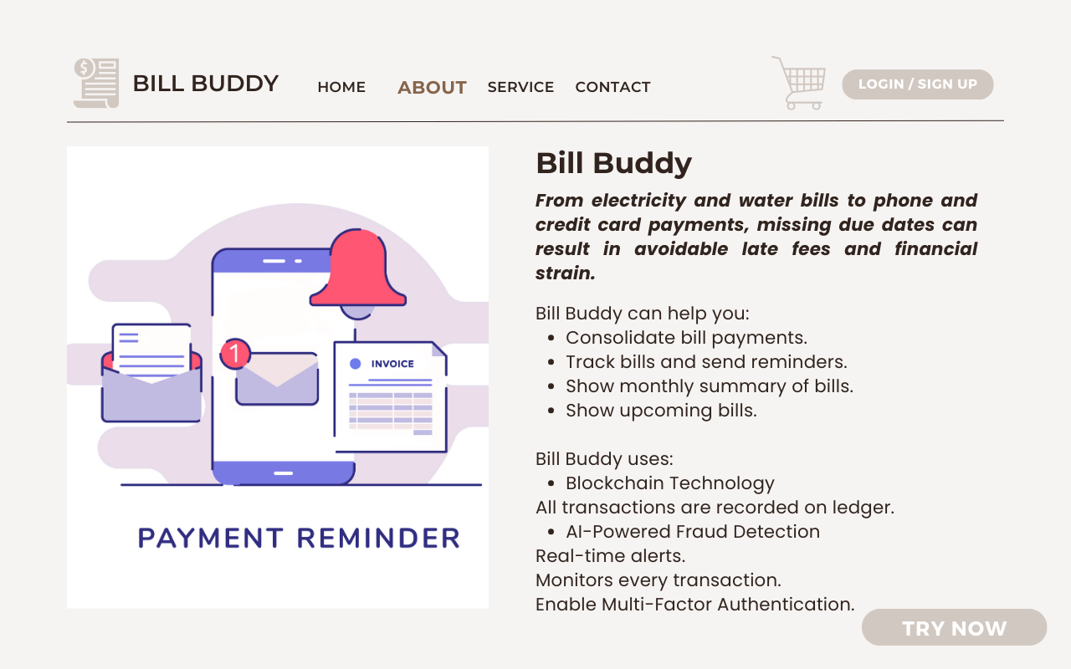
About Page
More features of the Bill Buddy application.

Slide 16
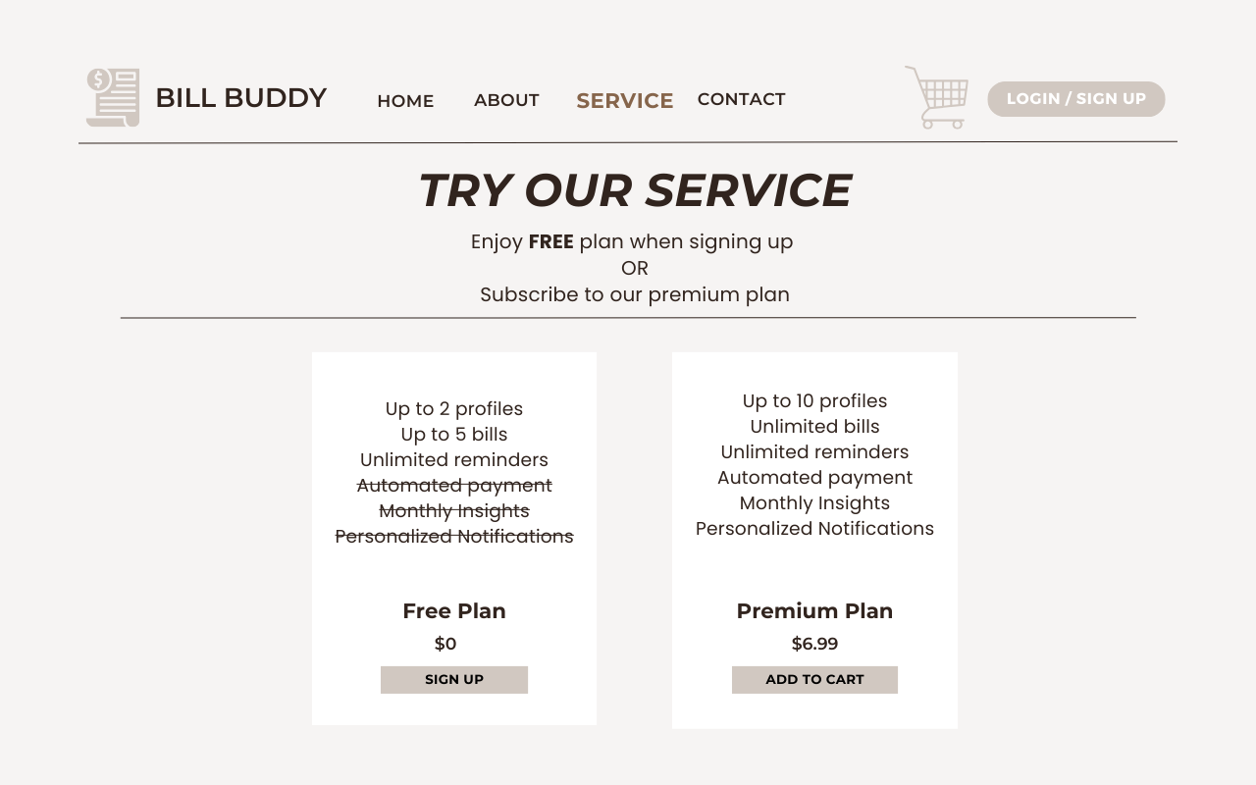
Service Page
Services plans provided by Bill Buddy, includes a free plan and premium plan.

Slide 17
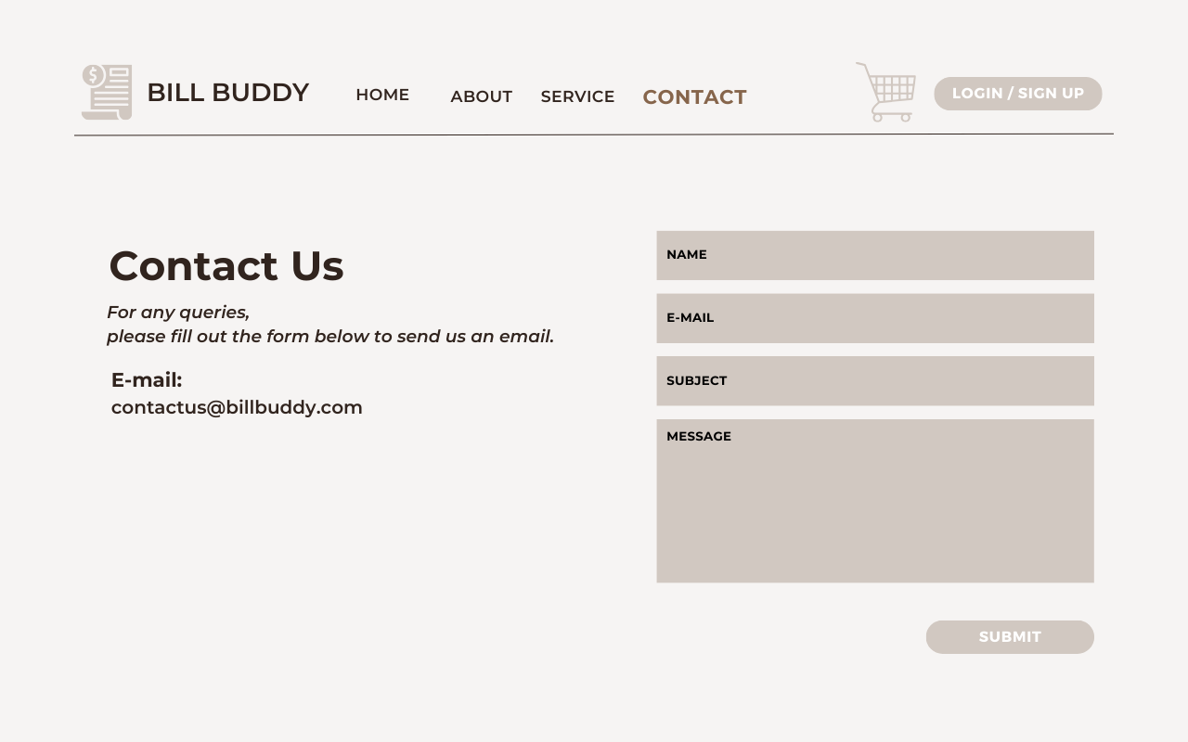
Contact Page
Contact page for queries and help.

Slide 18
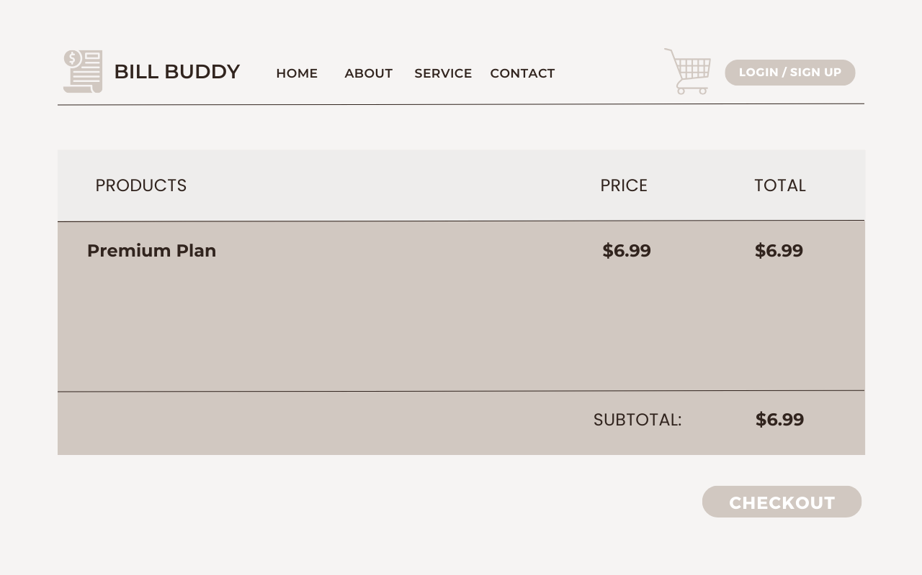
Shopping Cart Page
The shopping cart if the user wants to buy premium plan.

Slide 19
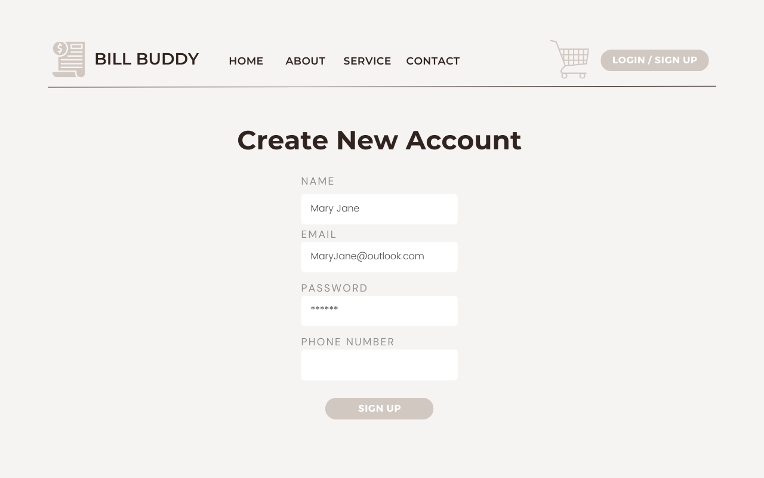
Sign Up Page
New users must create a new account if they want to try Bill Buddy’s free plan.

Slide 20
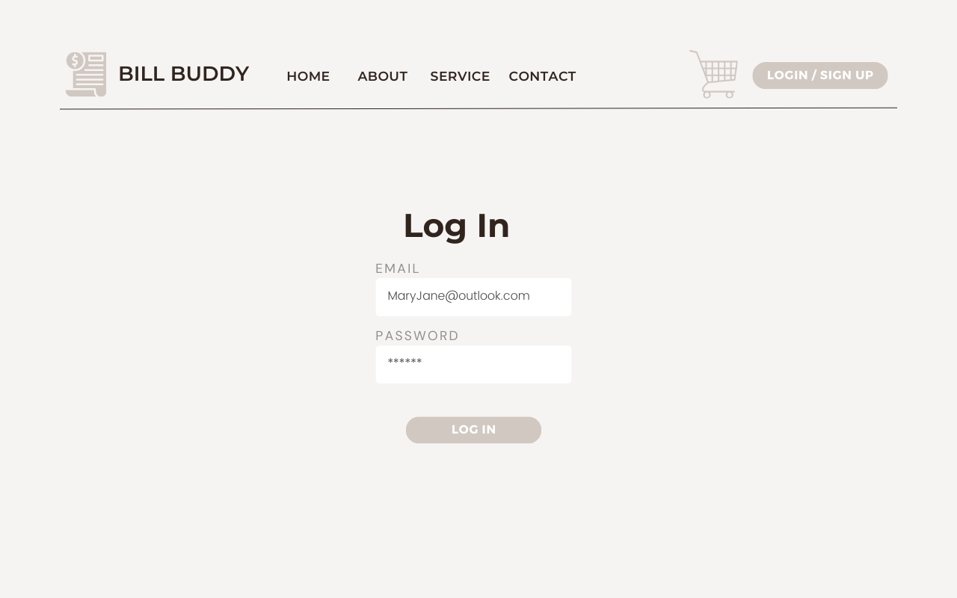
Log In Page
User can log into existing account to use Bill Buddy.

Slide 21
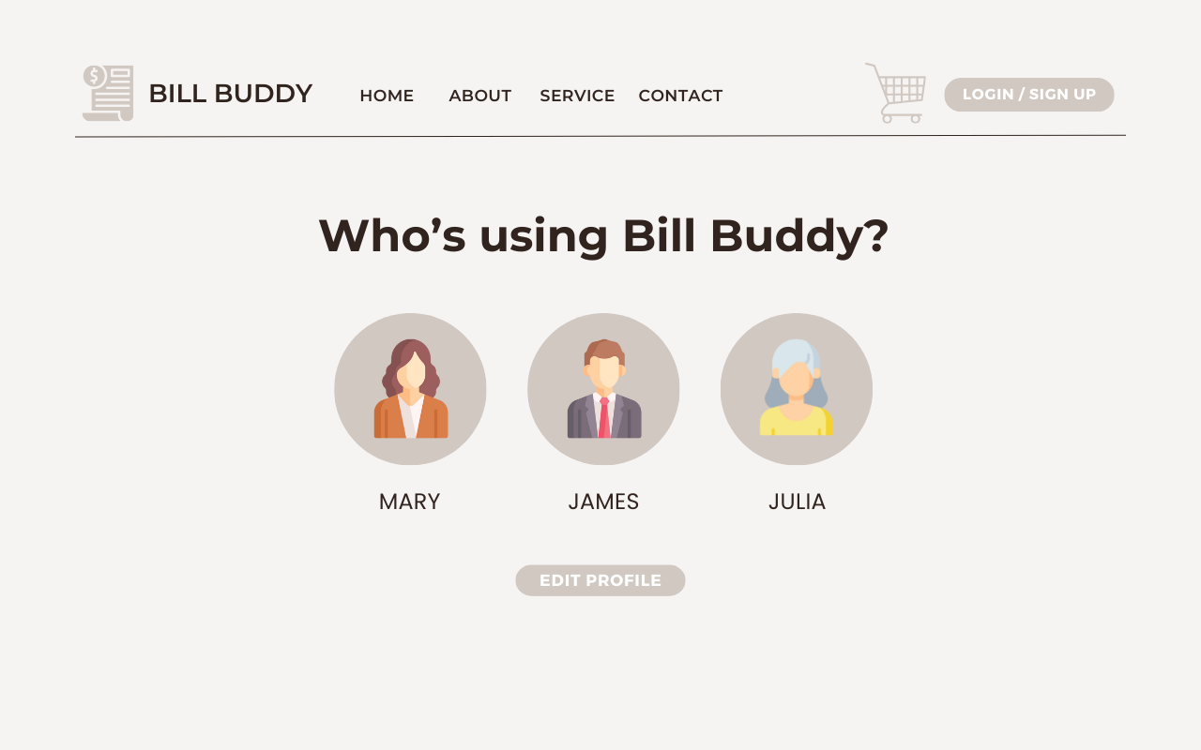
Profile Page
User can create different profiles and choose the profile they want to use.

Slide 22
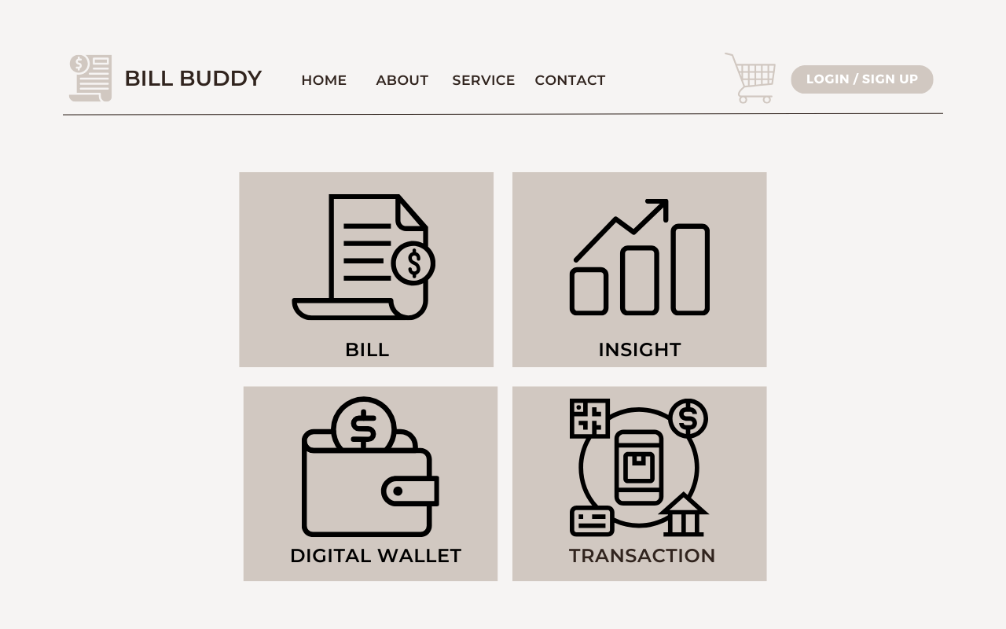
Main Page
User can opt to view or manage bill, insight, digital wallet and transaction after selecting their profile.

Slide 23
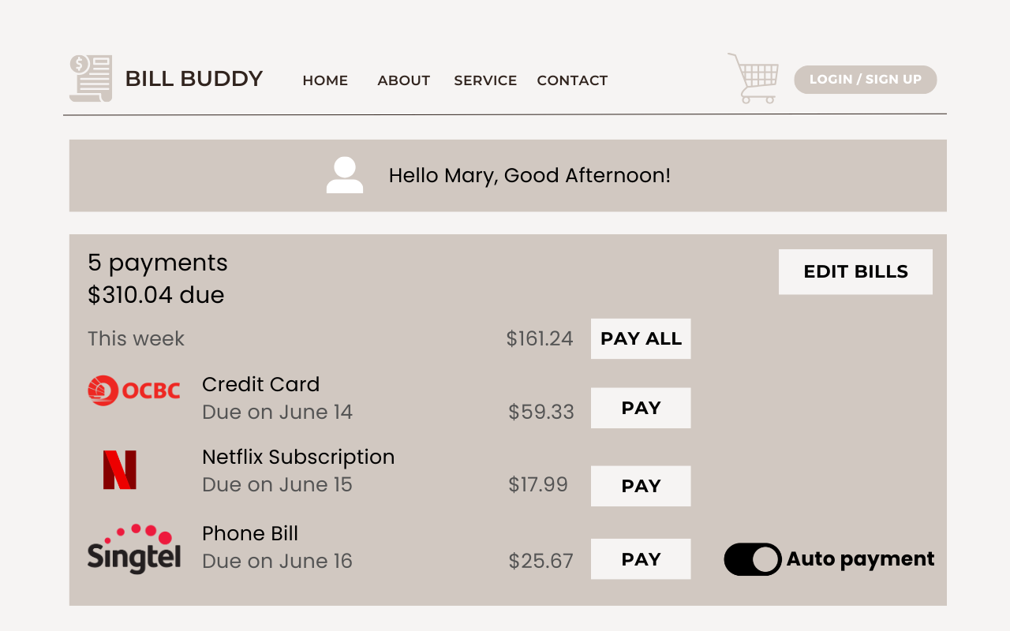
Bill Page
If user choose to enter bill, it will show the number of payments due, the total amount due.
User can edit bills to add new ones or remove existing bills.
User has the option to pay each bill separately or combine them into one payment.
If user has the premium plan, they can activate the auto payment feature.

Slide 24
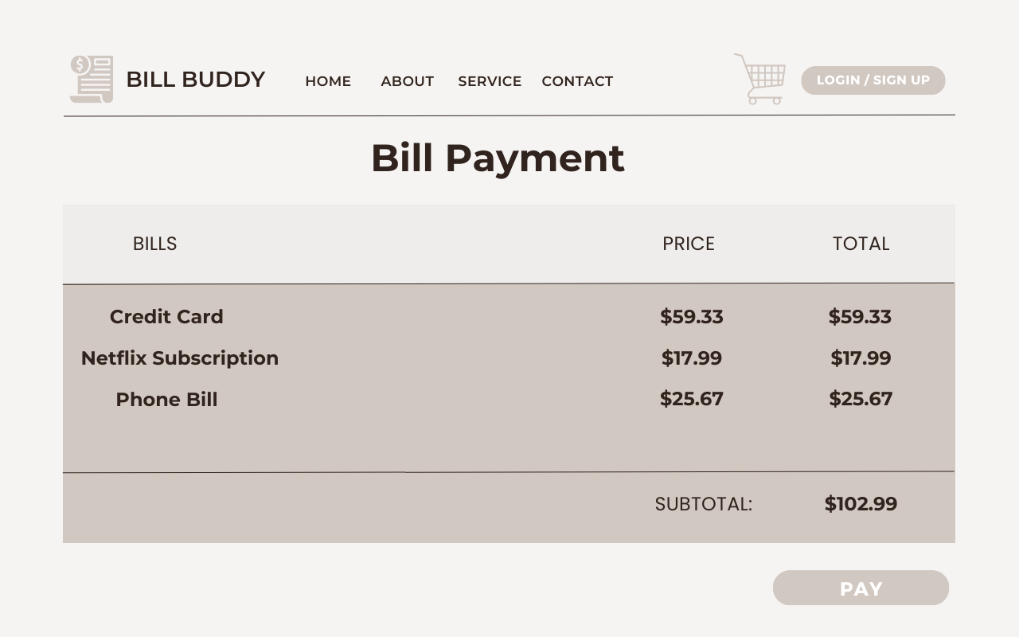
Bill Payment Page
The bill payment page if the user choose to pay the bills.

Slide 25
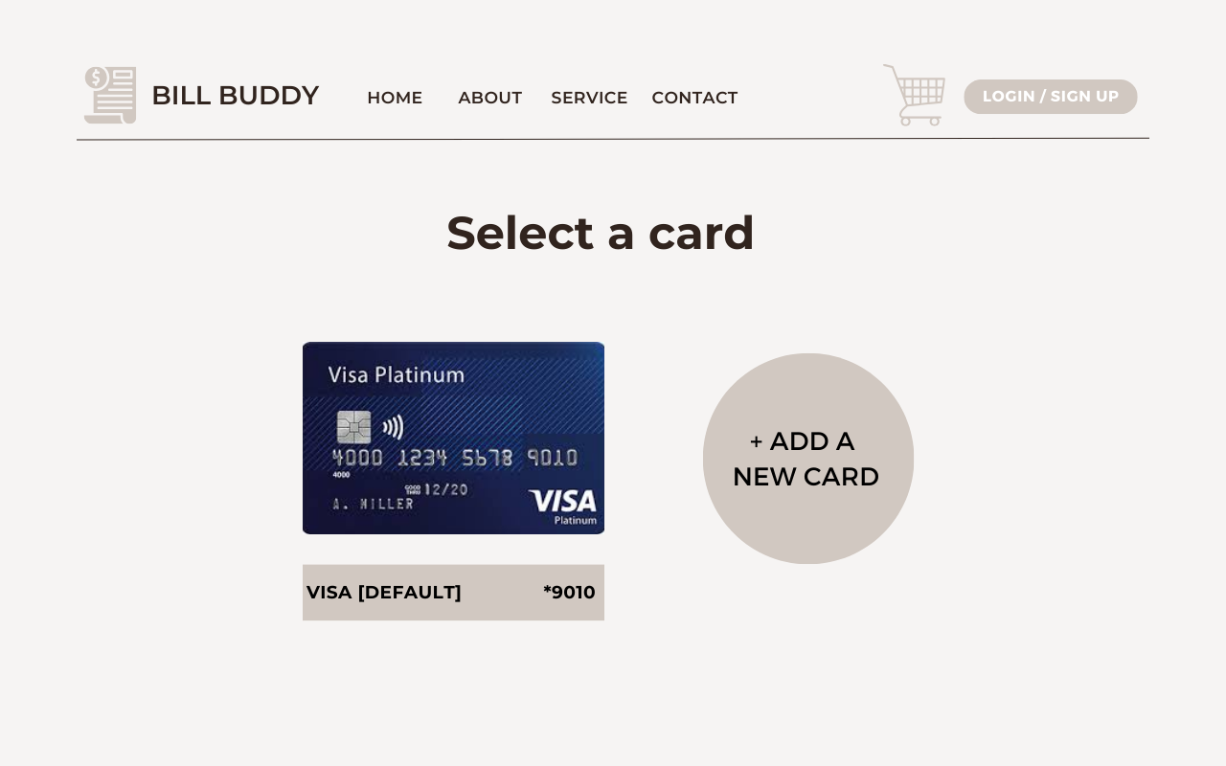
Digital Wallet Page
Once the user clicks on pay, it will be redirected to the digital wallet.
User can choose to use existing card to pay the bills or add a new card.

Slide 26
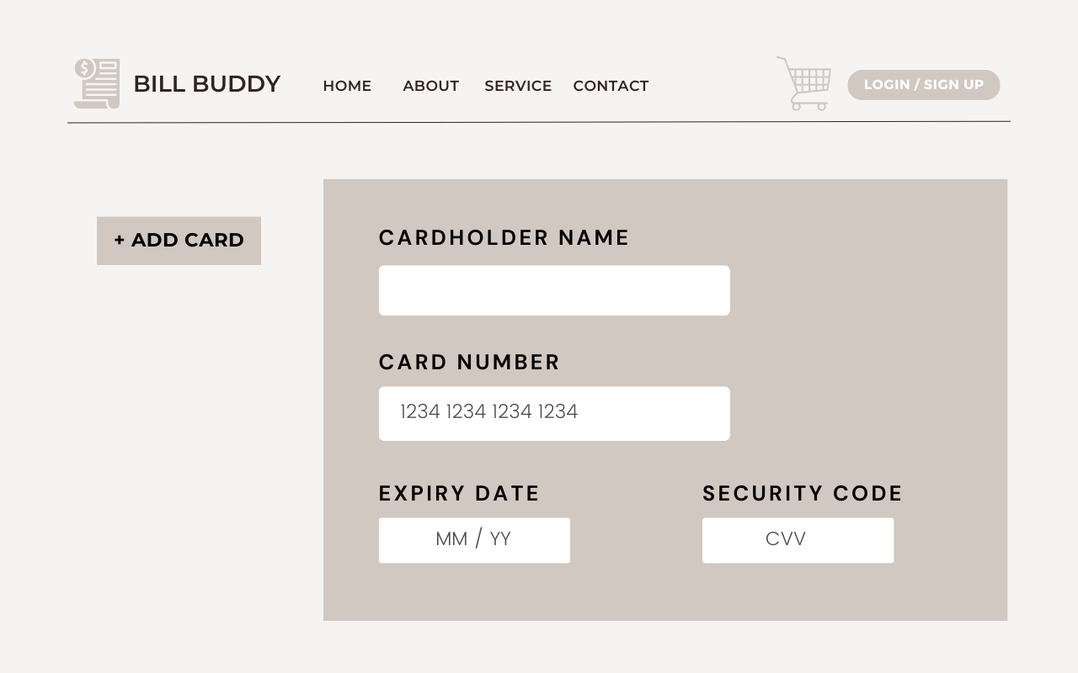
Add Card Page
If the user chooses to add a new card, the application will prompt them to include the card details.

Slide 27
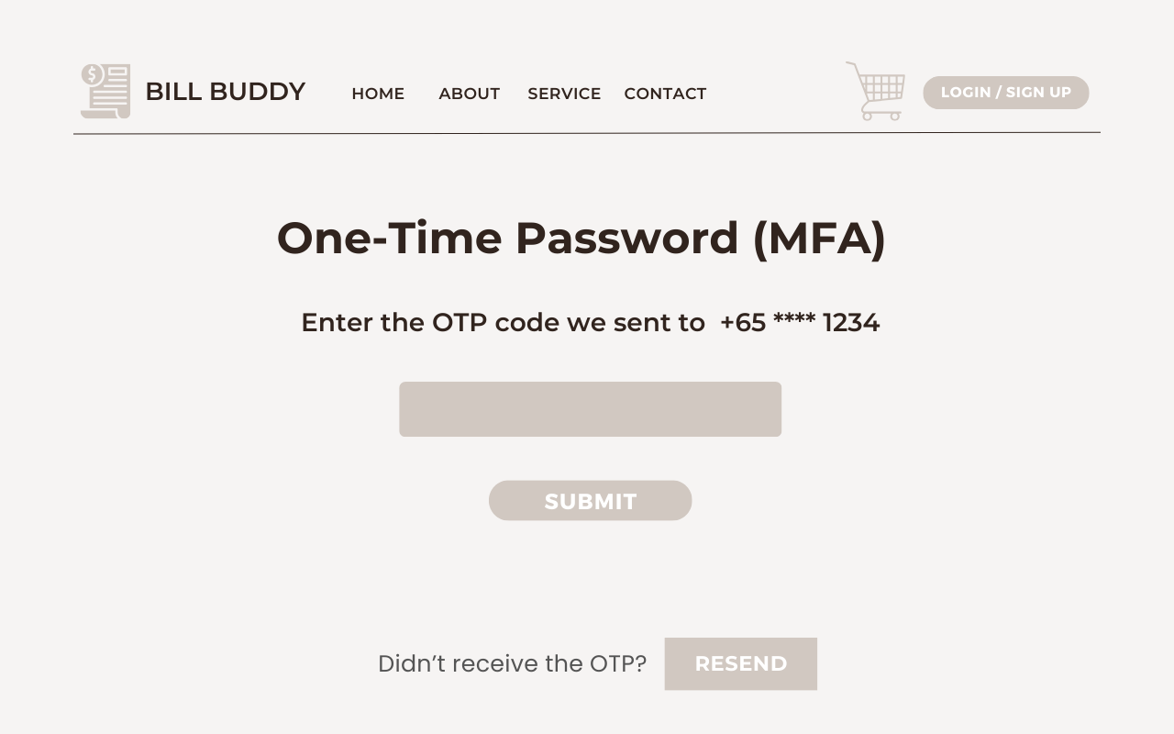
AI-Powered Fraud Detection (MFA) Page
An OTP code will be sent to the phone number linked to the user account as the user proceeds with bill payment.

Slide 28
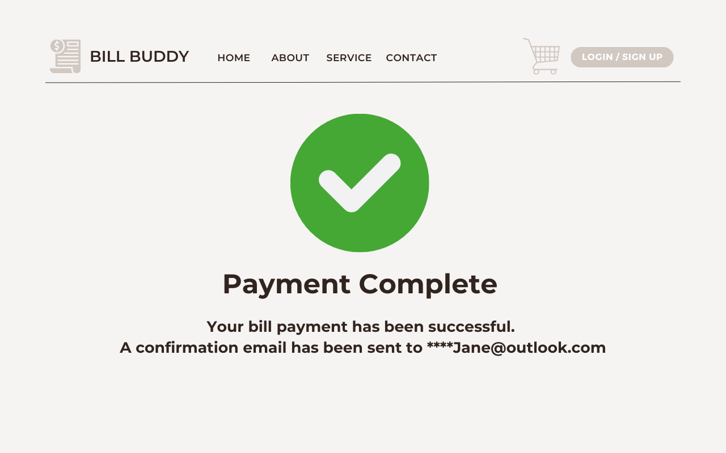
Bill Confirmation Page
The application will show “Payment Complete” and send a confirmation email to the user’s email address linked to their user account if MFA was successful.

Slide 29
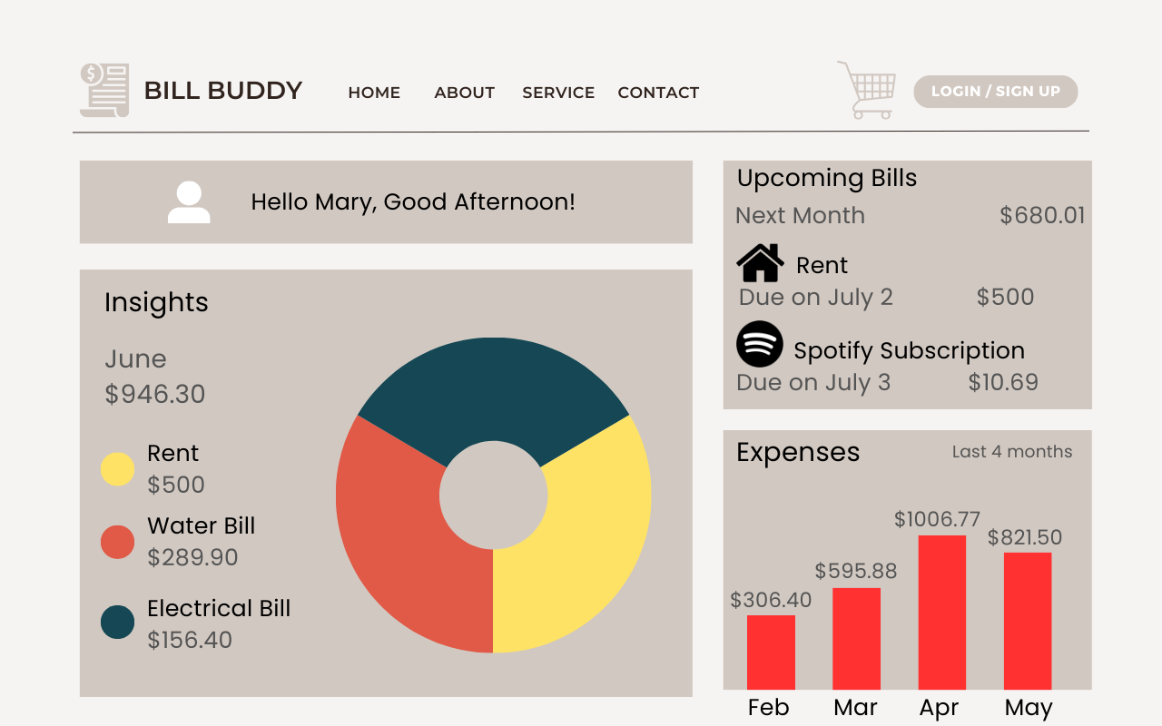
Insight Page
Displays user’s monthly insights, expenses and upcoming bills.

Slide 30
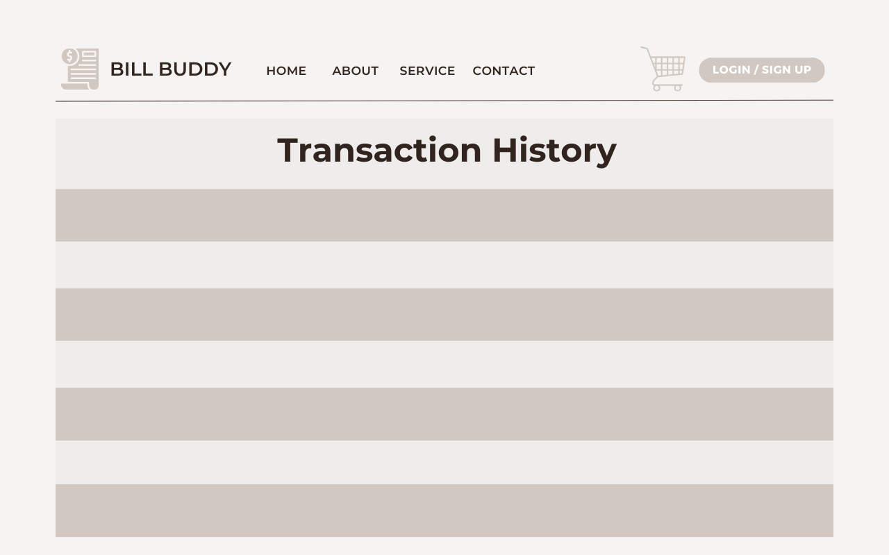
Transaction History Page
The blockchain technology will record every payment made in the transaction history.

