Slide 1
CodePulse
ShipCheck
Finds Bill of Lading mistakes before they ship
Erwyna · Nandhini · Charvhi · Riely · Taabish
AVERIS HACKATHON 2026
Notes:
Template slide. Content owner is shown in the footer.

Slide 2
02
The problem
2,000 emails a day. Manual checks. The same shipping field appears under many labels.
Replace this prompt with the owner’s final content. Keep the cream background, serif heading and orange accent.
CodePulse / ShipCheck
Taabish
Notes:
Template slide. Content owner is shown in the footer.

Slide 3
03
How ShipCheck works
Sort / Read / Compare / Ask a person
Replace this prompt with the owner’s final content. Keep the cream background, serif heading and orange accent.
CodePulse / ShipCheck
Taabish
Notes:
Template slide. Content owner is shown in the footer.

Slide 4
04
System architecture
Add the final architecture diagram and label each data boundary.
Replace this prompt with the owner’s final content. Keep the cream background, serif heading and orange accent.
CodePulse / ShipCheck
Erwyna
Notes:
Template slide. Content owner is shown in the footer.

Slide 5
05
Implementation
Rules handle clear cases. AI reads unfamiliar language. Code performs every comparison.
Replace this prompt with the owner’s final content. Keep the cream background, serif heading and orange accent.
CodePulse / ShipCheck
Erwyna
Notes:
Template slide. Content owner is shown in the footer.

Slide 6
06
Tech stack and cloud
Add the final Hugging Face, Supabase, DeepSeek and Gemini deployment view.
Replace this prompt with the owner’s final content. Keep the cream background, serif heading and orange accent.
CodePulse / ShipCheck
Erwyna
Notes:
Template slide. Content owner is shown in the footer.

Slide 7
07
Malay and Chinese support
Local wording is handled by explainable rules before the AI fallback
Bahasa Melayu
中文
Pihak penghantar → Shipper
Penerima kiriman → Consignee
Pelabuhan pemuatan → Port of loading
Pelabuhan destinasi → Port of discharge
Kuantiti kontena → Container count
托运人 → Shipper
提货人 → Consignee
起运港 → Port of loading
目的港 → Port of discharge
集装箱数量 → Container count
Example: “Sila semak draf bil muatan dan sahkan butirannya sepadan.”
Example: “请比较提单和装运指示，并确认所有信息是否相符。”
14 new labels / 10 new email phrases / 61 automated tests passing
CodePulse / ShipCheck
Nandhini + Charvhi
Notes:
Charvhi contribution: multilingual rules, labels and tests implemented in the repository.

Slide 8
08
Validation
100% score. 46 of 46 mistakes caught. No false alarms. Twenty cases correctly sent to a person.
Replace this prompt with the owner’s final content. Keep the cream background, serif heading and orange accent.
CodePulse / ShipCheck
Nandhini
Notes:
Template slide. Content owner is shown in the footer.

Slide 9
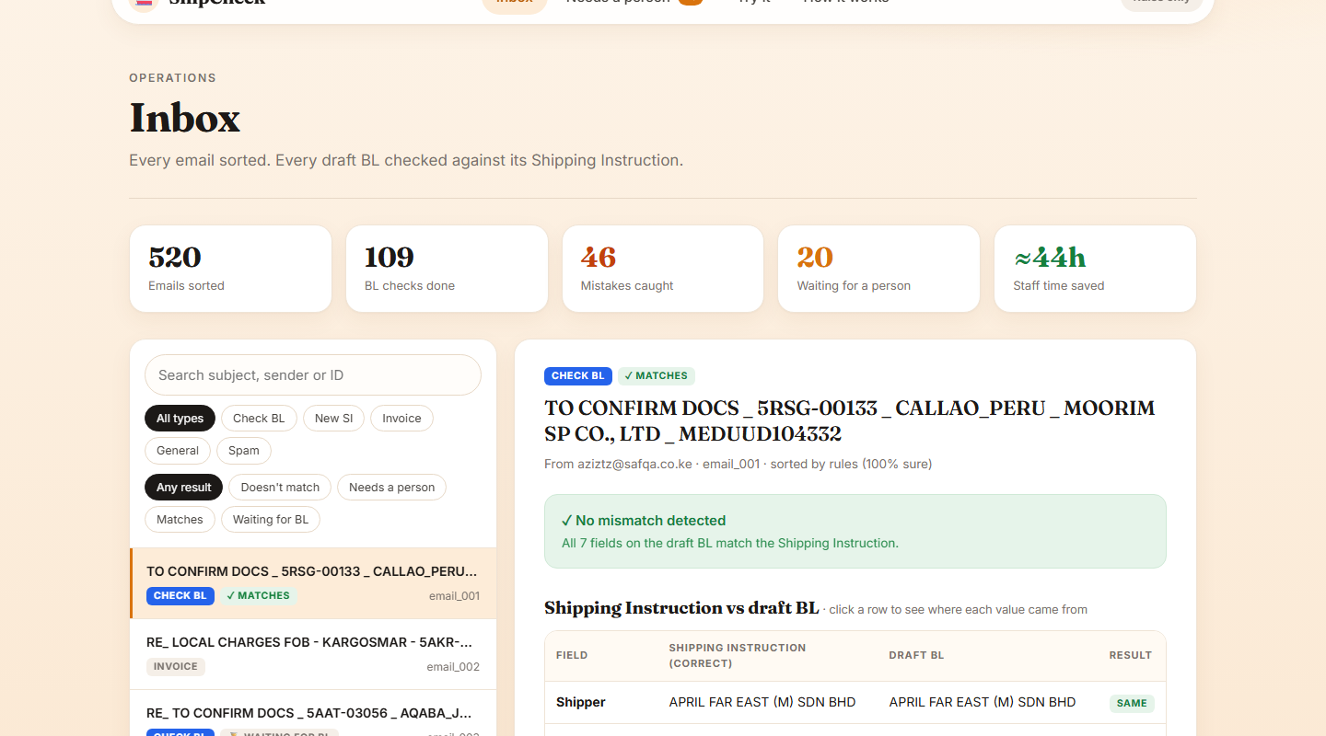
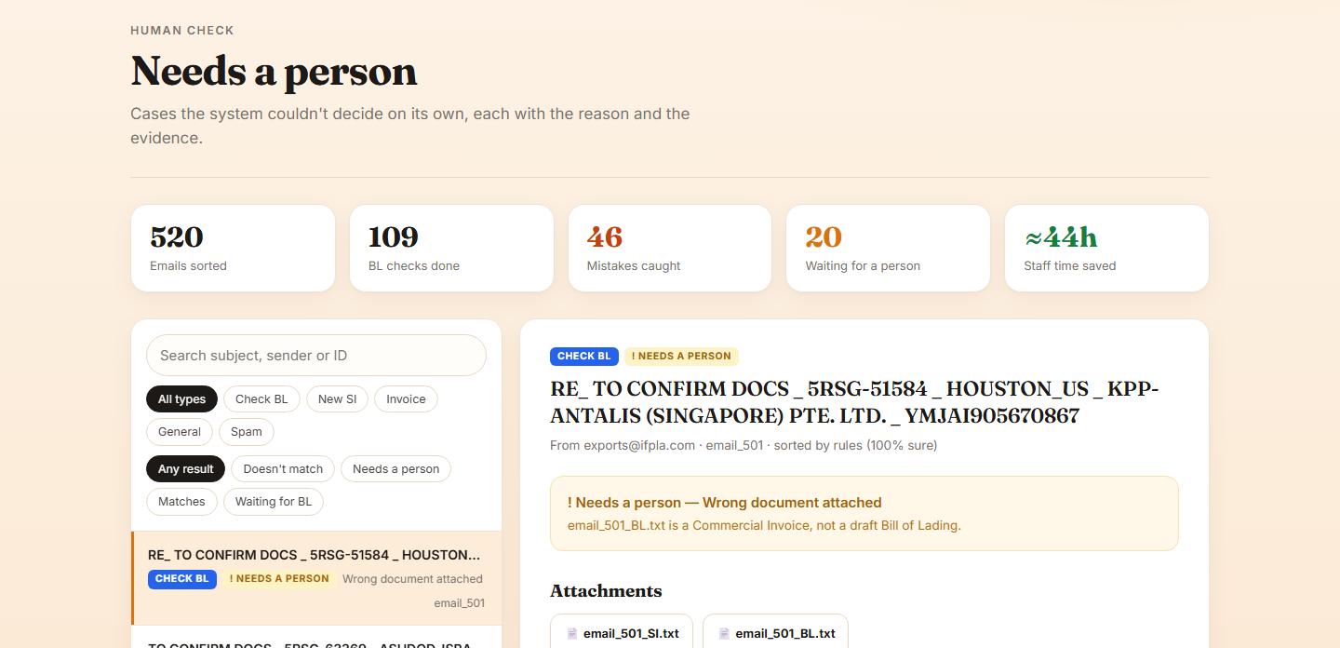
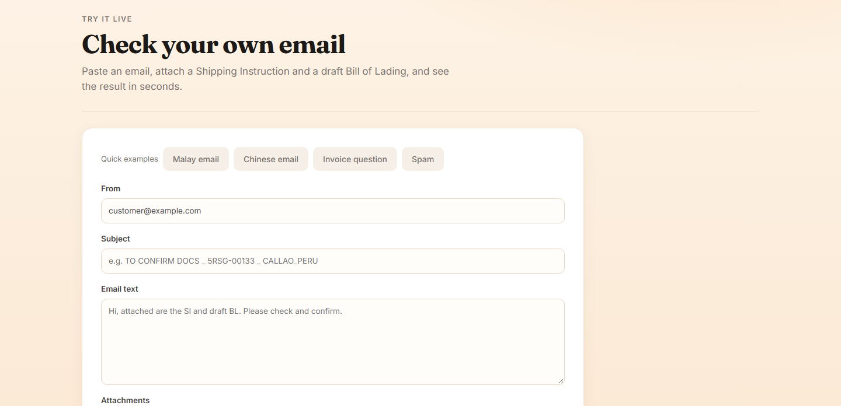
09
Product walkthrough
A reviewer can see the decision, evidence and next action on one screen
CodePulse / ShipCheck
Charvhi
Notes:
Screenshots captured from the locally running ShipCheck prototype after UI verification.

Slide 10
10
Operational impact
Show the time saved and the work that remains with people.
Replace this prompt with the owner’s final content. Keep the cream background, serif heading and orange accent.
CodePulse / ShipCheck
Riely
Notes:
Template slide. Content owner is shown in the footer.

Slide 11
11
Challenges and solutions
Explain document variation, unclear cases and the rules-first fallback design.
Replace this prompt with the owner’s final content. Keep the cream background, serif heading and orange accent.
CodePulse / ShipCheck
Riely
Notes:
Template slide. Content owner is shown in the footer.

Slide 12
12
Roadmap
Outlook integration, learning from reviewer corrections and more languages
Replace this prompt with the owner’s final content. Keep the cream background, serif heading and orange accent.
CodePulse / ShipCheck
Riely
Notes:
Template slide. Content owner is shown in the footer.

