Slide 1
42 ADApp
42 Abu Dhabi Application

Slide 2

Abstract
This app is basically what students or pisciners need when they use intra using their phones instead of going through a browser. It can help them to go through obstacles and find, use or even create using the application. So it’s an enhanced version of the 42 intra and used by 42 Abu Dhabi Students/Pisciners specifically.

Slide 3
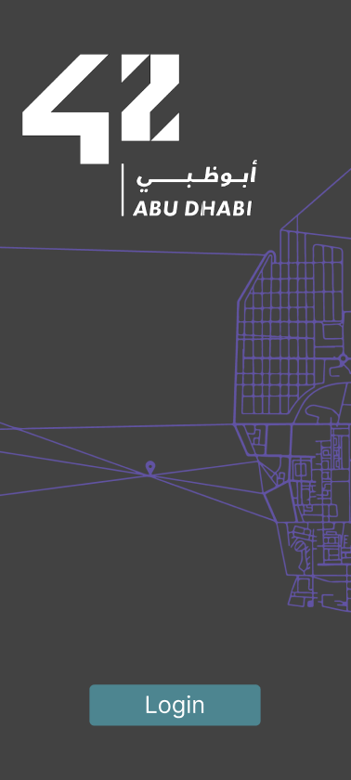
Login
The first page of the application also known as home screen basically only one thing which is login screen where a student can just login.

Slide 4
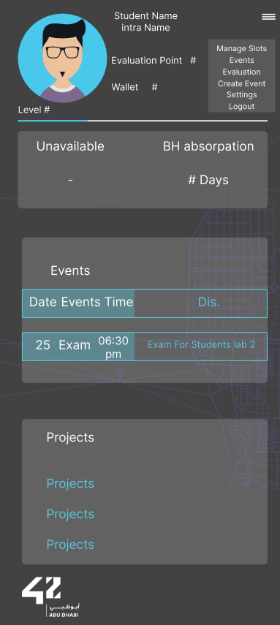
Homepage
After logging in, you will see the intra homepage where you can edit or open several things and find what you need using that homepage.
We will list and explain their features on the upcoming on the next slides.
The dropbox where manage slots, events, etc. will get appear or not once you press the top right panel.

Slide 5
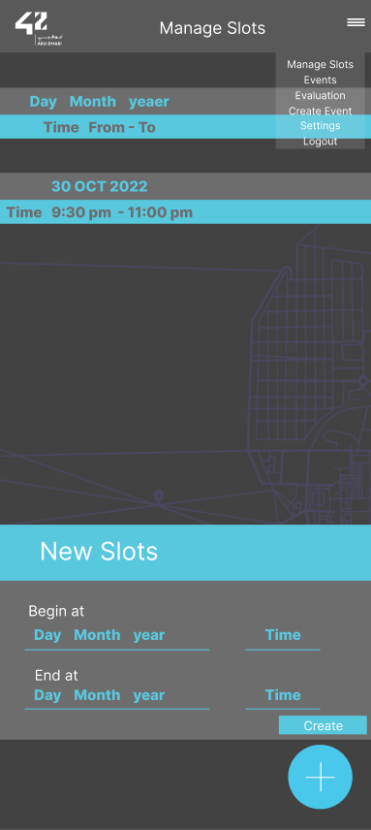
Manage Slots
A page where you can tell the others that you are free to evaluate them at set time.

Slide 6
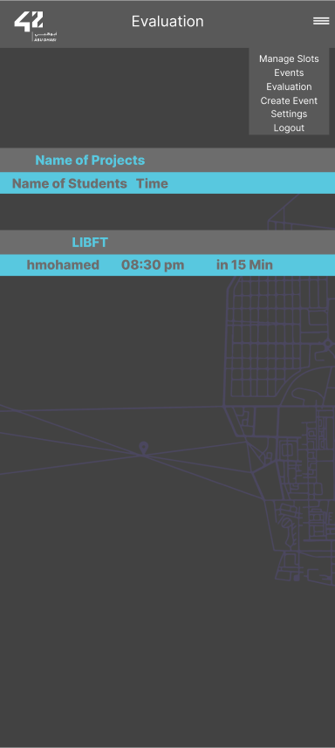
Evaluation
A page where it views when and who you’re going to evaluate or be evaluated by whom.

Slide 7
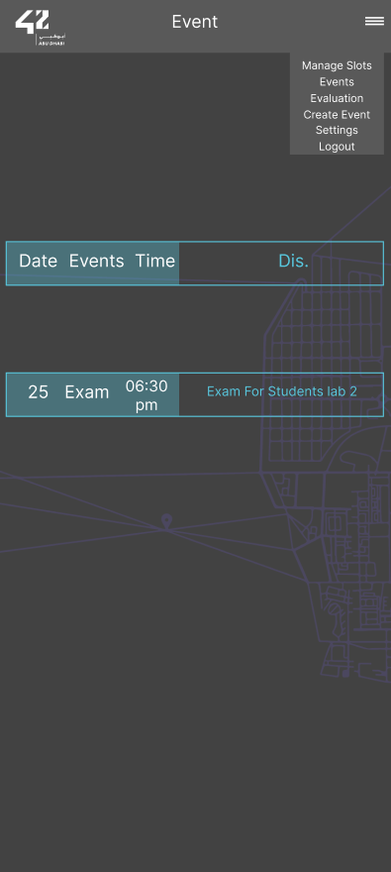
Events
A page where it views what and when events going to happen.

Slide 8
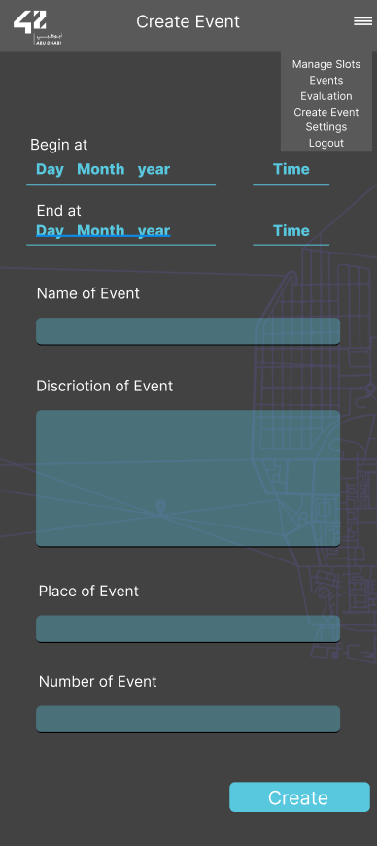
Create event
A new feature where a student can create an event.
For example if a student wants to host a football match and see if other students interested in them.

Slide 9
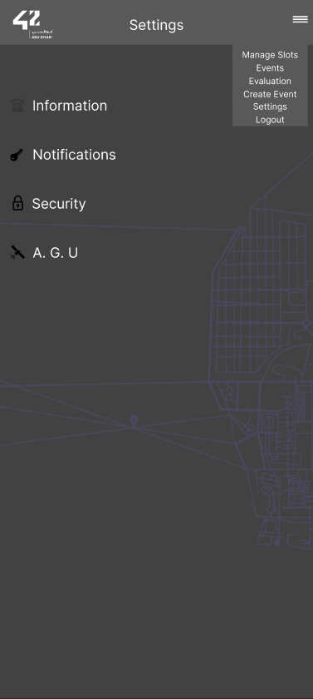
Settings
A page where you can see Information about yourself, enable or disable Notifications, use the A.G.U Panel or edit your password in Change Password.

Slide 10
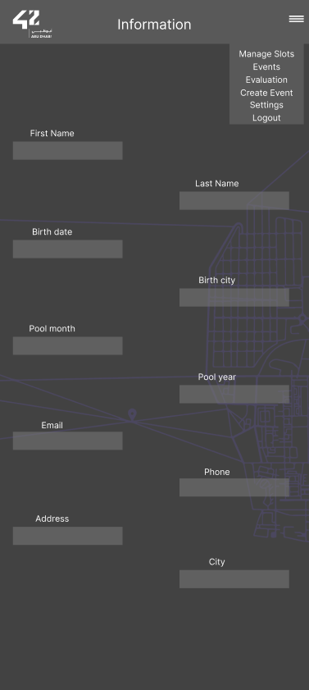

Information
A page where it views your Information like your Full name and Birthday.

Slide 11
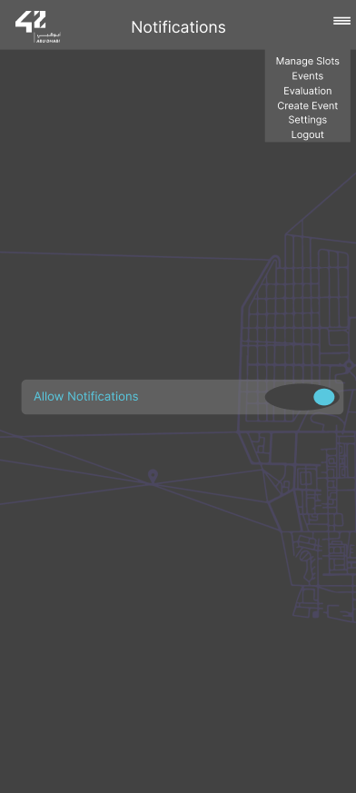
Notification
A page where it you can enable or disable notification of the app.

Slide 12
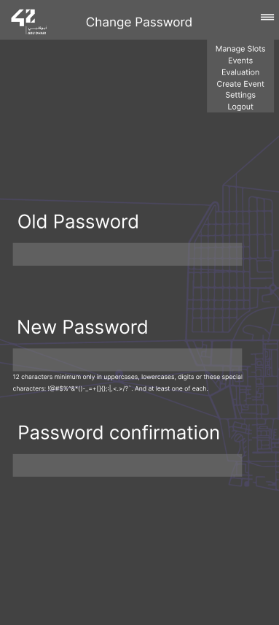
Change Password
A page where you can change your old password with your new password.

Slide 13
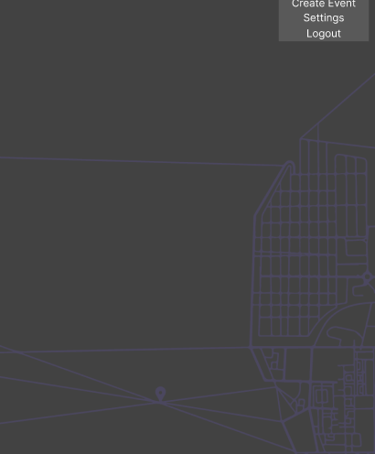
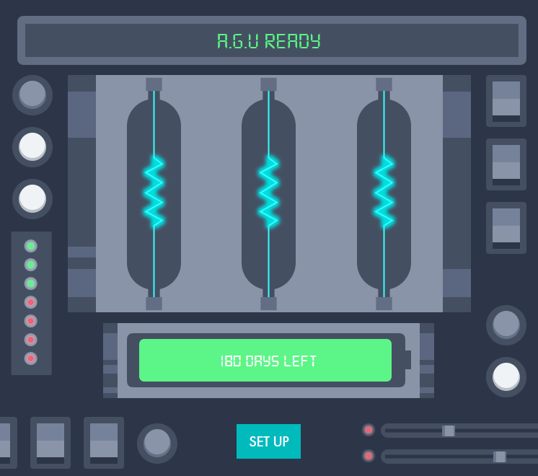
A.G.U
A page where you can freeze your account until the battery runs out or all the fuses break off.

Slide 14

Thank You For Your Time

