Slide 1
D4West QIP PDSA Cycle 2 (ward procedure trolley)
Dr. Shreya Gupta

Slide 2
The Problem
Routine procedures on ward- ABG, cannulation, venesection
Frequent difficulty locating necessary equipment- often having to go to neighbouring wards
Time consuming and frustrating- valuable clinical time spent ‘scavenging’

Slide 3
Plan
Focussing on ward D4W
Determine if a poorly stocked ward affects junior doctors
What impact does it have?
How can this be improved?
Measuring the impact of intervention; in this case a dedicated ‘procedures trolley’

Slide 4
Do
Survey of 15 junior doctors working in D4W and covering the ward OOH
Specific questions asked
1) Is it easy to locate equipment needed for clinical procedures on ward D4W?
2) How much longer does it take to locate equipment on D4W compared to other wards?
3) Do you find it stressful when trying to locate equipment on D4W during the day/on call
4) Any suggestions for improvement

Slide 5
Do
Borrowed trolley from ward D4E is replaced by a new trolley on D4W
Survey repeated for PDSA cycle 2

Slide 6
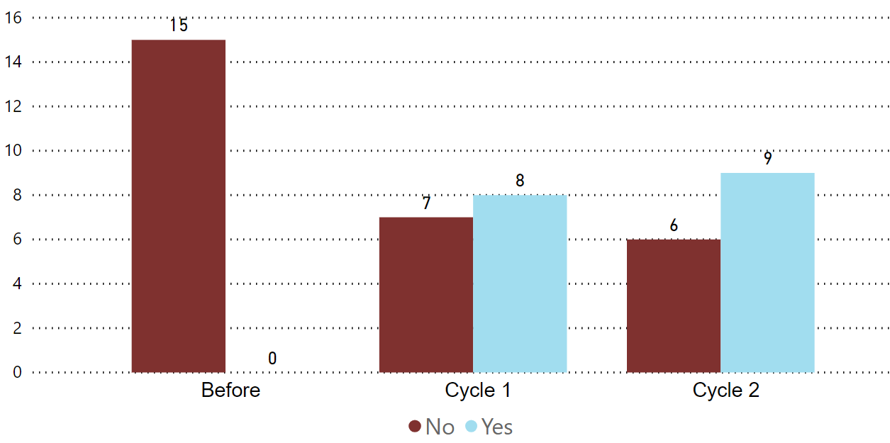
Do you find it easy to locate equipment needed for clinical procedures?
0/15 found it easy to locate equipment before introduction of a procedure trolley vs 9/15 after

Slide 7
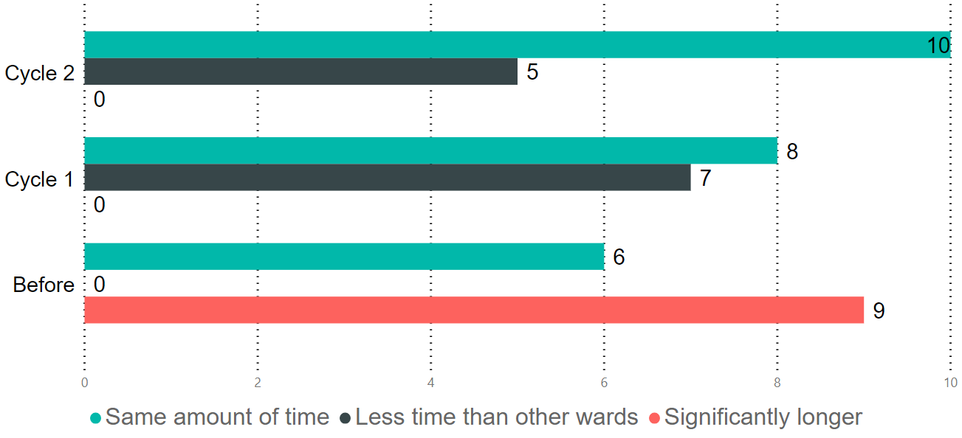
How much longer does it take to locate equipment on D4 west compared to other wards?
15/15 found it more or equally time consuming to locate equipment vs 5/15 who found it less time consuming after introduction of a procedure trolley

Slide 8
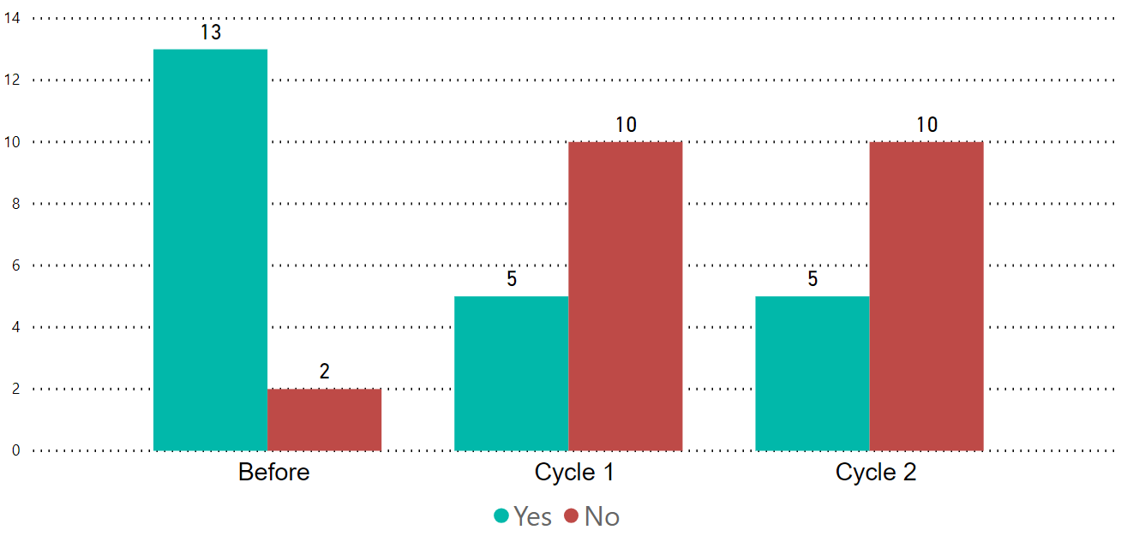
Do you find it stressful, when trying to locate equipment during the on call/day job on d4 west?
13/15 found locating equipment to be stressful vs 5/15 after introducing a procedure trolley

Slide 9
Suggestions made
Pre- intervention
Universal organised trolley- to ensure this is well stocked and to have exactly the same layout as all the wards.
Post PDSA cycle 2
To restock the trolley regularly.

Slide 10
Plan going forward
To arrange meeting with ward clerk and staff nurses to make sure that ward procedure trolley is stocked regularly.

