Slide 1
Data Visualization And Communication
Ragu Ravichandran
24-Nov-2023

Slide 2
A Quick Introduction

Slide 3
Table of contents
What is Data Visualization
Importance of Data Communication
Types of Data Visualization
Sample Code (Charts)
Tools used for Data Visualizations
Word Cloud
Sample code (word_cloud, sentimental-analysis)
Front end dashboard
Sample code (FrontEnd_Dashboard, bar_chart, notebook_embed)
Story telling
Communication
Use cases in finance/banking industry
Code Maintenance & Deployment
Other useful Python libraries (ipywidgets, jupyter_datatables, visual_python, pygwalker)
Question & Answers

Slide 4
A picture says a thousand words

Slide 5
What is Data Visualization
Transforming information into insight
An Exploration of the power of visual representations in conveying complex data
The visual representation of data is done through use of common graphics, such as charts, plots, infographics and even animations

Slide 6
Importance of Data Communication
Enhanced understanding
Visualization helps users comprehend large and intricate datasets more easily than raw data. It provides a visual context that aids in pattern recognition and trend identification.
Quick decision-making
Visualization enables stakeholders to make informed decisions rapidly by presenting data in a digestible format. This is crucial in time-sensitive situations.

Slide 7
Communication of insights
Visualization are powerful tools for conveying insights to both technical and non-technical audiences. They facilitate storytelling and make data more accessible.
Identification of Trends and Outliers
Patterns, trends and outliers are often more apparent in visual representations. Data visualization helps in identifying anomalies and understanding the overall data distribution.

Slide 8
Other Advantages
Simplicity and Clarity
Consistency
Relevance
Accuracy

Slide 9
Types of Data Visualization
Line Chart
Bar Chart
Histogram
Scatter Plot
Pie Chart
Heatmap
Tree map
Boxplot
Bubble Chart
Radar Chart
Choropleth Map
Sankey Diagram
Word Cloud
Network Graph
Gantt Chart

Slide 10
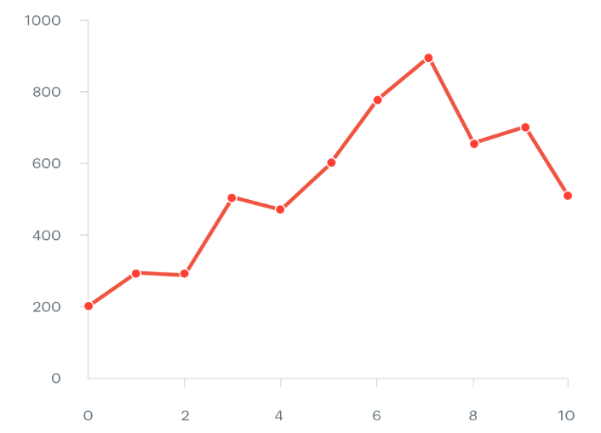
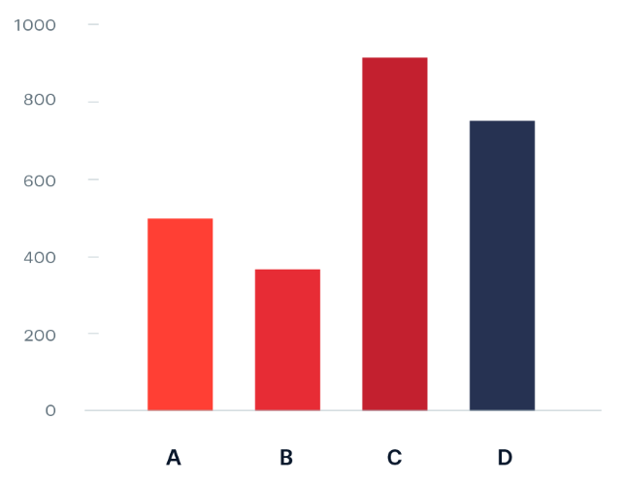
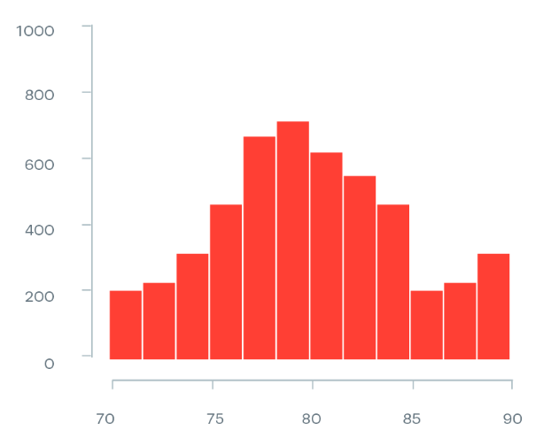
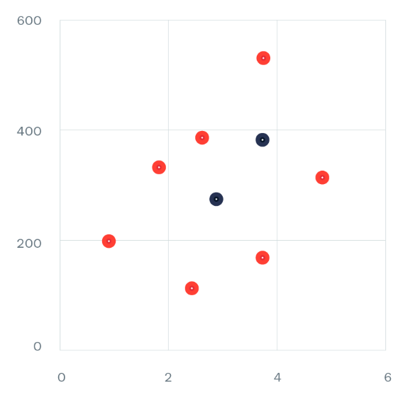
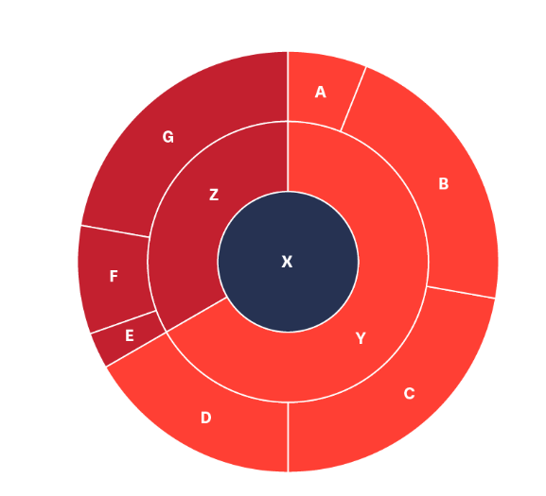
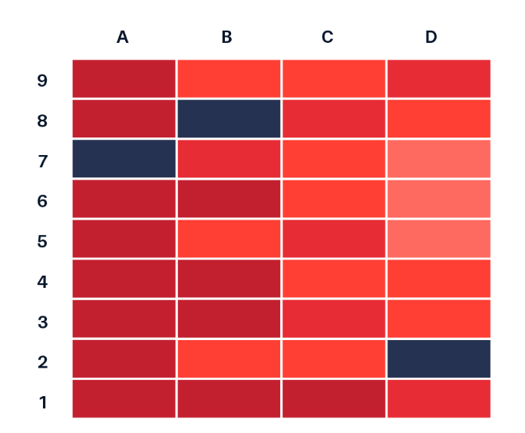
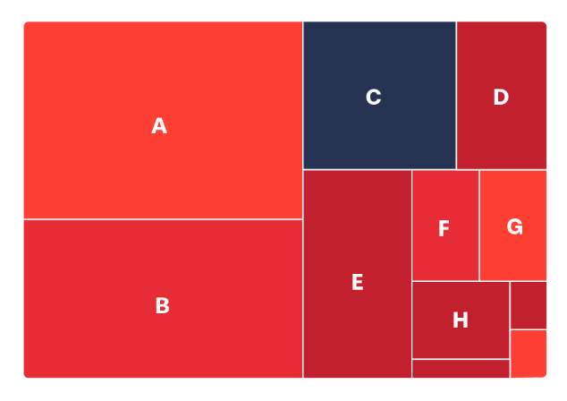
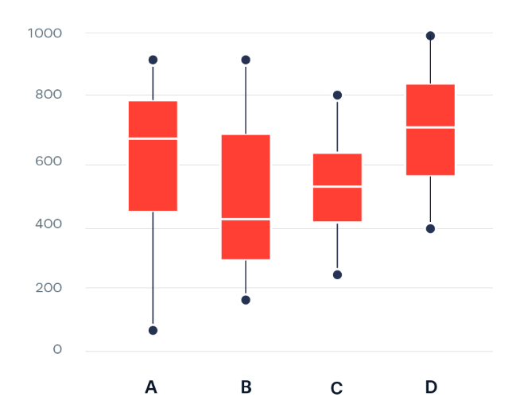
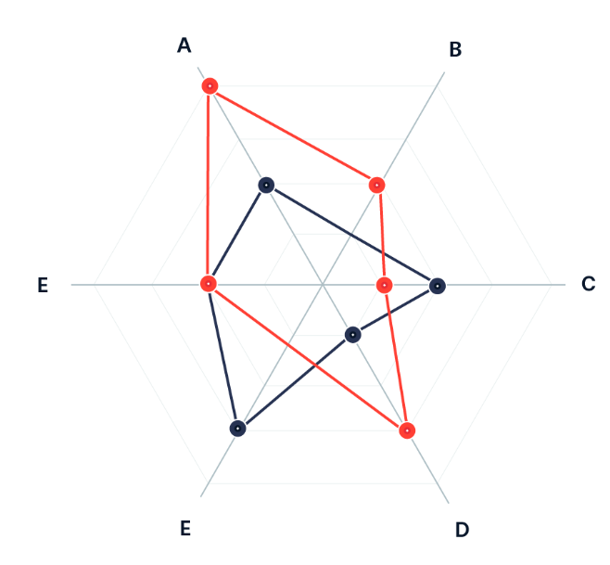
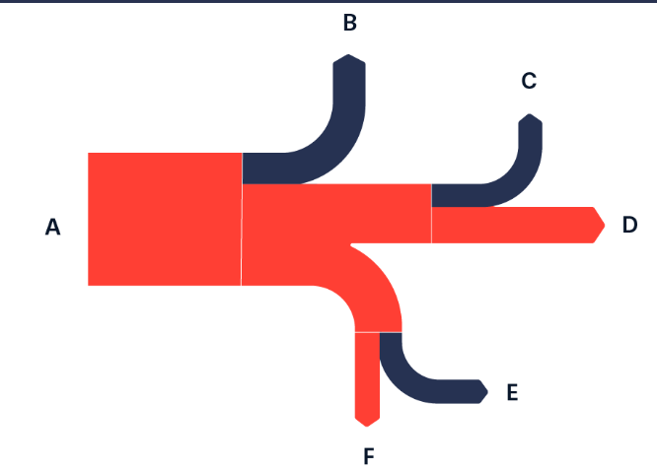
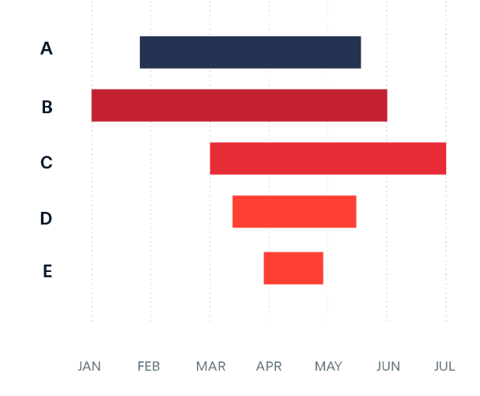
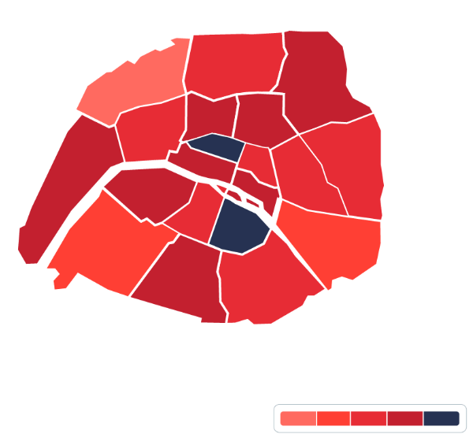

Slide 11
Univariate, Bi-variate and Multivariate Analysis
Analysis of variants in Data Science process, it could be Univariate (or) Bi-variate (or) Multivariate
Univariate - Only one variable at a time
Bi-variate - Compare two variables
Multivariate - Compare more than two variables

Slide 12
Tools for creating visualizations
Microsoft Excel
Tableau
Power BI
Google Data Studio
Python Libraries (Matplotlib, Seaborn, Plotly, Bokeh, Geopandas, Holoviews…)
R libraries (ggplot2, Lattice, Base R Graphics, Plotly, dygraphs…)

Slide 13
Word Cloud
For data in text based nature.
Graphical representation or image of a series of keywords. Also known as tag cloud.
Identifying new SEO terms to target
Allows to identify most relevant topics at a glance.

Slide 14
Front-end dashboard
1. Integration with Python ecosystem
2. Responsive design
3. Taking inputs
4. Interactive Charts and Graphs
5. Real-time updates
6. Dynamic Filtering and Drill down
7. Customization options
8. Data export and download
9. Data Annotations
10. Cross-visualization interactivity
11. Integration with backend API’s
12. User Authentication and Authorization

Slide 15
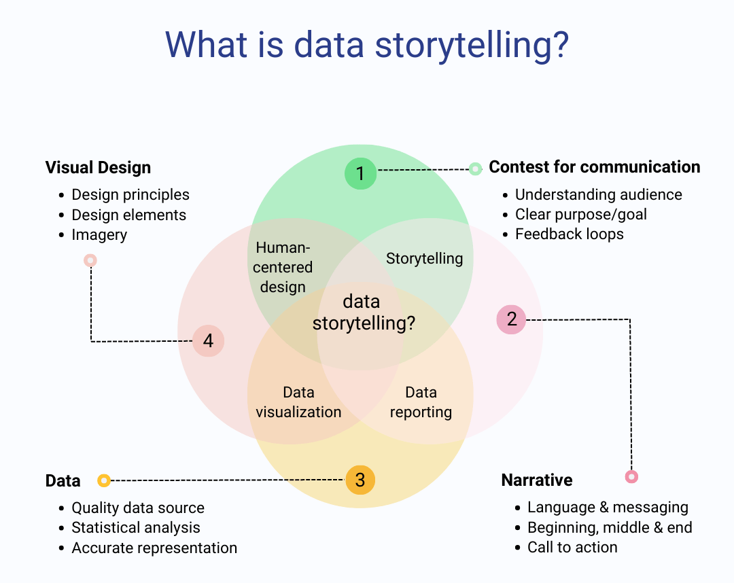
Story telling
Notes:
Statistical involves descriptive, inferential, predictive, prescriptive, Exploratory data analysis

Slide 16
Integrative practice that incorporates knowledge and skills from several disciplines, including communication, analysis and design.
Data storytelling – We are talking about stories in which data is the center point. The story is meant to explain the data why it matters.
Data storytelling couples data visualization with compelling narratives that helps audiences better comprehend and take action based on data analysis. While effective data visualization helps people grasp and remember key takeaways, data storytelling is essential for helping them understand why those takeaways matter.

Slide 17
Communication
Clarity and simplicity
Clear design – Easy to understand at a glance
Simplicity – Simplify complex data, use concise labels and legends
Audience consideration
Know your audience – Tailor visualizations to their understanding
Address questions – Anticipate potential questions, incorporate relevant information.
Story telling
Narrative structure – Narrate data that highlights key insights
Contextualization – Explain “why” behind the numbers
Use of color
Meaningful colors – Highlight important info and differentiate categories
Color consistency – Maintain consistent color schemes across visualizations for uniformity.

Slide 18
Interactivity
Interactive elements – Allow users to explore data by hovering, clicking or zooming
Tooltips – Provide additional information without cluttering the main visualization
Data Integrity and Accuracy
Data sources – Mention source of data to establish credibility
Accuracy – Of data and calculations. Clearly state any limitation or assumptions
Visualization types
Choose appropriate types – Right type of chart
Avoid misleading visualizations – Be mindful of unintentional biases or misinterpretations that may arise from certain visualization choices
Annotations and labels
Annotations – Use annotations to highlight specific data points or events
Descriptive labels – Clear descriptive labels for axes, data points and other elements
Accessibility
Accessible design – Ensure that visualizations are accessible to all users. Including visual impairments. Use alt text for images and provide textual summaries.

Slide 19
Feedback and iteration
Gather feedback – Seek feedback from stakeholders and users. Use it to refine and improve visualizations
Iterative process – Treat data visualization as a iterative process. Update visualizations as new data available
Consistency across platforms
Consistent branding – Maintain consistent branding and styling across different visualization platform or reports
Compliance and ethics
Ethical consideration – Be aware of ethical considerations related to data visualizations, including privacy concerns and avoid misleading representations

Slide 20
Use cases in finance/banking industry
Trend Forecasting
Examples - Stock market (Candlestick charts), E-Commerce (Time Series plots), Social media engagement (Heatmap and sentiment analysis), Supply chain and logistics trends, Healthcare trends (Epidemiological Models)
Fraud detection
Examples - Transaction monitoring (unusual pattern), identity verification, behavioral analysis, customer profiling…
Market research
Examples - Data collection, Sentiment Analysis, Economic indicators, Competitor Analysis, Risk Assessment, News and Event monitoring…
Investment management
Examples - Client profiling, Asset allocation, Risk Assessment, Dynamic rebalancing…

Slide 21
Customer service
Examples - Customer data management, Predictive analytics, Chatbots and Virtual assistants, personalized recommendations, Customer feedback analysis…
Risk Analysis
Examples - Credit scoring models, Collateral evaluation, Financial ratios analysis, Risk ratings and grading…
Task Automation
Examples - Invoice receipt and data capture, Data validation and verification, Invoice approval workflow, Reporting and analytics…
Scalability
Examples – Payment processing, Mobile and web application scalability, scalable database architecture…

Slide 22
Code Maintenance and Deployment
Prepare your code
Setup a version control system
Create a virtual environment
Containerization
CI / CD
Configuring database
Security consideration
Monitoring and logging
Documentation
Cloud deployment
Physical server deployment
Backup and disaster recovery

Slide 23
Other useful Python libraries
Pygwalker
Visual python
Summary tools
Jupyter datatables
Ipywidgets
Mito sheet

Slide 24
Any Questions?

Slide 25
Any Feedback

Slide 26
Thank You

