Slide 1
GUARDRAIL SOURCING DECISION
Do we buy a hosted guardrail,
or run our own?
Measured on 2,275 expert-annotated finance, healthcare and law prompts. Twenty-four guard configurations, identical rows, identical false-alarm budget.
Reza Rahimi, PhD
Full method, intervals and limitations: “Benchmark Gains Do Not Guarantee Transfer: Fine-Tuning Small Language Model Safety Guards” — the technical report and research deck
Notes:
Ninety seconds on this slide. The framing sentence is: we need a safety guardrail in front of
every request our assistant handles, and there are two ways to get one -- call a hosted
frontier model, or run a small open-weights model ourselves. This deck prices that choice.
Say up front what makes the comparison trustworthy, because it is the thing that makes the rest
land: every configuration is scored on the SAME rows, and every one is re-tuned to the SAME
false-alarm rate before we compare catch rates. Without the second step you can make any guard
look good by letting it cry wolf more often.
Do not promise a single recommendation yet. Slide 3 gives it.

Slide 2
THE DECISION
A guardrail runs on every request, so its cost is a recurring line, not a one-off
Which means accuracy, latency, unit cost and data residency all bind at once
— Accuracy. A missed unsafe prompt is the incident. A false alarm is a blocked customer. Both are real costs, so the guard must be judged at a fixed alarm rate.
— Latency. It sits in the request path. Whatever it adds, every user pays on every turn.
— Unit cost. Priced per prompt, it scales with traffic, not with headcount.
— Residency. In mortgage the prompt itself contains borrower information, so where it travels is a compliance question before it is an engineering one.
WHY WE COULD NOT JUST READ THE VENDOR BENCHMARKS
Public guard leaderboards score general web-safety prompts. Our exposure is regulated-domain advice, where the same words are safe or unsafe depending on who is asking and what was promised.
SO WE MEASURED ON OUR OWN TERMS
Expert-annotated finance, healthcare and law prompts; every guard scored on identical rows; catch rates compared only at a matched 5% false-alarm budget.
Guardrail sourcing · in-house inline, escalate the uncertain slice
01
Notes:
Purpose of this slide: establish that this is a sourcing decision with four binding
constraints, not a model-quality question. If someone in the room only cares about accuracy,
this is where you widen it.
The residency bullet is the one that tends to change the conversation with legal. Our mortgage
prompts contain borrower detail; sending them to a third party is a GLBA question. That is not
a reason to refuse hosted models, but it is a reason the decision cannot be made by the ML team
alone.
If asked why not just trust published guard benchmarks: because they measure general web
safety, and our failure mode is regulated-domain advice where context decides the label. We
have direct evidence in the technical report that guard rankings reorder when the benchmark
changes -- that is the report's title finding.

Slide 3
THE ANSWER
Run the small guard in-house on every request. Send out only the ones it is unsure about
One rule, three lanes. The question is not in-house OR outsource — it is which requests go out
Lane
Which requests
Guard
Why
1 Regulated
prompt contains borrower or patient data
in-house only
cannot lawfully leave
2 Uncertain
in-house guard is near its decision line
escalate to hosted
this is where the accuracy is won
3 Clear-cut
in-house guard is confident either way
in-house only
hosted would not change the answer
20%
of requests escalated — lane 2 only
51%
of the accuracy gap to hosted, closed
80%
of prompts never leave our network
Guardrail sourcing · in-house inline, escalate the uncertain slice
02
Notes:
This is the slide to spend time on. Everything after it is evidence.
The three numbers, precisely, for anyone who asks:
- catch-rate gap +0.066 at a matched 5% false-alarm rate, 95% interval
[+0.043, +0.089] -- the interval excludes zero, so this is not noise.
- 77x is median-to-median: about 1,553 ms hosted against
10-25 ms for a small guard on our own GPU.
- $0.80 per thousand prompts is billed tokens at public list prices, and it
excludes the GPU you already own on the self-hosted side. It is an estimate, not an
invoice.
The recommendation is deliberately a split, not a winner. If pushed for one answer: hosted,
because the accuracy difference is the largest single effect anywhere in this study. But the
regulated path is exactly where we cannot take it, which is why the split is the honest answer
rather than a hedge.
Third bullet matters for planning. Someone will propose "just fine-tune ours" or "just use a
bigger one". Both were tested. Neither worked. Slides 5 and 6.

Slide 4
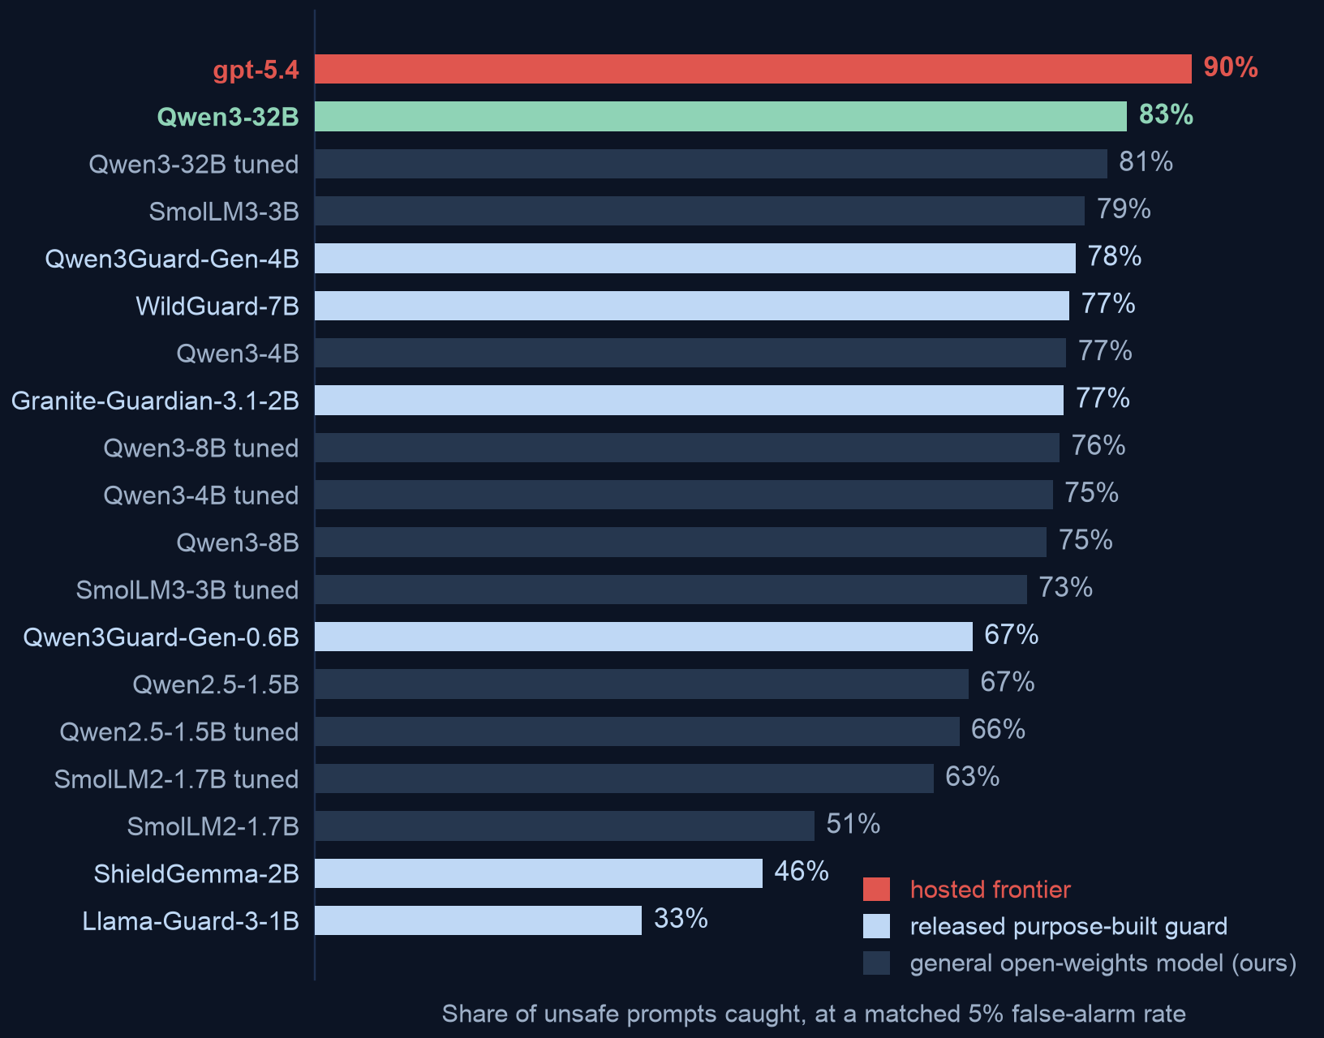
WHAT HOSTED BUYS
At the same false-alarm rate, the hosted model catches about half of the unsafe prompts our own guards miss
Catch rate on expert-annotated finance / healthcare / law prompts, all at a 5% false-alarm budget
READ THIS AS COARSELY RESOLVED
The hosted model reports only a coarse 0-100 confidence, which limits how finely we can rank its answers. That bounds precision without fixing a direction — a finer score could order a tied block either way — so do not read the gap as conservative.
WHY 'AT THE SAME FALSE-ALARM RATE' MATTERS
Any guard can raise its catch rate by alarming more often. Holding the alarm rate fixed at 5% is what makes every bar here comparable at all.
Guardrail sourcing · in-house inline, escalate the uncertain slice
03
Notes:
One claim: hosted is better, by about ten points of catch rate, and the comparison is fair.
Exact figures if challenged: gpt-5.4 (low) .896 against Qwen3-32B
.830, difference +0.066 with 95% interval [+0.043, +0.089].
Against the strongest model in our locked research panel it is +0.109
[+0.077, +0.139]. Both intervals exclude zero. These are paired comparisons on identical
rows, which removes row-difficulty as an explanation.
The coarse-confidence point is worth making unprompted, because it is the one place we
disadvantaged the hosted model and it strengthens rather than weakens the conclusion.
If asked about the labels: external, expert-annotated, and a stronger labelling tier than
anything we produced ourselves. We did not grade our own homework here.

Slide 5
BUT BETTER AT WHAT
On traffic we can describe in advance, our own guard already wins
Same five corpora, same 5% false-alarm budget, split by whether the source was in our training manifest
+0.083 catch rate
Averaged across every source we can describe in advance, our tuned guards rank BETTER than the hosted model at the same alarm budget. 95% interval [+0.013, +0.157] -- it excludes zero.
.967 vs .917
The same comparison on a source we did NOT train on. Hosted leads, and our best guard there is an UNTUNED base -- tuning is what costs us the position.
THE SOURCING RULE THIS IMPLIES
The gap is not a ceiling a bigger local model would break through -- it is the price of the regime. So the question is not “can a small guard match the frontier” but “what share of our traffic can we describe in a training manifest”. Self-host that share and escalate the rest by how near the local guard sits to its own decision line -- the router we measured. Routing on UNFAMILIARITY instead is the more attractive idea and we did not test it: treat it as the next experiment, not as the plan.
Guardrail sourcing · in-house inline, escalate the uncertain slice
04
Notes:
This is the slide that changes the recommendation, so do not rush it.
Slide 4 said hosted is about ten points better. True -- on prompts nobody anticipated. This
slide says that on sources we can enumerate in a training manifest the ordering inverts, and a
our tuned guards rank BETTER on average: the equal-source mean difference is
+0.083, 95% interval [+0.013, +0.157], which excludes zero. In AP it is
+0.039 [+0.015, +0.072].
Be careful with single benchmarks here, and say this before anyone asks. The most eye-catching
cell is a Qwen2.5-1.5B guard at .948 against .741 on
prompt_injections. That cell is the largest of 12, so quoting its own interval
overstates it: 3 of 12 cells clear zero on their own, and
0 survive a familywise correction. The average is the number to defend, not
the best cell.
Represented sources here are jailbreak_classification, prompt_injections, toxicchat. Held-out sources are the ones we never
trained on, and there the hosted model leads.
Two honest caveats, offered before they are asked. Per-source samples are small (67 to 451
rows), so read the direction rather than the exact margin. And this is retrospective analysis
on a panel we inspected while building the method -- it is a strong signal, not a sealed
confirmatory result.
The business consequence: we do not need to beat the frontier everywhere to stop paying per
prompt. We need to know which slice of traffic we can characterise, self-host that, and buy
hosted capacity only for the rest.

Slide 6
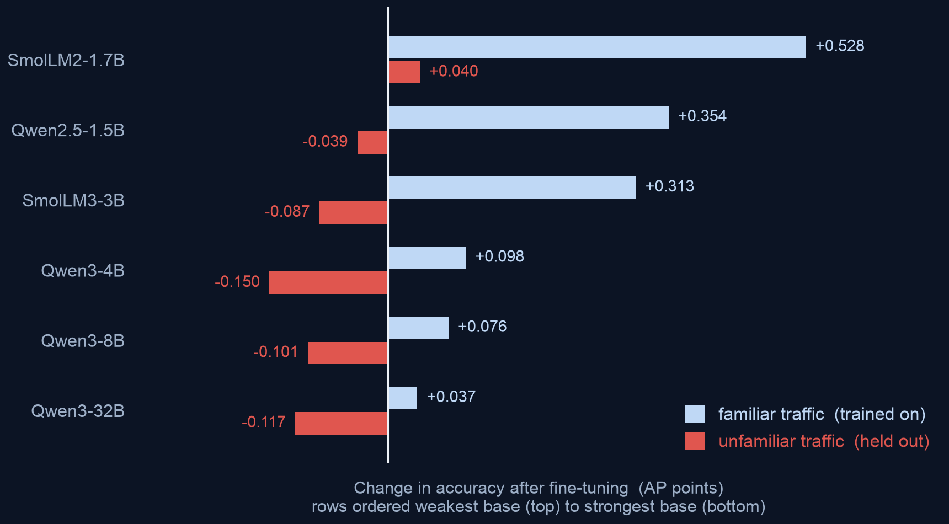
ROUTE ONE: FINE-TUNE OURS
Fine-tuning did not close the gap, and on unfamiliar traffic it usually made things worse
Change in catch rate after fine-tuning, across 6 models · 5 training runs each
THE PATTERN BEHIND IT
Fine-tuning teaches a model the traffic you trained it on and costs it accuracy on traffic you did not. Read the chart downward: the blue gain shrinks and the red cost grows as the starting model gets stronger.
PLANNING CONSEQUENCE
Budgeting a tuning project to close a vendor gap is not supported here. The best tuned result anywhere (81%) still loses to hosted (90%).
Guardrail sourcing · in-house inline, escalate the uncertain slice
05
Notes:
The headline is the sign split, not the average. If you quote only the mean change
(+0.005) you will mislead the room -- it is a small number sitting on top of
swings from -0.059 to +0.122.
Mechanism, in plain terms: fine-tuning on a fixed set of sources specialises the model to
those sources. It buys a lot of accuracy on traffic that looks like the training data and
gives some back on traffic that does not. Our measurements say the trade gets worse as the
starting model gets stronger -- the strongest model we tuned gained the least and lost the
most.
This is the central finding of the underlying research, reproduced here on external
expert-annotated data rather than on our own panel, which is a harder test.
If asked "did you tune it badly": five independent training runs per model, one recipe, and
the same recipe that produces large gains on in-distribution traffic. The gains are real; they
just do not transfer.

Slide 7
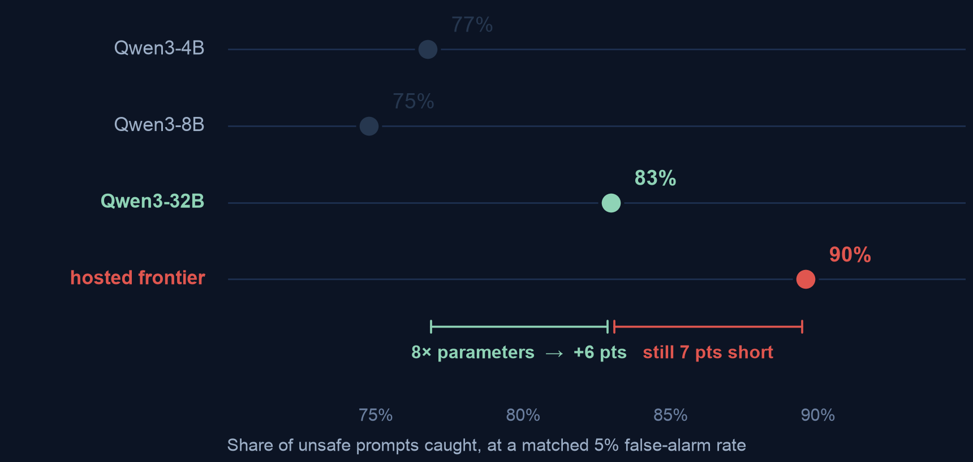
ROUTE TWO: BUY A BIGGER ONE
Eight times the parameters bought less than the gap that was left
Catch rate against model size, same family, same prompt, same rows
— 8× the parameters bought +6 pts. Going from 4B to 32B.
— The gap left is +7 pts. Slightly larger than everything that scaling bought.
— 4B to 8B bought nothing. Size does not buy guard accuracy smoothly.
WHAT THIS IMPLIES FOR A BUILD PLAN
Over the range we measured, size does not close the gap — and 32B is already past the point where a guard is cheap to run on every request, which was the reason to self-host in the first place. Three points, one of them non-monotonic, identify no scaling law, so we do not extrapolate a size that would close it.
Guardrail sourcing · in-house inline, escalate the uncertain slice
06
Notes:
One claim: scale is not the escape hatch either.
Exact numbers: 4B to 32B is +0.062, interval [+0.039, +0.084]. The remaining gap
to hosted from 32B is +0.066, interval [+0.043, +0.089]. So an eightfold
parameter increase bought slightly less than what was still missing.
The 8B row is worth flagging honestly: it came out below 4B, but the interval
([-0.050, +0.001]) includes zero, so the correct statement is "no gain", not "worse".
Do not oversell it -- but do use it to make the point that size and guard quality are not
tightly coupled.
The build-plan consequence is the part an executive audience should leave with. A 32B guard on
every inbound request is a serving cost close to the thing we were trying to avoid. If we are
paying that, the hosted option deserves another look on cost grounds alone.

Slide 8
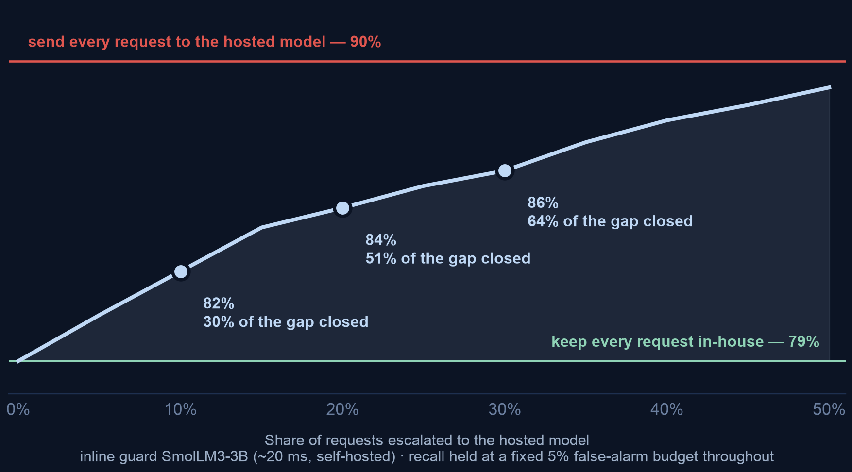
WHY THE RULE WORKS
You do not have to choose. Escalating the uncertain fifth buys half the difference
Recall against the share of requests sent out, at a fixed 5% false-alarm budget
THE CURVE IS STEEP EARLY
The first requests escalated are the ones the in-house guard is least sure about, so they carry the most information. Value per escalated request falls as the share rises — which is why a fifth buys half.
IT IS A DIAL, NOT A SWITCH
Legal sets the ceiling on what may leave; budget sets the rest. Pick a point on the curve — the architecture does not change.
WHAT THIS COSTS
At a 20% escalated share: about $0.16 per thousand requests instead of $0.80, and the 1,553 ms hosted round-trip lands on one request in five rather than on all of them.
Guardrail sourcing · in-house inline, escalate the uncertain slice
07
Notes:
This is the evidence slide for the rule on slide 3. One claim: the relationship is smooth and
steep early, so escalation is a dial rather than an architecture decision.
Mechanism, and it is why this works at all: the requests chosen for escalation are the ones
nearest the in-house guard's own decision line -- exactly the cases where a second opinion can
change the answer. Escalating confident rows adds cost and no accuracy.
Method, if challenged. One global false-alarm budget across the whole curve, so every point is
comparable and we are not buying recall by alarming more. The two guards are fused on RANK, not
raw score, because a logit margin and a self-reported 0-100 risk are not on the same scale. We
tried a per-band threshold first and rejected it: with a small escalated slice there are too few
deferred negatives to place a stable threshold, and the curve went non-monotone for purely
numerical reasons. The figure stops at 50% because past that you have outsourced the majority;
the upper rule shows where full escalation lands.
Cost is linear in the escalated share, so a fifth of the traffic is a fifth of the bill.

Slide 9
IF NOTHING MAY LEAVE
Combining our own guards helps a little. It does not reach the hosted model
Every option below priced against our strongest single in-house guard (83%), with what each costs per request
Option
Catch rate
Cost per request
Verdict
Best single in-house guard
83%
1 model call
the baseline
Average the 5 tuning runs of one guard
+0.026 on top
already paid for
worth doing
Average all 18 guards equally
79%
18 model calls
worse than one
Weighted blend of all 18
85%
18 calls + labelled data
best in-house
Escalate the uncertain 20% instead
84%
1.2 model calls
nearly matches, far cheaper
THE FINDING THAT MATTERS FOR PLANNING
Escalating one request in five gets within about a point of the 18-model blend (84% vs 85%) at a fifteenth of the compute and with no labelled data to collect. Ensembling is the right answer only when nothing may leave at all; then it is the in-house ceiling, worth about a quarter of the gap.
Guardrail sourcing · in-house inline, escalate the uncertain slice
08
Notes:
This slide exists because "just ensemble the small models" is the most common suggestion in the
room, and it deserves a measured answer rather than an opinion.
Row by row. Averaging the five tuning runs of a single guard is free -- the adapters already
exist -- and it reliably adds about +0.026. Do that regardless; it is also how the
tuned 32B recovers what fine-tuning cost it.
Averaging all 18 guards equally is WORSE than just using the best one
(.791 against .834). With members that differ this much in
quality, equal weights dilute the strong ones. If someone proposes "ensemble everything", this
is the row to show them.
A fitted weighted blend does beat any single guard, reaching .850, about a quarter of
the way to hosted. Two costs are easy to miss: 18 forward passes per request, and
it needs LABELLED in-domain data to fit the weights -- which is usually the thing a team reaching
for an ensemble does not have. We scored it 5-fold out-of-fold so it is not
grading its own homework, and its fitted weights include a negative coefficient on one guard,
which means it is exploiting error structure that may not survive a change of traffic.
The last row is the point: escalating the uncertain fifth reaches 84% against the
blend's 85% -- it does NOT beat the blend, it very nearly matches it for a
sixteenth of the compute and no labelled data. If challenged on this, the honest line is that
the blend is still the in-house ceiling; escalation is the cheaper route to almost the same place.
An earlier version of this slide printed 87% here and claimed escalation beat the blend, which
reversed the ordering. So ensembling is not the route -- unless lane 1 applies and nothing
may leave, in which case it is the in-house ceiling and worth building.

Slide 10
WHAT HOSTED COSTS
The accuracy is real. So is the bill, the latency, and the loss of control
Four costs, three of which do not appear on an invoice
Self-hosted small
Hosted frontier
THE ONE WE DID NOT EXPECT
The provider refused to evaluate a subset of prompts outright, and did so inconsistently — the same prompt was refused on some runs and not others. A guardrail that intermittently declines to answer is itself an audit finding.
Median latency
10–25 ms
~1,553 ms
Cost per 1k prompts
GPU you own
$0.80
Prompt leaves our network
no
yes
We choose the alarm rate
exactly
approximately
CONTROL OVER THE ALARM RATE
Our own model exposes a continuous score, so we can set the false-alarm budget precisely. The hosted model reports a coarse 0–100 value, so we can only land near a target.
NOT A REASON TO REFUSE HOSTED
It is a reason to scope it: hosted on traffic where the prompt may leave and latency is not critical; self-hosted on the regulated, latency-sensitive path.
Guardrail sourcing · in-house inline, escalate the uncertain slice
09
Notes:
Work down the table, then land on the two callouts, which are the non-obvious costs.
Latency: 1,553 ms median measured under load at high concurrency, so treat it as
an upper bound for a single request; the small-model figure is a batched GPU measurement. Even
allowing for that, the ratio is roughly 77x.
Cost: billed tokens at public list prices. It excludes the amortised GPU on the self-hosted
side, which is exactly why the comparison is about where to spend rather than a like-for-like
price.
The refusal finding is the one to say slowly. We saw a set of prompts refused by the provider's
own input filter before the model ever saw them, and the refusals were not reproducible --
different runs, different outcomes, no row refused every time. For a control that has to be
auditable, "sometimes declines, for reasons we cannot inspect or appeal" is a compliance
property, not a technical footnote.
Close on the scoping sentence. The answer is a split, and this slide is why.

Slide 11
THE USEFUL FINDING
If we must self-host, a bigger untuned model beats a tuned small one
Because tuning's cost lands on exactly the traffic a guardrail exists to catch
— Tuning a small model. Large gain on familiar traffic, and it gives back accuracy on unfamiliar traffic — which is where novel attacks arrive.
— A bigger untuned model. Recovers most of that same gain on familiar traffic, and holds its accuracy on unfamiliar traffic.
— So for a guardrail specifically. Prefer spending on a stronger base model over spending on a tuning programme.
WHY THIS IS WORTH MONEY
It reverses the intuitive plan. Tuning looks like the cheap, targeted option; measured on held-out traffic it is the one that quietly costs you coverage.
CONFIDENCE LEVEL
This is a comparison between different model sizes, not a controlled experiment at fixed size. Treat it as a strong steer on where to spend, not a proven law.
Guardrail sourcing · in-house inline, escalate the uncertain slice
10
Notes:
This slide did not exist in the plan. It fell out of the scale experiment and is probably the
most commercially useful thing in the deck.
The mechanism: fine-tuning specialises. It buys accuracy on the sources you trained on and
withdraws it from sources you did not. A bigger base model arrives with broad competence
already and does not have to trade any of it away. For a guardrail, the traffic you did not
anticipate is precisely the traffic that matters, so a technique that trades away
unfamiliar-traffic accuracy is badly matched to the job.
Numbers are in the technical report; the honest caveat is on the slide. Comparing a 32B untuned
model to a tuned 4B is a deployment-choice comparison, not a controlled one -- the 32B costs
much more to serve. What we can say is that the tuning route did not close the vendor gap and
made held-out accuracy worse on most models, while the size route at least moved in the right
direction on both regimes.

Slide 12
CONFIDENCE AND LIMITS
What this does not tell you
Stated plainly, so the recommendation can be trusted where it does apply
— It is one benchmark. Expert-annotated finance, healthcare and law prompt safety. It is the strongest external evidence we have, and it is still a single instrument — and our own research shows guard rankings reorder when the benchmark changes.
— It is prompt-only. We judged incoming prompts, not the assistant's replies, and not the harder mortgage-compliance question of whether a specific answer breaks a specific rule.
— Vendor behaviour is a moving target. Model versions change under you. The self-hosted side is pinned to an exact revision and reproduces indefinitely; the hosted side does not.
— Prices are list, not invoices. Cost figures are billed tokens at public rates and exclude the GPU cost on our own side.
— The escalation curve is optimistically tuned. Its decision line and its global 5% budget are both chosen on the same rows it is then scored on, so a live deployment should expect to close somewhat less than 51% of the gap at a fifth escalated.
WHAT WOULD CHANGE THE RECOMMENDATION
A regulated-domain benchmark that scores whole answers against specific rules, with expert adjudication. That is the instrument we do not have, and building it is the highest-value next step.
Guardrail sourcing · in-house inline, escalate the uncertain slice
11
Notes:
Do not rush this slide, and do not apologise through it. Naming the limits is what makes the
recommendation on slide 3 credible.
The first bullet is the most important and the most self-undermining, which is why it belongs
here: the underlying research finding is that guard rankings depend on the benchmark. We are
handing you a recommendation derived from one benchmark. It is external and expert-annotated,
which is the best tier available to us, but a different instrument could reorder the middle of
the table. It is unlikely to reverse a ten-point gap.
The pinning point matters more than it sounds. A hosted model can change under a fixed
deployment; that is a change-control problem for a compliance control. Our own checkpoints are
pinned to a content hash and will reproduce in a year.
Close on the final callout: the thing worth funding is the measuring instrument for our actual
domain, not more guard comparisons on general safety.

Slide 13
PROPOSAL
What we would do next
Sequenced so each step is cheap and the expensive one is last
— Now · keep the in-house guard inline on everything. It already runs, it answers in ~20 ms, and it is the only lane available for regulated traffic. No new build.
— Now · add the escalation lane. Route the least-confident band to the hosted model where the data may lawfully leave. Start at 10–20% and read the curve.
— Now · treat a provider refusal as 'needs review'. Never as 'safe'. A one-line policy change, and today it is a silent gap.
— Next · stop the tuning workstream as a gap-closer. Keep it only for rescuing weak models. Redirect the effort.
— Then · build the domain instrument. A mortgage-compliance benchmark that scores whole answers against specific rules, with expert adjudication.
THE CHEAPEST ITEM IS THE REFUSAL ONE
It costs a policy change, and it closes a case where an unsafe prompt currently receives no verdict at all.
THE ONE THAT NEEDS A DECISION FROM THIS ROOM
Whether borrower-bearing prompts may leave our network at all. That single answer decides how much of our traffic can use the more accurate option, and it is a legal call rather than a technical one.
Guardrail sourcing · in-house inline, escalate the uncertain slice
12
Notes:
Two minutes. The first two items need no budget. The third frees capacity. The fourth is the
only one that asks for money.
Push for a decision on the right-hand callout before the meeting ends -- whether prompts
containing borrower information may go to a third-party API. Everything about the split
architecture depends on that answer, and it is not ours to make.
The refusal item is the one to insist on regardless of the rest. Today, when the provider
declines to evaluate a prompt, our pipeline records no verdict. That is indistinguishable from
a pass unless we say otherwise, and the prompts most likely to be refused are the ones most
likely to be genuinely unsafe.
If asked for the whole thing in one sentence: hosted is about ten points better at catching
unsafe prompts and we should use it wherever the data is allowed to travel, we should stop
expecting to close that gap ourselves, and the thing worth building is a benchmark for our own
domain rather than another guard.

