Slide 1
Chapter 44 Testing Using JUnit

Slide 2
Objectives
To know what JUnit is and how JUnit works (§44.2).
To create and run a JUnit test class from the command window (§44.2).
To create and run a JUnit test class from NetBeans (§44.3).
To create and run a JUnit test class from Eclipse (§44.4).

Slide 3
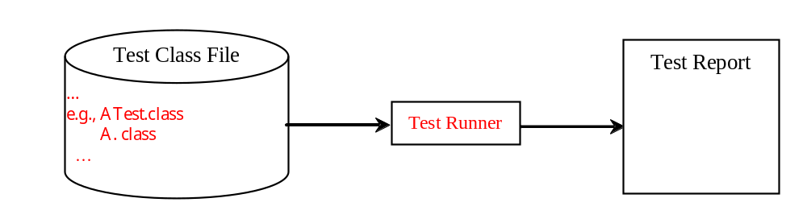
JUnit Basics
JUnit is the de facto framework for testing Java programs. JUnit is a third-party open source library packed in a jar file. The jar file contains a tool called test runner, which is used to run test programs. Suppose you have a class named A. To test this class, you write a test class named ATest. This test class, called a test class, contains the methods you write for testing class A. The test runner executes ATest to generate a test report, as shown in Figure 44.1.

Slide 4
Obtaining and Running JUnit
You will see how JUnit works from an example. To create the example, first you need to download JUnit from http://sourceforge.net/projects/junit/files/. At present, the latest version is junit-4.10.jar. Download this file to c:\book\lib and add it to the classpath environment variable as follows:
set classpath=.;%classpath%;c:\book\lib\junit-4.10.jar
To test if this environment variable is set correctly, open a new command window, and type the following command:
java org.junit.runner.JUnitCore

Slide 5
A JUnit Test Class
To use JUnit, create a test class. By convention, if the class to be tested is named A, the test class should be named ATest. A simple template of a test class may look like this:
package mytest;
import org.junit.*;
import static org.junit.Assert.*;
public class ATest {
@Test
public void m1() {
// Write a test method
}
@Test
public void m2() {
// Write another test method
}
@Before
public void setUp() throws Exception {
// Common objects used by test methods may be set up here
}
}

Slide 6
Run the Test
To run the test from the console, use the following command:
java org.junit.runner.JUnitCore mytest.ATest

Slide 7
Test ArrayList
Listing 44.1 is an example of a test class for testing java.util.ArrayList.
package mytest;
import org.junit.*;
import static org.junit.Assert.*;
import java.util.*;
public class ArrayListTest {
private ArrayList<String> list = new ArrayList<String>();
@Before
public void setUp() throws Exception {
}
@Test
public void testInsertion() {
list.add("Beijing");
assertEquals("Beijing", list.get(0));
list.add("Shanghai");
list.add("Hongkong");
assertEquals("Hongkong", list.get(list.size() - 1));
}
@Test
public void testDeletion() {
list.clear();
assertTrue(list.isEmpty());
list.add("A");
list.add("B");
list.add("C");
list.remove("B");
assertEquals(2, list.size());
}
}

Slide 8
Test the Loan Class
package mytest;
import org.junit.*;
import static org.junit.Assert.*;
public class LoanTest {
@Before
public void setUp() throws Exception {
}
@Test
public void testPaymentMethods() {
double annualInterestRate = 2.5;
int numberOfYears = 5;
double loanAmount = 1000;
Loan loan = new Loan(annualInterestRate, numberOfYears,
loanAmount);
assertTrue(loan.getMonthlyPayment() ==
getMonthlyPayment(annualInterestRate, numberOfYears,
loanAmount));
assertTrue(loan.getTotalPayment() ==
getTotalPayment(annualInterestRate, numberOfYears,
loanAmount));
}
/** Find monthly payment */
private double getMonthlyPayment(double annualInterestRate,
int numberOfYears, double loanAmount) {
double monthlyInterestRate = annualInterestRate / 1200;
double monthlyPayment = loanAmount * monthlyInterestRate / (1 -
(1 / Math.pow(1 + monthlyInterestRate, numberOfYears * 12)));
return monthlyPayment;
}
/** Find total payment */
public double getTotalPayment(double annualInterestRate,
int numberOfYears, double loanAmount) {
return getMonthlyPayment(annualInterestRate, numberOfYears,
loanAmount) * numberOfYears * 12;
}
}

