Slide 1
AE665A
Finite Volume Methods in Heat, Mass & Momentum Transfer
TERM PROJECT ON
''FVM Analysis of Lid Driven Cavity using SIMPLE Algorithm''
Course Instructor
Dr. Ashoke De
Presented By-
Rahul Ranjan (16101034)

Slide 2
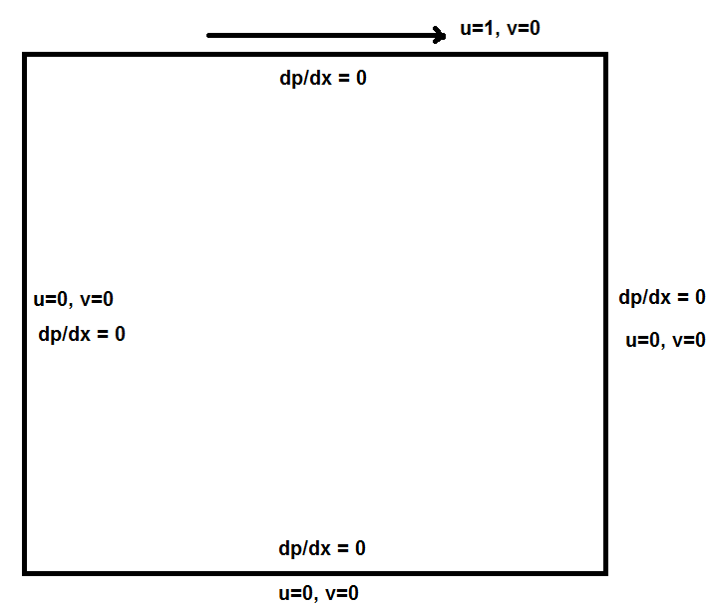
Problem Definition
Length of the square = 1m
A square shaped cavity is used whose upper lid is moving with velocity U=1m/s, while other boundaries have no slip tangential and zero normal velocity boundary condition.

Slide 3
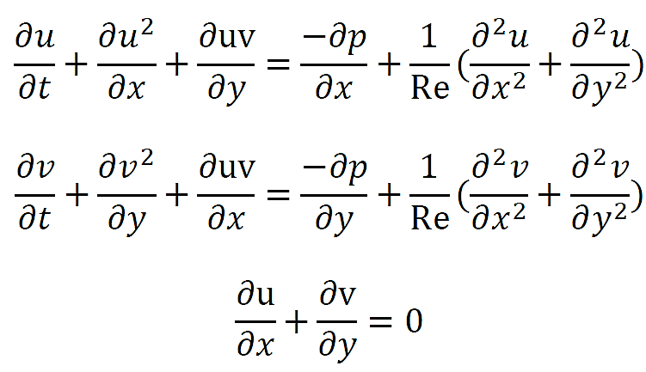
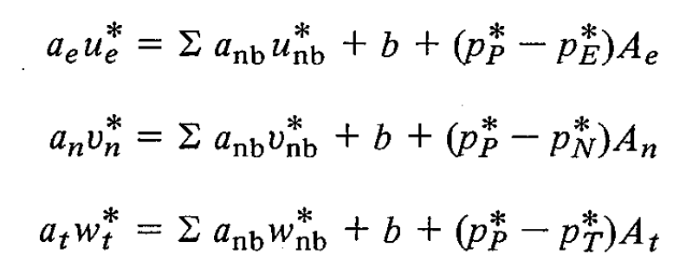

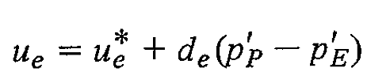
Objective :
Acquire the governing equations of fluid flow in Lid driven cavity and discretize the equations to solve it computationally.
To study and visualize the flow pattern in lid driven cavity at different Reynolds number.
Governing Equations:
Discretized Equations:

Slide 4
Methodology:
Simple Implicit Method for Pressure Linked Equation is used to obtain the discrete momentum equations.
The domain is uniformly meshed of size 128 X 128.
Ghost nodes is properly used for the ease of the computation.
X-momentum and Y-momentum discrete equation is solved by TDMA linear solver for one iteration.
Pressure Correction term is solved by TDMA until it is converged.
Then the overall iteration is carried out till convergence.
Convergence is tested on the basis of the net mass flux over the cell to be zero and on the basis of minimum iteration.

Slide 5
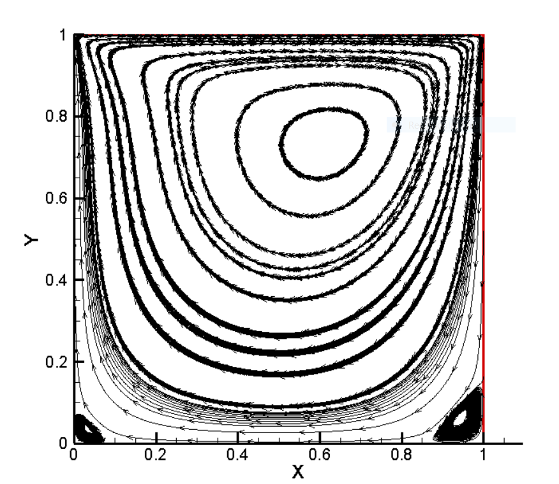
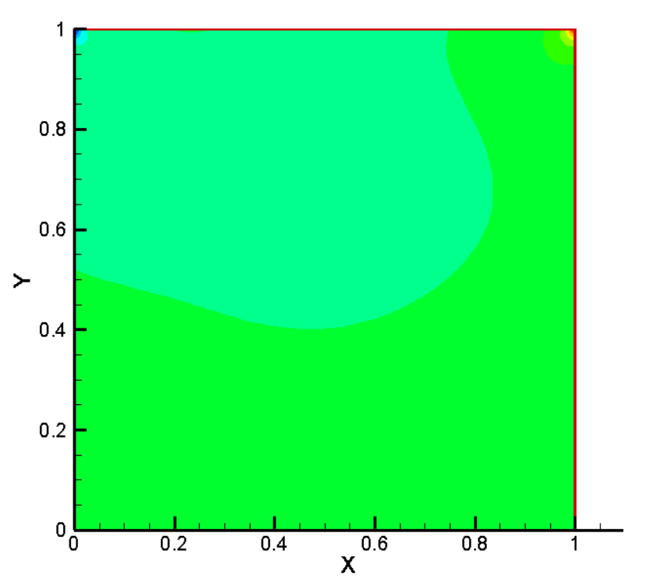
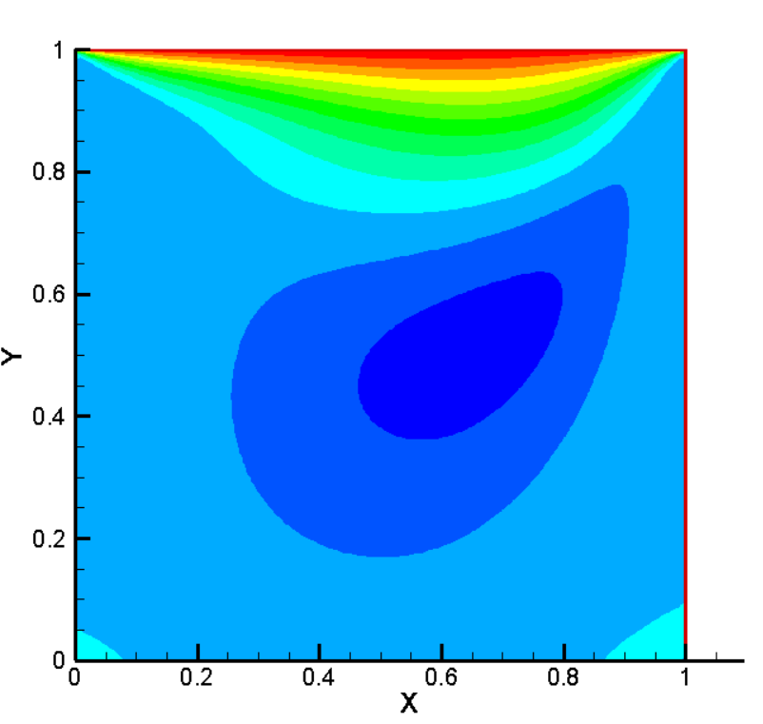
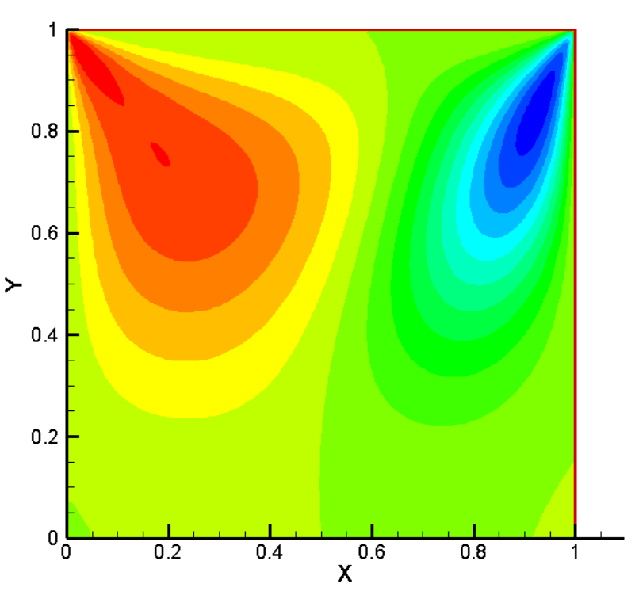
Results and Discussion: For Re=100
Time for Stability is about 10 seconds.
Primary Vortices are formed.
Secondary Vortices are formed at the bottom right and left corner.
Velocity streamline
Pressure Contour
U - contour
V - contour

Slide 6
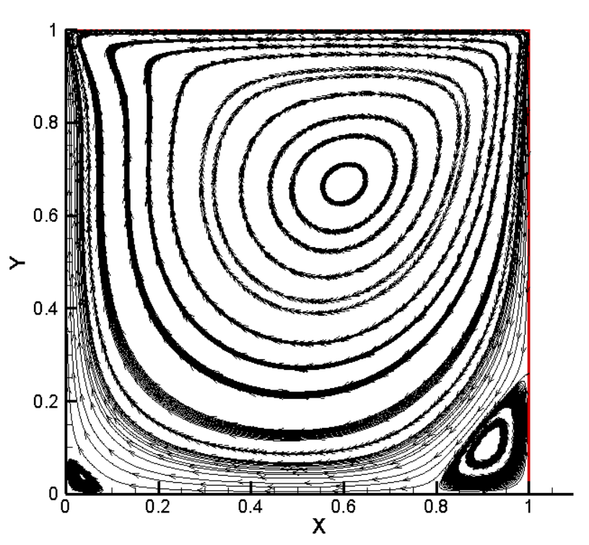
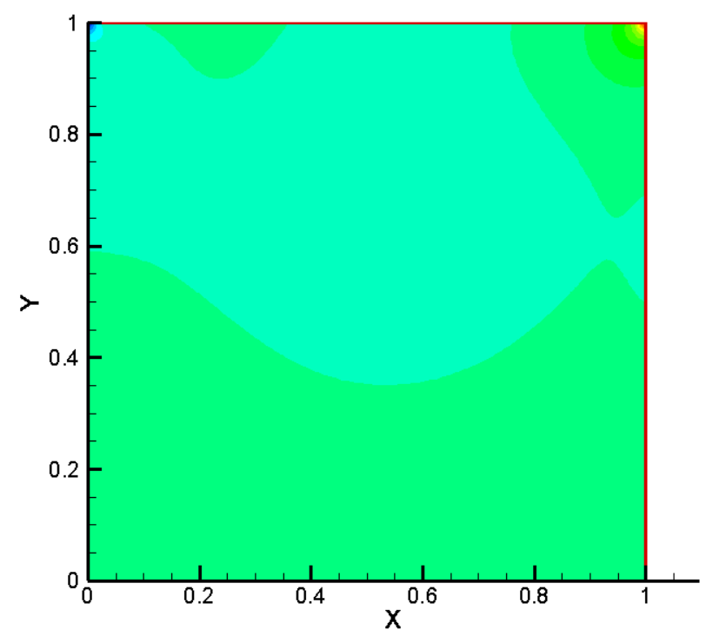
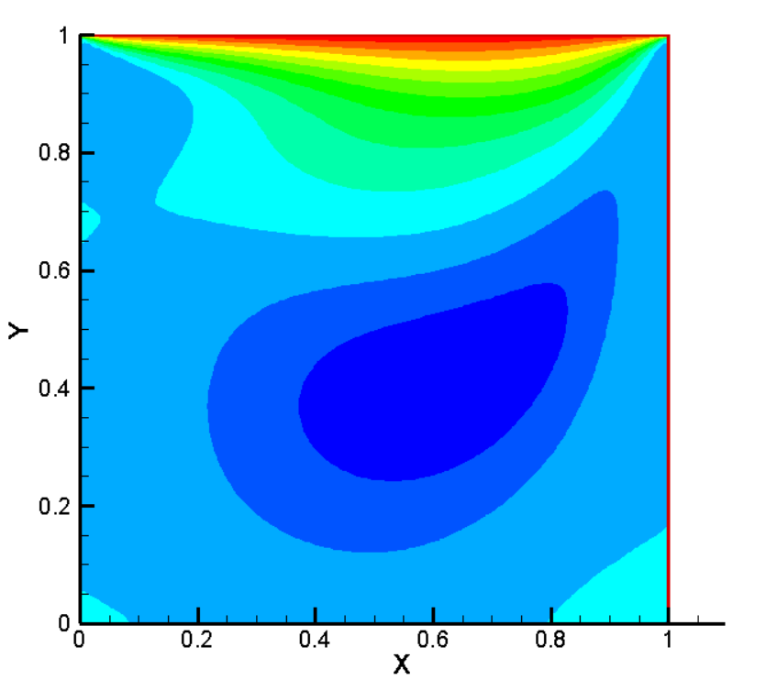
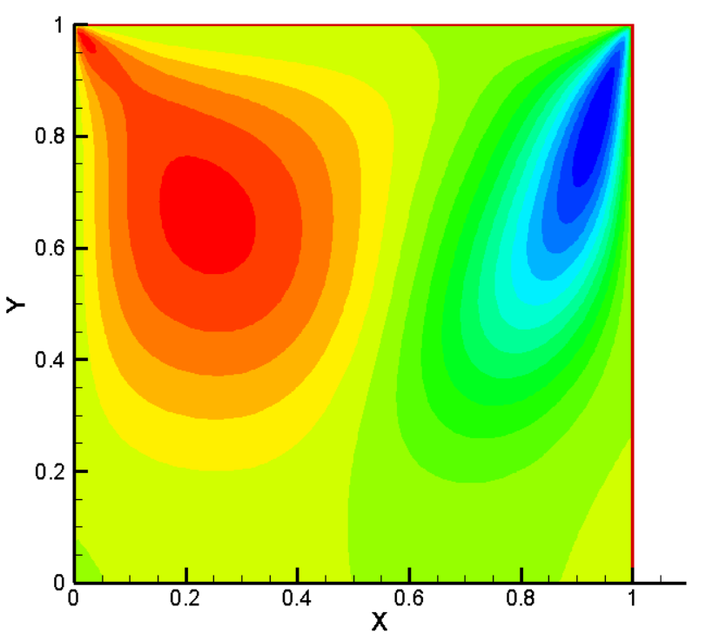
Results and Discussion: For Re=200
Time for Stability is about 24 seconds.
Primary Vortices are formed.
Secondary Vortices are formed at the bottom right and left corner.
Size of the secondary vortex increases.
Velocity streamline
Pressure Contour
U - contour
V - contour

Slide 7
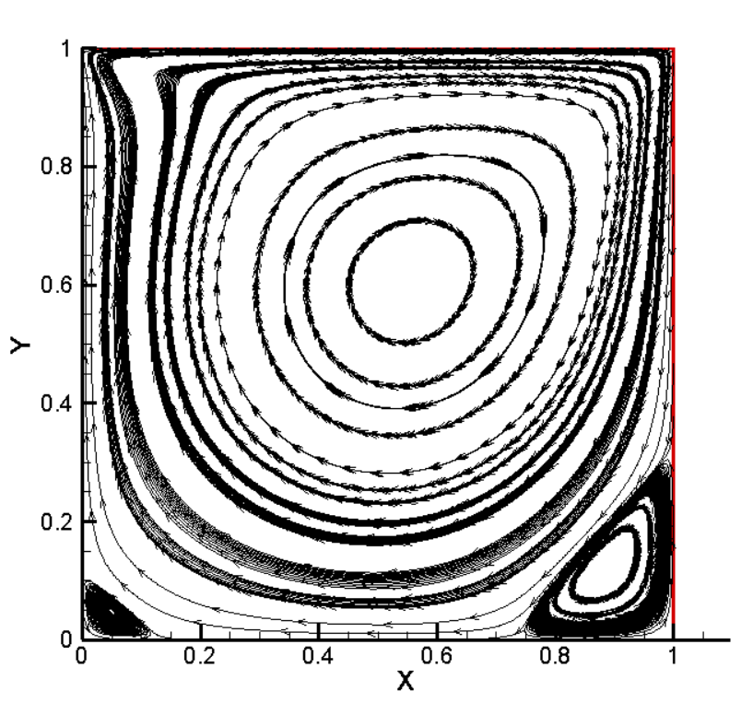
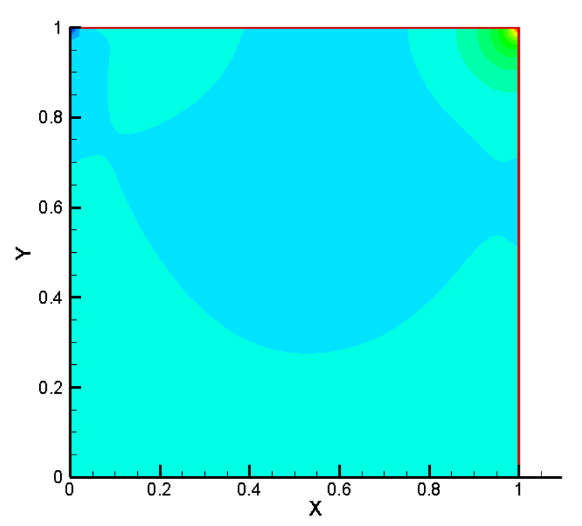
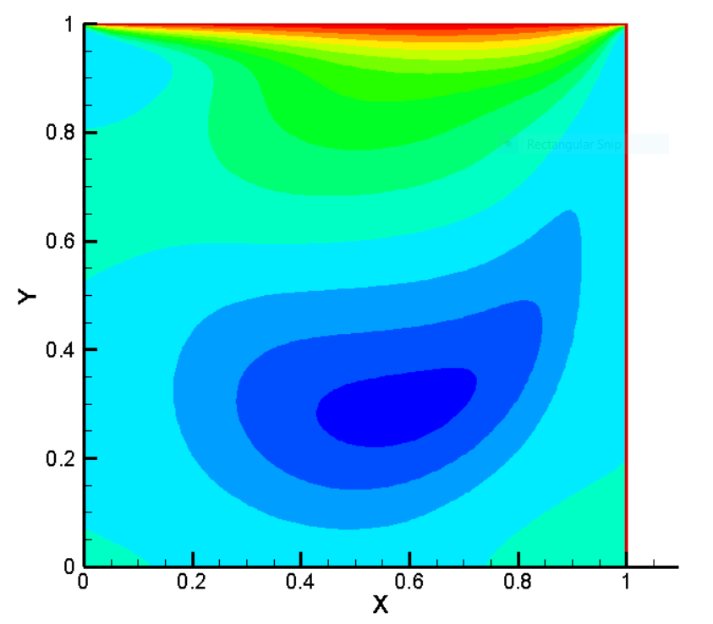
Results and Discussion: For Re=400
Time taken for Stability is about 100 seconds.
Primary Vortices are formed.
Secondary Vortices are formed at the bottom right and left corner.
Size of the secondary vortex increases.
Velocity streamline
Pressure Contour
U - contour
V - contour

Slide 8
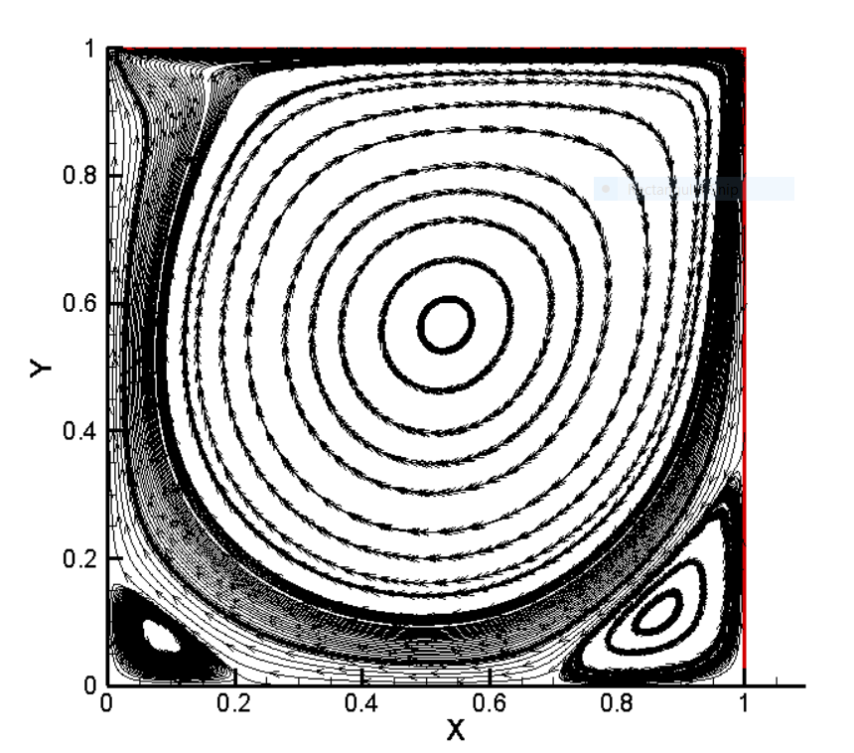
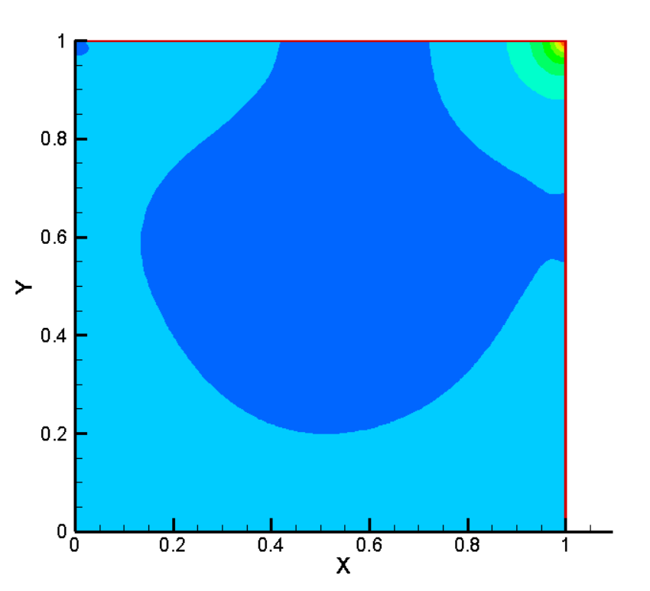
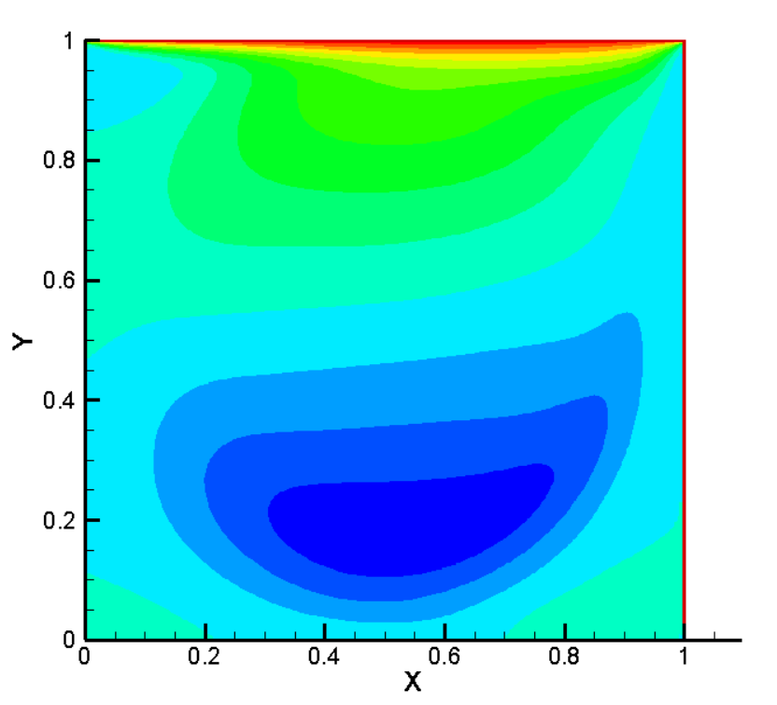
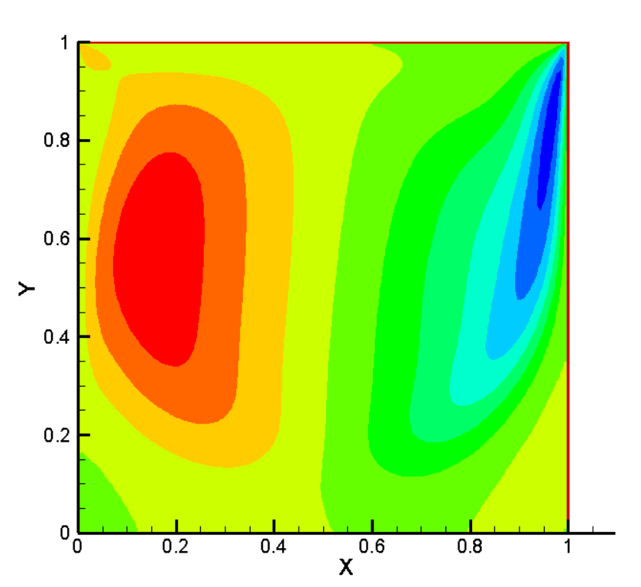
Results and Discussion: For Re=1000
Primary Vortices are formed.
Secondary Vortices are formed at the bottom right and left corner.
Size of the bottom right vortex increases.
Velocity streamline
Pressure Contour
U - contour
V - contour

Slide 9
Conclusion:
Numerical solution of the 2D incompressible unsteady Navier-stokes equations is obtained for lid-driven square cavity case for two different Reynolds Numbers using Finite Volume Method with primitive variable formulation on a uniform grid.
Convective terms are discretized by using hybrid scheme, and SIMPLE algorithm is used to decouple velocity and pressure.
Secondary vortices in the bottom right corner and bottom left corner is observed and reported.

Slide 10
THANK YOU!!

