Slide 1

BACHELOR OF TECHNOLOGY
IN
Artificial Intelligence and Machine Learning
TITLE Blockchain Based Secure FIR Registration System Batch Number: ST03
Project Guide Dr.MD Adam Baba Batch Names & Roll Numbers
Department of AIML, School of Engineering
Malla Reddy University
T. Raghuchandhan | : 2111CS020372
B. Rahul | : 2111CS020373
J. Rahul | : 2111CS020375
M. Rahul | : 2111CS020376
G. Raj Kumar Reddy | : 2111CS020377

Slide 2
CONTENTS
Problem Statement
Introduction
Literature Survey
Research Gap
Block Diagram/Architecture
Algorithms/Flow Charts
Observations

Slide 3
Problem Statement
Traditional FIR systems are prone to delays, data tampering, and security vulnerabilities, leading to inefficiencies and mistrust. Centralized databases are susceptible to manipulation and unauthorized access, compromising the integrity of legal records. Victims often face bureaucratic hurdles, corruption, and lack of transparency, hindering timely justice.
There is a critical need for a secure, transparent, and automated FIR registration system that ensures data integrity, real-time tracking, and resistance to tampering, enhancing trust and efficiency in law enforcement.

Slide 4
INTRODUCTION
Traditional FIR systems face inefficiencies, data tampering, and security risks, leading to delays and mistrust. This project leverages blockchain technology to create a secure, transparent, and tamper-proof FIR registration system.
By using smart contracts and cryptographic security, it ensures immutability, real-time tracking, and automated case processing, eliminating manipulation and enhancing law enforcement efficiency. This approach modernizes FIR filing, fostering trust and efficiency in the legal system.

Slide 5
LITERATURE SURVEY :
FIR registration plays a crucial role in the legal system, serving as the primary step in criminal investigations. A well-functioning FIR system ensures timely justice, prevents case manipulation, and enhances law enforcement efficiency. However, traditional FIR systems face several challenges, including manual delays, corruption, lack of transparency, and data manipulation, leading to mistrust and inefficiencies.
Recent research has explored blockchain technology as a potential solution to modernize FIR registration. Blockchain’s decentralized, immutable, and transparent nature offers significant advantages over conventional record-keeping methods. Smart contracts and cryptographic security ensure automated, tamper-proof complaint filing and tracking.
Several studies have explored the application of blockchain technology in law enforcement. Research by Sharma et al. (2021) discusses the use of smart contracts for automated complaint processing, reducing bureaucratic inefficiencies. Another study by Gupta and Rao (2020) highlights the benefits of decentralized FIR storage in preventing record tampering and ensuring real-time case updates. Additionally, Singh et al. (2019) analyze the legal and policy challenges associated with blockchain-based
FIR systems, emphasizing the need for regulatory alignment.

Slide 6
RESEARCH GAP :
Existing FIR systems lack security and trust.
Need for real-time tracking and secure storage.
Integration challenges with law enforcement databases.
Updated Gap Analysis Chart:
Challenges | Traditional FIR System | Blockchain-Based FIR System
Data Security | Prone to tampering and loss | Immutable and secure records
Transparency | Limited public access | Real-time tracking and verification
Process Efficiency | Time-consuming and manual | Automated with smart contracts
Corruption | Prone to manipulation | Reduced human intervention
Accessibility | Requires physical presence | Remote digital access

Slide 7
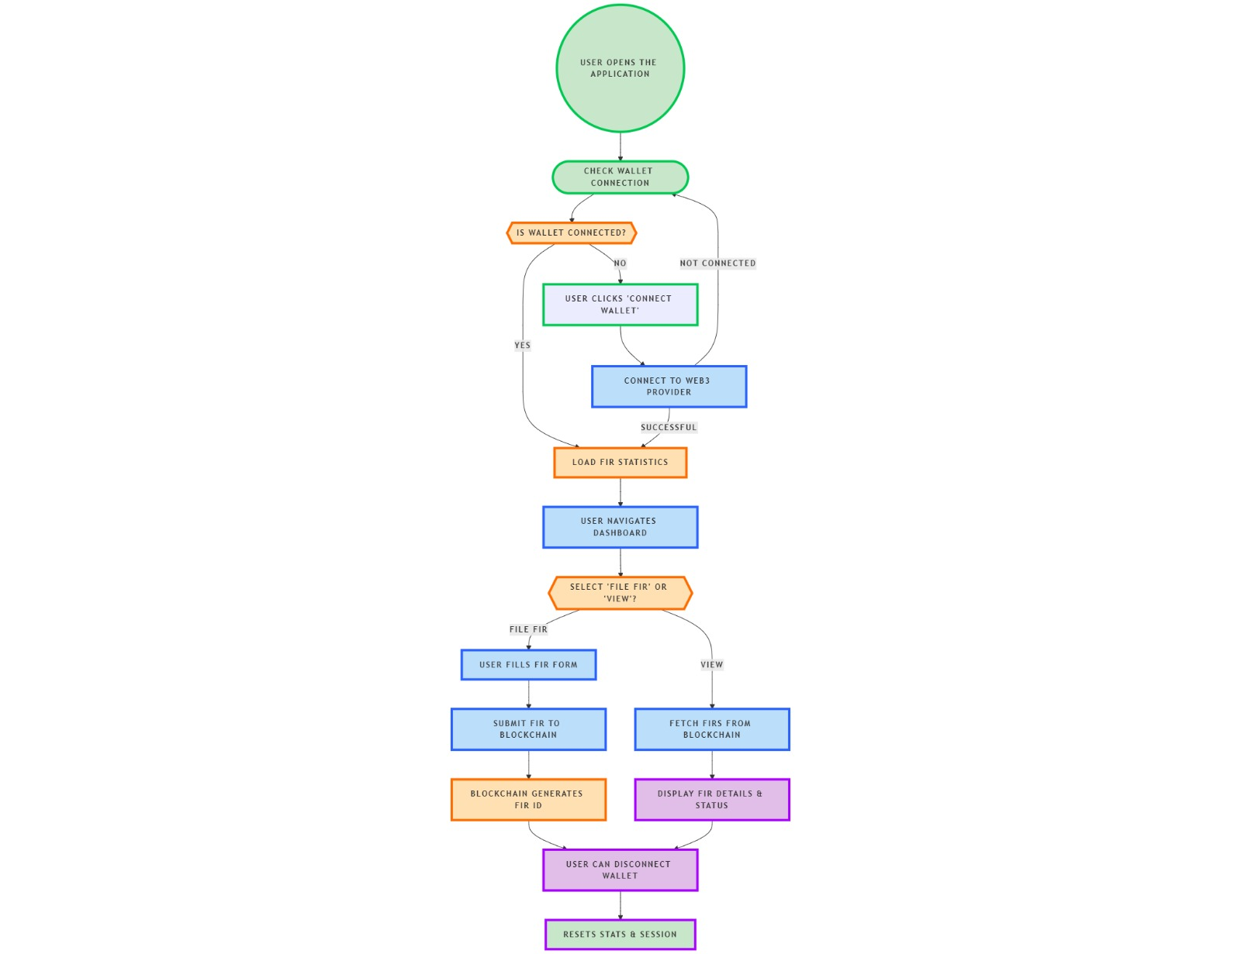
ARCHITECTURE :

Slide 8
ALGORITHMS :
User Authentication : Digital signatures (ECDSA).
FIR Registration : Smart contract-based complaint filing.
Case Verification : Law enforcement updates status via blockchain.
Evidence Management : IPFS for secure off-chain storage.

Slide 9
Observations & Expected Outcomes:
Security: Eliminates tampering and unauthorized access.
Efficiency: Reduces processing time and human errors.
Transparency: Enables real-time tracking and citizen engagement.
Scalability Challenges: Blockchain transaction costs and integration concerns.

