Slide 1

By Raj Kishore Agrawal
Business Analyst Career Program - Capstone Project

Slide 2

Agenda
Data Exploration
Statistical Analysis using Excel
Graphical Analysis using Excel
Insert the given data into the SQL server
Import the Data from the SQL Database into PowerBI
Interactive Dashboard by using visualization tools
Conclusion and Inferences
Endnotes

Slide 3
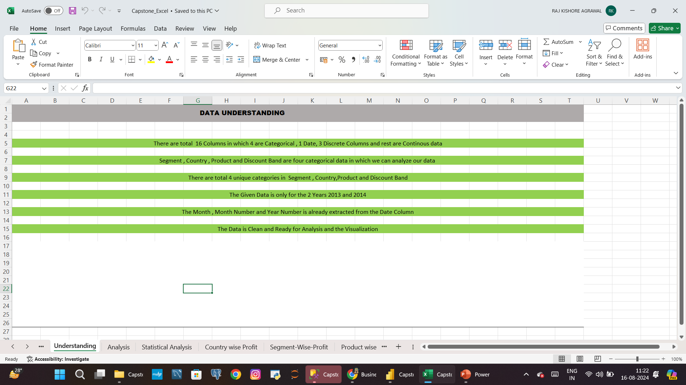
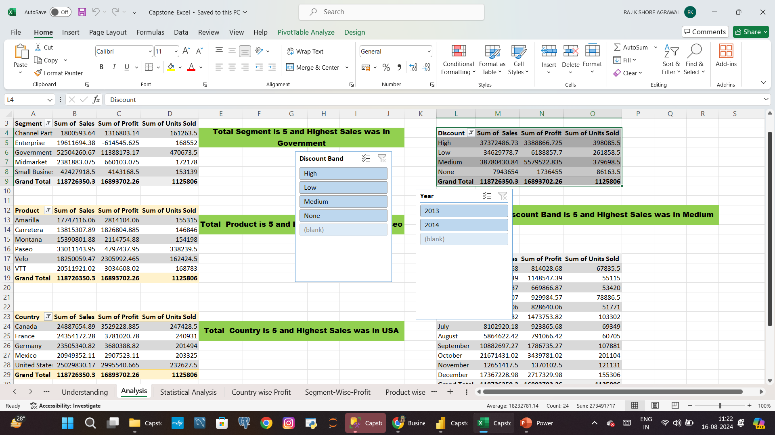
Data Exploration
Firstly I did an exploratory analysis and calculated the essential quantities and
There are 6 types of products which were sold across 5 countries within 5 segments from the given dataset.

Slide 4
Statistical Analysis using Excel
I have performed various statistical analysis like mean ,median ,std , iqr on sales ,profit , COGS etc

Slide 5
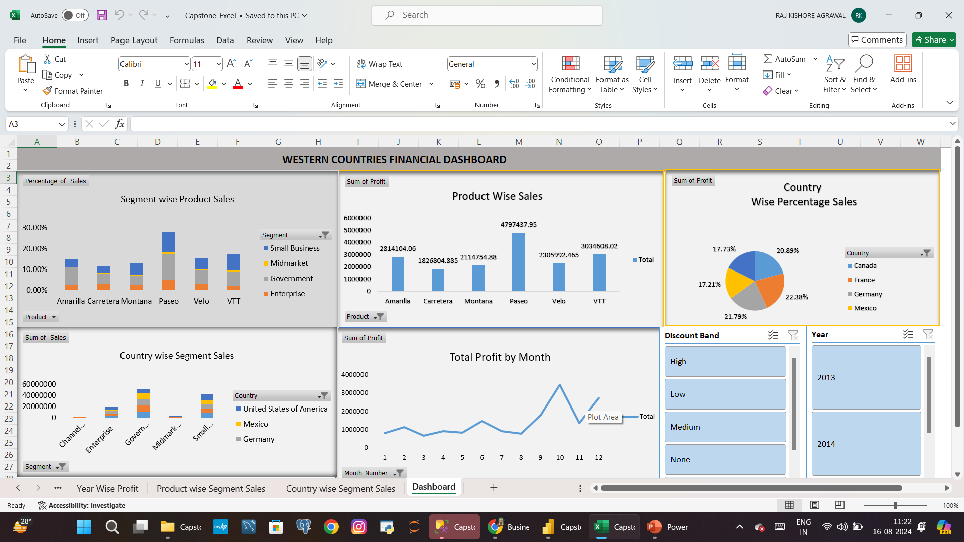
Graphical Analysis using Excel
Here is my Excel Dashboard which gives all Graphical Analysis

Slide 6
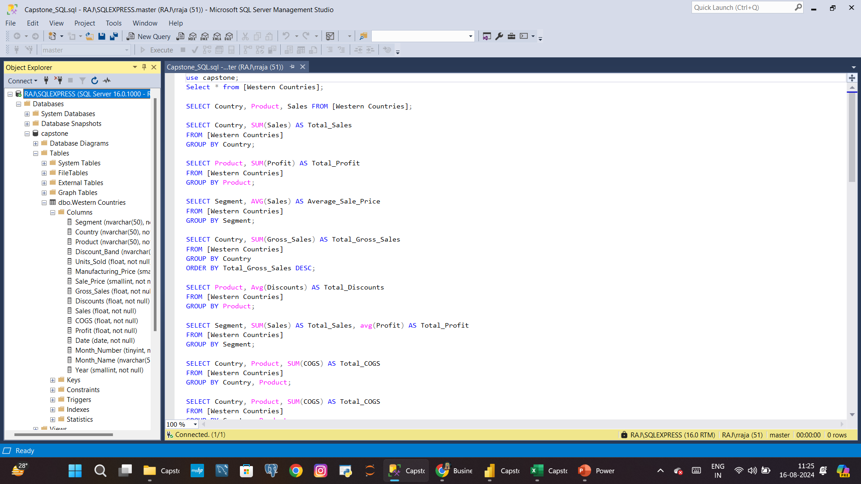
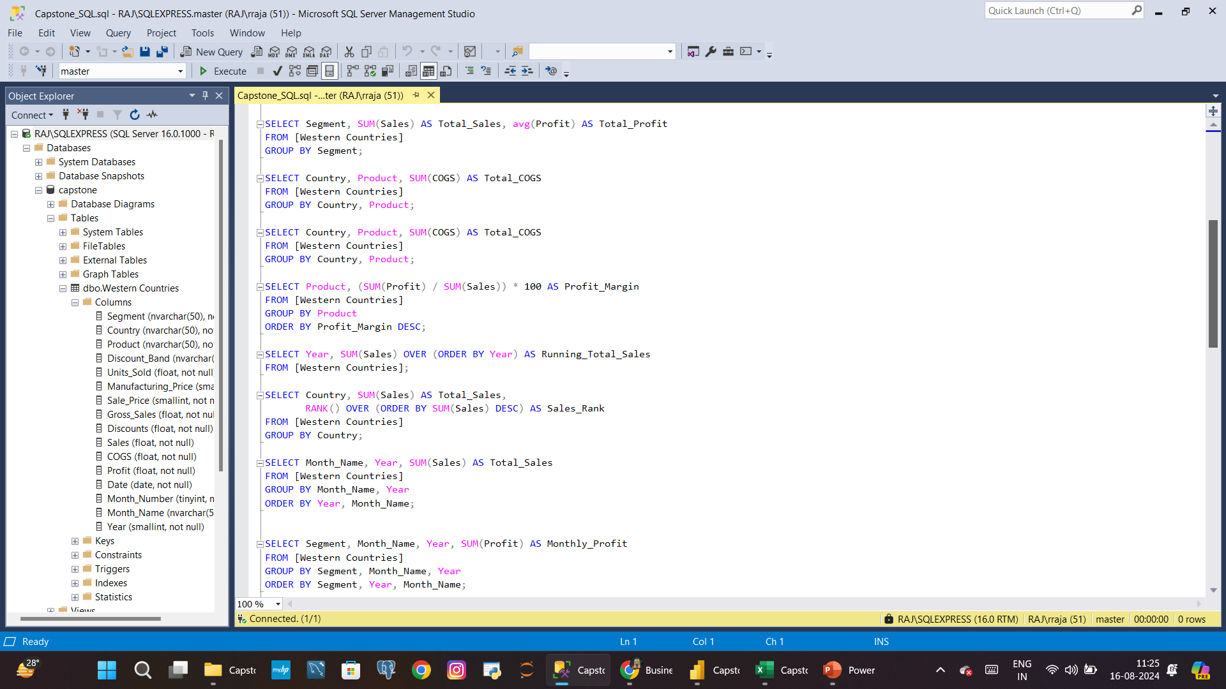
Insert the given data into the SQL server
I Uploaded the Excel file into Microsoft SQL Server and performed some basic Queries

Slide 7
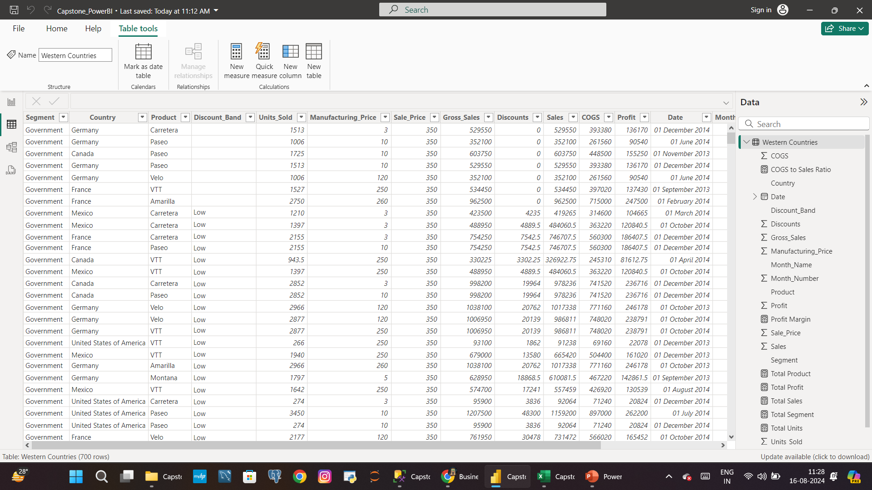
Import the Data from the SQL Database into PowerBI
The Data is Successfully Imported from SQL Database into PowerBI

Slide 8
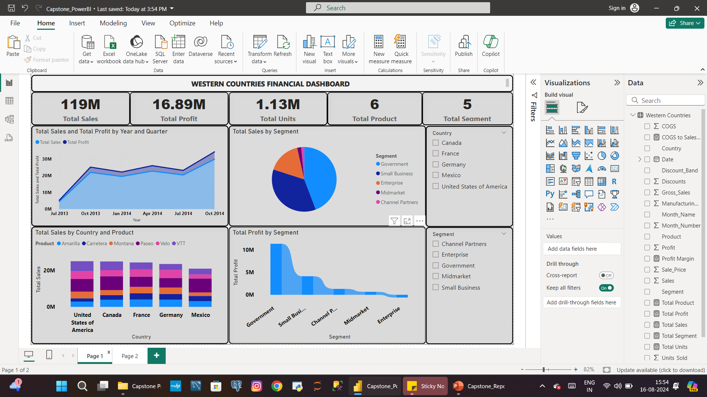
Interactive Dashboard by using visualization tools
Power-BI Dashboard

Slide 9
Conclusion and Inferences
Conclusion –
Paseo is the most sold product.
Government segment accounts for highest number of sales.
France has highest number of sales.
Paseo yields more profit 28% share as it has more sales.
As countries have most sales in Government , they have more profit from this segment.
Meanwhile there is loss in Enterprise sector- Countries need to discontinue business in this segment.

Slide 10
Answers of that 6 Questions
France and Canada are top two countries
Carretera , Montana , Velo are bottom three products
Velo , Amarilla , VTT ,Paseo , Montana , Carretera.
3 Units Year over Year
Paseo Government Wise.
Paseo Government Wise.

Slide 11
Endnotes
Reference Links:-
Excel - https://github.com/rraj12345/Skill-Academy-Capstone-Project/blob/main/Capstone_Excel.xlsx
SQL - https://github.com/rraj12345/Skill-Academy-Capstone-Project/blob/main/Capstone_SQL.sql
Power-BI - https://github.com/rraj12345/Skill-Academy-Capstone-Project/blob/main/Capstone_PowerBI.pbix

