Slide 1
web chat application
By ECE ‘c’

Slide 2
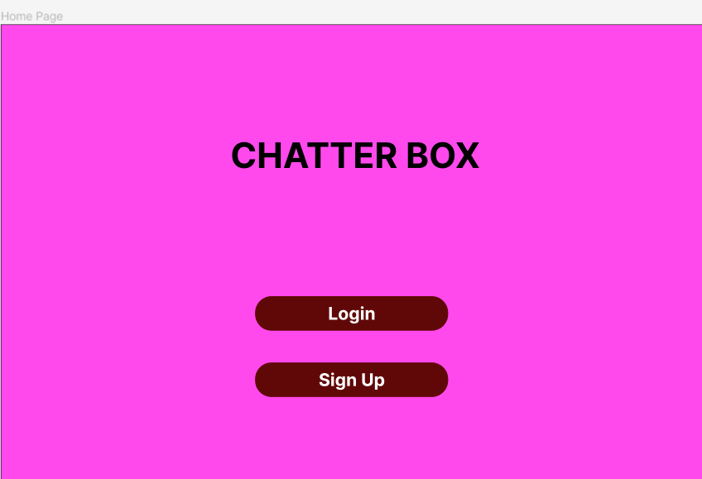

Slide 3
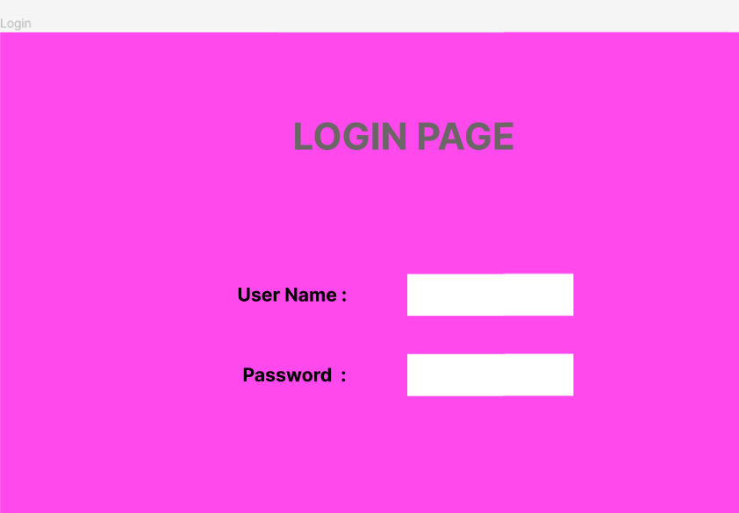

Slide 4
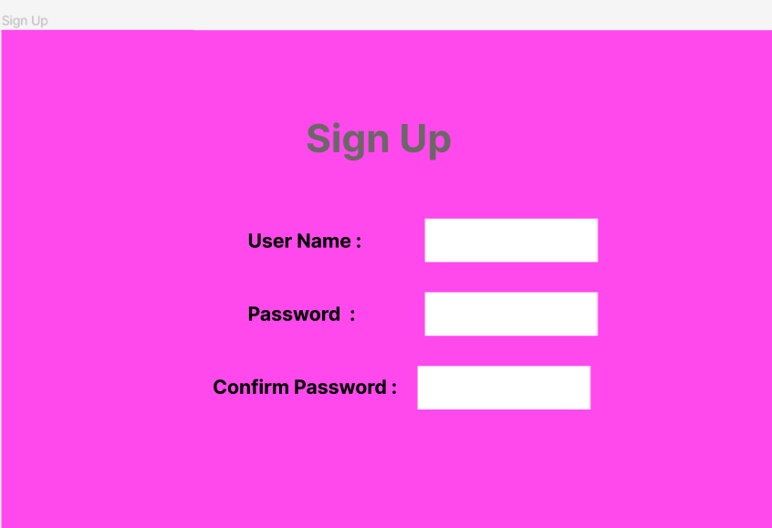

Slide 5
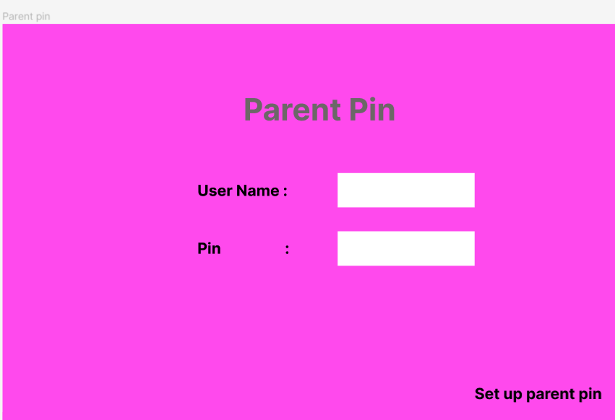

Slide 6
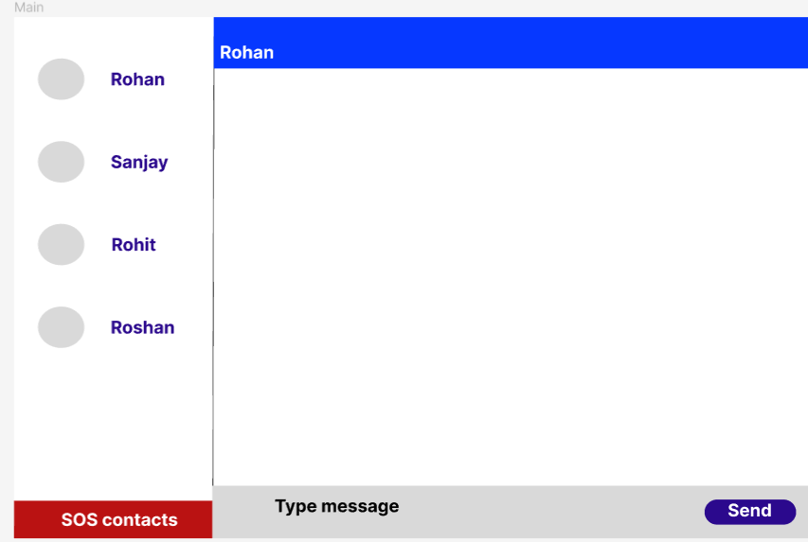

Slide 7
more than 2billion chatting application is there in the worldwide
Fun

Slide 8
have a great day

