Slide 1
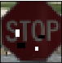
Neural Network
25 Speed Limit Sign

