Slide 1
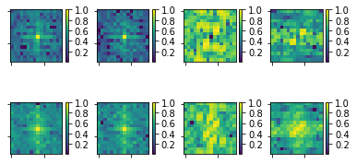
Natural
Adv
Difference
Blurred
Feature Map 1
Feature Map 2

