Slide 1



LOCUS AI
LOCUS
AI
Know Where to Grow Before you spend
Track:
MACECO (Analytics)
TEAM:
Not our team

Slide 2
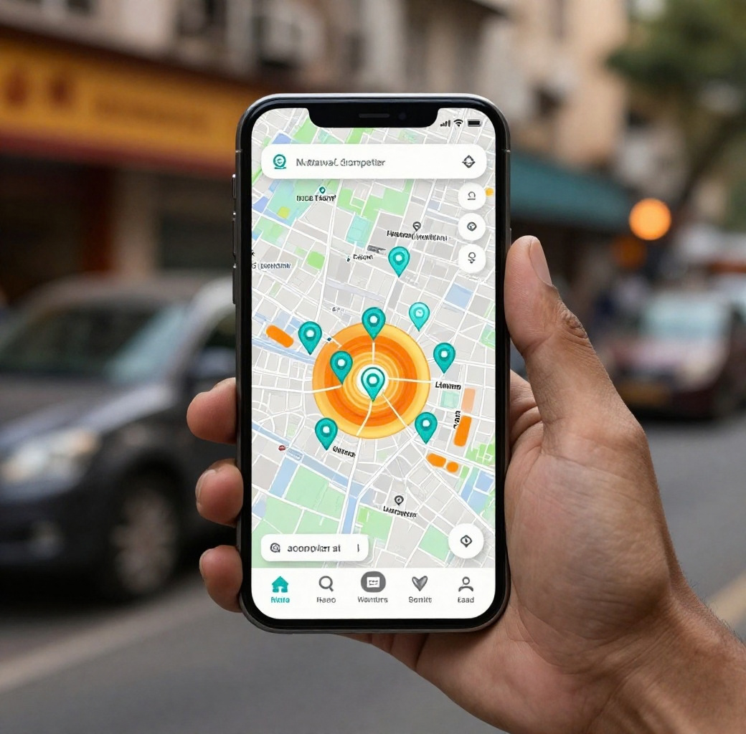

Real
Case
A street entrepreneur in Hyderabad wants to open a tea and snacks stall near a college campus with a budget of ₹30,000. By dropping a pin on the map, LOCUS AI instantly scans nearby competitors, foot traffic patterns, and student density across 0–300 m, 300 m–2 km, and 2–5 km bands — revealing whether the location is worth the investment before a single rupee is spent.
Use

Slide 3
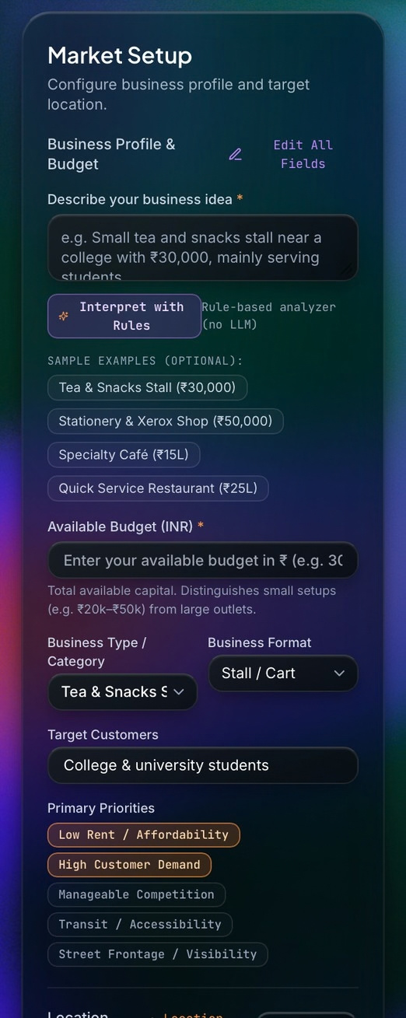
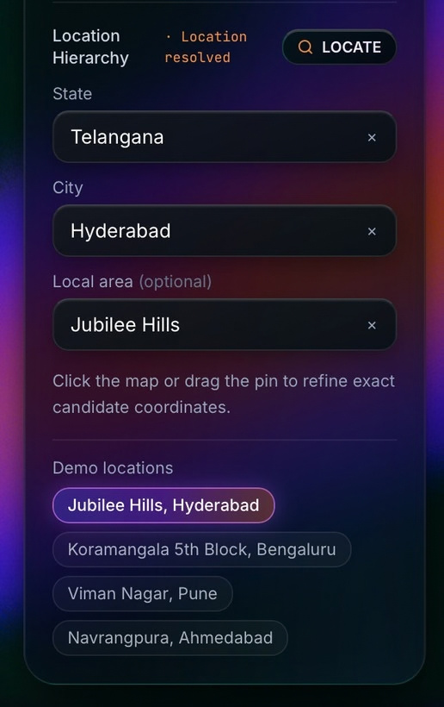


How LOCUS AI Works
Define Your Business
03/
Pin Your Location
01/
Enter your business idea, budget, format, and target customers to get started.
Select a target location on the map and drop a candidate pin to begin analysis.
Analyze the Market
04/
Assess & Decide
02/
Explore nearby competitors, foot traffic signals, and commercial activity across distance bands.
Review the location intelligence report and decide if the spot is worth your investment.

Slide 4

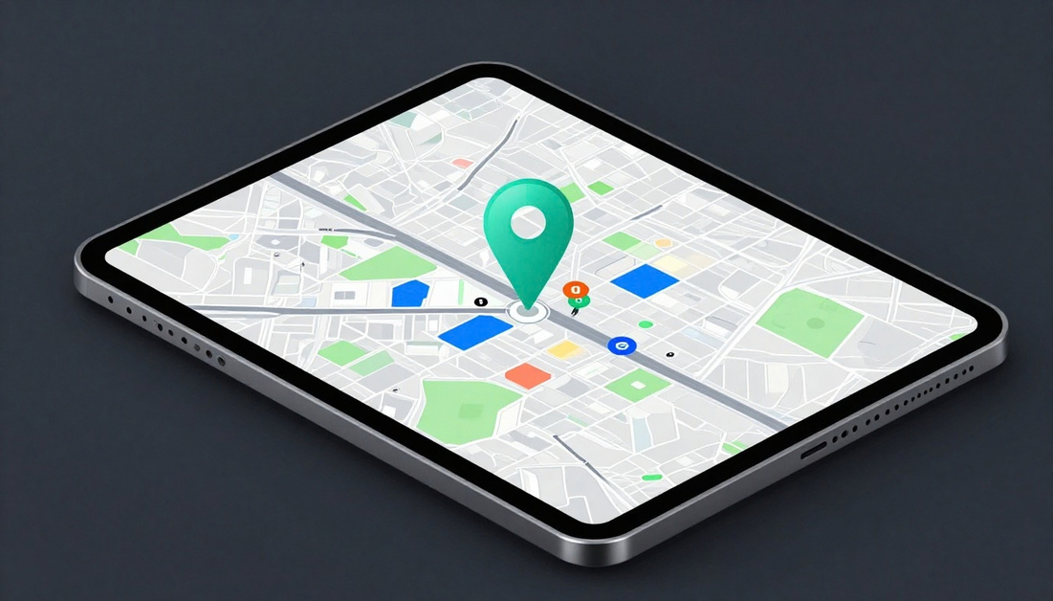

Market Discovery
Business Inputs
Business idea & format Budget & target customers Business format type
Location Selection
Interactive map view Drop a candidate pin Confirm target area

Slide 5



Competitor Density Analysis
12
34
Rivals (0–300 m)
Rivals (300m–2 km)
57
High
Listings (2–5 km)

Slide 6

Location
Intelligence
LOCUSAIaggregates localmarket signals—
competitor density, foot traffic patterns, commercial activity, and customer suitability — across three distance bands around your chosen outlet. Each signal is weighted and combined into a clear location score, giving small business owners the evidence they need to make a confident go/no-go decision before committing a single rupee to rent or setup costs.

Slide 7
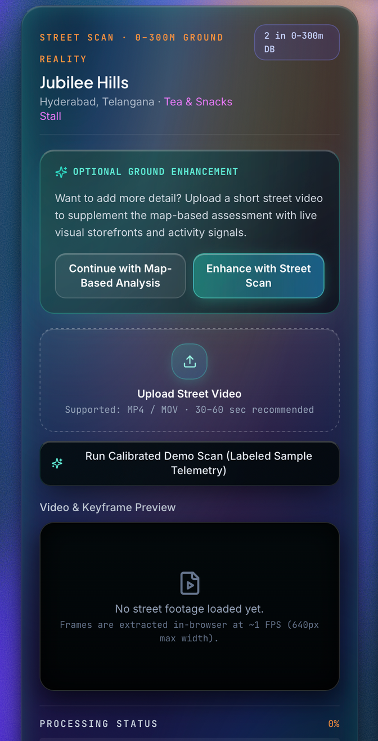
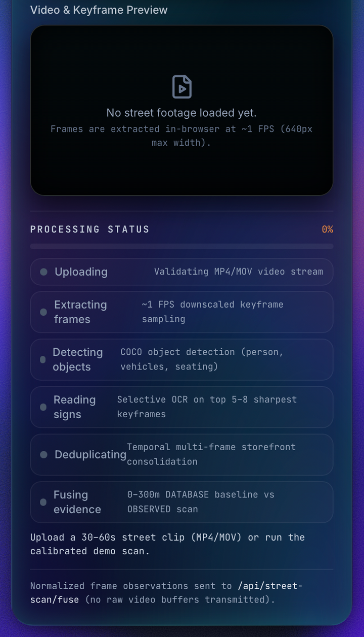
Street Scan – Ground-Level Validation
  Upload 30–60 second street videos.
  Detect people, vehicles, seating, and storefronts.
  Extract business information from visible signboards.
  Remove duplicate observations across video frames.
  Fuse observed evidence with existing location data.

Slide 8
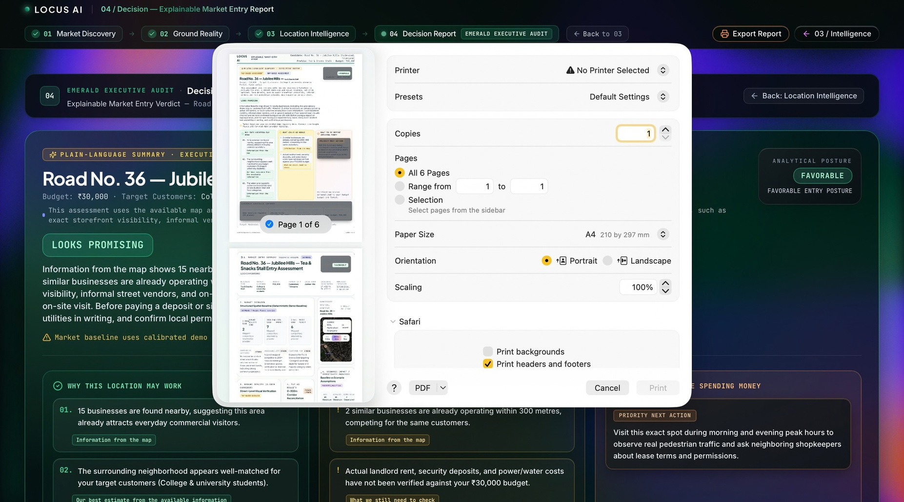
Decision
Report
LOCUSAI generates anexplainable market entry
reportto helpsmall-business owners make informed location decisions before investing money.The report evaluates nearby businesses, competitor density, target customer suitability, commercial activity, and available location evidence. It highlights potential advantages, identifies risks, and provides practical recommendations before committing to a location.

Slide 9
LOCUS AI
Know
Where to Grow Before you spend
Team Id :TRI26102

