Slide 1
Pancake Flipping
Arielle and Boris compete in the little-known sport of pancake flipping and have both been nominated for this season's "best pancake flipper" award. Half the people in the pancake flipping league office think Arielle is the better pancake flipper, and the other half think Boris is, so they have retained a data scientist to help solve the issue. The stats from this season are attached. The columns are:
the contestant's name,
the match day,
which hand they used to flip the pancakes,
their score (how many pancakes they flipped successfully), and
how many total pancakes they attempted to flip
Is Arielle or Boris the better pancake flipper? Justify your decision. Do both sides have a case here?
Submitted by,
Rakesh R
23 Jul 2021

Slide 2
Initial observations
Out of 50 match days:
23 times each participants has Won and 4 times matches are ended in Draw
Arielle's Dominant hand is 'R' with which he has played 35 matches and remaining 15 matches with 'L'
Boris's Dominant hand is 'L' with which he has played 35 matches and remaining 15 matches with ‘R’
Total successful flips by:
Arielle: 341 out of 1000 attempts (L: 72, R: 269)
Boris: 338 out of 1000 attempts (L: 199, R: 139)
Though Ariella has done only 3 flips more than Boris, we cannot confidently draw the conclusion here and further probing is required to decide.
Performed 3 Statistical analysis to arrive at conclusion:
A/B Testing
SCI analysis
CL effect size analysis

Slide 3

A/B testing
A/B testing is a basic randomized control experiment. It is a way to compare the two versions of a variable to find out which performs better in a controlled environment. It is a hypothetical testing methodology for making decisions that estimate population parameters based on sample statistics. To prove the statistical significance of our experiment using a "two-sample T-test".
Here let us adopt this technique to identify the better performing 'Pancake flipper' aka Award winner.
So, lets define hypothesis for our testing:
Null hypothesis: Inconclusive evidence, Arielle and Boris both are equally good.
Alternative hypothesis: Either Arielle or Boris can be considered as 'Best flipper'.

Slide 4
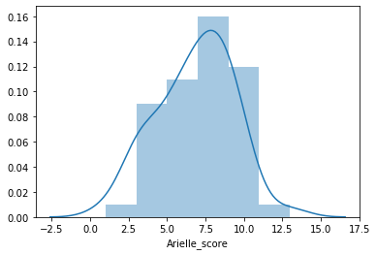
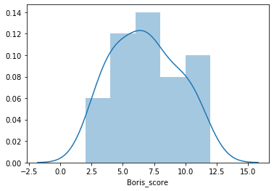
Experiment 1: All 50 Match days
 | Arielle | Boris
Count | 50 | 50
Sum | 341 | 338
Mean | 6.82 | 6.76
SD | 2.47 | 2.63
T-stat : 0.118
P-value : 0.907
Conclusion:
Here, our p-value is way higher than the significance level i.e 0.05.
Hence, we cannot reject the null hypothesis.
This means that based on our A/B testing, scores of Arielle and Boris are not statistically significant.
Experiment is inconclusive. Arielle and Boris both appears to be equally good.

Slide 5
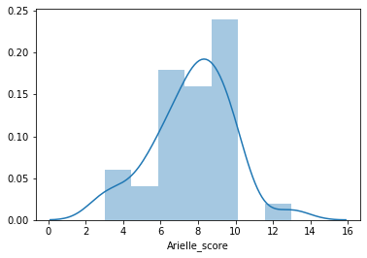
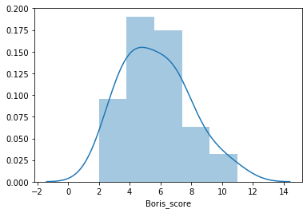
Experiment 2: Dominant hand with 35 Match days
 | Arielle | Boris
Count | 35 | 35
Sum | 269 | 199
Mean | 7.68 | 5.68
SD | 2.12 | 2.17
T-stat : 3.887
P-value : 0.0002
Conclusion:
Here, our p-value is lower than the significance level i.e 0.05.
Hence, we can easily reject the null hypothesis.
This means that based on our A/B testing, scores of Arielle and Boris are statistically significant.
Arielle has clearly outperformed Boris by a very large margin.
Arielle (R) is better flipper than Boris (L) while using Dominant hand.

Slide 6
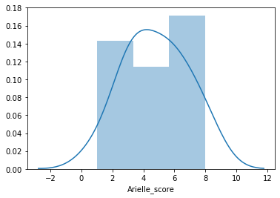
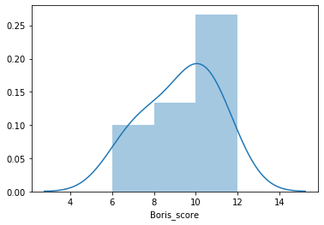
Experiment 3: Submissive hand with 15 Match days
 | Arielle | Boris
Count | 15 | 15
Sum | 72 | 139
Mean | 4.80 | 9.26
SD | 2.04 | 1.75
T-stat : -6.430
P-value : 0.000001
Conclusion:
Here, our p-value is lower than the significance level i.e 0.05.
Hence, we can easily reject the null hypothesis.
This means that based on our A/B testing, scores of Arielle and Boris are statistically significant.
Boris has clearly outperformed Arielle by a very large margin.
Boris (R) is better flipper than Arielle (L) while using Submissive hand.

Slide 7
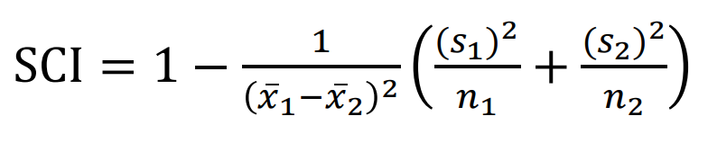
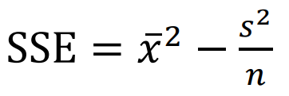
The SCI analysis
Signal Content Index (SCI)
Sample Signal Energy (SSE)
Exp: 1 (All)
Exp: 2 (Dominant)
Exp: 3 (Submissive)
 | Arielle | Boris
Count | 50 | 50
Sum | 341 | 338
Mean | 6.82 | 6.76
SD | 2.47 | 2.63
 | Arielle | Boris
Count | 35 | 35
Sum | 269 | 199
Mean | 7.68 | 5.68
SD | 2.12 | 2.17
 | Arielle | Boris
Count | 15 | 15
Sum | 72 | 139
Mean | 4.80 | 9.26
SD | 2.04 | 1.75
SCI : 6.90%
SSE_A : 46.39
SSE_B : 45.56
SCI : 94%
SSE_A : 58.94
SSE_B : 32.20
SCI : 6.90%
SSE_A : 22.78
SSE_B : 85.68
Arielle and Boris both appears to be equally good.
Arielle (R) is better flipper than Boris (L) while using Dominant hand.
Boris (R) is better flipper than Arielle (L) while using Submissive hand.

Slide 8
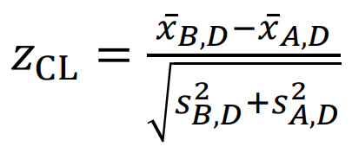
The Common Language (CL) effect size analysis
z-score =>
Exp: 1 (All)
Exp: 2 (Dominant)
Exp: 3 (Submissive)
 | Arielle | Boris
Count | 50 | 50
Sum | 341 | 338
Mean | 6.82 | 6.76
SD | 2.47 | 2.63
 | Arielle | Boris
Count | 35 | 35
Sum | 269 | 199
Mean | 7.68 | 5.68
SD | 2.12 | 2.17
 | Arielle | Boris
Count | 15 | 15
Sum | 72 | 139
Mean | 4.80 | 9.26
SD | 2.04 | 1.75
Arielle with 2% confidence
Arielle with 67% confidence
Boris with
100% confidence
Arielle and Boris both appears to be equally good.
Arielle (R) is better flipper than Boris (L) while using Dominant hand.
Boris (R) is better flipper than Arielle (L) while using Submissive hand.

Slide 9
Conclusion
Both Arielle and Boris appears to be performing very well based on the population parameters estimation
If we consider Dominant Hand data alone, we can conclude Arielle as winner
If we consider Submissive Hand data alone, we can conclude Boris as winner
My recommendation is to play one more 'non-Draw' match and conclude the winner
Reference:
Huang H (2021) Exceedance probability analysis: a practical and effective alternative to t-tests, preprint, DOI: 10.13140/RG.2.2.27268.55687

