Slide 1
Viewshed Variable for Hedonic Modeling: Surf City, NJ
Rachel Albritton ~ GIS 590 Final Project ~ Fall 2013
Clients:
Steven Dundas
PhD Candidate NCSU Environmental Economics
&
Jordan Smith , PhD
NCSU Center for Earth Observation, Visualization Lab

Slide 2
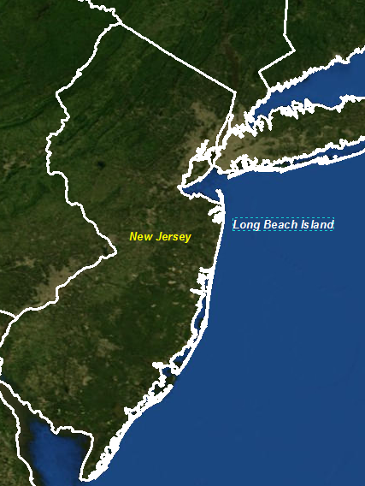
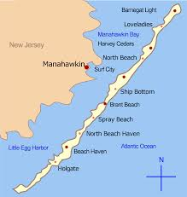
Background
Long Beach Island, NJ
Ocean County
18-miles long
6 municipalities
Surf City
1999: Army Corps of Engineers gained federal approval to build 22 ft. dune down the entire length of the island for storm protection.
Requires homeowner support.
Only three sections completed by 2007.
Homeowners concerned about property value loss

Slide 3
Purpose
Assess whether or not a parcels oceanfront viewshed was dimensioned as a result of dune construction.
Create a custom script tool that can be applied to each municipality along Long Beach Island.
Assess viewshed, in degrees, at both first (10ft.) and second floor heights (20ft) before and after dune construction.
Create a Web Application showing potential affects of dune construction.

Slide 4
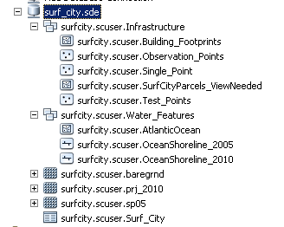
Data
Vector data provided
Lidar data:
NOAA Coastal Service Center
Enterprise geodatabase (web application)

Slide 5
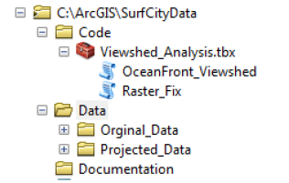
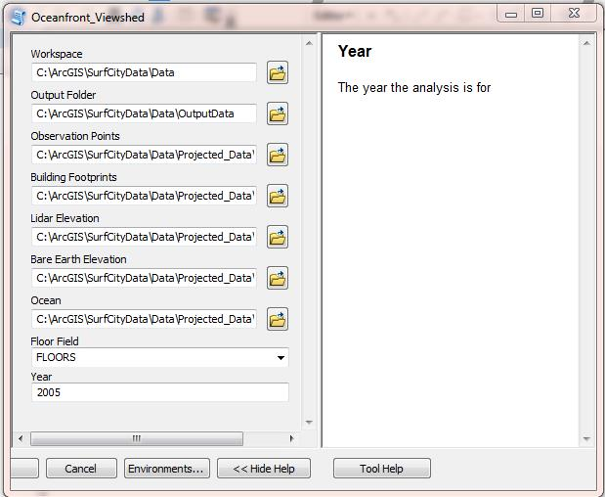
Custom Tool Package
Tool Documentation
Python script tools
Raster Fix
Used in data preparation
Takes 2 inputs
Oceanfront Viewshed
Repeatable tool that an be applied to other oceanfront areas.
Takes 9 inputs
10-12 hours processing time
All analysis done in ArcMap

Slide 6
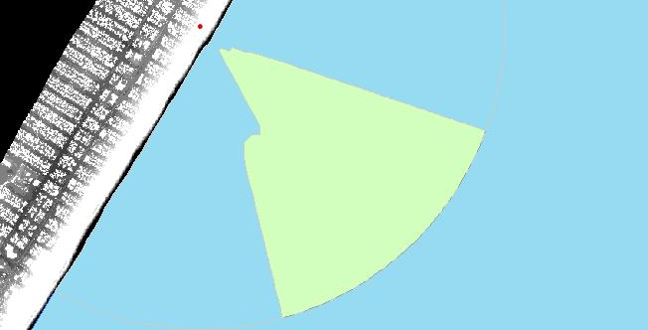
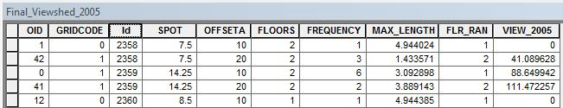
Oceanfront Tool Outputs
Individual Viewsheds
Viewshed Table

Slide 7


Challenges: Script Tool
Irregular Viewsheds
Formula:
(ArcLength/6.28)*180
First floor higher then second floor
Deleting intermediate Files
2430: First floor – 126 degrees( max length = 4.4 miles)
2430 second floor: 118 degrees (max length = 4.1 miles)

Slide 8
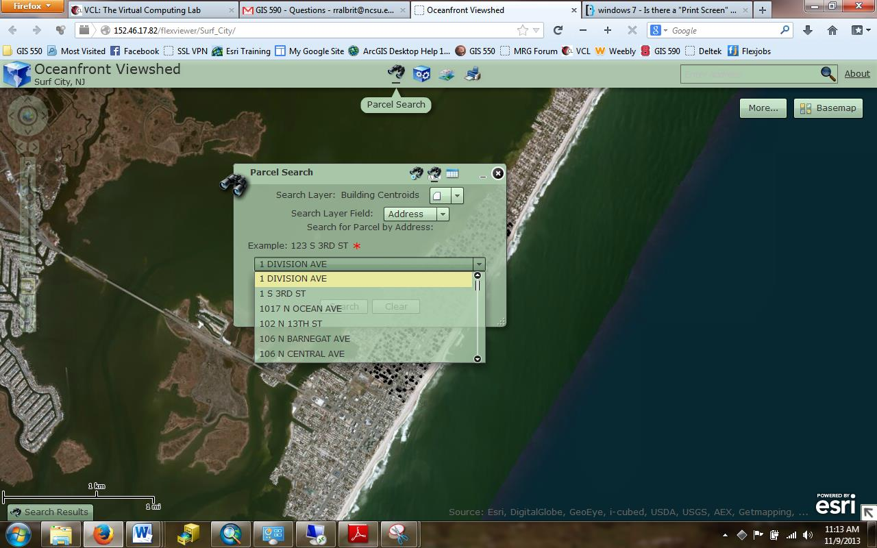
Web Application: Purpose
Allow users to create or search for comparative viewshed information for the first floor for each parcel.
Contains a geoprocessing service that draws the viewshed in real-time.
Viewshed values in degrees is done on the backend.

Slide 9
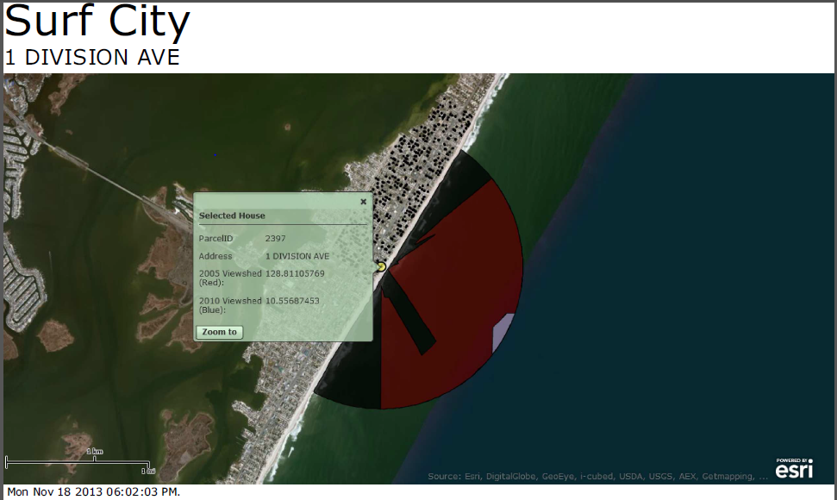
Web Application
http://152.46.17.82/flexviewer/Surf_City/
ArcGIS Server to Host Services
Draw viewshed
Search for parcel degree view information
Export gridded results in CSV format
Print map

Slide 10
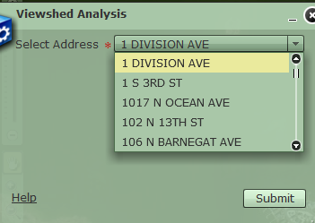
Web Application: Challenges
Wanted to run 1st and 2nd floors
Currently running 1st floor only
No choice list option

Slide 11
Web Application
Documentation:
Script tools
Models
User manual
Update manual

Slide 12
Questions ?

