Slide 1
DSE203 Project
Mary Kate, Ravi, Shitiz (12/10/2021)

Slide 2
Table of Contents
Data Sources
EDA & ETL schema
Knowledge Graph

Slide 3
Problem Statement
Medical devices have high failure rate
Includes pacemakers
Anyone with a new pacemaker project might want to have sense of landscape
Could be a startup
Could be a group within a larger company/organization
May want information on funding, clinical trials, and related publications
Where is funding going?
What indications getting the most attention?
What are affected populations?
Our goal: to create a knowledge graph which can give the user an understanding of the landscape of pacemakers to inform important early decisions regarding their product

Slide 4
Data Sources
NIH (research grants)
Pace-Maker specific Data mining
PubMed (scientific publications)
ClinicalTrials.gov (clinical trials)
Notes:
4

Slide 5
Top-level scope abstraction
PubMed Data
Column[a..c]
Column[l..n]
Column[x..z]
NIH
ClinicalTrials
PubMed
Keyword extraction through NLP
Ontology derived sub-class
Entity matching
Clinical Trials Data
NIH Data
Categories parsed from text
Generic DB Schema skeleton to represent relationships of consolidated data
Notes:
5

Slide 6
Workflow for ETL
Extract keywords from different columns of each dataset.
Deploy multiple methods for extractions 🡺 RAKE , Autophrase, LDA
Keyword extraction
Subclasses and heart conditions derived from SPARQL queries of ontologies
Matched against keywords to link to datasets
Sub-class recognition
Matched entities across 3 datasets leveraging extracted keywords and Title of documents
Used Dedupe for entity matching.
Entity Mathcing
Build knowledge graph, create relationship/edge between 3 datasets based on matched entity ids.
Heterogenous schema support, parked each dataSets, leveraged cypher query & neo4j DB.
Know-Graph

Slide 7
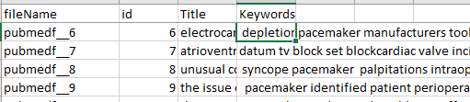
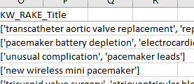
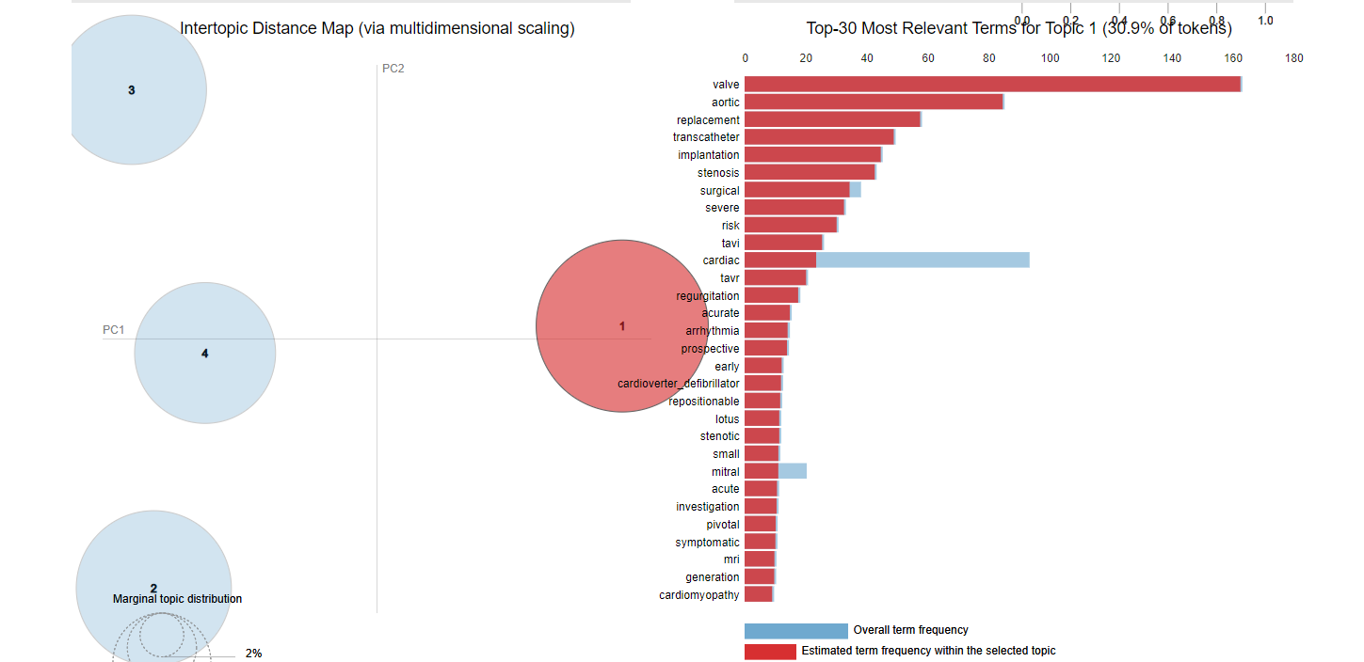
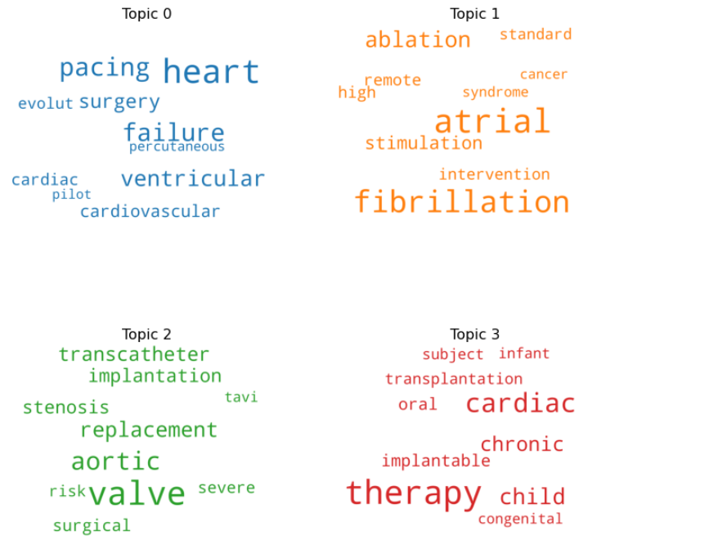
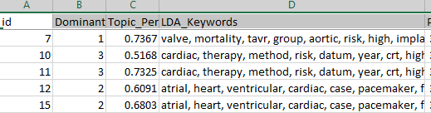
Keyword/Topic extraction & consolidation
Deployed multiple methods to extract keywords.
~1.1K pubmed documents.
~8K clinical-Trial documents.
Stop word removal & lemmatization incorporated.
Leveraged LDA for initial Topic Extraction.
Top keywords providing > 80% document coverage were retained.
RAKE
AUTOPHRASE
Keywords
LDA

Slide 8
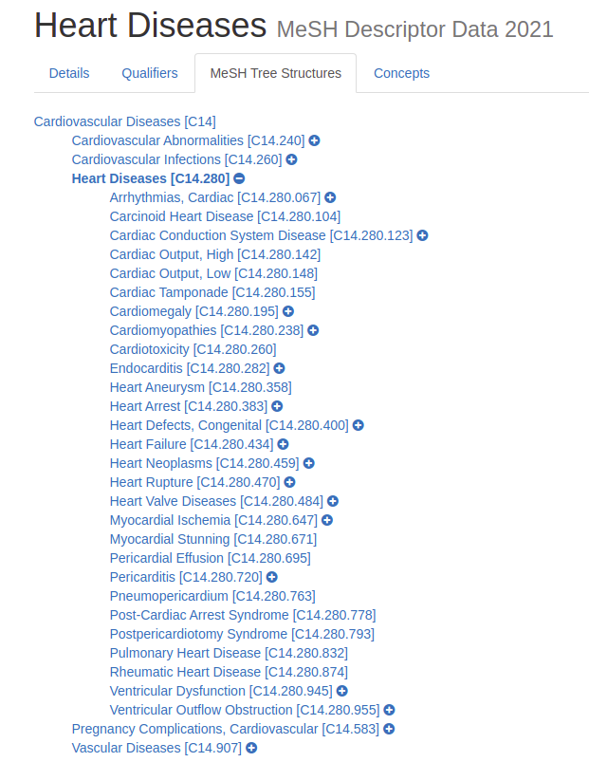
Ontology
Extracted flattened tree structure from ontologies related to important categories
Pacemaker Subclasses
Heart Conditions
Matched against key words to associate categories with nodes in datasets
Created nodes for querying in database

Slide 9
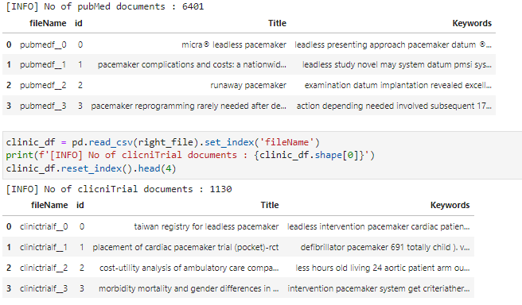

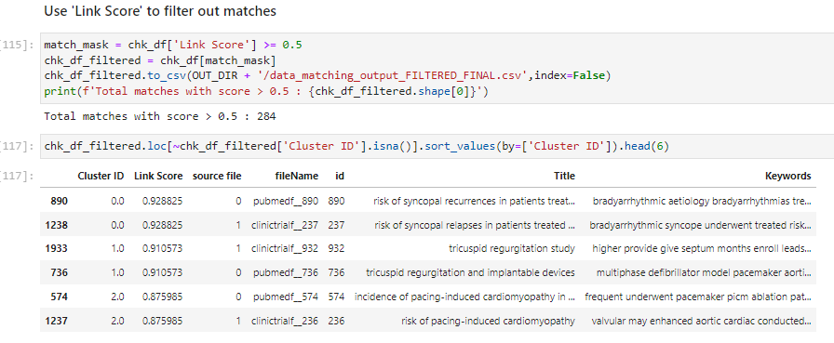
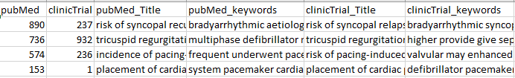

Entity Matching
Dedupe based Entity Matching
Sample snippet for PubMed vs clinical Trial
Consolidated Data with keywords
+
Preprocess
Dedupe:
Interactive learning on sample for initial calibration & Link-score threshold determination
Dedupe : Trained Model Reports matching entities for
Pubmed vs clinicalTrial
PubMed vs NIH

Slide 10
DB Graph’s node & edge derivation for consolidated Data
Pacemaker can be leveraged for classification & aggregation queries
Pacemaker Subclass
Heart Condition
Title
NIH sub-tree(id)
ClinicTrials sub-tree(id)
Pubmed sub-tree(id)
Sponsor/Collaborators
Cost ($)
Title
Title
Status
States
Authors
Years
Journals
Gender
Age range
Notes:
10

Slide 11
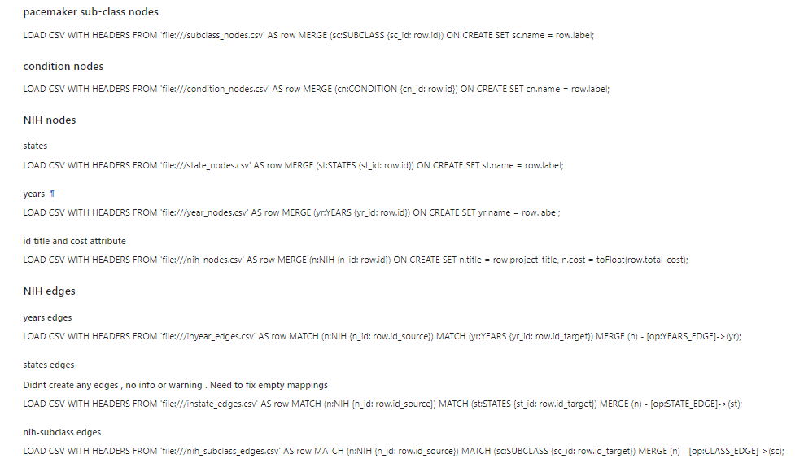
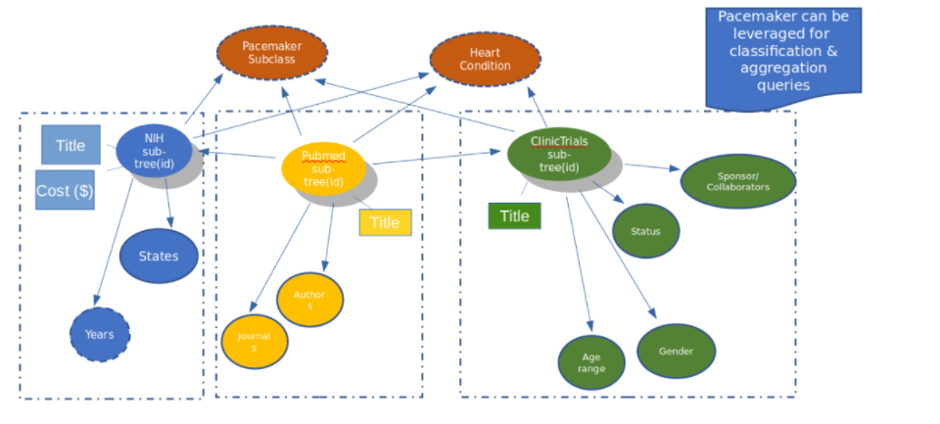
Graph-DB implementation
Database schema and data parking in neo4J

Slide 12
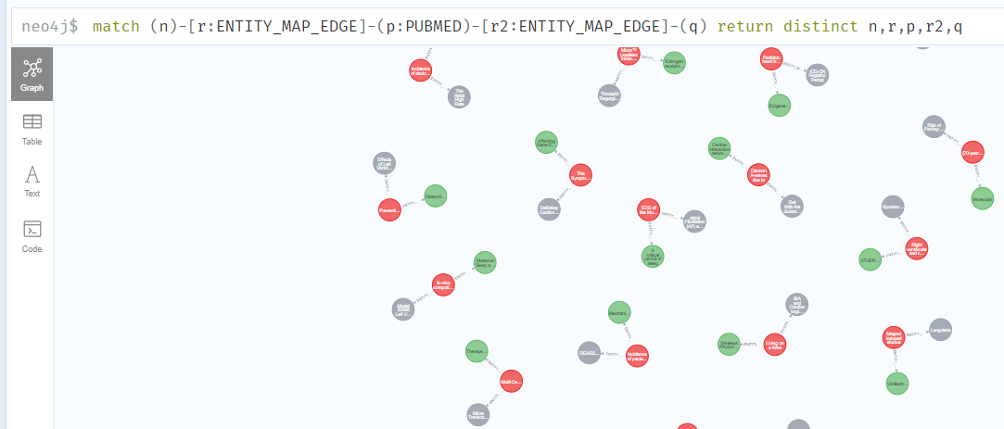
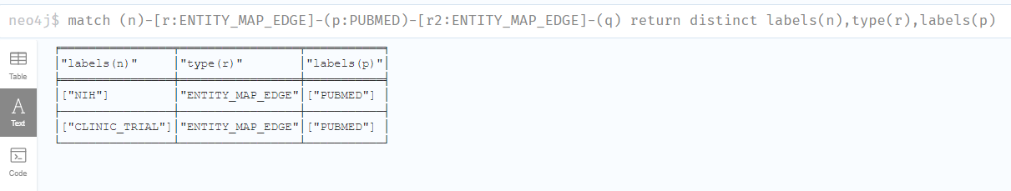
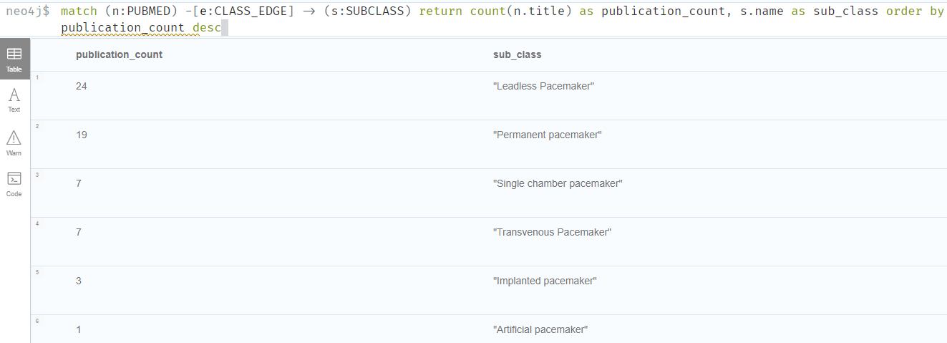
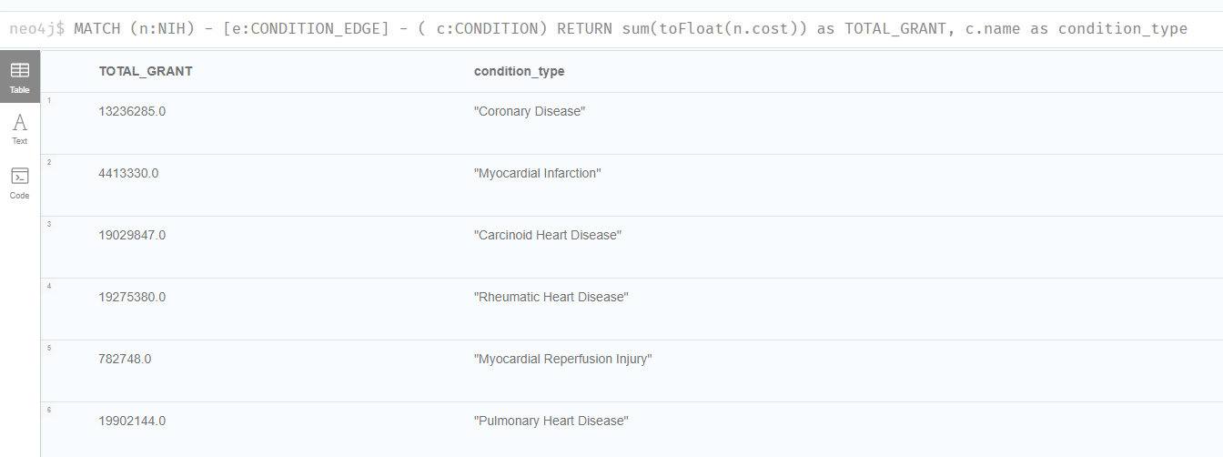
Sanity Cypher Queries verifying DB implementation
Simple Query output Snippet showing nodes and edge relationships.
Sample aggregation Query output Snippet leveraging pacemaker sub-class and heart-condition

Slide 13
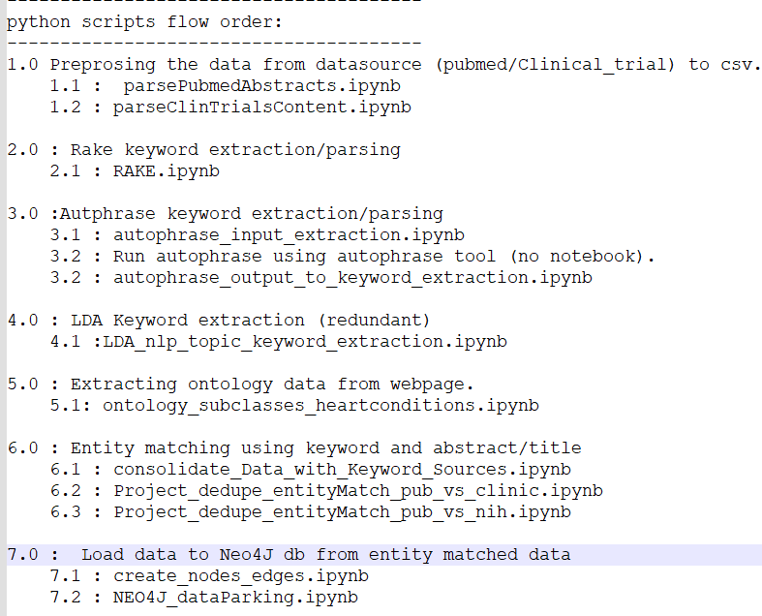
Script flow structure/order of python.
Step1: Preposing of raw data from websource
Step2-4: Key word extraction.
Step5: Ontology data extraction
Step6: Entity matching
Step7: Neo4J db extraction
Readme file screen shot:
https://github.com/rramachandra-ucsd/DSE203-ETL-Project

Slide 14
Sample Queries and Demo
In which states is the most money granted to NIH projects?
Which organizations are sponsoring the most clinical trials in the field?
Which heart conditions get the most funding through NIH grants?
What age groups / genders are eligible for a certain subclass of pacemaker? (i.e. Leadless Pacemaker)
Notes:
14

