Slide 1
The Global Weather Repository dataset contains over 152,000 weather observations collected from cities around the world
Prepared by: Rramandeip Singh

Slide 2
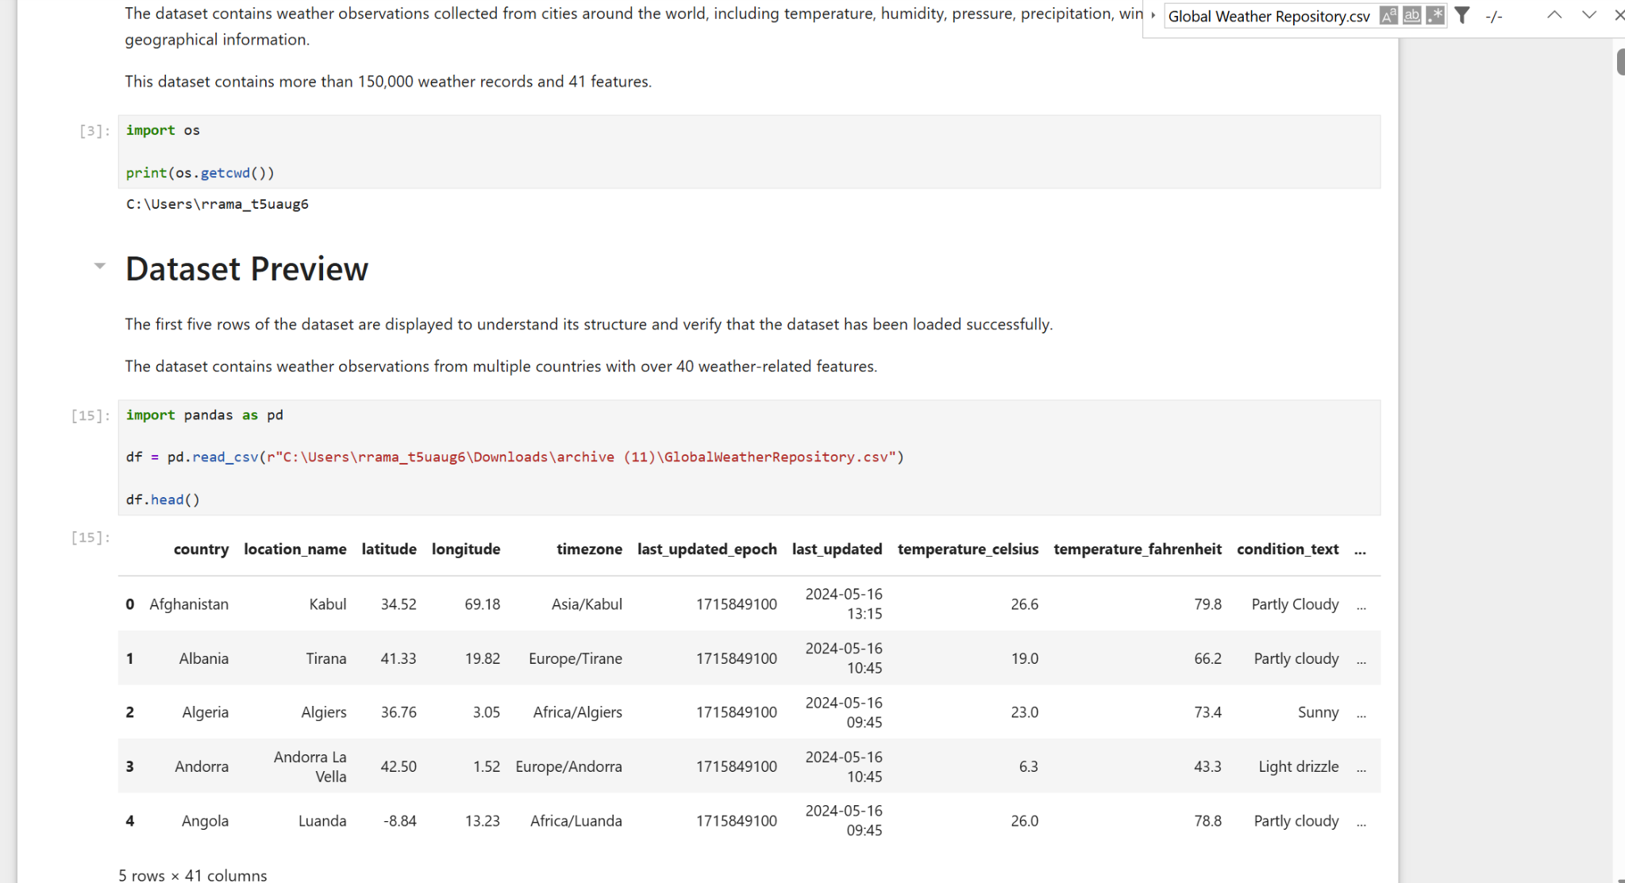
Project Overview
Analyse global weather data
Clean and preprocess data
Build ML models
Compare forecasting performance

Slide 3
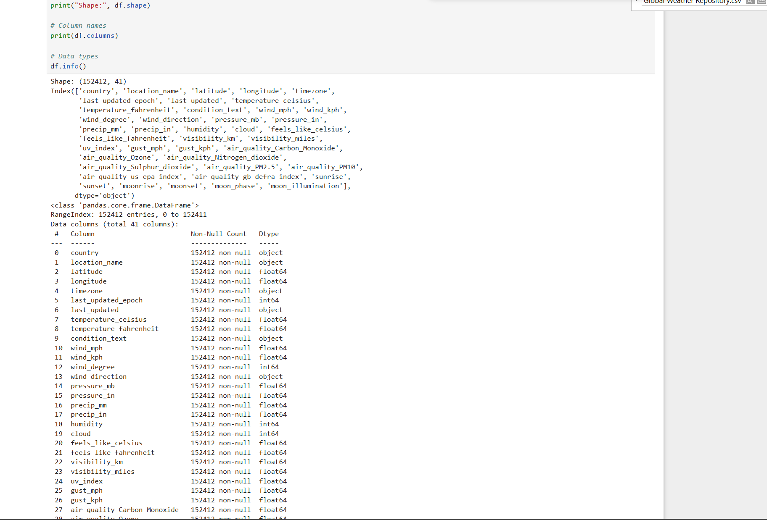
Dataset
152,412 records
41 features
Worldwide weather observations

Slide 4
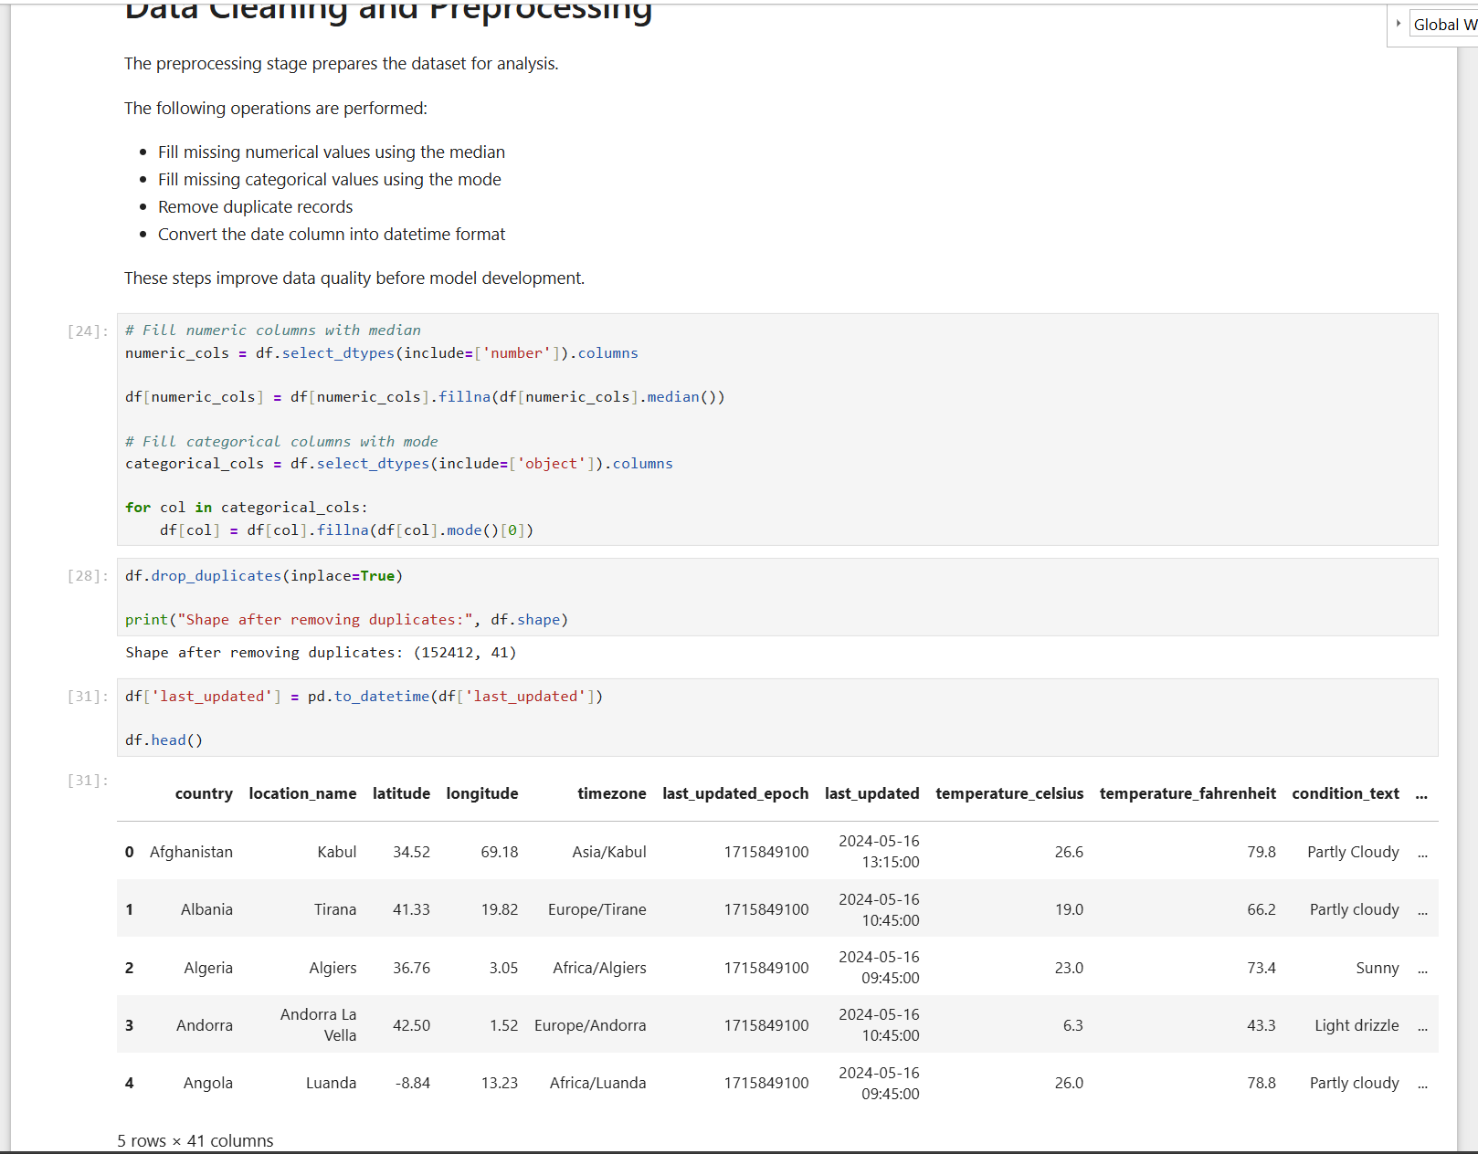
Data Cleaning
• Filled missing values
• Removed duplicates
• Converted dates

Slide 5
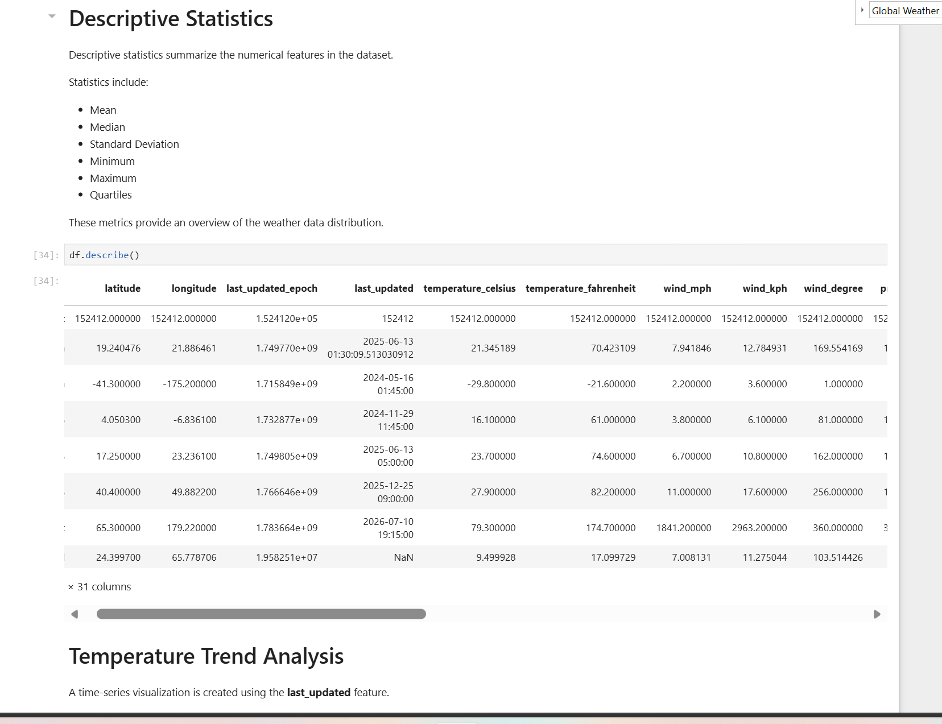
EDA
• Descriptive statistics
• Temperature trend
• Distribution analysis

Slide 6
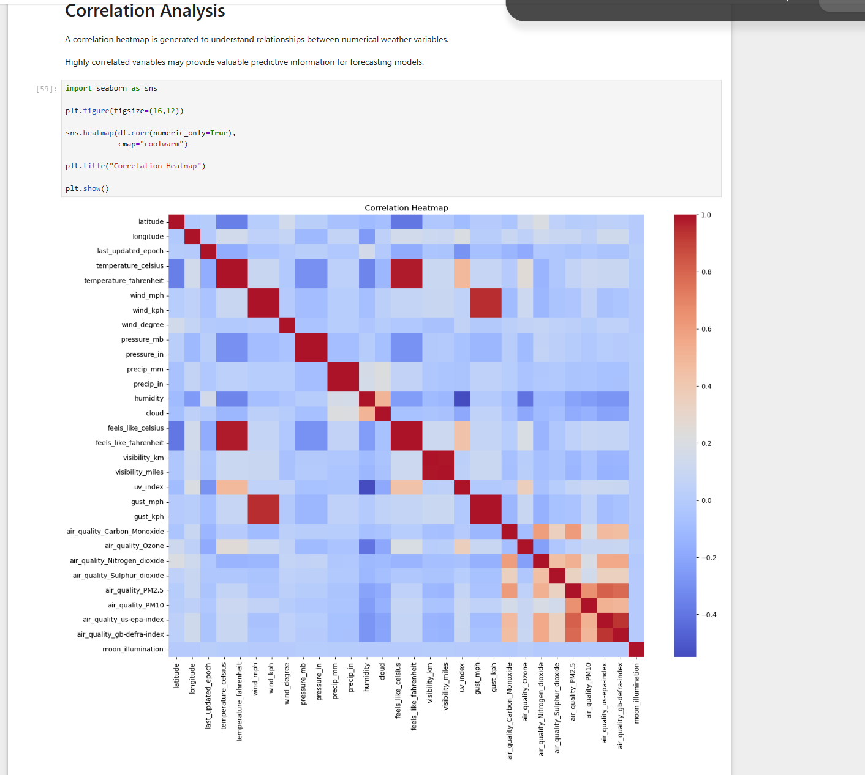
Correlation & Humidity
• Correlation heatmap
• Humidity negatively correlates with temperature

Slide 7
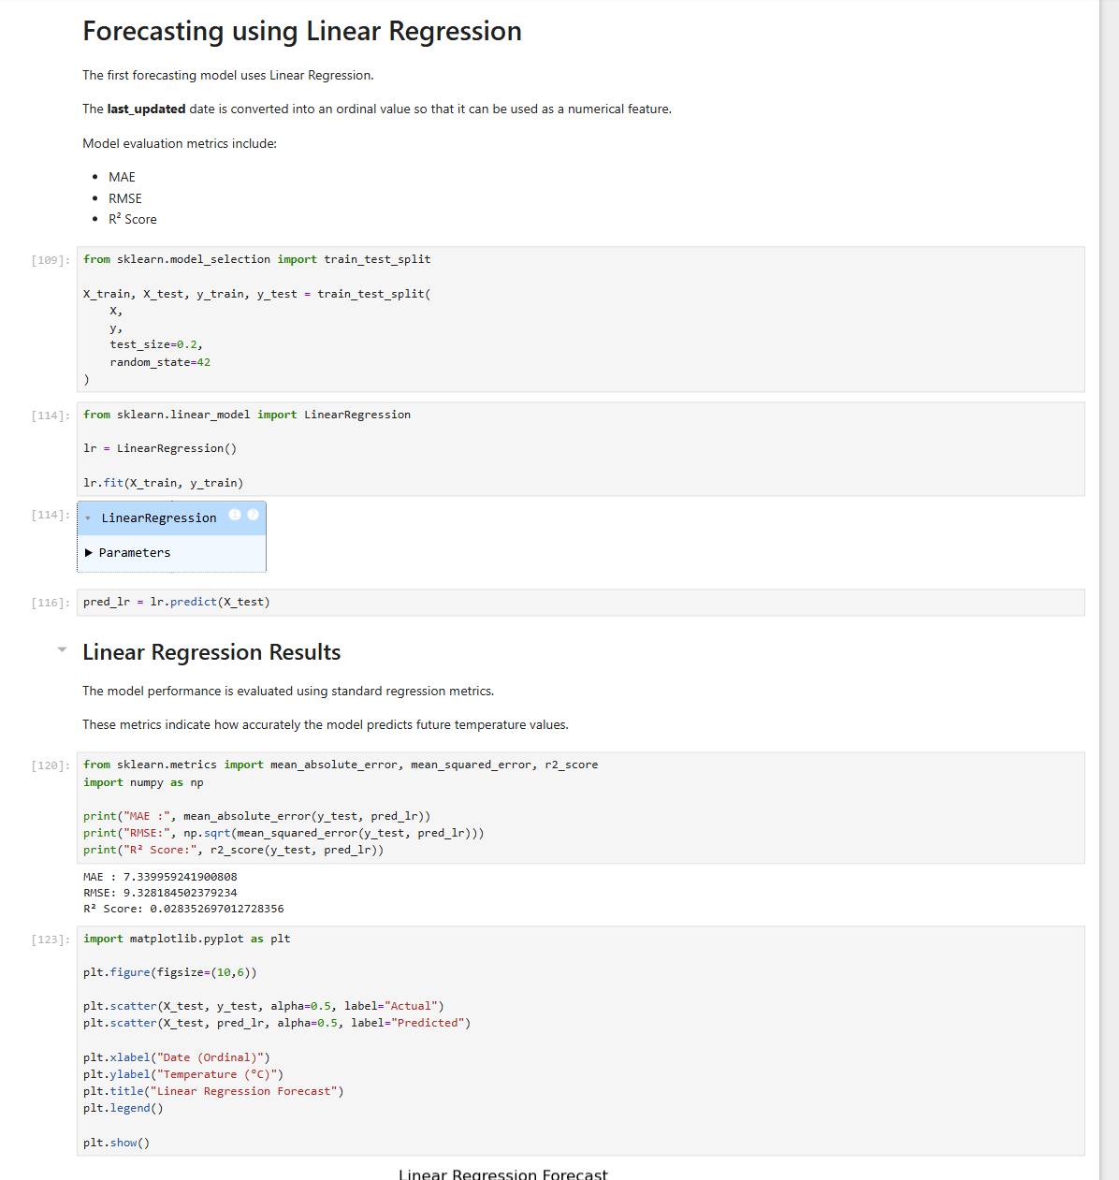
Random Forest Results
MAE: 3.27
RMSE: 4.93
R²: 0.728
Best performing model.
Metric | Linear Regression | Random Forest
MAE | 7.34 | 3.27
RMSE | 9.33 | 4.93
R² Score | 0.028 | 0.728
Random Forest achieved lower prediction errors and a higher R² score, making it the most accurate model for temperature forecasting

Slide 8
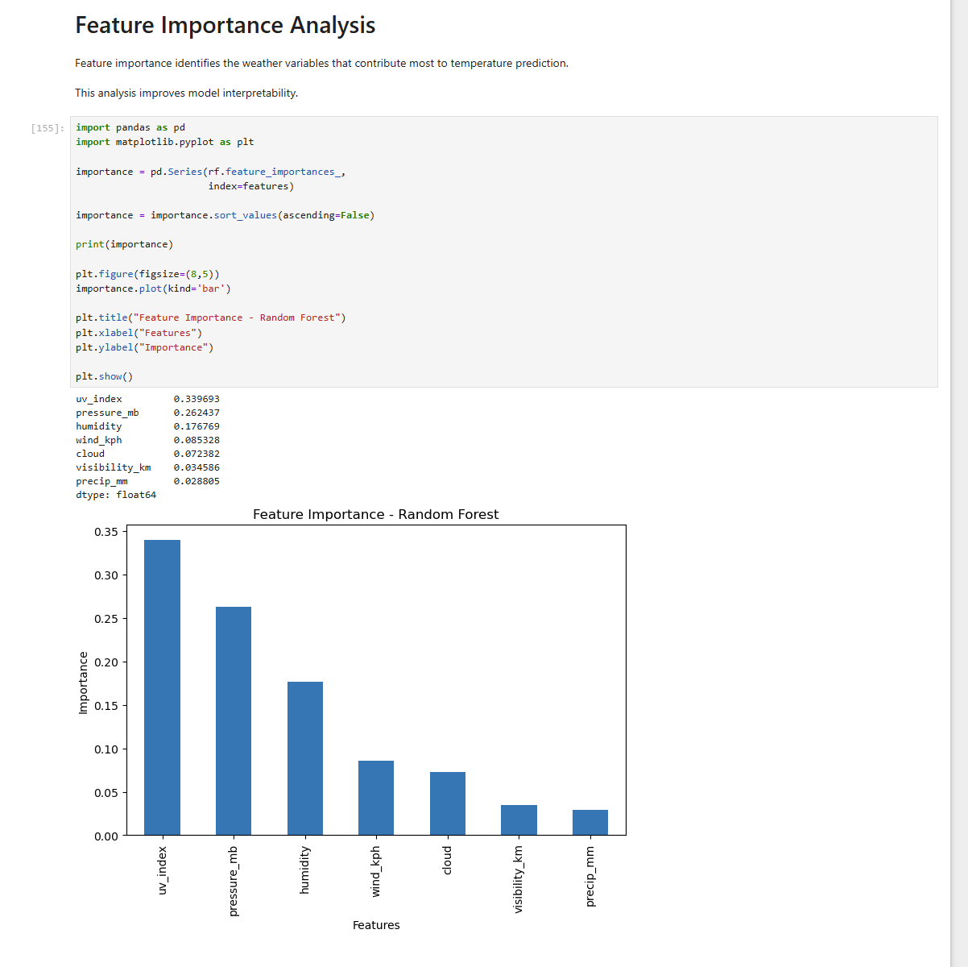
Feature Importance
Top features:
UV Index
Pressure
Humidity
Wind Speed
Cloud
Visibility

Slide 9
Conclusion
• Random Forest outperformed Linear Regression.
1
• UV Index and Pressure were the strongest predictors.
2
• Suitable for weather forecasting.
3

