Slide 1


Lending Club Case Study - Submission
Name: Ravi Ramchandran, Sreejith Sreekumaran
20-Feb-2021

Slide 2
Abstract of the problem
Background :
Objective :
Lending Club is a consumer finance company which specialises in lending various types of loans to urban customers
Lending loans to ‘risky’ applicants is the largest source of financial loss (called credit loss), like all Lending companies
LC wants to understand the driving factors (or driver variables) behind loan default, i.e. the variables which are strong indicators of default.
LC wants to identify these risky loan applicants, then such loans can be reduced thereby cutting down the amount of credit loss
Use EDA to understand how consumer attributes and loan attributes influence the tendency of default.

Slide 3
Problem Solving Methodology
Data Cleansing
Data Preparation
Data Exploration
Bi Variate Analysis
Create Derived Variables
Create joint distribution to see impact of see relations between Derived Variables/2 variables wrt to Target Variables
Analysis Recommendations
Drop Columns with Null Values
Remove Anomalies like %, Months etc
Define Target Variable
Create Derived Variable like Issue Year, Month etc
Overall View of Data using Charts to Narrow List of Features
Univariate Analysis/Segmented Univariate
Analyse One Feature with Target Variable to see Correlations
Create Segmented Distributions to visualize the same
Create distributions for Categorical and Numeric Variables
Publish Observations and Insights

Slide 4
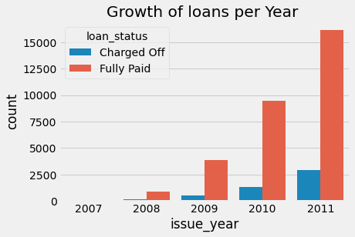
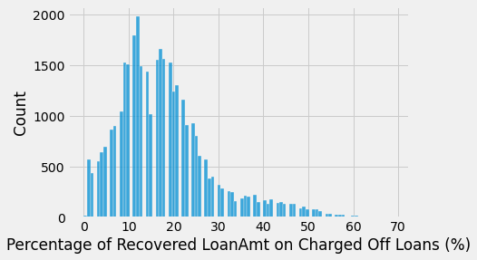
Data Analysis
State of the Business
Loans are Increasing on a Year on Year Basis which is a good sign
However Defaults are also increasing, at a similar rate which should be reduced
Recovery Rate is still relatively around 30% which needs to be improved

Slide 5
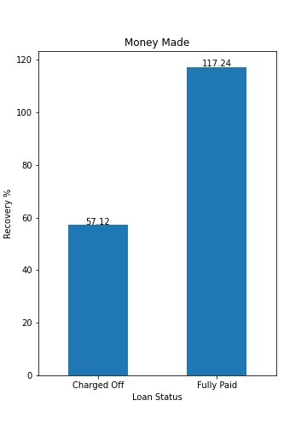
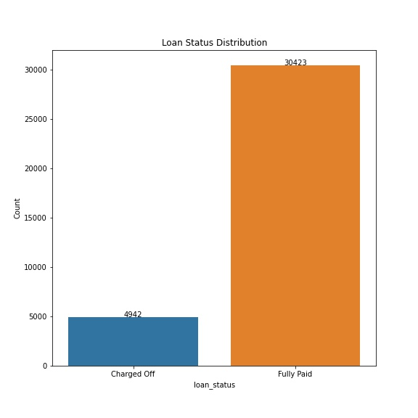
Around 14% of the loans are Charged off
LC made 17% profit in Fully paid loans while it could recover only 57% from Charge off Loans

Slide 6
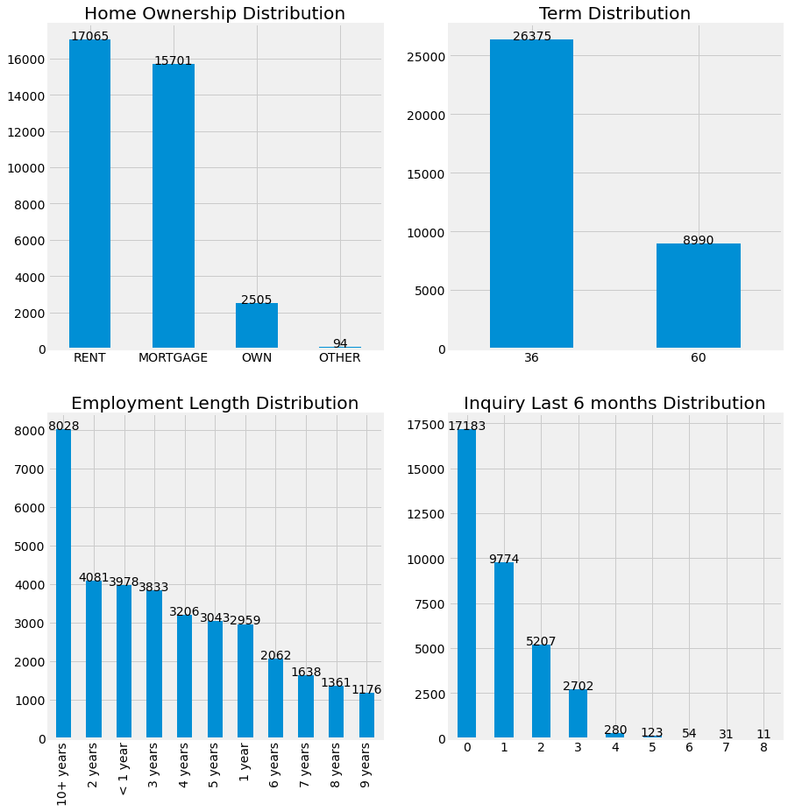
Understanding Data
Higher proportion of Loans are sought by people with 10+ years of employment.
Most loans have term of 36 months.
Maximum loans are taken by people staying on rent or homes on mortagage.
Repeat enquiries have been low in the last six months.

Slide 7
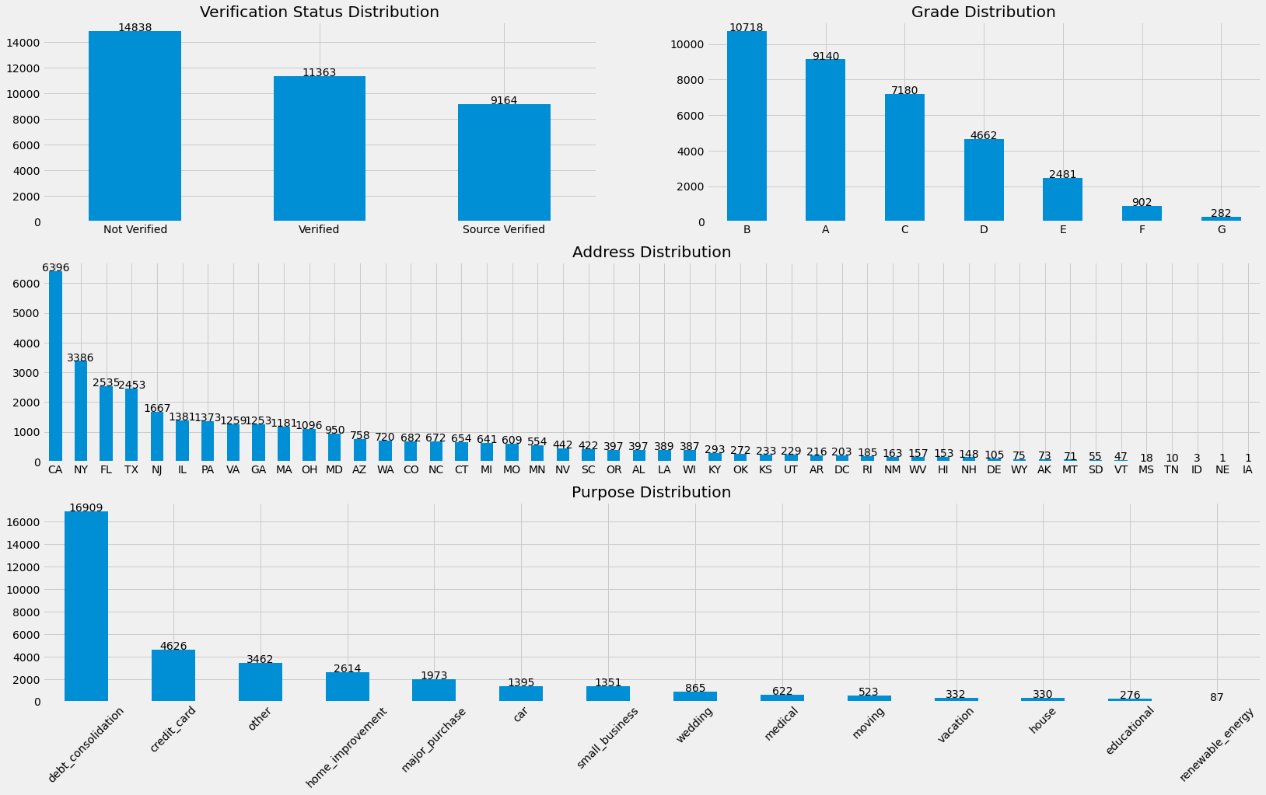
Understanding Data
Seems there is a higher tendency to give of loans without verification.
Most loans are taken from California state.
Most of loans are taken for debt consolidation.
Majority of the loans belong grade ‘B’.

Slide 8
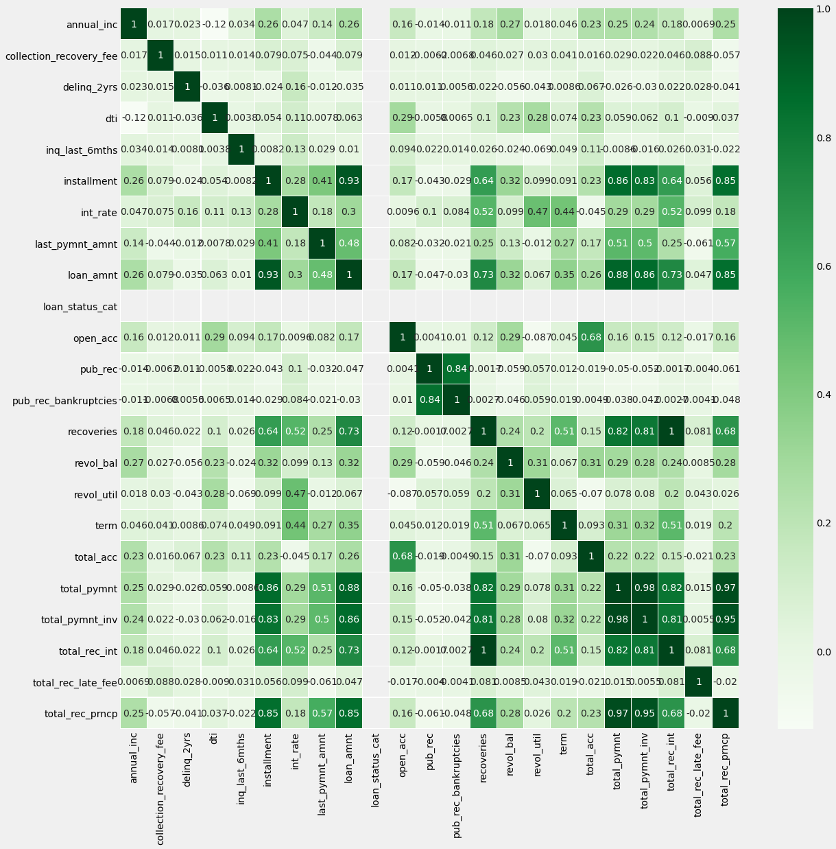
Data Analysis
total_payment and total_payment_inv and
loan_amt are highly correlated
pub_rec_bankruptcy and pub_rec show 100% correlation.
dti has a mild correlation to charged off loans which we can explore further

Slide 9
Univariate Analysis

Slide 10
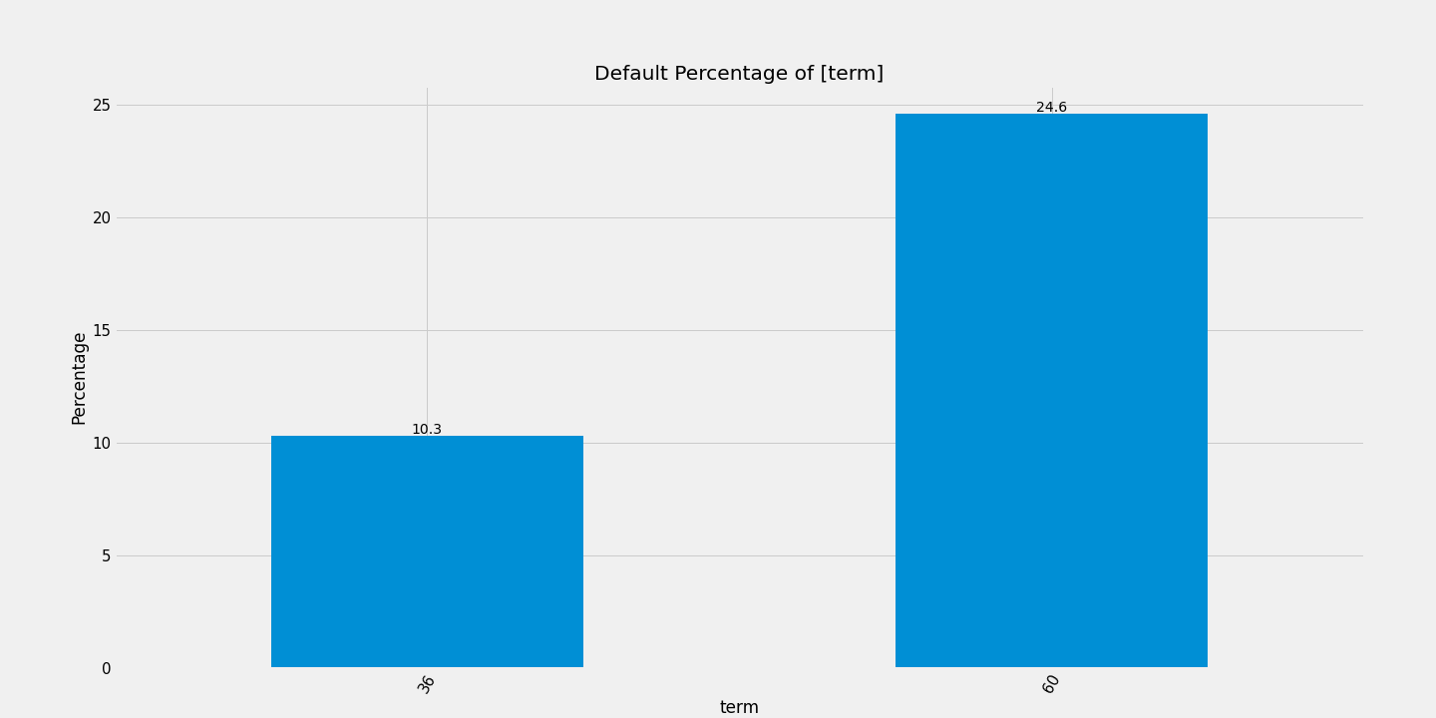
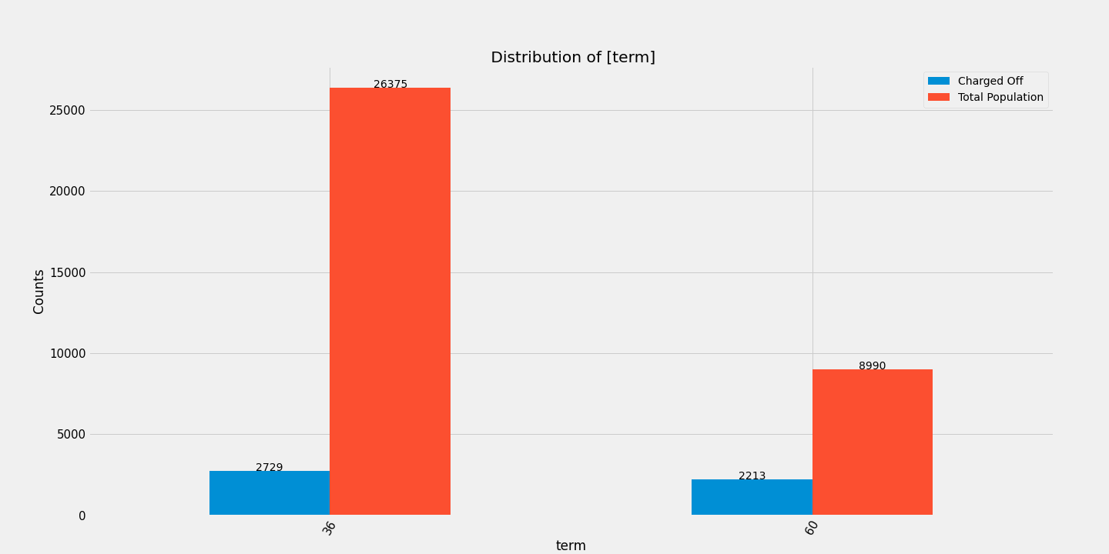
Term
Almost 25% of all charged off Loans have duration of 60 months
Higher the term means higher the probability of Default

Slide 11
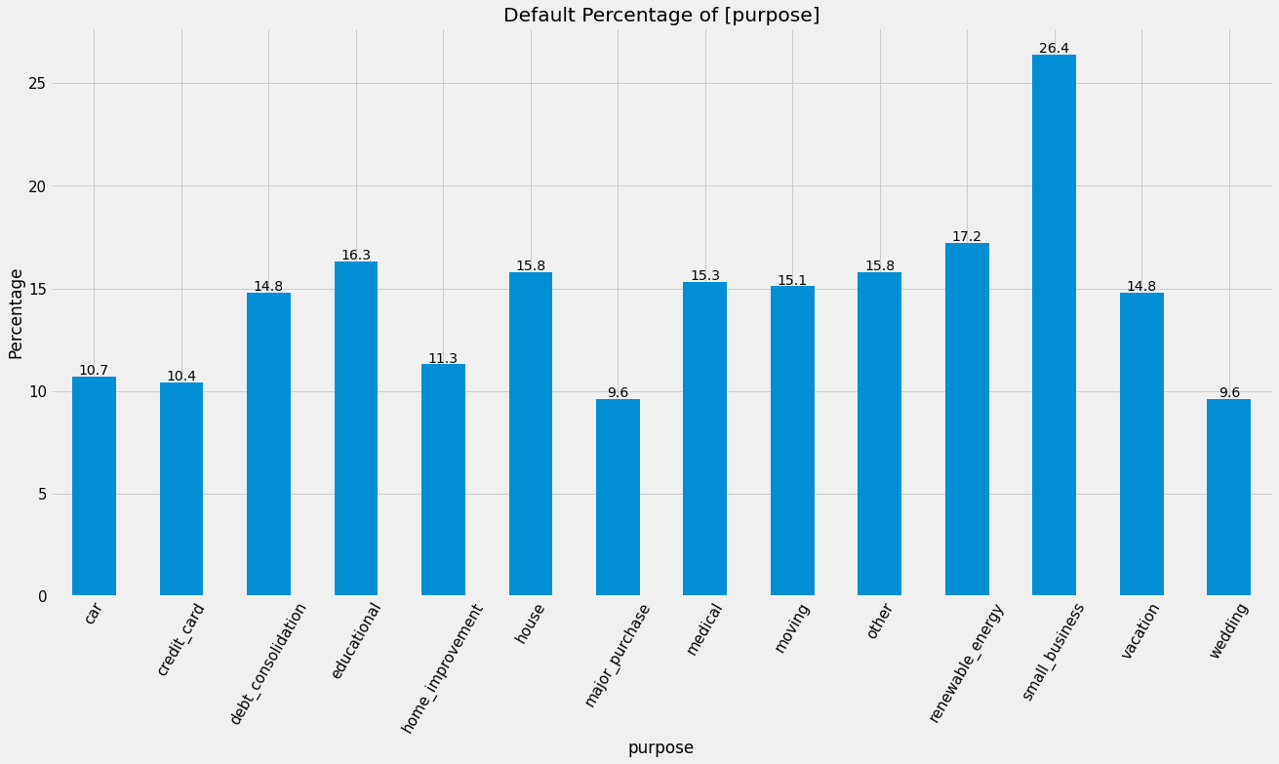
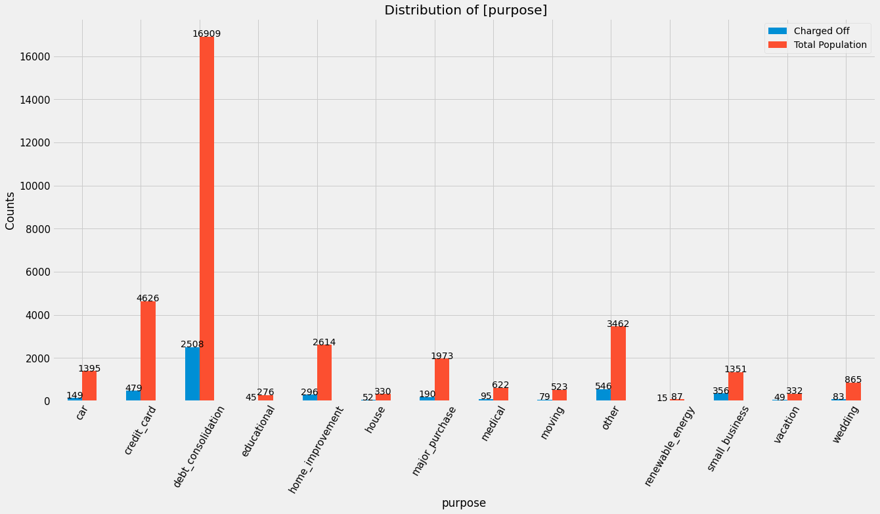
Purpose
Debt Consolidation has the maximum number of defaulters
But the percentage is still within the range of other categories
Small business is defaulting at a higher rate of 26% !

Slide 12
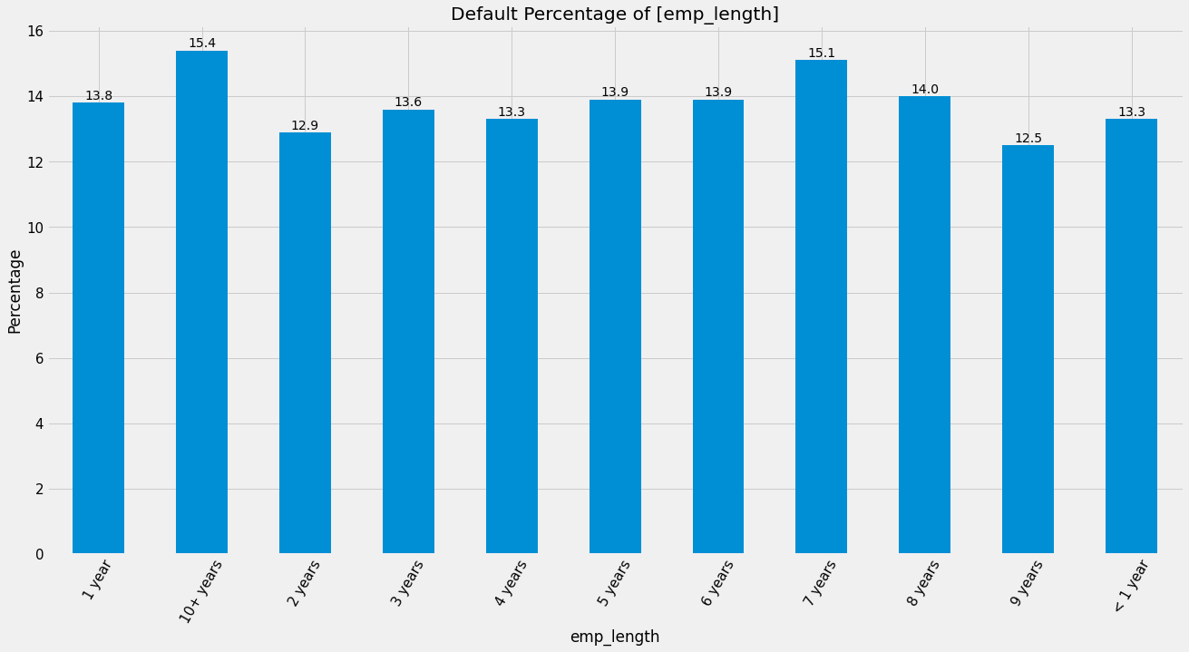
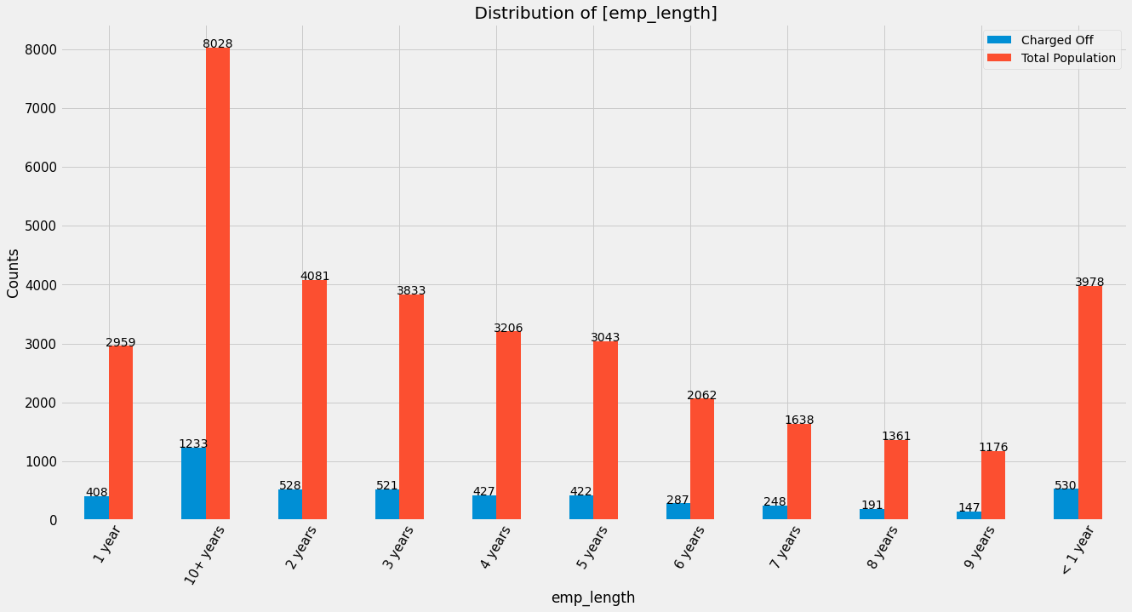
Employment Length
Good amount of loan taker have an employment length of more than 10 years.
There is no impact of employment length to chance of loan default.

Slide 13
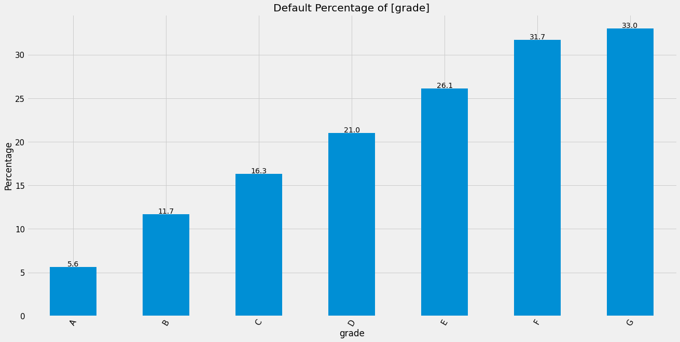
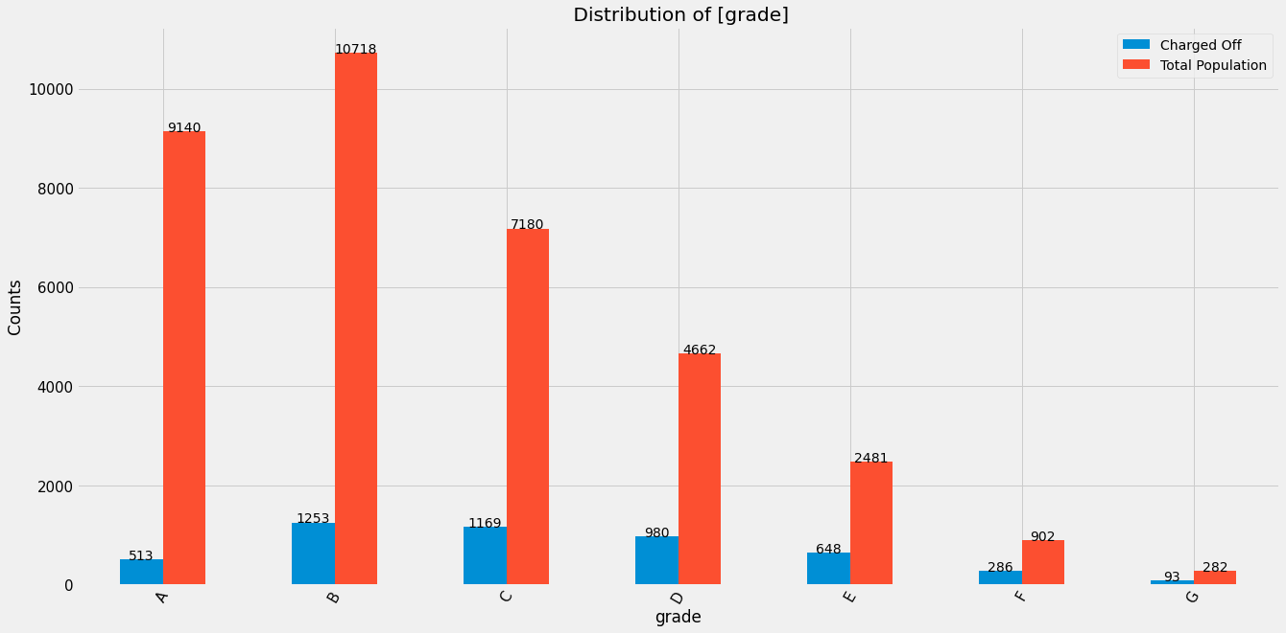
Grade
Nearly 30% of all loans in Grades F and G see a default.
Grade E onwards are risky, and less numerous.

Slide 14
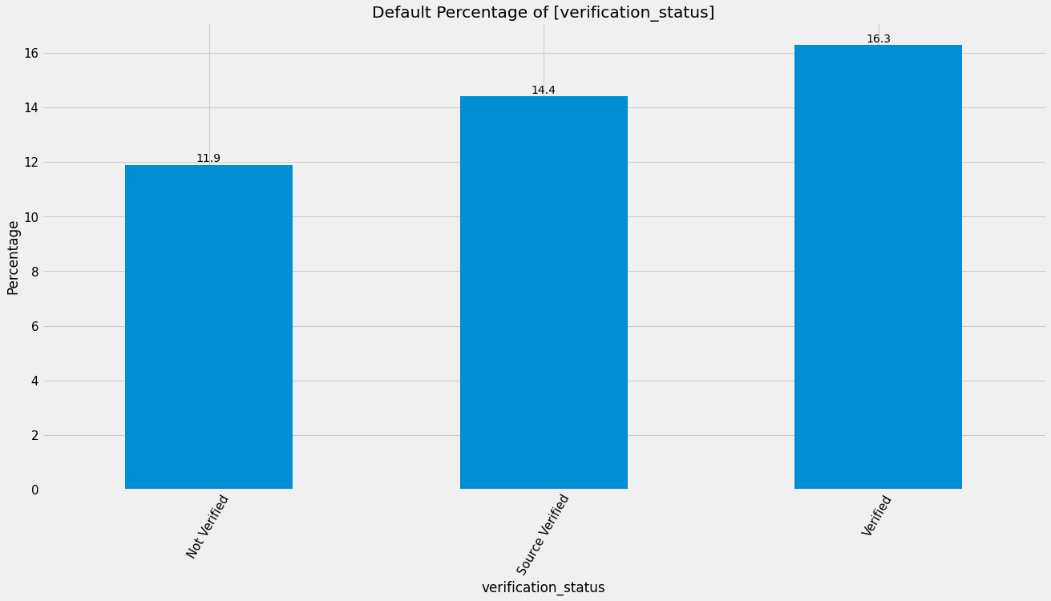
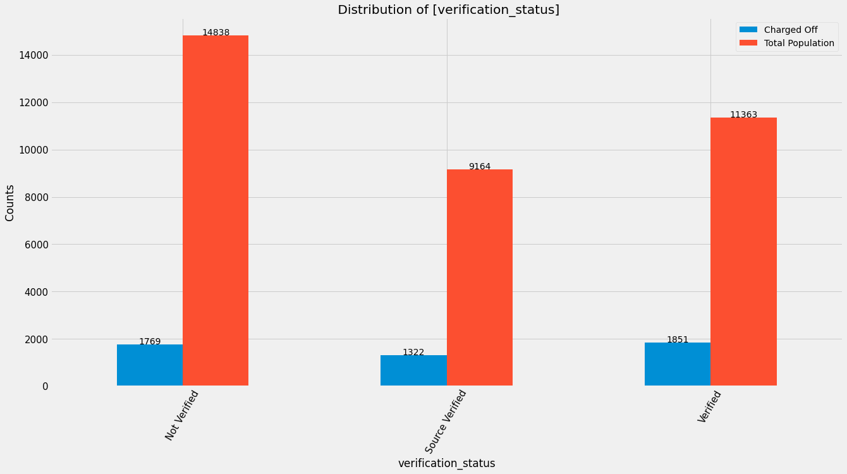
Verification Status
'Non Verified' loans is very high. LC should take steps to verify these loans.
Verified loans show more charged Off percentage as compared to Not verified loans.

Slide 15
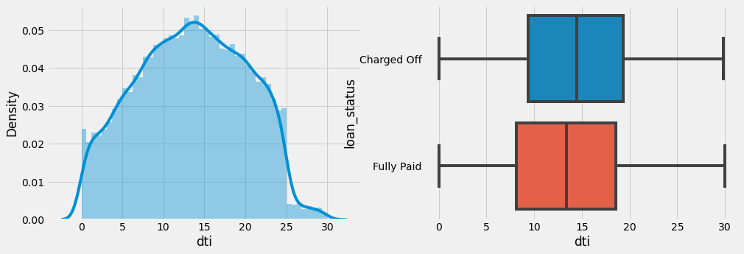
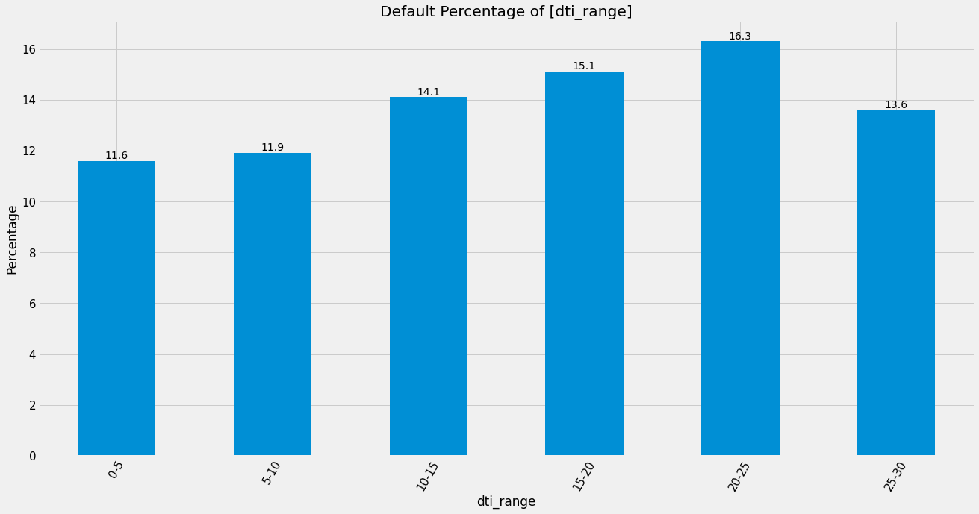
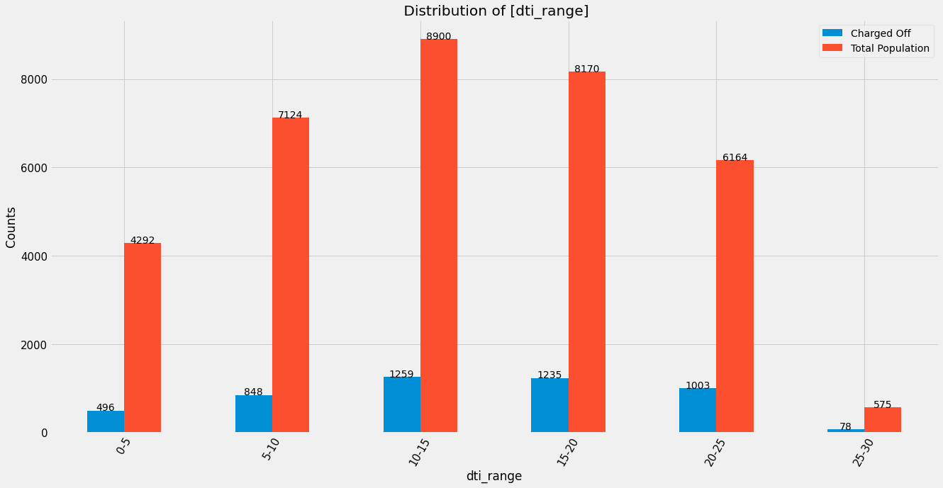
DTI
As can be seen the 75% of all Fully Paid Loans is around 17, which is less than that of Charged of Loans.
We can infer that the DTI above 18 is at higher risk of being "Charged Off" State

Slide 16
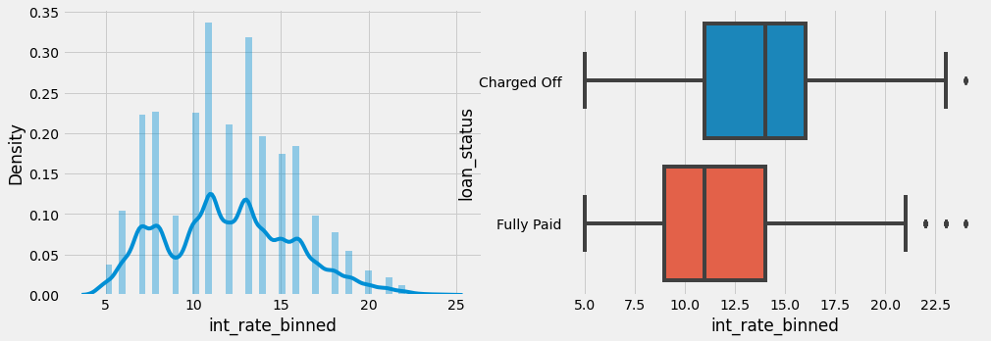
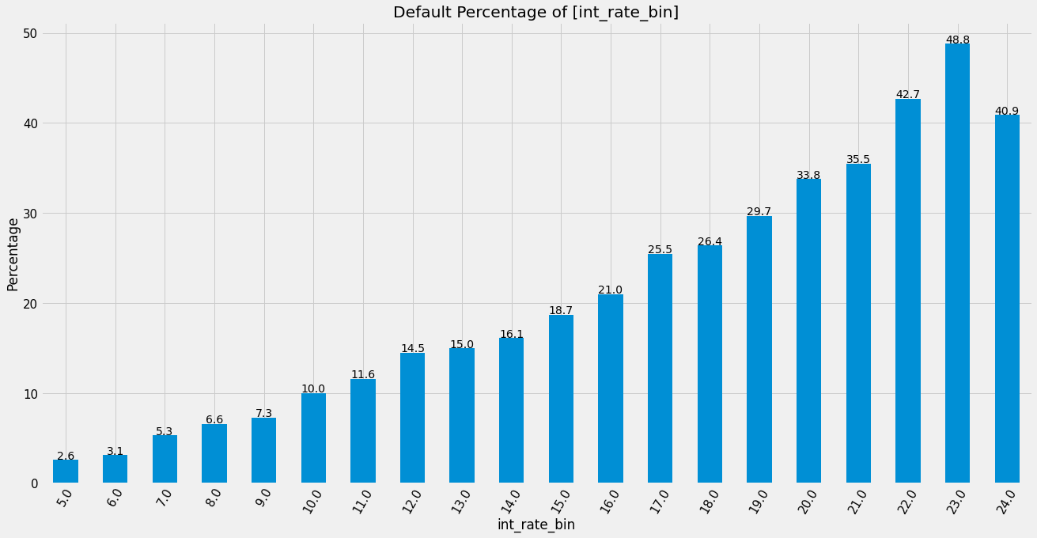
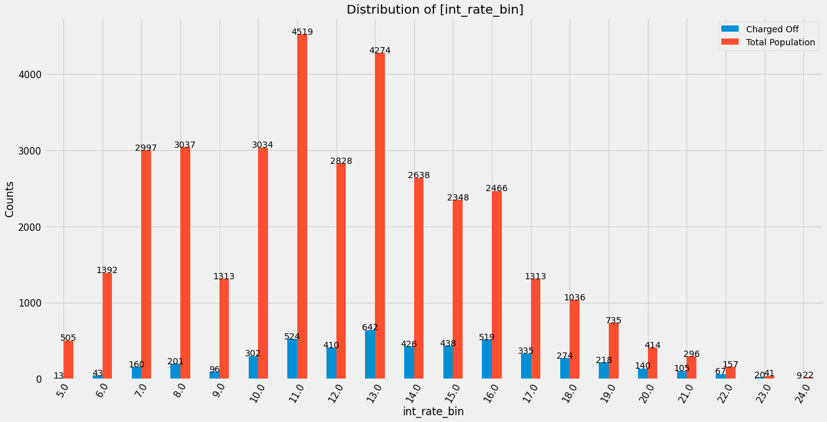
Interest Rate
Charged off loans are 2% points higher than Fully paid loans. Looks like -
LC is assessing risk correctly and charging riskier loans higher as the interest rate for Charged off loans seems to be on the higher side.

Slide 17
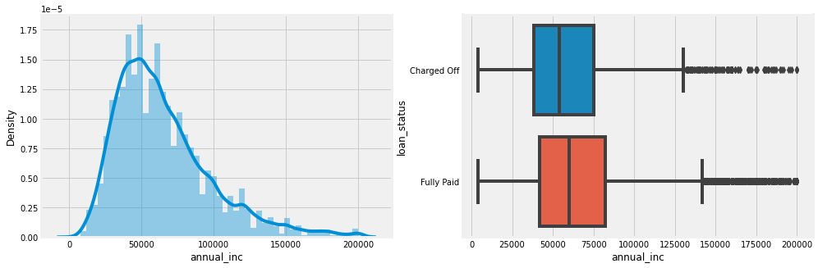
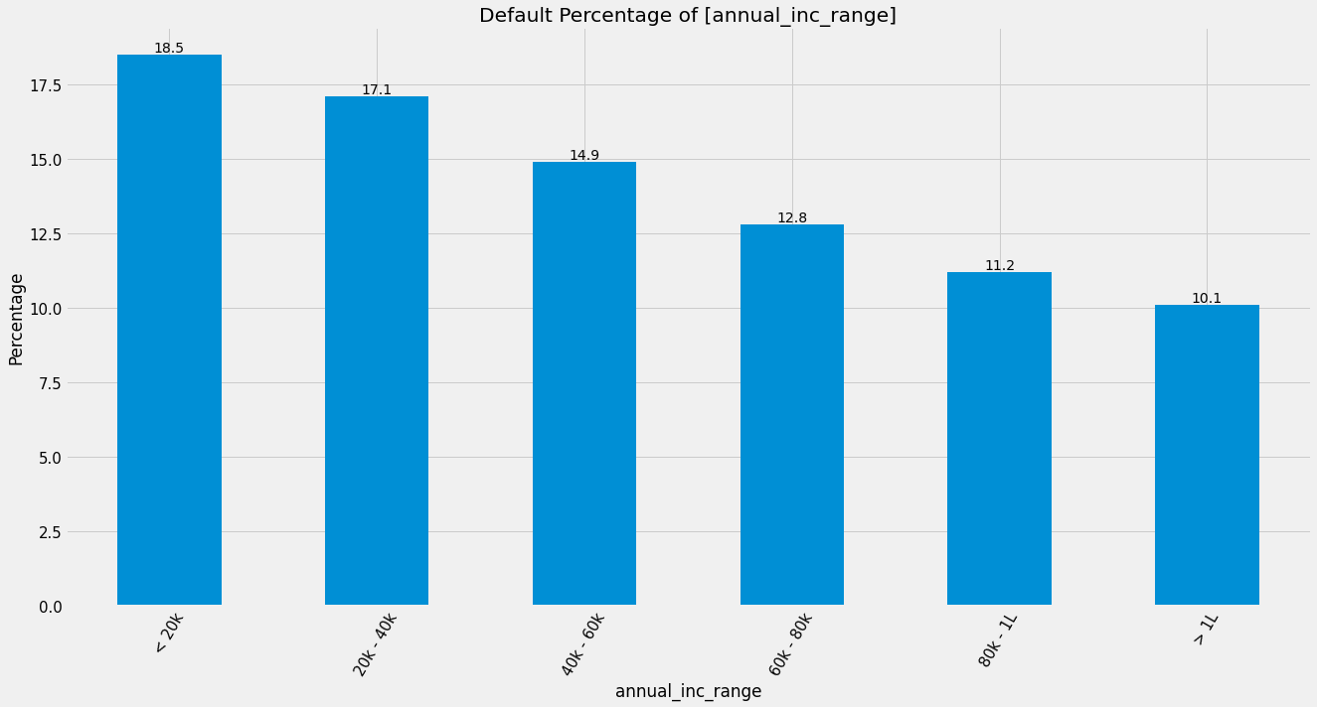
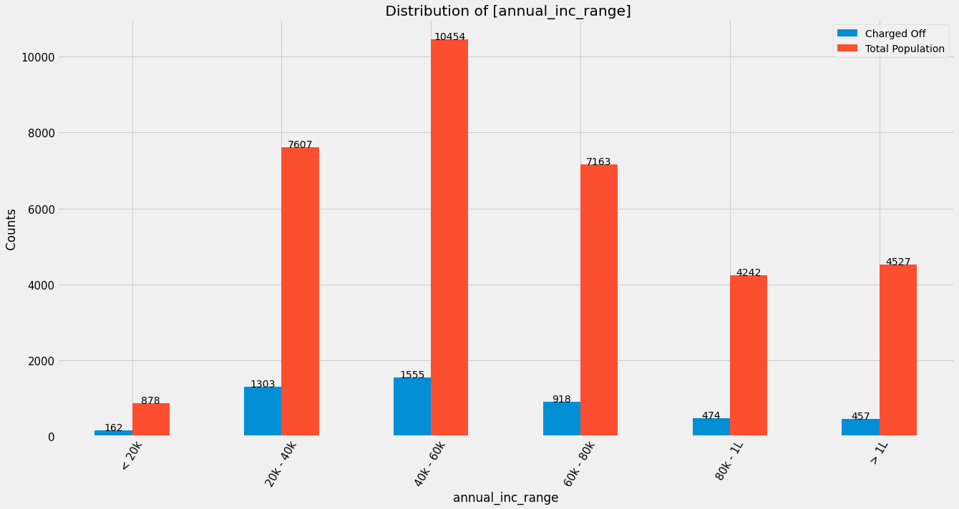
Annual Income
Loan defaults are higher at lower income and reduces as the income goes up.

Slide 18
Univariate Analysis
Distribution of Interest Rate across Loan Status
Charged off loans are 2% points higher than Fully paid loans. Looks like -
Interest Rate
DTI
As can be seen the 75% of all Fully Paid Loans is around 17, which is less than that of Charged of Loans.
We can infer that the DTI above 18 is at higher risk of being "Charged Off" State
LC should restrict lending to applicants having DTI >17
LC is assessing risk correctly and charging riskier loans higher
Distribution of DTA across Loan Status

Slide 19
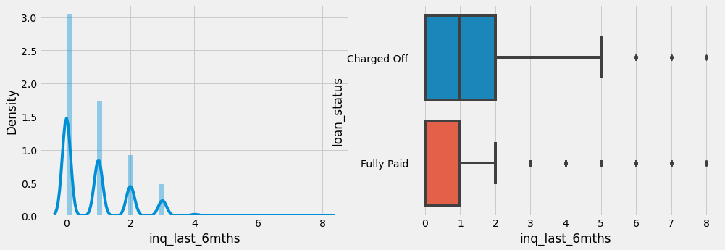
Univariate Analysis
Distribution of Enquiry across Loan Status
People with repeat enquiry tend to default more.
Repeat Enquiry
DTI
As can be seen the 75% of all Fully Paid Loans is around 17, which is less than that of Charged of Loans.
We can infer that the DTI above 18 is at higher risk of being "Charged Off" State
LC should restrict lending to applicants having DTI >17
Distribution of DTA across Loan Status

Slide 20
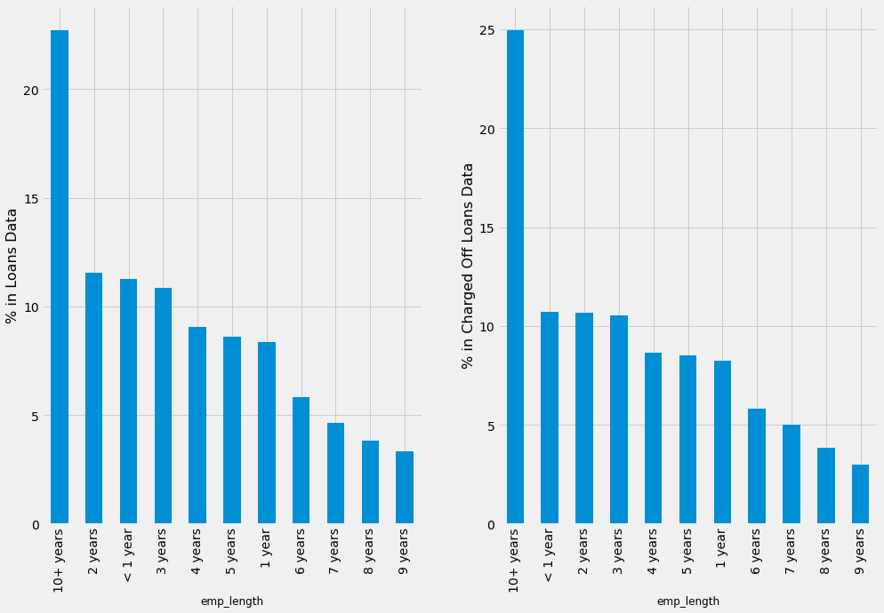
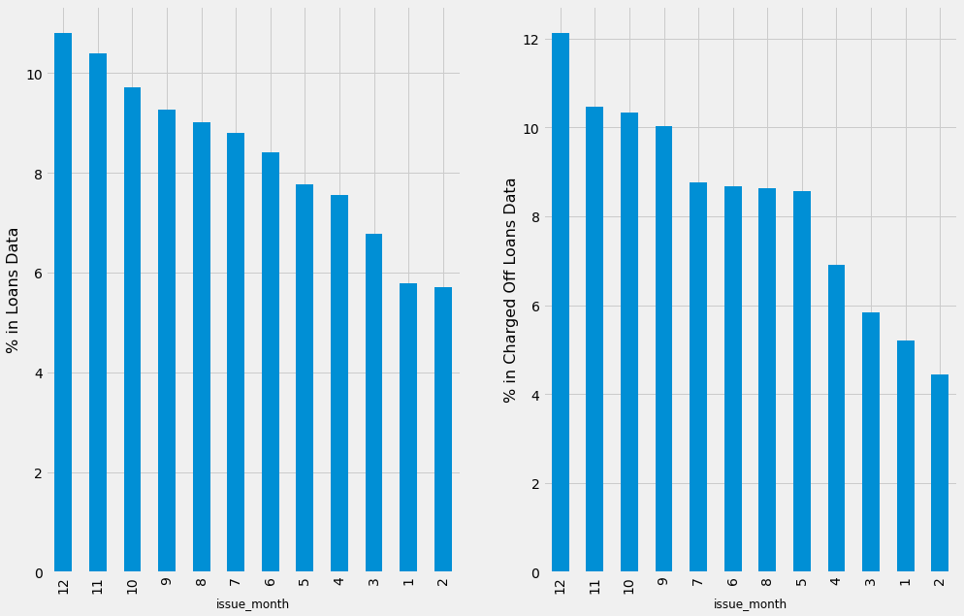
Univariate Analysis
Distribution of Employment Length across Loan Status
Distribution of Month across Loan Status
Max Loans are given to tenured employees, which is working well
Employment Length
Defaults ratios are same across categories LC should continue the same
LC has been giving out maximum loans in December
Month
There is a high distribution of Loans as the year is going to end. Any targets being met by LC ?

Slide 21
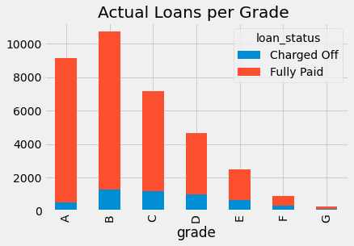
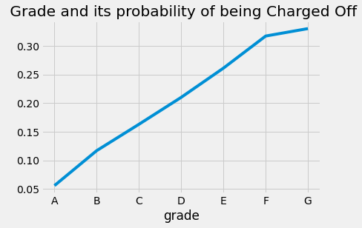
Bi Variate Analysis
Defaults are increasing as per grade, so LC must continue with the system
LC should restrict loans in grade E, F, G as the cost benefit of risk is not justified
LC has a Grading System from A to E
Grade and Probability of Default

Slide 22
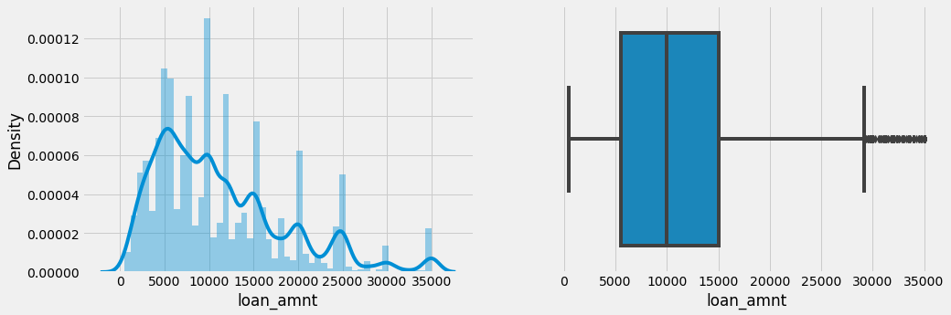
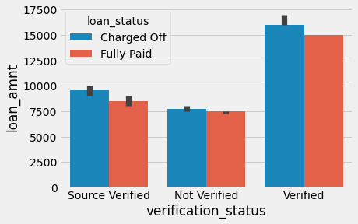
Bi Variate Analysis
Loan Amt Distribution
Verification is done for higher amounts
Verification Status with Loan Amount – Loan Status
LC should continue doing the same
However Verification process should be tightened further as Verification is not providing right results

Slide 23
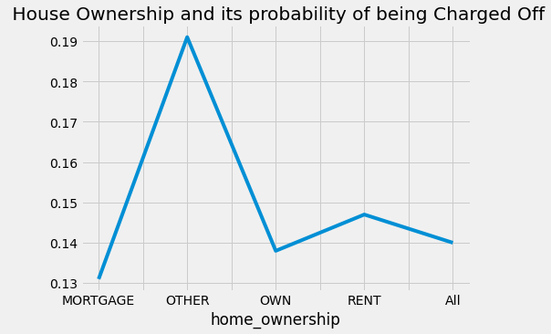
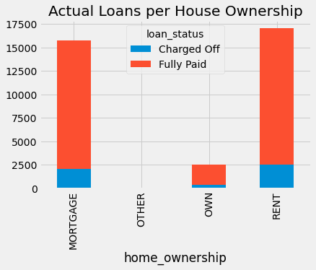
Bi Variate Analysis
Loan Amt Distribution
There is a bias towards Rented and Mortgaged Loan Seekers
House Ownership and Probability of Default
LC should prefer Mortgaged Owners over Rented ones as the probability is marginally lower on Mortgaged Seekes
Other Category should be strictly avoided

Slide 24
Analysis Recommendations
Continue Doing
Start Doing
Continue Lending irrespective of Purpose
Avoid Higher Terms of 60 months
Consider higher margin on Riskier loans
LC should restrict lending to applicants having DTI >17
Avoid grade categories E,F,G
Continue Charging Higher Loan Rates
Continue giving loans to Tenured Employees
Continue Lending Irrespective of Months
Continue the Grading System
Tighten the Verification process which has holes
Continue Verification for Higher Value Loans
Continue Preferring Rented/Mortgaged Owners
Avoid Other Category Home Owners

