Slide 1


Lending Club Case Study - Submission
Name: Ravi Ramchandran, Sreejith Sreekumaran
20-Feb-2021

Slide 2
Abstract of the problem
Background :
Objective :
Lending Club is a consumer finance company which specialises in lending various types of loans to urban customers
Lending loans to ‘risky’ applicants is the largest source of financial loss (called credit loss), like all Lending companies
LC wants to understand the driving factors (or driver variables) behind loan default, i.e. the variables which are strong indicators of default.
LC wants to identify these risky loan applicants, then such loans can be reduced thereby cutting down the amount of credit loss
Use EDA to understand how consumer attributes and loan attributes influence the tendency of default.

Slide 3
Problem Solving Methodology
Data Cleansing
Data Preparation
Data Exploration
Bi Variate Analysis
Create Derived Variables
Create joint distribution to see impact of see relations between Derived Variables/2 variables wrt to Target Variables
Analysis Recommendations
Drop Columns with Null Values
Remove Anomalies like %, Months etc
Define Target Variable
Create Derived Variable like Issue Year, Month etc
Overall View of Data using Charts to Narrow List of Features
Univariate Analysis/Segmented Univariate
Analyse One Feature with Target Variable to see Correlations
Create Segmented Distributions to visualize the same
Create distributions for Categorical and Numeric Variables
Publish Observations and Insights

Slide 4
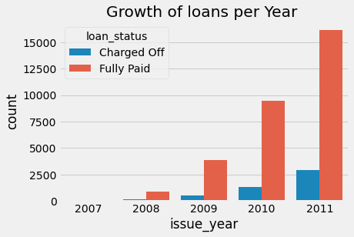
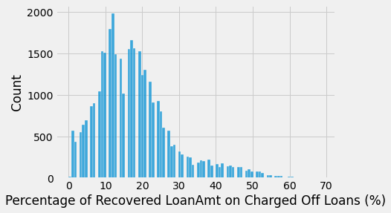
Data Analysis
State of the Business
Loans are Increasing on a Year on Year Basis which is a good sign
However Defaults are also increasing, at a similar rate which should be reduced
Recovery Rate is still relatively around 30% which needs to be improved

Slide 5
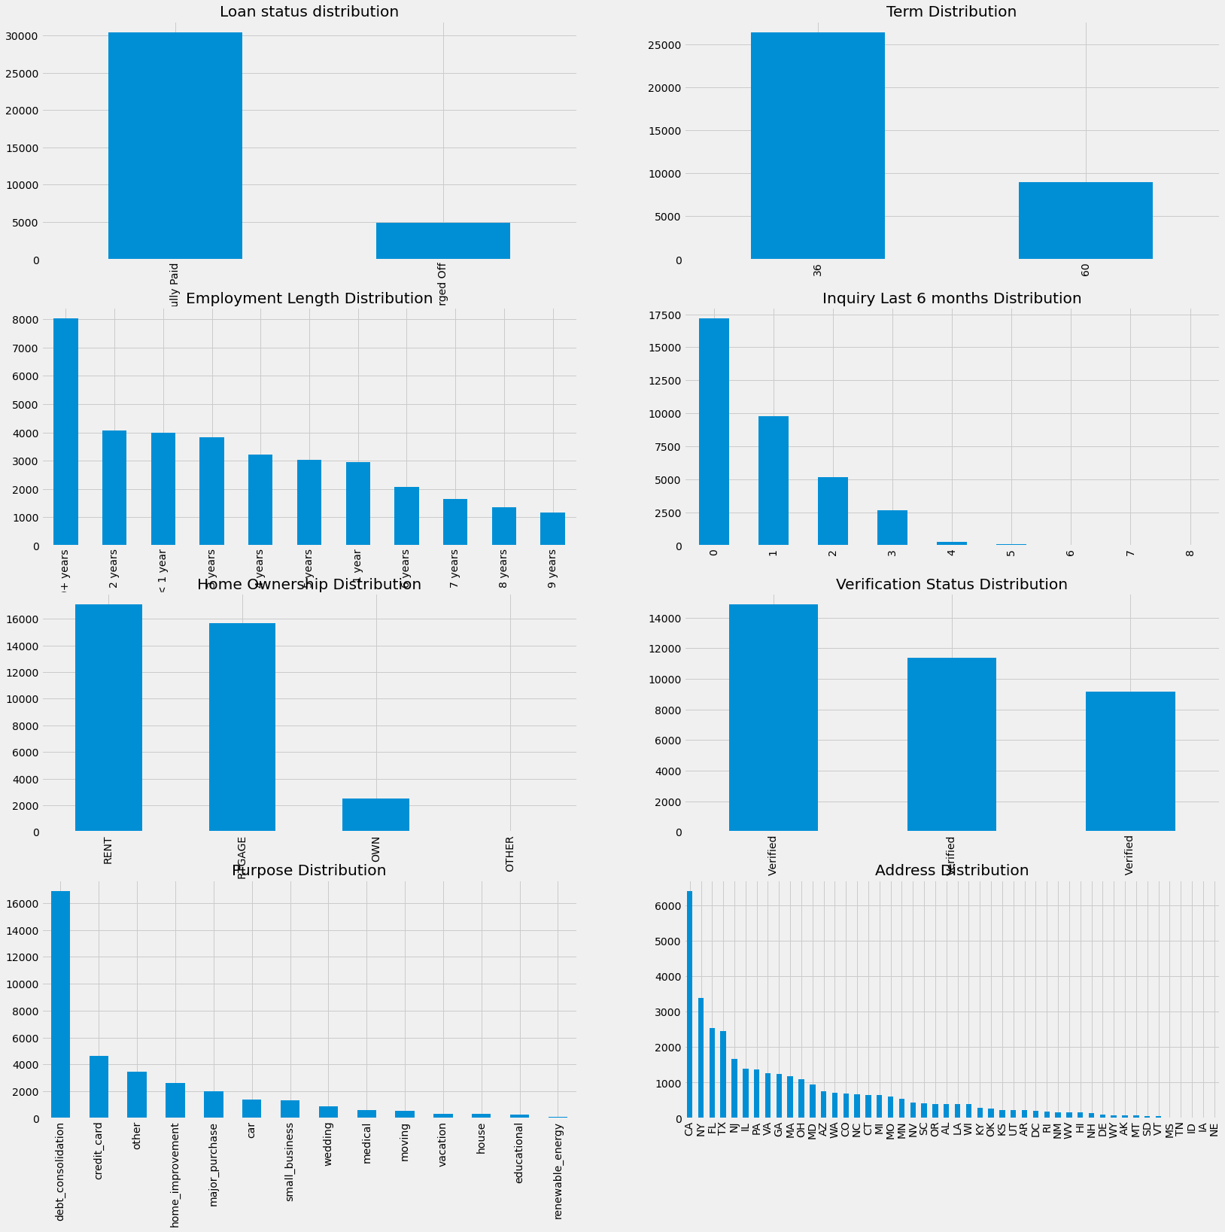
Data Analysis
14% of Total Loans are charged off
Loans are preferred to Higher Tenured Home owners
Majority of Users are having less than 2 Enquiries
Loans are skewed towards Rented/Mortgaged Home Owners
Debt Consolidation is the most common purpose for a loan for the existing Data
CA State is the most common state in the provided data

Slide 6
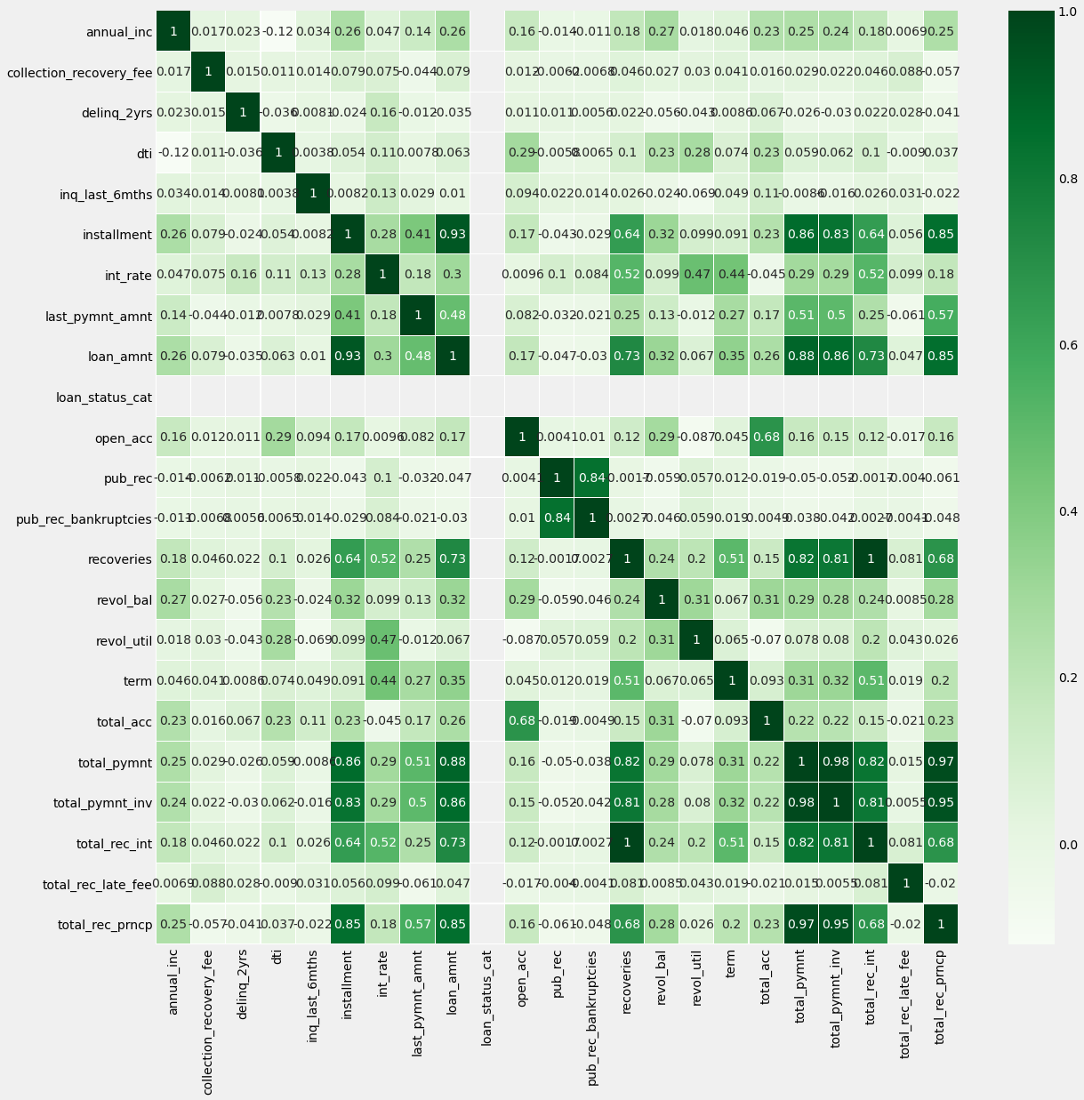
Data Analysis
total_payment and total_payment_inv and
loan_amt are highly correlated
pub_rec_bankruptcy and pub_rec show 100% correlation.
dti has a mild correlation to charged off loans which we can explore further

Slide 7
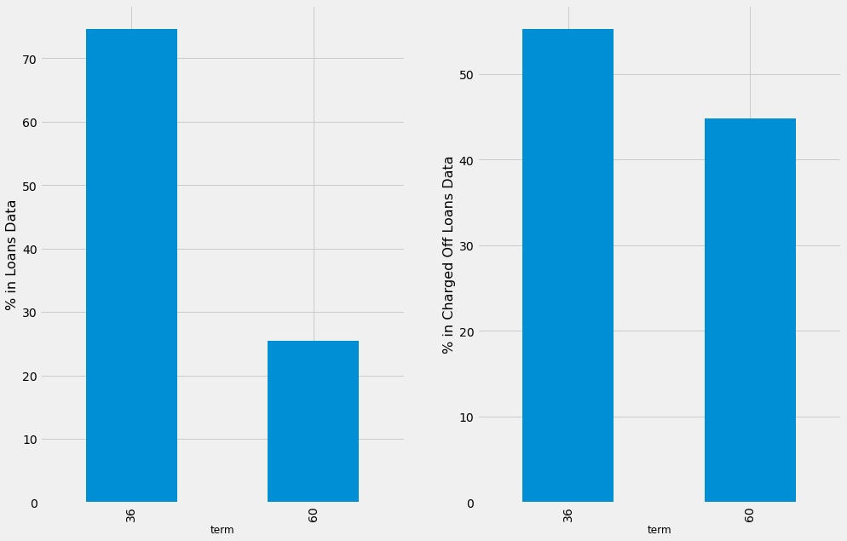
Univariate Analysis

Slide 8
Analysis Recommendations
Callouts
Continue Doing
Stop Doing
Test
Test
Test
Test
Test

