Slide 1

Using Large Language Models in Engineering Design
A rigorous, five-step methodology for integrating LLMs into engineering coursework — treating AI as a hypothesis generator that must be validated, not an authoritative solver.
ENGINEERING DESIGN · LLMS · METHODOLOGY

Slide 2
The Core Principle
LLMs Are Hypothesis Generators
The Wrong Approach
Large language models can accelerate design exploration — but they are not authoritative solvers. Every output must be treated as a hypothesis that requires independent validation before it can be trusted.
Ask a vague question
Accept the first answer
Apply results without checking
The Right Approach
Formalise the problem first
Test against known solutions
Iterate, then explore new designs

Slide 3
STEP 1
Problem Formalisation
Before writing a single prompt, define the engineering problem with precision. This prevents the most common failure: asking vague questions and receiving unreliable answers.
Inputs
Outputs
Governing Principles
Constraints, materials, loads, boundary conditions, and environmental factors that define the problem space.
Target dimensions, performance metrics, safety factors, and design specifications to be determined.
Relevant physics, engineering standards, and governing equations that constrain and guide the solution.

Slide 4


STEP 2
Model Selection & Prompt Design
Choosing Your Tool
Select the appropriate LLM — a general-purpose GPT-type model or a domain-specific engineering tool — based on problem complexity and required accuracy.
Designing Effective Prompts
Zero-shot vs few-shot: provide worked examples when the task is complex
Force the model to state assumptions explicitly
Require equations and units in every response
Enforce step-by-step reasoning before conclusions
Prompt design is equivalent to choosing a numerical method in classical engineering.

Slide 5

STEP 3
Benchmarking Against Known Solutions
This is the most critical step. Test the LLM on a problem with a known, verified solution before trusting it with new designs. This transforms LLM use from guesswork into a scientific experiment.
Numerical Accuracy
Quantify the percentage error between the LLM's output and the known solution.
Methodology Correctness
Check whether the reasoning path and equations used are physically sound.
Missing Constraints
Identify any assumptions or boundary conditions the model overlooked or hallucinated.

Slide 6
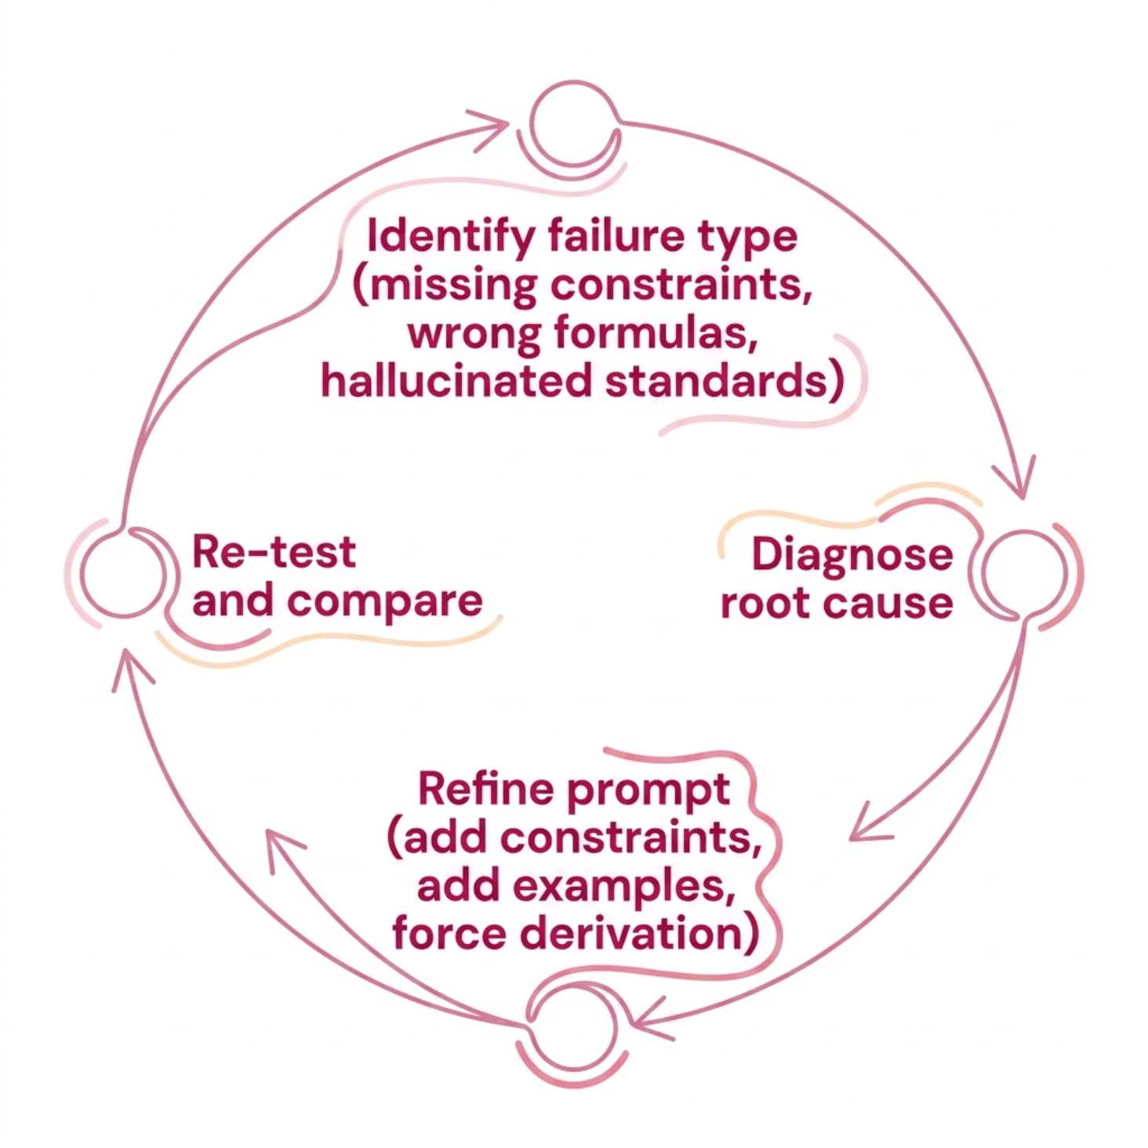

STEP 4
Error Analysis & Model Calibration
Diagnose Before You Iterate
Not all errors are equal. A conceptual error — using the wrong governing equation — is far more serious than a rounding mistake. Identify the failure type before refining your prompt.
Missing constraints? Add them explicitly to the prompt.
Wrong formulas? Provide the correct equation as a reference.
Hallucinated standards? Specify the applicable code or standard.

Slide 7



STEP 5
Controlled Design Exploration
Only after validation should students modify parameters to explore new designs. This is where LLMs become genuinely powerful — enabling rapid iteration and sensitivity analysis at scale.
Geometry
Materials
Boundary Conditions
Vary dimensions, profiles, and structural shapes to explore the design space systematically.
Swap materials and evaluate how properties affect performance, weight, and cost.
Modify loads, supports, and constraints to test robustness under different scenarios.

Slide 8
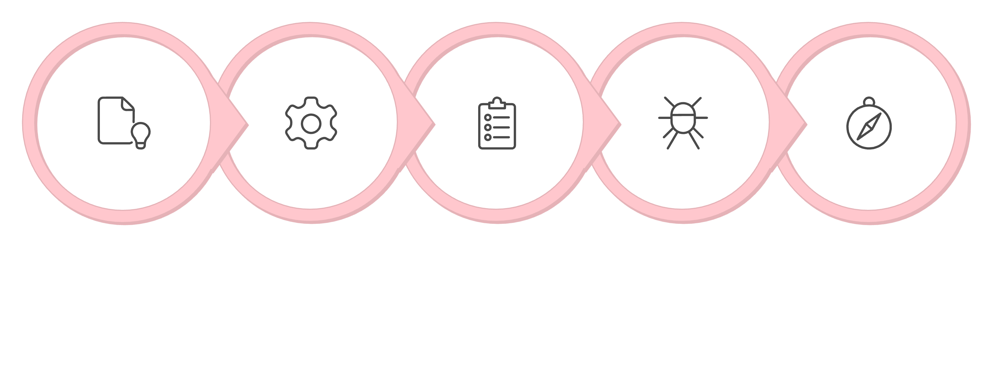
The Five-Step Methodology at a Glance
Formalise Problem
Model & Prompt
Error Analysis
Design Exploration
Benchmark
Each step builds on the last. Skipping benchmarking or error analysis invalidates the entire process — the methodology only works when followed in sequence.

Slide 9
Group Exercise: Evaluation Rubric
Criterion
Not Met (0%)
Developing (50%)
In Progress (80%)
Outstanding (100%)
Problem Formalisation
No definition
Partial
With omissions
Complete with equations
LLM Use & Prompts
Incorrect use
Basic use
Partially structured
Structured and clear
Validation (Known Solution)
Not validated
Weak validation
Partial comparison
Full with error quantified
Error Analysis
None
Superficial
Some errors identified
Deep diagnosis
Iteration & Improvement
None
Minimal
Partial improvement
Clear and effective
Design Exploration
None
Minimal changes
Partial exploration
Complete and justified
New Design Validation
Not validated
Weak
Partial
Solid independent
Technical Communication
Confusing
Unclear
Acceptable
Clear and professional

Slide 10

Key Takeaways
1
Formalise first, prompt second
A well-defined problem is the foundation of every reliable LLM output.
2
Always validate against a known solution
Benchmarking transforms LLM use from guesswork into a scientific method.
3
Treat errors as diagnostic data
Error analysis and prompt refinement are not failures — they are calibration.
4
Explore only after validation
Validated prompts unlock rapid, confident design iteration and sensitivity analysis.

