Slide 1
TF Study Group @ EAFIT
Create environment to:
Learn about TF technology
Understand on what problems can TF be applied
Explore how can TF be applied
Gain working experience with TF

Slide 2
TF Study Group @ EAFIT
What is TF:
Support machine learning ALGORITHM DESIGN worlflow (symbolic computing + numeric optimization)
Semi automatic mapping computation graphs to devices (CPU, GPU, distributed)
Growing deep learning library implementations
Inherits concepts from other frameworks (Theano, Torch, CAFFE)

Slide 3
TF Study Group @ EAFIT
In practice, main ML/DL areas
Image processing with CNNs
Signal processing with RNNs

Slide 4
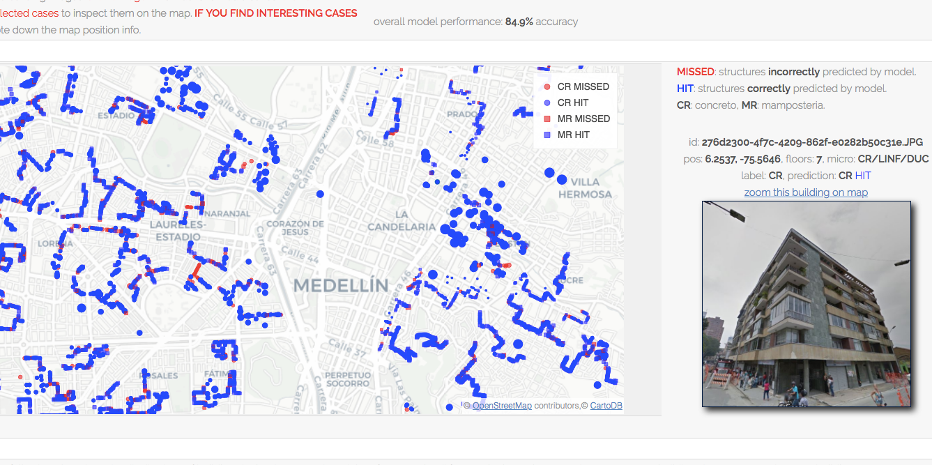
TF Study Group @ EAFIT

Slide 5
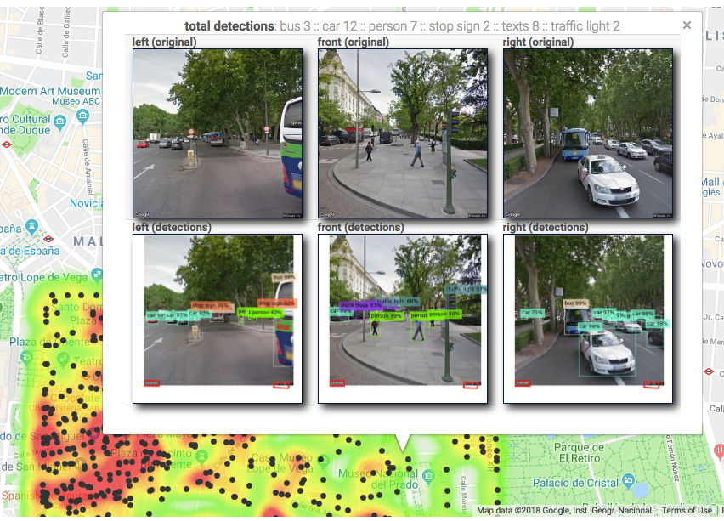
TF Study Group @ EAFIT

Slide 6
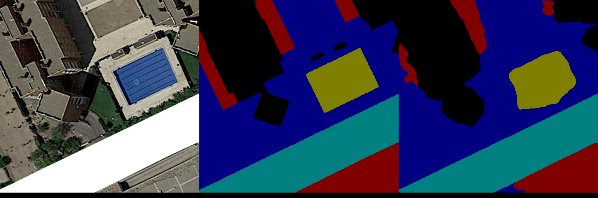
TF Study Group @ EAFIT

Slide 7
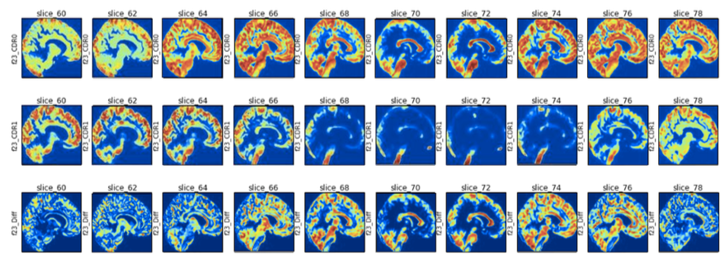
TF Study Group @ EAFIT

Slide 8
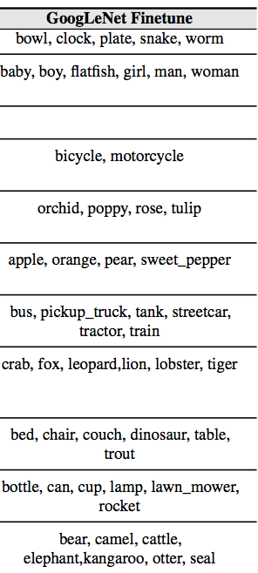
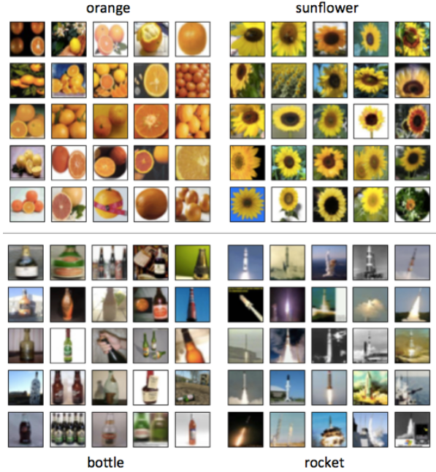
TF Study
Group @ EAFIT

Slide 9
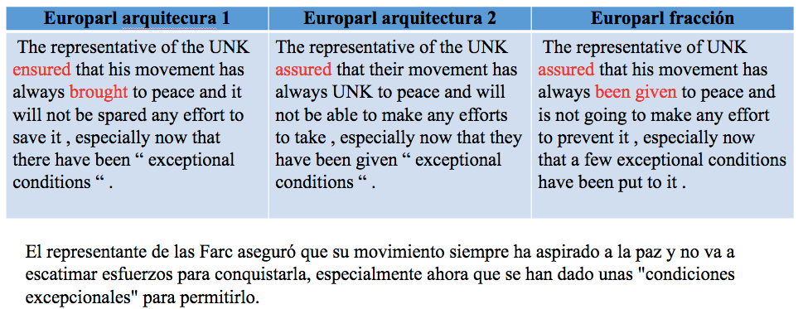
TF Study Group @ EAFIT

Slide 10
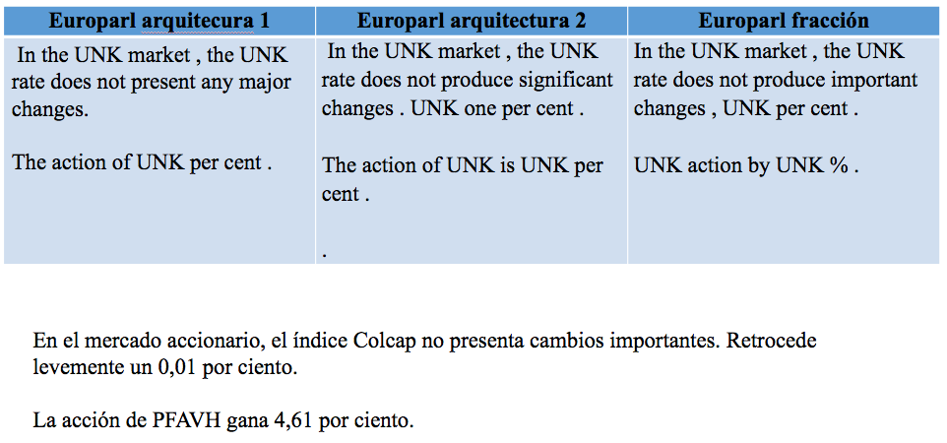
TF Study Group @ EAFIT

Slide 11
TF Study Group @ EAFIT
Methodology
Technical TF introductory session
Define focus teams (learning, problems, technology)
Define road map for each team

Slide 12
TF Study Group @ EAFIT
Focus teams
Learn TF: choose MOOC and share progress
Solve problem: choose data and task
    Own data / project
    KAGGLE
CNN/RNN Methods:
    Interpretability
Explore technology:
    Multi GPU
    TF Cluster

Slide 13
TF Study Group @ EAFIT
Mailing list / Wiki / Githubs??
Thursdays 7pm-9pm every two weeks??
2/3 presentations per session

Slide 14
TF Study Group @ EAFIT
Focus teams:
Learn TF: choose MOOC and share progress
Solve problem: choose data and task
    Own data / project
    KAGGLE
Explore technology
    Multi GPU
    TF Cluster

