Slide 1
DATA MINING presentation final project
© 2024 Yehia – Sara – Rana - Mohammed

Slide 2
agenda
Introduction
Team
Overview on The Dataset
Data Analysis
Data Cleaning
Extra operations (Bonus)
Kmedoids
Hierarchical
Fuzzy
Kmeans (Bonus)
Conclusion
© 2024 Yehia – Sara – Rana - Mohammed

Slide 3
Introduction Unlocking Passenger Satisfaction
1. Objectives:
Our goal is clear – to uncover insights from passenger data that drive satisfaction and inform strategic improvements.
2. Data Collection:
We've gathered comprehensive data on passenger demographics, travel habits, and satisfaction ratings to fuel our analysis.
3. Data Cleaning:
Prior to analysis, we meticulously cleaned the data, ensuring accuracy and reliability.
4. Data Analysis:
Leveraging advanced mining techniques such as regression and classification, we've unearthed hidden patterns and relationships within the data.

Slide 4
Introduction Unlocking Passenger Satisfaction
5. Key Insights:
Our analysis reveals crucial factors influencing passenger satisfaction, guiding targeted interventions for service enhancement.
6. Documentation:
Every step of our journey has been documented for transparency and reproducibility.
7. Report and Presentation:
Our findings are synthesized into a concise report and dynamic presentation, ready to inform strategic decisions and drive positive change.
IN summary:
our data mining journey equips stakeholders with actionable insights to elevate passenger satisfaction and ensure sustained success in the airline industry.

Slide 5
Team
Yehia Tarek
2205062
Sara Ahmed
2205094
Rana Ashraf
2205019
Mohamed Essam
2205049

Slide 6
Overview On the dataset
Attributes:
ID: Unique identifier for each passenger.
Gender: Male or Female.
Age: Age of the passenger.
Customer Type: Whether the passenger is a first-time or returning customer.
Type of Travel: Purpose of travel, likely Business or Personal.
Class: Class of service (e.g., Business class).
Flight Distance: Distance of the flight in kilometers.
Departure Delay: Delay in minutes at departure.
Arrival Delay: Delay in minutes at arrival.
Departure and Arrival Time Convenience: Rating of convenience related to departure and arrival times.

Slide 7
Overview On the dataset
Rating Attributes:
On-board Service
Seat Comfort
Leg Room Service
Cleanliness
Food and Drink
In-flight Service
In-flight WIFI Service
In-flight Entertainment
Baggage Handling

Slide 8
Overview On the dataset
Target Variable:
Satisfaction: Indicates whether the passenger was satisfied or not (e.g., Satisfied, Neutral or Dissatisfied).
Statistics:
The dataset contains 10 rows.
It seems to be a subset of a larger dataset, as indicated by the relatively small number of entries.
Potential Insights:
There might be patterns in satisfaction levels based on factors like gender, age, or class of service.
Analysis could reveal which onboard services have the most significant impact on overall satisfaction.
Understanding the relationship between flight distance and satisfaction could be valuable for airline service improvement.

Slide 9
Overview On the dataset
Summary:
Most passengers are returning customers.
The majority seem to be traveling for business purposes.
Flight distances vary, ranging from relatively short to longer flights.
Delays at departure and arrival are present but not consistent across all passengers.
Ratings for onboard services vary across different aspects, with generally high ratings observed.
Overall satisfaction varies among passengers, with some being satisfied and others neutral or dissatisfied.

Slide 10
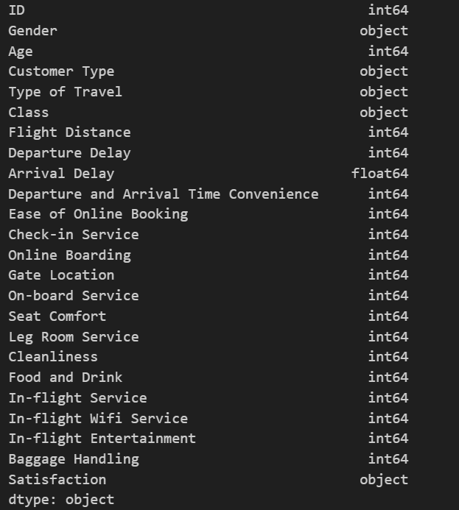
Data Analysis
we import the dataset
data=pd.read_csv('air.csv')
we check dimensions
data.shape (129880, 24)
we check variables types
data.info() dtypes: float64(1), int64(18), object(5)
data.dtypes

Slide 11
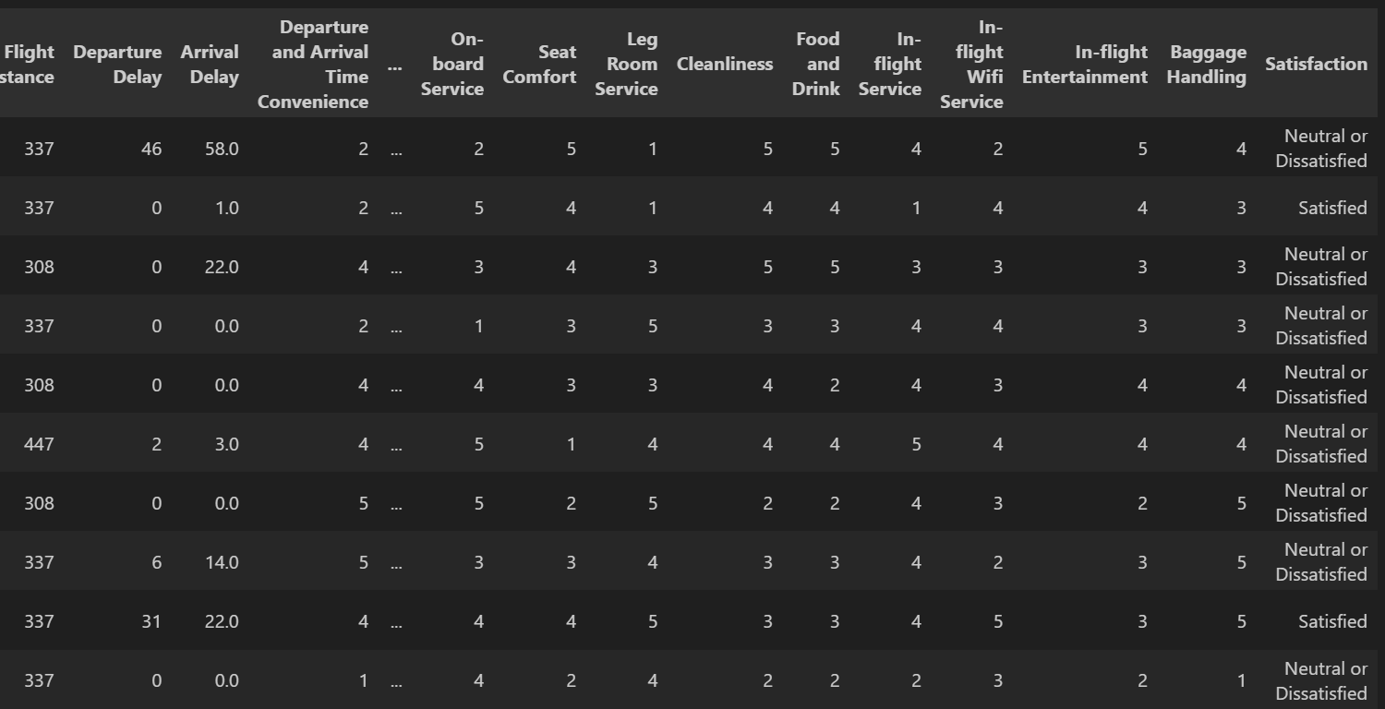
Data Analysis
we check last 10 rows
data.tail(10)

Slide 12
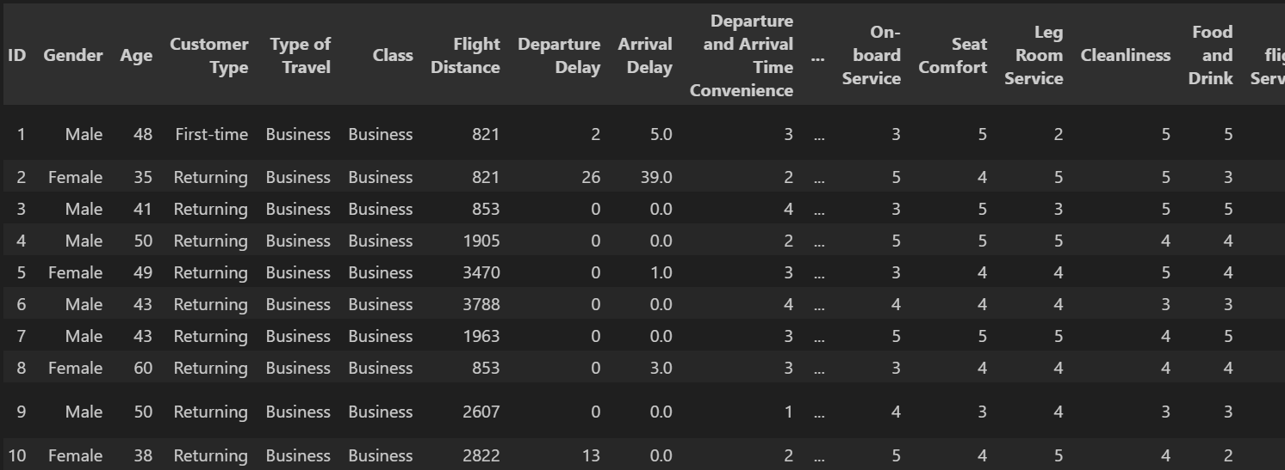
Data Analysis
we check 10st rows
data.head(10)

Slide 13
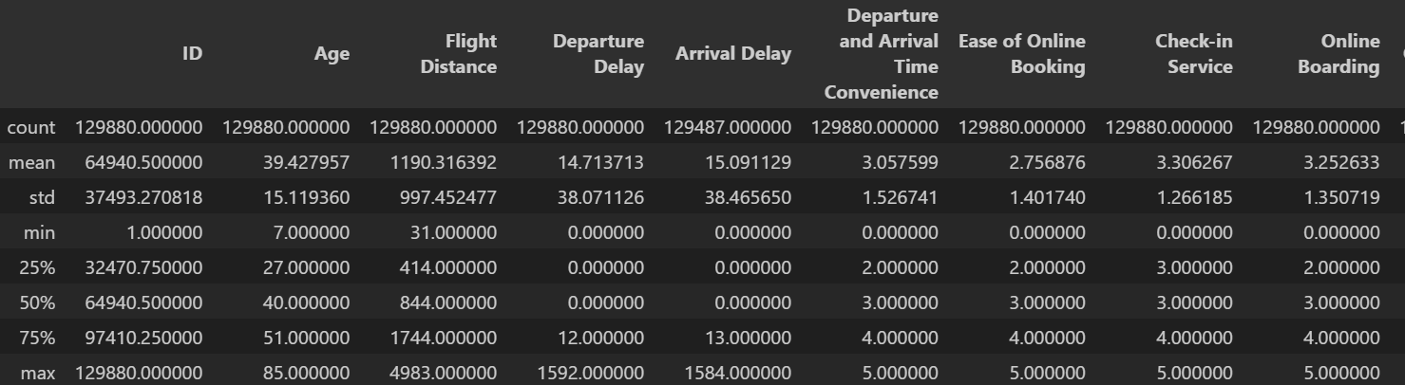
Data Analysis
stats summary
data.describe()

Slide 14
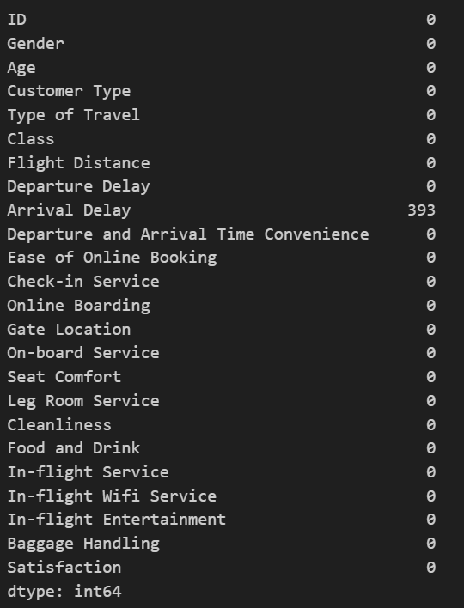
Data Analysis
Missing values check
print(data.isnull().sum())

Slide 15
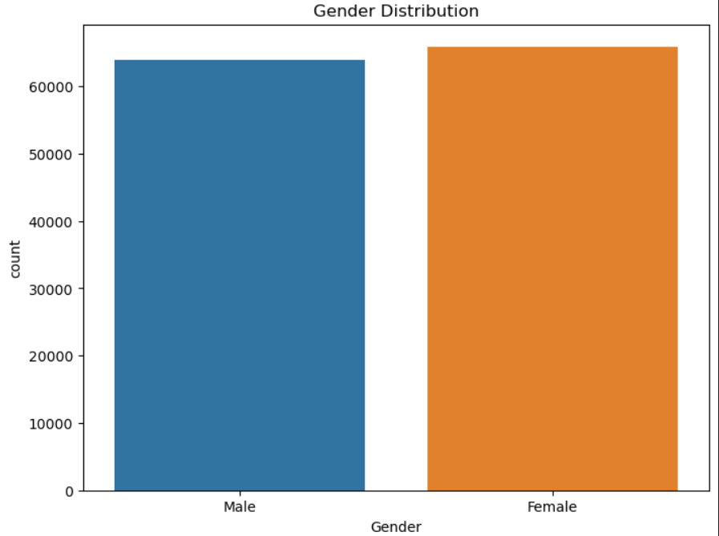
Data Analysis
Duplicated rows check
print("Number of Duplicated rows:",data.duplicated().sum())
Number of Duplicated rows: 0
Gender (male or female) percentage
plt.figure(figsize=(8, 6))
sns.countplot(x='Gender', data=data)
plt.title('Gender Distribution')
plt.show()

Slide 16
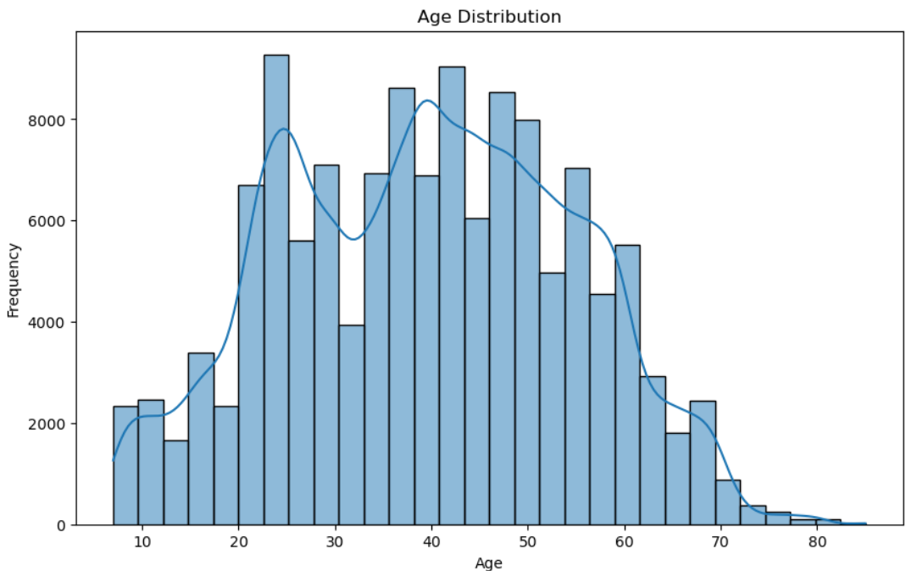
Data Analysis
Age distribution
plt.figure(figsize=(10, 6))
sns.histplot(data['Age'], bins=30, kde=True)
plt.title('Age Distribution')
plt.xlabel('Age')
plt.ylabel('Frequency')
plt.show()

Slide 17
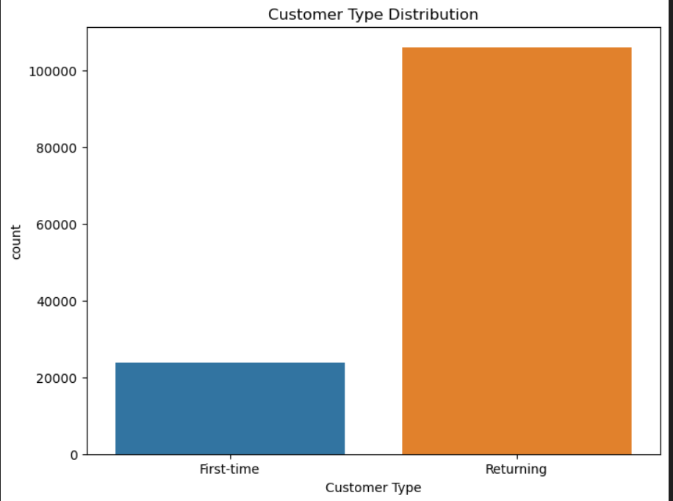
Data Analysis
Customer type distribution
plt.figure(figsize=(8, 6))
sns.countplot(x='Customer Type', data=data)
plt.title('Customer Type Distribution')
plt.show()

Slide 18
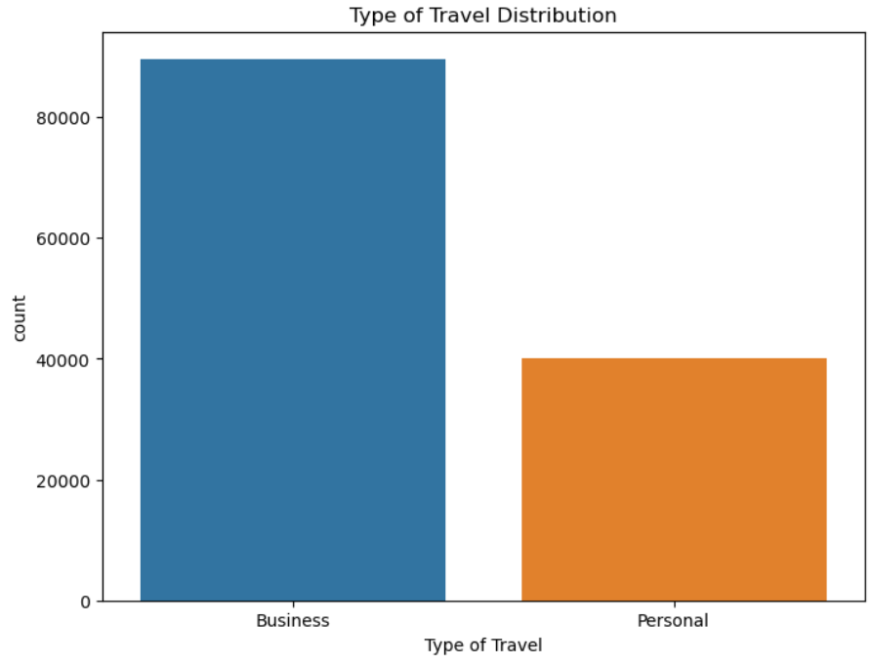
Data Analysis
Travel type distribution
plt.figure(figsize=(8, 6))
sns.countplot(x='Type of Travel', data=data)
plt.title('Type of Travel Distribution')
plt.show()

Slide 19
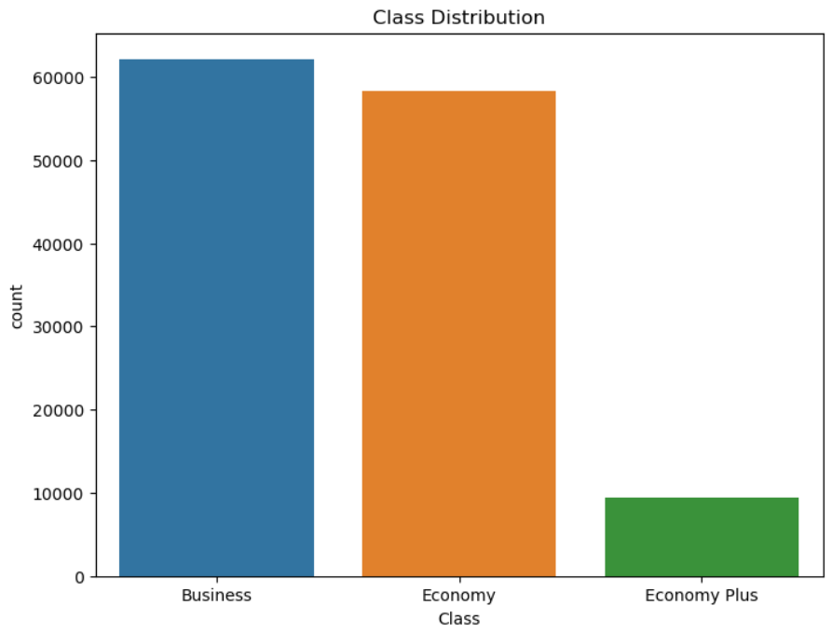
Data Analysis
Class type distribution
plt.figure(figsize=(8, 6))
sns.countplot(x='Class', data=data)
plt.title('Class Distribution')
plt.show()

Slide 20
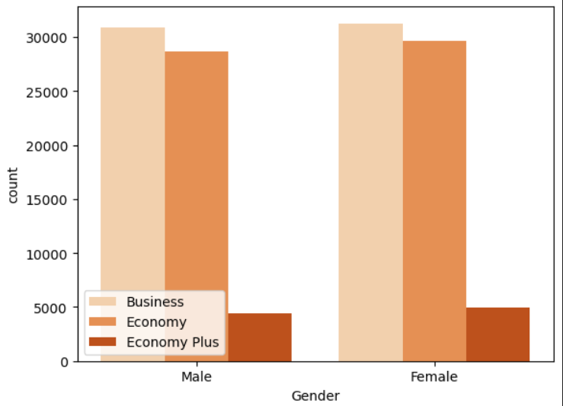
Data Analysis
Gender and their class numbers
sns.countplot(x="Gender", data=data, palette="Oranges", hue="Class")
plt.legend(loc=3)
plt.show()

Slide 21
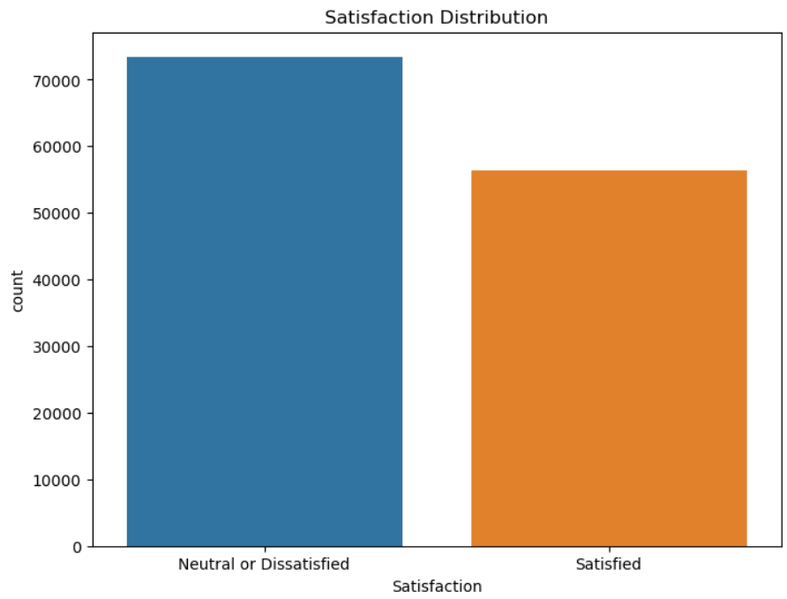
Data Analysis
Satisfaction Distribution
plt.figure(figsize=(8, 6))
sns.countplot(x='Satisfaction', data=data)
plt.title('Satisfaction Distribution')
plt.show()

Slide 22
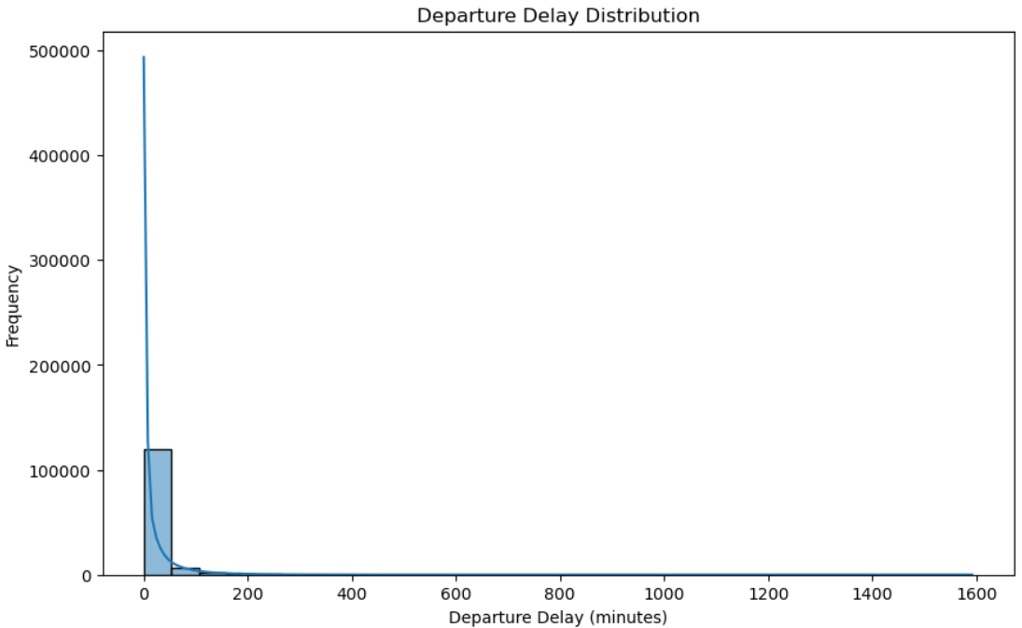
Data Analysis
Departure Delay Distribution
plt.figure(figsize=(10, 6))
sns.histplot(data['Departure Delay'], bins=30, kde=True)
plt.title('Departure Delay Distribution')
plt.xlabel('Departure Delay (minutes)')
plt.ylabel('Frequency')
plt.show()

Slide 23
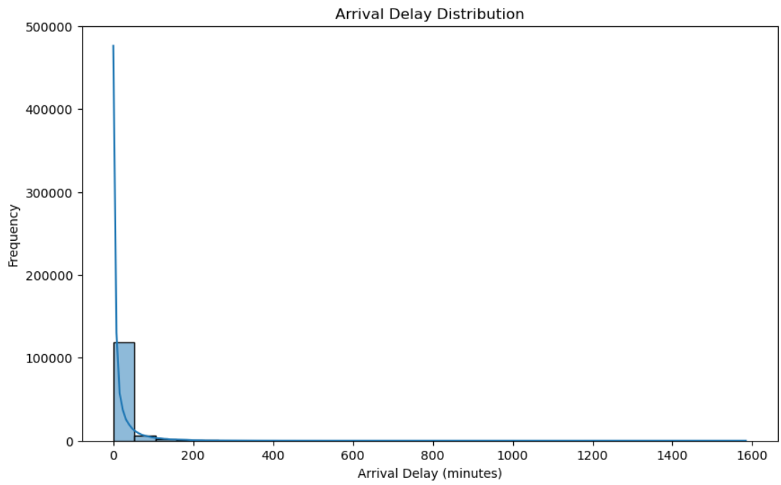
Data Analysis
Arrival Delay Distribution
plt.figure(figsize=(10, 6))
sns.histplot(data['Arrival Delay'].dropna(), bins=30, kde=True)
plt.title('Arrival Delay Distribution')
plt.xlabel('Arrival Delay (minutes)')
plt.ylabel('Frequency')
plt.show()

Slide 24
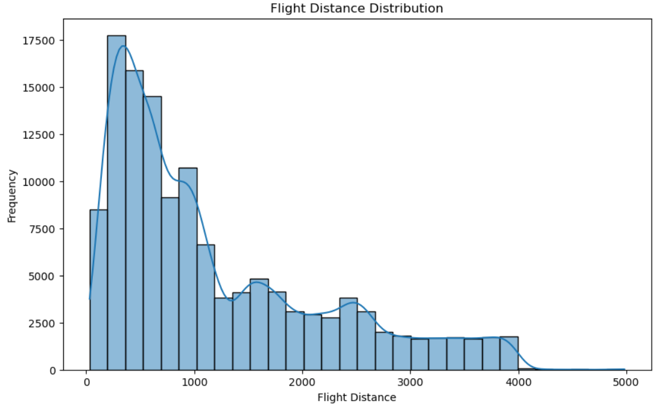
Data Analysis
Flight Distance Distribution
plt.figure(figsize=(10, 6))
sns.histplot(data['Flight Distance'], bins=30, kde=True)
plt.title('Flight Distance Distribution')
plt.xlabel('Flight Distance')
plt.ylabel('Frequency')
plt.show()

Slide 25
Data Cleaning
Delete Duplicated rows
Delete Missing value rows
data = data.dropna()
print(data.shape)
data = data.drop_duplicates()
print(data.shape)
(129487, 24)
(129487, 24)

Slide 26
Extra Operations (bonus)
Divide Data Into numerical and categorical
numerical_cols = data.select_dtypes(include=['number']).columns.tolist()
print("Number of Numerical Column: ",len(numerical_cols))
categorical_cols = data.select_dtypes(include=['object', 'category']).columns.tolist()
print("Number of Categorical Column: ",len(categorical_cols))
Number of Numerical Column: 19 Number of Categorical Column: 5

Slide 27
Extra Operations (bonus)
Standardize numerical variables
Standardize to have a mean of 0 and a standard deviation of 1 to ensure they contribute equally to the clustering process.
stnd = scaler.fit_transform(data[numerical_cols])
print(stnd)
[[-1.73267445 0.56697318 -0.37011481 ... 0.20422039 1.23070131 1.15934237] [-1.73264778 -0.29295518 -0.37011481 ... -0.548095 1.23070131 1.15934237] [-1.7326211 0.10393483 -0.33803645 ... 0.95653579 -0.26838688 -0.53546117] ... [ 1.73166963 0.17008317 -0.85530007 ... -0.548095 -0.26838688 1.15934237] [ 1.7316963 0.69926985 -0.85530007 ... 1.70885118 -0.26838688 1.15934237] [ 1.73172298 -1.28518021 -0.85530007 ... 0.20422039 -1.01793097 -2.2302647 ]]

Slide 28
Extra Operations (bonus)
Standardize numerical variables
Standardize to have a mean of 0 and a standard deviation of 1 to ensure they contribute equally to the clustering process.
stnd = scaler.fit_transform(data[numerical_cols])
print(stnd)
[[-1.73267445 0.56697318 -0.37011481 ... 0.20422039 1.23070131 1.15934237] [-1.73264778 -0.29295518 -0.37011481 ... -0.548095 1.23070131 1.15934237] [-1.7326211 0.10393483 -0.33803645 ... 0.95653579 -0.26838688 -0.53546117] ... [ 1.73166963 0.17008317 -0.85530007 ... -0.548095 -0.26838688 1.15934237] [ 1.7316963 0.69926985 -0.85530007 ... 1.70885118 -0.26838688 1.15934237] [ 1.73172298 -1.28518021 -0.85530007 ... 0.20422039 -1.01793097 -2.2302647 ]]

Slide 29
Extra Operations (bonus)
Encoding
convert categorical variables into binary variables (members or nonmembers)
encoded_data = pd.get_dummies(data[categorical_cols])
print(encoded_data)
Gender_Female Gender_Male Customer Type_First-time \ 0 False True True 1 True False False 2 False True False 3 False True False 4 True False False ... ... ... ... 129875 False True False 129876 False True False 129877 False True False 129878 False True False 129879 True False False Customer Type_Returning Type of Travel_Business \ 0 False True 1 True True 2 True True 3 True True 4 True True ... ... ... 129875 True False 129876 True False 129877 True False 129878 True False 129879 True False ...
129878 True 129879 False

Slide 30
Extra Operations (bonus)
Random sample of data
random_sample = data.sample(n=5000)
Retrieve best and worst reviews based on customer satisfaction
sorted_df = data.sort_values(by=criteria_column, ascending=False)
criteria_column = 'Satisfaction'
top_10_reviews = sorted_df.head(10)
worst_10_reviews = sorted_df.tail(10)
Divide data based on numerical and categorical columns
best_numerical_data = top_10_reviews[numerical_cols]
best_categorical_data = top_10_reviews[categorical_cols]
worst_numerical_data = worst_10_reviews[numerical_cols]
worst_categorical_data = worst_10_reviews[categorical_cols]

Slide 31
Kmedoids
Applying KMEDOIDS on a random sample
k = 5 # Number of clusters
kmedoids = KMedoids(n_clusters=k)
kmedoids.fit(random_sample[numerical_cols])
# Get cluster labels
cluster_labels = kmedoids.labels_
# Add cluster labels to the DataFrame
random_sample['Cluster'] = cluster_labels
# Print cluster assignments
print(random_sample[['ID','Cluster']])
ID Cluster 63886 63887 2 51599 51600 0 60946 60947 2 127 128 3 70841 70842 2 ... ... ... 79108 79109 1 117488 117489 4 55448 55449 2 62714 62715 2 18035 18036 3 [5000 rows x 2 columns]

Slide 32
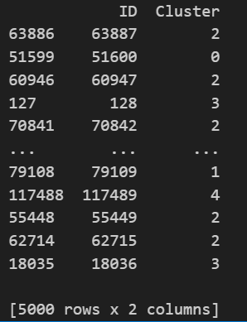
Kmedoids
Applying KMEDOIDS on a random sample
k = 5 # Number of clusters
kmedoids = KMedoids(n_clusters=k)
kmedoids.fit(random_sample[numerical_cols])
# Get cluster labels
cluster_labels = kmedoids.labels_
# Add cluster labels to the DataFrame
random_sample['Cluster'] = cluster_labels
# Print cluster assignments
print(random_sample[['ID','Cluster']])

Slide 33
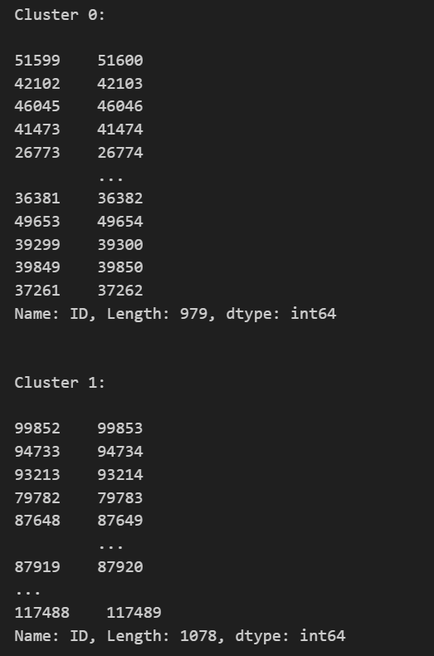
Kmedoids
Iterate over clusters and examine the data points within each cluster
for cluster_label in range(k):
cluster_data = random_sample[random_sample['Cluster'] == cluster_label]
print(f"Cluster {cluster_label}:\n")
print(cluster_data["ID"])
print("\n")

Slide 34
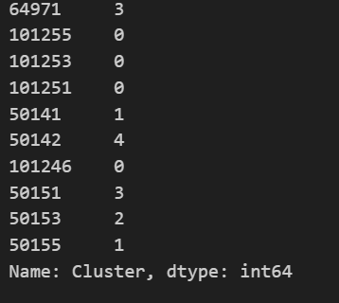
Kmedoids
Applying KMEDOIDS on best 10
k = 5 # Number of clusters
kmedoids = KMedoids(n_clusters=k)
kmedoids.fit(best_numerical_data)
# Get cluster labels
cluster_labels = kmedoids.labels_
# Add cluster labels to the DataFrame
best_numerical_data['Cluster'] = cluster_labels
# Print cluster assignments
print(best_numerical_data['Cluster'])

Slide 35
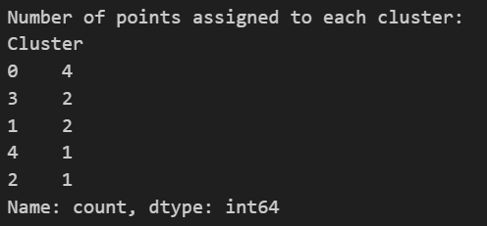
Kmedoids
Print number of points assigned to each cluster
# Get the counts of points assigned to each cluster
cluster_counts = best_numerical_data['Cluster'].value_counts()
# Print the number of points assigned to each cluster
print("Number of points assigned to each cluster:")
print(cluster_counts)

Slide 36
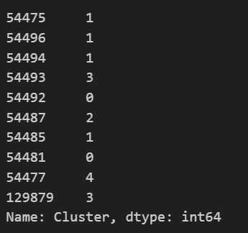
Kmedoids
Applying KMEDOIDS on worst 10
k = 5 # Number of clusters
kmedoids = KMedoids(n_clusters=k)
kmedoids.fit(worst_numerical_data)
# Get cluster labels
cluster_labels = kmedoids.labels_
# Add cluster labels to the DataFrame
worst_numerical_data['Cluster'] = cluster_labels
cluster = kmedoids.cluster_centers_
# Print cluster assignments
print(worst_numerical_data['Cluster'])

Slide 37
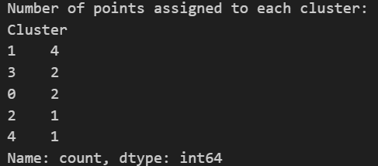
Kmedoids
Print number of points assigned to each cluster
# Get the counts of points assigned to each cluster
cluster_counts = worst_numerical_data['Cluster'].value_counts()
# Print the number of points assigned to each cluster
print("Number of points assigned to each cluster:")
print(cluster_counts)

Slide 38
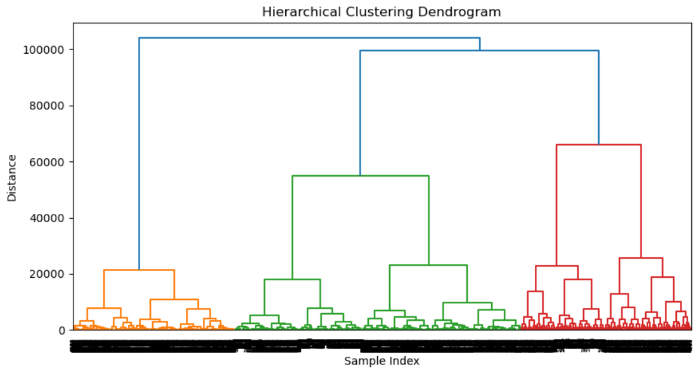
Hierarchical
Applying HIERARCHICAL on first 5000 column Ward (based on variances)
# Compute the hierarchical clustering
Z = hierarchy.linkage(data[numerical_cols].iloc[1:5000,:], method='ward')
# Plot the dendrogram
plt.figure(figsize=(10, 5))
dn = hierarchy.dendrogram(Z)
plt.title('Hierarchical Clustering Dendrogram')
plt.xlabel('Sample Index')
plt.ylabel('Distance')
plt.show()

Slide 39
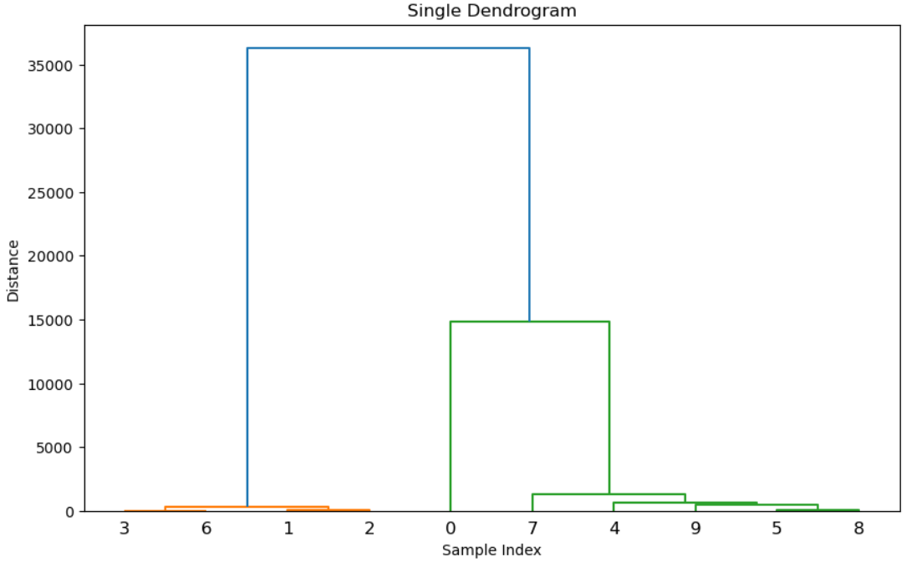
Hierarchical
Applying HIERARCHICAL on best 10 Single (Minimum)
Z1 = linkage(best_numerical_data, method='single', metric='euclidean') # minimum
plt.figure(figsize=(10, 6))
dendrogram(Z1)
plt.title('Single Dendrogram')
plt.xlabel('Sample Index')
plt.ylabel('Distance')
plt.show()

Slide 40
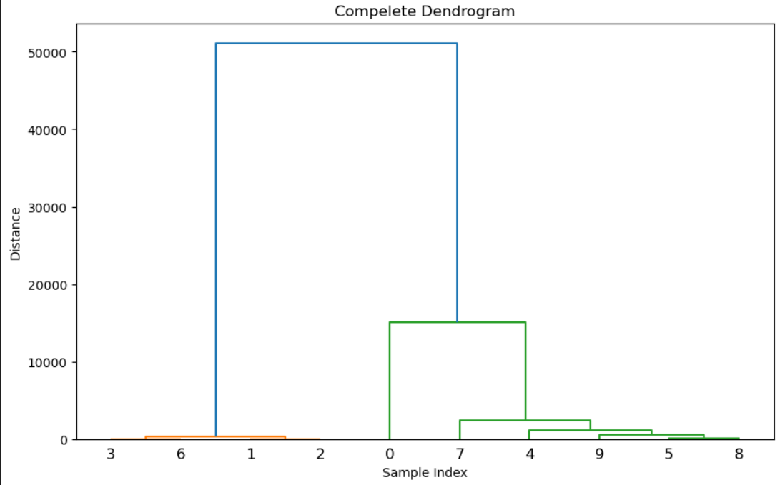
Hierarchical
Applying HIERARCHICAL on best 10 Complete (Maximum)
Z2 = linkage(best_numerical_data, method='complete', metric='euclidean') # maximum
plt.figure(figsize=(10, 6))
dendrogram(Z2)
plt.title('Compelete Dendrogram')
plt.xlabel('Sample Index')
plt.ylabel('Distance')
plt.show()

Slide 41
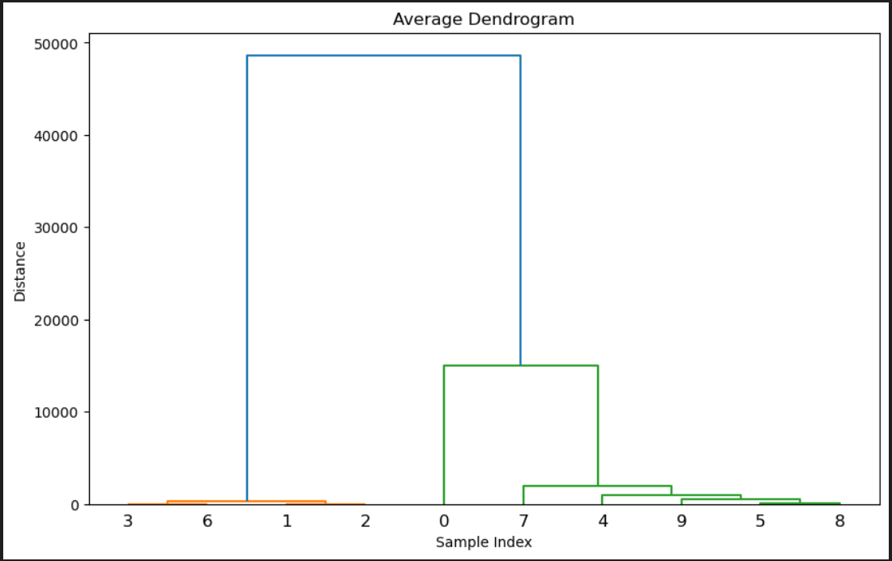
Hierarchical
Applying HIERARCHICAL on best 10 Average
Z3 = linkage(best_numerical_data, method='average', metric='euclidean') # average
plt.figure(figsize=(10, 6))
dendrogram(Z3)
plt.title('Average Dendrogram')
plt.xlabel('Sample Index')
plt.ylabel('Distance')
plt.show()

Slide 42
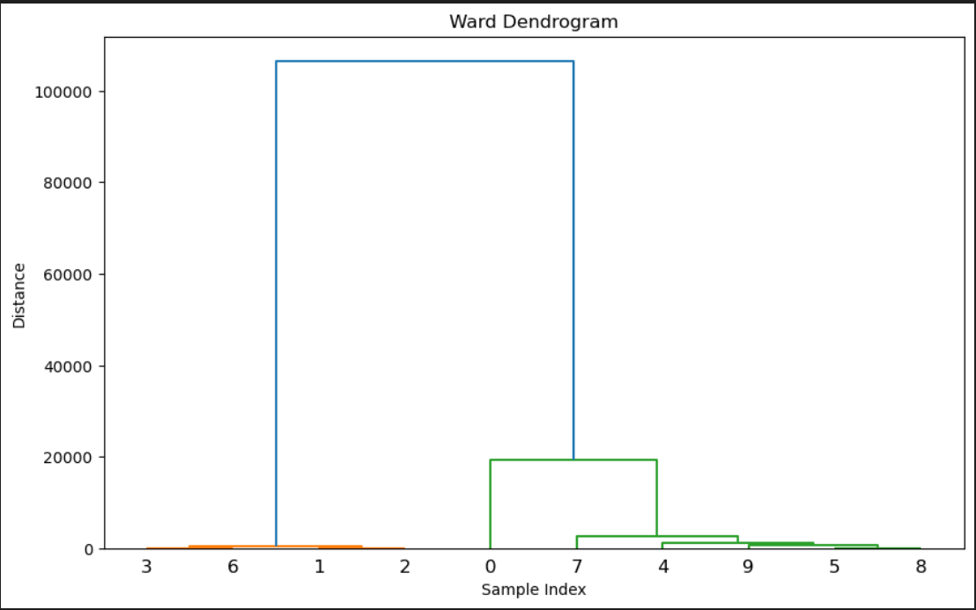
Hierarchical
Applying HIERARCHICAL on best 10 Ward (Variance)
Z4 = linkage(best_numerical_data, method='ward', metric='euclidean') # variance
plt.figure(figsize=(10, 6))
dendrogram(Z4)
plt.title('Ward Dendrogram')
plt.xlabel('Sample Index')
plt.ylabel('Distance')
plt.show()

Slide 43
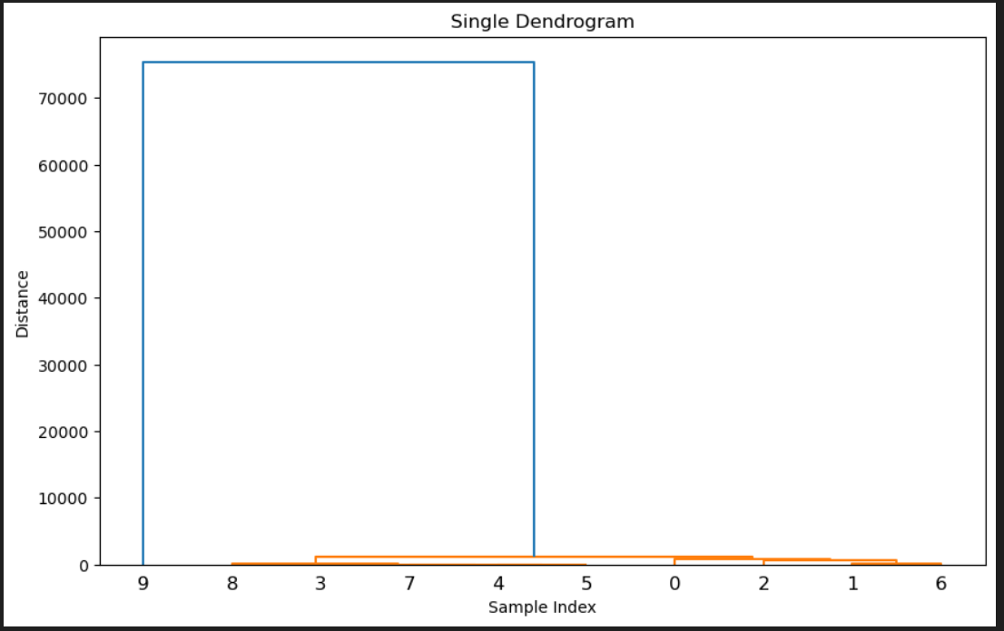
Hierarchical
Applying HIERARCHICAL on worst 10 Single (Minimum)
Z1 = linkage(worst_numerical_data, method='single', metric='euclidean') # minimum
plt.figure(figsize=(10, 6))
dendrogram(Z1)
plt.title('Single Dendrogram')
plt.xlabel('Sample Index')
plt.ylabel('Distance')
plt.show()

Slide 44
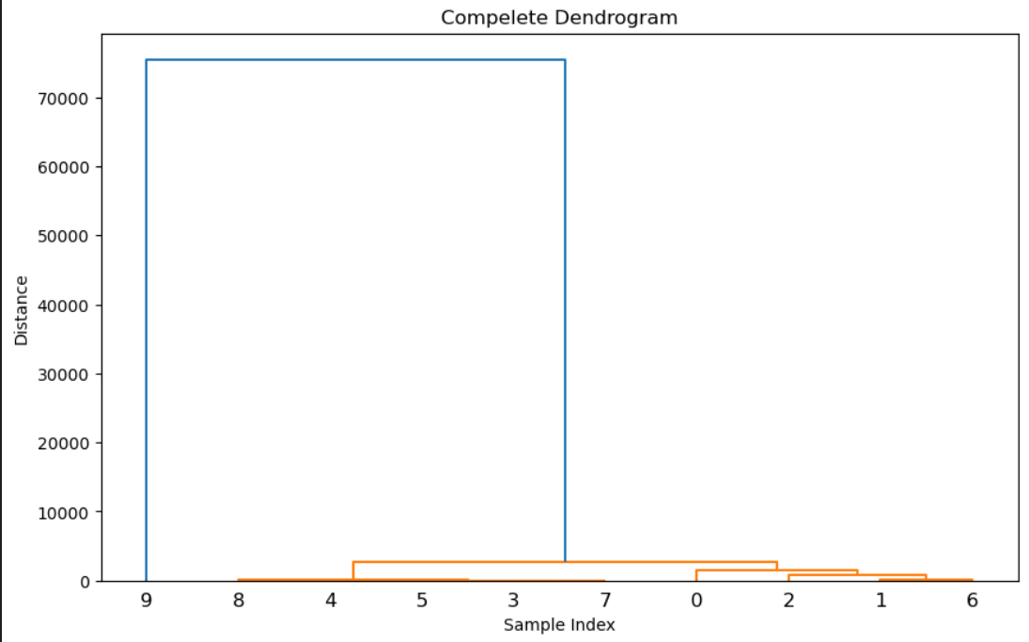
Hierarchical
Applying HIERARCHICAL on worst 10 Complete (Maximum)
Z2 = linkage(worst_numerical_data, method='complete', metric='euclidean') # maximum
plt.figure(figsize=(10, 6))
dendrogram(Z2)
plt.title('Compelete Dendrogram')
plt.xlabel('Sample Index')
plt.ylabel('Distance')
plt.show()

Slide 45
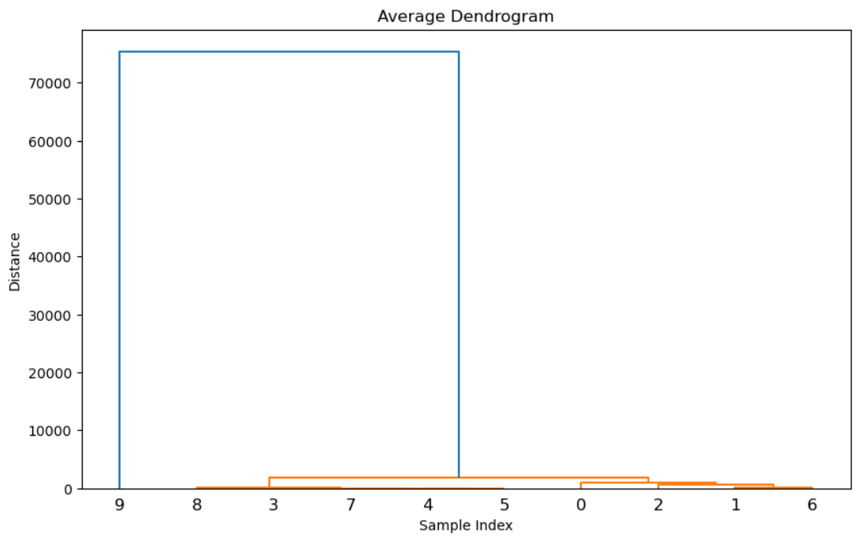
Hierarchical
Applying HIERARCHICAL on worst 10 Average
Z3 = linkage(worst_numerical_data, method='average', metric='euclidean') # average
plt.figure(figsize=(10, 6))
dendrogram(Z3)
plt.title('Average Dendrogram')
plt.xlabel('Sample Index')
plt.ylabel('Distance')
plt.show()

Slide 46
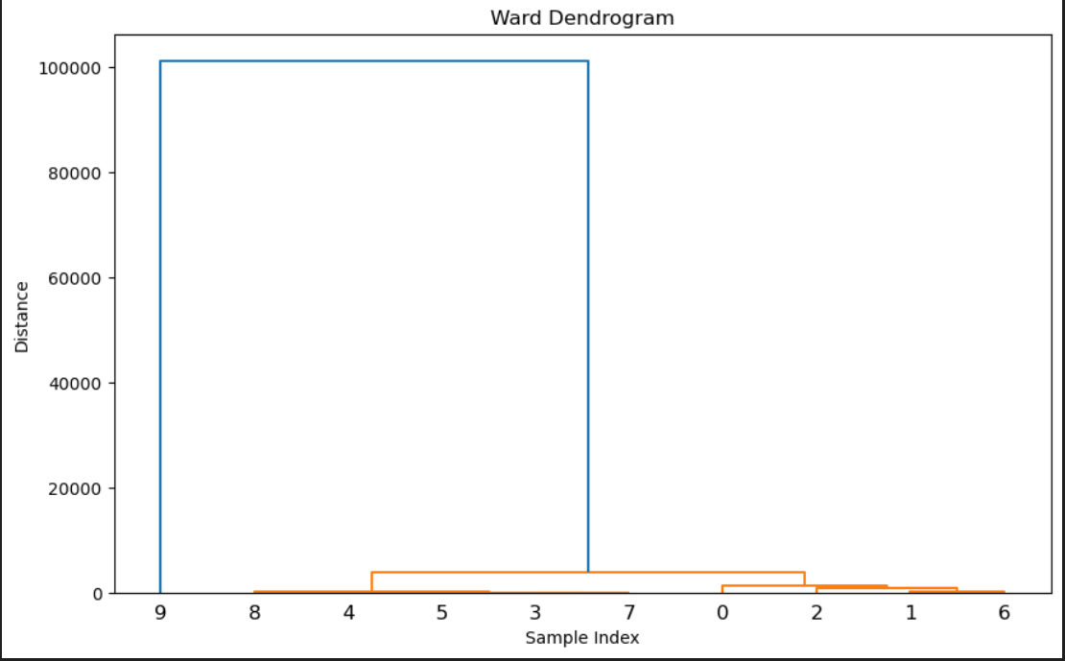
Hierarchical
Applying HIERARCHICAL on worst 10 Ward (Variance)
Z4 = linkage(worst_numerical_data, method='ward', metric='euclidean') # variance
plt.figure(figsize=(10, 6))
dendrogram(Z4)
plt.title('Ward Dendrogram')
plt.xlabel('Sample Index')
plt.ylabel('Distance')
plt.show()

Slide 47
Fuzzy
Define linguistic variables and terms
dep_arriv = ctrl.Antecedent(np.arange(0, 6, 1), 'Departure and Arrival Time Convenience')
booking = ctrl.Antecedent(np.arange(0, 6, 1), 'Ease of Online Booking')
check_in = ctrl.Antecedent(np.arange(0, 6, 1), 'Check-in Service')
online_boarding = ctrl.Antecedent(np.arange(0, 6, 1), 'Online Boarding')
gate = ctrl.Antecedent(np.arange(0, 6, 1), 'Gate Location')
on_board = ctrl.Antecedent(np.arange(0, 6, 1), 'On-board Service')
seat_comfort = ctrl.Antecedent(np.arange(0, 6, 1), 'Seat Comfort')
leg_room = ctrl.Antecedent(np.arange(0, 6, 1), 'Leg Room Service')
cleanliness = ctrl.Antecedent(np.arange(0, 6, 1), 'Cleanliness')
food_drink = ctrl.Antecedent(np.arange(0, 6, 1), 'Food and Drink')
in_flight = ctrl.Antecedent(np.arange(0, 6, 1), 'In-flight Service')
in_flight_wifi = ctrl.Antecedent(np.arange(0, 6, 1), 'In-flight Wifi Service')
in_flight_ent = ctrl.Antecedent(np.arange(0, 6, 1), 'In-flight Entertainment')
bag = ctrl.Antecedent(np.arange(0, 6, 1), 'Baggage Handling')
satisfaction = ctrl.Consequent(np.arange(0, 6, 1), 'satisfaction')

Slide 48
Fuzzy
Define Membership functions
dep_arriv['low'] = fuzz.trimf(dep_arriv.universe, [0, 0, 2])
dep_arriv['medium'] = fuzz.trimf(dep_arriv.universe, [1, 2, 4])
dep_arriv['high'] = fuzz.trimf(dep_arriv.universe, [3, 4, 5])
booking['low'] = fuzz.trimf(booking.universe, [0, 0, 2])
booking['medium'] = fuzz.trimf(booking.universe, [1, 2, 4])
booking['high'] = fuzz.trimf(booking.universe, [3, 4, 5])
check_in['low'] = fuzz.trimf(check_in.universe, [0, 0, 2])
check_in['medium'] = fuzz.trimf(check_in.universe, [1, 2, 4])
check_in['high'] = fuzz.trimf(check_in.universe, [3, 4, 5])
online_boarding['low'] = fuzz.trimf(online_boarding.universe, [0, 0, 2])
online_boarding['medium'] = fuzz.trimf(online_boarding.universe, [1, 2, 4])
online_boarding['high'] = fuzz.trimf(online_boarding.universe, [3, 4, 5])
gate['low'] = fuzz.trimf(gate.universe, [0, 0, 2])
gate['medium'] = fuzz.trimf(gate.universe, [1, 2, 4])
gate['high'] = fuzz.trimf(gate.universe, [3, 4, 5])
on_board['low'] = fuzz.trimf(on_board.universe, [0, 0, 2])
on_board['medium'] = fuzz.trimf(on_board.universe, [1, 2, 4])
on_board['high'] = fuzz.trimf(on_board.universe, [3, 4, 5])
seat_comfort['low'] = fuzz.trimf(seat_comfort.universe, [0, 0, 2])
seat_comfort['medium'] = fuzz.trimf(seat_comfort.universe, [1, 2, 4])
seat_comfort['high'] = fuzz.trimf(seat_comfort.universe, [3, 4, 5])
leg_room['low'] = fuzz.trimf(leg_room.universe, [0, 0, 2])
leg_room['medium'] = fuzz.trimf(leg_room.universe, [1, 2, 4])
leg_room['high'] = fuzz.trimf(leg_room.universe, [3, 4, 5])
cleanliness['low'] = fuzz.trimf(cleanliness.universe, [0, 0, 2])
cleanliness['medium'] = fuzz.trimf(cleanliness.universe, [1, 2, 4])
cleanliness['high'] = fuzz.trimf(cleanliness.universe, [3, 4, 5])
food_drink['low'] = fuzz.trimf(food_drink.universe, [0, 0, 2])
food_drink['medium'] = fuzz.trimf(food_drink.universe, [1, 2, 4])
food_drink['high'] = fuzz.trimf(food_drink.universe, [3, 4, 5])
in_flight['low'] = fuzz.trimf(in_flight.universe, [0, 0, 2])
in_flight['medium'] = fuzz.trimf(in_flight.universe, [1, 2, 4])
in_flight['high'] = fuzz.trimf(in_flight.universe, [3, 4, 5])
in_flight_wifi['low'] = fuzz.trimf(in_flight_wifi.universe, [0, 0, 2])
in_flight_wifi['medium'] = fuzz.trimf(in_flight_wifi.universe, [1, 2, 4])
in_flight_wifi['high'] = fuzz.trimf(in_flight_wifi.universe, [3, 4, 5])
in_flight_ent['low'] = fuzz.trimf(in_flight_ent.universe, [0, 0, 2])
in_flight_ent['medium'] = fuzz.trimf(in_flight_ent.universe, [1, 2, 4])
in_flight_ent['high'] = fuzz.trimf(in_flight_ent.universe, [3, 4, 5])
bag['low'] = fuzz.trimf(bag.universe, [0, 0, 2])
bag['medium'] = fuzz.trimf(bag.universe, [1, 2, 4])
bag['high'] = fuzz.trimf(bag.universe, [3, 4, 5])
satisfaction['low'] = fuzz.trimf(satisfaction.universe, [0, 0, 2])
satisfaction['medium'] = fuzz.trimf(satisfaction.universe, [1, 2, 4])
satisfaction['high'] = fuzz.trimf(satisfaction.universe, [3, 4, 5])

Slide 49
Fuzzy
Define FUZZY rules
rule1 =ctrl.Rule(dep_arriv['low'] | booking['low'] | check_in['low'] | online_boarding['low'] |
gate['low'] | on_board['low'] | seat_comfort['low'] | leg_room['low'] |
cleanliness['low'] | food_drink['low'] | in_flight['low']
| in_flight_wifi['low'] | in_flight_ent['low'] | bag['low']
, satisfaction['low'])
rule2 = ctrl.Rule(dep_arriv['medium'] | booking['medium'] | check_in['medium'] | online_boarding['medium'] |
gate['medium'] | on_board['medium'] | seat_comfort['medium'] | leg_room['medium'] |
cleanliness['medium'] | food_drink['medium'] | in_flight['medium']
| in_flight_wifi['medium'] | in_flight_ent['medium'] | bag['medium']
, satisfaction['medium'])
rule3 = ctrl.Rule(dep_arriv['high'] | booking['high'] | check_in['high'] | online_boarding['high'] |
gate['high'] | on_board['high'] | seat_comfort['high'] | leg_room['high'] |
cleanliness['high'] | food_drink['high'] | in_flight['high']
| in_flight_wifi['high'] | in_flight_ent['high'] | bag['high']
, satisfaction['high'])

Slide 50
Fuzzy
Create FUZZY control system
satisfaction_ctrl = ctrl.ControlSystem([rule1, rule2, rule3])
satisfaction_level = ctrl.ControlSystemSimulation(satisfaction_ctrl)
input_types=['Departure and Arrival Time Convenience', 'Ease of Online Booking',
'Check-in Service', 'Online Boarding', 'Gate Location',
'On-board Service', 'Seat Comfort', 'Leg Room Service', 'Cleanliness',
'Food and Drink', 'In-flight Service', 'In-flight Wifi Service',
'In-flight Entertainment', 'Baggage Handling']

Slide 51
Fuzzy
Iterate over 10 rows
for j in range (10): #iterate over 10 rows
print("*"*40)
print('Customer ',j," = ")
for i, types in zip(range(14), input_types): #iterate over columns
input=best_numerical_data[input_types].iloc[j].iloc[i]
satisfaction_level.input[types]=input
print(types," rating= ",input)
# Compute satisfaction level
satisfaction_level.compute()
# Output satisfaction level
print("Satisfaction Level of customer ",satisfaction_level.output['satisfaction'])

Slide 52
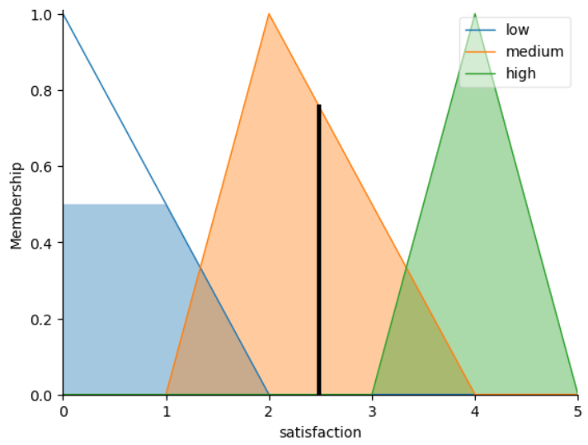
Fuzzy
Customer 0 = Satisfaction Level of customer 2.487179487179487

Slide 53
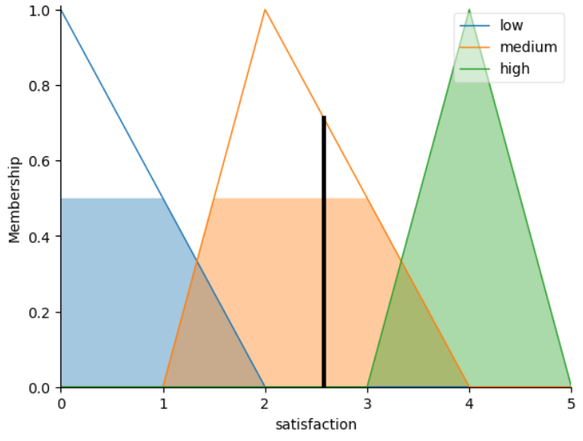
Fuzzy
Customer 1 = Satisfaction Level of customer 2.5757575757575752

Slide 54
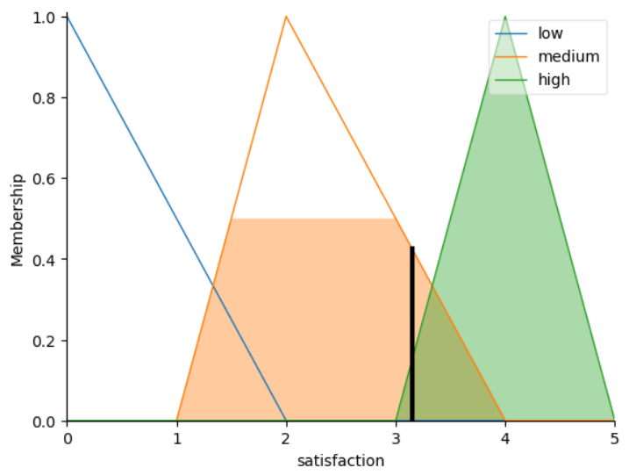
Fuzzy
Customer 2 = Satisfaction Level of customer 3.1470588235294117

Slide 55
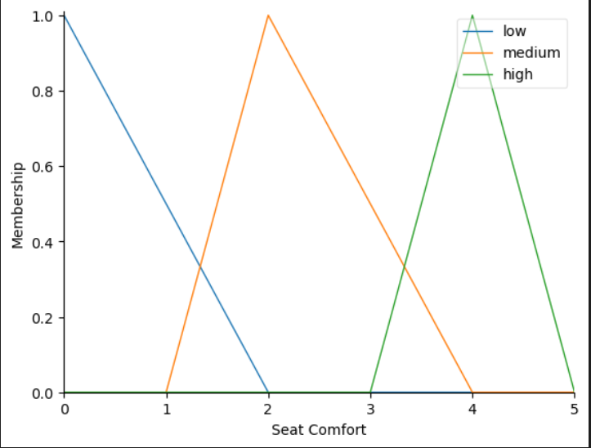
Fuzzy
seat_comfort.view()

Slide 56
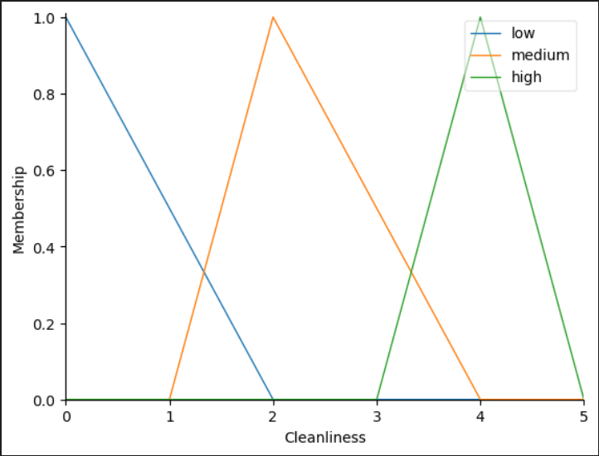
Fuzzy
cleanliness.view()

Slide 57
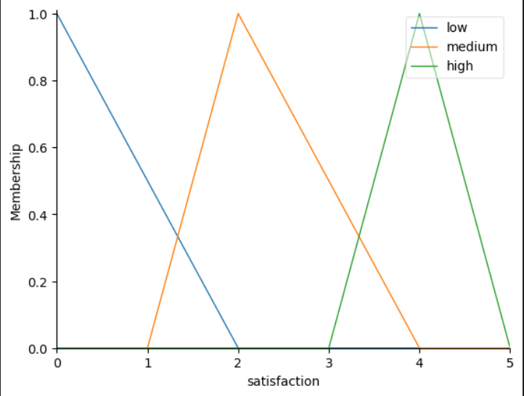
Fuzzy
satisfaction.view()

Slide 58
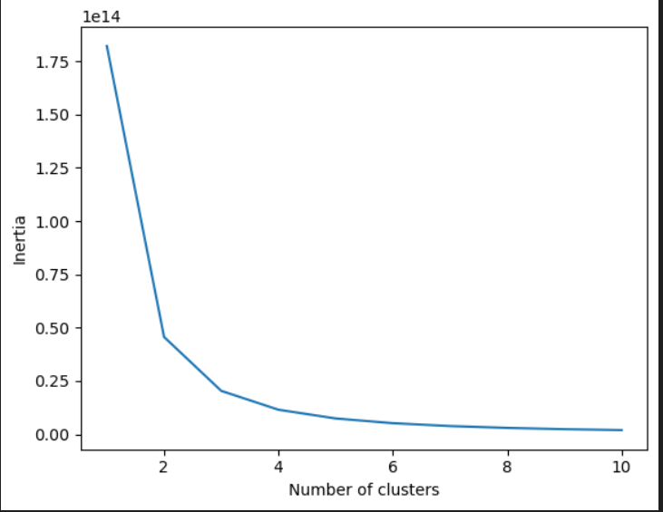
Kmeans (Bonus)
Visualizing the optimal k value
inertia = [] for k in range(1, 11):
kmeans = KMeans(n_clusters=k, random_state=42)
kmeans.fit(data[numerical_cols])
inertia.append(kmeans.inertia_)
plt.plot(range(1, 11), inertia)
plt.xlabel('Number of clusters')
plt.ylabel('Inertia')
plt.show()

Slide 59
Kmeans (Bonus)
We chose k = 3 from the previous plot
Applying KMEANS with k = 3
k = 3
kmeans = KMeans(n_clusters=k, random_state=42)
kmeans.fit(data[numerical_cols]) data['Cluster'] = kmeans.labels_
centroids = pd.DataFrame(kmeans.cluster_centers_, columns=numerical_cols) #

Slide 60
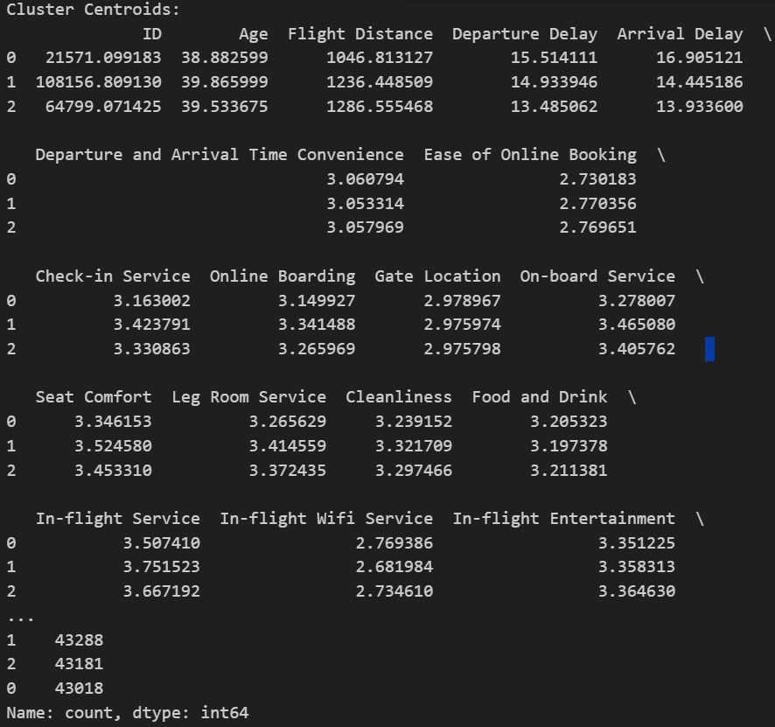
Kmeans (Bonus)
Printing the clusters
print("Cluster Centroids:")
print(centroids)
print("Counts per Cluster:")
print(data['Cluster'].value_counts())

Slide 61
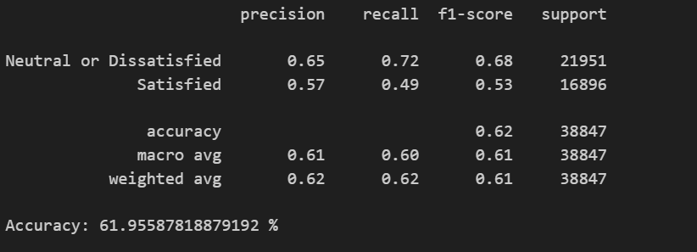
Logistic regression (Bonus)
X = data[numerical_cols]
y = data['Satisfaction’]
X_train, X_test, y_train, y_test = train_test_split(X, y, test_size=0.3, random_state=42)
model = LogisticRegression()
model.fit(X_train, y_train)
y_pred = model.predict(X_test)
print(classification_report(y_test, y_pred))
accuracy = accuracy_score(y_test, y_pred)
print("Accuracy:", accuracy*100,"%")

Slide 62
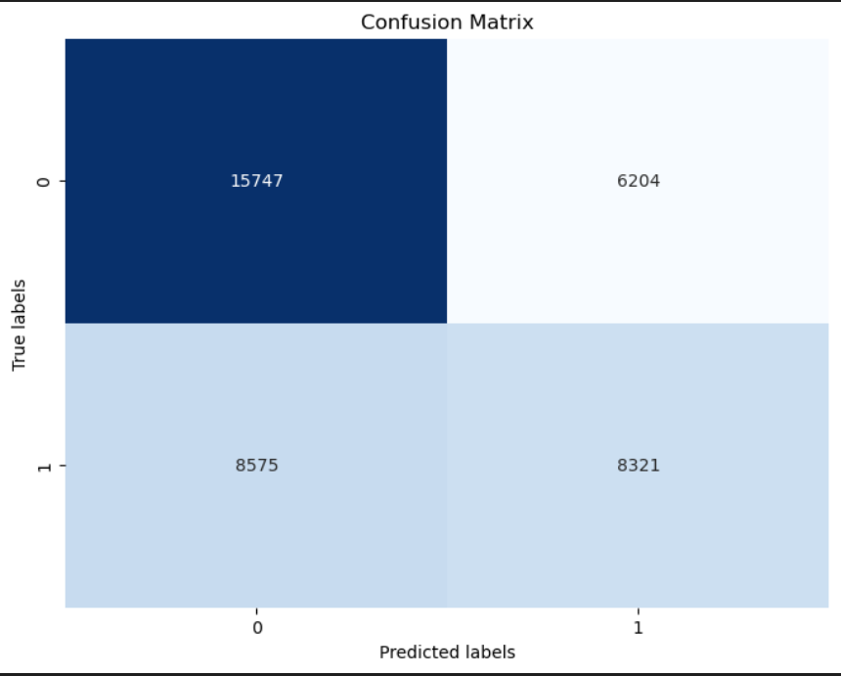
Logistic regression (Bonus)
# Calculating confusion matrix
cm = confusion_matrix(y_test, y_pred)
print("Confusion Matrix:")
print(cm)
# Plotting confusion matrix
plt.figure(figsize=(8, 6))
sns.heatmap(cm, annot=True, fmt="d", cmap="Blues", cbar=False)
plt.xlabel("Predicted labels")
plt.ylabel("True labels")
plt.title("Confusion Matrix")
plt.show()

Slide 63
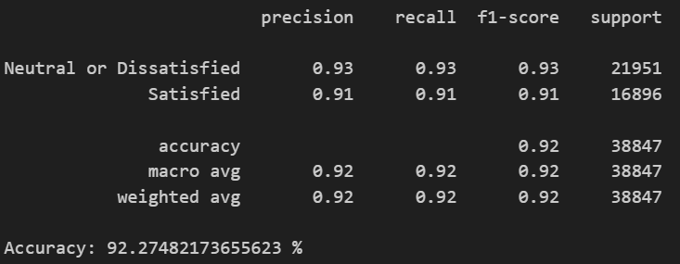
Decision tree (Bonus)
X = data[numerical_cols]
y = data['Satisfaction']
X_train, X_test, y_train, y_test = train_test_split(X, y, test_size=0.3, random_state=42)
dtree = DecisionTreeClassifier()
dtree.fit(X_train, y_train)
y_pred = dtree.predict(X_test)
print(classification_report(y_test, y_pred))
accuracy = accuracy_score(y_test, y_pred)
print("Accuracy:", accuracy*100,"%")

Slide 64
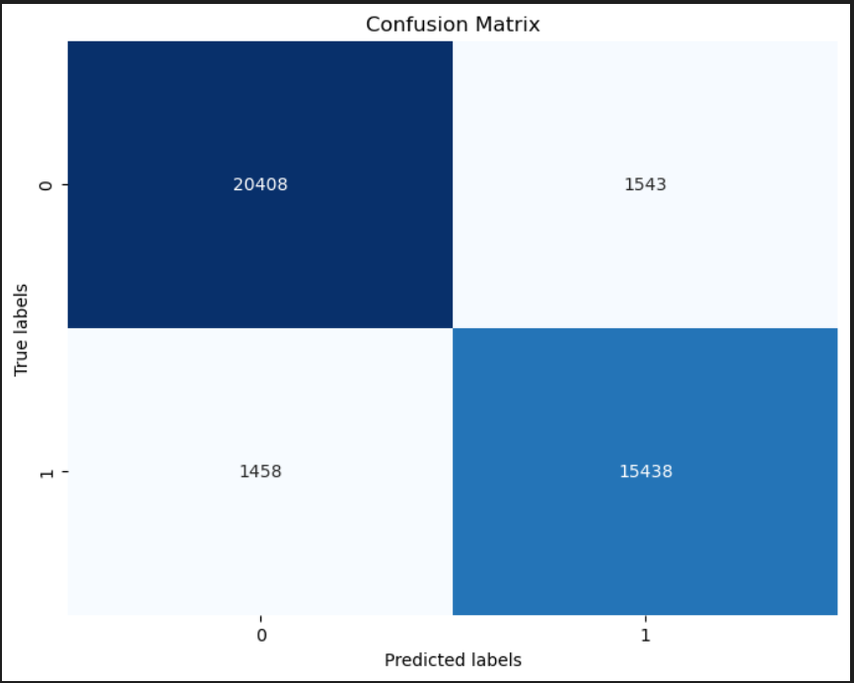
Decision tree (Bonus)
cm = confusion_matrix(y_test, y_pred)
print("Confusion Matrix:")
print(cm)
plt.figure(figsize=(8, 6))
sns.heatmap(cm, annot=True, fmt="d", cmap="Blues", cbar=False)
plt.xlabel("Predicted labels")
plt.ylabel("True labels")
plt.title("Confusion Matrix")
plt.show()

Slide 65
Thank you
© 2024 Yehia – Sara – Rana - Mohammed

