Slide 1



GROUP 5
The AI UX
Conversational Agent
Turning boring static surveys into a guided AI interview
that actually gets useful feedback out of users.
Conversational
Local LLM
Data-driven

Slide 2





THE PROBLEM
Traditional UX Surveys Fall Flat
We kept hitting the same wall navigating our own university's website — so we fixed it.
Static & one-way
Usual surveys are boring and hand back no real feedback — a form that just says ‘Thanks.’
A FORM SAYS
“Thanks for your feedback.”
We built an AI client instead
It provides feedback for university websites the way a human researcher would.
OUR AI ASKS
Acts like an interviewer
“Where did you look first when you couldn't find your schedule?”
The AI probes for the most constructive reviews to actually improve the site.
Short & clear
Surveys stay quick, eliminating the annoying part of taking them.
02

Slide 3




OUR SOLUTION
The Guided Conversational UI
01
02
03
User picks a category
AI handles the interview
Zero-friction, empathetic
Efficiency, Learnability — the user sets the boundary of the chat.
From there the AI runs the actual conversation, hybrid human + machine.
Friendly dialogue that doesn't feel like an interrogation.
Embeddable widget. Built in vanilla JS / HTML / CSS — drop it into any website's page, no framework required.
03

Slide 4


UNDER THE HOOD
Early Prototypes & The State Machine
From a static terminal script to an asynchronous web server.
Llama 3
FastAPI
Terminal → Web
Powered locally via Ollama — reasoning runs entirely on-device.
Python backend manages sessions and the async chat flow.
Moved from a static terminal script to a full async web server.
Static script → FastAPI session server → Embedded chat widget
04

Slide 5
MODEL CHOICE
Why We Chose Llama 3 (via Ollama)
Free & open-source
Ollama provides open-source, local LLMs at no cost for personal projects.
$0
Strong context, light footprint
cost to run — fully local,
no API bills, no cloud lock-in
Llama 3's context window is solid, and it's not overly resource-demanding.
The right tool for the job
Runs entirely offline on
ordinary development hardware
For our core use case, it was simply the best-fit choice available.
05

Slide 6



HANDLING SPAM
The 'Guardrail' Evaluator
The problem
Guardrail in action
‘User bleed’ — irrelevant or vague answers that derail the interview.
“I ate 5 bananas.”
Guardrail flags: off-topic
The solution
A hidden 1-token LLM evaluation loop checks every answer for detail before the main AI replies.
“Just to clarify — was that about the cafeteria menu, or something on the site itself?”
✓ Approves specific answers
✓ Asks for clarification on vague ones
06

Slide 7

CONTEXT
The Problem of Context
No internet, no site knowledge
Local LLMs can't browse and have zero specific knowledge of our website.
?
Generic follow-ups
“What's a course schedule page?”
Without context, every follow-up question sounds the same and unhelpful.
The AI needed a map
An AI with no map of the site
can't ask a smart follow-up.
It needed a real map of the University of Ruse platform to sound credible.
07

Slide 8


THE FIX
Implementing Local RAG
Local vector database
Mapped the site's secrets
Real-time queries
Built with ChromaDB — fully local, no external calls.
e.g. ‘Erasmus is under International Relations’ — encoded as retrievable facts.
The AI queries the DB live to ask hyper-specific, grounded follow-ups.
In practice: user complains about the Erasmus schedule → AI secretly searches ChromaDB → asks ‘Did you check under International Relations?’
08

Slide 9
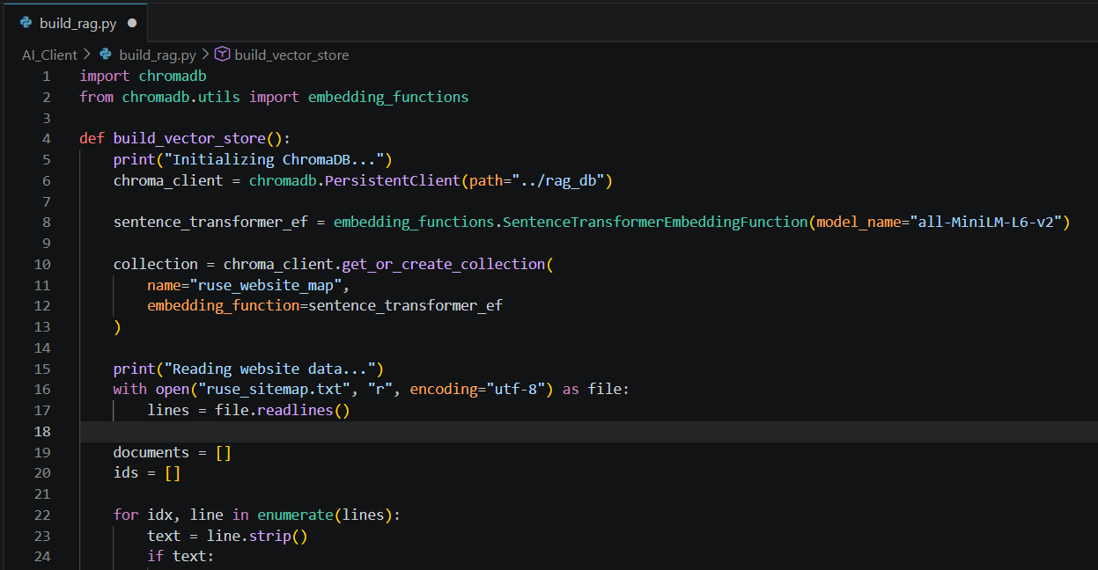
IMPLEMENTING LOCAL RAG
Building the Vector Store
The ChromaDB build script that indexes the university site map for retrieval.
09

Slide 10

POST-PROCESSING
From Messy Chat to Actionable Data
Draconian prompt engineering
Core insight + sentiment
Structured storage
A strict post-interview synthesis prompt compresses the whole chat.
Extraction of the essential insight and emotional sentiment only.
Saved into a local SQLite database, ready for the dashboard.
Chat log → Sentiment + Core Insight → SQLite
10

Slide 11

THE PAYOFF
The Executive Dashboard
Negative feedback only
Visualizes critical problem areas — we intentionally filter out praise.
Dynamic SQL sorting
Only what matters
A CTE sorts issues live by urgency and toxicity.
Sorted by urgency & toxicity, so admins see exactly where the fires are — first.
Built with Chart.js
Presented directly to administration — no chat logs to dig through.
11

Slide 12
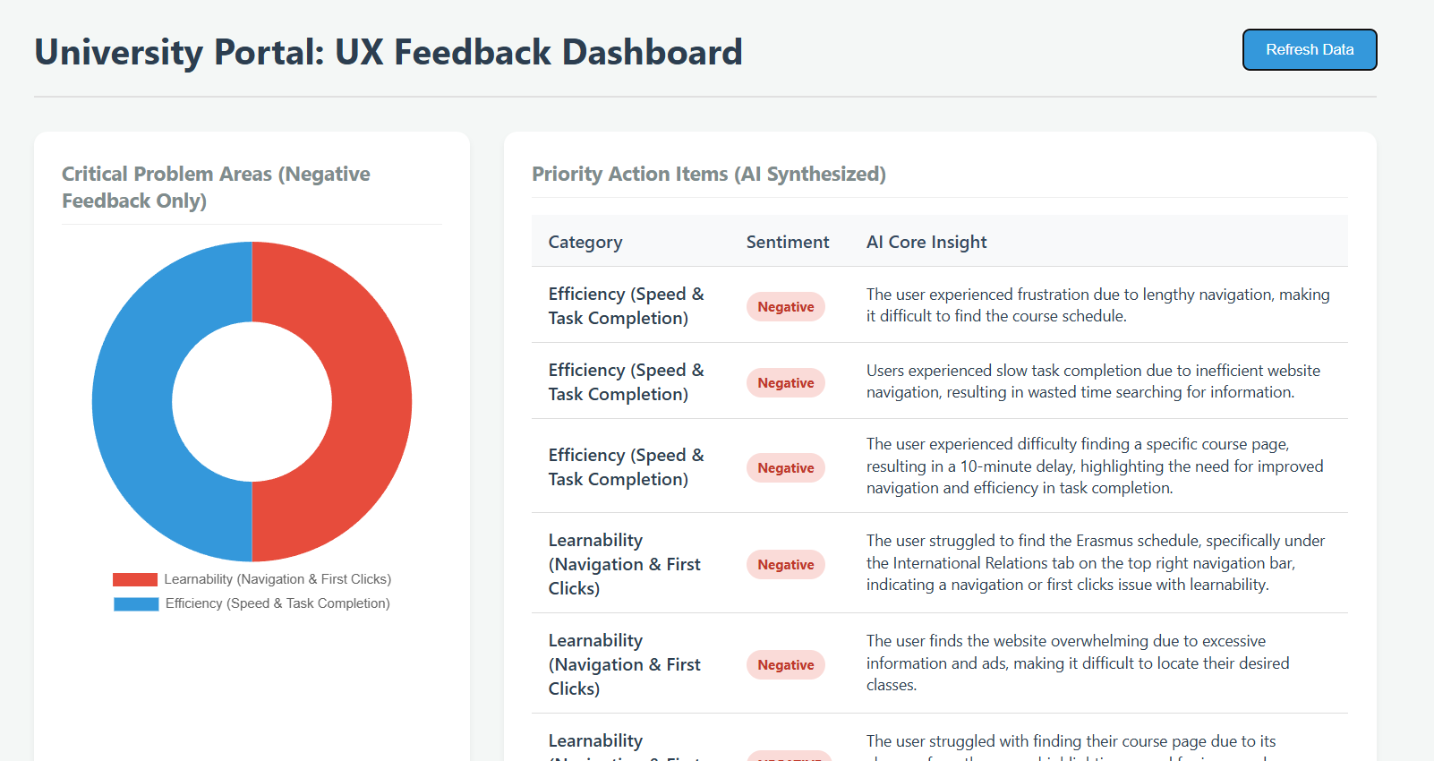
THE EXECUTIVE DASHBOARD
What Administration Sees
Live Chart.js dashboard: critical problem areas and AI-synthesized priority action items.
12

Slide 13




WHAT FOUGHT BACK
Technical Challenges
Prompt drift
Balancing empathy
Skipping ahead
Forcing the AI to stop using conversational filler and stay on-message.
Stopping the AI from interrogating users who are already happy.
Stopping the AI from jumping to the next metric on a contextless answer.
The real headache wasn't the AI — it was our dev environment. Database writes were triggering Live Server to refresh the page, wiping the user's chatbox. We learned to separate backend data files from frontend watch folders.
13

Slide 14



WHAT'S NEXT
The Future Roadmap
01
02
Automated web scraping
Multi-language support
Keeps the RAG database dynamically up to date on its own.
So international Erasmus students can give feedback natively.
03
04
Jira / Trello integration
Beyond university sites
Automatic bug ticket creation straight from negative feedback.
Implementation on other products and websites, not just ours.
14

Slide 15
Thank You!
Happy to take any questions about the architecture or the UX flow.
Group 5

