Slide 1
Git
Version Control System

Slide 2
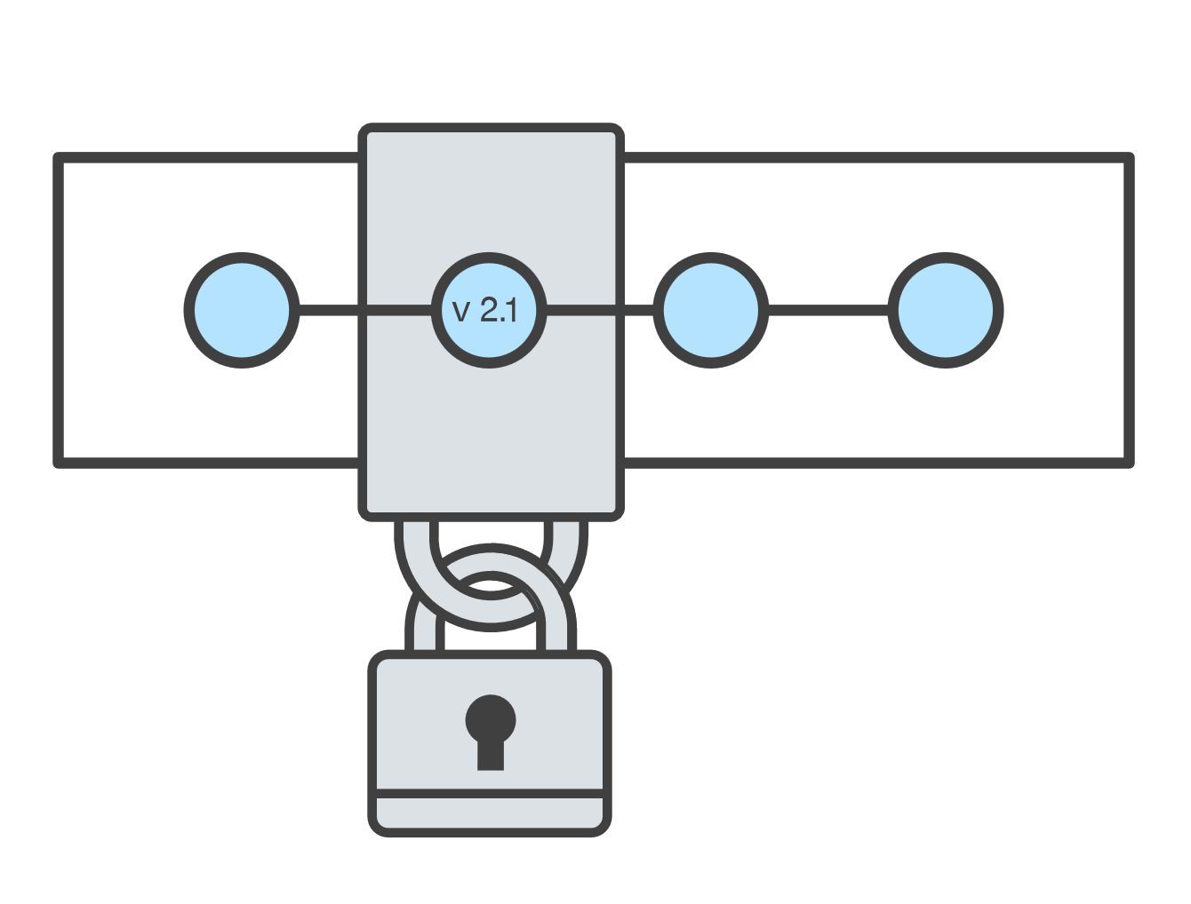
What is version control?
Version control systems are a category of software tools that help a software team manage changes to source code over time.
Version control software keeps track of every modification to the code in a special kind of database.
If a mistake is made, developers can turn back the clock and compare earlier versions of the code to help fix the mistake while minimizing disruption to all team members.
Version control protects source code from both catastrophe and the casual degradation of human error and unintended consequences.

Slide 3

What is Git?
Git is a mature, actively maintained open source project originally developed in 2005 by Linus Torvalds, the famous creator of the Linux operating system kernel.
Git is a version control system for tracking changes in computer files and coordinating work on those files among multiple people.
It is primarily used for source code management in software development, but it can be used to keep track of changes in any set of files.

Slide 4

Install Git on Windows
Download the latest Git for Windows installer.
When you've successfully started the installer, you should see the Git Setup wizard screen. Follow the Next and Finish prompts to complete the installation. The default options are pretty sensible for most users.
Open a Command Prompt (or Git Bash if during installation you elected not to use Git from the Windows Command Prompt).
Run the following commands to configure your Git username and email using the following commands. These details will be associated with any commits that you create:
Optional: Setup Proxy configuration
For HP Proxy: $ git config --global http.proxy http://16.85.88.10:8080

Slide 5
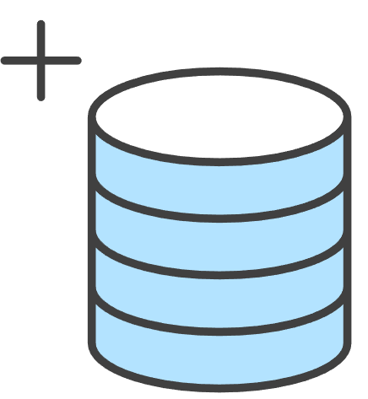
Setting up a repository
The high level points this guide will cover are:
Initializing a new Git repo
Cloning an existing Git repo
Committing a modified version of a file to the repo
Configuring a Git repo for remote collaboration
Common Git version control commands
By the end of this module, you should be able to create a Git repo, use common Git commands, commit a modified file, view your project’s history and configure a connection to a Git hosting service (GitHub)

Slide 6
What is a Git repository?
A Git repository is a virtual storage of your project. It allows you to save versions of your code, which you can access when needed.
Initializing a new repository: git init
To create a new repo, you'll use the git init command. git init is a one-time command you use during the initial setup of a new repo. Executing this command will create a new .git subdirectory in your current working directory. This will also create a new master branch.

Slide 7

Cloning an existing repository: git clone
git clone is used to create a copy or clone of remote repositories. You pass git clone a repository URL.
When executed, the latest version of the remote repo files on the master branch will be pulled down and added to a new folder.

Slide 8

Inspecting a repository: git status
The git status command displays the state of the working directory and the staging area. It lets you see which changes have been staged, which haven’t, and which files aren’t being tracked by Git.
It's good practice to check the state of your repository before committing changes so that you don't accidentally commit something you don't mean to.

Slide 9

Saving changes to the repository: git add and git commit
Now that you have a repository cloned or initialized, you can commit file version changes to it.
Create a new file CommitTest.txt with contents "test content for git tutorial"
git add CommitTest.txt to the repository staging area
Create a new commit with a message describing what work was done in the commit
After executing this example, your repo will now have CommitTest.txt added to the history and will track future updates to the file.

Slide 10


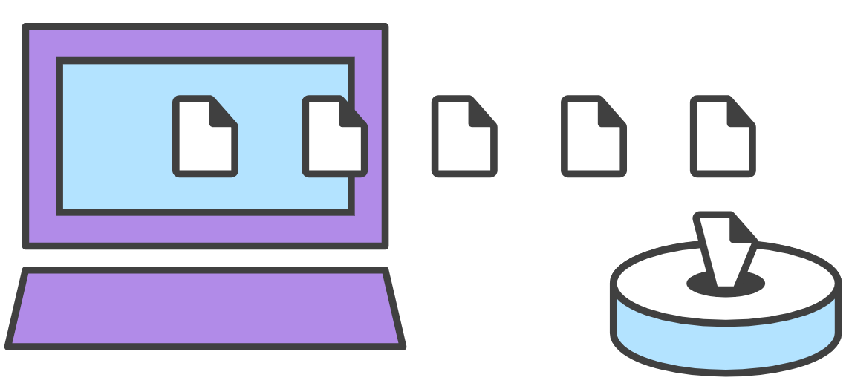
Remote repo setup and saving changes: git remote and git push
Once you have a remote repo setup, you will need to add a remote repo url to your local git config, and set an upstream branch for your local branches. The git remote command offers such utility.
Note: If you used git clone you can skip git remote command.
Once you have mapped the remote repo you can push local branches to it.
This command will push the local repo branch to the remote repo.

Slide 11

Comparing changes: git diff
Diffing is a function that takes two input data sets and outputs the changes between them. git diff is a multi-use Git command that when executed runs a diff function on Git data sources.

Slide 12
Ignoring file: .gitignore
Ignored files are usually build artifacts and machine generated files that can be derived from your repository source or should otherwise not be committed. Some common examples are:
Dependency caches, such as the contents of /node_modules or /packages
Compiled code, such as .o, .pyc, and .class files
Build output directories, such as /bin, /out, or /target
Files generated at runtime, such as .log, .lock, or .tmp
Hidden system files, such as .DS_Store or Thumbs.db
Personal IDE config files, such as .idea/workspace.xml
Ignored files are tracked in a special file named .gitignore that is checked in at the root of your repository. There is no explicit git ignore command: instead the .gitignore file must be edited and committed by hand when you have new files that you wish to ignore.

Slide 13
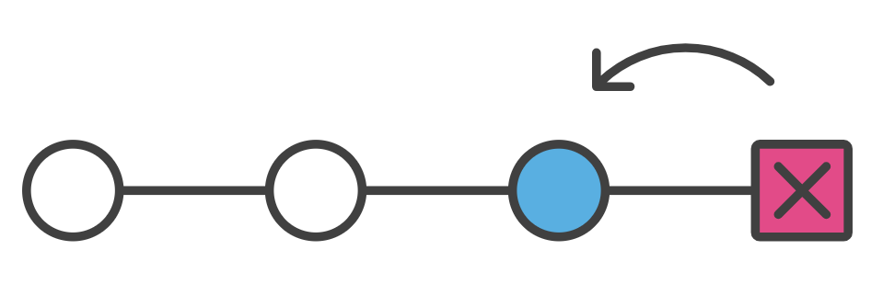
Undoing Commits & Changes: git revert and git reset
In this section, we will discuss the available 'undo' Git strategies and commands.
How to undo a public commit with git revert
If we execute $ git revert HEAD , Git will create a new commit with the inverse of the last commit. This adds a new commit to the current branch history.
How to undo a commit with git reset
If we invoke $ git reset --hard <commit> the commit history is reset to that specified commit.
Doing a reset is great for local changes however it adds complications when working with a shared remote repository.

