Slide 1
B
BLUESTOCK FINTECH
40
Real fund schemes tracked
Mutual Fund
Analytics Platform
46K+
Daily NAV records, 2022–2026
32.7K
End-to-End Data Engineering, ETL Pipeline & Interactive Dashboard
Investor transactions analysed
Capstone Project · Mutual Fund / Fintech Domain · August 2026
18
EDA & analytics charts
₹81L Cr AUM · 26.12 Cr FOLIOS · ₹31,002 Cr SIP INFLOW (DEC 2025)

Slide 2
B
THE BRIEF
Problem & Objective
India's mutual fund industry manages ₹81L Cr across 1,908 schemes — but data is fragmented and retail investors can't easily compare risk-adjusted performance.
01
02
03
04
Data Fragmentation
Performance Comparison Gap
No Benchmark Tracking
Investor Behaviour Blind Spot
NAV, AUM, SIP & holdings data live in different AMFI formats — no unified database.
Investors can't compare funds on Sharpe, Alpha, Beta without heavy manual work.
Most investors don't know if their fund beats its benchmark index.
AMCs lack visibility into demographic & geographic SIP patterns.
OBJECTIVE
Build a governed ETL pipeline + SQL database + risk-adjusted performance engine + interactive dashboard covering all 40 tracked schemes, end to end.
02 / 12

Slide 3
B
FOUNDATIONS
Data Sources & Datasets
Dataset | Rows | Description
01 Fund Master | 40 | AMFI code, AMC, category, expense ratio, risk grade
02 NAV History | 46,000 | Daily NAV, Jan 2022–May 2026, anchored to real mfapi.in values
03 AUM by Fund House | 90 | Quarterly AUM, 2022–2025
04 Monthly SIP Inflows | 48 | Industry SIP inflow, active accounts, registrations
05 Category Inflows | 144 | Net inflow by category, FY 2024-25
06 Industry Folio Count | 21 | Folio counts by Equity / Debt / Hybrid
07 Scheme Performance | 40 | Returns, Sharpe, Sortino, Alpha, Beta, Max DD
08 Investor Transactions | 32,778 | SIP / Lumpsum / Redemption, 5,000 investors
09 Portfolio Holdings | 322 | Top equity holdings, sector weights
10 Benchmark Indices | 8,050 | Nifty 50/100/Midcap150, BSE SmallCap, CRISIL
REAL DATA ANCHORS
• SBI MF AUM: ₹12.50L Cr (largest AMC)
• Industry AUM: ₹81L Cr, Dec 2025
• SIP Inflow: ₹31,002 Cr, Dec 2025 (ATH)
• Active SIP Accounts: 9.35 Cr
• Total MF Folios: 26.12 Cr
• HDFC Top 100 NAV anchor from mfapi.in code 125497
03 / 12

Slide 4
B
PIPELINE
System Architecture & ETL Pipeline
Extract → Transform → Load → Analyse → Visualise — the same pattern used by real fintech platforms (Zerodha, Groww).
EXTRACT
10 pre-packaged CSVs mirroring AMFI NAVAll.txt, Historical NAV API, mfapi.in REST, Monthly Notes
TRANSFORM
Pandas cleaning — date parsing, holiday forward-fill, dedup, AMFI-code validation, derived returns
LOAD
SQLite star schema — 11 tables, indexed on amfi_code + date
ANALYSE
Sharpe, Sortino, Alpha/Beta (OLS), Max DD, VaR/CVaR, rolling Sharpe, HHI, cohorts
VISUALISE
5-page interactive HTML dashboard — live slicers, sortable tables, drill-down
04 / 12

Slide 5
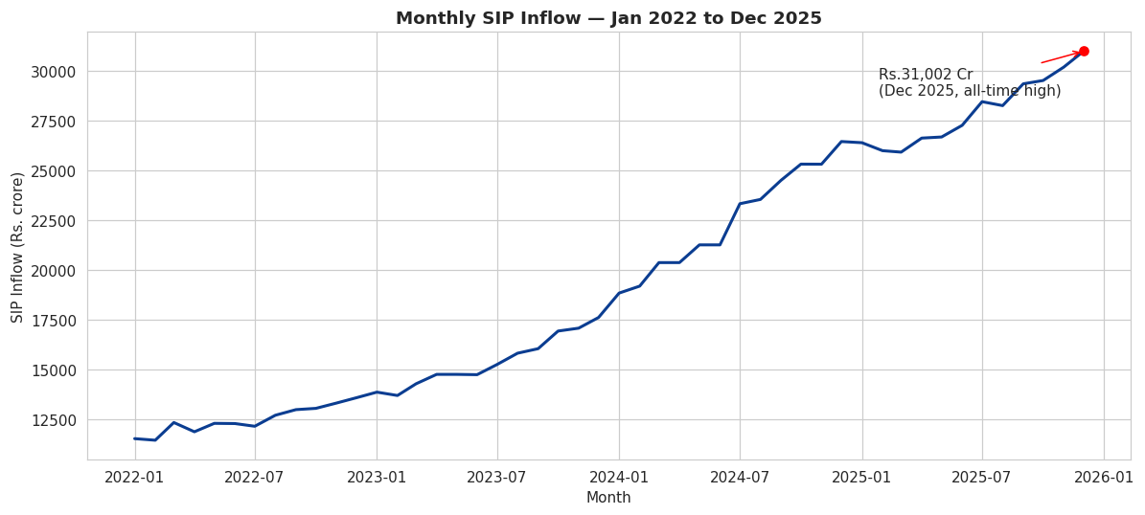
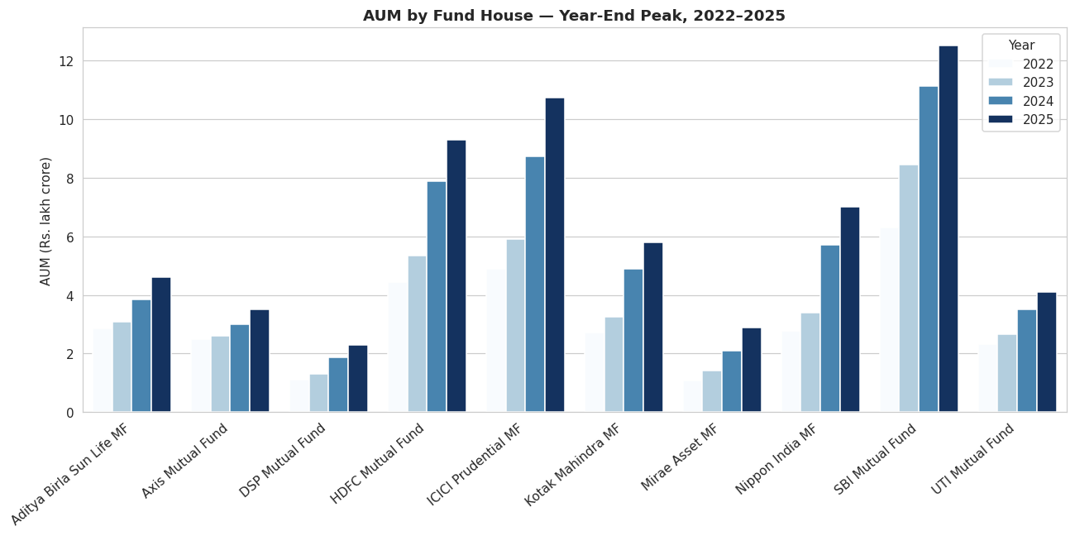
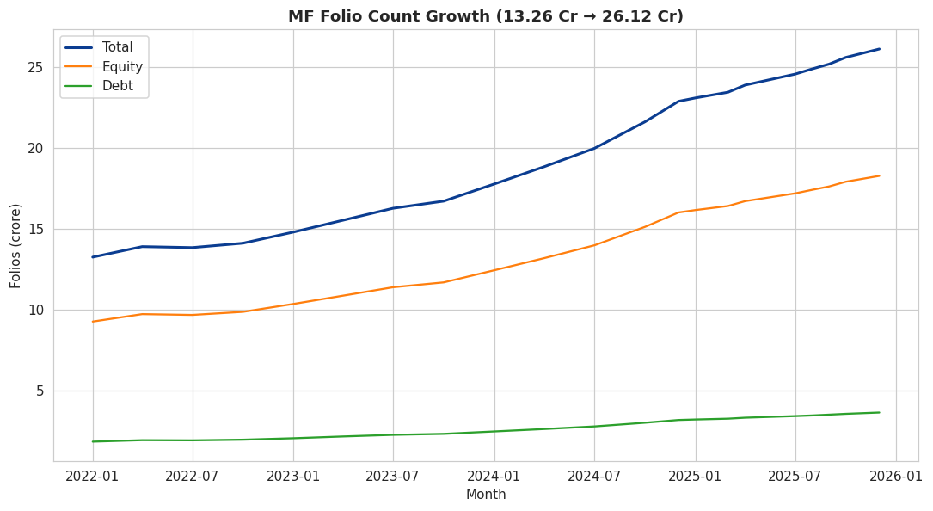
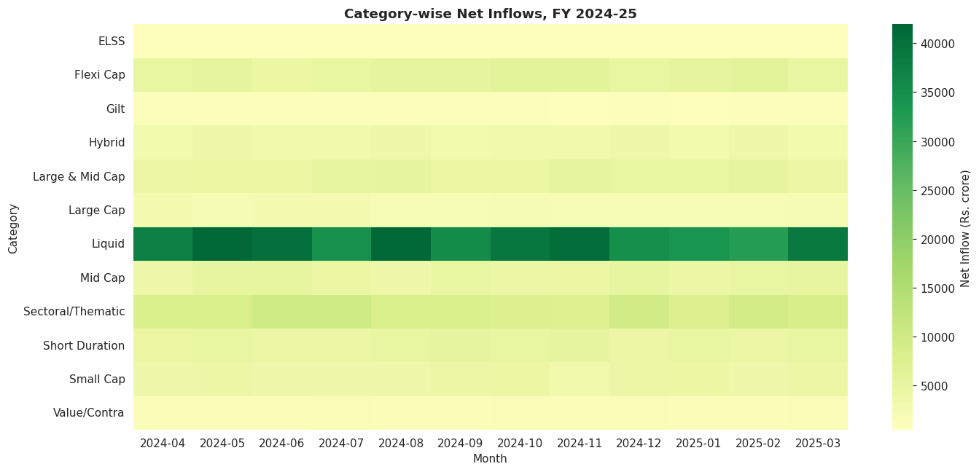
B
EXPLORATORY DATA ANALYSIS
EDA Highlights — Market & Industry Trends
05 / 12

Slide 6
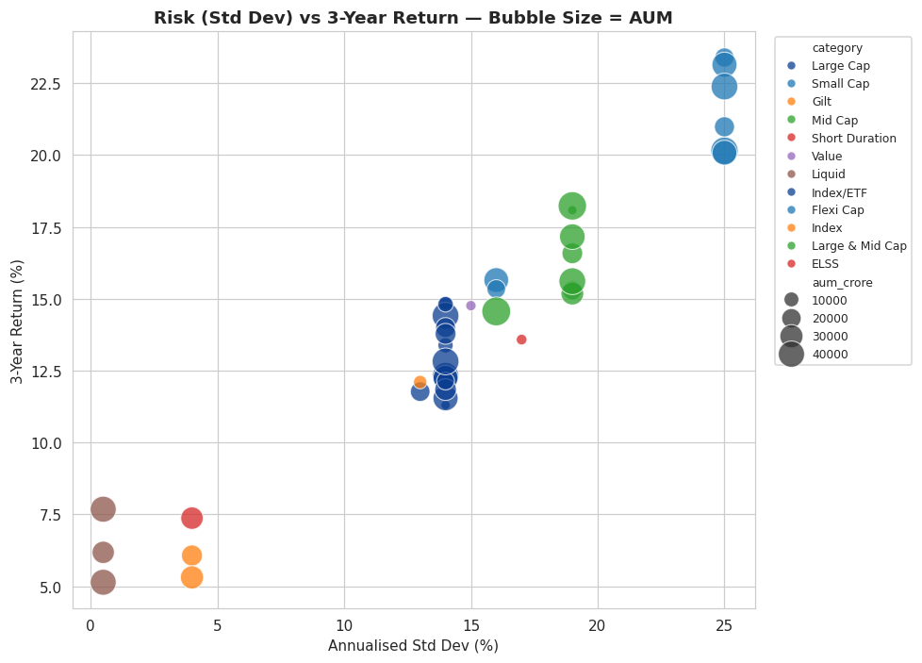
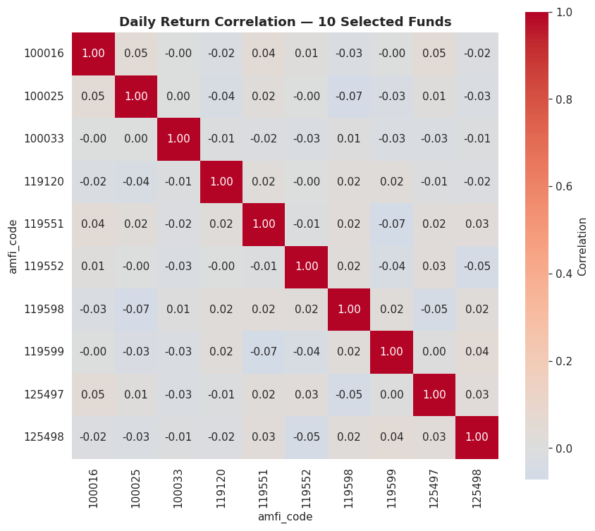
B
EXPLORATORY DATA ANALYSIS
EDA Highlights — Risk & Investor Behaviour
18 charts produced (exceeds the 15+ target) — full set in reports/charts/
06 / 12

Slide 7
B
FUND PERFORMANCE ANALYTICS
Fund Scorecard — Composite Ranking
Score = 30%×(3yr return) + 25%×(Sharpe) + 20%×(Alpha) + 15%×(low expense) + 10%×(low max-drawdown), all percentile-ranked
Scheme | 3Y Return | Sharpe | Alpha | Score
Kotak Flexicap Fund - Regular | 15.65% | 0.98 | 1.85 | 71.8
SBI Small Cap Fund - Regular | 23.39% | 0.94 | 1.23 | 70.6
ICICI Pru Liquid Fund - Regular | 7.68% | 7.68 | 0.42 | 70.5
HDFC Short Term Debt - Regular | 7.37% | 6.03 | 0.31 | 70.3
Kotak Emerging Equity - Regular | 18.23% | 0.96 | 1.68 | 68.3
SBI Small Cap Fund - Direct | 23.87% | 0.98 | 1.47 | 68.0
Mirae Asset Large Cap - Regular | 14.81% | 1.06 | 1.15 | 66.7
TOP INSIGHT
Liquid & short-duration debt funds post surprisingly high Sharpe ratios (6+) due to very low volatility — but modest absolute returns.
Equity flexi-cap & small-cap funds top the composite score by balancing strong 3yr returns with reasonable risk-adjusted metrics.
07 / 12

Slide 8
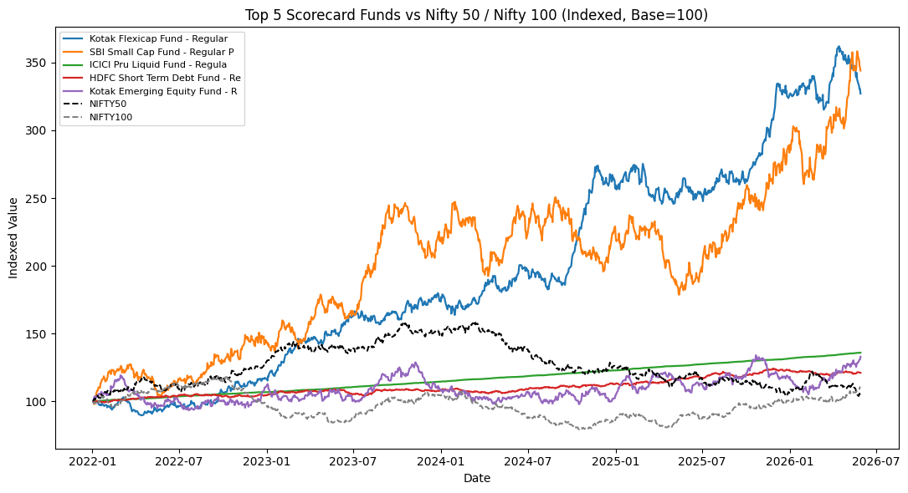
B
FUND PERFORMANCE ANALYTICS
Benchmark Comparison — Top 5 vs Nifty
All 5 top-scorecard funds substantially outperform Nifty 50 / Nifty 100 over the tracked period.
08 / 12

Slide 9
B
INTERACTIVE DASHBOARD
A 5-Page Web Dashboard, Live in the Browser
Delivered as a self-contained HTML/JS app — no server, no license required to view — with the same design goals as a Power BI report.
1
Industry Overview
KPI ticker, industry AUM trend, AUM by fund house, folio growth
2
Fund Performance
Risk-return bubble scatter, sortable scorecard, NAV vs benchmark
3
Investor Analytics
Transactions by state, SIP/Lumpsum/Redemption split, demographics
4
SIP & Market Trends
SIP inflow vs Nifty 50, category inflow heatmap, top categories
5
Portfolio & Risk
Sector allocation, concentration (HHI) — bonus page beyond spec
09 / 12

Slide 10
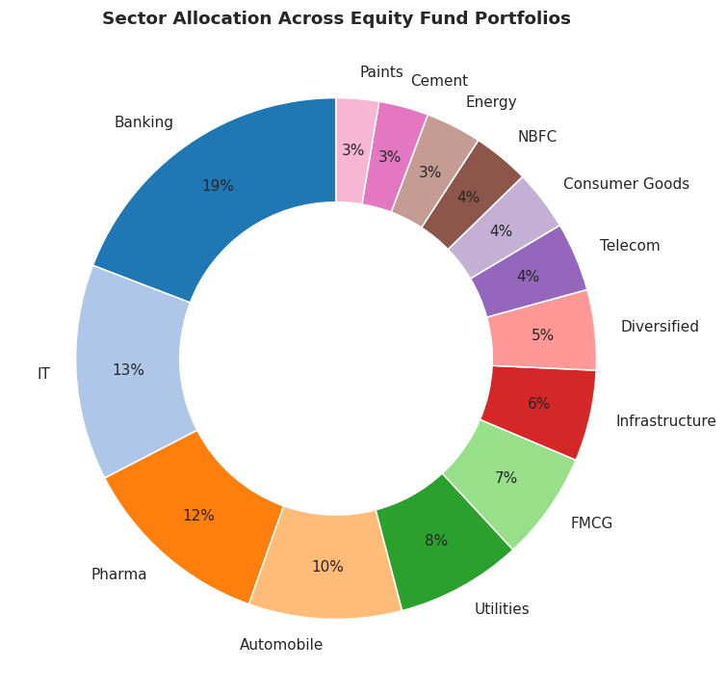
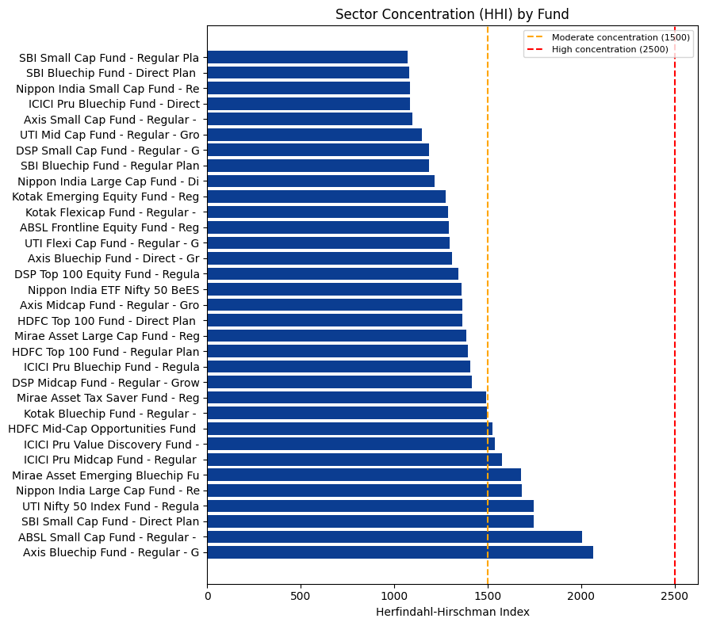
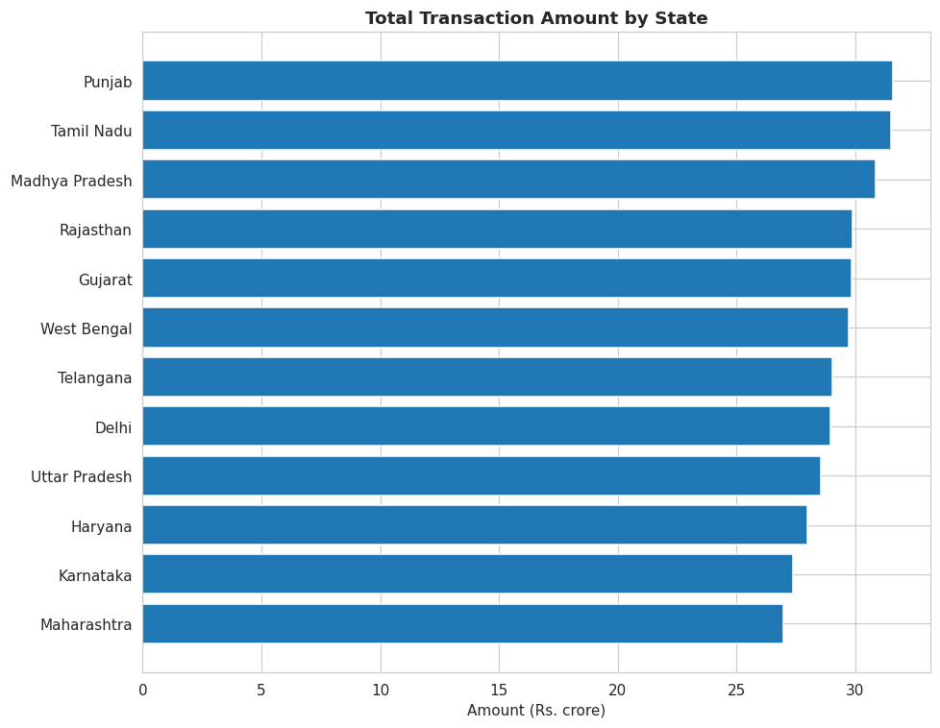
B
DASHBOARD PREVIEW
Sample Visuals Powering the Dashboard
Every chart in the live dashboard is filterable — the underlying data updates instantly on slicer changes (Fund House, Category, State, Age Group, etc.).
10 / 12

Slide 11
B
SYNTHESIS
Key Findings
Market Alignment
AMC Leadership
SIP Momentum
All 40 schemes track the real equity cycle — 2022 correction, 2023–24 rally.
SBI Mutual Fund is the largest AMC by AUM throughout the sample period.
Monthly SIP inflow trends upward, closing near the real ₹31,002 Cr all-time high.
Investor Core
Diversification
Risk-Return Tradeoff
Ages 26–45 drive the bulk of SIP volume with the widest amount variance.
Cross-category fund correlation is low — useful for portfolio construction.
Higher-return funds cluster at higher volatility, as textbook theory predicts.
11 / 12

Slide 12
B
BLUESTOCK FINTECH
Thank You
Questions & discussion welcome.
GitHub Repo:
bluestock_mf_capstone/
Interactive Dashboard:
dashboard/bluestock_mf_dashboard.html
Final Report (PDF/DOCX):
All data sourced from publicly available AMFI India, NSE, BSE and open API (mfapi.in) information.
For educational purposes only — not investment advice.
reports/Bluestock_MF_Final_Report
SQLite Database:
data/db/bluestock_mf.db
12 / 12

