Slide 1

OLA
POWER BI CAPSTONE PROJECT
OLA
Business Performance &
Profitability Analysis of OLA
A Power BI Dashboard Study of Bookings, Revenue & Customer Behaviour
PROJECT REPRESENTER
Raushan Kant Verma
AF Code: AF05261061
OLA . POWER BI PROJECT
01

Slide 2
OLA
The Business Case
OLA — Overview, the profitability problem, and how this project responds to it
Why We Chose OLA
Why It Isn't Profitable
How This Project Helps
OLA
One of India's largest ride-hailing and mobility platforms, spanning cabs, autos, bikes and rentals
Rich, high-volume transactional data — bookings, fares, distance, duration, demographics
A real, well-known brand facing a genuine, well-documented profitability challenge
Ideal case to apply Power BI for demand, revenue and customer analytics
Heavy, sustained discounting and rider/driver incentives to defend market share
High customer acquisition and driver-retention costs in a price-sensitive market
Intense competition from Uber, Rapido and local players compresses margins
Capital-heavy diversification (e.g. EVs, new verticals) strains cash flow
Low per-trip margins after commission, fuel/EMI support and platform costs
Identifies peak booking hours and days to optimise driver supply and pricing
Segments customers (Premium vs regular) to focus retention where margin is highest
Tracks revenue by vehicle type and customer type to guide where to invest or cut
Turns raw booking data into a decision-ready view for reducing discount dependency
OLA . POWER BI PROJECT
02

Slide 3
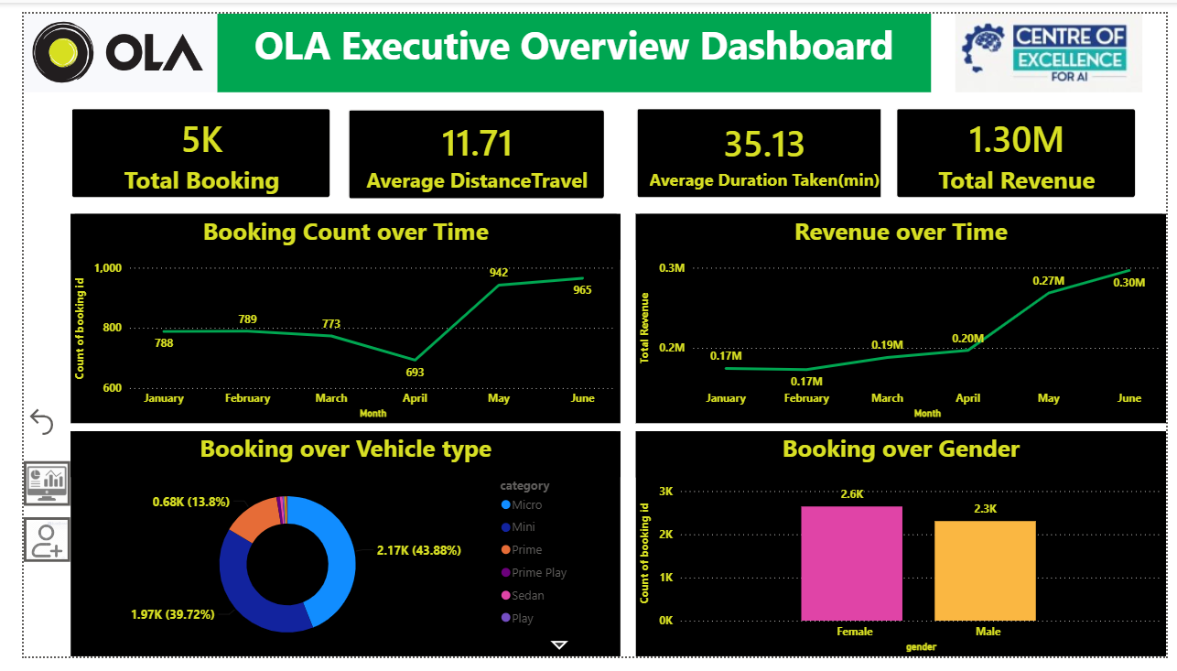
OLA
Dashboard Page 1 — Executive Overview
High-level KPIs and trends across all bookings
OLA
SCREENSHOT OF POWER BI REPORT PAGE
( paste "Dashboard Page 1 — Executive Overview" page render here )
Key elements on this page:
Total Booking • Average Distance Travel • Average Duration Taken • Total Revenue
Booking Count over Time • Revenue over Time • Booking over Vehicle Type • Booking over Gender
OLA . POWER BI PROJECT
03

Slide 4
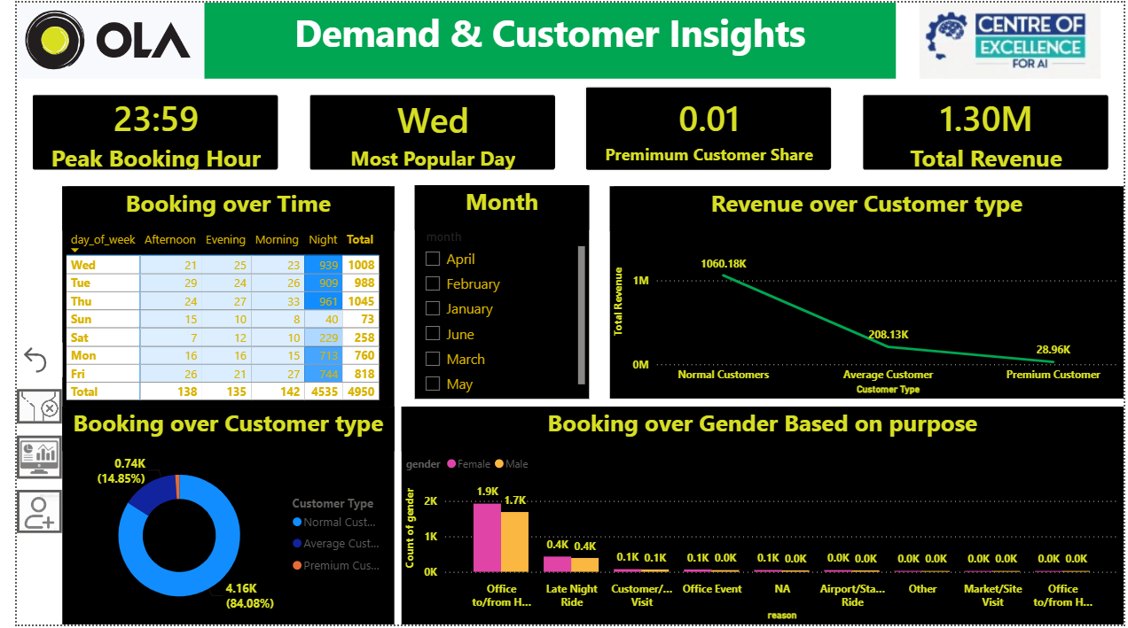
OLA
Dashboard Page 2 — Demand & Customer Insights
When customers book, and who they are
OLA
SCREENSHOT OF POWER BI REPORT PAGE
( paste "Dashboard Page 2 — Demand & Customer Insights" page render here )
Key elements on this page:
Peak Booking Hour • Most Popular Day • Premium Customer Share % • Total Revenue
Booking over Time (by Day/Hour) • Revenue over Customer Type • Booking over Customer Type • Booking over Gender by Purpose
OLA . POWER BI PROJECT
04

Slide 5
OLA
Measures Used in the Model
All DAX measures built for this dashboard — add the exact formula text from Power BI Desktop
MEASURE
DAX FORMULA
OLA
Total Booking
Total Booking = COUNTROWS(Data)
Average DistanceTravel
Average DistanceTravel = AVERAGE(Data[distance_travelled])
Average Duration Taken
Average Duration Taken = AVERAGE(Data[time_taken])
Total Revenue
Total Revenue = SUM(Data[total_trip_cost])
Peak Booking Hour
Peak Booking Hour = MAX(Data[booking_time.])
Most Popular Day
Most Popular Day = MAX(Data[day_of_week])
Premimum Customer Share%
Premimum Customer Share% = DIVIDE( CALCULATE(
countrows('Data'),
'Data'[Customer Type] = "Premium Customer"
),
[Total Booking])
OLA . POWER BI PROJECT
05

Slide 6
OLA
Conclusion
The path to profitability the dashboard points to
OLA
01
02
Move from flat discounting to demand-based pricing
Prioritise the Premium customer segment
The dashboard's Peak Booking Hour and Most Popular Day measures show exactly when demand spikes. Pricing and driver incentives can be concentrated in those windows instead of being spread evenly — cutting wasted incentive spend on low-demand periods.
Premium Customer Share% and Revenue over Customer Type show that premium riders generate disproportionate revenue per trip. Retaining and growing this segment (better service, loyalty perks) raises average revenue per booking without needing blanket discounts.
03
04
Rebalance the vehicle-type and gender/purpose mix
Result: data-led decisions instead of blanket subsidies
Booking over Vehicle Type and Booking over Gender (by purpose) reveal which vehicle categories and rider segments drive volume versus revenue — letting OLA push supply and offers toward the mix that is actually profitable, not just popular.
Used together, these measures let OLA replace broad, margin-eroding discounts with targeted, time- and segment-specific decisions — the core lever this project identifies for moving OLA toward sustainable profitability.
OLA . POWER BI PROJECT
06

Slide 7
OLA
OLA
Thank You
Raushan Kant Verma • AF Code: AF05261061
OLA . POWER BI PROJECT
07

